Slide 1
HCCMeshes: Hierarchical-Culling oriented Compact Meshes
Tae-Joon Kim¹, Yongyoung Byun¹, Yongjin Kim²,
Bochang Moon¹, Seungyong Lee², and Sung-Eui Yoon¹
¹ KAIST ² POSTECH
Notes:
Thanks for introduction.
Hello, I’m Tae-Joon Kim. I’m currently at KAIST in Korea.
Today, I’d like to talk about “Hierarchical-Culling oriented Compact Meshes”
This is co-worked with Yongyoung Byun, Yongjin Kim, Bochang Moon, Seungyong Lee, and Sung-Eui Yoon.

Slide 2
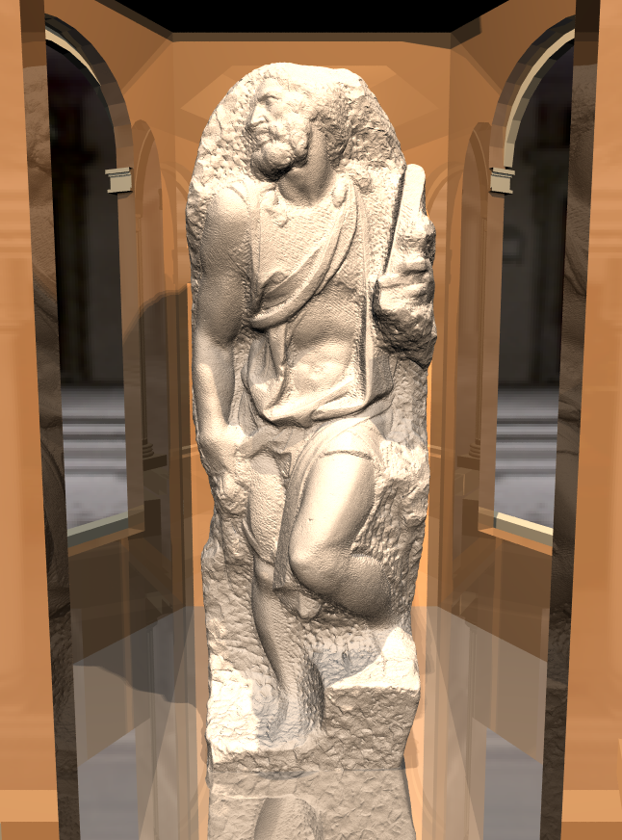
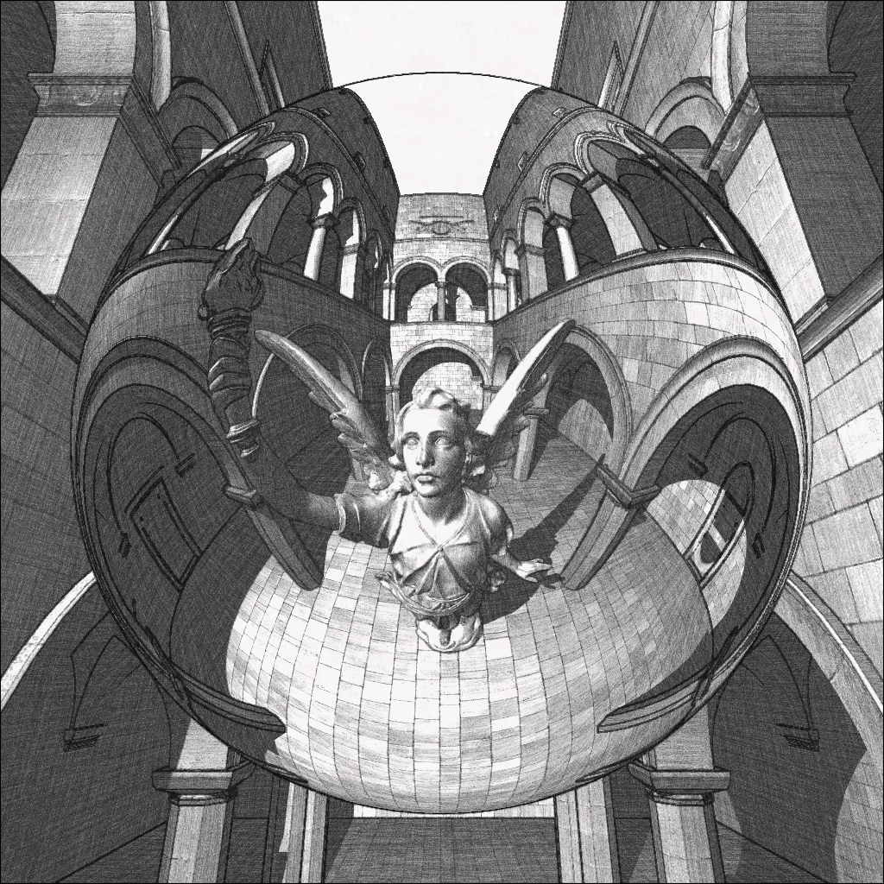
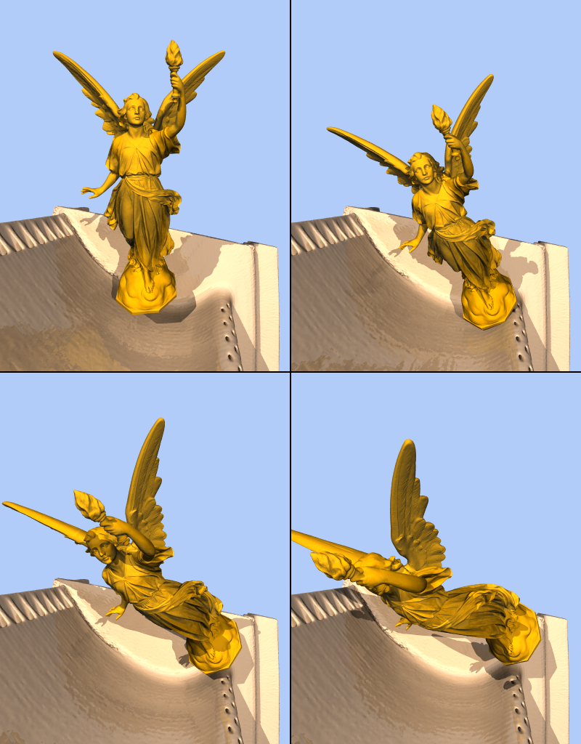
Motivation – Massive Models
Take high disk/memory spaces
Long data access time and low I/O performance
Lucy model (28 M triangles)
St. Matthew model (372 M triangles)
Notes:
These days the model complexity is getting bigger due to the advances of modeling techniques.
Therefore, there are more cases that we have to deal with massive models such as lucy model and St. Matthew model.
One of major problem of dealing with such massive models is that the massive models take high disk and memory spaces and long data access time.

Slide 3
Low Growth Rate of Data Access Speed
Accumulated
growth rate
during 1999~2009
(log scale)
Reducing data access time is critical!
access
speed
disk access speed
Notes:
Even worse, there has been consistently a lower growth rate of data access time compared to the growth rate of computational power.
While CPU and GPU speed grows about 50 and 200 times during last decade, the randomly disk access time almost didn’t grow.
Therefore, recent hardware advance may not provide an efficient solution to the problem in massive model since data access time is main bottleneck.
¶We can conclude that reducing data size and , thus, reducing data access time is more and more critical in the future
Despite of this problem,

Slide 4
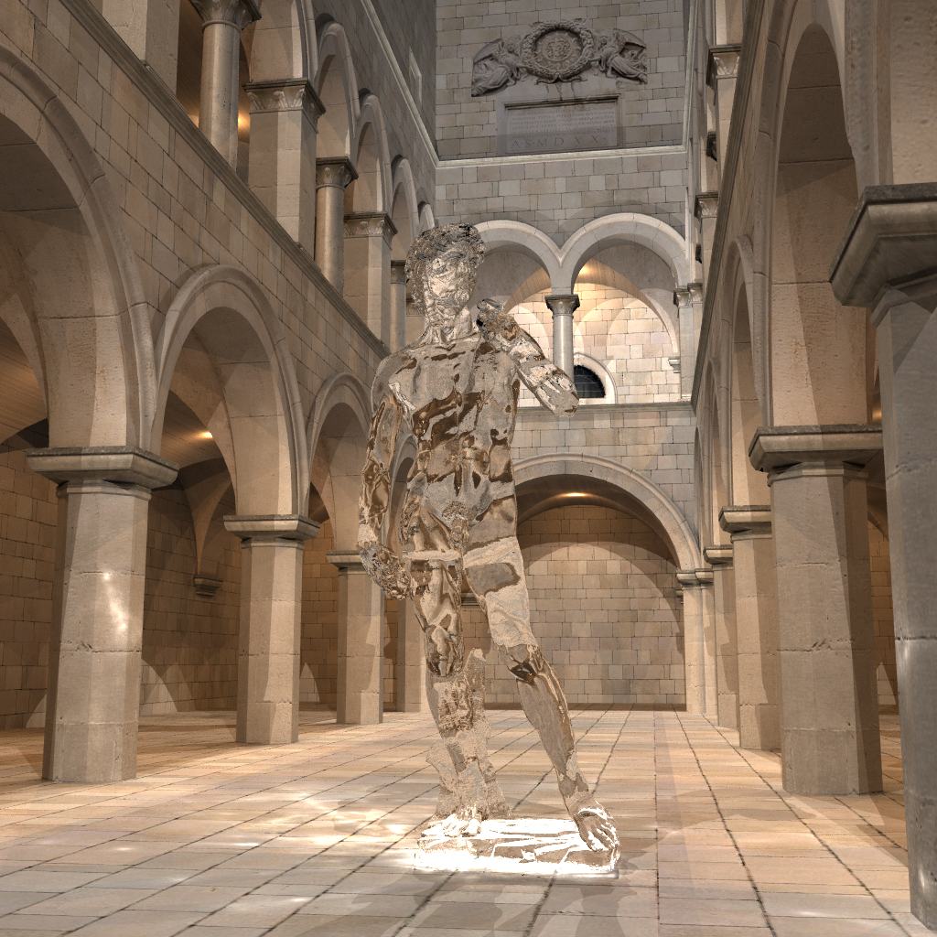
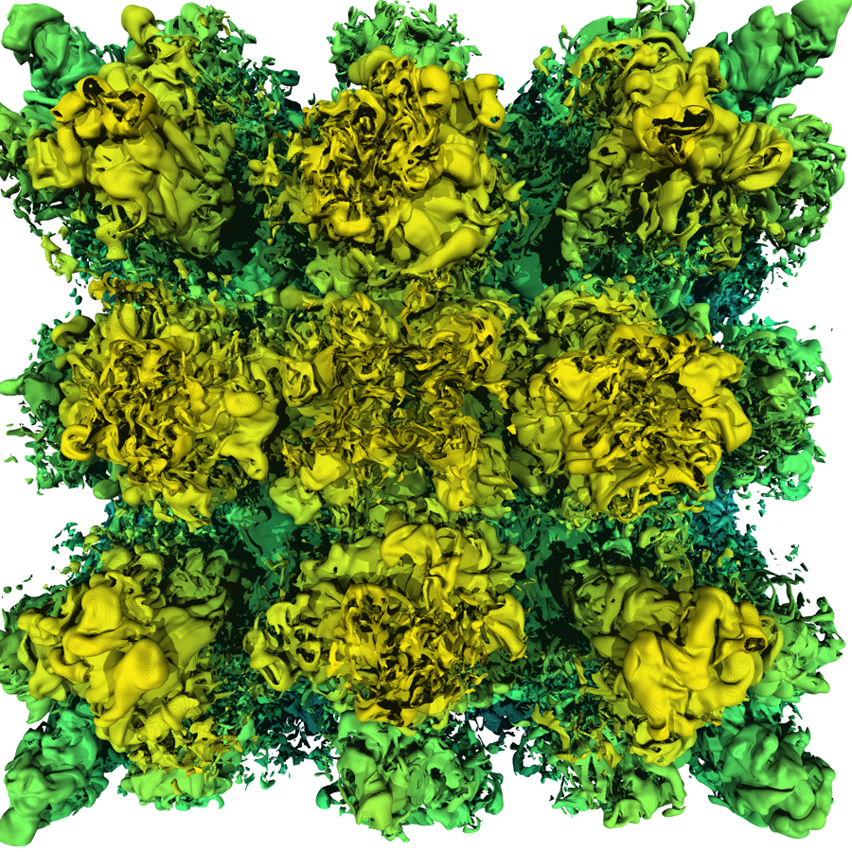
Large Scale Applications
Ray tracing
Collision detection
Non-photorealistic rendering
Dynamic simulation
Motion planning
Notes:
The massive models become widely used in many different fields as follows.
The large scale applications include ray tracing, collision detection, non-photorealistic rendering, dynamic simulation, motion planning, and so on.

Slide 5
Large Scale Applications
Common geometric data structures
Meshes
Acceleration hierarchies (e.g., k-d trees, bounding volume hierarchies (BVHs))
Random hierarchical traversal is necessary
Notes:
The large scale applications commonly use meshes. Because hierarchical culling is a key technique to accelerate large scale applications, acceleration hierarchies such as k-d trees and bounding volume hierarchies are also commonly used.
One thing we need to note is that the applications usually require random hierarchical traversal.
That means, we can randomly choose any child nodes but the child node is accessed after accessing its parent node.

Slide 6
Goal
Design a compact mesh representation for interactive geometric and graphics applications of massive models
Support hierarchical random access and culling
Support various applications
Improve performance of applications
Notes:
Our goal is to design a compact mesh representation for interactive geometric computation of massive model.
The algorithm should support hierarchical culling and various applications.
Also, we would like our algorithm to improve performance of applications.

Slide 7
Handling Massive Models
Sufficient memory
Main memory
Original data
Data pool
Applications
Requested
data
Request
data
Notes:
From now, I’ll talk about how we can handle the massive models in general.
First, the simplest case is when we have sufficient memory and entire data can fit into the main memory.
In this case, the applications can easily and efficiently access the data. So this is not our interesting problem.

Slide 8
Handling Massive Models
Insufficient memory
Out-of-core technique: [Silva et al. 02, Cignoni et al. 03]
Main memory
Original data
Cached data
Cluster c₀
Applications
Cluster c₁
Cluster c₂
Requested
data
Request
data
Cluster c₃
External drive
Cluster c₄
Cluster c₅
Original data
…
Cluster c_{n}
Notes:
When we use term “massive model”, usually the data cannot fit into the memory.
¶ In this case, the data is stored in some external drives such as disk, ¶
¶ and the memory is used to cache some portions of the data.
¶ The data is usually decomposed into several clusters because the access patterns are expected to have temporal and spatial locality.
¶ Then the data is fetched from the external drive cluster by cluster.
This becomes a major bottleneck because the data fetching time is relatively very slow as I said in previous slides.
¶ In order to reduce the bottleneck, some out-of-core techniques are proposed.

Slide 9
Handling Massive Models
Compress data for reducing expensive I/O thrashing
Main memory
Original data
Cached data
Compressed data
Cluster c₀
Applications
Cluster c₁
Cluster c₂
Requested
data
Request
data
Cluster c₃
External drive
Cluster c₄
Cluster c₅
Data pool
Compressed data
…
Cluster c_{n}
Decompress using CPU
Notes:
The recent and aggressive approaches for reducing the expensive I/O thrashing is that compress the data.
¶ We can compress the data in the external drive,
¶ then reduce the fetching time
¶ and decompress it using powerful CPU
¶ then finally transmit to the memory
Because of widening gap between CPU power and disk access speed, this kind of approach can improve the performance of applications

Slide 10
Handling Massive Models
Compress data for reducing expensive I/O thrashing
Random-accessible compression
For meshes: [Yoon et al. 07, Choe et al. 09, Kim et al. 06]
For hierarchies: [Melero et al. 08, Kim et al. 10]
[Yoon et al. 07] & [Kim et al. 10] improve ray tracing performance by a factor of 4 compared to uncompressed data
20 : 1 compression ratio
Main memory
Cached data
Cluster c₀
Applications
Cluster c₁
Cluster c₂
Requested
data
Request
data
Cluster c₃
External drive
Cluster c₄
Cluster c₅
Data pool
Compressed data pool
…
Cluster c_{n}
Decompress using CPU power
Notes:
Please note that we need compression techniques which support random access because of the randomness of the data access pattern.
There are several approaches about the random-accessible compression.
When we use combination of Yoon et al. and Kim et al. ‘s methods, we can improve ray tracing performance about a factor of 4 compared to the uncompressed data.
Both methods have about 20 to 1 compression ratio, but why the performance improvement is only 4 times?

Slide 11
Limited Performance Improvements
Decompression speed is slow
Memory caches uncompressed data: cache misses
Main memory
Cached data
Cluster c₀
Applications
Cluster c₁
Cluster c₂
Requested
data
Request
data
Cluster c₃
External drive
Cluster c₄
Cluster c₅
Data pool
Compressed data pool
…
Cluster c_{n}
Decompress using CPU
Notes:
The reason is that ¶ the decompression speed is not still fast enough so the performance improvement is limited even we use CPU power.
¶ Moreover, memory cache the original uncompressed data, hence, the cache miss ratio is still high.
Therefore, we need fetch and decompress the cluster many times using already slow decompression.

Slide 12
Our Approach
Intermediate compressed data
Main memory
i-HCCMeshes
Original data
Cached data
Compressed data
o-HCCMeshes
Cluster c₀
Cluster c₀
Cluster c₀
Cluster c₁
Cluster c₁
Applications
Cluster c₂
Cluster c₁
Cluster c₃
Cluster c₂
Cluster c₄
Cluster c₂
Requested
data
Request
data
Cluster c₅
Cluster c₃
External drive
Cluster c₆
Cluster c₃
Cluster c₇
Cluster c₄
Cluster c₈
Cluster c₈
Cluster c₄
Cluster c₉
Cluster c₉
Cluster c₅
Cluster c₁₀
Cluster c₁₀
Cluster c₅
Data pool
Cluster c₁₁
Compressed data pool
Cluster c₁₁
…
Cluster c₁₂
Cluster c₁₂
…
Cluster c₁₃
Cluster c₁₃
Cluster c_{n}
…
…
Cluster c_{n}
Cluster c_{m}
Cluster c_{m}
High performance decompression
Low performance decompression
Notes:
So.. I’ll talk about our approach
This figure is about handling massive models using previous compression techniques.
¶ We compress the out-of-core representation to take advantages of previous work.
¶ Additionally, we also compress the in-core representation.
¶ So there is another intermediate representation.
¶ And we need very high performance decompression methods to let the applications use the data
¶ The out-of-core decompression have relatively low performance.
¶ We call the intermediate representation as i-HCCMesh which stands for in-core HCCMesh, and we call the out-of-core representation as o-HCCMeshe which stands for out-of-core HCCMesh.
The reason why we propose this kind of different level of compression approach is that
i-HCCMesh has high decompression performance but low compression ratio and
o-HCCMesh has high compression ratio but low decompression performance.
By using this approach, we can maximize the performance and minimize the memory consumption.
Imagine that memory hierarchy including L1, L2 caches, main memory, and disk.
L1 caches have high performance but small space and disks have large space but low performance.

Slide 13
Ray Tracing of St. Matthew Model
128 M triangles (5.6 GB)
256 M BVH (8 GB)
i-HCCMeshes (1.9 GB)
o-HCCMeshes (678 MB)
More than 100X speedup over uncompressed data by avoiding the disk I/O thrashing
Notes:
I’ll continue this talk after seeing brief demo.
¶ This is a result from ray tracing of St. Matthew model consisting of 128M triangles which takes 12 GB total.
We achieve more than 7 times compression ratio and moreover,
We achieve more than 100 times speedup over uncompressed data by avoiding the disk I/O thrashing

Slide 14
Ray Tracing of St. Matthew Model
128 M triangles (5.6 GB)
256 M BVH (8 GB)
i-HCCMeshes (1.9 GB)
o-HCCMeshes (678 MB)
Captured in real time
Notes:
¶ This demo captured in real time. There are some artifacts because we do not use any super sampling but we can handle interactively.

Slide 15
Outline
Overview
i-HCCMesh representation
o-HCCMesh representation
Results
Notes:
Here is an outline for the rest of the talk.
I’d like to talk about overview first, followed by i-HCCMesh representation.
Then, I’d like to talk about o-HCCMesh representation followed by main results of our approach.

Slide 16
Outline
Overview
i-HCCMesh representation
o-HCCMesh representation
Results
Notes:
Now, let’s look at overview of our approach.

Slide 17
Overall Structure
High-level BVH
Takes small memory
Used frequently
Low-level BVHs and sub- meshes
Take large memory
Less frequently used
Compress clusters only
BVH
High-level BVH
Low-level BVHs
…
…
…
…
…
Sub-meshes
Mesh
Clusters
Notes:
For now, let’s see overall structure of our problem.
The data consist of two data structures mesh and its BVH.
¶ We decompose the BVH into two level as you can see in the figure.
¶ We call the upper BVH as high-level BVH, and ¶ lower BVHs as low-level BVHs.
We decompose the BVH because of their different characteristic.
¶ The high-level BVH takes small amount of memory but very frequently used.
¶ In contrast, the low-level BVHs take a lots of memory but each sub-BVH is relatively less frequently used.
¶ Therefore, we make a cluster together with a low-level BVH and corresponding meshes.
¶ Then we only compress the clusters.
We do not compress the high-level BVH.

Slide 18
Overview - Runtime Access Framework
Main memory
High-level BVH
…
…
Low-level BVH
…
External drive
i-HCCMeshes (cached)
o-HCCMeshes
…
Notes:
Then I’ll talk about runtime access framework briefly.
The high-level BVH is stored in memory in advance because it take small space and very frequently used.
Any other data is stored in external drive as o-HCCMesh representation.
¶ BVH is randomly traversed at first time in the high-level BVH.
¶ If the access flow reaches a leaf node of the high-level BVH,
¶ we fetch the corresponding cluster from external drive and decompress to the i-HCCMesh representation.
¶ The resulting cluster is cached and used for a while.
¶ Then we can further traverse the BVH.
¶ Other low-level BVH can be accessed in same way.

Slide 19
Outline
Overview
i-HCCMesh representation
o-HCCMesh representation
Results
Notes:
Now, let’s see how the i-HCCMesh representation is generated in detail.

Slide 20
Bounding Volume Hierarchies (BVHs)
BV
A node of BVHs has:
Indices of children nodes
A bounding volume (BV)
We use the axis-aligned bounding box (AABB) and a binary BVH
Due to its simplicity and the wide use
We assume each leaf node contains a single triangle
Index of
child node
Notes:
Our method compress bounding volume hierarchies.
A node of BVHs has indices of children nodes and a bounding volume.
We compress each component separately.
¶ We use the axis-aligned bounding box and a binary BVH due to its simplicity and the wide use.
¶ Also, we assume each leaf node contains a single triangle

Slide 21
Encoding Bounding Volumes
v₂
v₂
Parent BV
v₂
x
v₅
v₅
v₅
v₃
v₃
v₆
v₃
v₆
y
v₆
Left BV
v₇
v₇
v₇
v₈
v₈
v₁
v₈
Right BV
v₁
v₁
v₄
v₄
v₄
v₁
v₂
min
x
min
y
max
x
max
y
v₁
v₂
v₃
v₃
v₄
Parent BV:
v₄
v₁
v₅
v₆
v₅
v₆
v₇
v₇
v₈
Child BVs:
v₈
v₂
v₃
v₄
Reuse mask:
1
0
0
0
= ~
0
1
1
1
Additional vertices:
v₈
v₅
v₆
v₇
v₈
v₅
v₆
v₇
0
0
Final child BVs:
1
0
Left BV
Right BV
Notes:
Now, let me introduce how we efficiently compress the bounding volumes.
Let assume that there is a bounding volume as seen in the figure.
Without loss of generality, we can assume the BVs are defined in 2D space.
¶ Since the BV is tight, there is at least one vertex on the boundary of each side. We can extract BV information from such mesh information, v1, 2, 3, 4.
¶ Let a BV of left node of this node is like this, ¶ and right BV is like this.
¶ The left BV also can be defined by some boundary vertices.
¶ Please note that the v1 define an extent of not only the parent BV but also the left BV because of BV’s tightness.
¶ Therefore, left BV can be defined using v1, 5, 6, 7.
¶ Similarly, when we add v8 ¶ we can define right BV using v2, 3, 4, 8
¶ Actually, the BVs are encoded using following process.
The information of parent BV is encoded using vertex indices, 1, 2, 3, 4 rather than itself.
¶ The meanings of their positions are like this
¶ In the same way, we can represent child BVs like these.
¶ The v1 is reused to left BV, ¶ and the v2, 3, 4 are reused to right BV. ¶
¶¶¶The such reusing information is encoded in reuse mask.
¶ The reuse mask of right BV is not encoded because it can be computed by inversing of left BV.
¶ We already know the parent BV, so we only need to encode the additional vertices ¶ v5, 6, 7 ¶ and v8 ¶
¶ The final form of encoding child BVs can be shown like this.
In our implementation, we use only 4 bytes for encoding a single 3D BV

Slide 22
Encoding Tree Structure
Horizontally partition into height of k
All sub-trees have same height k
Types of sub-trees’ structures are limited
…
k
…
…
Notes:
Next, I’ll explain the process of compression tree structure.
Let the left figure as a BVH,
¶ we horizontally partition into height of k
¶ then all sub-trees have same height k.
¶ As a result, the number of kinds of sub-trees’ structures are limited.
We will see in next slide.

Slide 23
Encoding Tree Structure
Tree template (k = 2)
Tree
template ID
2
0
1
2
3
4
0
Partitioning line
1
Encode only template IDs and inter connections
Notes:
Let assume that the k is 2
In this case, there are only 5 different structure in binary tree.
¶ We call this as tree template.
¶ And we assign IDs to each template.
¶ If there is a tree likes right side,
¶ We partition the tree from root.
¶ Then the tree is decomposed into 3 sub-trees.
¶ And types of each template is like this.
¶ Also, there are some inter-connection between sub-tree like green arrows.
¶ By doing this, we can encode the tree structure using only template IDs and inter-connections rather than encode itself.
At runtime, we can very efficiently reconstruct the tree structure by a few memory access.

Slide 24
Outline
Overview
i-HCCMesh representation
o-HCCMesh representation
Results
Notes:
From now, I’ll talk about how we can further compress the i-HCCMesh.

Slide 25
Out-of-core Compression
It is not easy to further compress i-HCCMesh representation using general methods (e.g., gzip)
Each cluster is compressed independently for random access
Tree structures are encoded using our dictionary-based compression
We do not encode BVs
Reconstruct using tree structures and mesh information
Notes:
It is not easy to further compress i-HCCmesh representation using general compression methods such as gzip.
¶ For random access, we compress each cluster independently.
¶ The tree structures are encoded using our dictionary-based compression.
¶ And we do not encode BVs since we can reconstruct them using tree structures and mesh information in linear time complexity.

Slide 26
Out-of-core Compression
Mesh information is compressed following to the encoding layout
Triangle indices need not to be encoded
Order preserving mesh compression method is necessary
Streaming mesh [Isenburg et al. 05]
We modify steaming mesh to use our dictionary-based compression for fast decompression
Layout of a BVH
Triangles
Notes:
And mesh information is compressed following to the encoding layout as you can see in the figure.
¶ By doing this, we don’t need to encode the triangle indices.
¶ However, we need order preserving mesh compression method in this case.
Fortunately, streaming mesh can preserve the original order.
¶ Also, we modify the streaming mesh to use our dictionary-based compression for the fast decompression.

Slide 27
Outline
Overview
i-HCCMesh representation
o-HCCMesh representation
Results
Notes:
Finally, I’ll show you some results of our approach.

Slide 28
Compression Results
Model | Tri. (M)
St. Matthew | 372
Lucy | 28
David | 8
Iso-surface | 102
CAD turbine | 2
Size (MB) of uncomp. data
40,459
3,008
897
11,148
192
i-HCCMesh
Size(MB) | Ratio
5,474 | 7.4 : 1
413 | 7.3 : 1
122 | 7.4 : 1
1,554 | 7.2 : 1
26.4 | 7.3 : 1
o-HCCMesh
Size(MB) | Ratio
1,738 | 23.3 : 1
153 | 19.7 : 1
45 | 19.9 : 1
657 | 17.0 : 1
11 | 17.4 : 1
i-HCCMesh and o-HCCMesh achieve 7.3 : 1 and 19.5 : 1 compression ratio on average
Notes:
We have tested our method with various size of models.
¶ The sizes of original uncompressed data are shown the table.
¶ And this shows the compression results of i-HCCMesh
¶ and o-HCCMesh.
¶ i-HCCMesh and o-HCCMesh achieve 7.3 : 1 and 19.5 : 1 compression ratio on average.

Slide 29
Benchmark Applications
Whitted-style ray tracing
Non-photorealistic rendering
LOD-based ray tracing
Collision detection
Photon mapping
Notes:
We applied our method to various applications.
These applications include whitted-style ray tracing, non-photorealistic rendering,
LOD-based ray tracing, collision detection, and photon mapping.

Slide 30
Video for Benchmark Applications
Notes:
Let see the video.

Slide 31
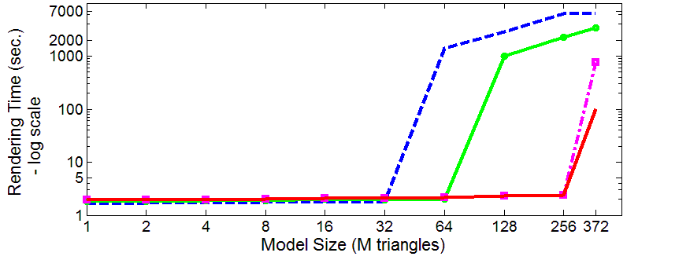
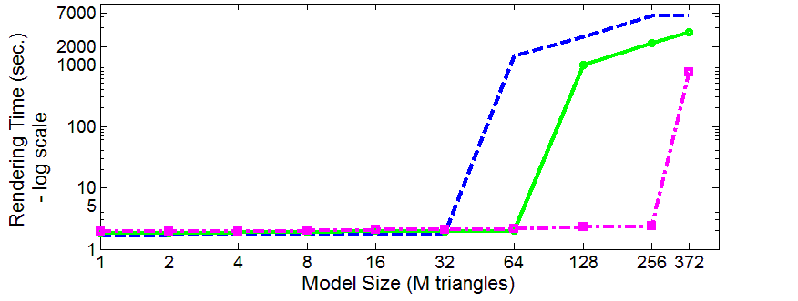
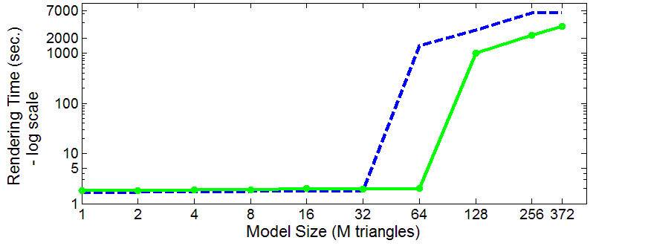
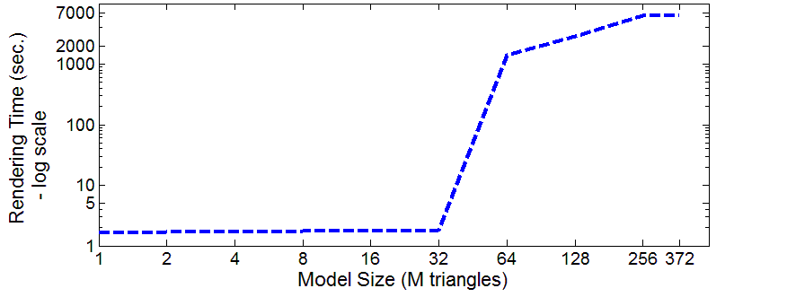
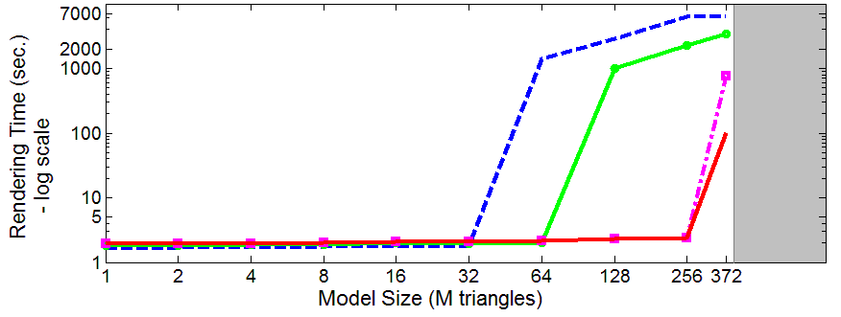
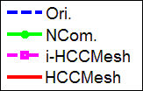
Performance Improvement
Mainly due to higher I/O performance
Reduce the data size by using compression → Reduce or remove the expensive disk I/O time
Notes:
The performance improvement mainly due to higher I/O performance.
By using our method, the size of the original data is reduce, thus, the expensive disk I/O time can be reduced or removed when preload the whole data.
¶ In order to clearly verify the benefits of our method, we measure ray tracing time with various size of models.
Please note that both x and y axis have log scale.
By using original uncompressed representation, we can handle until 32M triangles but the rendering time suddenly jumps from 64M triangles.
This is because the model cannot fit into the main memory.
¶ By using naively compressed method, we can efficiently handle until 64M triangles.
¶ However, when we use our i-HCCMesh representation, we can handle until 256M triangles.
Note that even bigger model which has 372M can be more efficiently handled using our representation then original representation.
¶ Moreover, by using both I and o-HCCMesh, we can improve the performance much more.
¶ We have not yet test with bigger model than 372M, but we expect that the performance trend will be like the gray region.

Slide 32
Limitations
Compression ratios of k-ary trees may be lower than binary trees
Many more templates
Runtime performance overhead for small models
33% for the Whitted-style ray tracing over uncompressed data
Notes:
Our method has some limitations.
First, the compression ratios of k-ary trees may be lower than binary trees because the number of templates can be bigger.
Second, when all data of a model is in main memory, our method might lower the performance.
In our experiments, we observe 33% overhead for the Whitted-style ray tracing over original representation.

Slide 33
Summary & Conclusion
A novel, compact mesh representations
Compressed by tightly coupling meshes and BVHs
Supports hierarchical random access and culling
Can be used with many applications
Low storage requirement
Achieve 7.2 : 1 (i-HCCMesh) and 20.9 : 1 (o-HCCMesh) compression ratio over uncompressed data
High performance
Handle 7 times bigger model without I/O than uncompressed data
60 times faster than uncompressed data even much bigger models that causes disk I/O acccess
Notes:
Our compression method requires low storage.
We can achieve about 7 and 21 compression ratio over original representation.
More importantly, we can handle about 7 times bigger model without I/O thrashing.
We can improve the performance more than a factor of 60 even much bigger models.
HCCMesh allows various applications as we demonstrate before.

Slide 34
Acknowledgments
Members of SGLab. in KAIST
Model contributors
Funding agencies
MKE, MCST, KEIT, IITA, KOCCA
Microsoft Research Asia
Korea Research Foundation
Notes:
We would like to thank to Member of SGLab in KAIST, model contributors, and funding agencies.

Slide 35
Any Questions?
Q & A
Thank you!
Notes:
This concludes my talk.
Thank you!

