Slide 1
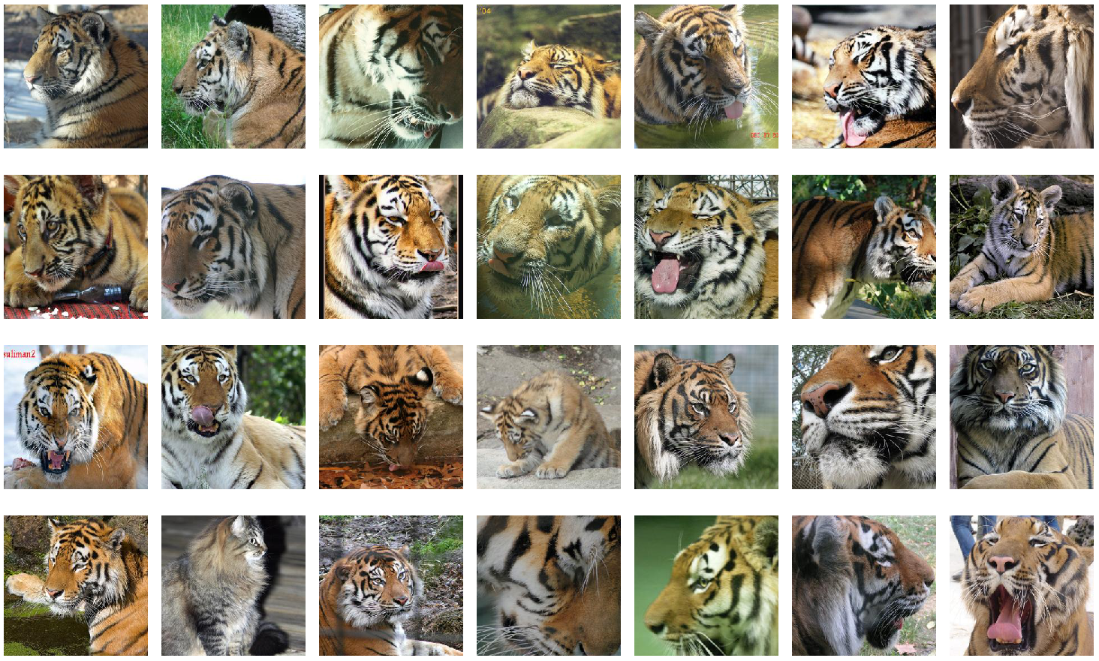
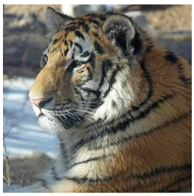
Image Search
query
search results

Slide 2
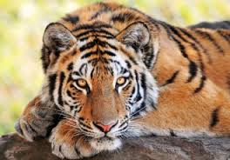
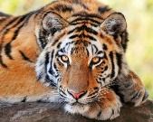
Image Search Framework
Image Database
Feature Extractor
index encode
features
Indexed Images
Similar Images
search
Query

Slide 3
Image Search Framework
Image Database
Feature Extractor
index encode
features
Indexed Images
Similar Images
search
Query

Slide 4
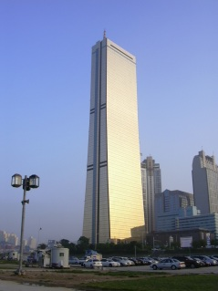
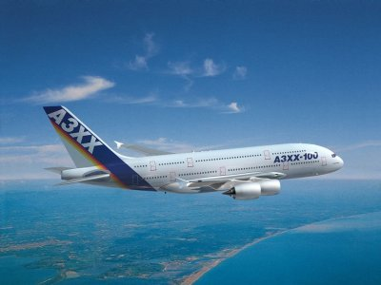
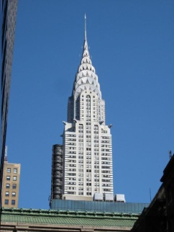
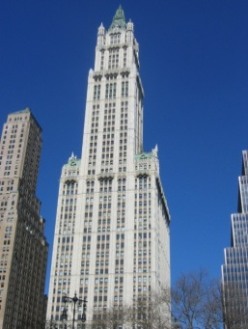
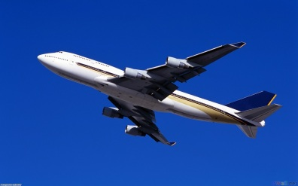
Image Features
High dimensional vectors that describe images
$$dist↓sim↑$$

Slide 5
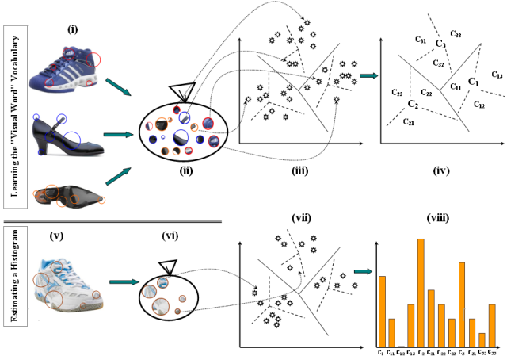
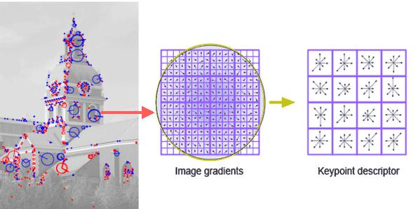
Image Features
SIFT and bag of visual words [Lowe 2004, Sivic and Zisserman 2003]
GIST descriptors [Oliva and Torralba 2001]
Color histogram [Novak and Shafer 1992]
Deep convolutional neural network [Krizhevsky et al. 2012]
SIFT
Bag of visual words
images from OpenCV website

Slide 6
Image Search Framework
Image Database
Feature Extractor
index encode
features
Indexed Images
Similar Images
search
Query

Slide 7
Challenge
High dimensionality (>100dim)
Massive image databases (> 100M)
A simple calculation: $128 bits ×100M ≈1.6 GB$
A few hundreds bits can be allocated to handle 100M images in a PC.
Hierarchical data structures (ex: kd-tree, R-tree)
Suffer from ‘curse of dimensionality’
Do not provide a compact data representation
Hard to support dynamic data
Descriptor | Bag of Words | CNN
Dim | 1000+ | 4000+
1 item | 4 KB+ | 16 KB+
100M items | 400 GB+ | 1.6 TB+
kd-tree [Bentley1975]

Slide 8
Indexing and Encoding
Inverted File
$$x$$
$$c_{2}$$
feature space
$$c_{k}$$
$$c_{1}$$
$$c_{3}$$
Indexer
(ex: Vector Quantizer)
$${List}_{1}$$
$${Data}_{1,1}$$ | $${Data}_{1,2}$$ | $${Data}_{1,3}$$ | … | $${Data}_{1,n_1}$$
$$x$$
Index
$${List}_{2}$$
$${Data}_{2,1}$$ | $${Data}_{2,2}$$ | $${Data}_{2,3}$$ | … | $${Data}_{2,n_2}$$
…
$${List}_{k}$$
$${Data}_{m,1}$$ | $${Data}_{m,2}$$ | $${Data}_{m,3}$$ | … | $${Data}_{k,n_k}$$
Encoder
Compact Code
Img-ID / Compact Code

Slide 9
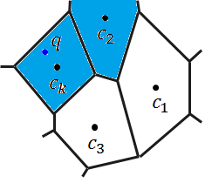
Search
Inverted File
feature space
$$L_{1}$$
$T$ (shortlist size)
$$q$$
$$L_{2}$$
Near cluster search
…
$$L_{k}$$
Shortlist
$$R$$
Re-ranking
Top $R$ elements according to estimated distance

Slide 10
My Contributions
Image Database
- Spherical Hashing [CVPR 2012]
- Distance Encoded Product Quantization [CVPR 2014]
- Accurate Shortlist Computation [ongoing]
Feature Extractor
index encode
features
Indexed Images
Similar Images
search
Query

Slide 11
Contents
Image Database
- Spherical Hashing [CVPR 2012]
- Distance Encoded Product Quantization [CVPR 2014]
- Accurate Shortlist Computation [ongoing]
Feature Extractor
index encode
features
Indexed Images
Similar Images
search
Query

Slide 12
Compact Data Representation
Represent high-dimensional data as compact codes
High compression ratio (scalability)
Fast distance estimation (efficiency)
Research goal
Minimizing reconstruction error (maximize accuracy) of estimated distances
Two popular directions:
Hashing
Product quantization

Slide 13
Design Principles
Three design principles of compact code representation from my perspective on the problem:
A) Space Partitioning
How to (geometrically) partition the space.
B) Compact Code Assignment
How to assign a compact code for each partitioned region.
C) Distance Estimation
How to define a distance between compact codes for estimation of their original distance.

Slide 14
Spherical Hashing
IEEE Conf. on Computer Vision and Pattern Recognition (CVPR), 2012

Slide 15
Prior Hashing Methods
Partitioning: Hyper-planes
Assignment: Projection
Distance estimation: Hamming distance
the number of hyper-planes between two points
can be efficiently computable with the XOR operation
0
1
1
0
0
011
1
010
000
110
111
$$b_{i}=\left\{\begin{aligned}0 , if x∙v_{i}< t_{i} \\ 1 , otherwise \end{aligned}\right.$$
100
$b_{i}:$ $i$^{th} bit of binary code
$v_{i}:$ $i$^{th} proj. dir.
$t_{i}:$ threshold for $i$^{th} proj.

Slide 16
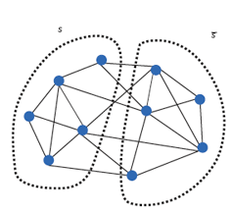
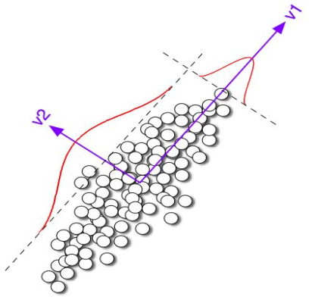
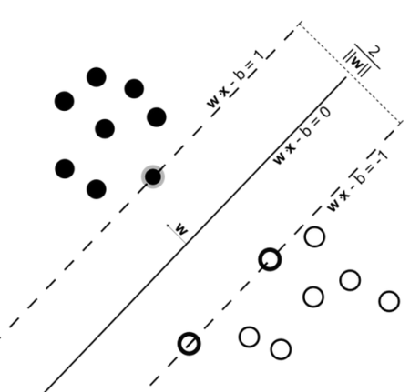
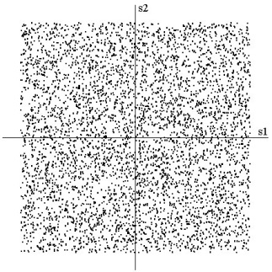
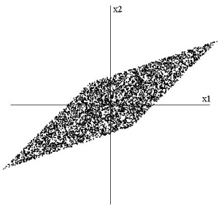
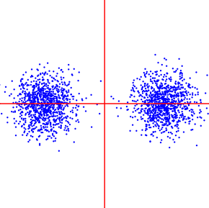
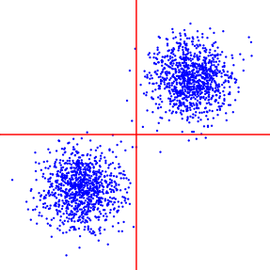
Related Work – Hashing
Random projection [Indyk and Matwani, STOC 1998]
Spectral graph partitioning [Weiss et al., NIPS 2008]
Principal Component Analysis [Gordo and Perronnin, CVPR 2011]
Independent Component Analysis [He et al., CVPR 2011]
Large margin hyper-planes [Joly and Perronnin, CVPR 2011]
Optimally rotated PCA [Gong and Lazebnik, CVPR 2011]
Some figures are from authors.

Slide 17
Spherical Hashing
Partitioning: Hyper-Spheres
Assignment: Inside/Outside
101
001
100
1
111
011
0
110
000
010

Slide 18
Bounding Power of Hyper-Spheres
closed regions
open regions
Hyper-Spheres gives tighter bound

Slide 19
Two Criteria for Hashing [Yeiss 2008, He 2011]
Developed for projection-based methods:
Balanced partitioning
2. Independence
<

Slide 20
Two Criteria with Hyper-Spheres
1. Balance
2. Independence
$$\frac{N}{4}$$
$$\frac{N}{4}$$
$$\frac{N}{2}$$
$$\frac{N}{2}$$
$$\frac{N}{2}$$
$$\frac{N}{4}$$
$$\frac{N}{2}$$
$$\frac{N}{4}$$

Slide 21
Iterative Optimization
1. Balance - by controlling radius for $n\left(S\right)=\frac{N}{2}$
2. Independence
- by moving two hyper-spheres for $n\left(S_{1}∩S_{2}\right)=\frac{N}{4}$
Repeat step 1, 2 until convergence.

Slide 22
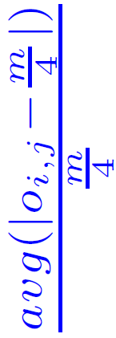
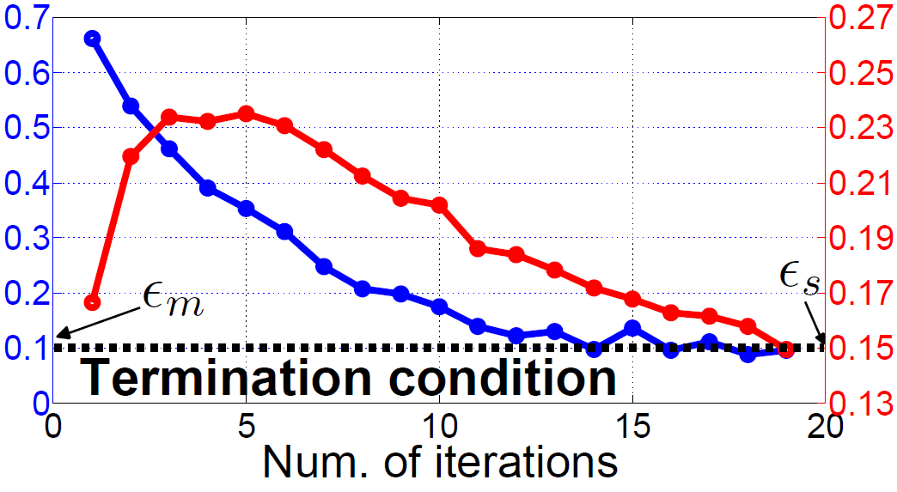
Convergence Rate
Optimization finishes within 20~30 iterations (which take less than 1 min)

Slide 23
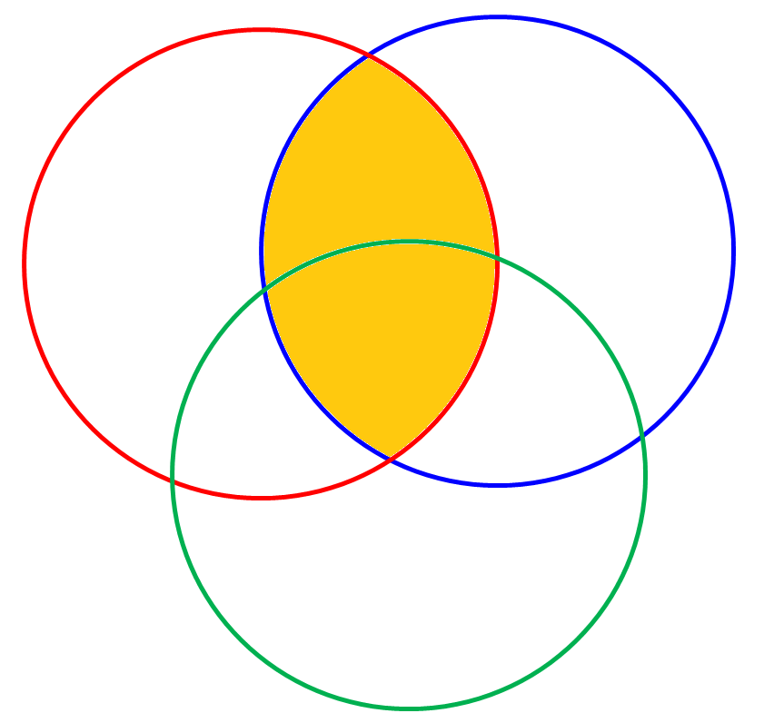
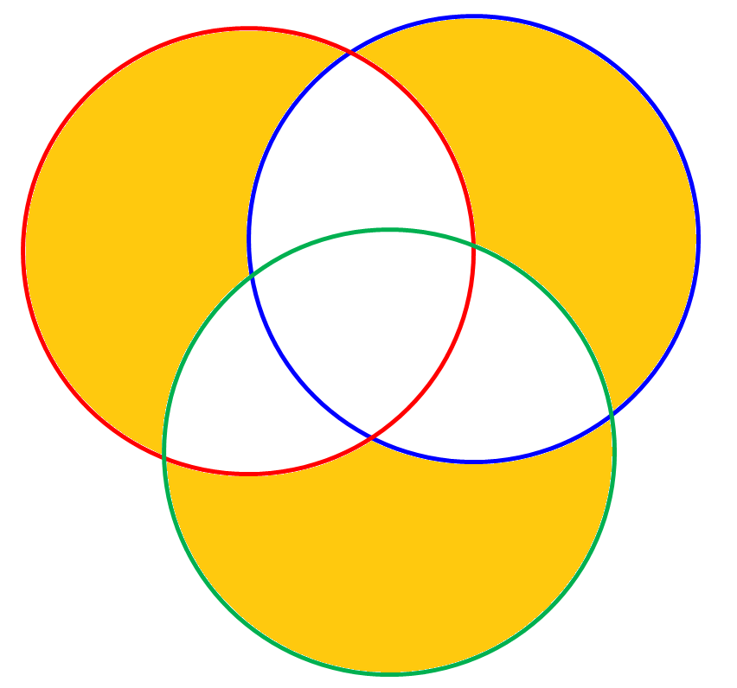
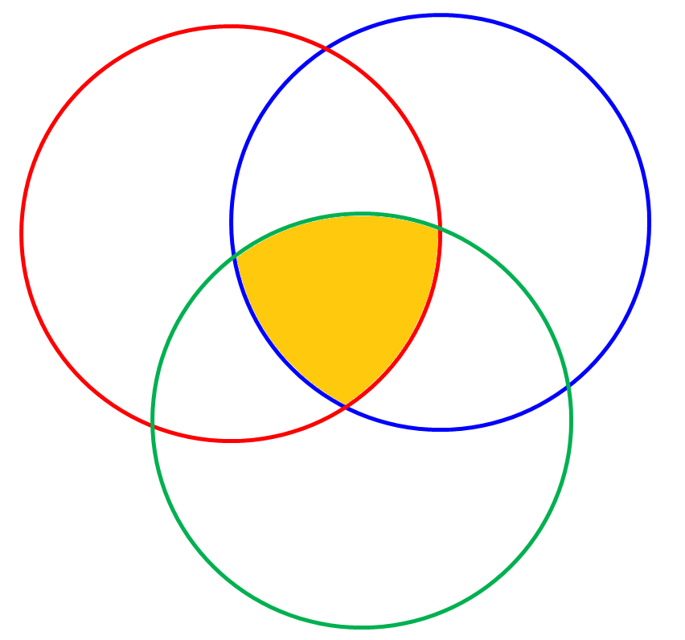
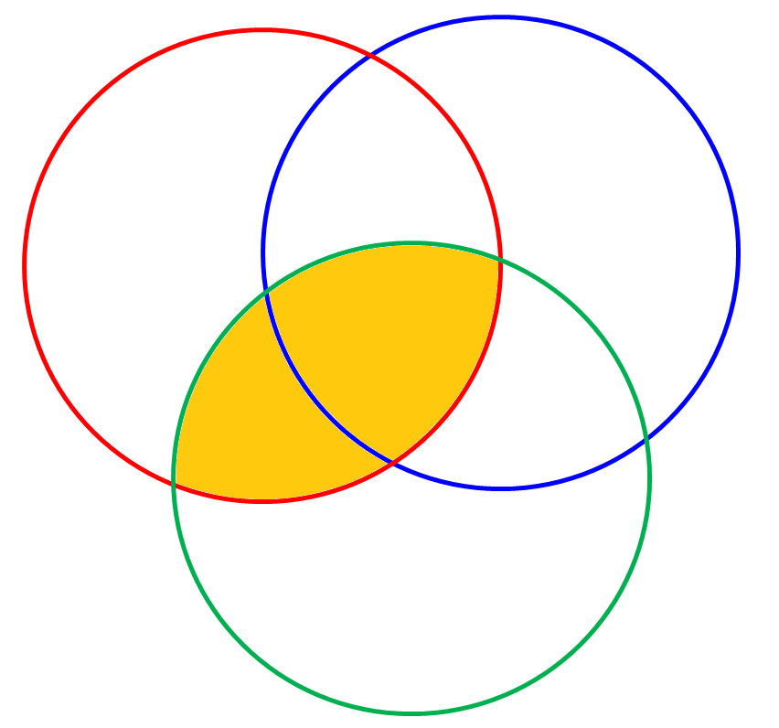
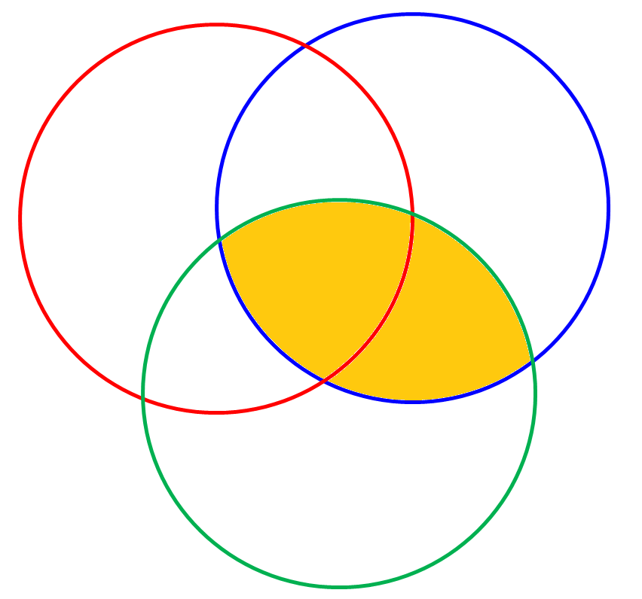
Distance Estimation
Hamming distance
# of common bounding hyper-spheres
bounded by 1 hyper-sphere
bounded by 2 hyper-spheres
bounded by 3 hyper-spheres

Slide 24
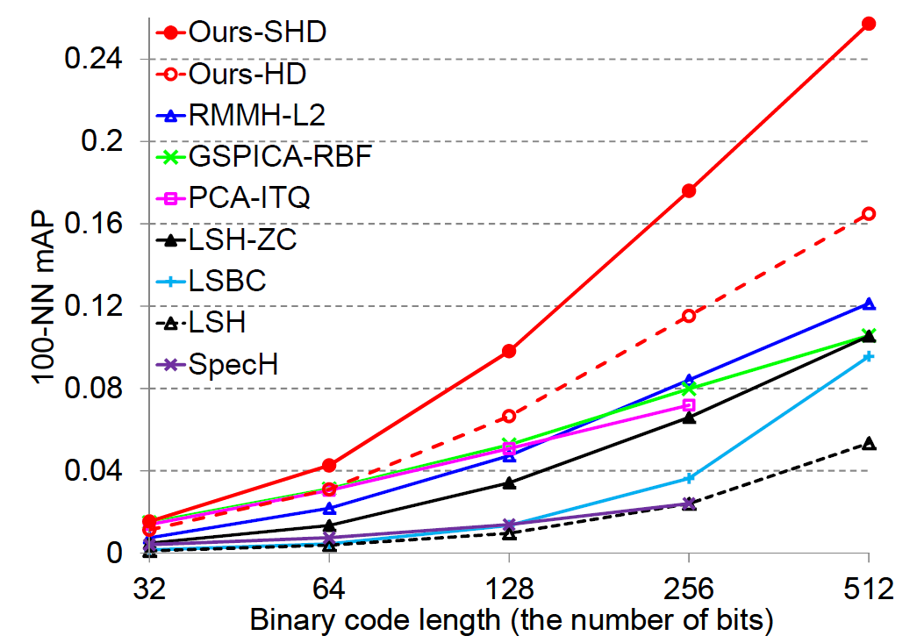
Result (1M, 384-Dim GIST)
100-nearest neighbor search mAP (mean Average Precision)

Slide 25
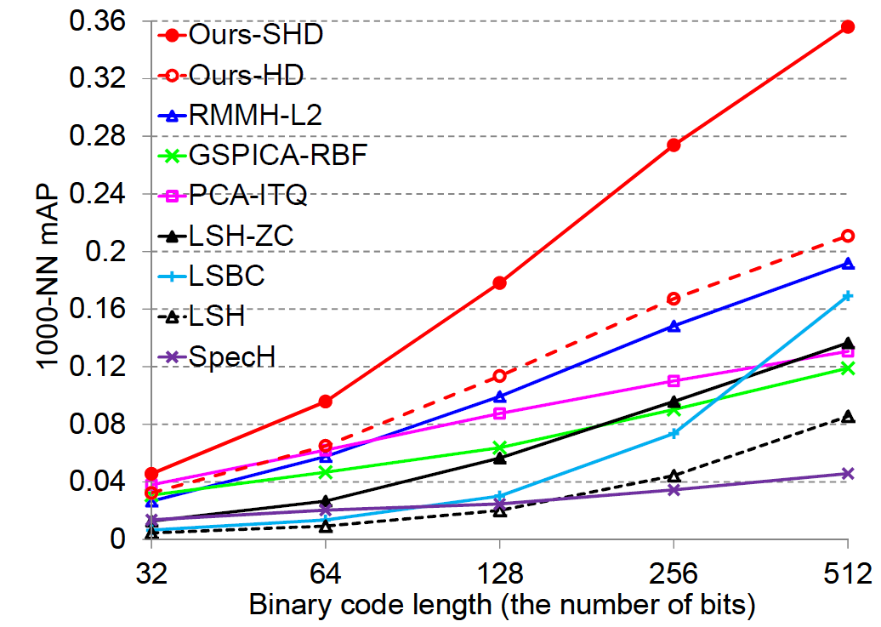
Result (1M, 960-Dim GIST)
1000-nearest neighbor search mAP

Slide 26
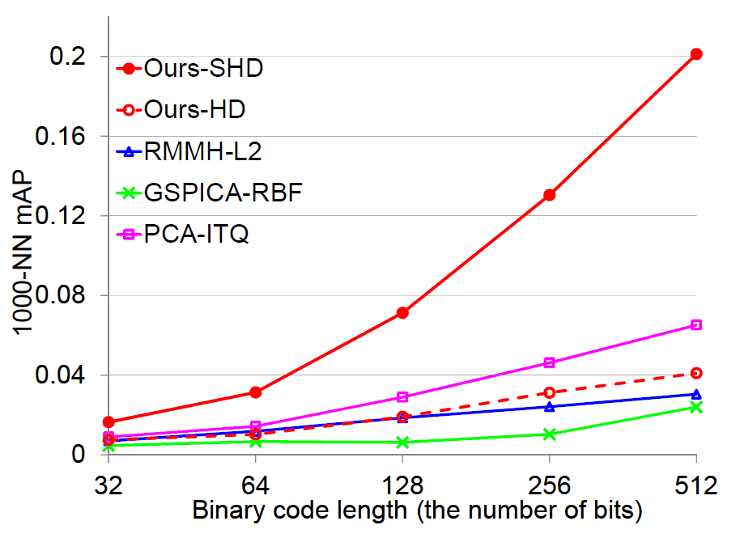
Result (1M, 8192-Dim VLAD)
1000-nearest neighbor search mAP

Slide 27
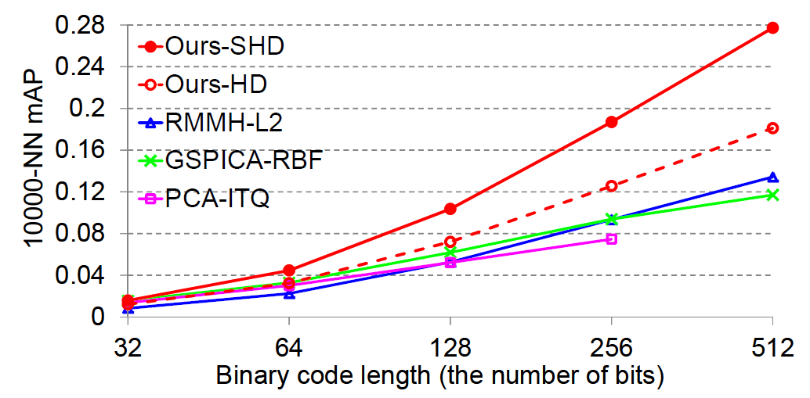
Result (75M, 384-Dim GIST)
10000-nearest neighbor search mAP

Slide 28
Distance Encoded Product Quantization
IEEE Conf. on Computer Vision and Pattern Recognition (CVPR), 2014

Slide 29
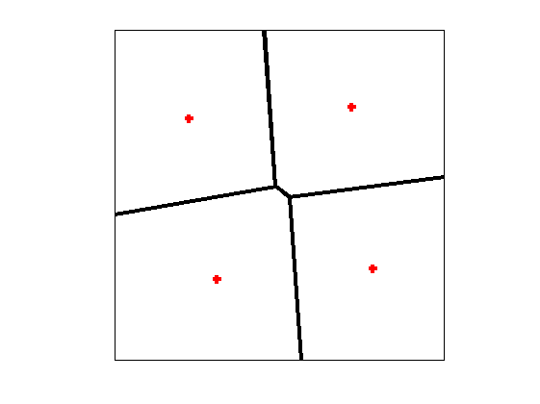
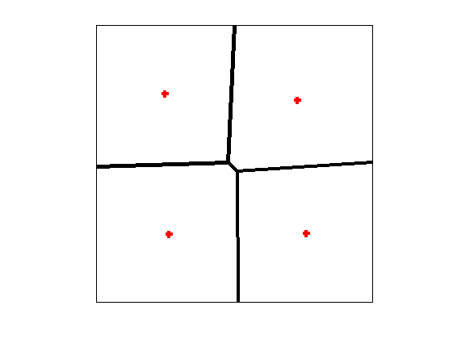
Product Quantization [Jegou et al., TPAMI 2011]
- Partitioning: Subspaces and Quantization
- Assignment: Cluster index
$$x_{1}$$
$$x_{2}$$
$$x_{3}$$
$$x_{4}$$
. . . .
$$x_{D−2}$$
$$x_{D−1}$$
$$x_{D}$$
$$x_{1}$$
$$x_{2}$$
$$x_{3}$$
Quantization
01
$$x$$
.
.
.
.
.
.
.
.
.
.
$$x→01…11$$
$$x_{D−2}$$
$$x_{D−1}$$
$$x_{D}$$
Quantization
11
Subspace #1
00
01
Quantization
11
10
01
.
.
.
.
$$x→01…11$$
$$x$$
00
01
11
Original space
Quantization
11
10
Subspace #M

Slide 30
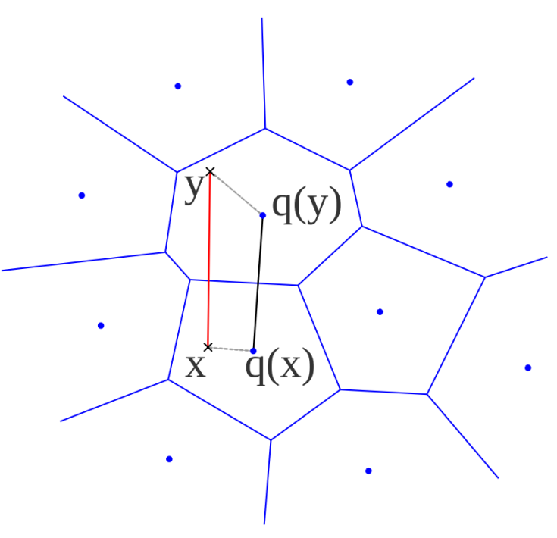
Product Quantization [Jegou et al., TPAMI 2011]
Distance estimation (between encoded y and query $x)$
Subspace #1
Asymmetric distance
$$x$$
$$y$$
$$c_{y}$$
+
.
.
.
.
.
Actual distance
+
Symmetric distance
Subspace #M
$x$: query, $y$: data
q(x)=c_{x}
q(y)=c_{y}
$$y$$
$$c_{y}$$
$$x$$
Left figure is from [Jegou et al., TPAMI 2011]

Slide 31
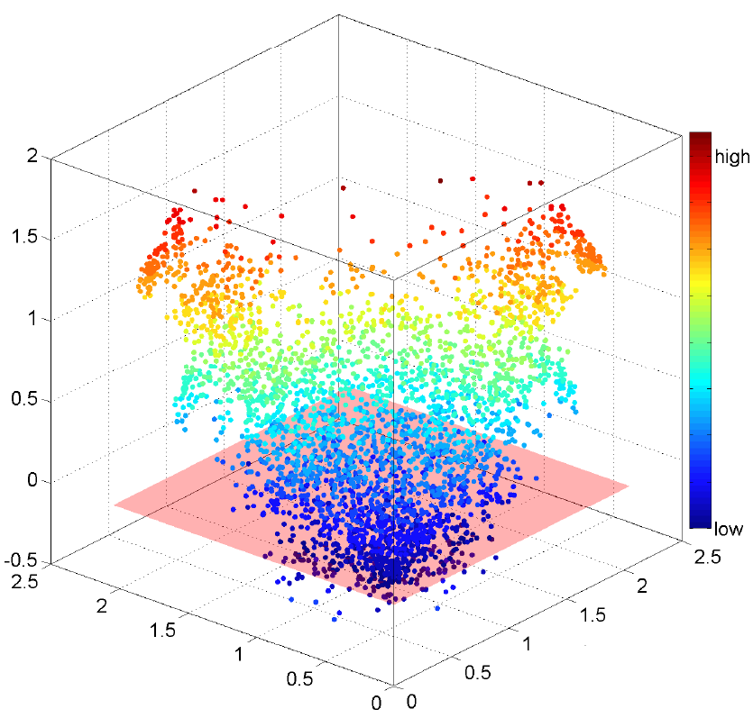
Motivation
actual dist.
Error: $d\left(x,y\right)−{d(c_{x},c}_{y})$
$$d(x,y)$$
$$x$$
$$y$$
$$r_{x}$$
$$r_{y}$$
$$c_{x}$$
$$c_{y}$$
$${d(c_{x},c}_{y})$$
estimated dist.
$$r_{y}$$
$$r_{x}$$
In PQ, errors of estimated distances $d\left(x,y\right)−{d(c_{x},c}_{y})$ tends to be higher as $r_{x}$ and $r_{y}$becomes larger.

Slide 32
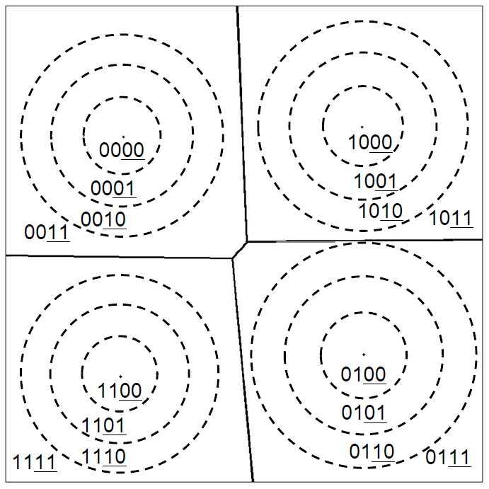
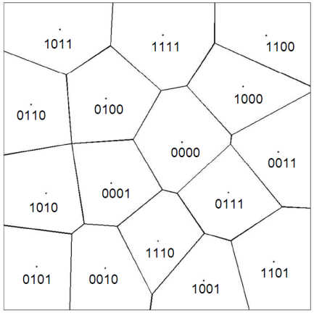
Distance Encoded PQ
Encode quantized distance from cluster center as well as the cluster index
Distribute bit budget to encode cluster index and quantized distance, while PQ use all budget to encode cluster index.
quantized distance from cluster center
cluster index
PQ
DPQ

Slide 33
Orthogonality in High Dim. Space
In high dimensional space, two randomly chosen vectors are highly likely to be orthogonal*.
$$x$$
$$x$$
$$d(x,y)$$
$$y$$
$$c_{x}$$
orthogonality
$$c_{x}$$
$$c_{y}$$
$${d(c_{x},c}_{y})$$
$$c_{y}$$
$$y$$
$${d\left(x,y\right)}^{2}={\left\|x−y\right\|}^{2}={\left\|\left(c_{x}−c_{y}\right)+\left(x−c_{x}\right)+(y−c_{y}) \right\| }^{2}$$
$$≈{\left\|c_{x}−c_{y}\right\|}^{2}+{\left\|x−c_{x}\right\|}^{2}+{\left\|y−c_{y}\right\| }^{2}$$
$(∵c_{x}−c_{y},x−c_{x},$ and $y−c_{y}$ are mutually orthogonal.)
*Mathematical foundations for the information age [J. Hopcroft, 2010]

Slide 34
Distance Estimation
Distance quantization boundary
Cluster boundary
$$\overline{r_{x}^{}}$$
$$d(C_{x},C_{y})$$
$$d(x,C_{y})$$
$$C_{x}$$
$$x$$
$$x$$
$$C_{y}$$
$$C_{y}$$
$$\overline{r_{y}^{}}$$
$$\overline{r_{y}^{}}$$
$$y$$
$$y$$
Symmetric Distance
Asymmetric Distance
$$d_{SD}^{DPQ}{(x,y)}^{2}={d(C_{x},C_{y})}^{2}+{\overline{r_{x}^{}}}^{2}+{\overline{r_{y}^{}}}^{2}$$
$$d_{AD}^{DPQ}{(x,y)}^{2}={d(x,C_{y})}^{2}+{\overline{r_{y}^{}}}^{2}$$
$\overline{r_{p}^{}}$: average distance from the center to points in the ring-shaped region where $p$ is in.

Slide 35
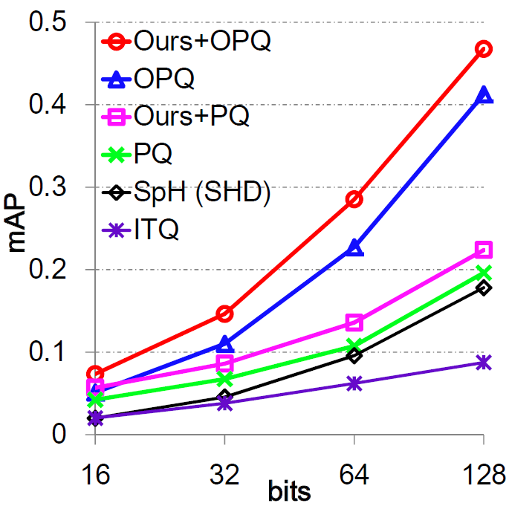
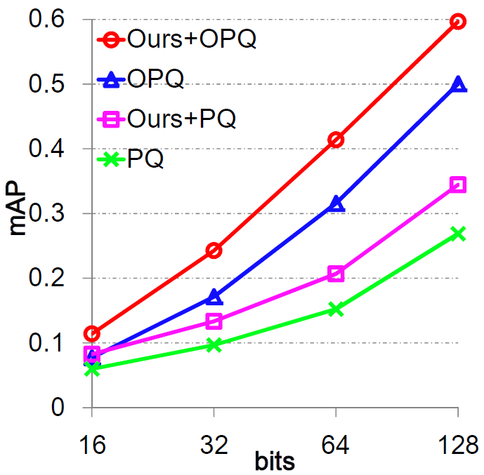
Result (1M, 960-Dim GIST)
Symmetric distance
Asymmetric distance
1000-nearest neighbor search mAP
OPQ: Optimized PQ [Ge et al., CVPR 2013]
SpH: Sperical Hashing [Heo et al., CVPR 2012]
ITQ: Iterative Quantization [Gong and Lazebnik, CVPR 2011]

Slide 36
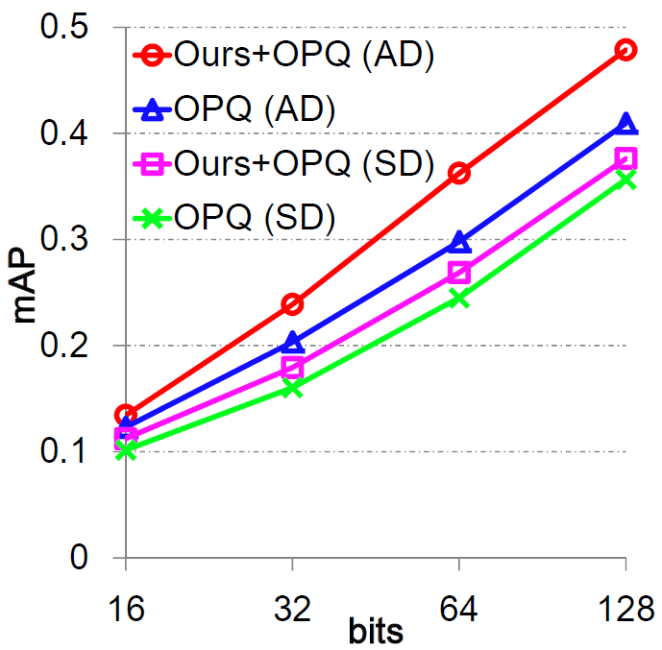
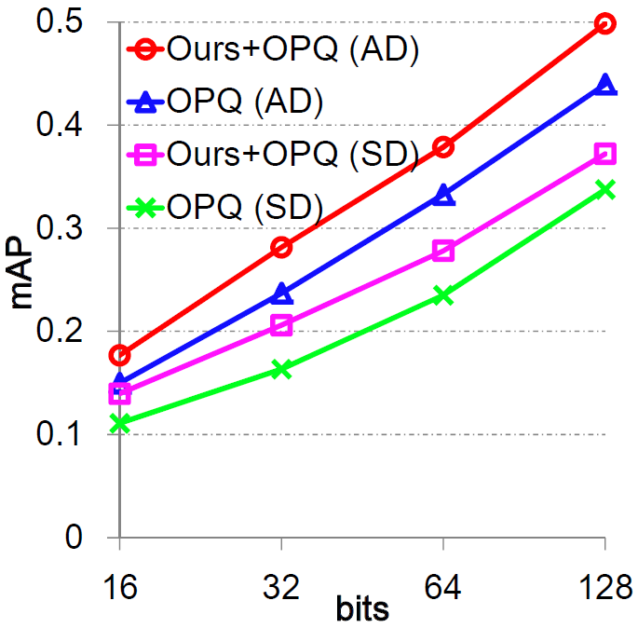
Result (1M, 1024-Dim BoW)
Original Data
$L_{2}$ Normalized data
1000-nearest neighbor search mAP
SD: Symmetric distance
AD: Asymmetric distance

Slide 37
Result (Accuracy/Time/Memory)
Tested on 4096-dimensional 11M CNN features
Indexer: Vector Quantization with 4K centroids (4K lists)
T = 100K (shortlist size)

Slide 38
Image Search Demo
11M images from Flickr
4096 dimensional image features
convolutional neural network
Developed during 1st internship at Adobe

Slide 39
Contents
Image Database
- Spherical Hashing [CVPR 2012]
- Distance Encoded Product Quantization [CVPR 2014]
- Accurate Shortlist Computation [ongoing]
Feature Extractor
index encode
features
Indexed Images
Similar Images
search
Query

Slide 40
Search (Revisited)
Inverted File
feature space
$$L_{1}$$
$T$ (shortlist size)
$$q$$
$$L_{2}$$
Near cluster search
…
$$L_{k}$$
Shortlist
$$R$$
Re-ranking
Top $R$ elements according to estimated distance

Slide 41
To Improve Shortlist
Limitation of current method
$$c_{2}$$
$$c_{2}$$
?
$$c_{3}$$
$$q$$
$$c_{3}$$
$$q$$
$$c_{1}$$
$$c_{1}$$
$$L_{1}$$
$$L_{1}$$
$$L_{2}$$
$$L_{2}$$
$$L_{3}$$
$$L_{3}$$

Slide 42
Distance Estimator and Approach
Our distance estimator between $q$ and $x$ based on orthogonality:
Compute shortlist according to $h^{2}+r^{2}$, instead of only $h^{2}$
$$q$$
$${d(q,x)}^{2}≈{d\left(q,c\right)}^{2}+{d\left(c,x\right)}^{2}=h^{2}+r^{2}$$
$$h$$
$$x$$
$$r$$
$$c$$
$$c_{2}$$
$$c_{2}$$
$$c_{3}$$
$$q$$
$$c_{3}$$
$$q$$
$$c_{1}$$
$$c_{1}$$
$$L_{1}$$
$$h^{2}$$
$$L_{1}$$
$$h^{2}+r^{2}$$
$$L_{2}$$
$$L_{2}$$
$$L_{3}$$
$$L_{3}$$

Slide 43
Pre-Computation
Items $x$ in each list $L_{i}$are sorted according to squared distances $r_{x}$ to the center
We uniformly divide $r^{2}$ values into fixed sized ($∆R$) intervals
$W\left(i,j\right)$ is the number of data in $L_{i}$ whose squared distance to the center is less than $R_{j}$
$W\left(i,j\right)=num( \left\{ x | r_{x}^{2}<R_{j}, x∈L_{i} \right\} )$
$$L_{1}$$
$$r^{2}$$
$$L_{2}$$
$$L_{3}$$
$$R_{0}$$
$$R_{1}$$
$$R_{2}$$
$$∆R$$
$$R_{max}$$
$$W$$
$$L_{1}$$
0 | 0 | 10 | 15 | 22 | 30 | 40 | 40 | 50 | 55
5 | 10 | 15 | 15 | 20 | 28 | 30 | 35 | 35 | 35
0 | 4 | 10 | 15 | 20 | 27 | 33 | 28 | 30 | 30
$$L_{2}$$
$$L_{3}$$

Slide 44
Shortlist Computation (Runtime)
In runtime, $h_{i}^{2}$ is dynamically computed with given query. We need to refer the table with shifted index.
$h_{i}^{2}+r_{x}^{2}<t$ → $r_{x}^{2}<t−h_{i}^{2}$
$num\left( \left\{ x \right| r_{x}^{2}<t−h_{i}^{2}, x∈L_{i} \right\} )=W( i , \left[\frac{ t−h_{i}^{2}−R_{0}}{∆R}\right])$
$$h_{1}^{2}$$
$${h^{2}+r}^{2}$$
$$L_{1}$$
$$h_{2}^{2}$$
$$L_{2}$$
$$h_{3}^{2}$$
$$L_{3}$$
$$t$$
$$L_{1}$$
0 | 0 | 10 | 15 | 22 | 30 | 40 | 40 | 50 | 55
5 | 10 | 15 | 15 | 20 | 28 | 30 | 35 | 35 | 35
0 | 4 | 10 | 15 | 20 | 27 | 33 | 28 | 30 | 30
$$L_{2}$$
$$L_{3}$$

Slide 45
Shortlist Comp. based on H2R2 (Runtime)
Given desired size of shortlist $T$, binary search is performed to find appropriate threshold $t$.
Example: $T=50$
Complexity Analysis
Baseline: $O(kD+k\log{k})$
Ours: $O(kD+k\log{\frac{R_{max}−R_{0}}{∆R}})$
$∆R$ can be set to satisfy $\frac{R_{max}−R_{0}}{∆R}=k$ for the same complexity
$$L_{1}$$
0 | 0 | 10 | 15 | 22 | 30 | 40 | 40 | 50 | 55
5 | 10 | 15 | 15 | 20 | 28 | 30 | 35 | 35 | 35
0 | 4 | 10 | 15 | 20 | 27 | 33 | 28 | 30 | 30
$$L_{2}$$
$$L_{3}$$
35
50
83

Slide 46
Current Result
Tested on 4096-dimensional 11M image descriptors
Indexer: Vector Quantization with 4K centroids
 | Time (ms)
Baseline | 6.16 ~ 6.55
H2R2 | 6.34 ~ 6.82
K = 1000

Slide 47
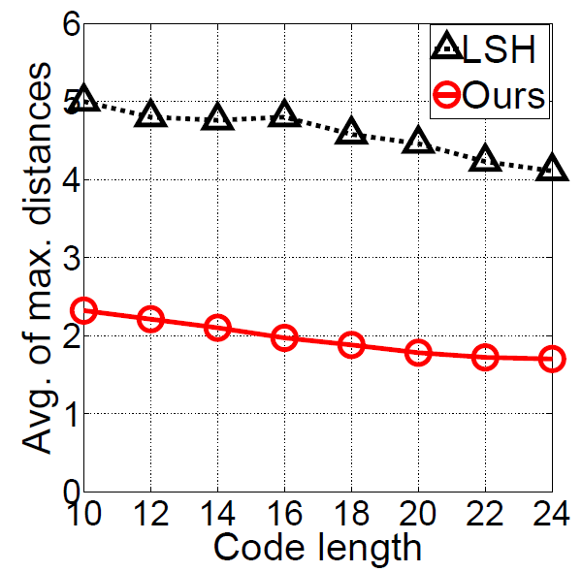
Bounding Power of Hyper-Spheres
closed regions
open regions
Average of maximum distances within each partition:
- Hyper-Spheres gives tighter bound!

Slide 48
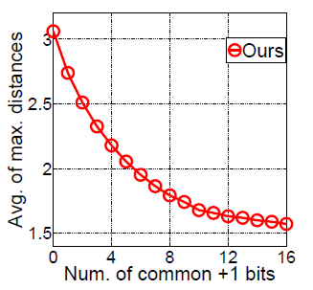
Max Dist. and Common ‘1’
Common ‘1’s: 1
Common ‘1’s: 2
Average of maximum distances between two partitions: decreases as number of common ‘1’

Slide 49
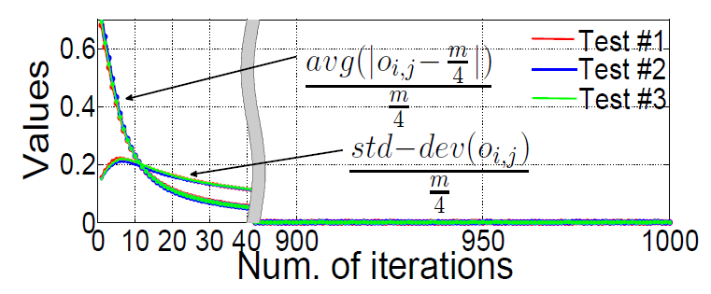
Convergence Rate

Slide 50
Distance Estimation
bounded by 1 hyper-sphere
bounded by 2 hyper-sphere
bounded by 3 hyper-sphere
The sizes of colored regions are getting smaller as the number of bounding hyper-spheres increases.
→ Expected distance between two points getting smaller as the number of common ‘1’ bits (common bounding hyper-spheres) increases.

Slide 51
Spherical Hamming Distance (SHD)
Hamming Distance divided by the number of common ‘1’s.
$$b_{i}: binary code ⊕:XOR ⋏:AND$$

Slide 52
Orthogonality in High-Dim Space*
The surface area of a hyper-sphere in a high-dim space is dominated by its equator.
Given randomly chosen point $x$ on the surface. We rotate coordinate system such that $x$ located at the north pole.
We have high probability that another randomly chosen point $y$ located at the equator. Thus it is highly likely that $x−c$ and $y−c$ are orthogonal.
$$x$$
$$y$$
$$c$$
* Detailed proof is given in the course notes of mathematical foundations for the information age [J. Hopcroft, 2010]

