Slide 1

Data-driven Multiple Importance Sampling for Monte Carlo Rendering
M.S. Defense (2014. 06. 17.)
Myounghwan Seo (서 명 환)
Advisor: Professor Sung-Eui Yoon
Graduate School of Culture Technology
Notes:
Good morning, Professors.
I’m Myounghwan Seo, master student of Professor Sung-Eui Yoon.
Today I’m going to present Data-driven Multiple Importance Sampling for Monte Carlo Rendering.
Please never mind to interrupt me whenever you have anything unclear.

Slide 2
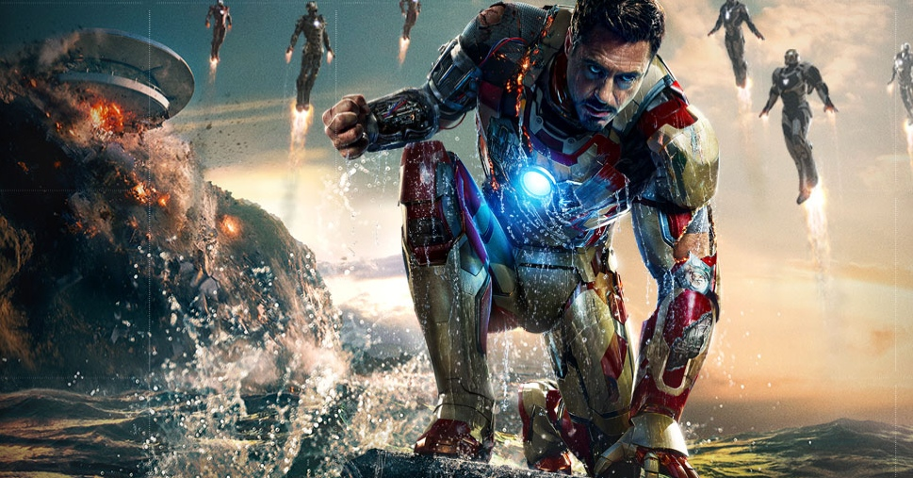
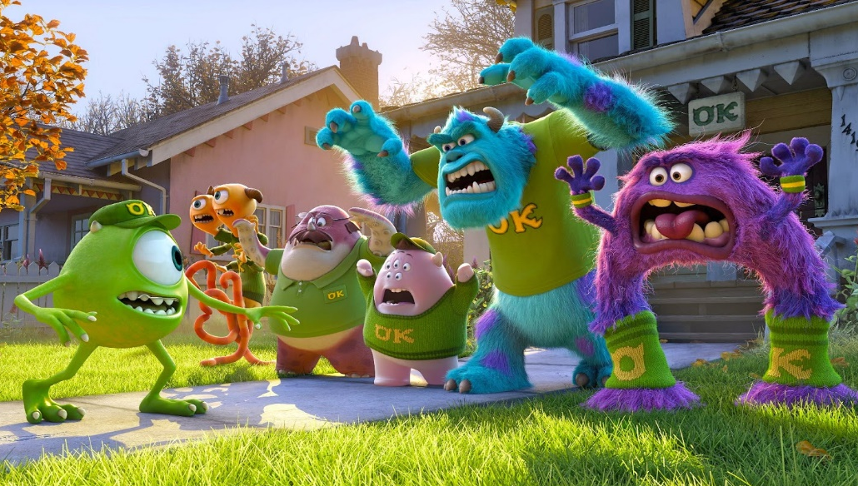
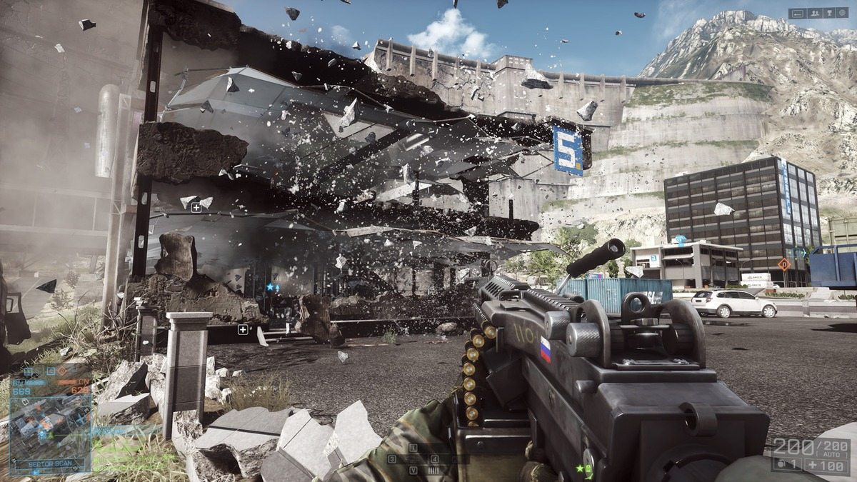
Movie Animation Game
IronMan3
Monster University
BattleField4
Notes:
First of all, Rendering, especially ray tracing method is widely used in the industry including movie, animation and game.
My research part is that
We focus on rendering part in computer graphics, blah blah.

Slide 3


Rendering Equation [Kajiya 86]
$$L_{o}\left(x,w_{o}\right)=\int_{Ω}{f\left(x,w_{o},w_{i}\right)L_{i}\left(x,w_{i}\right)cosθdw_{i}}$$
$$≈\frac{1}{N}\sum_{i=1}^{N}{\frac{f\left(x,w_{o},w_{i}\right)L_{i}\left(x,w_{i}\right)cosθ}{p(w_{i})}}$$
Notes:
Rendering equation is presented by Kajiya in 1986.
It is a light transport equation. When we want to photo-realistic rendering image, we have to solve this equation for global or direct illumination.
As you can see, this term consists of BRDF function and incident light.
To efficiency this equation, we use monte-carlo integration to estimate the value for image.

Slide 4

Issue
To accelerate Monte Carlo Rendering
  Choose optimal probability density of choosing direction
$$L≈\frac{1}{N}\sum_{i=1}^{N}{\frac{f\left(x,w_{o},w_{i}\right)L_{i}\left(x,w_{i}\right)cosθ}{p(w_{i})}}$$
Notes:
Monte-Carlo integration is a way to approximate integrals.

Slide 5
Main Contribution
To accelerate Monte Carlo Rendering
  Choose optimal probability density of choosing direction
    Multiple Importance Sampling (heuristic method)[Veach & Guibas, SIG 95]
    Local weighting function (ours)
$$L≈\frac{1}{N}\sum_{i=1}^{N}{\frac{f\left(x,w_{o},w_{i}\right)L_{i}\left(x,w_{i}\right)cosθ}{p(w_{i})}}$$

Slide 6
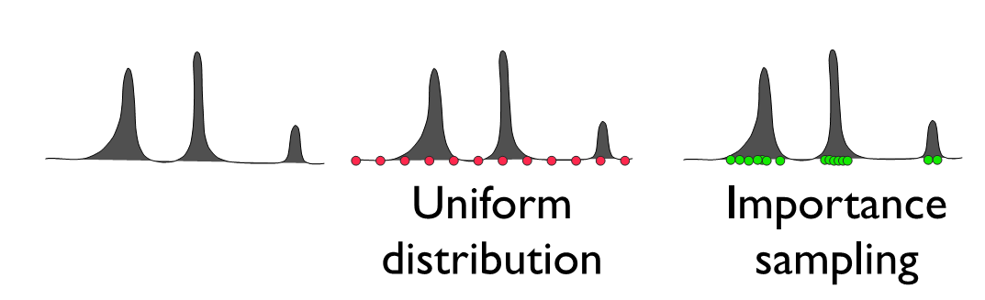
Importance Sampling
Light density
Sample region
Notes:
Background

Slide 7

Importance Sampling
$$L≈\frac{1}{N}\sum_{i=1}^{N}{\frac{f\left(x,w_{o},w_{i}\right)L_{i}\left(x,w_{i}\right)cosθ}{p(w_{i})}}$$
Notes:
We have to focus on Pdf

Slide 8



Choosing Sampling Strategy
Variance depends on $p(w_{i})$
Ideal sampling strategy $p\left(w_{i}\right)∝BRDF∙Light$
$$L≈\frac{1}{N}\sum_{i=1}^{N}{\frac{f\left(x,w_{o},w_{i}\right)L_{i}\left(x,w_{i}\right)cosθ}{p(w_{i})}}$$
$$p\left(w_{i}\right)=cf\left(x\right)$$
Ideal sampling density
However, it needs a lot of work and
precomputation needed!

Slide 9



Multiple Importance Sampling
Optimally Combining Sampling Techniques for Monte Carlo Rendering
[Veach & Guibas, SIGGRAPH 95]
To solve these problem, they
  Presents combine sampling strategies
  Use weighting function
$$L≈\frac{1}{N}\left[\sum_{i=1}^{N_{a}}{w_{1}\left(x_{1,i}\right)\frac{f\left(x_{1,i}\right)}{p_{1}\left(x_{1,i}\right)}+\sum_{i=1}^{N_{b}}{w_{2}\left(x_{2,i}\right)\frac{f\left(x_{2,i}\right)}{p_{2}\left(x_{2,i}\right)}+⋯}}\right]$$
$$L≈\frac{1}{N}\sum_{i=1}^{N}{\frac{f\left(x,w_{o},w_{i}\right)L_{i}\left(x,w_{i}\right)cosθ}{p(w_{i})}}$$
$$w_{i}= \frac{p_{i}(x)}{\sum_{j}{\frac{N_{j}}{N}p_{j}(x)}}$$
Balance Heuristic

Slide 10
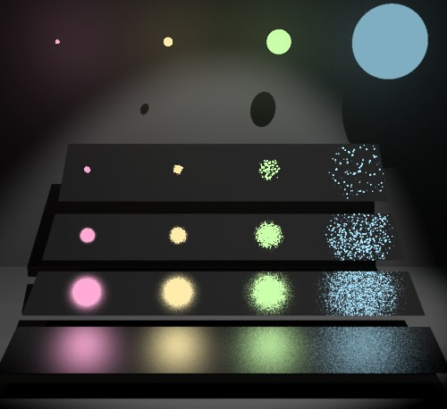
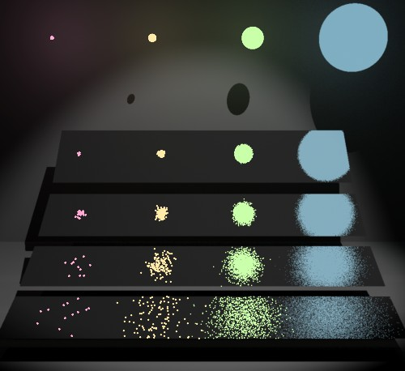
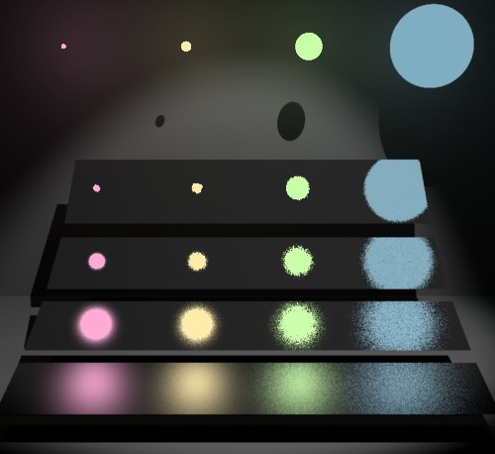
Combining Sampling Strategies
Sampling the light source
Sampling the BRDF
A combination of samples
Light and BRDF
From Veach and Guibas, 1995

Slide 11

Related Work
BRDF sampling
  Material function[Phong75, Blinn77, Ward92]
  Complex BRDF[TS92, CT82]
  Wavelet[Claustres et al, 03]
  Factored representation[Lawrence et al, 04]
  Spherical Harmonics[Jarosz 09]
$$I≈\frac{1}{N}\sum_{i=1}^{N}{\frac{f\left(x,w_{o},w_{i}\right)L_{i}\left(x,w_{i}\right)cosθ}{p(w_{i})}}$$

Slide 12
Related Work
Light sampling
  Environment map[ARBJ 03, KK 03, ODJ 04]
Product sampling
  Wavelet[Clarberg et al, 05]
  Resampling[Burke et al, 05]
  Rejection[Talbot et al, 05]
$$I≈\frac{1}{N}\sum_{i=1}^{N}{\frac{f\left(x,w_{o},w_{i}\right)L_{i}\left(x,w_{i}\right)cosθ}{p(w_{i})}}$$

Slide 13
Related Work
Multiple Importance Sampling
  Representativity strategy[Pajot et al, 11]
  Second-order taylor expansion[Lu et al, 13]

Slide 14
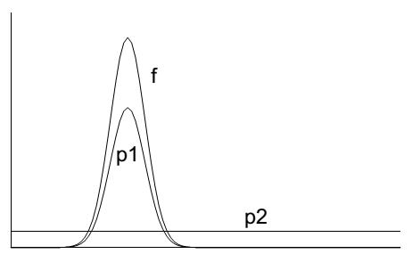



Observation
$p_{1}$ $∝f$
$$p_{2} :Uniform distribution$$
Two distributions for sampling the integrand
$p_{1}$ is Zero-variance importance sampling distribution
Optimal weight function
$$w_{1}\left(X\right)≡1 \\ w_{2}\left(X\right)≡0$$
$$\frac{f(X)}{p_{1}(X)}=F(constant)$$
Notes:
Limitation case.
For example, there are two distribution for sampling the intergrand. Where f is original integrand distribution. And p1 and p2 is given two strategy distribution.
As you can see p1 is proportional to f and p2 is the uniform distribution.
Assume that we take an equal number of samples from both p1 and p2, and apply for balance heuristic.

Slide 15
Objectives
Limitations
  Balance heuristic weight function
  Pre-defined weight before samples taken
  No prior knowledge about the scene
Goals
  Find optimal weight using preprocessing
  Robust & Efficient weight with balance heuristic
Notes:
So we focus on estimating weight to solve limitation case.
Because Balance heuristic assumes that pre defined weight and apply this for sampling. So, sampling result has high dependency weight value. And occurs light and brdf sampling problems as I previous mentioned.
Because of this, I will estimate weight using preprocess and find optimal weight.
So I want to get Our Goal which is robust & efficient weight for balance heuristic.

Slide 16
Overview of Our Approach
BRDF Sampling(4spp)
Balance Heuristic(4spp)
Light Sampling(4spp)
Reference(8k spp)

Slide 17




Overview of Our Approach
BRDF Sampling(4spp)
Balance Heuristic(4spp)
Light Sampling(4spp)
Reference(8k spp)
$$v_{1}^{i}$$
$$v_{2}^{i}$$
$$v_{3}^{i}$$
Comparing Patch Variance
$$Comp\left(v_{1}^{i}, v_{2}^{i}, v_{3}^{i} \right)=W_{optimal}^{i}$$
Ours(128spp)

Slide 18
Overview of Our Approach
Precomputing variance
Comparing variance in each patch
Optimization

Slide 19



Precomputing variance
Multiple Importance Sampling is unbiased method
Render the scene with small sample(precomputation sample, 2 or 4)
  Calculate variance for every pixel in render image
  Grouping variance for patch of specific size(ex, 16X16, 32X32)
$$MSE ∝var$$
$$MSE={bias}^{2}+var$$
$$MSE=var$$
BRDF Sampling(4spp)
Balance Heuristic(4spp)
Light Sampling(4spp)

Slide 20




Comparing variance
Compare variance in each patch
Use the least square method for comparing
$$v_{1}^{i}$$
$$v_{2}^{i}$$
$$v_{3}^{i}$$
BRDF Sampling(4spp)
Balance Heuristic(4spp)
Light Sampling(4spp)
$$Comp\left(v_{1}^{i}, v_{2}^{i}, v_{3}^{i} \right)=W_{optimal}^{i}$$

Slide 21
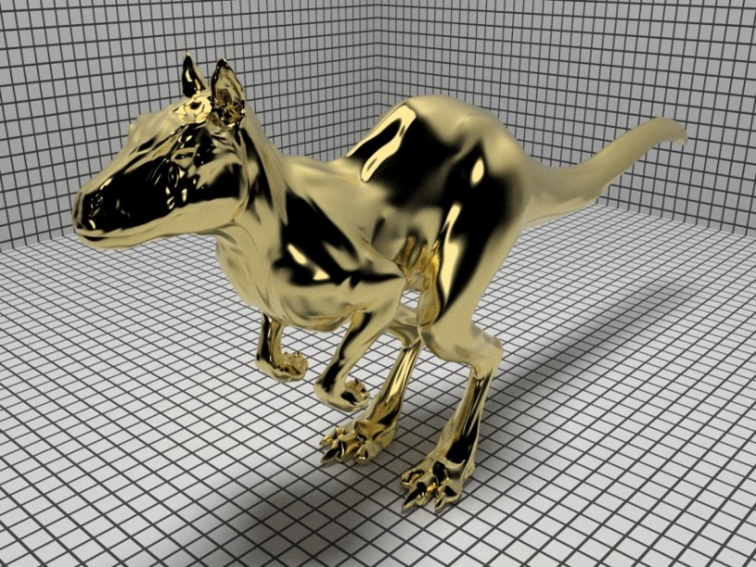
Experiment result
Light
Sampling
BRDF
Sampling
1:1 balance
heuristic
Optimal weight
Weight ratio

Slide 22
Optimization
Numerical error
  Truncation error
  Round-off error
Use Gaussian filter for patch

Slide 23
Results
Ours: 128spp(6spp: precomputation sample + 122spp: render sample
Other: 128spp
Equal-sample comparison
The smaller the better: MSE
Method | Scene1 | Scene2 | Scene3 | Scene4 | Scene5 | Scene6
Balance 0.5 | 1.00 |  | 1.00
Ours | 0.80 |  | 1.02

Slide 24
Results
Equal-time comparison
The smaller the better: MSE
Method | Scene1 | Scene2 | Scene3 | Scene4 | Scene5 | Scene6
Balance 0.5
Ours

Slide 25
Results
Light
Sampling
Teapot-area-light (diffuse scene)

Slide 26
Results

Slide 27
Results (precompute sample: 2spp, ratio 2:8)
 | Balance | Ours (same time) | Ours (same #samples) | Ours (same effective samples)
Sample | 128 | 126(6+120) | 128(6+122) | 134(6+128)
Time | 340s | 342.9s | 349.5s | 368.3s
MSE | 1.244e-6 | 8.16699e-7 | 9.84233e-7 | 7.46e-7
35%
Teapot-area-light (diffuse scene)

Slide 28
Results
Light
Sampling
Killeroo-gold-diffuse_no_texture
(diffuse scene)

Slide 29
Results (precompute sample: 2spp, BRDF/Light ratio 2:8)
 | Balance | Ours (same time) | Ours (same #samples) | Ours (same effective samples)
Sample | 128 | 126(6+120) | 128(6+122) | 134(6+128)
Time | 213s | 214s | 228s | 232.7s
MSE | 3.25015e-4 | 3.06812e-4 | 3.02086e-4 | 2.88389e-4
Killeroo-gold-diffuse_no_texture
(diffuse scene)

Slide 30
Results
BRDF
Sampling
yeahright (glossy scene)

Slide 31
Results(precompute sample: 2spp, BRDF/Light ratio: 8:2)
 | Balance | Ours (same time) | Ours (same #samples) | Ours (same effective samples)
Sample | 128 | 126(6+120) | 128(6+122) | 134(6+128)
Time | 87s | 87.9s | 91.1s | 93.4s
MSE | 1.1617e-4 | 1.20705e-4 | 1.18624e-4 | 1.11e-4
yeahright (glossy scene)

Slide 32
Results
1:1 balance
heuristic
TT (general scene)

Slide 33
Results(precompute sample: 2spp, , BRDF/Light ratio: 6:4)
 | Balance | Ours (same time) | Ours (same #samples) | Ours (same effective samples)
Sample | 128 | 126(6+120) | 128(6+122) | 134(6+128)
Time | 147s | 148s | 152.5s | 157.3s
MSE | 8.252e-6 | 1.07279e-5 | 1.06342e-5 | 8.44e-6
TT (general scene)

Slide 34
Conclusion
Our Goals
  Find optimal weight using preprocessing
  Robust & Efficient weight with balance heuristic
We present robust & efficient algorithm
  Variance reduction with local weighting function
  Find good balancing weight on preprocessing for small samples

Slide 35
Future Work
Automatical patch size
Extension to the more sampling strategies
Variance reduction for all the pixels

Slide 36
Thanks for your attention
Any question or feedback?
Notes:
Thank you for your attention.
Please let me know, if you have any question or feedback to me.

Slide 37
Problem – Light Sampling
BRDF very small
: Low contribution
Light
PDF very small
: unexpectedly high
Contribution / spike

Slide 38
Problem – Light Sampling
Small
Big
Glossy
Diffuse
Sampling the light source
From Veach and Guibas, 1995

Slide 39
Problem – BRDF Sampling
Light
PDF small
: Large contribution
Miss light
: zero contribution

Slide 40
Problem – BRDF Sampling
Small
Big
Glossy
Diffuse
Sampling the BRDF
From Veach and Guibas, 1995

Slide 41
Experiment results

