Slide 1
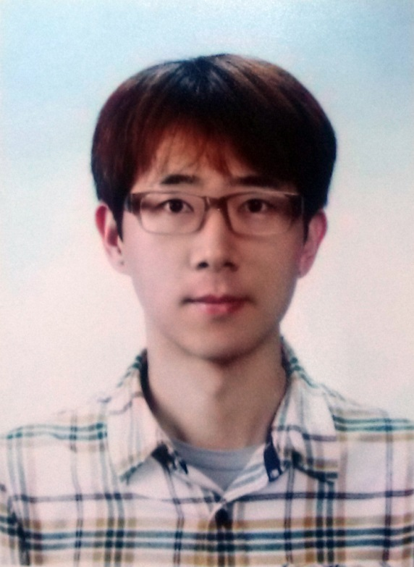
김 덕 수 (Duksu Kim)
석·박사 통합과정, 전산과, KAIST
  2008/02 ~
  대용량 그래픽스 연구실
    지도교수: 윤성의
B.S., 정보통신 공학, 성균관 대학교
  2001/03 ~ 2008/02

Slide 2
Proximity Computation on Heterogeneous Computing Systems
Ph. D. Defense (20140520)
Duksu Kim
Advisor: Sung-Eui Yoon

Slide 3
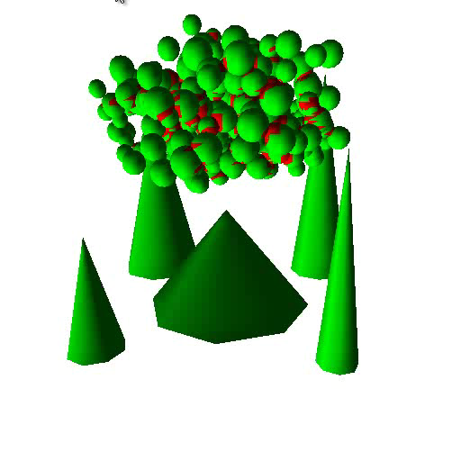
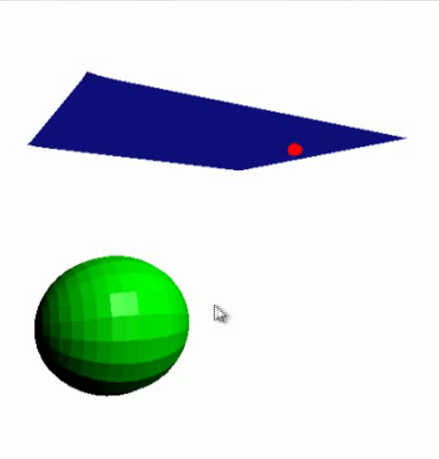
Proximity Queries (PQs)
Compute relative placement or configuration of two objects
  Collision detection
  Distance computation
    Neighbor search
Basic operations in various applications
  Graphics, simulations,
  robotics, Etc.

Slide 4
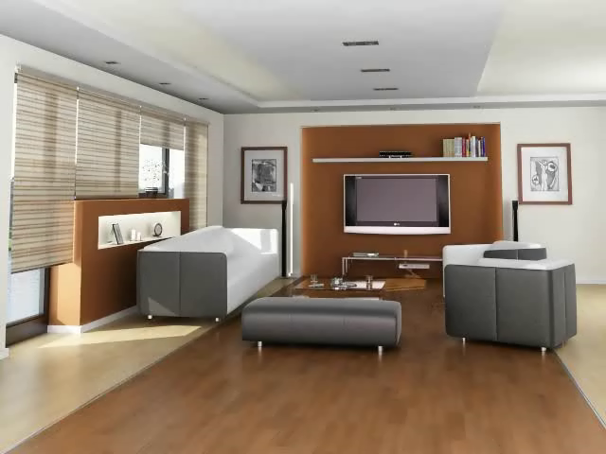
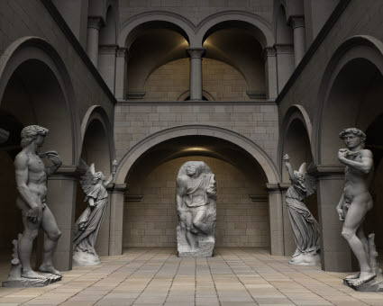
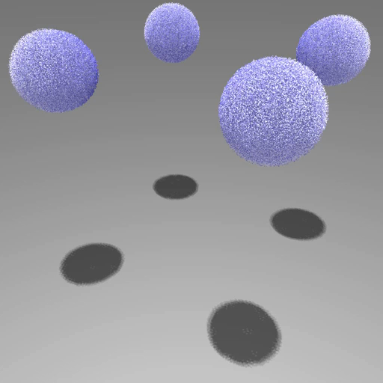
Proximity Queries in App.
Motion planning
Realistic rendering
Particle-based Sim.
Collision
detection
Neighbor
search
Ray tracing
[Jia 2010] [Liangjun 2008]
[Our in-house render]
[Our in-house simulator]

Slide 5
Proximity Query Acceleration
Various acceleration techniques
  Acceleration hierarchies
  Culling algorithms
  Specialize algorithms for a target application
  Approximation algorithms
Achieve several orders of magnitude performance improvement

Slide 6
Demands for High Performance
Motion planning
Realistic rendering
Particle-based Sim.
Takes few ~ tens or hundreds seconds
  for solving complex motion planning problem
  per frame for realistic rendering and particle simulations
Model complexity continue to grow for more realistic and accurate outputs

Slide 7
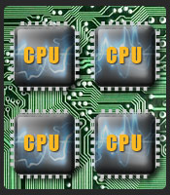
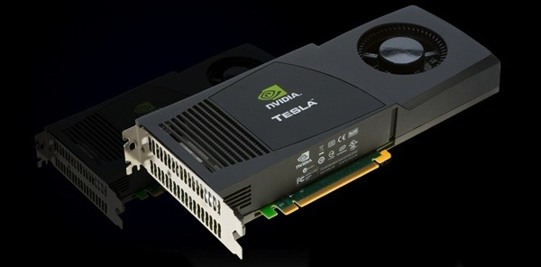
Parallel Computing Trend
Multi/Many-core architectures
  Multi-core CPU
  Graphics processing unit (GPU)
Image from NVIDIA

Slide 8
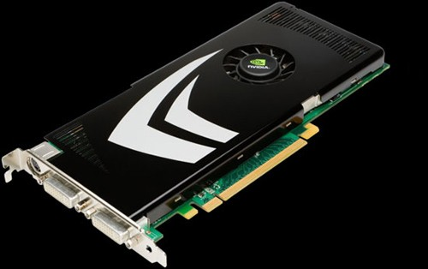
Parallel Computing Trend
Multi/Many-core architectures
Heterogeneous architectures
  Different types of computing devices in a system
    Multi-core CPUs and GPUs in a PC
  Intel Sandy Bridge, AMD Fusion, Sony Cell, ..
Images from NVIDIA

Slide 9
Multi-core CPU
GPU
Proximity computation
Proximity computation
Achieve high performance improvement
Utilize either multi-core CPU or GPU
Do not provide interactive performance yet for large-scale models
[Lawlor 2002] [Ize 2007] [Wald 2007] [Tang 2009] [Lee 2010] [IABT 2011]
…
[Vassilev 2001] [Baciu 2002] [Govindaraju2005] [Govindaraju2005*] [Sud 2006] [HKK 2007] [Lauterbach 2010] [GSSP 2010]
…

Slide 10
Multi-core CPU
GPU
Proximity computation
Proximity computation

Slide 11
Multi-core CPU
GPU
Proximity computation
Proximity computation
Proximity computation

Slide 12
Comp. Res. A
Comp. Res. B
Comp. Res. C
Comp. Res. D
Comp. Res. E
…
Work distributor
(Scheduler)
Proximity computation

Slide 13
Thesis Statement
We design systems that accelerate proximity computation for large-scale data by using heterogeneous computing resources
We maximize the utilization efficiency of heterogeneous systems by designing scheduling algorithms that consider the heterogeneity

Slide 14
Approaches
Heterogeneous computing system for a specific proximity query
General proximity computing system and scheduling algorithm for a various proximity queries
Out-of-core proximity computation

Slide 15
Outline
Introduction & Overview
Approaches
Conclusion

Slide 16
Approaches
Heterogeneous computing system for a specific proximity query
General proximity computing system and scheduling algorithm for a various proximity queries
Out-of-core proximity computation

Slide 17
HPCCD:
Hybrid Parallel Continuous Collision Detection using CPUs and GPUs
Multi-core CPU
GPU
Hierarchical work
Elementary test
CCD
Duksu Kim, Jae-Pil Heo, JaeHyuk Huh, John Kim, Sung-Eui Yoon
Computer Graphics Forum (Pacific Graphics), 2009
Received a distinguished paper award at the conference

Slide 18
Contributions
Utilize both multi-core CPUs and GPUs
  Workload distribution algorithm
  Efficient data communication technique
Propose a novel parallel continuous collision detection algorithm on multi-core CPUs

Slide 19
Workload Distribution
Hierarchy update
Hierarchy traversal
Elementary test
(Tri-Tri intersection)
CCD

Slide 20
Workload Distribution
Hierarchy update
Hierarchy traversal
Elementary test
(Tri-Tri intersection)
Random accesses
- Solving cubic equations
BVH update and traversal
Elementary tests
- Branch prediction
- Caching
Streaming processors optimized with floating point operations
Multi-core CPUs
GPUs

Slide 21
Improve the Efficiency of Parallel Computing
Remove synchronization in the main loop of continuous collision detection algorithm
Optimize data communication between CPU and GPU
BVH update and traversal
Data communication optimization
Elementary tests
Synchronization free parallel hierarchy update and traversal
Multi-core CPUs
GPUs
Please see the thesis for the details

Slide 22
Results
Testing Environment
  One quad-core CPU (Intel i7 CPU, 3.2 GHz )
  Two GPUs (NVIDIA GeForce GTX285)
  Run eight CPU threads by using Intel’s hyper threading technology
Compare the performance over using a single CPU-core

Slide 23
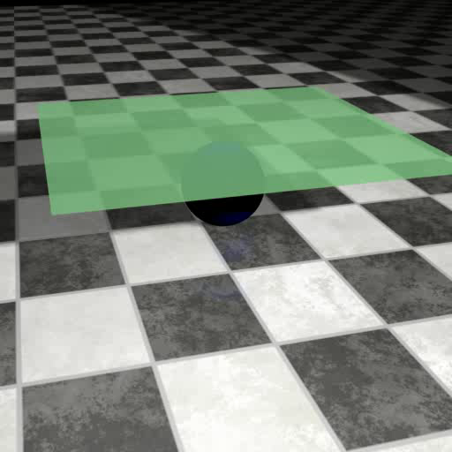
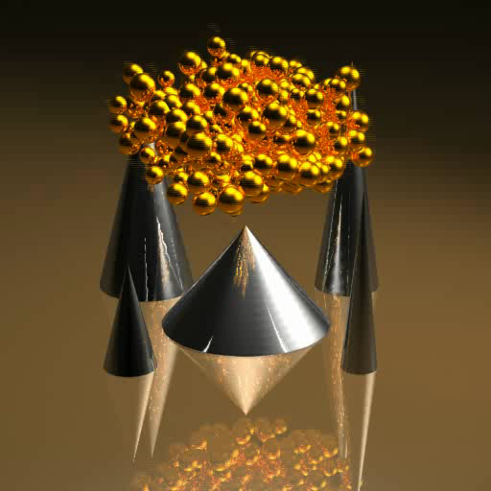
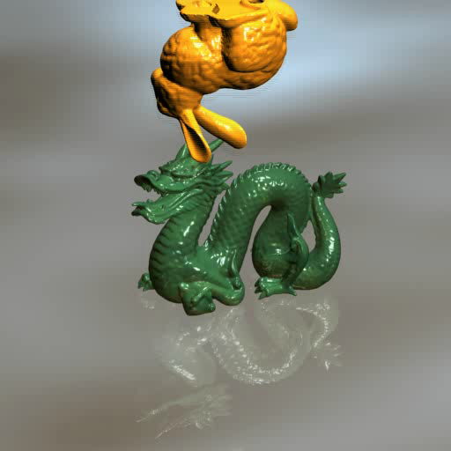
Results
94K triangles
10.4 X speed-up
23ms (43 FPS)
146K triangles
13.6 X speed-up
54ms (19 FPS)
252K triangles
12.5 X speed-up
54ms (19 FPS)

Slide 24
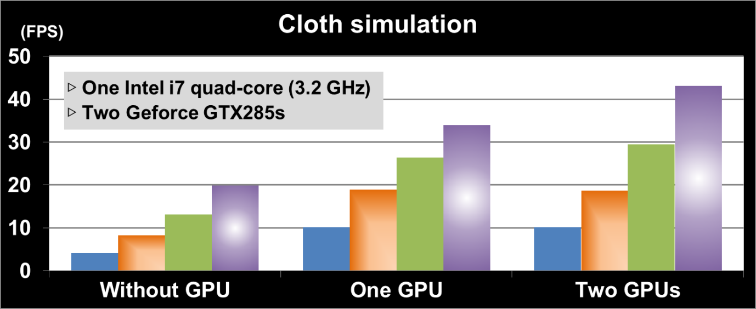
Results
94K triangles

Slide 25

Limitations
Generality issue
  Specialize for CCD
No guarantee to efficient utilization of computing resource
  Manual workload distribution depending on the application-dependent heuristic

Slide 26
Approaches
Heterogeneous computing system for a specific proximity query
General proximity computing system and scheduling algorithm for a various proximity queries
Out-of-core proximity computation

Slide 27
Scheduling in Heterogeneous Computing Environments for Proximity Queries
Comp. Res. A
Comp. Res. B
Comp. Res. C
Comp. Res. D
Comp. Res. E
…
Optimization-based scheduling
Proximity computation
Duksu Kim, Jinkyu Lee, Junghwan Lee, Insik Shin, John Kim, Sung-Eui Yoon
IEEE Transactions on Visualization and Computer Graphics, Sept., 2013
Selected as the Spotlight Paper for the issue

Slide 28
Contributions
Design a general heterogeneous computing framework for various proximity queries
Propose optimization-based scheduling algorithm
  Maximize the utilization efficiency of heterogeneous computing resources

Slide 29
Overview
Optimization based job
scheduling
Resource 1
Proximity queries
Hierarchical
traversal
Resource 2
Leaf-level computation
.
.
.
.
.
.
Resource n
Common job types of
various proximity queries

Slide 30
Overview
Optimization based job
scheduling
Resource 1
Proximity queries
Hierarchical
traversal
Resource 2
Leaf-level computation
.
.
.
.
.
.
Resource n

Slide 31
Optimization-based Scheduling
Expected running time model
Optimization formulation
Iterative LP solver
Design an accurate performance model
  Predict how much computation time is required to finish jobs on a resource
  Important to achieve the optimal scheduling result

Slide 32
Performance Model
Performance relationship between jobs and resources is complex
Resource 1
Resource 2
Processor architecture
Processor architecture
Job type 1
Memory
Memory
…
Execution model
Execution model
Job type n
Communication
Communication
…
…

Slide 33
Performance Model
Abstract the complex relationship as an expected, linear model
Resource 1
Resource 2
Processor architecture
Processor architecture
Job type 1
Expected, linear Running Time
Memory
Memory
…
Execution model
Execution model
Job type n
Communication
Communication
…
…

Slide 34
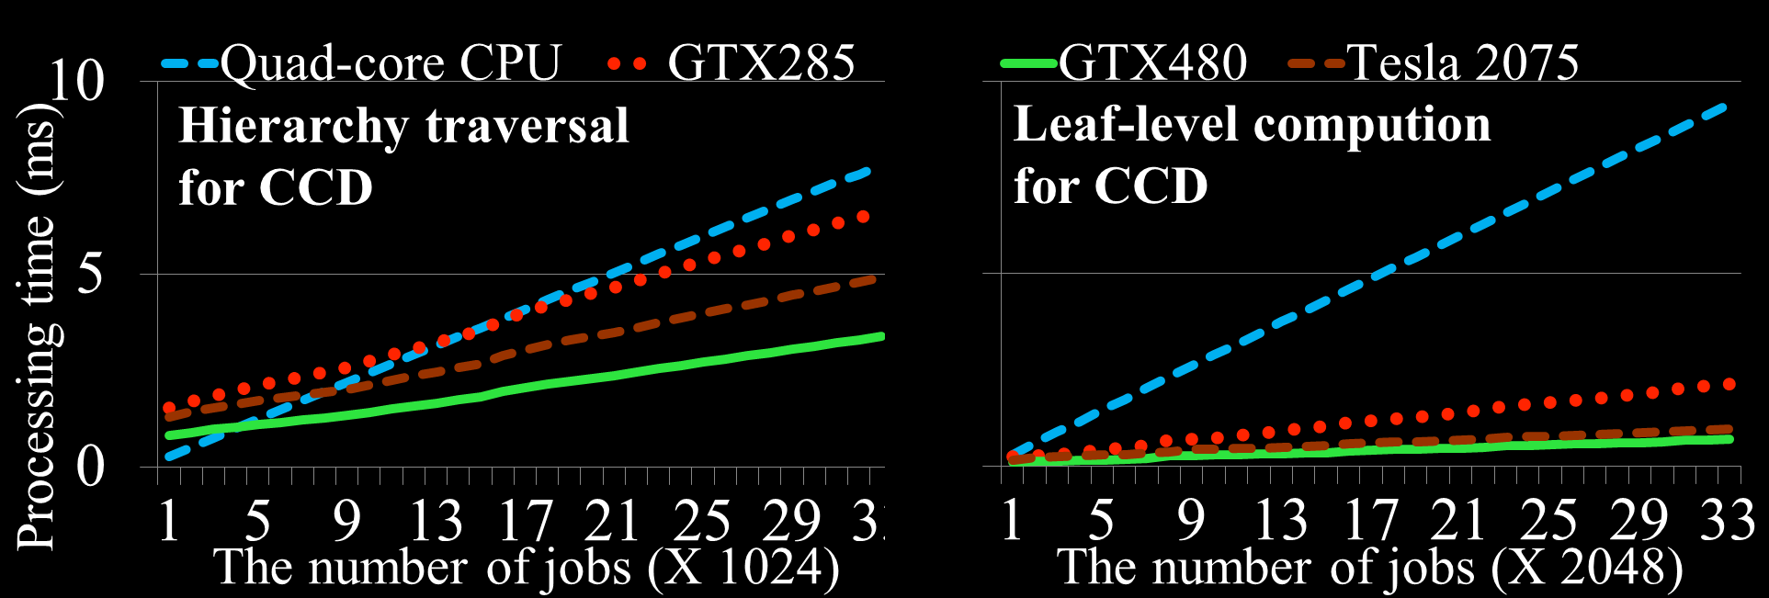
Performance Model
Running time is linearly increased as the number of jobs is increased

Slide 35
Performance Model
Running time is linearly increased as the number of jobs is increased
Each computing resource requires a specific amount of setup cost

Slide 36
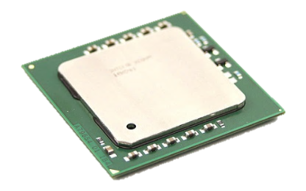
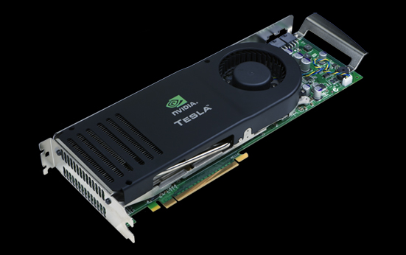
Performance Model
Inter-device data transfer time depends on the pair of devices
Data transfer time is linearly increased as the number of jobs is increased

Slide 37
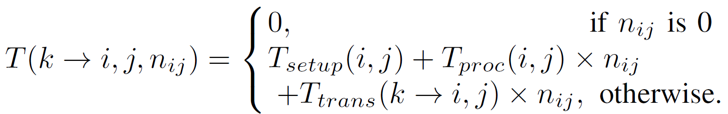
Expected Running Time Model
T() : Expected running time on computing resource i for processing n jobs of job types j that are generated from computing resource k
Setup time
Processing time
Data transfer time

Slide 38
Expected Running Time Model
Measure coefficients of our linear formulation for each proximity query with sample jobs
  The expected running time model shows high correlation (0.91 on average) with the observed data in tested benchmarks

Slide 39

Optimization-based Scheduling
Expected running time model
Optimization formulation
Iterative LP solver
Formulate an optimization problem
  Based on the expected running time model
  Need to represent the scheduling problem as a form of optimization problem

Slide 40
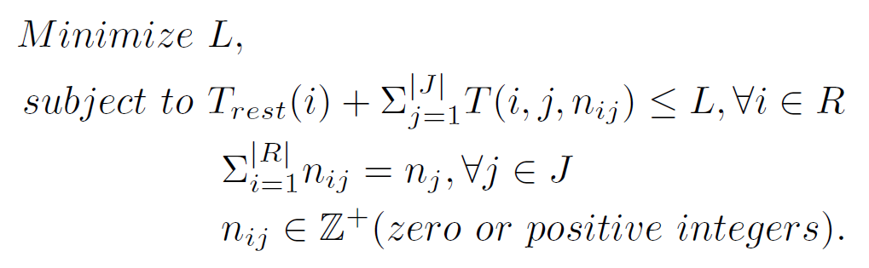
Optimization Formulation
Minimize the makespan (L) problem
Computing
resource
CPU 1
Processing time
CPU 2
Processing time
GPU 1
Processing time
GPU 2
Processing time
Makespan (L)
Time

Slide 41
Optimization Formulation
Calculate the optimal job distribution with the expected running time
①
Expected processing time
Resource i
Rest time for completing
already assigned jobs
Processing time for
jobs will be assigned
The expected processing time of computing resources is equal or smaller than the makespan

Slide 42
Optimization Formulation
Calculate the optimal job distribution with the expected running time
①
②
The expected processing time of computing resources is equal or smaller than the makespan
There are no missing or duplicated jobs

Slide 43
Optimization Formulation
Calculate the optimal job distribution with the expected running time
Job distribution
①
②
③
The expected processing time of computing resources is equal or smaller than the makespan
There are no missing or duplicated jobs
Each job is atomic

Slide 44
Optimization-based Scheduling
Expected running time model
Optimization formulation
Iterative LP solver

Slide 45
Optimization-based Scheduling
Expected running time model
Optimization formulation
Iterative LP solver
NP-hard Problem!
High computational cost
  Jobs are dynamically generated at runtime
  Optimization process takes long time for interactive or real-time applications

Slide 46
Optimization-based Scheduling
Expected running time model
Optimization formulation
Iterative LP solver
Designed an iterative LP solving algorithm to handle the piece-wise condition
Positive floating-point numbers
Please see the thesis for the details

Slide 47
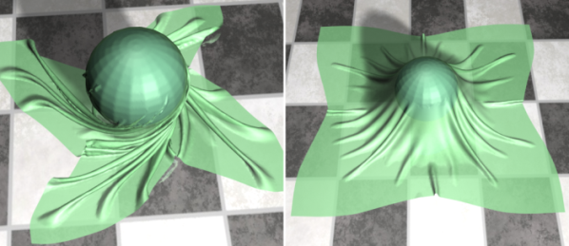
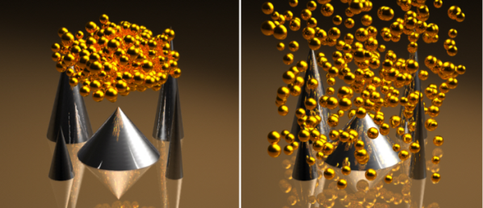
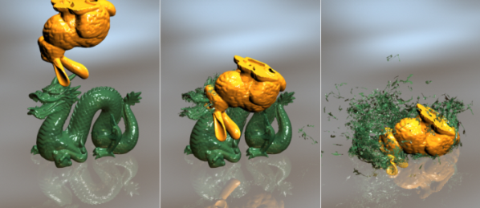
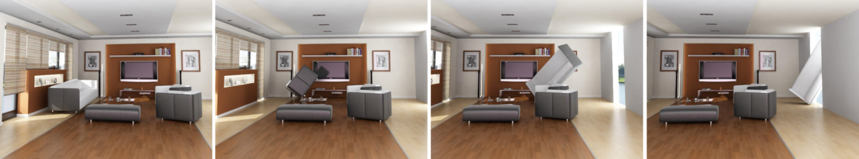
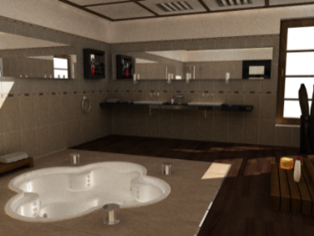
Results
Tested with various applications
  Simulations (Continuous collision detection)
  Motion planning (Discrete collision detection)
  Global illumination (Ray-Triangle intersection)

Slide 48
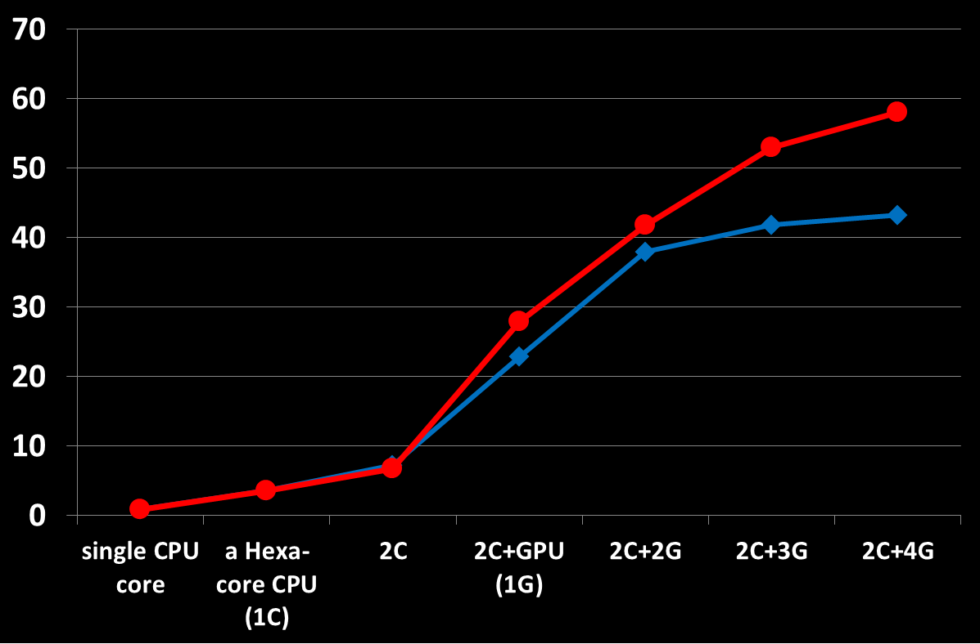
Results
FPS
Continuous collision detection
Ours
Work stealing
(an well-known
algorithm for dynamic
workload distribution)
Fracturing simulation
(252K Tri.)
GTX480
+GTX480
+GTX480
+GTX480
Use same GPUs (low heterogeneity)
For conservative comparison, we did manual tuning to get the best performance for tested methods except for ours

Slide 49
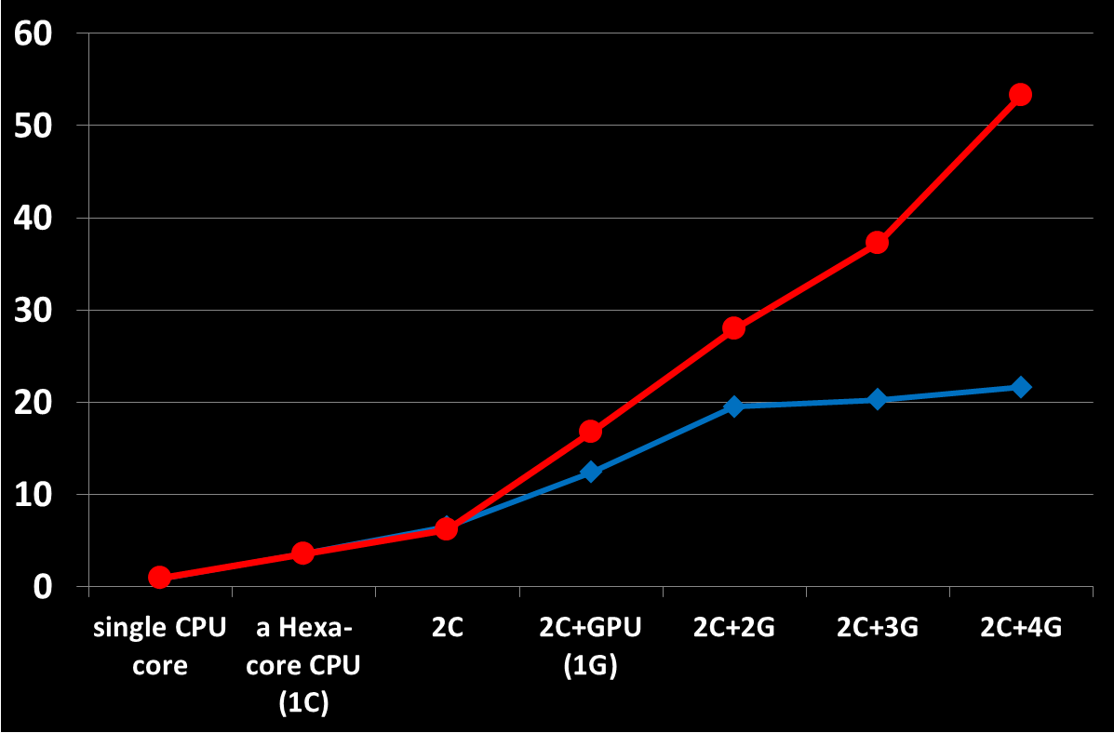
Results
FPS
Ours
Continuous collision detection
Work stealing
Fracturing simulation
(252K Tri.)
+GTX285
+Tesla2075
Use different GPUs (high heterogeneity)
+GTX480
+GTX580
For conservative comparison, we did manual tuning to get the best performance for tested methods except for ours

Slide 50
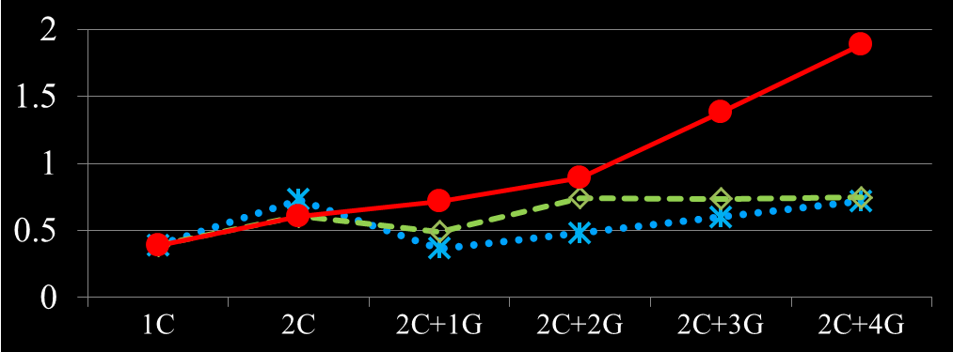

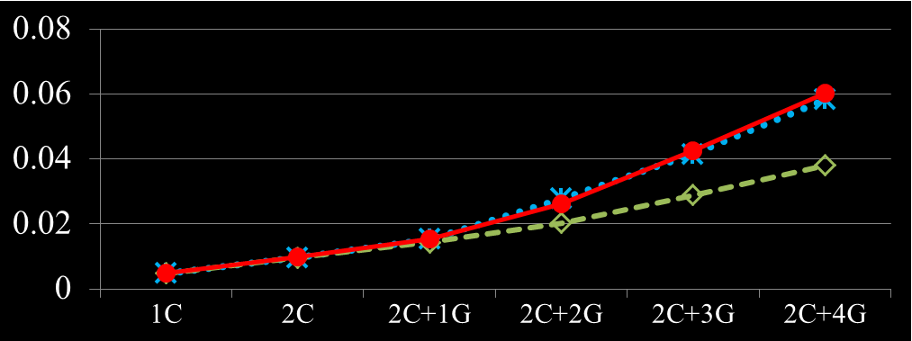
Results
FPS
Ours
Motion planning
(137K Tri., 50K samples)
Round-robin
Work
stealing
FPS
Use different GPUs
Global illumination
(436K Tri., 80M rays)
Ours
Work
stealing
Round-robin
Use different GPUs
For conservative comparison, we did manual tuning to get the best performance for tested methods except for ours

Slide 51
Limitation
Scheduling algorithm dose not consider the memory requirement for processing queries
  We assume that all computing resources have enough memory space

Slide 52
Approaches
Heterogeneous computing system for a specific proximity query
General proximity computing system and scheduling algorithm for a various proximity queries
Out-of-core proximity computation
Improve computational efficiency for in-core algorithms

Slide 53
Out-of-Core Proximity Computation for Particle-based Fluid Simulations
Duksu Kim, Myung-Bae Son, Young J. Kim, Jeong-Mo Hong, Sung-Eui Yoon
(To appear) Computer Graphics Forum (High Performance Graphics), July, 2014

Slide 54
Motivation
To meet the higher realism, a large number of particles are required
  Tens of millions particles
In-core algorithm
  Manage all data in GPU’s video memory
  Can handle up to 5 M particles with 1 GB memory for particle-based fluid simulation
    [HKK 2007]
Recent commodity GPUs have 1 ~ 3 GB memories (up to 12 GB)

Slide 55
Contributions
Propose out-of-core methods that utilize heterogeneous computing resources and processes neighbor search for a large number of particles
Propose memory footprint estimation method to identify a maximal work unit for efficient out-of-core processing

Slide 56
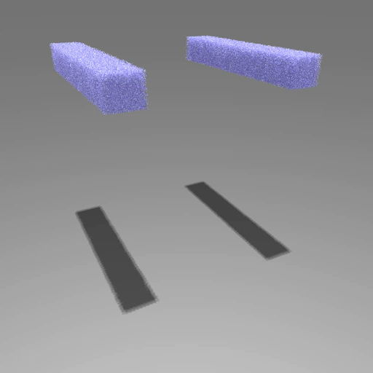
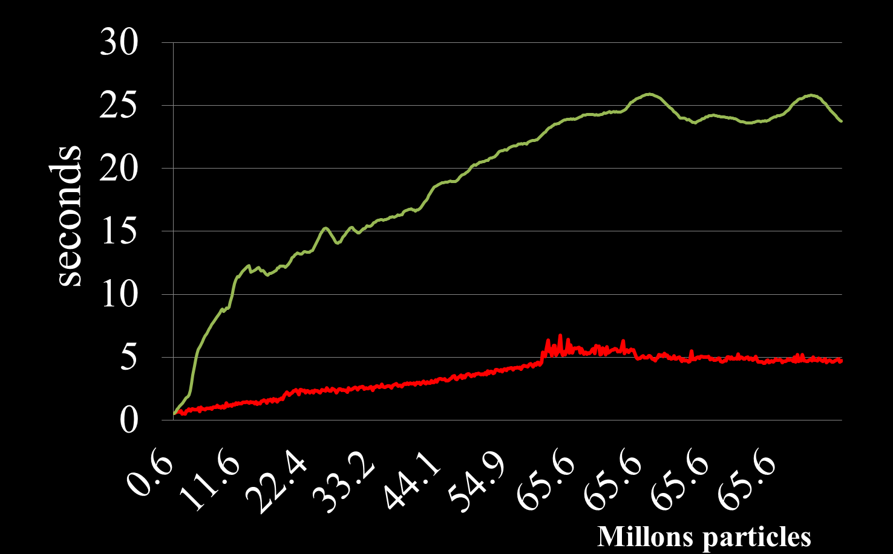
Result
NVIDIA mapped memory Tech.
- Map CPU memory space
into GPU memory address space
Map-GPU
Ours
Up to 65.6 M Particles
Maximum data size: 13 GB
- Two hexa-core CPUs (192 GB Mem.)
- One GPU (3 GB Mem.)

Slide 57
Particle-based Fluid Simulation
Neighbor search
Performance bottleneck
- Takes 60~80% of simulation computation time
Compute force
ε
Move particles
ε-Nearest Neighbor (ε-NN)

Slide 58


Preliminary: Grid-based ε-NN
ε
$$l$$
(ε < $l$)

Slide 59
Preliminary: Grid-based ε-NN
$$l$$
(ε < $l$)

Slide 60
In-Core Algorithm
(Data<Video Memory)
Main memory (CPU side)
GPU
- Grid data
- Particle data
Video memory
Results
Results
Assume:
Main memory is enough
- can equip up to 4 TB
ε-NN

Slide 61
Data > Video Memory
Main memory (CPU side)
GPU
- Grid data
- Particle data
Video memory
Results
Results
ε-NN

Slide 62
Out-of-Core Algorithm
Main memory (CPU side)
GPU
- Sub-grid(Block) data
- Particle data
Video memory
Results
Results
ε-NN

Slide 63
Boundary Region
Required data in adjacent blocks
Inefficient to handle in out-of-core manner

Slide 64
Boundary Region
Required data in adjacent blocks
Inefficient to handle in out-of-core manner
Multi-core CPUs handles the boundary region
  CPU (main) memory contain all required data
  Ratio of boundary region is usually much smaller than inner region

Slide 65
How to Divide the Grid ?

Slide 66
How to Divide the Grid ?
Goal: Find the largest block that fits to the GPU memory
  Improve parallel computing efficiency
    Processing a large number of particles at once
    Minimize data transfer overhead
  Reduce the boundary region
    As the ratio of boundary region is increased, the workload of CPU is increased

Slide 67

Required Memory Size for processing a block, B
# of neighbor particles
for the particle i (p_{i})
# of particles in B
$$S\left(B\right)=n_{B}S_{p}+S_{n}\sum_{p_{i}∈B}{n_{p_{i}}}$$
Data size
for storing a particle
Data size
for storing a neighbor info.

Slide 68

Hierarchical Work Distribution
Workload tree
- # of particles in the block
- # of neighbors in the block
a
b
a
b
…
Front nodes
c
c
…
d
d
$S\left(B\right)$ < GPU memory

Slide 69

Chicken-and-Egg Problem
# of neighbor particles
for the particle i, p_{i}
# of particles in B
$$S\left(B\right)=n_{B}S_{p}+S_{n}\sum_{p_{i}∈B}{n_{p_{i}}}$$
Data size
for storing a particle
Data size
for storing a neighbor info.

Slide 70
Chicken-and-Egg Problem
$$S\left(B\right)=n_{B}S_{p}+S_{n}\sum_{p_{i}∈B}{n_{p_{i}}}$$
Our approach:
Estimation the number of neighbors for particles

Slide 71
Problem Formulation
Assumption
  Particles are uniformly distributed in a cell
Idea
  For a particle, the number of neighbors in a cell is proportional to the overlap volume between the search sphere and the cell weighted by the number of particles in the cell
S(p,ε)
p
ε

Slide 72


Expected Number of Neighbors of a particle p located at (x, y, z)
$$E\left(p_{x, y, z}\right)=\sum_{i}{n\left(C_{i}\right)∗\frac{Overlap\left({S(p}_{x,y,z}, ε\right), C_{i})}{V(C_{i})}}$$
- $C_{i}$ : cells of $p_{x,y,z}$ and its adjacency cells
- $n\left(C_{i}\right)$ : the number of particles in the cell
- $Overlap\left({S(p}_{x,y,z}, ε\right), C_{i})$ : overlap volume between them
- $V\left(C_{i}\right)$ : volume of the cell

Slide 73

Problem Formulation
Compute $E\left(p_{x, y, z}\right)$ for each particle takes high computational overhead
Instead, (approximation)
  Compute the average $E\left(p_{x, y, z}\right)$ for particles in a cell
  Use the value for all particles in the cell

Slide 74
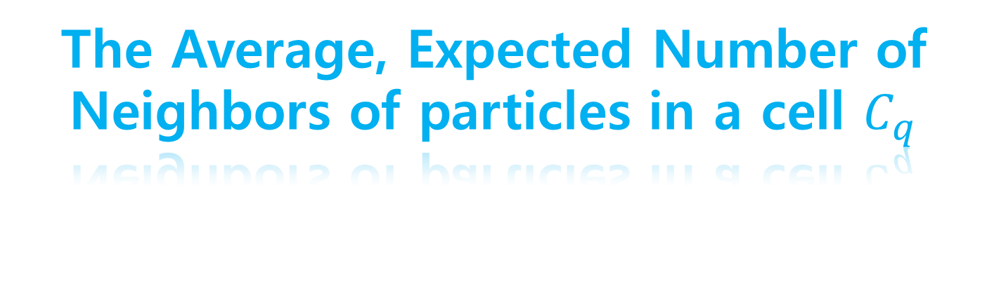

The Average, Expected Number of Neighbors of particles in a cell $C_{q}$
Expensive to compute at runtime
$$E\left(C_{q}\right)=\frac{1}{V\left(C_{q}\right)}∗\int_{0}^{l}{\int_{0}^{l}{\int_{0}^{l}{E\left(p_{x,y,z}\right)dx}dy}dz}$$
- $l$ is the length of a cell along each dimension
- $p_{x,y,z}$ is a particle positioned at (x, y, z) on a local coordinate space in $C_{q}$

Slide 75


The Average, Expected Number of Neighbors of particles in a cell $C_{q}$
$$E\left(C_{q}\right)=\frac{1}{V\left(C_{q}\right)}∗\int_{0}^{l}{\int_{0}^{l}{\int_{0}^{l}{E\left(p_{x,y,z}\right)dx}dy}dz}$$
$$=\frac{1}{V\left(C_{q}\right)}∗ \sum_{i}{n\left(C_{i}\right)∗\frac{D\left(C_{q},C_{i}\right)}{V\left(C_{i}\right)}}$$
$$D\left(C_{q},C_{i}\right)= \int_{0}^{l}{\int_{0}^{l}{\int_{0}^{l}{Overlap\left(S\left(P_{x,y,z}, ε\right), C_{i}\right)dx}dy}dz }$$

Slide 76

The Average, Expected Number of Neighbors of particles in a cell $C_{q}$
Pre-compute $D\left(C_{q},C_{i}\right)$
  The value depends on the ratio between $l$ and $ε$ values
  $l$ and $ε$ are not frequently changed by user
  Use Monte-Carlo method with many samples (e.g., 1 M)
Use look-up table at runtime
$$D\left(C_{q},C_{i}\right)= \int_{0}^{l}{\int_{0}^{l}{\int_{0}^{l}{Overlap\left(S\left(P_{x,y,z}, ε\right), C_{i}\right)dx}dy}dz }$$

Slide 77
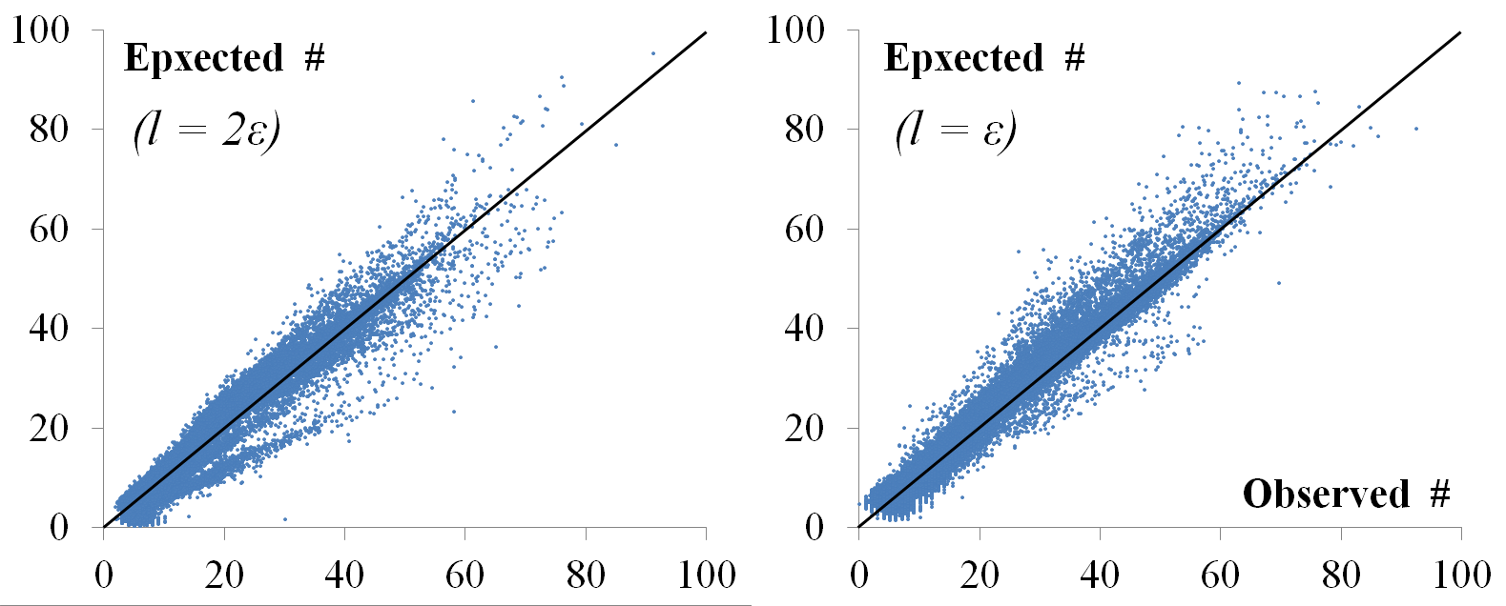
Validation
Correlation = 0.97
Root Mean Square Error (RMSE) = 3.7

Slide 78


Chicken-and-Egg Problem
Expected number
of neighbors
$$S\left(B\right)=n_{B}S_{p}+S_{n}\sum_{p_{i}∈B}{{n′}_{p_{i}}}+S_{Aux}$$
Auxiliary space to cover the estimation error
$$S_{Aux}=3.7∗n_{B}S_{n}$$
RMSE

Slide 79
Chicken-and-Egg Problem
Expected number
of neighbors
$$S\left(B\right)=n_{B}S_{p}+S_{n}\sum_{p_{i}∈B}{{n′}_{p_{i}}}+S_{Aux}$$
Auxiliary space to cover the estimation error
$$S_{Aux}=3.7∗n_{B}S_{n}$$
RMSE

Slide 80
Results
Testing Environment
  Two hexa-core CPUs
  192 GB main memory (CPU side)
  One GPU (GeForce GTX 780) with 3 GB video memory

Slide 81
Results
NVIDIA mapped memory Tech
- Map CPU memory space
into GPU memory address space
Map-GPU
Ours
Up to 65.6 M Particles
Maximum data size: 13 GB

Slide 82
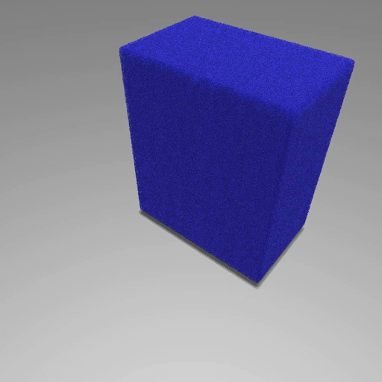
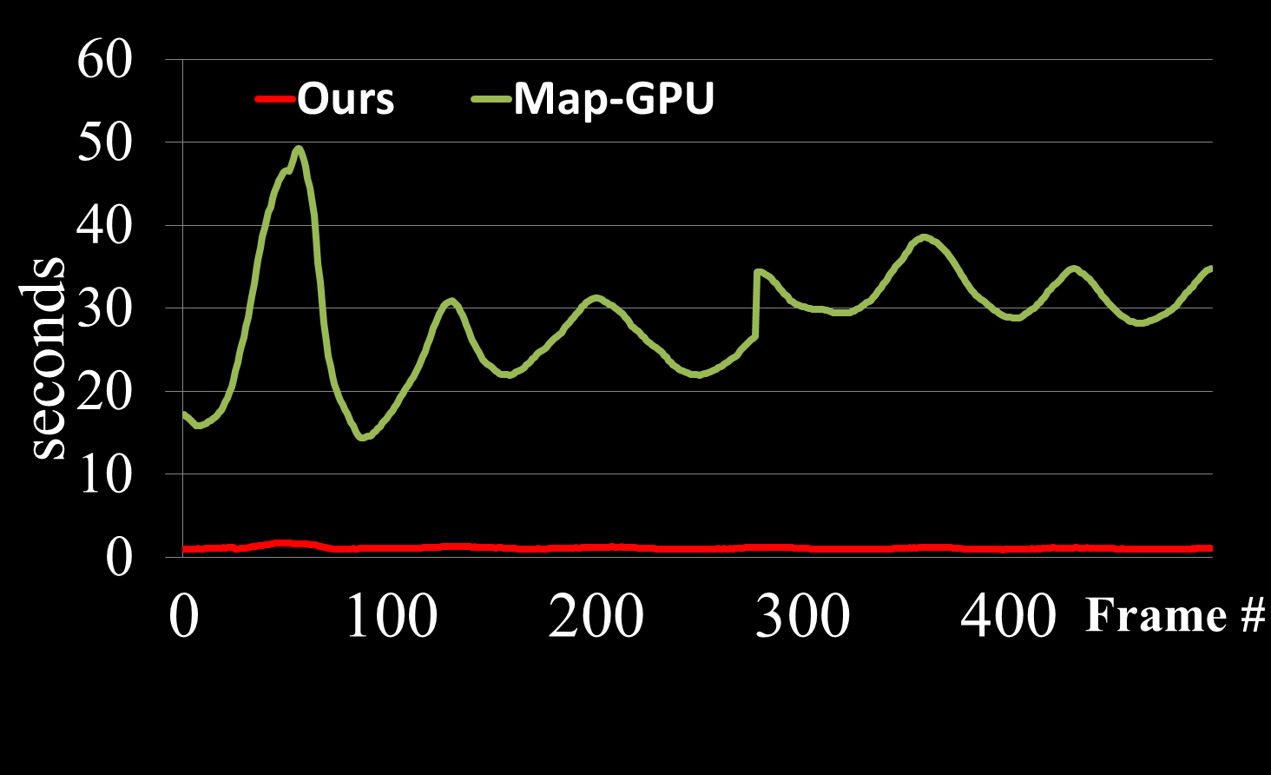
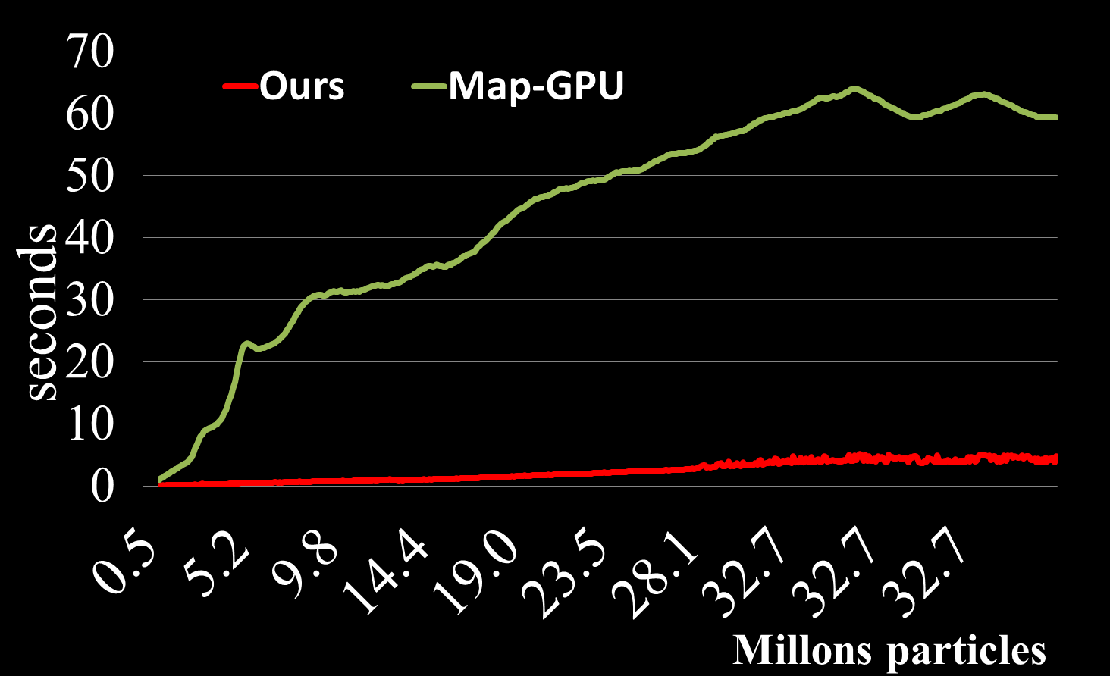
15.8 M Particles
Maximum data size: 6 GB
Up to 32.7 M Particles
Maximum data size: 16 GB

Slide 83
Results
Up to 26 X
Map-GPU
Our method
Up to 51 X
12 CPU cores
+One GPU
A CPU core
Up to 8.4 X
Up to 6.3 X
12 CPU cores

Slide 84
Outline
Introduction
Approaches
Conclusion

Slide 85
Conclusion
We accelerate various proximity computation
  by efficiently utilizing heterogeneous computing resources
  With scheduling algorithm that considers heterogeneity of computing resources in computational and spatial perspective

Slide 86
Future Work
General out-of-core techniques for various proximity queries
Extend our method to other applications

Slide 87
Outcomes
3 Publications
  1 TVCG (SCI), 2 CGF (SCI-E)
6 Presentations
  3 conference talks (I3D, PG, GTC)
  3 conference poster (I3D, SIGGRAPH, HPG)
3 Patents, 1 SW package

Slide 88
Publications
HPCCD: Hybrid Parallel Continuous Collision Detection using CPUs and GPUs
  Duksu Kim, Jae-Pil Heo, Jaehyuk Huh, John Kim, Sung-eui Yoon
  Computer Graphics Forum, Vol. 28, No. 7, pp 1791-1800, 2009
Scheduling in Heterogeneous Computing Environments for Proximity Queries
  Duksu Kim, Jinkyu Lee, Junghwan Lee, InSik Shin, John Kim, Sung-eui Yoon
  IEEE Transactions on Visualization and Computer Graphics, Vol. 19, No. 9, pp 1513-1525
Out-of-Core Proximity Computation for Particle-based Fluid Simulations
  Duksu Kim, Myung-Bae Son, Young J. Kim, Jeong-Mo Hong, Sung-Eui Yoon
  (To appear) Computer Graphics Forum, 2014

Slide 89
Awards
Distinguished Paper Award
  Pacific graphics 2009
Student Stipend Award
  ACM I3D, Invited poster
Best CUDA Programming Award
  NVIDIA (Korea) CUDA coding contest 2010
Spotlight Paper
  IEEE TVCG, Sept., 2014

Slide 90
Acknowledgements
Advisor, Sung-Eui Yoon
Committee members
SGLab. members and other co-workers

Slide 91
Questions & Comments
Thank you!

Slide 92
References
[Lawler 2002] A voxel-based parallel collision detection algorithm, O. S. Lawlor and V. K. Laxmikant, Super-computing, 2002
[Ize 2007] Asynchronous BVH construction for ray tracing dynamic scene on parallel multi-core architectures, T. Ize et al., Eurographics Symposium on Parallel Graphics and Visualization, 2007
[Wald 2007] On fast construction of sah-based bounding volume hierarchies, I. Wald, IEEE Symposium on Interactive Ray Tracing, 2007
[Tang 2009] Multi-core collision detection between deformable models, M. Tang et al., in SIAM/ACM Joint Conf. on Geometric and Solid & Physical Modeling, 2009
[Lee 2010] Simple and Parallel Proximity Algorithms for General Polygonal Models, Youngeun Lee et al, Journal of Computer Animation and Virtual Worlds, 2010
[Vassilev 2001] Fast cloth animation on walking avatars, T. Vassilev et al., Computer Graphics Forum (Eurographics), 2001
[Baciu 2002] Image-based techniques in a hybrid collision detector, G. Baciu and S. Wong, IEEE TVCG, 2002
[Govindaraju 2005] CULLIDE: Interactive collision detection between complex models in large environments using graphics hardware, EG. Workshop on Graphics Hardware, 2003
[Govindaraju 2005*] Collision detection between deformable models using chromatic decomposition," ACM Trans. on Graphics, 2005
[Lauterbach 2010] gProximity: Hierarchical GPU‐based Operations for Collision and Distance Queries, C Lauterbach et al., EG 2010
[GSSP 2010] GOSWAMI P., SCHLEGEL P., SOLENTHALER B., PAJAROLA R.: Interactive SPH simulation and rendering on the GPU. In Proc. of ACM SIGGRAPH/EGSymposium on Computer Animation, 2010

Slide 93
References
[HKK 2007] HARADA T., KOSHIZUKA S., KAWAGUCHI Y.: Smoothed particle hydrodynamics on GPUs. In Proc. of Computer Graphics International, 2007
[IABT 2011] IHMSEN M., AKINCI N., BECKER M., TESCHNER M.: A parallel SPH implementation on multi-core CPUs. Computer Graphics Forum 30, 1, 2011

Slide 94
Appendix

Slide 95
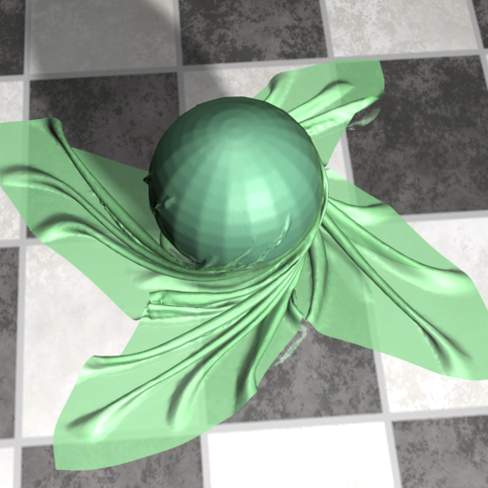
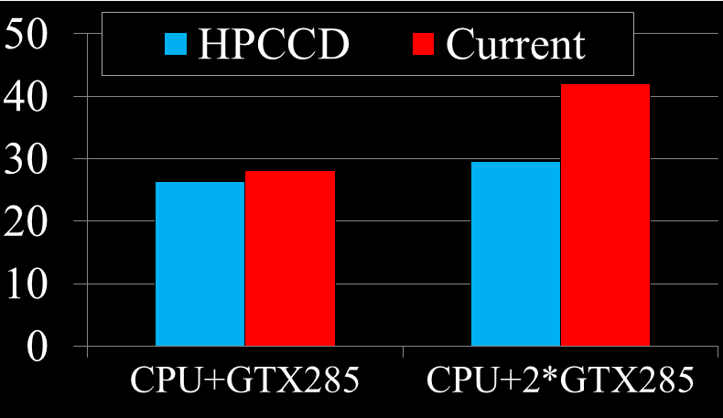
Results
FPS

Slide 96
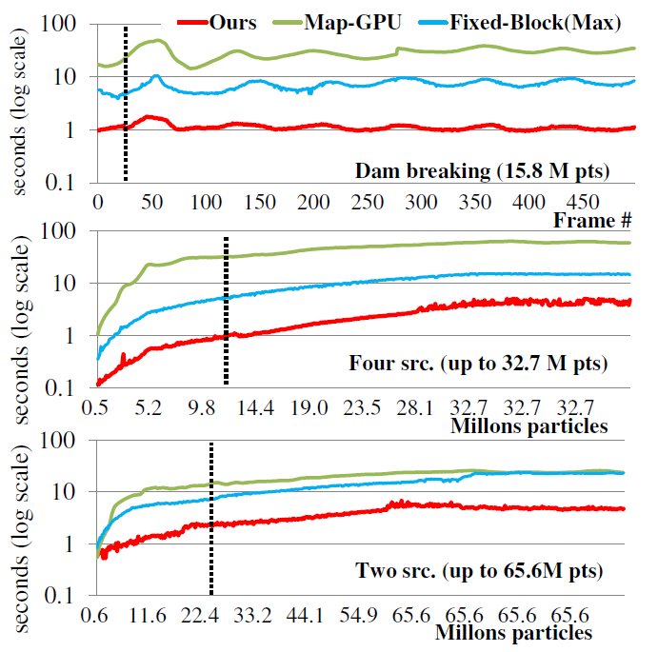

Slide 97
