Slide 1
Anytime RRBT for Handling Uncertainty and Dynamic Objects
Hyun-chul Yang(양 현 철)
Advisor: Sung-Eui Yoon
Dec. 09, 2015
Notes:
1
Hello everyone.
Thanks for coming my master thesis talk.
My name is Hyunchul Yang, and I’ve studied under professor sung-eui yoon from 2014
My research title is Anytime RRBT for handling uncertainty and dynamic objects.

Slide 2
Contents
Background
Goal
Related work
Approach
Result
Conclusion & Future work
Notes:
This is contents of my presentation.

Slide 3
Background
Mobile robot navigation problem
S. Karaman, M. Walter, A. Perez, E. Frazzoli, and S. Teller, “Anytime
motion planning using the rrt*,” in ICRA, 2011
Notes:
mobile robot navigation problem has been researched for a long time

Slide 4
Background
Navigation in dynamic environments
Sungjoon Choi, Eunwoo Kim, and Songhwai Oh, "Real-Time Navigation in Crowded Dynamic Environments Using Gaussian Process Motion Control," in ICRA, 2014
Notes:
And the mobile robot navigation problem in dynamic environments are challenging problem in motion planning research area.
One of main issues is to predict potential collisions against other moving obstacles

Slide 5
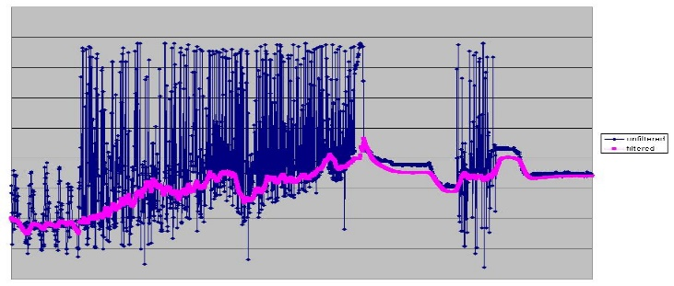
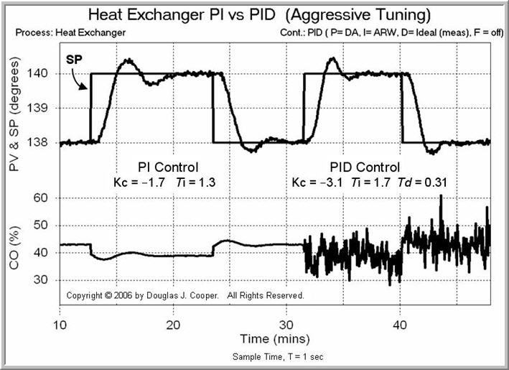
Background
Uncertainty caused by:
Various sensors
Low-level controllers
Sensor noise
Controller noise
Notes:
Moreover, various noises from controllers and sensors are generated in the real world.
Therefore, The motion planner should consider the uncertainty.

Slide 6
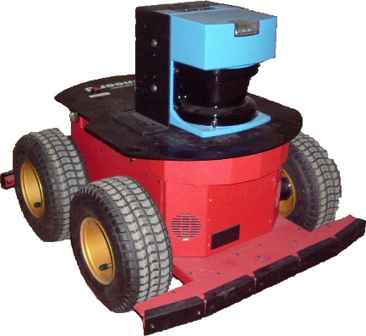
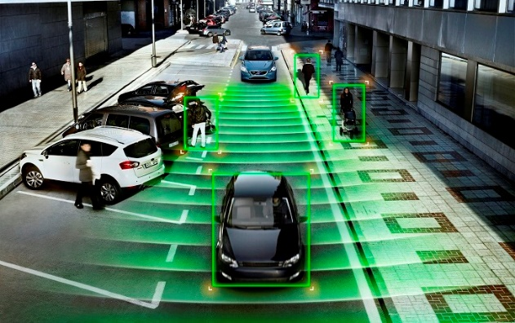
Goal
Mobile robot
Dynamic environment
Uncertainty
Motion planner for mobile robot that considers both other dynamic obstacles and uncertainty
Notes:
So I set the goal like below
I want to propose a motion planner for mobile robot that considers both dynamic obstacles and uncertainty.

Slide 7
Main Contribution: Anytime Extension
Bigger circle means higher uncertainty
Measurement
region
Goal
region
The robot computes better path while executing the path
Notes:
Before starting the detail explanation, I prepare one of main contribution for your interesting.
the robot can update sensor data only on the green region.
And black line is computed trajectories of the robot. The robot starts with a high uncertainty.
So the robot should visit the green regions at least one time to collect exact sensor data, .
When the initial path is computed, the robot starts following it, and thanks to the proposed anytime feature, the robot computes better paths while executing the prior path,
and reaches the goal in effective way.

Slide 8
Main Contribution: Anytime Extension
Notes:
This is a video demonstration of our contribution.
After computing an initial path, algorithm improve it to the optimal path, while following the previous path

Slide 9
Problem Formulation Considering Uncertainty
Robot state
Control noise
Measurement state
Sensor noise
Initial robot state
covariance
mean
Obstacle state
Uncertainty on
sensors and controllers
Notes:
Ok, Let me describe problem formulation.
This is a general formulation of navigation problem that considers the uncertainty.
S is a state of the robot,
Q is a control noise.
Z is a measurement of the robot
and R is a sensor noise
Robot state and obstacle state are assumed as a Gaussian distribution with mean and covariance

Slide 10
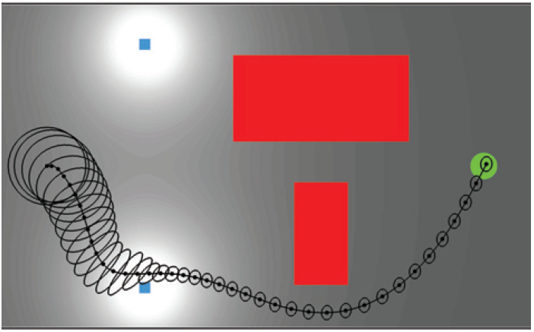
Problem Formulation Considering Uncertainty
Objective function
Minimize a weighted sum of path lengths and uncertainty
: no collision
Measurement beacon
Goal region
Bigger circle means higher uncertainty
Notes:
And this is an objective function of navigation problem.
it is designed to minimize a weighted sum of path lengths and uncertainty, without collision along the path.

Slide 11
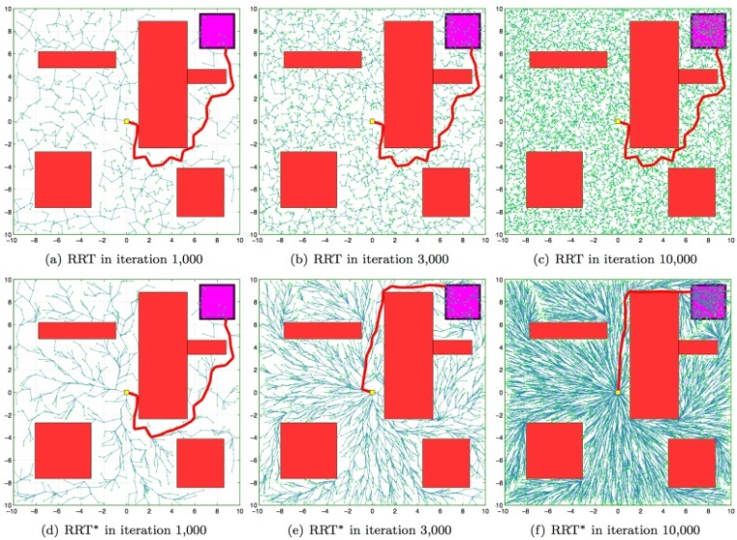
Related work
Sampling based motion planning algorithms
Rapidly-exploring Random Tree(RRT) [LaValle & Kufner, IJRR 01]
Probabilistically complete
Single query
Scalable to high dimensions
Notes:
In this field, Sampling based algorithms have been used to solve motion planning problems in high-dimensional configuration spaces.
Among these techniques, Rapidly-exploring Random Tree (RRT) has received much attention over the last decade.
RRT has many advantages including the probabilistic completeness and scalability in high dimensional spaces.

Slide 12
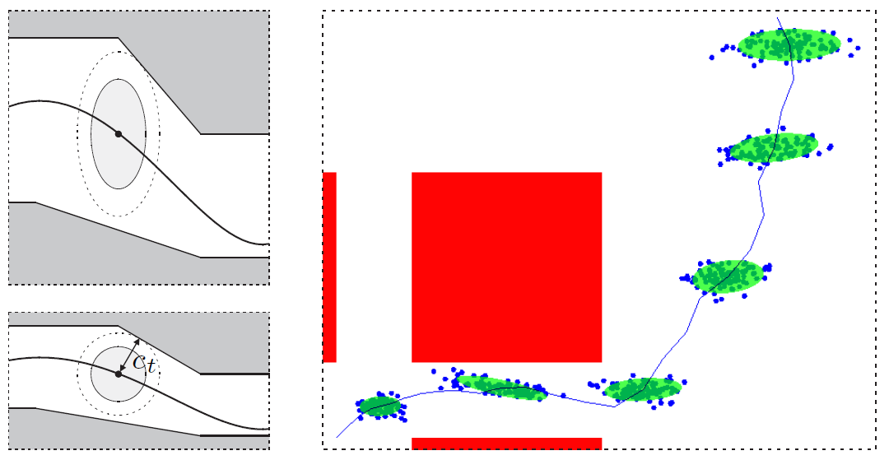
Related work
Handling the uncertainty
Linear Quadratic Gaussian Motion Planning(LQG-MP) [J.Van Den Berg, et al., IJRR11]
Models uncertainty using Gaussian noise
Propagate the uncertainty using the Kalman filter
Considering both uncertainty and real-time has been less studied
Notes:
Linear Quadratic Gaussian Motion Planning (LQG-MP) is one of the most popular method that models uncertainty using Gaussian noise and
It propagates the uncertainty using the Kalman filter iteratively.
But motion planner that considering both uncertainty and real-time has been less studied.

Slide 13
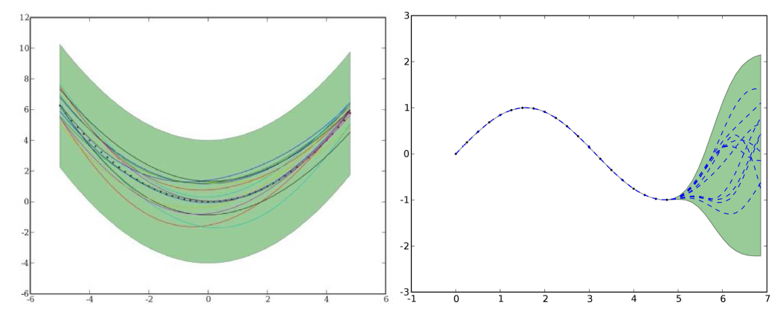
Related work
Dynamic environments
CC-RRT with Gaussian process [Chiara Fulgenzi, et al,.IROS08, AURO13]
Predict obstacle trajectory using Gaussian process
Require pre-learned Gaussian processes
Do not consider to compute the velocity
Notes:
Various motion planner that handle dynamic obstacles also have been proposed.
Gaussian-process method have been commonly used to predict trajectory of the moving obstacles.
These studies work well for environments with many occluded zones.
however, they require pre-learned Gaussian processes,
and it does not consider to compute the velocity

Slide 14
Contents
Background
Goal
Related work
Approach
Result
Conclusion & Future work
Notes:
Next is approach.

Slide 15
Overview of Proposed Approach
Rapidly-exploring Random Belief Tree(RRBT)
Consider uncertainty
(too slow)
Anytime extension
Tree reusing
Branch-and-bound(BB)
Speed up with optimization
Uncertainty-aware Velocity Obstacle(UVO)
Local geometric analysis
considering dynamic environments
Anytime RRBT
Notes:
This is an overview of the proposed approach.
Basically, our method can be categorized into 3 different approaches.
First is Sampling-based motion planner that named RRBT
And second is its Anytime extension
And the last is a Uncertainty-aware Velocity Obstacle.
Rapidly-exploring random belief tree consider the uncertainty. But it is too slow to use in real-time problem.
To address it, I accelerate algorithm with optimization.
And I propose the UVO method for considering the dynamic environments
Finally a novel method that named anytime RRBT.

Slide 16
Approach
Sampling-based motion planner
Rapidly-exploring Random Belief Tree(RRBT)
Anytime extension
Tree reusing
Branch-and-bound
Avoiding the dynamic obstacle
Collision check with Uncertainty-aware Velocity Obstacle(UVO)
Notes:
First I will describe RRBT

Slide 17
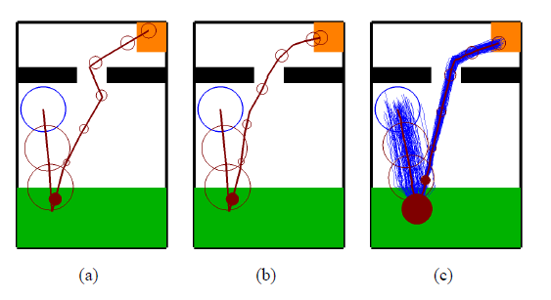
Rapidly-exploring Random Belief Tree [Bry et al., ICRA 11]
Use Kalman filter to propagate Gaussian states
Improve solutions toward optimal
500
1000
1500
Number of iteration
Preserve optimal path
Notes:
RRBT is an incremental sampling based motion planning algorithm that provably converges to the optimal path, taking the uncertainty,
This algorithm incrementally constructs a graph with random sample strategy. The algorithm builds a graph with set of vertices and edges.
This approach use Kalman filter to propagate Gaussian states
And it improve solutions toward optimal.

Slide 18
Limitation of RRBT
Has a simple culling method, resulting in inefficient culling
Multiple belief nodes in the same vertex
Partial ordering method:
$n_{a}<n_{b}⇔\left(n_{a}.Σ<n_{b}.Σ\right)$ $⋀(n_{a}. c<n_{b}.c)$
Color | Cost | Uncertainty
Red | 1 | 3
Yellow | 2 | 2
Blue | 3 | 1
Generate too many belief nodes
Notes:
This approach guarantees the optimal path.
However, It has a simple culling method,
Left figure is an example, nothing can be pruned using partial ordering method.
so it can generate too many belief nodes in the same vertex,
it is resulting in unsuitable performance for real-time robotics systems.

Slide 19
Approach
Sampling-based motion planner
Rapidly-exploring Random Belief Tree(RRBT)
Anytime extension
Tree reusing
Branch-and-bound
Avoiding the dynamic obstacles
Collision check with Uncertainty-aware Velocity Obstacle(UVO)
Notes:
To accelerate RRBT, I propose anytime extension method
In this section, I explain two anytime extension, one is tree reusing and, the other is a branch-and-bound method

Slide 20
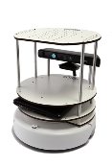
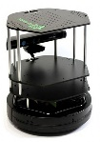
1) Tree reusing
Delete branches off committed trajectory
Make the endpoint the new tree root
Update the uncertainty and obstacle states
Check collision with our Uncertainty-aware Velocity Obstacle method for dynamic models
Goal
Dynamic
Obstacle
Start
Notes:
First is tree reusing method.

Slide 21
1) Tree reusing
Delete branches off committed trajectory
Make the endpoint the new tree root
Update the uncertainty and obstacle states
Check collision with our Uncertainty-aware Velocity Obstacle method for dynamic models
Goal
Dynamic
Obstacle
Start
Notes:
Robot fallows path,

Slide 22
1) Tree reusing
Delete branches off committed trajectory
Make the endpoint the new tree root
Update the uncertainty and obstacle states
Check collision with our Uncertainty-aware Velocity Obstacle method for dynamic models
Goal
Dynamic
Obstacle
Notes:
After than, delete committed trajectory.

Slide 23
1) Tree reusing
Delete branches off committed trajectory
Make the endpoint the new tree root
Update the uncertainty and obstacle states
Check collision with our Uncertainty-aware Velocity Obstacle method for dynamic models
Goal
Dynamic
Obstacle
New Root
Notes:
Than make the endpoint as the new tree root.

Slide 24
1) Tree reusing
Delete branches off committed trajectory
Make the endpoint the new tree root
Update the uncertainty and obstacle states
Check collision with our Uncertainty-aware Velocity Obstacle method for dynamic models
Goal
Dynamic
Obstacle
New Root
Notes:
And Update uncertainty of the node, and update dynamic obstacles state.

Slide 25
1) Tree reusing
Delete branches off committed trajectory
Make the endpoint the new tree root
Update the uncertainty and obstacle states
Check collision with our Uncertainty-aware Velocity Obstacle method for dynamic models
Goal
Dynamic
Obstacle
New Root
Notes:
Finally, Check whether collide or not using UVO method.
With this method, robot can reuse tree after executing the trajectory

Slide 26
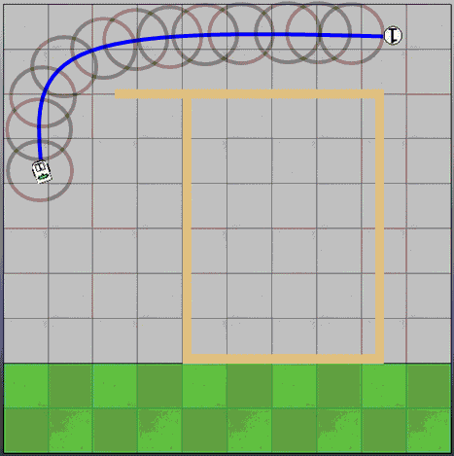
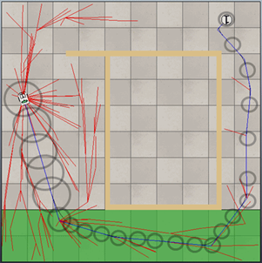
2) Branch and Bound
Definition of cost function
$α$ and $β$ are the weights
Measurement region
Measurement region
$$α≫β$$
$$α≪β$$
Notes:
And then I propose Branch and bound method.
The branch-and-bound technique has been used to accelerate various search problems including graph and tree. I apply this concept to anytime RRBT
Firstly, I focus on balancing between the travel distance and uncertainty. I use a simple, monotonic form for cost function. alpha and beta are the user defined parameters.
If alpha is bigger than beta, then robot would be likely to move shown in left figure.

Slide 27
2) Branch and Bound
Definition of proposed Cost-To-Go function:
Probabilistically conservative heuristic by making $ε$ to be zero
Can compute optimal paths
Cull out belief nodes that have longer costs
Notes:
Then I propose a CostToGo function like the heuristic function of A* techniques.
CostToGo function should have conservative value.
because of uncertainty, I propose to probabilistically conservative heuristic function. by making 입실론 to be zero.
with probabilistic approach, we can compute optimal path.
Then I cull out belief nodes that have longer costs than CostToGo function.

Slide 28
Approach
Sampling-based motion planner
Rapidly-exploring Random Belief Tree(RRBT)
Anytime extension
Tree reusing
Branch-and-bound
Avoiding the dynamic obstacles
Collision check with Uncertainty-aware Velocity Obstacle(UVO)
Notes:
Next approach is Uncertainty-aware Velocity Obstacle
I propose UVO method for considering the dynamic environments.

Slide 29
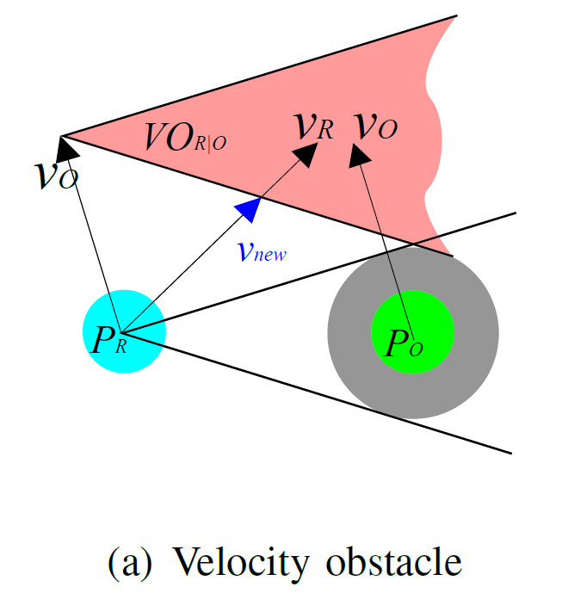
Velocity Obstacle: Local Geometric Analysis
“The hybrid reciprocal velocity obstacle” TRO11 J Snape, J van den Berg, SJ Guy
“Reciprocal velocity obstacles for real-time multi-agent navigation” J van den Berg
“Generalized Velocity Obstacles” IROS09, D Wilkie, J Van den Berg
Notes:
Velocity obstacle has been used for local collision avoidance and navigation of a robot in two dimensions
the region of VO has the red triangular shape in the figure.
If the velocity of robot indicate that region, the robot and the obstacle will collide in some future.
To avoid collision, planner need to compute a new velocity that is not in that region.

Slide 30
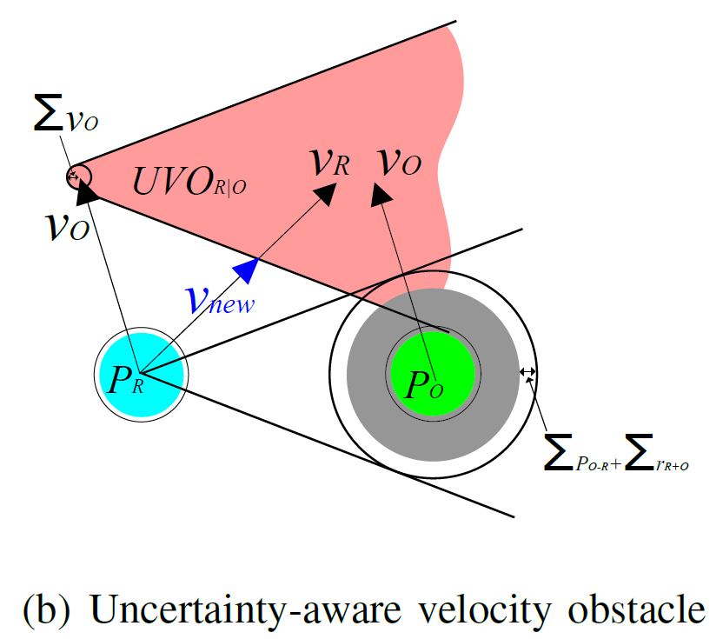
Uncertainty-aware Velocity Obstacle
Conservative collision checking
Notes:
I design uncertainty-aware velocity obstacle. UVO has more conservative collision boundary.
And the region of UVO is an extended triangle for considering the uncertainty.
The most powerful point of UVO method is that the UVO calculate new velocity to avoid collision.

Slide 31
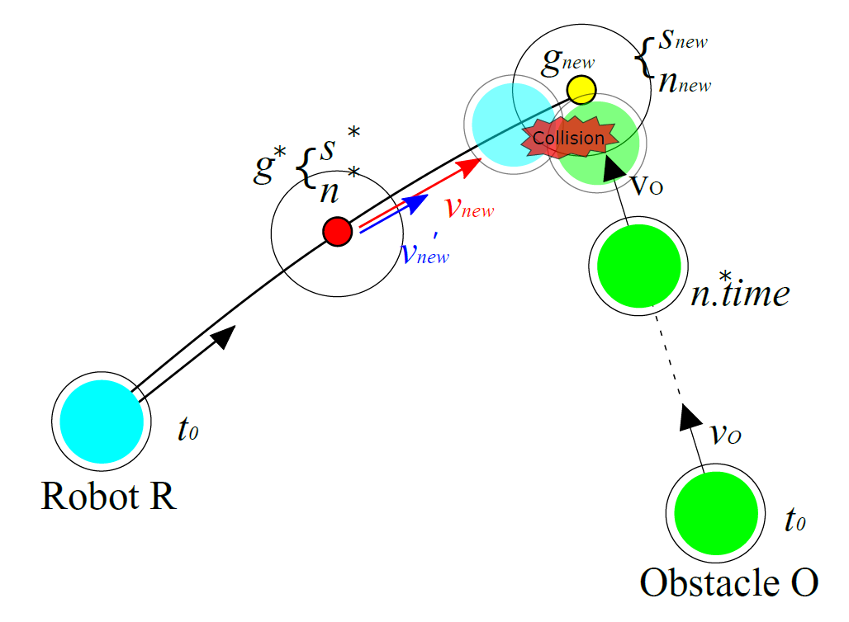
Collision Check and Compute a Collision-Free Velocity
1. Efficient collision checking
2. Adjusted velocity
avoiding collisions without
rejecting samples.
Notes:
Thanks to the UVO method.
The planner can check collision detection efficiently, moreover, it can calculate adjusted velocity for avoiding collisions

Slide 32
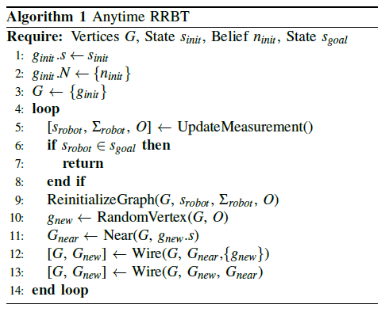
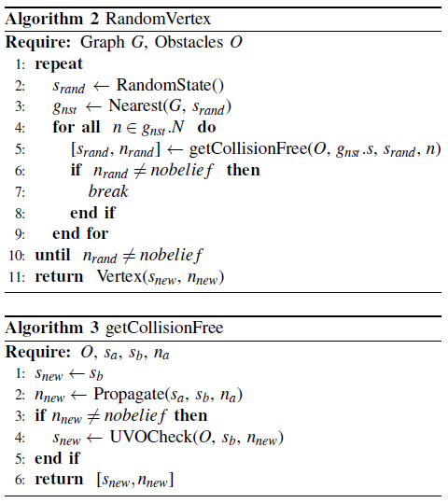
Algorithm
Tree reusing
Branch-and-bound
UVO Method
Notes:
This is the proposed algorithm,
It just modified a little line in RRBT algorithm.
I added a tree re-using method
And branch-and-bound method in propagate function
And UVO method.

Slide 33
Contents
Background
Goal
Related work
Approach
Result
Conclusion & Future work
Notes:
Next is result;

Slide 34
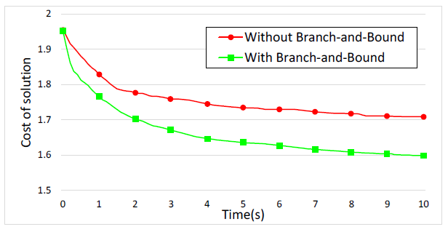
Result – Branch and bound
Cost of solution / Time(s)
Notes:
I measured benefits of Branch-and-Bound (BB) method
I achieve lower costs given the same time budget than without BB method.
For example, at the cost of 1.7, we achieve about five times faster performance.
Since our BB method culls out belief nodes with higher costs and uncertainty, our method focuses more on exploring new space by generating more vertices,

Slide 35
Intersection scene – without UVO
Notes:
And this is an intersection scene, without UVO method.
The robot has zig-zag trajectory. Because the robot doesn’t consider velocity

Slide 36
Intersection scene – with UVO
Notes:
On the other hand, the robot can have smooth trajectory with proposed UVO method.
As you can see, the robot reduce their velocity when the robot encounters the moving obstacle. After then, the robot restores velocity.

Slide 37
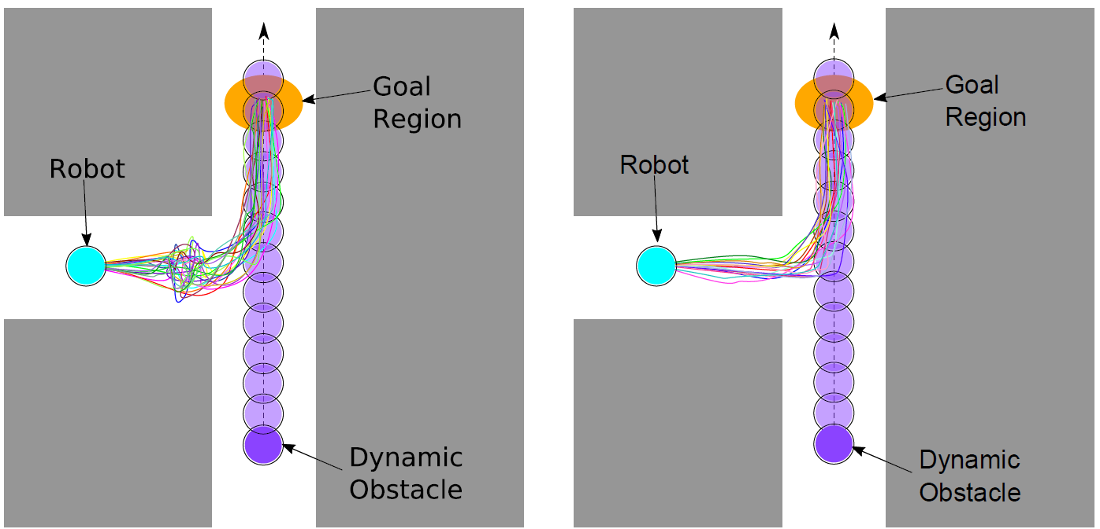
Result – Uncertainty-aware Velocity Obstacle
Trajectory Plots
Without UVO
With UVO
Notes:
I simulated this scene 100 times for each method.
Left is without UVO method, there are many zig-zag trajectories.
With UVO method has smooth paths.

Slide 38
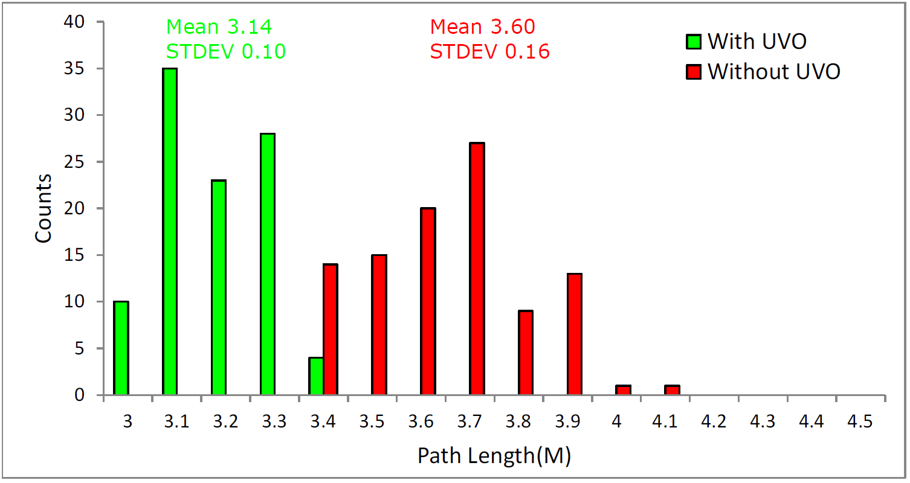
Result – Uncertainty-aware Velocity Obstacle
Path length
Notes:
This is histograms of path lengths in the scene. With UVO method have 15% shorter path than the other.

Slide 39
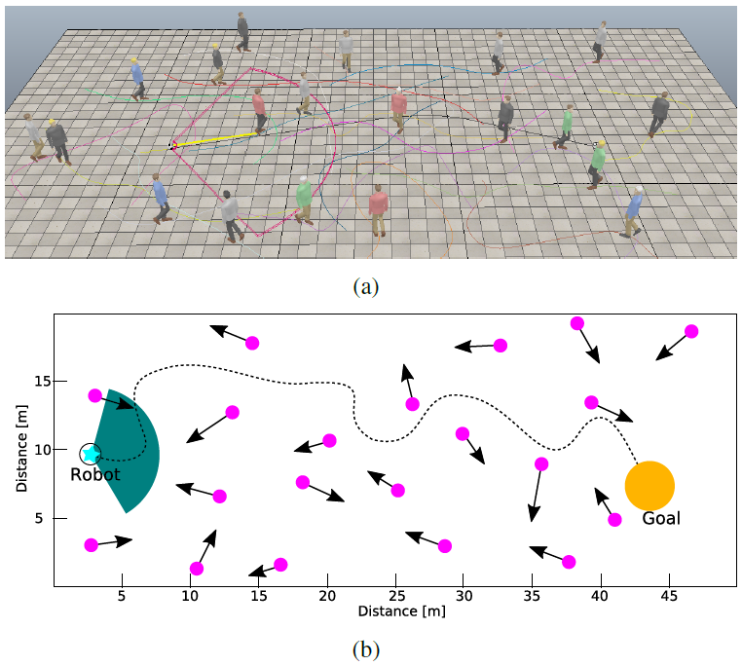
Result – Crowd scene
Notes:
I also apply our method to a scene with 20 human agents, each human agent follows his or her own path, which is generated randomly

Slide 40
Result – Crowd scene
Notes:
I run this test 30 times, and proposed method is able to find collision-free paths successively
Sometimes, the robot reduces velocity, or calculate new trajectory to avoid human agent.

Slide 41
Conclusion
Anytime RRBT
Handled the uncertainty and dynamic environments in efficient manner
Continuously improved collision-free paths toward the optimal solution, as we get more computational time
Proposed the uncertainty-aware velocity obstacle to effectively perform collision detection and find an adjusted velocity avoiding collisions without rejecting samples
Notes:
Here is conclusion
I have presented a novel anytime RRBT method for handling uncertainty and dynamic environments in an efficient manner.
Proposed method continuously improves collision-free paths toward the optimal solution
And I have proposed UVO method to perform collision detection and find an adjusted velocity, avoiding collisions without rejecting samples

Slide 42
Future work
Design a massively parallel version utilizing recent GPUs to achieve better performance
Design anisotropic shapes to support elongated robots and extend it to 3D cases for more accurate analysis
Notes:
This is my future works,
To achieve better performance, I would like to design a parallel version utilizing recent GPUs.
And extend to 3d case for more accurate analysis.

Slide 43
Publications
양현철, 임종우, 윤성의. Anytime 고속 탐색 임의 신뢰 트리 [KROC2015]
Hyunchul Yang, Jongwoo Lim, Sung-Eui Yoon. Anytime RRBT for Handling Uncertainty and Dynamic Objects (submitted to ICRA2016 and currently under review)
Notes:
This is my publications.

Slide 44
Thank you
Q & A

