Slide 1
CS380 Lab 1
2017 Spring
Myungbae Son

Slide 2
Acknowledgement
The reference material has been brought from
  OpenGL course slides by Rasmus Stenholt
  OpenGL course slides by Donghyuk Kim
  http://nehe.gamedev.net/
  http://www.opengl-tutorial.org/

Slide 3
Goal
Introduce OpenGL programming
Lab 1: OpenGL version 2.x and under
  Help you do CS380 homework by yourself
Lab 2: OpenGL version 3.x and above
  Dip into modern OpenGL

Slide 4
Notes
Our lab assumes following environment
  C++ programming language … (prerequisite!)
  Microsoft Windows, MSVC 14.0 (Visual Studio 2015)
You can program in other platforms and submit the code
  Avoid platform-specific features to prevent unexpected score deduction
  TAs will score your PA based on above environment
Any question while following the tutorial? Ask us!
  Off-session questions go to KLMS

Slide 5
Getting Started

Slide 6
Today’s Outline
Set up OpenGL development environments on Visual Studio
  Download and setup GLUT and others
Start with the OpenGL framework
  Draw a OpenGL primitive
  Address keyboard and mouse input

Slide 7

OpenGL is an API for graphics programming
  Platform-independent
    Same code to render the image for Windows and iPhone
  Language-independent
    Use same gl*() functions in any popular languages
API is a specification
  Your OS provides the OpenGL interface
  Your graphic card driver implements OpenGL functions
Driver
OS
Your application

Slide 8
GLUT
Different platforms, Different window systems
  Connecting OpenGL to window system is NOT platform-independent
    Windows Win32 API, X11 GLX, macOS Cocoa binding, etc..
  Tricky, cumbersome and dirty to implement
GLUT (OpenGL Utility Toolkit)
  Third-party utility library
  Provides a platform-independent window and OpenGL context creation
    Saves you from platform-specific hurdles

Slide 9
Download GLUT
Windows binaries and build toolkits can be downloaded from:
  https://www.opengl.org/resources/libraries/glut/glutdlls37beta.zip
  https://goo.gl/av1Lrr
Unzip it somewhere (Here we assume the location is C:\GLUT)

Slide 10
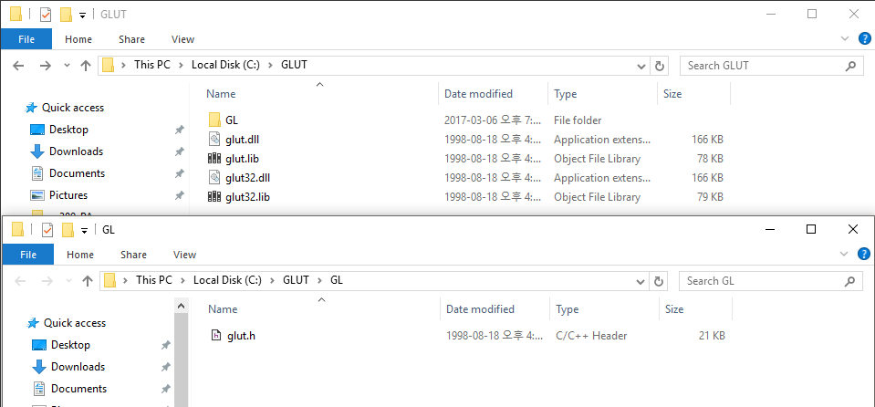
Download GLUT
For standard compliance
  Create GL folder inside the folder
  Move glut.h into GL folder

Slide 11
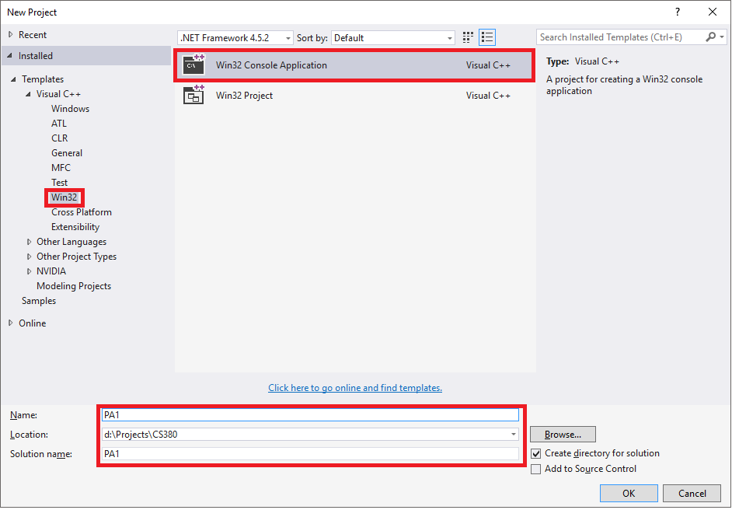
Create Project
Run Visual Studio
File -> New -> Project
Create Win32
Console Application
Type in your project name

Slide 12
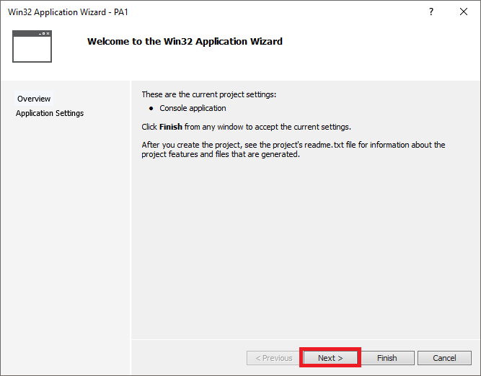
Create Project
Run Visual Studio
File -> New -> Project
Create Win32
Console Application
Type in your project name

Slide 13
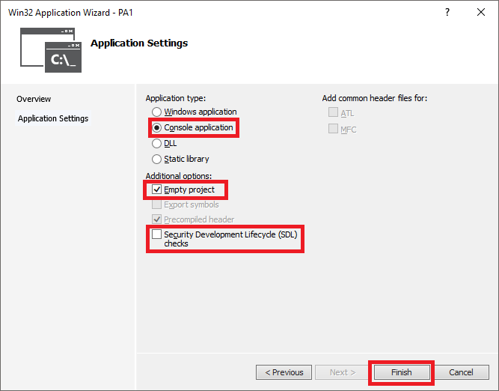
Create Project
Run Visual Studio
File -> New -> Project
Create Win32
Console Application
Type in your project name
Create an empty project
  You might want to remove
  SDL checks as well

Slide 14
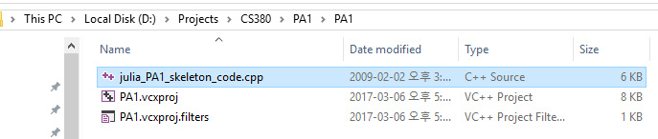
Download PA1 Skeleton Code
Available from our course website
Unzip it to project folder (where *.vcxproj resides)

Slide 15
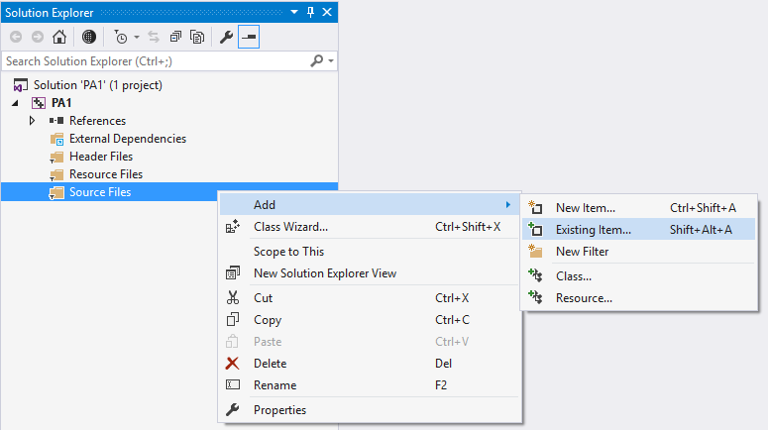
Download PA1 Skeleton Code
Add skeleton code
to project

Slide 16
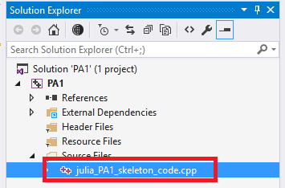
Download PA1 Skeleton Code
Add skeleton code
to project

Slide 17
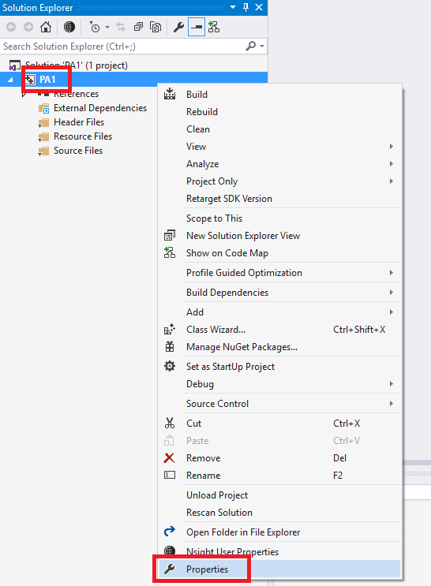
Project Setup
Go to project properties

Slide 18
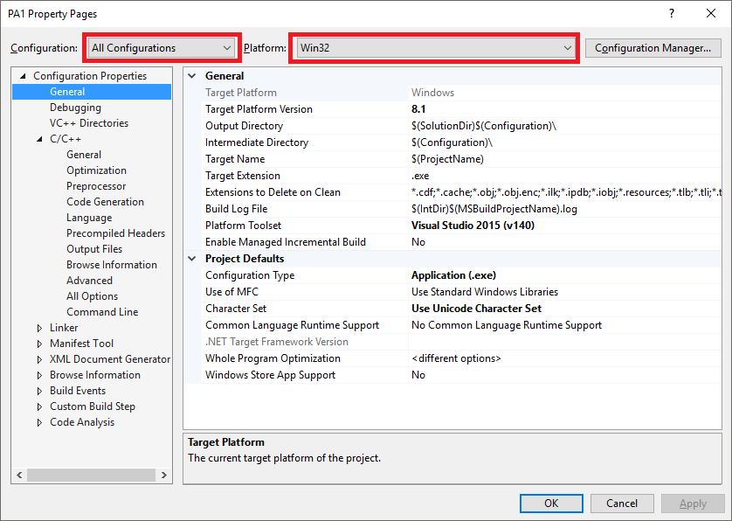
Project Setup
Go to project properties
Make sure that
  We’re setting both debug
  and release modes
  (All Configuration)
  We’re making 32 bit binary
  (Win32)

Slide 19
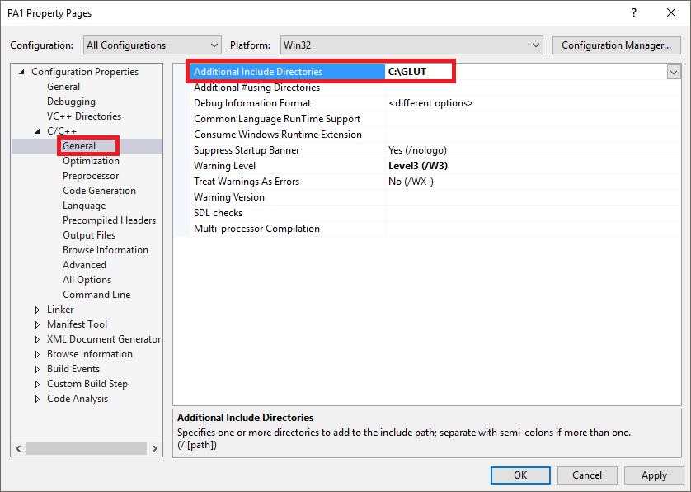
Project Setup
Setup header (*.h)
search directory

Slide 20
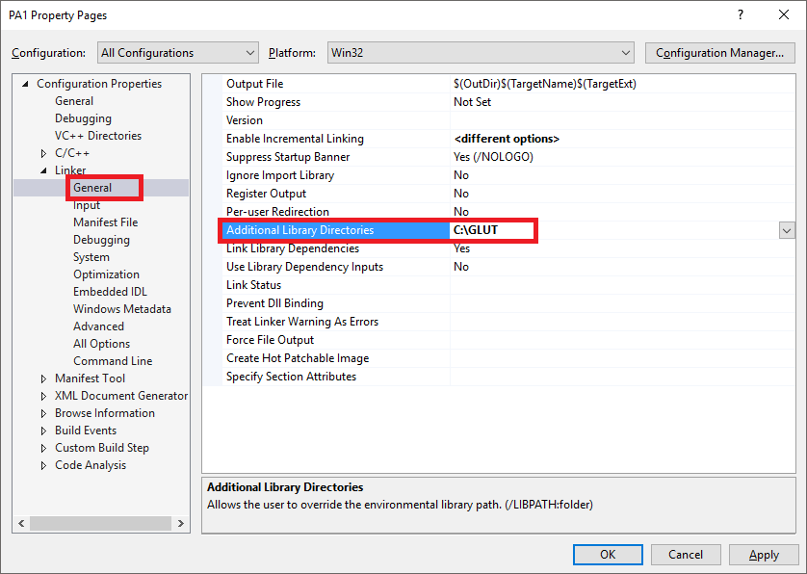
Project Setup
Setup header (*.h)
search directory
Setup library (*.lib)
search directory

Slide 21
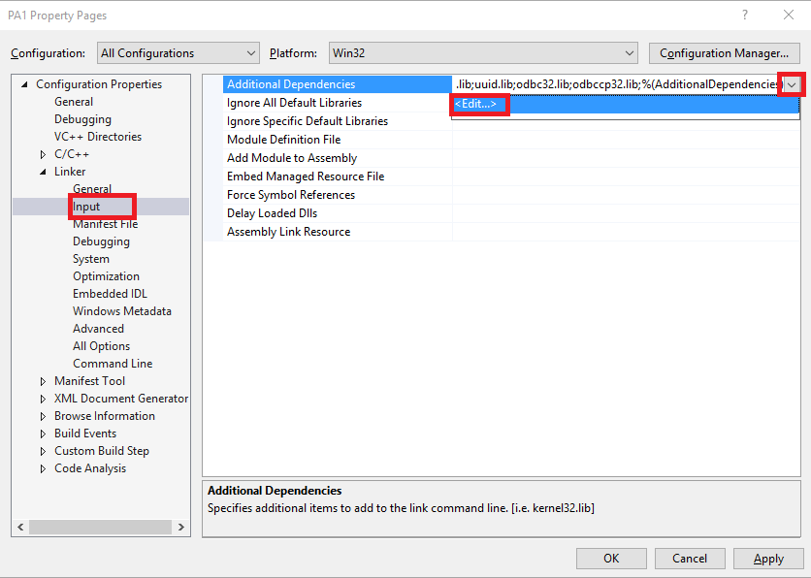
Project Setup
Setup header (*.h)
search directory
Setup library (*.lib)
search directory
Setup required libraries

Slide 22
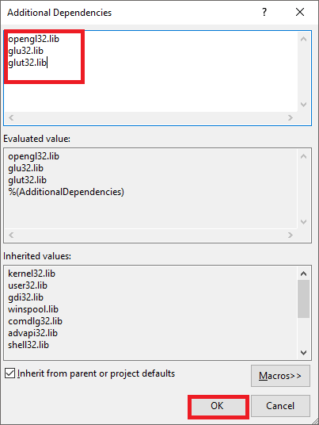
Project Setup
Setup header (*.h)
search directory
Setup library (*.lib)
search directory
Setup required libraries
  OpenGL API libraries (from your OS)
    opengl32.lib, glu32.lib
  GLUT library
    glut32.lib

Slide 23
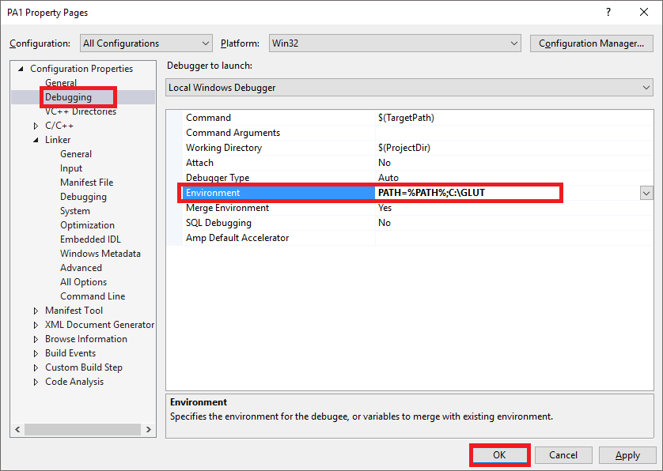
Project Setup
Setup DLL search path
when debugging
your project
  Alternatively, copy
  glut32.dll file to your
  *.exe file location
Setup is done, click OK
PATH=%PATH%;<path to glut32.dll directory>

Slide 24
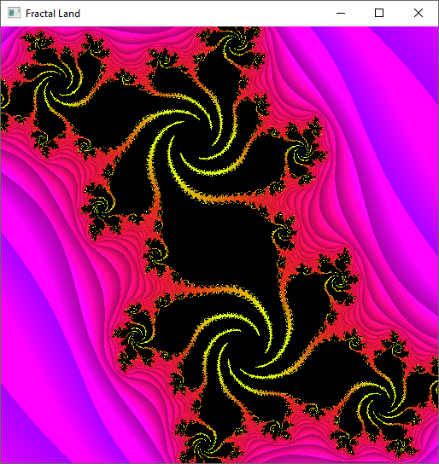
Now Build and Run Project!
F7 for build
Ctrl+F5 for run
F5 for debug run

Slide 25
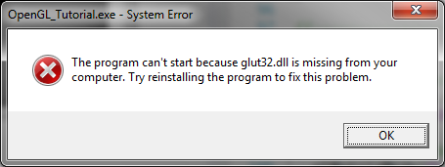
Troubleshooting
  Make sure that glut32.dll is within DLL search path
  The easiest way is to copy DLL to EXE folder
LNK2026: module unsafe for SAFESEH image.
  Set project properties -> Linker -> Advanced
  -> Image Has Safe Exception Handlers -> No (/SAFESEH:NO)

Slide 26

Creating an empty window
#include <GL/glut.h>
#include <GL/glu.h>
void display()
{
}
int main( int argc, char* argv[] )
{
glutInit(&argc, argv);
glutInitDisplayMode(GLUT_SINGLE | GLUT_RGBA | GLUT_DEPTH);
glutInitWindowSize(512, 512);
glutCreateWindow("CS380 LAB");
glutDisplayFunc( display );
glutMainLoop();
return 0;
}

Slide 27
Draw your first polygon
void display()
  Main display function where we can do all the drawing

Slide 28

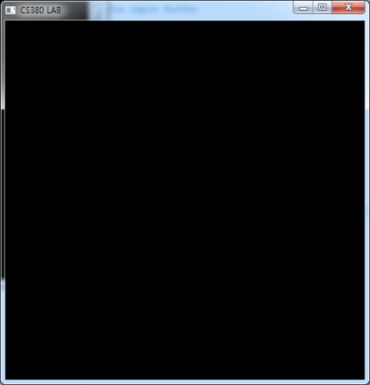
Draw your first polygon
Clear your screen
  void display() {
  glClear(GL_COLOR_BUFFER_BIT | GL_DEPTH_BUFFER_BIT);
  glFlush();
  }
glClear(parameters) // clear input buffers
glFlush() // forces all pending commands to be executed

Slide 29
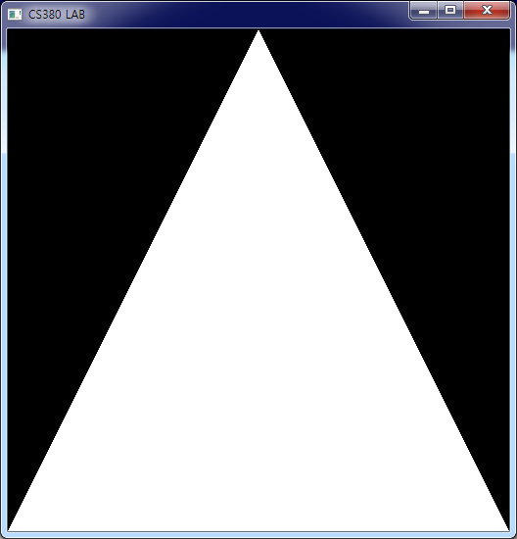
Draw your first polygon
void display() {
glClear(GL_COLOR_BUFFER_BIT | GL_DEPTH_BUFFER_BIT);
glLoadIdentity(); // Reset our view
glBegin(GL_TRIANGLES); // Draw a triangle
glVertex3f( 0.0f, 1.0f, 0.0f);
glVertex3f(-1.0f,-1.0f, 0.0f);
glVertex3f( 1.0f,-1.0f, 0.0f);
glEnd();
glFlush();
}
(0,0,0)

Slide 30
Draw your first polygon
In OpenGL, geometry is specified by vertices
Vertices must be specified between glBegin(primitive type) and glEnd() function calls
The primitive type represents how vertices are to be connected
glBegin(GL_TRIANGLES);
glVertex3f( 0.0f, 1.0f, 0.0f);
glVertex3f(-1.0f,-1.0f, 0.0f);
glVertex3f( 1.0f,-1.0f, 0.0f);
glEnd();

Slide 31
OpenGL Primitives
Triangles
  There are 3 ways of making triangles with OpenGL
    Individual triangles
      Type is GL_TRIANGLES
      Each triangle requires 3 explicit vertices
      Sets of unconnected triangles are often called polygon soups
    Strips of connected triangles
      Type is GL_TRIANGLE_STRIP
      The first triangle requires 3 vertices, the rest use 1 new vertex and the 2 most recently defined vertices
      Complex objects are often built from
    Fans of connected triangles
      Type is GL_TRIANGLE_FAN
      Every triangle use the first, the previous, and a new vertex
      Useful for creating polygons or approximating circles/ellipses
GL_TRIANGLES
GL_TRIANGLE_STRIP
GL_TRIANGLE_FAN

Slide 32
OpenGL Primitives
Quadrilaterals (quads)
  Individual quads
    Type is GL_QUADS
    A quad is defined by 4 vertices
    Quads can be decomposed into two triangles
    Quads are not necessarily plane or convex
      Be careful with the vertex sequence
  Strips of connected quads
    Type is GL_QUAD_STRIP
    Uses the most recent 2 vertices and 2 new vertices
GL_QUADS
GL_QUAD_STRIP

Slide 33
OpenGL Primitives
Polygons
  Type is GL_POLYGON
  Polygons need 3 or more vertices
    I.e. can be used for any polygon
  Polygons are divided into triangles by the graphics card
GL_POLYGON

Slide 34
OpenGL Primitives
Points
  Type is GL_POINTS
  Points are 0-D
  Points represent the simplest drawable primitive
  1 vertex is used per point
  Points are rendered as small, unconnected dots on the screen
  Theoretically points have no area
GL_POINTS

Slide 35
OpenGL Primitives
Lines
  Type is GL_LINES
  Lines are 1-D
  Each line needs 2 vertices
  Lines have no area
Open series of lines
  Type is GL_LINE_STRIP
Closed series of lines
  Type is GL_LINE_LOOP
GL_LINES
GL_LINE_STRIP
GL_LINE_LOOP

Slide 36
OpenGL functions
OpenGL functions all follow the same naming conventions
  Function names have gl, glu, or glut as prefix depending on their package of origin
  The name of the function follows the prefix
  The parameter type of the function is placed as a postfix

Slide 37
OpenGL functions
glVertex3fv( v )
Number of
components
Data Type
Vector
b - byte
ub - unsigned byte
s - short
us - unsigned short
i - int
ui - unsigned int
f - float
d - double
omit “v” for
scalar form
glVertex2f( x, y )
2 - (x,y)
3 - (x,y,z)
4 - (x,y,z,w)

Slide 38
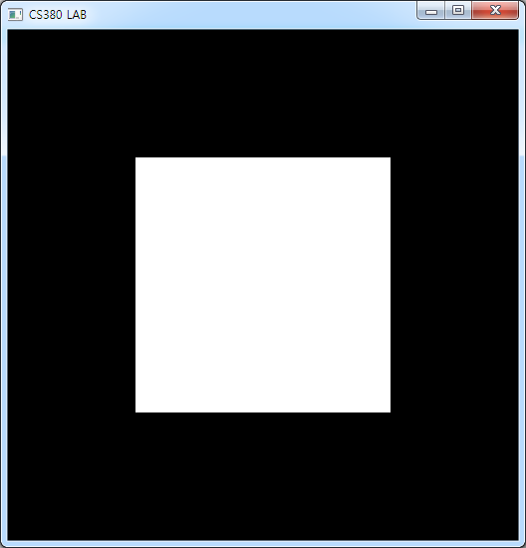
Tutorial
Draw this rectangle

Slide 39
Tutorial
Drawing a red rectangle
glBegin(GL_QUADS);
glVertex3f( -0.5f, -0.5f, 0.0f);
glVertex3f(-0.5f, 0.5f, 0.0f);
glVertex3f( 0.5f, 0.5f, 0.0f);
glVertex3f( 0.5f,-0.5f, 0.0f);
glEnd();

Slide 40
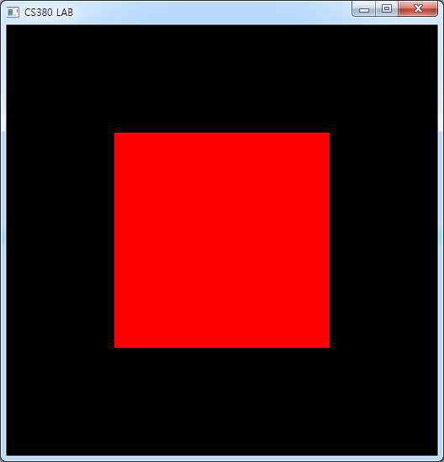
Adding colours
glColor3f(red, green, blue)
Drawing a red rectangle
glBegin(GL_QUADS);
glColor3f(1.0f,0.0f,0.0f);
glVertex3f( -0.5f, -0.5f, 0.0f);
glVertex3f(-0.5f, 0.5f, 0.0f);
glVertex3f( 0.5f, 0.5f, 0.0f);
glVertex3f( 0.5f,-0.5f, 0.0f);
glEnd();

Slide 41
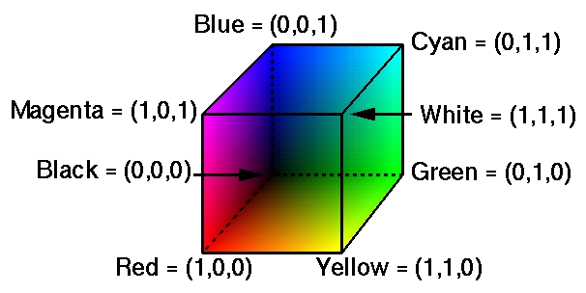
Colours in OpenGL
Colours are modelled using the red-green-blue (RGB) system

Slide 42
Colours in OpenGL
There are several ways of representing colour in OpenGL
  Directly as RGB-tuples
  Extended RGBA-tuples
  Indexed mode
The RGBA mode has an extra component, alpha, which does not affect the colour directly
  Alpha is used when blending colours
    E.g. transparency effects

Slide 43
Colours in OpenGL
Colours are specified by the glColor*() family of functions
Example: glColor3f()
  Specifies a colour by three floating point values in the range [0.0;1.0]
  The parameters represent R, G, and B, respectively

Slide 44
Keyboard input
int main( int argc, char* argv[] ) {
glutInit(&argc, argv);
glutInitDisplayMode(GLUT_SINGLE | GLUT_RGBA | GLUT_DEPTH);
glutInitWindowSize( width, height );
glutCreateWindow("CS380");
glutDisplayFunc( display );
glutMouseFunc( mouse );
glutKeyboardFunc( keyboard );
glutReshapeFunc( reshape );
glutMainLoop();
return 0;
}

Slide 45
Keyboard input
void keyboard(unsigned char key, int x, int y) {
if (key == 'r') {
// todo
}
glutPostRedisplay();
}

Slide 46
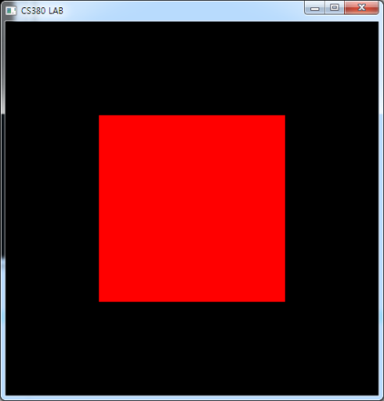
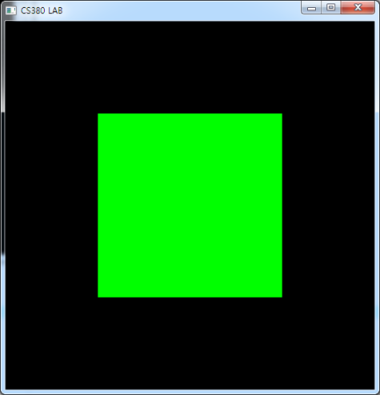
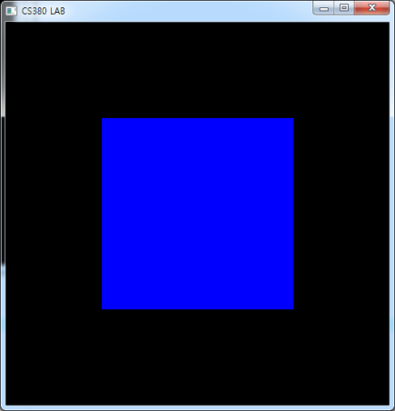
Tutorial
Change the color of your rectangle
  Press ‘r’: change it to a red rectangle
  Press ‘g’: change it to a green rectangle
  Press ‘b’: change it to a blue rectangle

Slide 47
Tutorial
void keyboard(unsigned char key, int x, int y){
if (key == 'r') {
r = 1.0, g = 0.0, b = 0.0;
}
else if (key == 'g') {
r = 0.0, g = 1.0, b = 0.0;
}
else if (key == 'b') {
r = 0.0, g = 0.0, b = 1.0;
}
glutPostRedisplay();
}
void display() {
…
glColor3f(r,g,b);
…
}

Slide 48
Mouse input
int main( int argc, char* argv[] ) {
glutInit(&argc, argv);
glutInitDisplayMode(GLUT_SINGLE | GLUT_RGBA | GLUT_DEPTH);
glutInitWindowSize( width, height );
glutCreateWindow("CS380");
glutDisplayFunc( display );
glutMouseFunc( mouse );
glutKeyboardFunc( keyboard );
glutReshapeFunc( reshape );
glutMainLoop();
return 0;
}

Slide 49
Mouse input
void mouse( int button, int state, int mx, int my )
button
  GLUT_LEFT_BUTTON
  GLUT_MIDDLE_BUTTON
  GLUT_RIGHT_BUTTON
state
  GLUT_DOWN
  GLUT_UP
mx, my
  positions

Slide 50
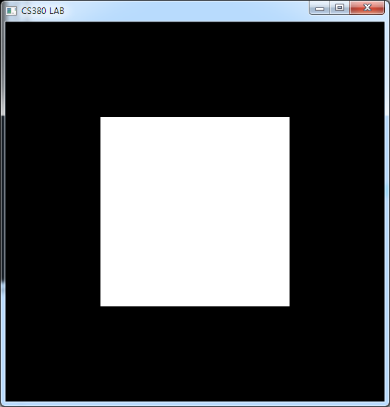
Mouse input
void mouse( int button, int state, int mx, int my ) {
if((button == GLUT_LEFT_BUTTON) && (state == GLUT_DOWN) ) {
r = 1.0, g = 1.0, b = 1.0;
display();
}
}

