Slide 1
Ray Tracing via Markov Chain Monte-Carlo Method
Toshiya Hachisuka, Anton S. Kaplanyan, Carsten Dachsbacher, Multiplexed Metropolis Light Transport, SIGGRAPH 2014.
Toshiya Hachisuka, Henrik Wann Jensen, Robust Adaptive Photon Tracing Using Photon Path Visibility, ACM TOG 2011.
Jungpyo Hong
2016.06.07

Slide 2
Contents
Basic Backgrounds
Metropolis-Hastings Method
Metropolis Light Transport (MLT)
Primary Sample Space (PSS)
Multiplexed Metropolis Light Transport (MMLT)
Multiple Importance Sampling
Multiplexed Primary Sample Space
Robust Adaptive Photon Tracing
Problem Specification
Replica Exchange Monte-Carlo

Slide 3
Metropolis-Hastings (MH) Method
A kind of Markov Chain Monte-Carlo (MCMC) method
A sampling method
from a unknown probability distribution $P\left(x\right)$
You can compute a value of function $f\left(x\right)$, while $P\left(x\right)∝f\left(x\right)$
So it is difficult to calculate the normalize constant $∫f\left(x\right)dx$
Arbitrary jumping distribution $q\left(x | x^{′}\right)$ is needed

Slide 4
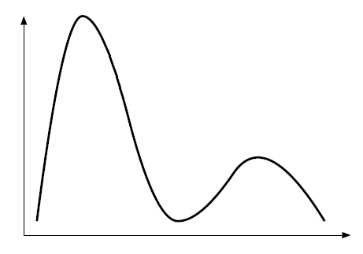
Metropolis-Hastings (MH) Method
Algorithm
From current state $x_{t}$, pick a target state $z$
$z\sim q\left(z | x_{t}\right)$, $x_{0}$ is an arbitrary point
Calculate $f\left(x_{t}\right), f\left(z\right),q\left(x_{t} | z\right), q\left(z | x_{t}\right)$
Calculate an acceptance probability
$$a\left(x_{t},z\right)=\min\left(\frac{f\left(z\right)q\left(x_{t} | z\right)}{f\left(x_{t}\right)q\left(z | x_{t}\right)},1\right)$$
Accepted: $x_{t+1}=z$
Rejected: $x_{t+1}=x_{t}$
$$f\left(x\right)$$
$$x_{t}$$
$$q$$
$$z$$
$$x$$

Slide 5
Metropolis-Hastings (MH) Method
Algorithm
From current state $x_{t}$, pick a target state $z$
$z\sim q\left(z | x_{t}\right)$, $x_{0}$ is an arbitrary point
Calculate $f\left(x_{t}\right), f\left(z\right),q\left(x_{t} | z\right), q\left(z | x_{t}\right)$
Calculate an acceptance probability
$$a\left(x_{t},z\right)=\min\left(\frac{f\left(z\right)q\left(x_{t} | z\right)}{f\left(x_{t}\right)q\left(z | x_{t}\right)},1\right)$$
Accepted: $x_{t+1}=z$
Rejected: $x_{t+1}=x_{t}$
$$f\left(x\right)$$
$$x_{t}$$
$$a\left(x_{t},z\right)=\min\left(\frac{f\left(z\right)q\left(x_{t} | z\right)}{f\left(x_{t}\right)q\left(z | x_{t}\right)},1\right)$$
$$z$$
$$x$$

Slide 6
Metropolis-Hastings (MH) Method
Algorithm
From current state $x_{t}$, pick a target state $z$
$z\sim q\left(z | x_{t}\right)$, $x_{0}$ is an arbitrary point
Calculate $f\left(x_{t}\right), f\left(z\right),q\left(x_{t} | z\right), q\left(z | x_{t}\right)$
Calculate an acceptance probability
$$a\left(x_{t},z\right)=\min\left(\frac{f\left(z\right)q\left(x_{t} | z\right)}{f\left(x_{t}\right)q\left(z | x_{t}\right)},1\right)$$
Accepted: $x_{t+1}=z$
Rejected: $x_{t+1}=x_{t}$
$$f\left(x\right)$$
$$x_{t}$$
$$x_{t+1}$$
After a sufficient steps,
$x_{t}$ will follows $P\left(x\right)∝f\left(x\right)$
$$x_{t+10}$$
$$x$$

Slide 7
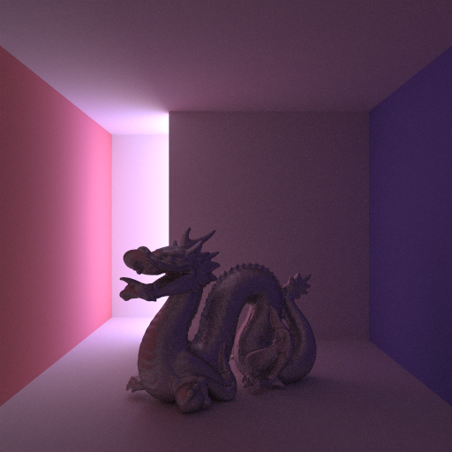
Metropolis Light Transport (MLT)
Use MH to sample paths while rendering!
Idea
Pick paths which contributes more (radiance) on the image
very important
not such important
http://cyhsu0831.blogspot.kr/2014/09/mmlt.html

Slide 8
Metropolis Light Transport (MLT)
Algorithm
From a current path $x_{t}$, pick a target path $z$
$z$ is mutated path from $x_{t}$
Calculate the acceptance probability
$$a\left(x_{t},z\right)=\min\left(\frac{f\left(z\right)q\left(x_{t} | z\right)}{f\left(x_{t}\right)q\left(z | x_{t}\right)},1\right)$$
$f\left(x\right)$ is an radiance of path $x$
$x_{t+1}=z$ if accepted, $x_{t+1}=x_{t}$ if rejected
Problem: how to mutate paths (well)?
$q$ is often symmetric
so that $q\left(x_{t} | z\right)=q\left(z | x_{t}\right)$
(Metropolis method)
$$x_{t}$$
$$z$$

Slide 9
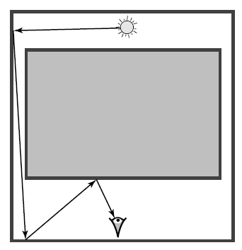
Primary Sample Space (PSS)
MLT has a hard time to cover all possible mutations
Idea
Mutate the paths in another transformed spaces!

Slide 10
Primary Sample Space (PSS)
Veach, Eric, and Leonidas J. Guibas. "Metropolis light transport." Proceedings of the 24th annual conference on Computer graphics and interactive techniques, 1997.
MLT has a hard time to cover all possible mutations
Idea
Mutate the paths in another transformed spaces!

Slide 11
Primary Sample Space (PSS)
Primary sample spaces are defined as a hypercube
$u=\left[u_{1}, …, u_{O\left(k\right)}\right]$ where $k$ is a length of path $x$
$u_{i}∈\left[0, 1\right]$
$u_{i}$ are the parameters which select the shape of path $x$
Two MCMC papers today uses PSS

Slide 12
Multiplexed Metropolis Light Transport
Toshiya Hachisuka, Anton S. Kaplanyan, Carsten Dachsbacher
ACM TOG (SIGGRAPH 2014), 2014.

Slide 13
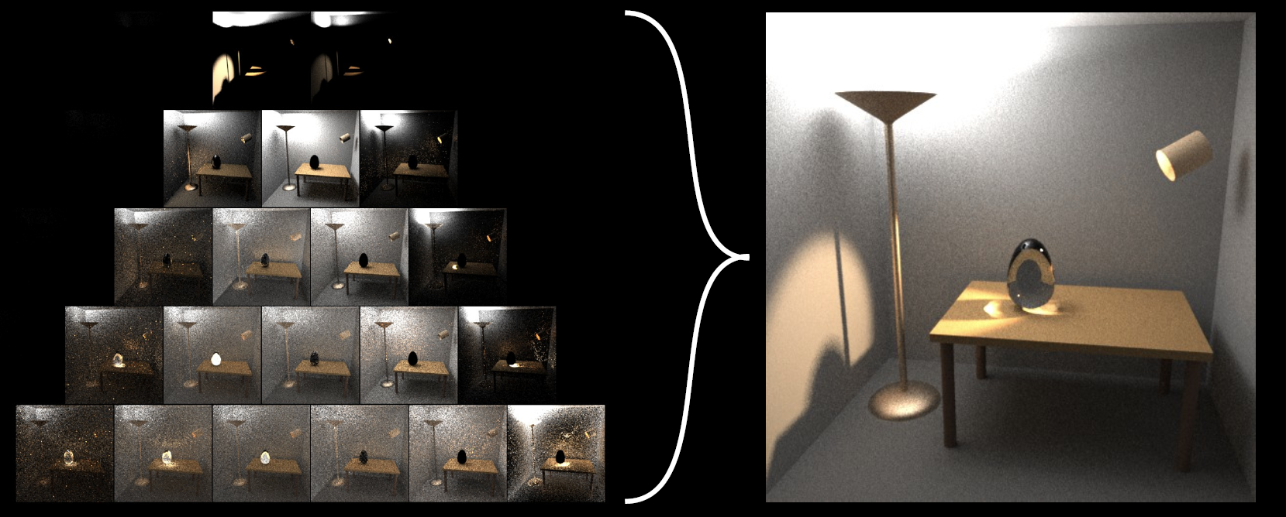
Multiple Importance Sampling (MIS)
Weighted sum of many importance samplings

Slide 14
Multiple Importance Sampling (MIS)
(Ordinary) importance sampling
For known PDF $P\left(x\right)$, sample $N$ times: $x_{1}…x_{N}$
$∫f\left(x\right)dx≈\frac{1}{N}\sum{\frac{f\left(x_{i}\right)}{P\left(x_{i}\right)}}$
Works better if $P≈f$
Multiple importance sampling
For $K$ known PDF $P_{k}\left(x\right){\left.​\right|}_{k=1..K}$, sample $N_{k}$ times each: $x_{1}…x_{N_{k}}$
$∫f\left(x\right)dx≈\sum_{t=1}^{K}{\frac{1}{N_{t}}\sum_{i=1}^{N}{ω_{k}\left(x_{k,i}\right)\frac{f\left(x_{k,i}\right)}{P_{k}\left(x_{k,i}\right)}}}$
$ω_{k}$ is a MIS weight function such that $\sum_{k=1}^{K}{ω_{k}\left(x\right)}=1$

Slide 15
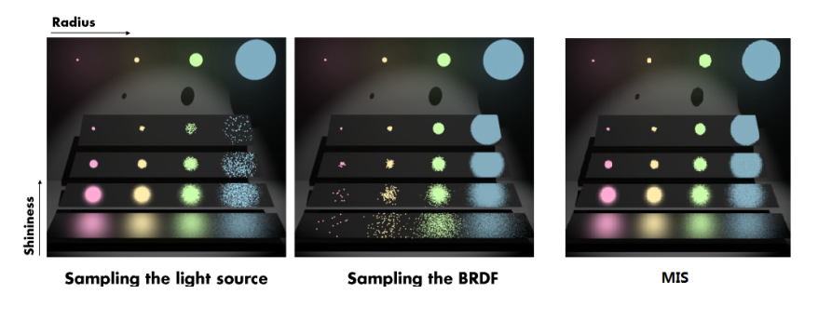
Multiple Importance Sampling (MIS)
By using MIS, we can use different PDFs according to the situation
VEACH, E., AND GUIBAS, L. J. 1995. Optimally combining sampling techniques for Monte Carlo rendering. In SIGGRAPH ’95, 419–428.

Slide 16
Pros and Cons
Multiple Importance Sampling
+ : Can use various techniques according to the situation
‒ : We need to know sampling PDFs exactly
So ‘Sampling from radiance’ is impossible
Metropolis Light Transport
+ : Can sample from unknown function value (like radiance distribution)
‒ : Path tracing (or other single technique) only
 | Multiple techniques | Arbitrary distribution
MC via MIS | Yes | No
MLT | No | Yes
? | Yes | Yes

Slide 17
Expanding Primary Sample Space
Primary Sample Space
Transform

Slide 18
Expanding Primary Sample Space
Multiplexed Primary Sample Space
technique
1
Transform
technique
2
technique
3

Slide 19
Expanding Primary Sample Space
Multiplexed Primary Sample Space
technique
1
Transform
technique
2
technique
3

Slide 20
Expanding Primary Sample Space
Multiplexed Primary Sample Space
technique
1
Transform
technique
2
technique
3
(Ordinary) path mutation

Slide 21
Expanding Primary Sample Space
Multiplexed Primary Sample Space
technique
1
Transform
technique
2
technique
3
Inter-technique mutation

Slide 22
Multiplexed MLT (MMLT)
Multiplexed Metropolis Light Transport
Set type of technique as a MC state, too!
technique
1
Ordinary MLT
$$a\left(u_{t},z\right)=\min\left(\frac{f\left(z\right)}{f\left(u_{t}\right)},1\right)$$
By adapting MIS,
$$a\left((u_{t},k),\left(z,k^{′}\right)\right)=\min\left(\frac{ω_{k^{′}}\left(z\right)\frac{f(z)}{P_{k^{′}}(z)}}{ω_{k}\left(u_{t}\right)\frac{f(u_{t})}{P_{k}(u_{t})}},1\right)$$
technique
2
technique
3

Slide 23
Overall Algorithm
Initialize current state with any (visible) path and technique
Mutate current state to make target state
Calculate its radiance
Calculate its acceptance probability
Accept or reject the target
Loop from 2 until converged

Slide 24
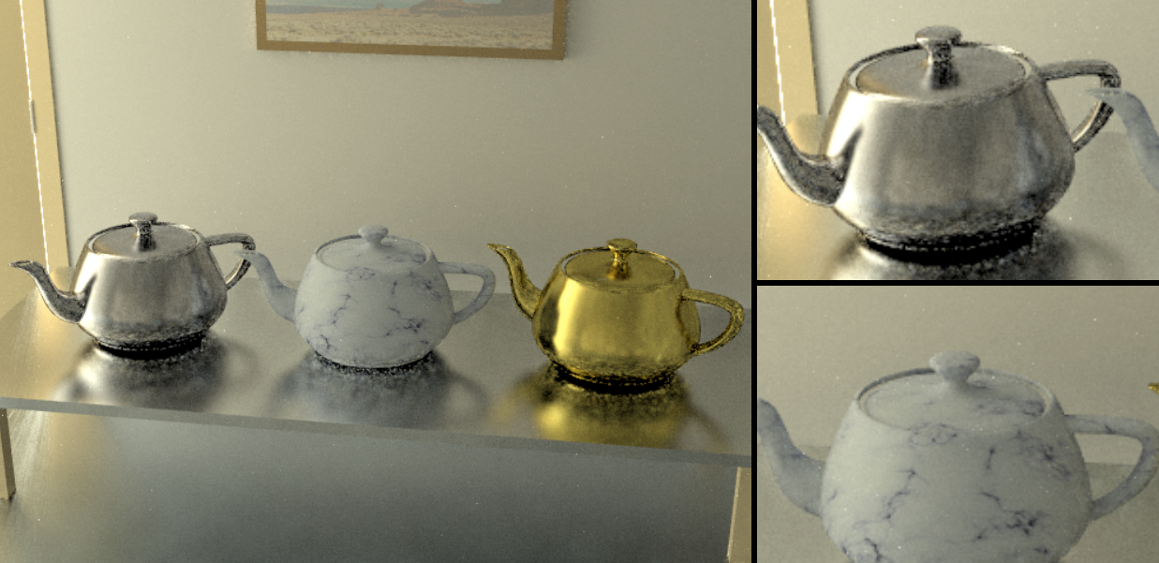
Experiment
MMLT do better than MLT when various materials are mixed
Metropolis Light Transport Result

Slide 25
Experiment
MMLT do better than MLT when various materials are mixed
Multiplex Metropolis Light Transport Result

Slide 26
Experiment ‒ Door
MLT
(RMSE: 0.0314)
PSSMLT
(RMSE: 0.0517)
MMLT
(RMSE: 0.0385)

Slide 27
Experiment
PSSMLT
MLT
MMLT

Slide 28
Robust Adaptive Photon Tracing Using Photon Path Visibility
Toshiya Hachisuka, Henrik Wann Jensen
ACM TOG, (Volume 30 Issue 5, presented at SIGGRAPH 2013) 2011.

Slide 29
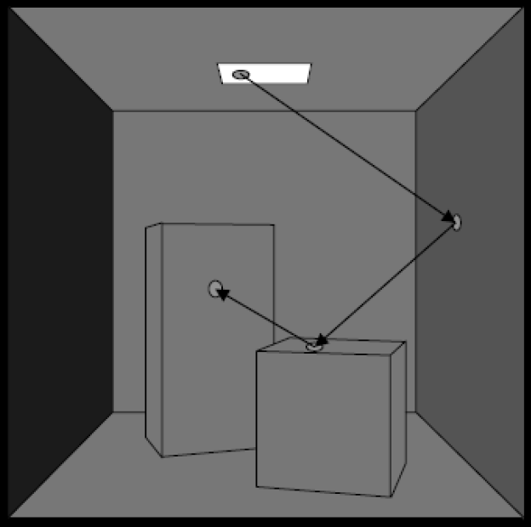
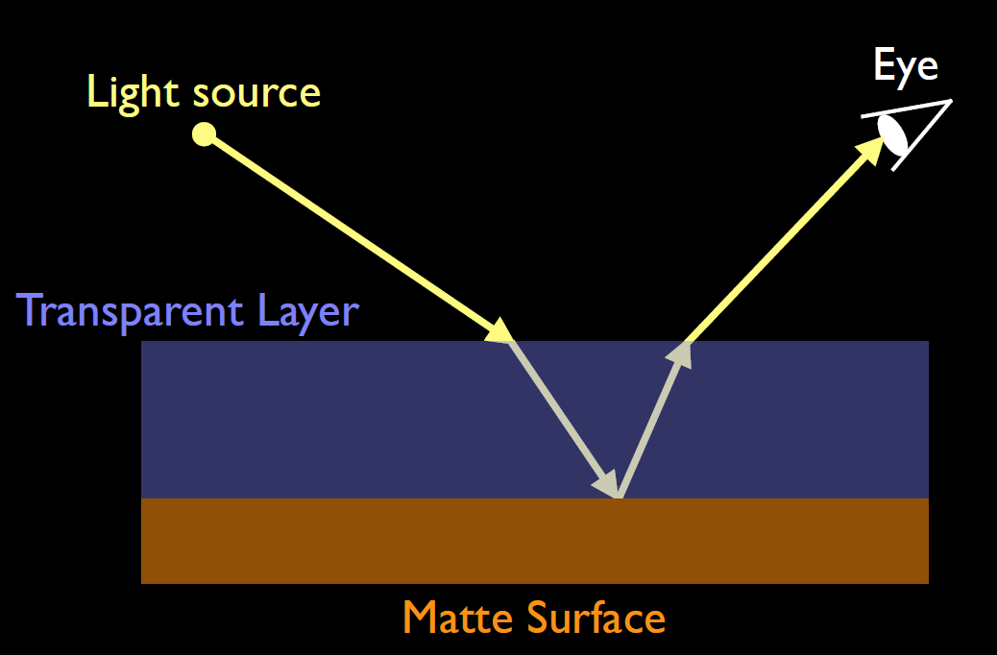
Problem Statement
(Progressive) Photon Mapping
Pros: can handle
specular-diffuse-specular problem
State of the Art in Photon Density Estimation SIGGRAPH 2012 Course
Kavita Bala, Computer Sicence, Cornel University
From Presentation of Prof. Sungeui Yoon

Slide 30
Problem Statement
(Progressive) Photon Mapping
Cons: cannot handle scene with small indirect lighting
Kavita Bala, Computer Sicence, Cornel University
From Presentation of Prof. Sungeui Yoon
http://cyhsu0831.blogspot.kr/2014/09/mmlt.html
MCMC may be handle this?

Slide 31
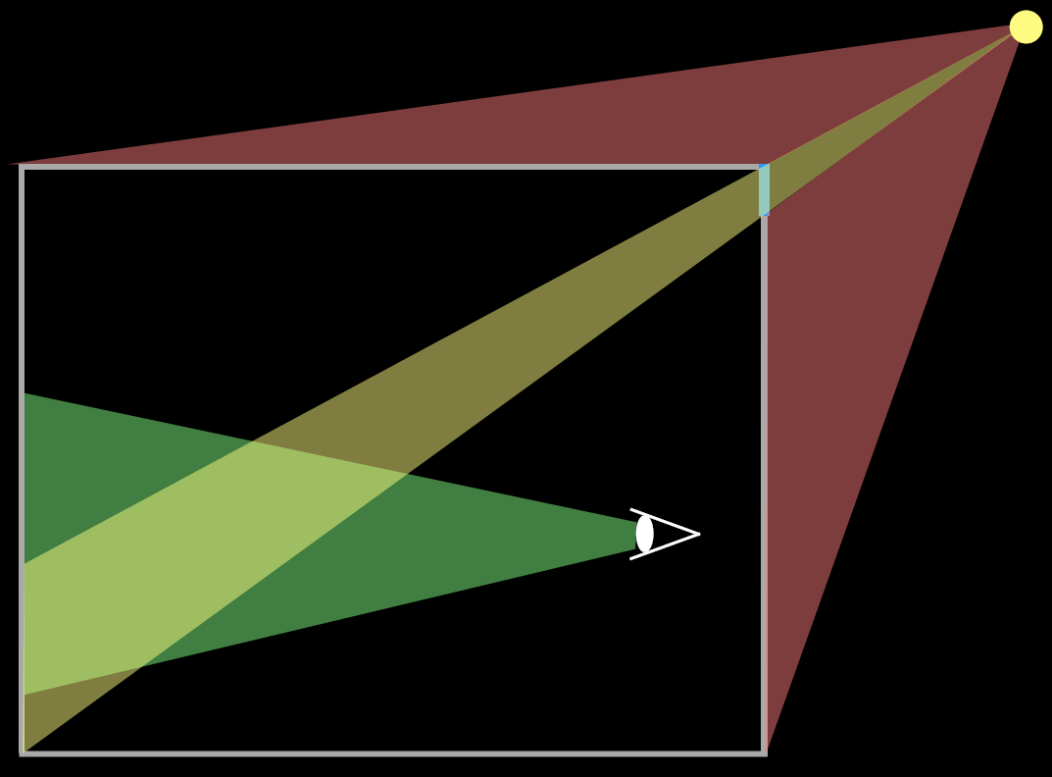
More Problem Statement
Why photon mapping cannot handle such scene?
Too many photons are wasted by invalidation
Light
Window
Valid
lights
Camera
Invalid
light

Slide 32
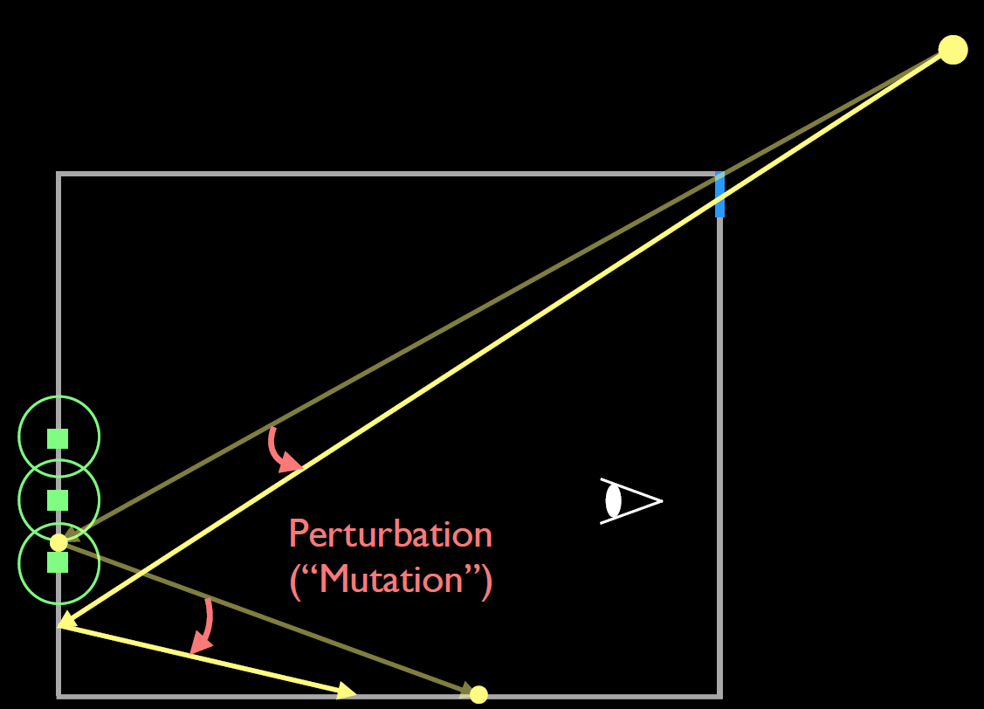
Applying Metropolis Method
Unlike before, this paper uses ‘visibility function’ on sampling
Sample visible paths more
Visibility function $V(u)$: 1 if photon path $u$ is visible, else 0
Normalized visibility function $F\left(u\right)=\frac{V(u)}{∫V\left(u\right)du }=\frac{V(u)}{V_{c}\left(u\right)}$
Use MCMC method to sample from function $F(u)$
Acceptance probability: $\min\left(1,\frac{F\left(z\right)}{F\left(u\right)}\right)$?

Slide 33
Replica Exchange Monte-Carlo
Directly applying MCMC is dangerous
Because $F(u)$ is very sparse function
$$F(u)$$
Too far
to reach!
Jumping probability
$$u_{1}$$
$$u_{2}$$
$$u_{3}$$
$$u_{4}$$
$$u_{5}$$
$$u_{6}$$
Visible
Invisible

Slide 34
Replica Exchange Monte-Carlo
Let’s think about $Q$ independent MCMC
$Q$ functions to be sampled: $F_{1}$ … $F_{Q}$
$Q$ independent states: $u_{1}$ … $u_{Q}$
Replica exchange Monte-Carlo allows to exchange states inter-distribution
Acceptance probability $a\left(u_{p},u_{q}\right)=\min\left(1,\frac{F_{i}\left(u_{q}\right)F_{j}\left(u_{p}\right)}{F_{i}\left(u_{p}\right)F_{j}\left(u_{q}\right)}\right)$
If it is accepted, $u_{p}$ and $u_{q}$ are exchanged

Slide 35
Replica Exchange Monte-Carlo
This paper uses two importance function
$F\left(u\right)$ is a normalized visibility function
$I\left(u\right)=1$ is a constant function
$u_{I},u_{F}$ is a state of constant/visibility function
$a\left(u_{I},u_{F}\right)=\min\left(1,\frac{F\left(u_{I}\right)I\left(u_{F}\right)}{F\left(u_{F}\right)I\left(u_{I}\right)}\right)=\min\left(1,\frac{F\left(u_{I}\right)}{\frac{1}{V_{c}}}\right)=V\left(u_{l}\right)$
It means that
accept (exchange state) if path from uniform dist. is visible
reject if it is invisible

Slide 36
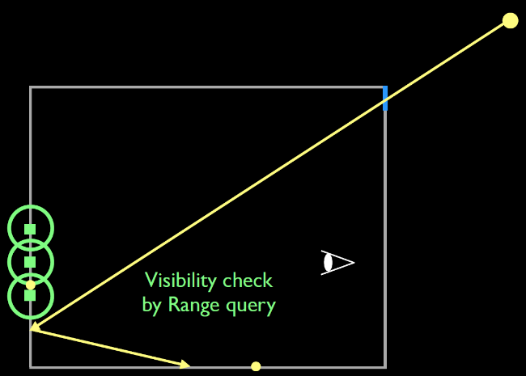
Overall Algorithm
Uniformly sample any path
Exchange to current path if it is visible
If it is not, do regular MCMC method
Target path = Mutate the current path
Accept if it is visible -> change to the current path
Reject if it is not

Slide 37
Experiment
Photon sampled by uniform distribution
Photon sampled by MCMC

Slide 38
Experiment
Photon sampled
by uniform distribution
Photon sampled
by MCMC

Slide 39
Experiment
Photon sampled by uniform distribution
Photon sampled by MCMC

Slide 40
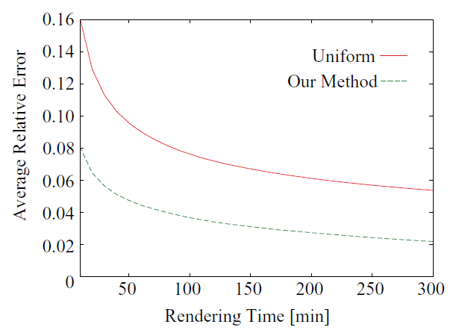
Experiment
RMSE of previous scene

Slide 41
Thank you!
Please ask a question if you have

Slide 42
Quiz
1. (T/F)
In the first paper “Multiplexed Metropolis Light Transport”,
MMLT algorithm fuses multiple importance sampling and Markov Chain Monte-Carlo method.
2. (T/F)
In the second paper “Robust Adaptive Photon Tracing Using Photon Path Visibility”,
the algorithm uses only Metropolis method to do MCMC sampling.

