Slide 1
Rendering Synthetic Objects &
Reduce Monte Carlo Noise
Kim Kiho
CS580[CG] Presentation
May 31, 2016

Slide 2
Papers
Rendering Synthetic Objects into Legacy Photographs
Kevin Karsch, SIGGRAPH Asia 2011.
SURE-based Optimization for Adaptive Sampling and Reconstruction, Tzu-Mao Li, SIGGRAPH Asia 2012.
Notes:
My first presentation paper is Rendering Synthetic Objects into Legacy Photographs .
And My second presentation paper is SURE-based Optimization for adaptive sampling and reconstruction.
Most of slides are made by me, and most of pictures are from author’s paper.
Let’s start with the first paper.

Slide 3
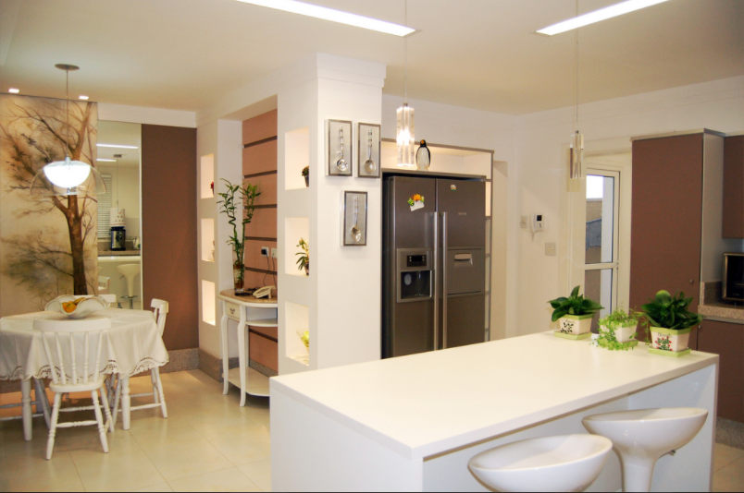
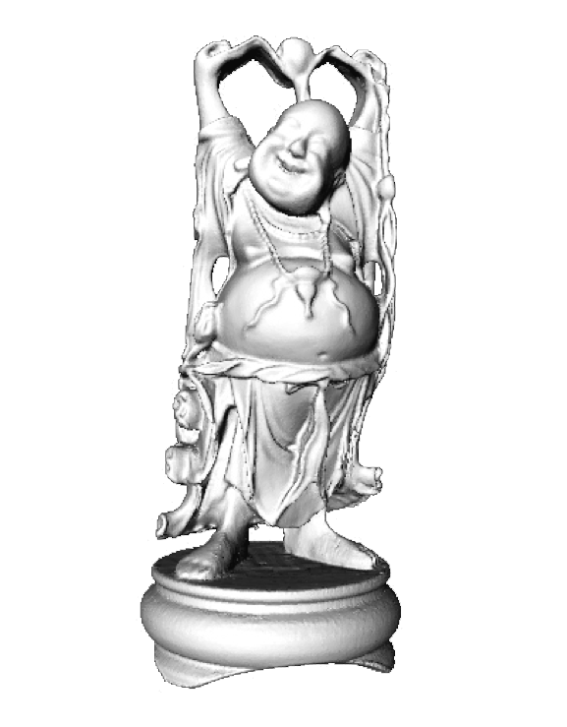
1st Topic
Inserting synthetic objects into picture.
One of the foundation tools of content creation.
Notes:
The first paper’s topic is inserting synthetic objects into picture.
It is one of foundation tools of content creation.

Slide 4
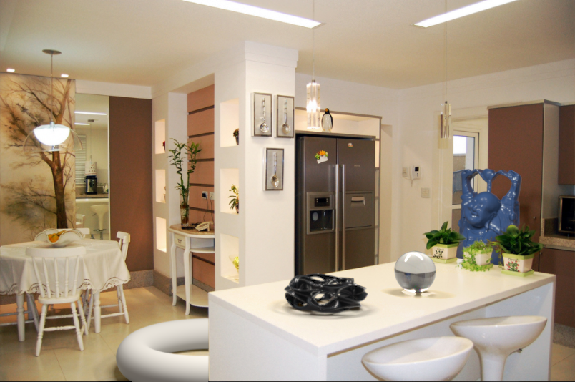
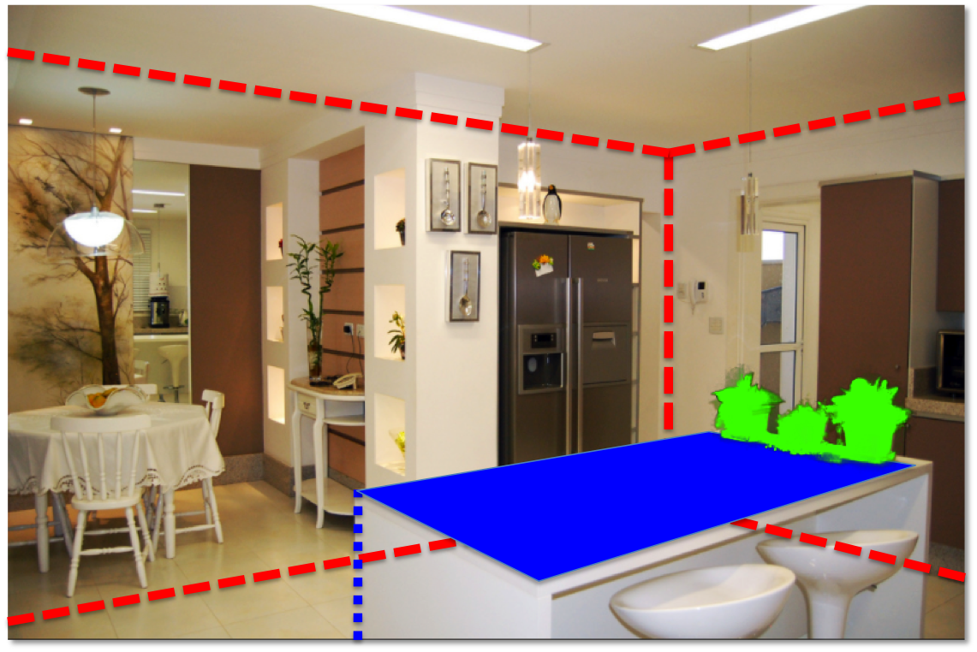
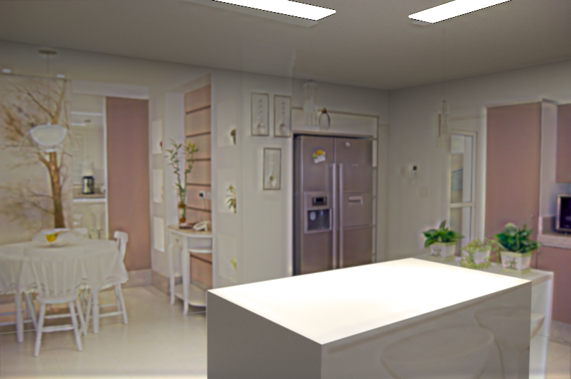
System overview
Input image
Object insertion
Scene authoring
Scene synthesis
Notes:
System overview is like that.
First is scene authoring. Authoring means System edits a input image.
Second, scene synthesis, which is about surface properties and lighting parameters.
and the last, after those procedure, we can insert object into input image.
Now let’s look at the scene authoring procedure.

Slide 5
Scene authoring
Bounding geometry
Spatial Layout [Hedau et al. ’09]
Notes:
To editing a scene, system needs geometry information, surface property information , light source information, and so on.
First, using given input image, estimate boundary geometry by the spatial layout method of Hedau.

Slide 6
Scene authoring
Bounding geometry
Supporting geometry
Spatial Layout [Hedau et al. ’09]
Manual input
Notes:
And then , user can add supporting geometry.
This type of geometry generally consists of planar surface, and can be used to quickly model things like tables, chairs, and other common scene elements.
To specify supporting geometry, user clicks the surface boundary in the image.

Slide 7

Scene authoring
Bounding geometry
Supporting geometry
Spatial Layout [Hedau et al. ’09]
Occluding geometry
Spectral matting[Levin et al. ’09]
Manual input
Notes:
Also, there are more complex geometry which is occluding geometry, now green one in image.
These kind of geometry will hide any objects inserted behind them.
Paper’s author use the Spectral matting approach to determine the object boundaries.

Slide 8
Scene authoring
Manual input
Bounding geometry
Supporting geometry
Spatial Layout [Hedau et al. ’09]
Occluding geometry
Light sources
Spectral matting[Levin et al. ’09]
Manual input
Notes:
Finally, any visible light sources in the scene are marked. And I will describe the procedure to automatically estimate light intensity and other lighting parameters a little bit later in the talk.

Slide 9
Scene authoring
Area lights
Textured billboard
(with transparency)
Bounding cuboid
Extruded polygon
Notes:
By applying single-view metrology and reconstruction techniques, system can recover a rough 3D layout for input image using those annotations.

Slide 10
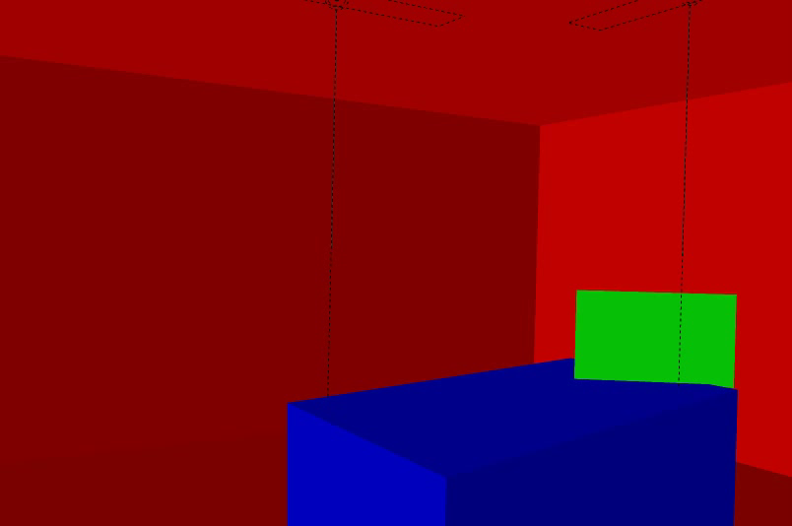
Scene authoring
Notes:
Here’s the recovered 3D model color-coded.

Slide 11
Scene synthesis
Input image
Object insertion
Scene authoring
Scene synthesis
Notes:
We have shown how to reconstruct a geometric representation of a scene from a single image.
So let’s move on next step.

Slide 12
Scene synthesis
Physical scene model
Rendered scene
Area lights
Bounding cuboid
Textured billboard
Extruded polygon
Auto-material estimation
&
Auto-lighting refinement
Match input image and rendered scene
Notes:
Paper’s author made a rendered scene, because it makes inserted objects more realistic.
To rendering scene, system need surface properties and lighting parameters.
In this paper, system use a auto-material estimation, which is similar as Retinex method.

Slide 13
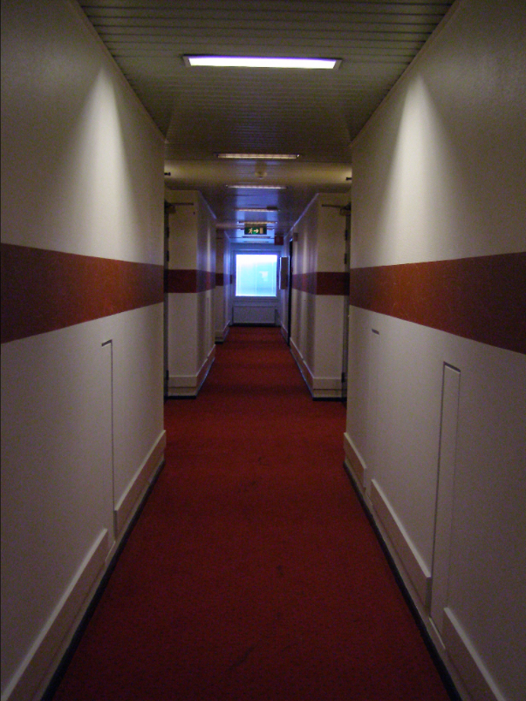
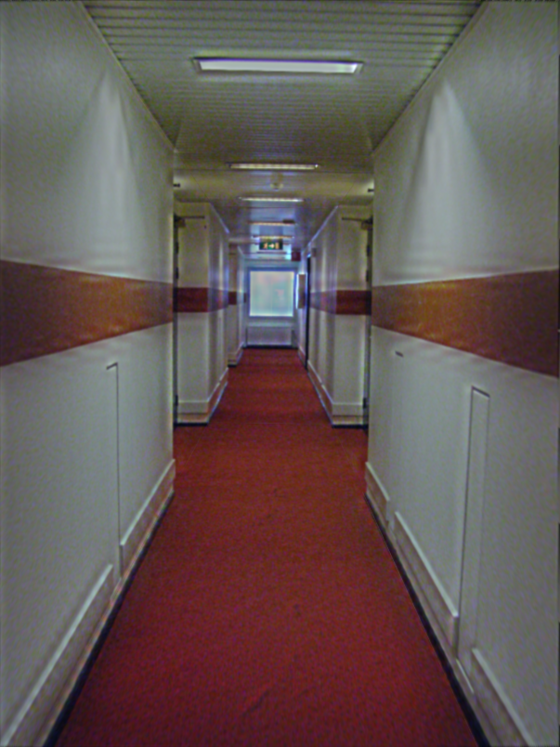
Estimate lighting
Input image
Physical model
Lights
Notes:
And estimate lighting parameters, This is one of the most important parts of this system.
Because getting the lighting can generate big difference between a real image and rendered image.
First generate a bounding geometry. red dotted line is that.
And the user indicate roughly where the light sources are in the image, then the system naively initialize the light source intensity.

Slide 14
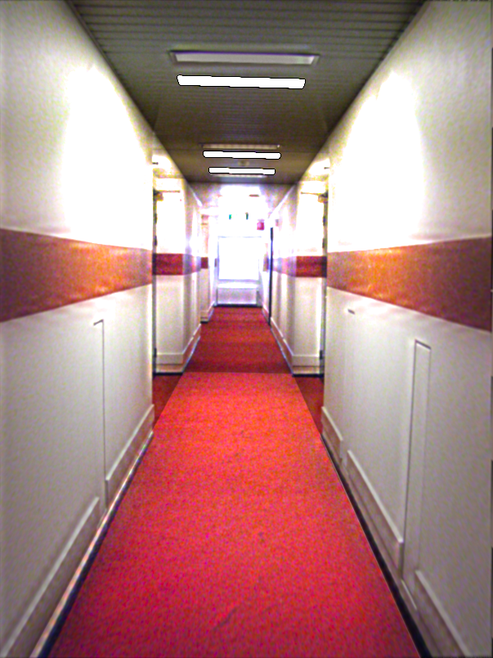
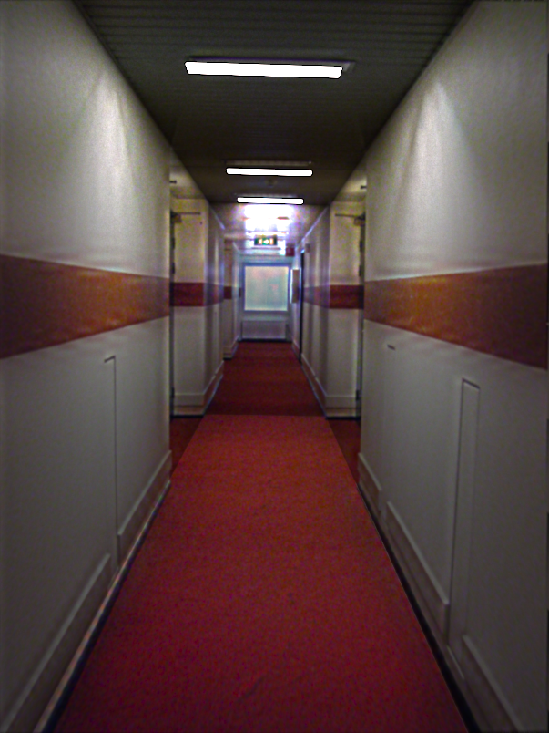
Estimate lighting
Input image
Rendered (initial)
Rendered (final)
Notes:
But system can only approximates the initial value, so there are some errors in initial rendering.
So to optimize lighting parameter value, System adjusts lighting parameters so that the input and rendered images have similar appearance.
As you can see, the final rendered result looks much more like the input than initial rendered result.

Slide 15
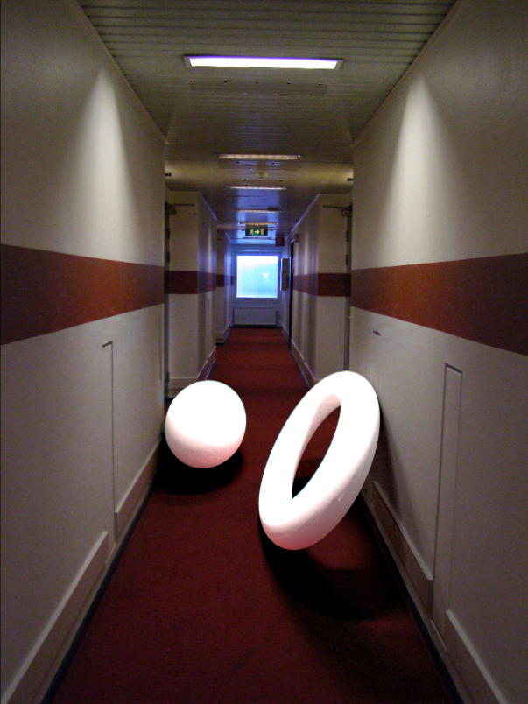
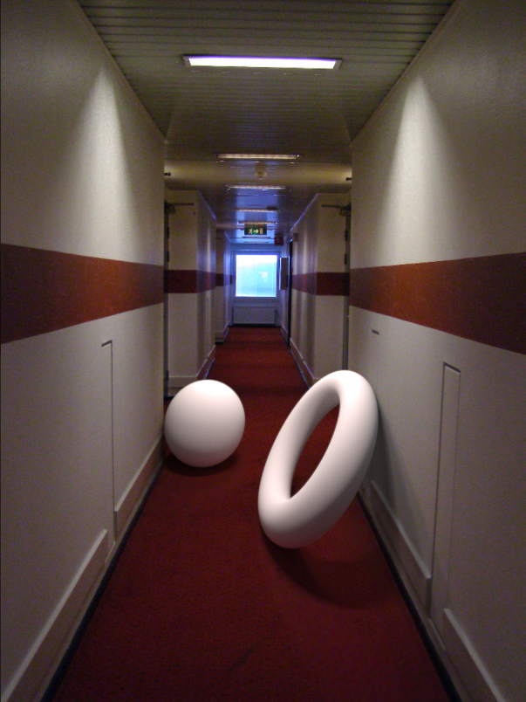
Estimate lighting
Result using initial lights
Result using refined lights
Notes:
Here’s another example. Left is an initial result using the initial lighting parameters, and right is an refined result using the optimized lighting parameters. In the left image, objects are much too bright, but right image, objects are much more natural. So lighting parameters are very important in this technique.

Slide 16
Object insertion
Input image
Object insertion
Scene authoring
Scene synthesis
Notes:
Now we have an estimated 3D model of the scene, so let’s go final procedure.

Slide 17
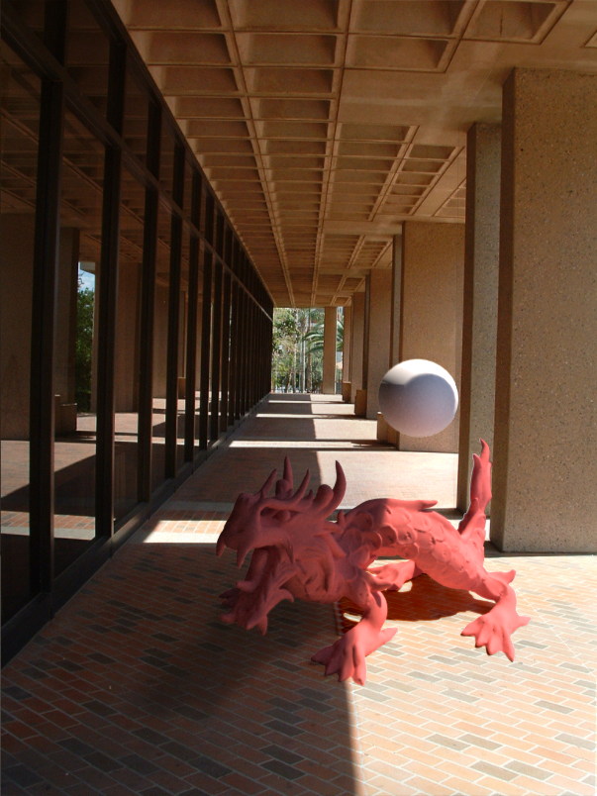

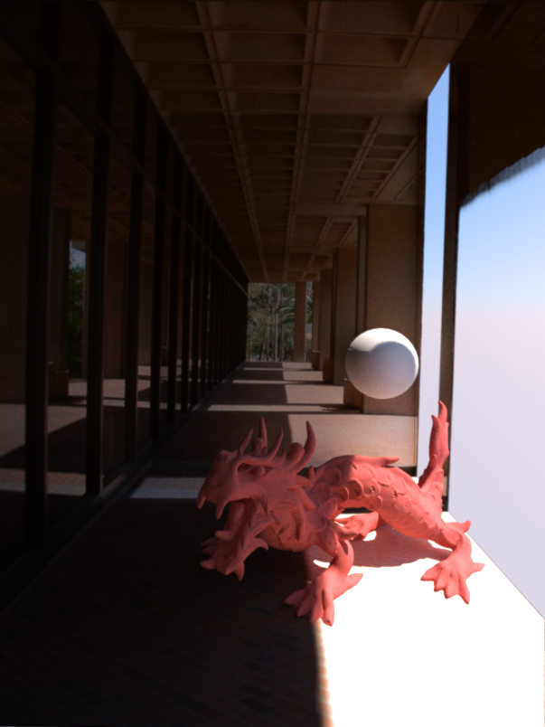

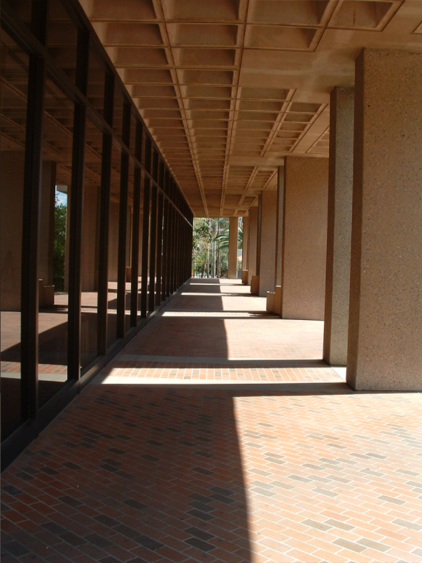
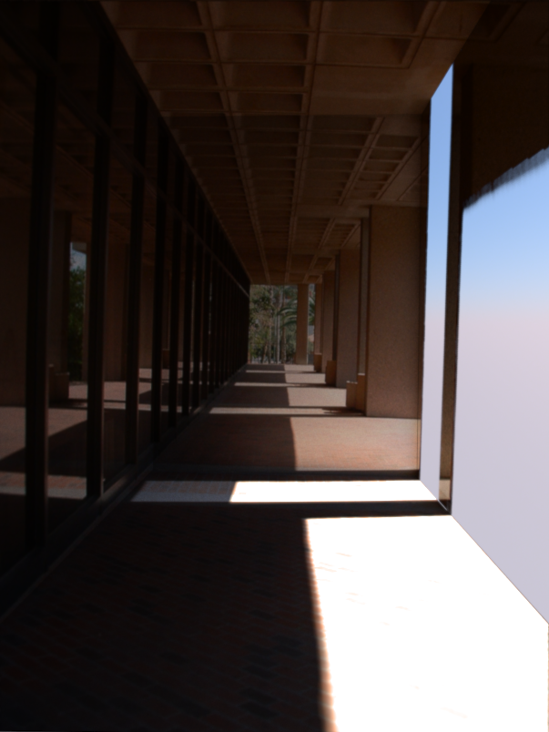
Object insertion
Additive differential technique [Debevec ‘98]
Notes:
After the scene has been rendered, we need to composite the objects into the rendered scene.
Paper’s author do this by using the additive differential technique proposed by Debevec.
This technique equation has two terms. The first term places pixels from the rendered image that are occupied by an inserted object.
And the second term ensures the influence of light source to the object. In other words, second terms makes the shadows and bounced light from the rendered image.
By using this technique, object can be inserted to the scene.

Slide 18
Results
Notes:
OK. Then I will show you some results.
This is a before image.

Slide 19
Results
Notes:
And this is the after image using some objects.

Slide 20
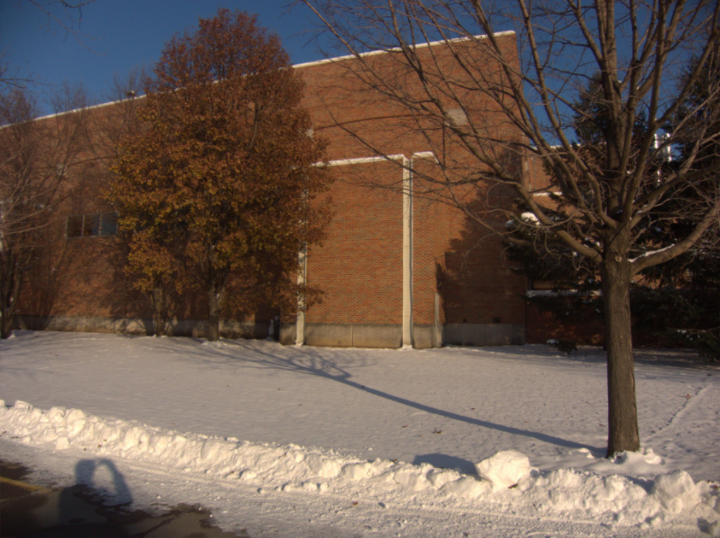
Results
Notes:
This is the before image.

Slide 21
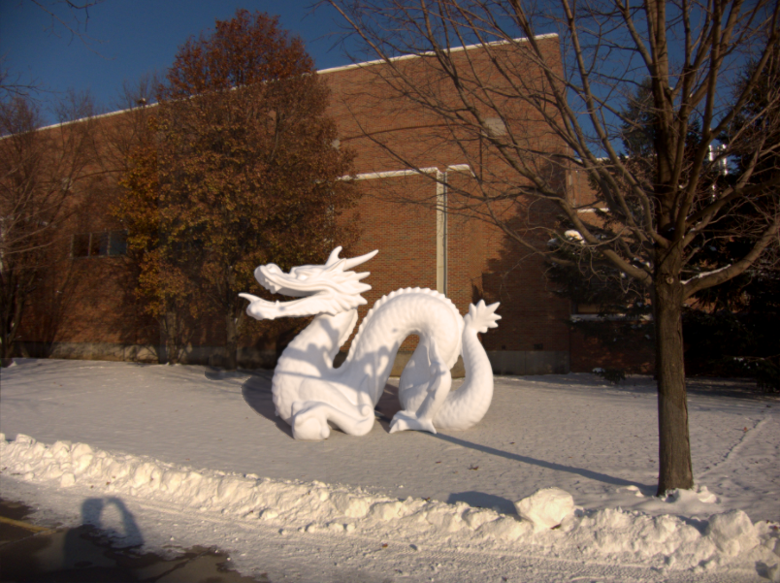
Results
Notes:
Using very popular dragon, the system made this after image.

Slide 22
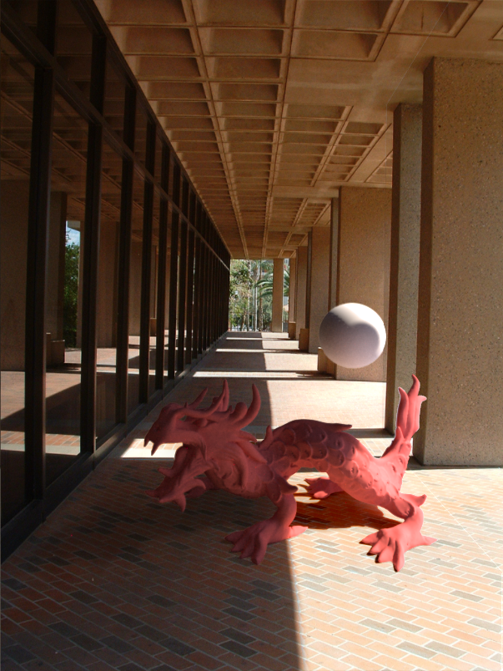
Results
Notes:
Here’s the before and after.

Slide 23

Notes:
But there are some problems with this image.
For example, you can see some red dots in the shadow.
and on the sphere, there is a some odd round shadow.
So that’s the limitation of this paper.

Slide 24
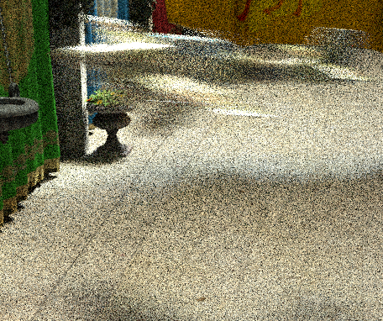
2nd Paper
2nd paper : SURE-based Optimization for Adaptive Sampling and Reconstruction, Tzu-Mao Li, SIGGRAPH Asia 2012.
Problem of Monte Carlo
Integration : If we do not use
enough samples, result will
look noisy.
Notes:
I will move on the second paper. The second paper’s topic starts at problem of Monte Carlo integration.
If we do not use enough samples, result will look noisy because of variances.

Slide 25
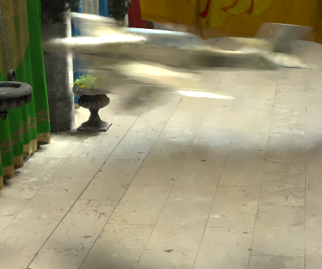
2nd Paper
Good-quality result with fewer samples by adapting samples to different regions (Adaptive Sampling) and filtering (reconstruction) the image.
Monte Carlo, 68 spp, 890 sec SURE-based , 64 spp, 890 sec
Notes:
So, if we use adaptive sampling and filtering the image, then it can produce more good quality result.

Slide 26





Estimate filter error
Converged
$$x_{i}$$
$$y_{i}$$
Mean
Filtered
$$f(y_{i})$$
$$σ_{i}$$
Variance
Notes:
To solve Monte Carlo noise problem, we need to know estimating the error.
Here, each cell represents a pixel.
For each pixel, there are several samples.
y is the pixel value reconstructed from samples.
sigma is the variance between sample and pixel value.
If infinitely many samples are used, then the estimated pixel value y would converge to the true pixel value.
it called x.
But, we can only take a limited number of samples.
When the number of samples are not sufficient, the approximation could be bad.
That is what we called noise.
To address the problem of noise, we need to use x.
However, we cannot use x because sample number is limited.
So we use a filter to average pixels to have a more good estimation.
The filter f is like that.

Slide 27
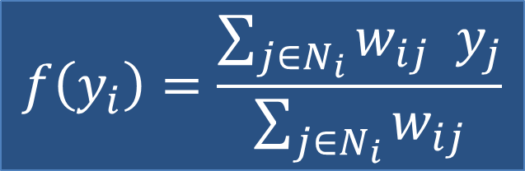
Estimate filter error
Converged
$$x_{i}$$
$$y_{i}$$
Mean
Filtered
$$f(y_{i})$$
$$σ_{i}$$
Variance
Notes:
In this case, cross bilateral filters are used. That filter means weighted average of neighboring pixels.

Slide 28

Estimate filter error
Want to estimate : $E[{(f\left(y_{i}\right)−x_{i})}^{2}]$
E[ ] : Error
$f\left(y_{i}\right)$ : filtered pixel value
$x_{i}$ : true(real) pixel value
Notes:
Now we have shown x, y, sigma and filter f.
So we need to estimate the error of the filtered pixel value f y to the true pixel value x.
It is defined as the squared difference between f y and x.

Slide 29
Estimate filter error
Want to estimate : $E[{(f\left(y_{i}\right)−x_{i})}^{2}]$
E[ ] : Error
$f\left(y_{i}\right)$ : filtered pixel value
$x_{i}$ : true(real) pixel value
Don’t know!
Notes:
However, we don’t know the true pixel value x, so we cannot calculate the error.

Slide 30

SURE
Want to estimate : $E[{(f\left(y_{i}\right)−x_{i})}^{2}]$ = $E[SURE(f(y))]$
E[ ] : Error
$f\left(y_{i}\right)$ : filtered pixel value
$x_{i}$ : true(real) pixel value
SURE = Stein’s Unbiased Risk Estimator
Notes:
Although we cannot calculate the exact error, but we can estimate it.
SURE is an error estimator made by Charles Stein.

Slide 31


SURE
Want to estimate : $E[{(f\left(y_{i}\right)−x_{i})}^{2}]$ = $E[SURE(f(y))]$
E[ ] : Error
$f\left(y_{i}\right)$ : filtered pixel value
$x_{i}$ : true(real) pixel value
$$SURE\left(f\left(y_{i}\right)\right)=$$
$${(f\left(y_{i}\right)−y_{i})}^{2}+2{σ_{i}}^{2}\frac{df(y_{i})}{dy_{i}}−{σ_{i}}^{2}$$
Notes:
This is the definition of SURE.
As you can see, there are not x. So we can estimate the error.

Slide 32
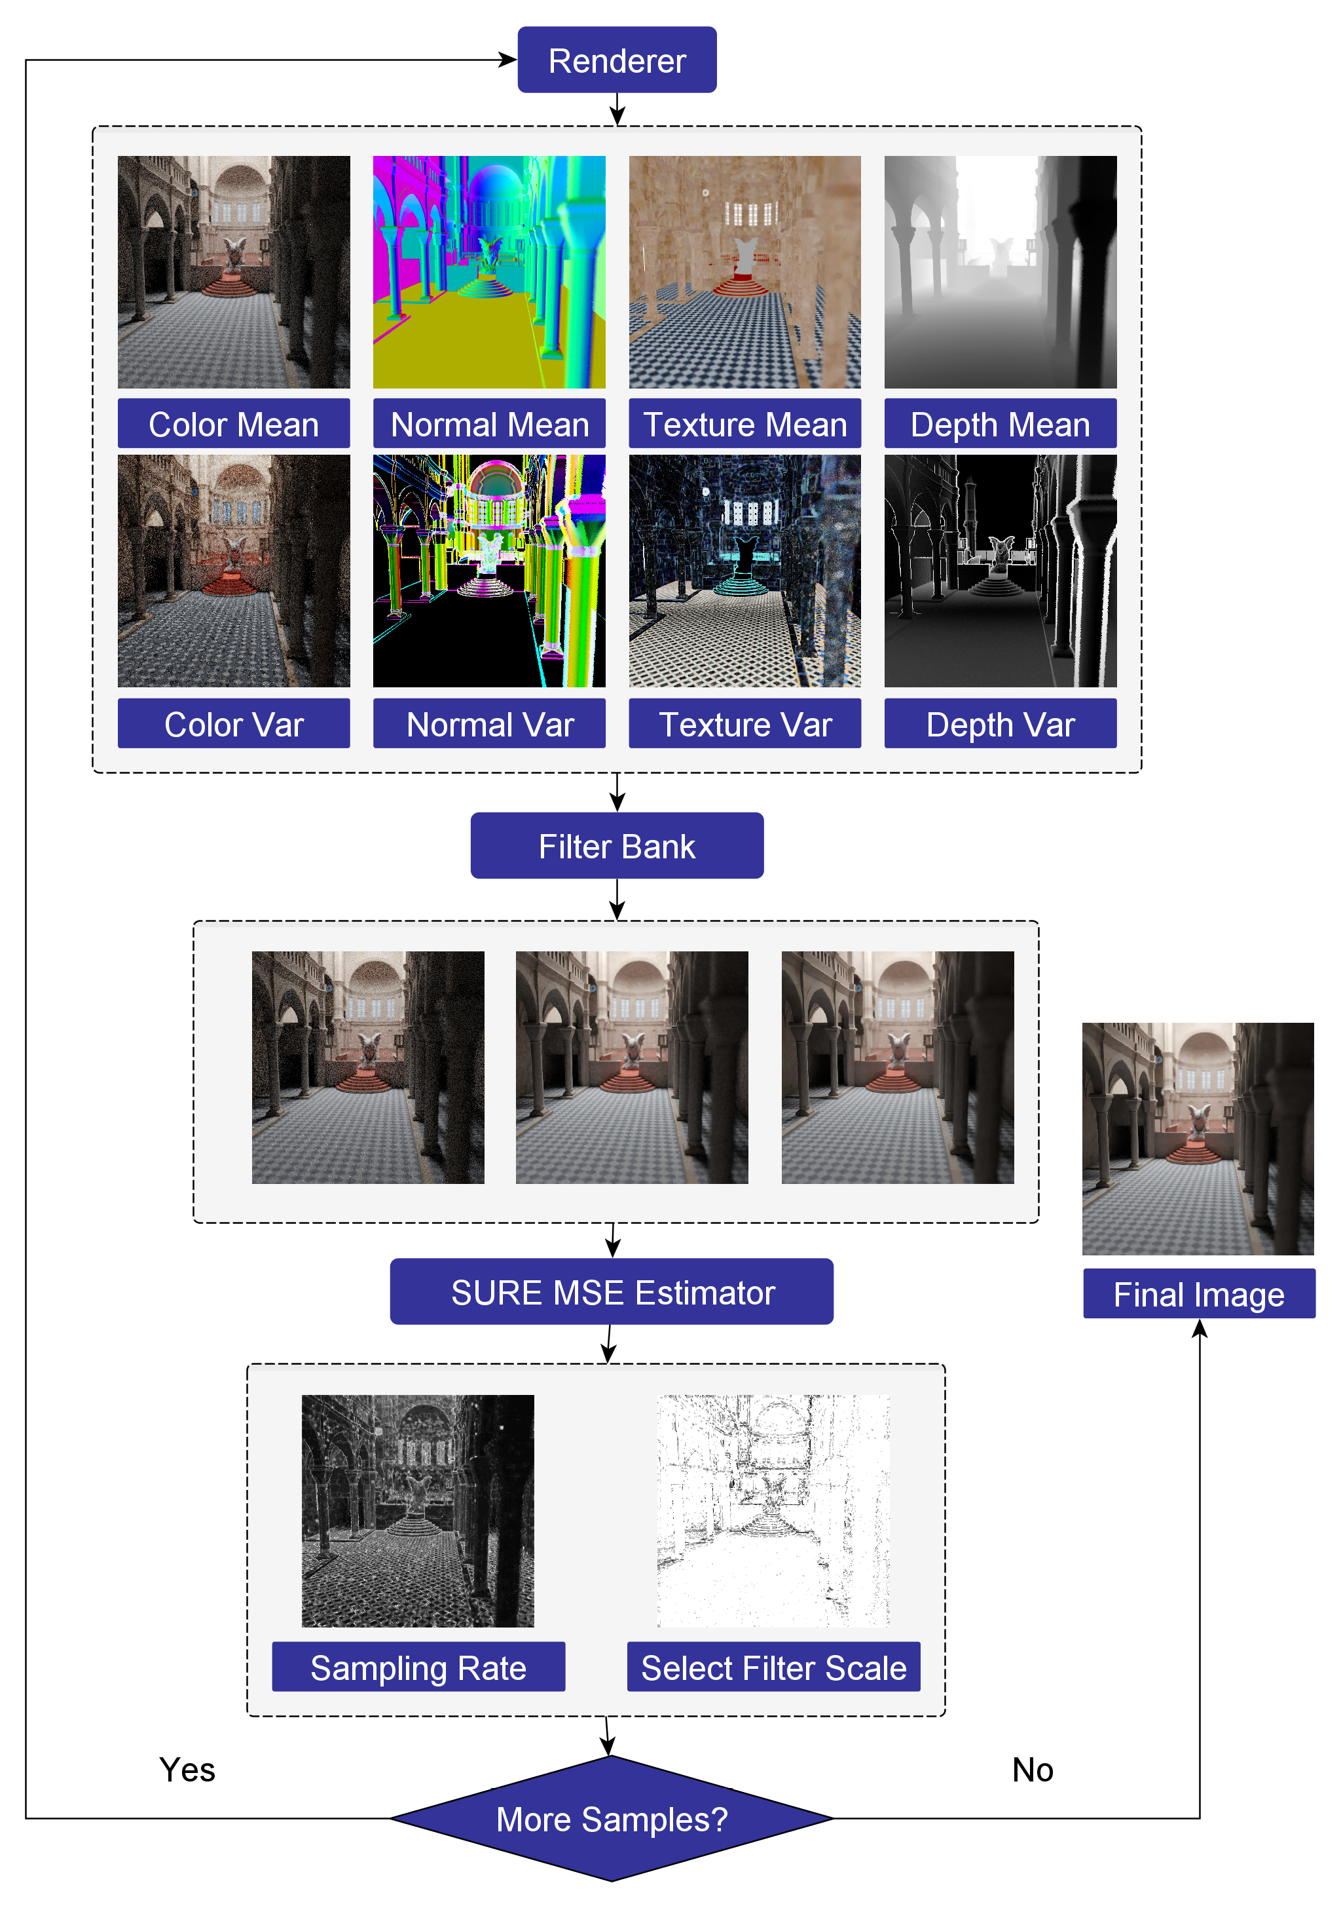
Method
Notes:
Now let’s move on the method.
This figure explains the flowchart of the method.

Slide 33
Method
Starts with rendering a small number
of initial samples
Notes:
It starts with rendering a small number of initial samples for each pixel.

Slide 34
Method
Starts with rendering a small number
of initial samples
Iterates filter selection and sampling
until reaching the target sample number
Notes:
Then iterates filter selection and adaptive sampling stages for each pixel.
It iterates until reaching the target sample number.
During sampling, it collects colors, normal, textures and depths over the image plane.
They are used as the side information for filters in the reconstruction stage.

Slide 35
Method
Starts with rendering a small number
of initial samples
Iterates filter selection and sampling
until reaching the target sample number
Reconstruct a set of images using a
filter bank.
Notes:
After filter selection and sampling stage, reconstruct a set of images using a filter bank.
The filter bank is composed of cross bilateral filters with different value.
Each pixel is filtered multiple times with many filters in the filter bank.

Slide 36
Method
Starts with rendering a small number
of initial samples
Iterates filter selection and sampling
until reaching the target sample number
Reconstruct a set of images using a
filter bank.
For each filtered pixel, the error of pixel
color is estimated by computing SURE.
Notes:
For each filtered pixel, the error of pixel color is estimated by computing SURE.

Slide 37
Method
Starts with rendering a small number
of initial samples
Iterates filter selection and sampling
until reaching the target sample number
Reconstruct a set of images using a
filter bank.
For each filtered pixel, the error of pixel
color is estimated by computing SURE.
If target number of samples (sample
budget) is available, it goes to the
adaptive sampling stage and iterates
this procedure.
Notes:
If more sample budget is available, it goes to the adaptive sampling stage and iterates this procedure.
If not, then the result becomes a final image.

Slide 38
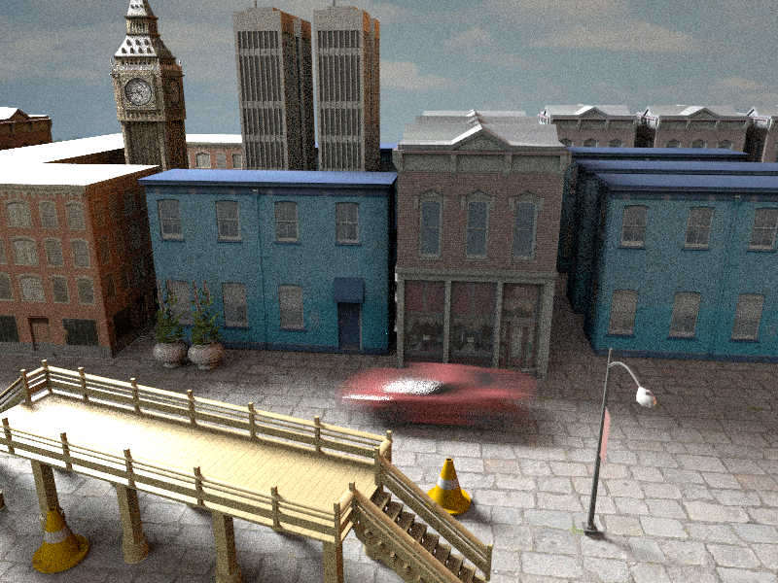

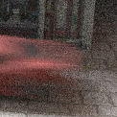
Result : Monte Carlo, 82 spp, 60sec
Notes:
OK. So now let me show result of this method.
This is a noisy image produces by monte carlo ray tracing.

Slide 39
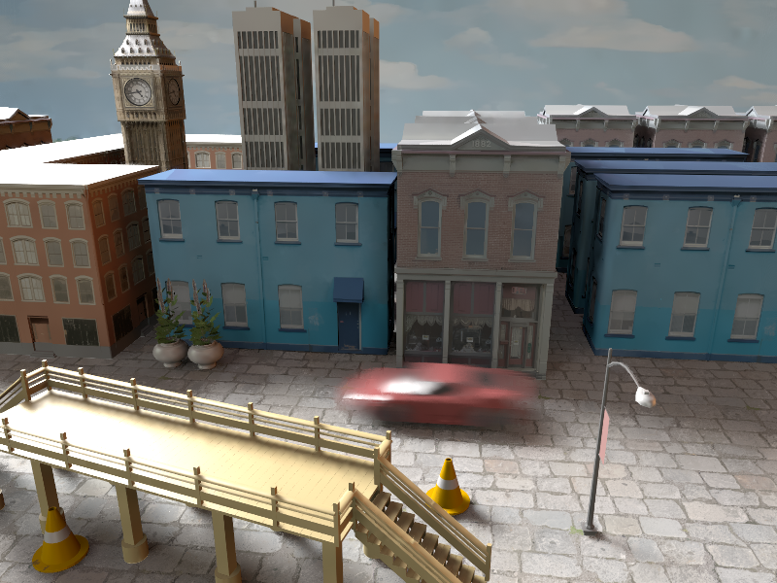


Result : SURE-based, 40 spp, 60sec
Notes:
Given the same amount of time, SURE-based method generates more higher quality image.

Slide 40
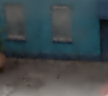


Result : Comparison to GEM
GEM
Average 52 spp
~60 sec
SURE-based
Average 40 spp
~60 sec
Reference
4096 spp
~3000 sec
Notes:
Within the same amount of time, GEM can use more samples than SURE-based, but SURE-based method generates better image.

Slide 41
Q & A
Thank you for your attention !
Notes:
Thank you for your attention. Any questions?

Slide 42
Quiz
1. In rendering synthetic objects stages, Which stage performs the estimating of light source?
a. Input Image
b. Scene Authoring
c. Scene Synthesis
d. Object Insertion
2. Why use the SURE function?
a. to render image
b. to modify filter
c. to estimate filter error
d. to make filter bank

