Slide 1
Differentiable Monte Carlo Ray Tracing
Team 3
Hyunwoo Lee
Hangyeol Yu
Juho Park

Slide 2
Motivation
????

Slide 3
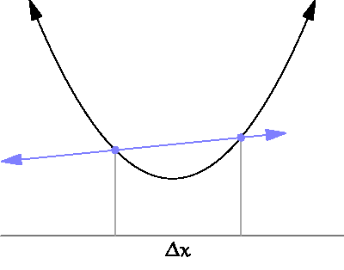
Motivation
How final result changed by small change of given parameter?
If x changes very small, how much f(x) changes?
Derivatives

Slide 4
Differentiable rendering
Object
Camera position
Light position
Pixel Color
Scene
Rendering
$$F :Φ↦I$$
We want to know $∇F$!

Slide 5
Inverse Graphics
Object
Camera position
Light position
Pixel Color
Scene
Rendering
Inverse Graphics

Slide 6
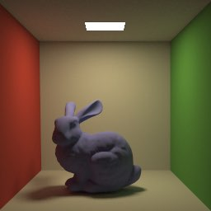
Inverse graphics with Derivatives
From Tzu-Mao’s slides

Slide 7
Inverse graphics with Derivatives
Difference
input
From Tzu-Mao’s slides

Slide 8
Inverse graphics with Derivatives
Difference
render
3D scene
target
From Tzu-Mao’s slides

Slide 9
Pixel Value
I : value of certain pixel
(x, y) : a point on the image plane
k : filter
L : radiance
Φ : scene parameter
f : scene function

Slide 10
Pixel Value
I : value of certain pixel
(x, y) : a point on the image plane
k : filter
L : radiance
Φ : scene parameter
f : scene function

Slide 11
Pixel Value
f may not be differentiable !
The integral of f is differentiable.

Slide 12
Pixel function f is discontinuous
θ : Heaviside step function (0 or 1 value)
$α_{i}$ : region-defining equation
$f_{i}$ : differentiable component of f on the region defined by $α_{i}$
$$(x,y)$$
$$f_{1}$$
$$f_{3}$$
$$f_{2}$$
$$∇I= ∇\sum_{i}{\iint{θ\left(α_{i}\left(x, y;Φ\right)\right)f_{i} \left(x, y;Φ\right)\text{dxdy}}}$$

Slide 13
Key Idea
$$I= \iint{θ(α(x, y;Φ))f(x, y;Φ) }$$
$$I= \iint_{A(Φ)}{f(x, y;Φ) }$$
$∇I$ = (internal change) + (change of region)
= $\iint_{A(Φ)}{∇f(x, y;Φ) }$ + $\int_{∂A\left(Φ\right)}{f\left(x, y;Φ\right)\vec{v}∙ds}$

Slide 14
Key Idea (Leibniz’s rule)
$$\vec{v}$$
$$I= \iint{θ(α(x, y;Φ))f(x, y;Φ) }$$
$$I= \iint_{A(Φ)}{f(x, y;Φ) }$$
$∇I$ = (internal change) + (change of region)
= $\iint_{A(Φ)}{∇f(x, y;Φ) }$ + $\int_{∂A\left(Φ\right)}{f\left(x, y;Φ\right)\vec{v}∙ds}$
color change
when blue triangle
moves up?

Slide 15
MC Estimator of Gradient
N : number of samples on edges
M : number of samples in the total area
∥E∥ : length of the edge E
P (E) : the probability of selecting edge E.
(change of region)
(internal change)
$$+ \frac{1}{M}\sum_{k=1}^{M}{\frac{θ\left(α_{i}\left(x_{k}, y_{k};Φ\right)\right){∇f}_{i}\left(x_{k}, y_{k};Φ\right)}{1/(Area of pixel)}}$$

Slide 16
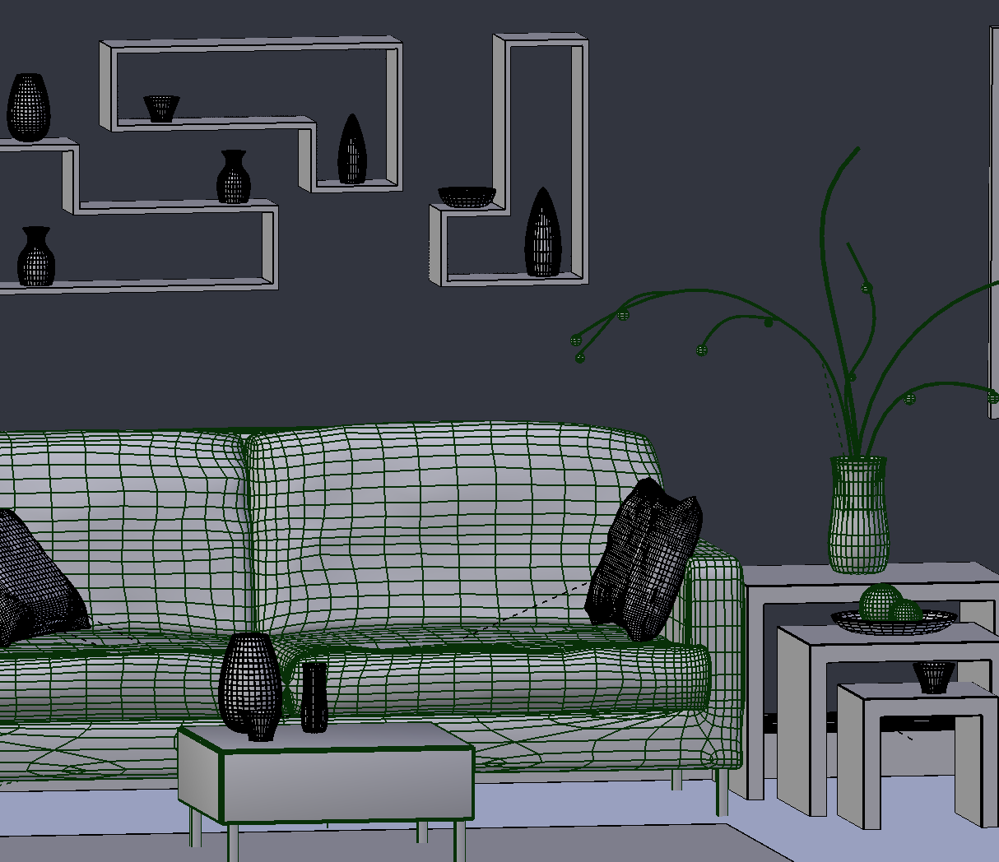
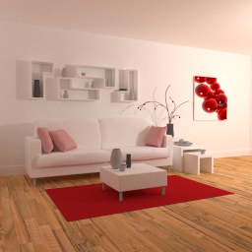
Gradients update the 3D scene
evaluation
Update $Φ$
update
L1 distance
3D scene:
triangle positions
camera pose
materials
…
image
∇ loss
target
From Tzu-Mao’s slides
Notes:
You then update the 3D scene using the gradients of a loss function, so it minimizes the distance between your output and the target.
(pause)

Slide 17
Synthetic examples - global illumination
optimize camera
initial guess
target
From Tzu-Mao’s slides
Notes:
Here we optimize for the camera pose on a more realistic scene.

Slide 18
Our Plan
Edge sampling -> volume integration
Denoising intermediate images
Pixel(scene) prediction

Slide 19
Sampling edge -> Volume integration
$$I=$$
$$∇I\text{ = (}\text{internal} \text{change}\text{) + (}\text{change} \text{of} \text{area}\text{) =}\iint_{A(Φ)}{∇f(x, y;Φ) }\text{ + }\int_{∂A\left(Φ\right)}{f\left(x, y;Φ\right)\vec{v}∙ds}$$
By Stokes’ Theorem,
$$I=\int_{∂A\left(Φ\right)}{f\left(x, y;Φ\right)\vec{v}∙ds}=\iint_{A(Φ)}{∇∙(f\left(x, y;Φ\right)\vec{v})}$$

Slide 20
Sampling edge -> Volume integration
$$∇I\text{ = }\iint_{A(Φ)}{∇f\left(x, y;Φ\right)+∇∙\left(f\left(x, y;Φ\right)\vec{v}\right) dxdy}$$
Single integral !

Slide 21
Sampling edge -> Volume integration
Pros
It is still unbiased estimator of the gradient
No need to keep edge information
No samples on the edges
We can easily generalize this method to higher dimensional version (Motion blur)
Cons
It may increase the variance.
Possibly more computation

Slide 22
Denoising intermediate images
What if we use images with less noise?
Our hypothesis:
Less noise may increase speed of convergence.

Slide 23
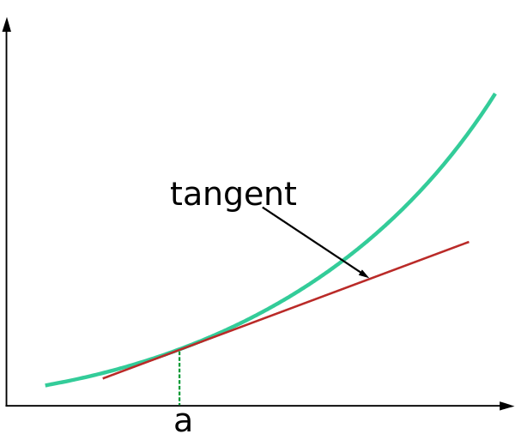
Pixel prediction
$$f\left(x\right)≈f\left(a\right)+f′(a)(x−a)$$

Slide 24
Pixel prediction
Re-rendering!

Slide 25
Pixel prediction
$$∇F$$
$$F(Φ)$$
$$F(Φ′)$$

Slide 26
Thanks

Slide 27
References
[1] TZU-MAO LI, MIIKA AITTALA, FREDO DURAND, JAAKKO LEHTINEN, Differentiable Monte Carlo Ray Tracing through Edge Sampling, SIGGRAPH 2018
https://people.csail.mit.edu/tzumao/diffrt/
SIGGRAPH powerpoint (Very highly informative): https://people.csail.mit.edu/tzumao/diffrt/redner_sigasia.pptx
https://ps.is.tuebingen.mpg.de/research_projects/inverse-graphics-proj
Brief explanation about inverse rendering: https://slideplayer.com/slide/4979698/

