Slide 1
Path Guiding for
Participate Media
20193169 김현수
20193512 임주원

Slide 2
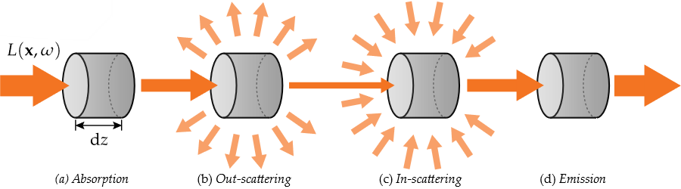
Introduction
Participate media
  Includes cloud, smoke, liquid etc.

Slide 3
Purpose
We want to explore accelerating technique for light-transport simulation in participate media.
High cost of accessing voxel data and high-albedo of volumes make challenge for simple MC methods.
There are machine learning technique to learn distance and directional samples proposed for surface rendering.
What if to apply the sampling technique to participate media?

Slide 4
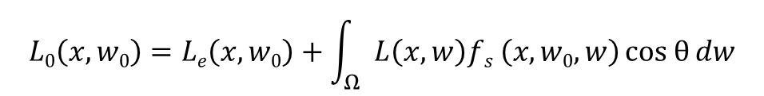
Practical path guiding for efficient light-transport simulation
Approximate the representation of scene’s incident radiance field from learning.
Proposed adaptive spatio-directional hybrid data structure, SD-tree.
This is BSDF term
Rendering equation
$$L0\left(x, w0\right)=Le\left(x, w0\right)+\int_{Ω}{L\left(x, w\right)fs \left(x, w0, w\right)cos θ{dw}}$$
This term will be approximated by learning
Muller, T., Gross, M., Novak, J.: Practical path guiding for efficient light-transport simulation. ´ In: Proceedings of the Eurographics Symposium on Rendering (2017)

Slide 5
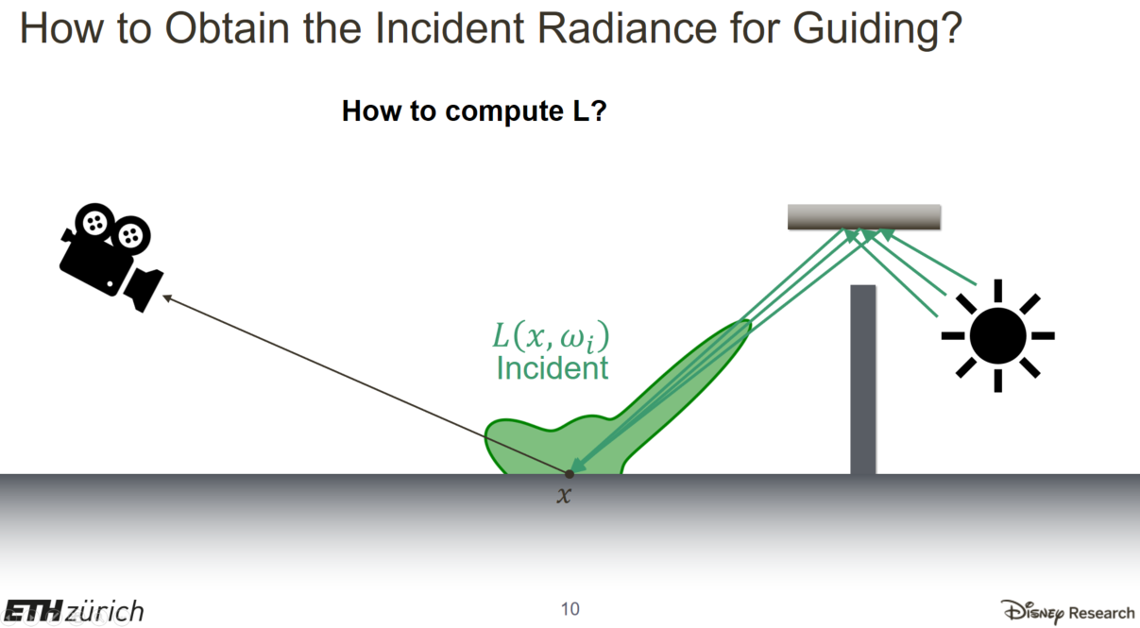
PPT slide Jan Novak’s homepage : http://drz.disneyresearch.com/~jnovak/publications/PathGuide/index.html

Slide 6
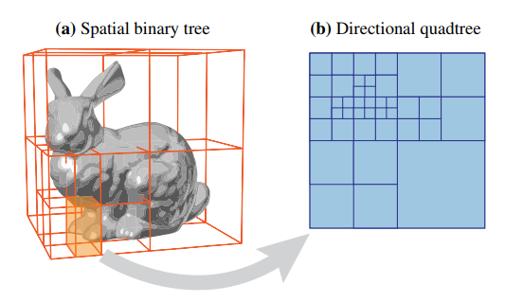
Practical path guiding for efficient light-transport simulation
Spatio-directional tree (SD-tree) consist of two level tree.
  Binary tree that partitions the 3D space domain of the light field
  Quadtree that partition the 2D directional domain of the light field
Muller, T., Gross, M., Novak, J.: Practical path guiding for efficient light-transport simulation. ´ In: Proceedings of the Eurographics Symposium on Rendering (2017)

Slide 7
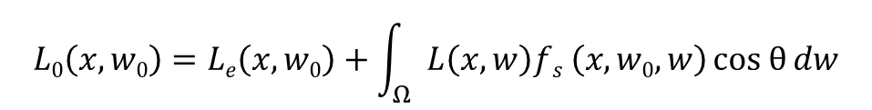
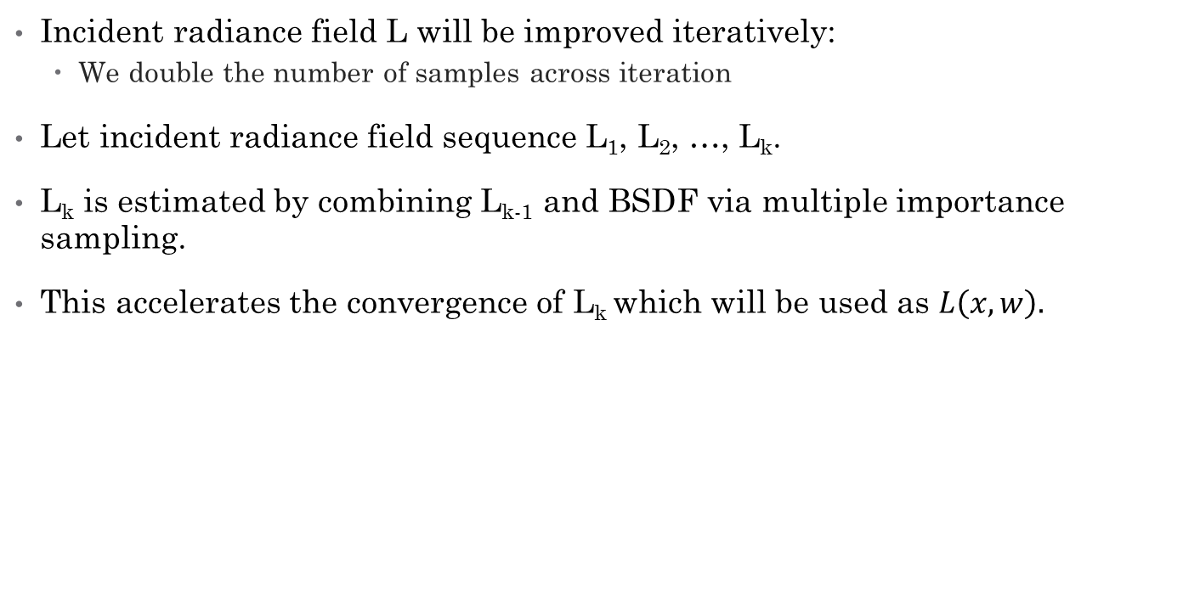
Practical path guiding for efficient light-transport simulation
Incident radiance field L will be improved iteratively:
  We double the number of samples across iteration
Let incident radiance field sequence L₁, L₂, …, L_{k}.
L_{k} is estimated by combining L_{k-1} and BSDF via multiple importance sampling.
This accelerates the convergence of L_{k} which will be used as $L\left(x, w\right).$
Rendering equation
$$L0\left(x, w0\right)=Le\left(x, w0\right)+\int_{Ω}{L\left(x, w\right)fs \left(x, w0, w\right)cos θ{dw}}$$
Muller, T., Gross, M., Novak, J.: Practical path guiding for efficient light-transport simulation. ´ In: Proceedings of the Eurographics Symposium on Rendering (2017)

Slide 8
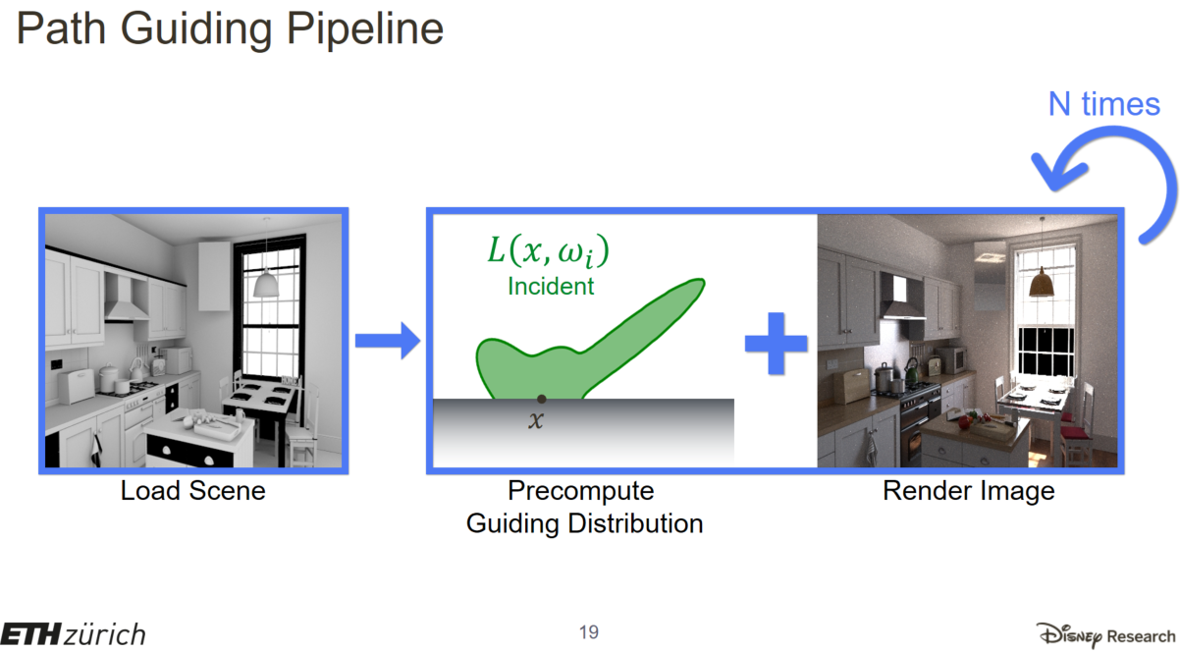
PPT slide Jan Novak’s homepage : http://drz.disneyresearch.com/~jnovak/publications/PathGuide/index.html

Slide 9
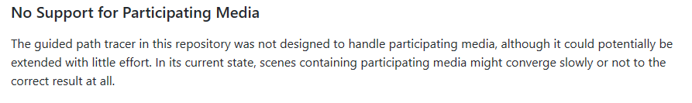
Path guiding for participate media
The authors choose to build radiance field on spherical directional domain, other than hemispherical one
  The method can be possibly generalized into volumetric path tracing
However, in the authors’ implementation, the feature was opted out
We could not find the exact reason why it fails for participate media in the paper or the implementation

Slide 10
Our goal
Extend the current implementation to support participate media
  (Hopefully with little effort, as the original authors mentioned)
Figure out what causes the poor performance for volumetric path tracing
Come up with the idea to fix the problem
Implement our solution into current implementation

Slide 11
What we have done
Read through the paper
Downloaded the authors’ implementation
  https://github.com/Tom94/practical-path-guiding
  Contains the renderer and the SD-tree visualizer
Set up the build environment
Now we are able to:
  Render a sample scene using the authors’ method
  Inspect the SD-tree of each iteration using included visualizer

Slide 12
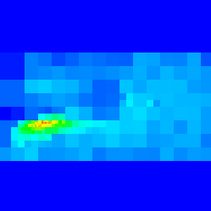
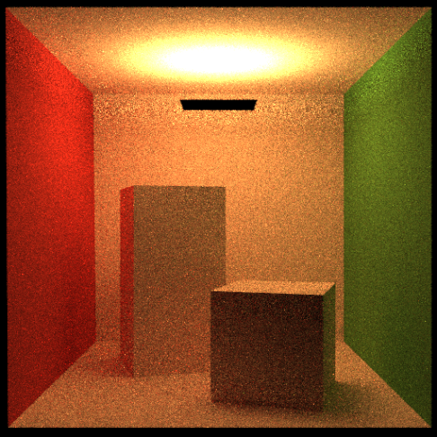
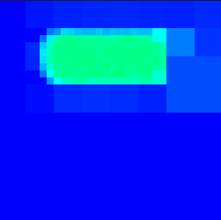
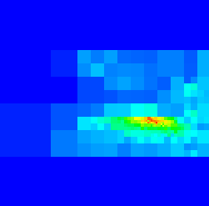
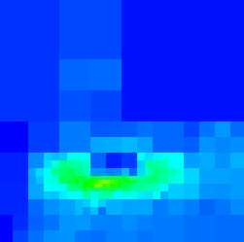
What we have done
Rendered example scene, containing illumination dominated by indirect illumination
Inspect the directional quad-tree of each point in the scene

