Slide 1
Position-free monte carlo simulation for arbitrary layered BSDFs
Hyunwoo Lee

Slide 2
Motivation-BRDF
$$Ψ$$
$$Θ$$
$$x$$
$$f_{r}\left(x,Θ,Ψ\right)=\frac{dL(x→Θ)}{dE(x ←Ψ)}$$

Slide 3
Motivation-BSDF
$$Ψ$$
$$Θ_{1}$$
$$x$$
$$Θ_{2}$$

Slide 4
Motivation-Multi layer surface
………….
How can we model this situation??

Slide 5
Past work and their problem
Significant approximations (Weidlich and Wilkie , 2007)
Super expensive (Jakob et al. , 2014)

Slide 6
Assumption - BSDF
Ignore!
$$Δx$$
Whole situation can be modeled by single BSDF!

Slide 7
Assumption – Position free
They are all same in local

Slide 8
Light path and path integral
$$d_{0}$$
$$d_{1}$$
$$d_{0}$$
$$d_{0}$$
$$d_{3}$$
$$z_{1}$$
$$z_{1}$$
$$z_{1}$$
$$z_{3}$$
$$d_{1}$$
$$d_{1}$$
$$d_{2}$$
$$z_{2}$$
$$z_{2}$$
$$d_{2}$$
$$\overline{x_{1}}=(d_{0},z_{1},d_{1})$$
$$\overline{x_{2}}=(d_{0},z_{1},d_{1},z_{2},d_{2})$$
$$\overline{x_{3}}=(d_{0},z_{1},d_{1},z_{2},d_{2},z_{3},d_{3})$$

Slide 9
Light path and path integral
$Ω\left(ω_{i},ω_{0}\right)$: The set of every light path starts from direction $ω_{i}$ to $ω_{0}$
$$f_{l}\left(ω_{i},ω_{0}\right)=\int_{Ω\left(ω_{i},ω_{0}\right)}{f(\overline{x}})dμ(\overline{x})$$
-> Monte Carlo Simulation

Slide 10
Monte Carlo simulation for Path Integral
Sampling
Evaluation
Pdf computation

Slide 11
Sampling
Sample outgoing direction at first
$$f_{l}\left(ω_{i},ω_{0}\right)=\int_{Ω\left(ω_{i},ω_{0}\right)}{f(\overline{x}})dμ(\overline{x})$$

Slide 12
Sampling
Sample $ω_{i}$ by path tracing
$$ω_{i}$$
$$ω_{0}$$
$$f_{↑}$$
$$f_{↓}$$

Slide 13
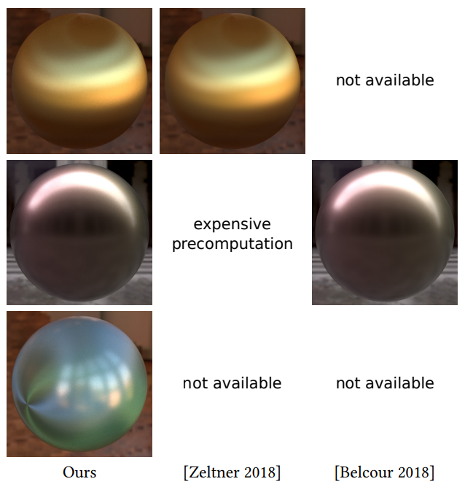
Result

Slide 14
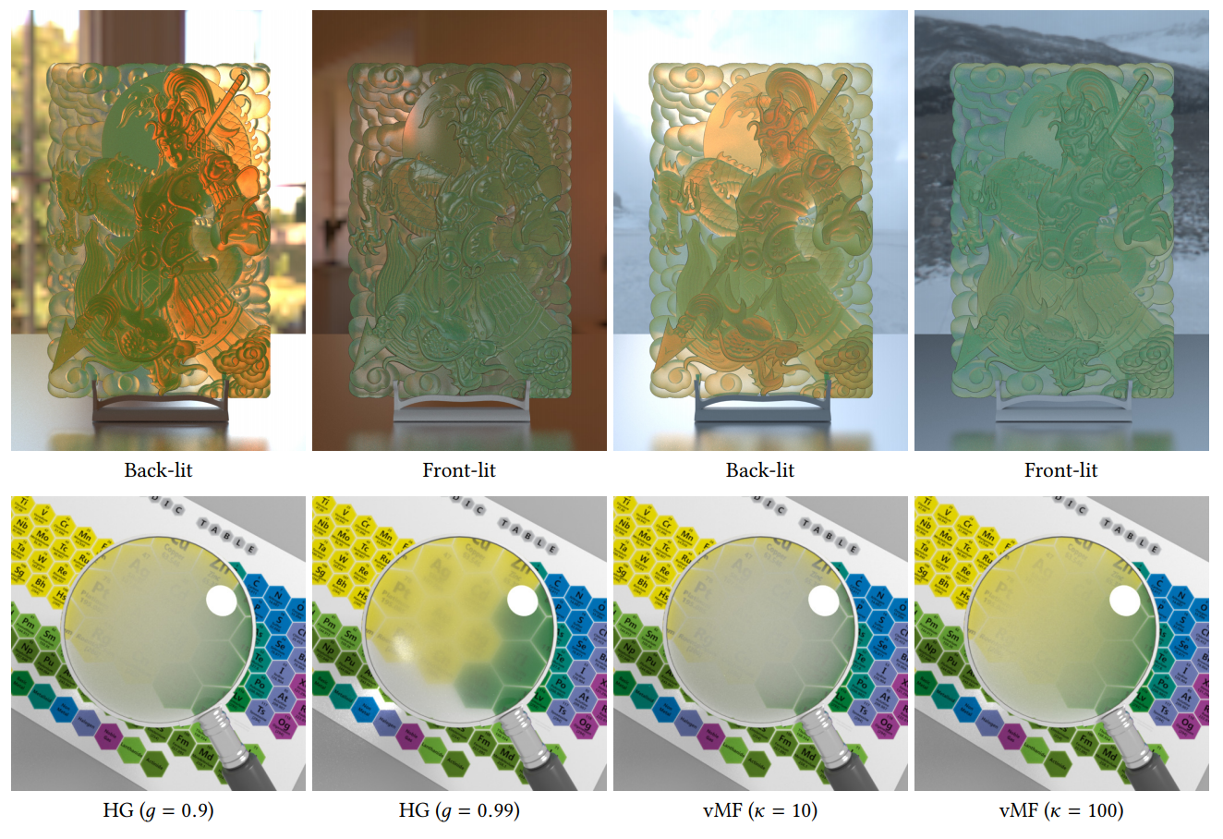
Result

Slide 15
FEPR: fast energy projection for real-time simulation of deformable objects
Hyunwoo Lee

Slide 16
Before we start…
Position Data
Camera
Light
Scene
Rendering

Slide 17
Physical state
Position $x_{i}$
Velocity $v_i$
By solving differential equations, we can explicitly know such function
-> We can know the physical state fully for every time in future.
They are function of time $t$

Slide 18
Physics based animation
For every frame, position and momentum of particle are changed by rule of physics.
For every time, we render the such position data.

Slide 19
Numerical Method
$x$: Physical State
From known value $x\left(t\right),$try to compute $x\left(t+Δt\right)$
Explicit Method
$$x\left(t+Δt\right)=F(x\left(t\right))$$
Implicit Method
$$G(x\left(t\right),x\left(t+Δt\right))=0$$

Slide 20
Motivation
How long does it takes?
0.05 seconds per each
0
$$Δt$$
$$2Δt$$
$$3Δt$$
$$4Δt$$
Explicit method -> Cannot guarantee the FPS.

Slide 21
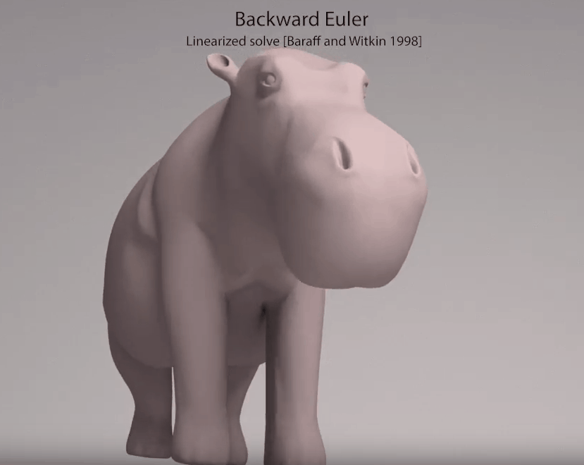
Numerical Damping
Why? -> Total energy exploded during computation!

Slide 22
Projection method
$X$ : Vector of position of all particles in system.
$V$ : Vector of velocity of all particles in system.
$H(X,V)$ : Total energy of system
$P(X,V)$ $=$ $\sum_{i}{m_{i}v_{i}}$ : Total linear momentum of system
$L\left(X,V\right)=\sum_{i}{x_{i}×m_{i}v_{i}}$: Total angular momentum of system
Compute $X\left(t+Δt\right),V(t+Δt)$ by any implicit method
If $H\left(X\left(t+Δt\right),V\left(t+Δt\right)\right)≠H\left(X\left(t\right),V\left(t\right)\right)$, change the value slightly.

Slide 23
Projection method
$$Let X_{n}=X\left(t\right), { X}_{n+1}=X(t+Δt)$$
Find $X,V,s,t$ to minimize
$${\frac{1}{2}\left|\left|X−X_{n+1}\right|\right|}^{2}+\frac{h^{2}}{2}{\left|\left|V−V_{n+1}\right|\right|}^{2}+\frac{ε}{2}(s^{2}+t^{2})$$
Which satisfy following condition.
$$H\left(X,V\right)=H\left(X_{n},V_{n}\right)$$
$$P\left(V\right)=P\left(V_{n+1}\right)+s(P\left(V_{n}\right)−P\left(V_{n+1}\right))$$
$$L\left(X,V\right)=L\left(X_{n+1},V_{n+1}\right)+t\left(L\left(X_{n},V_{n}\right)−L\left(X_{n+1},V_{n+1}\right)\right) \\ ε=cmr^{2}$$

Slide 24
Advantage of FEPR method
It guarantees that no explosion occurs
This method can be equipped to any numerical solver you used before
It does not need so much computation time

Slide 25
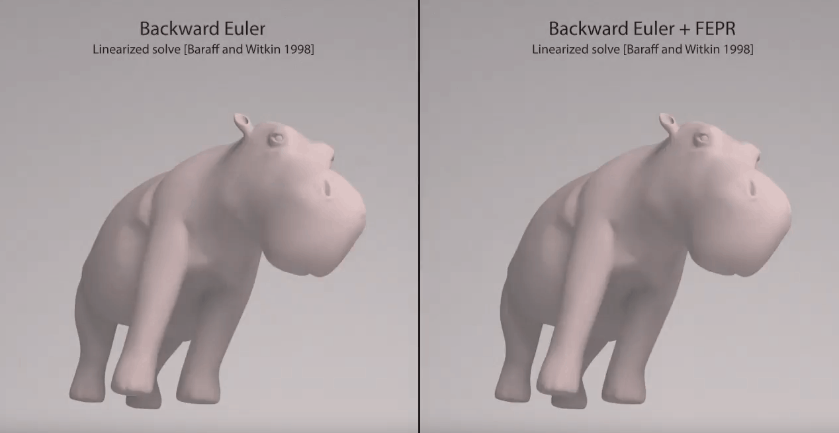
Result

Slide 26
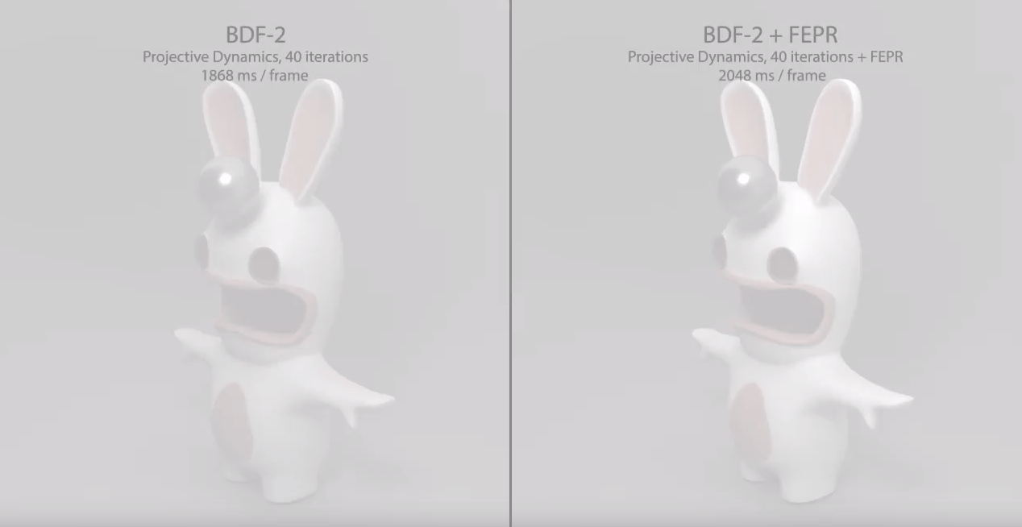
Result

Slide 27
Result

Slide 28
Thank you!

Slide 29
Quiz
What is the two assumptions of method using in part1?
Which of those cannot guarantee the FPS?
a. Explicit method
b. Implicit method

