Slide 1
MLT using inverse mappings
“Charted Metropolis Light Transport”, J. Pantaleoni, ACM, 2017
“Reversible Jump Metropolis Light Transport Using Inverse Mappings”, B. BITTERLI et al., ACM, 2017
Juho Park
30/Apr/2019
Notes:
Hi, I’m Juho Park. My student presentation is about Metropolis Light Transport using inverse mappings.

Slide 2
Review
Rendering volumes by Hyunsoo Kim
Decomposition tracking
Lighting grid hierarchy (LGH)

Slide 3
Decomposition tracking
Distance sampling with closed-form tracking
Control medium (homogeneous)
Distance sampling with delta tracking
Only lookup if $d_{r}<d_{c}$
Original medium
Residual medium + fictitious medium

Slide 4
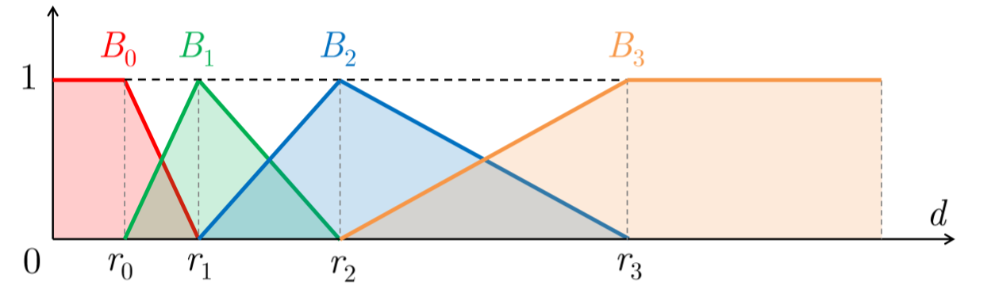
Lighting grid hierarchy
Lights in each level has a limited range
Efficient computation!
Smooth blending
☺ Avoid binary decision → Spatially coherent

Slide 5
Contents
Introduction
Reversible Jump Metropolis Light Transport Using Inverse Mappings
Charted Metropolis Light Transport
Notes:
First, I’ll briefly recover the preliminaries of metropolis light transport and then move on to the papers, “Charted Metropolis Light Transport” and “Reversible Jump Metropolis Light Transport Using Inverse Mappings.”

Slide 6
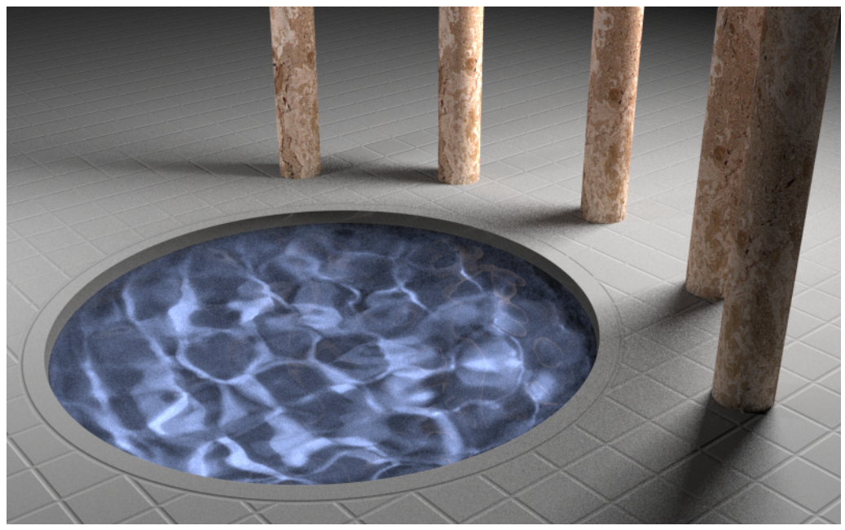
Introduction
Metropolis Light Transport
Notes:
So, to start with, let’s assume that we want to render this scene. This kind of scene is very hard to render because there are so many light paths between the light source and the eye. Consider that the light goes through the wood rod, to the water surface, and the ground below the water, and the water surface again. Like this, there are conceptually infinite number of light paths required to render this scene. That’s why we need Metropolis sampling method to efficiently sample the light paths that effectively contributes to the scene.

Slide 7
Light path
Light path X = (x0, x1, …, x3) for length=3
$f_{s}$: BRDF
Notes:
Light path means the ray path from the light source to the observer. In this illustration, the light goes through source x0 to the x1 and reflected from x1, multiplied by BRDF function fs, and go over to x2, multiplied by G, which contains distance and visibility function. In this scheme, we can formulate measurement for pixel of an image.

Slide 8
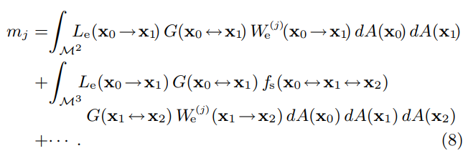
Measurement function
Rendering equation
Measurement equation
Measurement equation (path integral)
Notes:
The measurement equation for pixel j is defined by an integral of energy through the entire space of light path. To transform this equation into path integral, we use rendering equation. By recursive expanding of rendering equation, we can separate the measurement equation to the integrals on different length of light paths.

Slide 9
Measurement function
Ex)
Notes:
The measurement function then can be re-written in simplified form. Large X denotes the light path from x0 to 타, du represents the differential area components, and 러 is for the energy transport through the light path.
The important part here is f, measurement contribution function. This function will be the integrand of Monte Carlo integration.

Slide 10
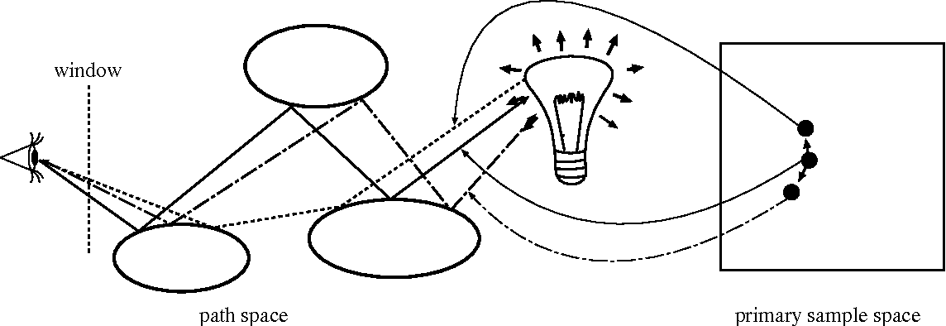
Primary sample space MLT
Mapping from primary sample space to path space
Change in primary sample space results in light path alteration in path space
Notes:
Primary sample space MLT uses mapping from primary sample space to path space. The elements in primary sample space are probability variables from uniform probability distribution function. Each element in primary sample space represents certain light path in path space.

Slide 11
Primary sample space MLT
Sampling technique S
Primary sample space u
Target function C
(integrand of Monte Carlo integration)
Notes:
Mathematically, primary sample space u is summation of primary sample space with light path length k. Light path x is sampled from u in primary sample space. The target function C is a combination of measurement contribution function f and sampling function S.

Slide 12
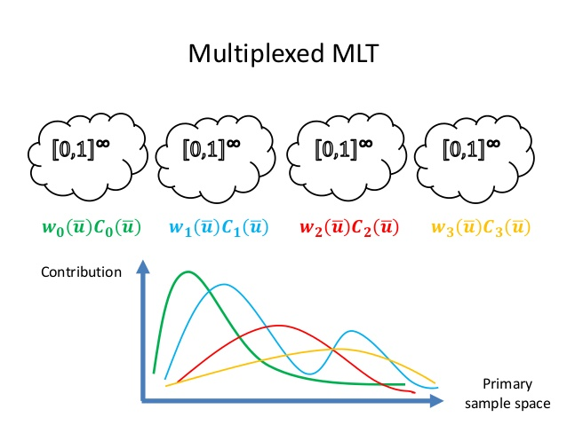
Multiplexed MLT
Target function using
single sampling technique
Target function using
different sampling techniques j
Notes:
Multiplexed MLT uses different sampling techniques simultaneously and yield an weighted average for each sampling techniques.

Slide 13
Reversible Jump Metropolis Light Transport Using Inverse Mappings
Notes:
Let’s move on to the first paper, reversible jump metropolis light transport using inverse mappings.

Slide 14
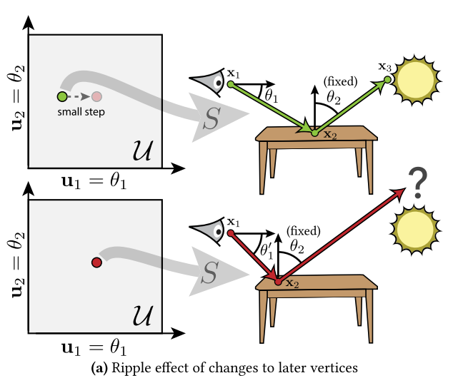
Limitation of PSSMLT
Small perturbation in primary sample space (PSS) can result in large change of light path
In such case, switching to different sampling strategy can be useful
Notes:
There are fundamental issues in using primary sample space MLT. As you can see, small change in primary sample space can greatly alter the light path, propagating a ripple effect for later vertices. In this situation, the last vertex x3 largely deviates from its original position, requiring additional treatment to the path space. In such case, switching to different sampling strategy can be useful.

Slide 15
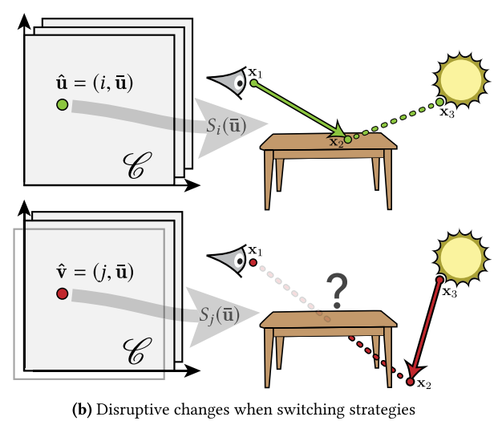
Limitation of PSSMLT
However, changing to other sampling strategy is highly likely to be rejected because light path changes a lot
Path geometry should be intact -> Reverse Jump MLT
Notes:
However, merely changing to different sampling strategy can be dangerous, because it is highly likely to be rejected as light path changes a lot. If there is a technique that leaves the light path geometry intact, the rejection rate would be significantly decreased. So there comes the reverse jump MLT.

Slide 16
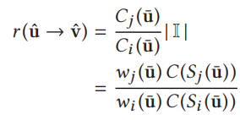
Reverse Jump
Try: change sampling technique only
Technique i -> j
In general, , therefore leads to large amount of change
Therefore, unlikely to be accepted

Slide 17
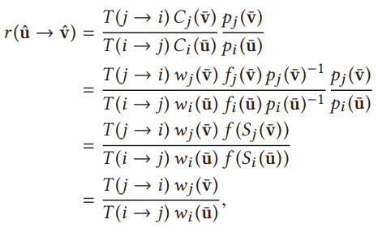
Reverse Jump
Find such that
Then, acceptance rate leads to
Assume sampling technique is invertible (deterministic scheme)
By choosing , acceptance rate becomes 1

Slide 18
RJMLT algorithm

Slide 19
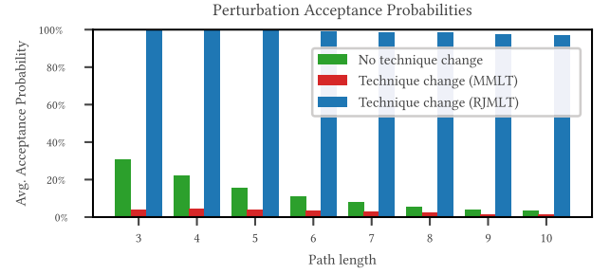
Result: acceptance rate

Slide 20
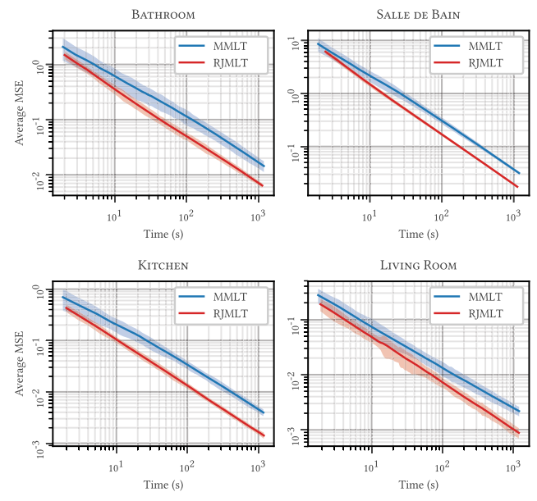
Result: average MSE

Slide 21
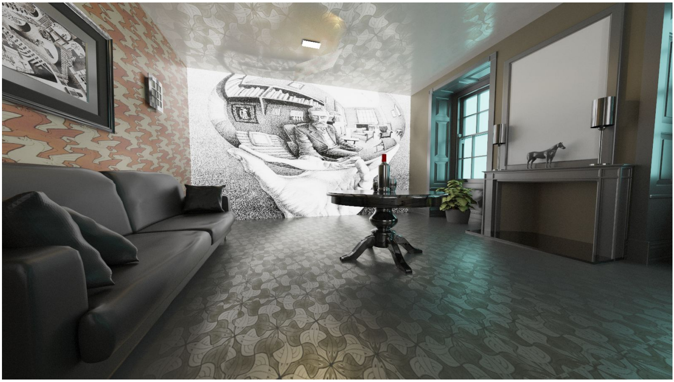
Charted Metropolis Light Transport

Slide 22
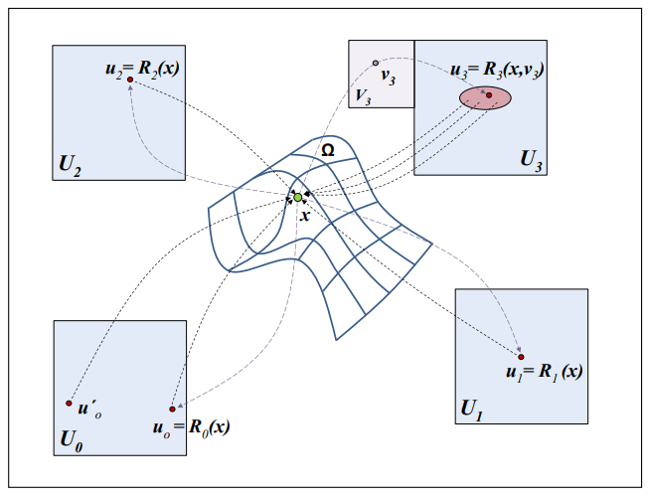
Sampling chart
Allow swap bidirectional sampling techniques
Unlike RJMLT, path sampling function need not be invertible
Get out of local maxima to other sampling techniques

Slide 23
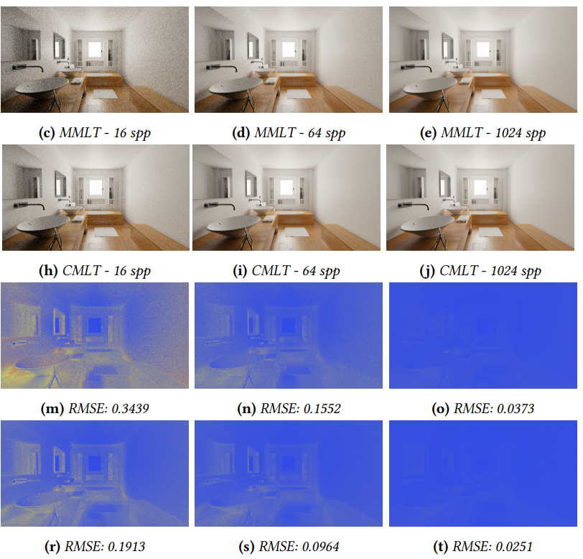
Result: RMSE

Slide 24
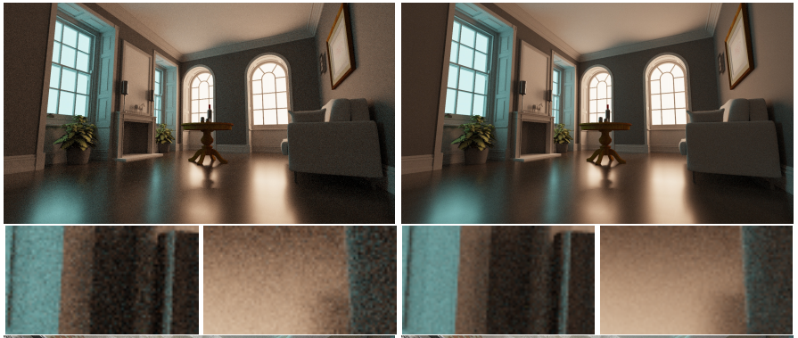
Result: Living Room
MMLT
CMLT

Slide 25
Quiz
Reverse Jump MLT algorithm includes three steps.
What is the last step of RJMLT algorithm?
2. Choose the right answer for the statement.
① Always accept $\hat{v}$ ② Accept $\hat{v}$ if $\hat{v}$ < α ③ Always reject $\hat{v}$ ④ Reject $\hat{v}$ if $\hat{v}$ < α
a. In RJMLT, the sampling technique should be invertible. (T/F)
b. In CMLT, the sampling technique should be invertible. (T/F)

