Slide 1
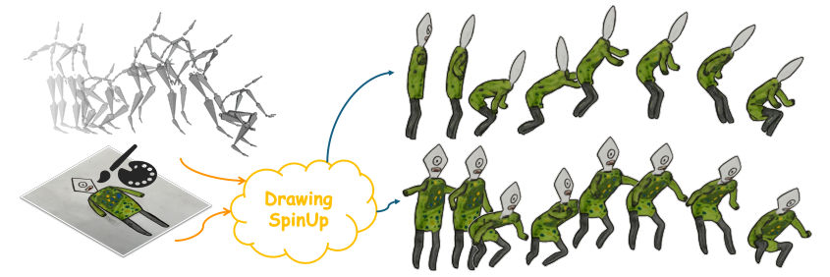
Computer Systems & Networks Lab
DrawingSpinUp:
3D Animation from Single Character Drawings
2024
JIE ZHOU, City University of Hong Kong, China
CHUFENG XIAO, Hong Kong University of Science and Technology, China
MIU-LING LAM, City University of Hong Kong, China
HONGBO FU, Hong Kong University of Science and Technology, China

Slide 2
Background: 2D animation
As-Rigid-As-Possible based modelisation
2D shape deformation (dragging key points in 2D image space)
Not adaptable to 3D motions beyond the 2D image plane
Dependent to the viewpoint in inputs

Slide 3
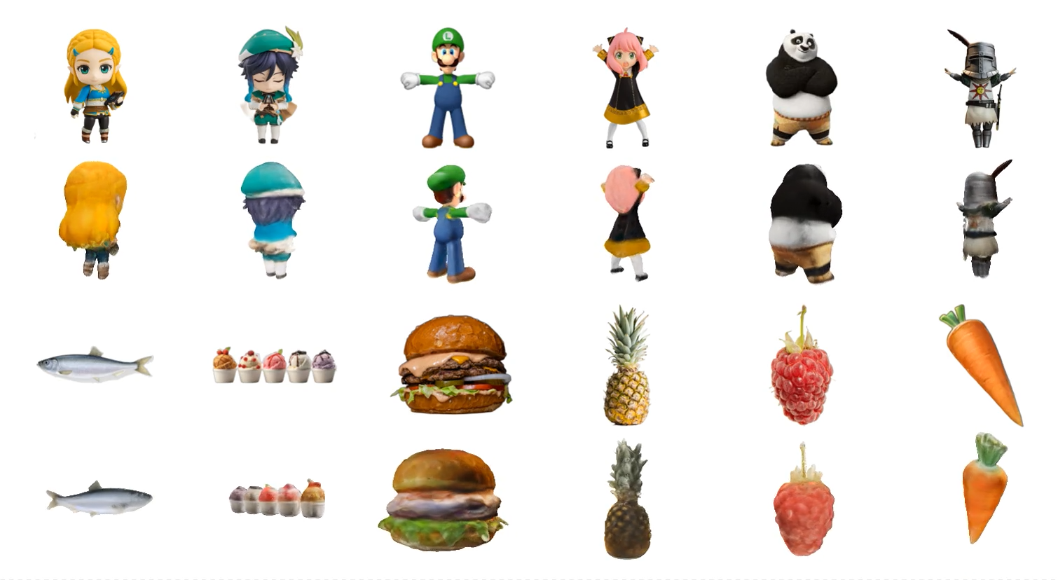
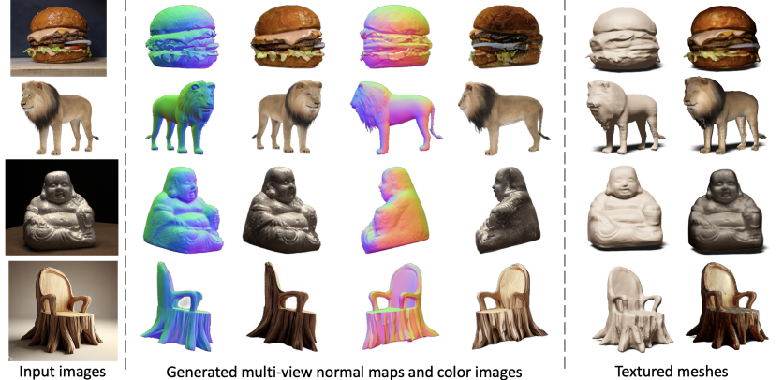
Background: 3D animation
DreamGaussian (2024)
Wonder3D (2023)
Photo-realistic-based methods (not adaptable to hand-drawings)
Issues with contour lines (seen as textures)
Other methods: too expensive or back textures issues

Slide 4
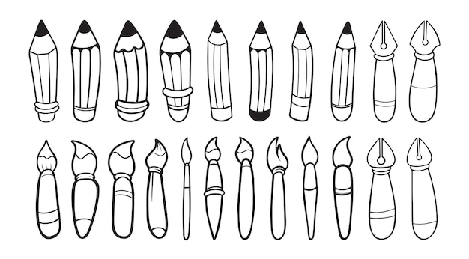
Background: Contour rendering
Non photo-realistic contour lines
Various thickness and harmonization with interior textures
View-dependent

Slide 5
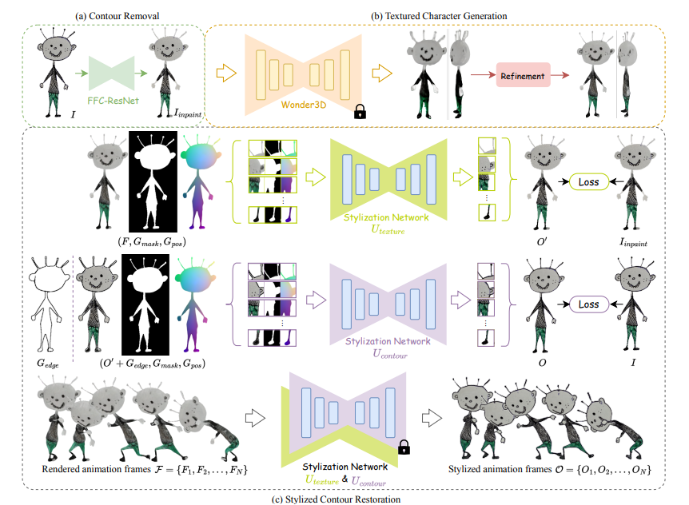
Overall Pipeline

Slide 6
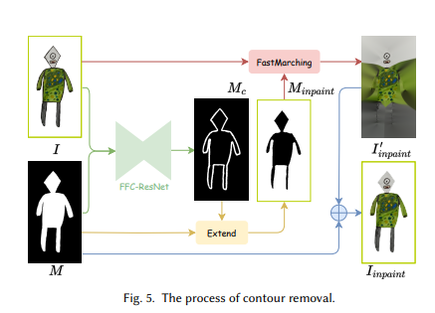
1- Contour Removal
Prediction of the contour mask (Background region added into the contour mask)
FFC-Resnet (Fast Fourier Convolution)
Training dataset: 3DBiCar dataset
Gives the predicted contour mask to remove

Slide 7
2- 3D Generation
Pre-trained diffusion model Wonder3D for multi-view normal maps and color images
Off-the-shelf segmentation network IS-Net
Neural surface reconstructor Instant-NSR for textured geometry
Refinement Skeleton based shape deformation algorithm for refinement
Gives a 3D character (contour free)

Slide 8
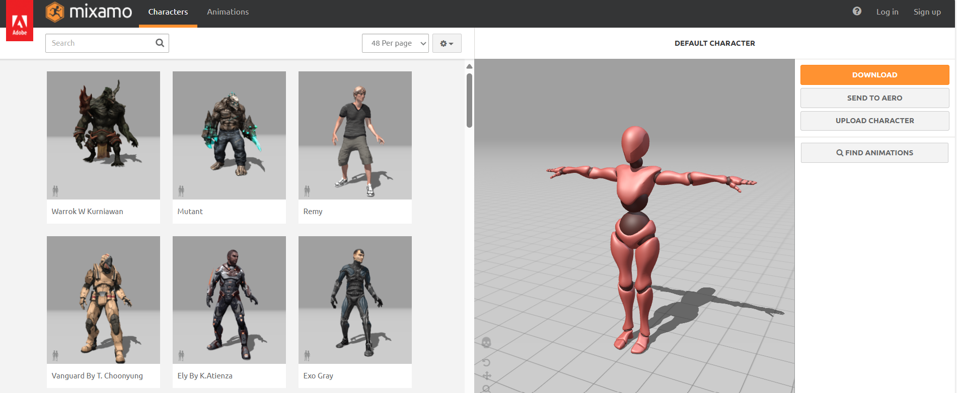
3- Rigging and retargeting
Mixamo’s online rigging tool for automatic rigging
Key points-based auto-rigging algorithm based on eight 2D joint key points (Smith)
Rokoko for retargeting onto the rigged characters (Blender plugin)
Gives a 3D animation of the character (still contour free)

Slide 9
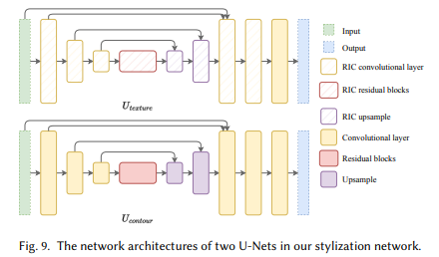
4- Stylized contour restoration
Two cascaded modified U-nets of Futschik (one for internal texture, one for external contour lines)
Four types of guidance channels in inputs (original color frame, foreground mask, positional hint, edge map)
Patch-based training strategy
Gives animated full stylized character’s frames

Slide 10
Results
Contour Removal | 3D Character Generation | Online Rigging | Stylization Network
0.1 s | 2-3 min | 1-2 min | 0.2 s/frame
TOTAL training time: 10-15min per character
Diverse animations from different 3D motions for the same character:
- require only the frame rendering and stylization inference

Slide 11
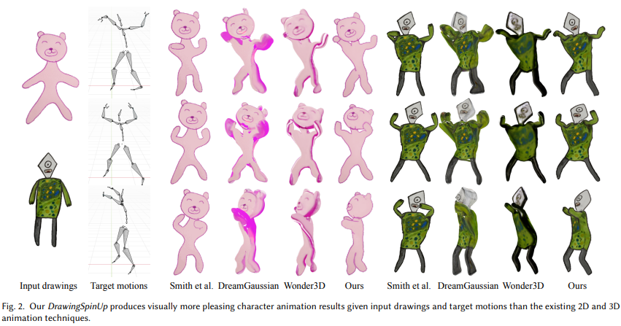
Comparison
 | Smith and al. | DreamGaussian | Wonder3D | DrawingSpinUp
Motion consistency | 3.85 | 4.30 | 4.30 | 4.55
Style preservation | 4.18 | 3.65 | 3.50 | 4.53
DrawingSpinUp:
Can produce plausible 3D animation
Maintains consistent styles in animations
(contour removal network and stylization network)

Slide 12
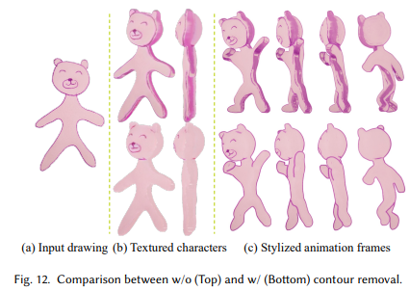
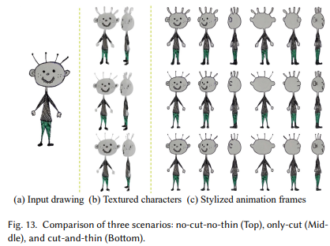
Ablation study
No shape refinement or only cutting without:
=> inflated results for fine structures
No contour removal:
=> contour lines considered as part of the internal texture
(no view-dependent contours)

Slide 13
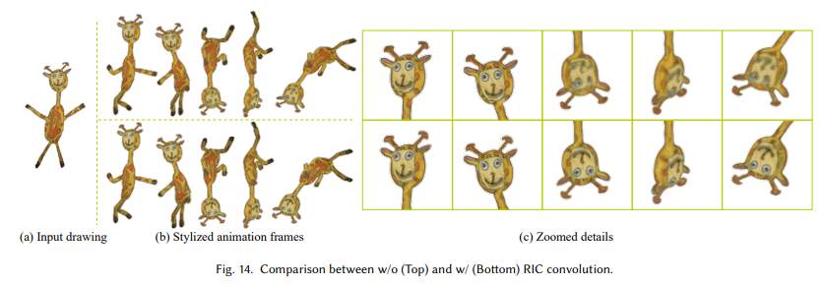
Ablation study
Style restoration with vanilla convolution instead of rotation invariant:
=> issues with some animation frames
(unable to align feature maps of a transformed image with its original ones)

Slide 14
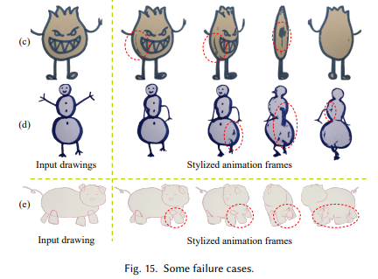
Conclusion
Non-photo-realistic characters’ animations
Contour style consistency
Constraints: - input drawings in frontal A/T pose without self-occlusion
- adapted threshold in edges extraction to render contours

Slide 15
Quiz
https://docs.google.com/forms/d/e/1FAIpQLSdDUiq9A-X71Vs_wCIqeh9Jp6kjbf2wzWrqEcxxxHx7pQmuCg/viewform?usp=sf_link

