Slide 1
PA1 - Specification
Goal
To see how modern graphics engine and application works
Objective
Compile and run samples from a modern ray tracing engine
Send screenshots of three different samples
Choose either one of following:
OptiX
Embree

Slide 2
PA1 – Playing with OptiX
NVIDIA OptiX Ray Tracing Engine
NVIDIA’s ray tracing engine based on CUDA
Requires NVIDIA GPU to work
NVIDIA’s commercial renderer, Iray, is built upon OptiX Technology

Slide 3
PA1 – Playing with OptiX
“whirligig” sample
“progressivePhotonMapping” sample

Slide 4
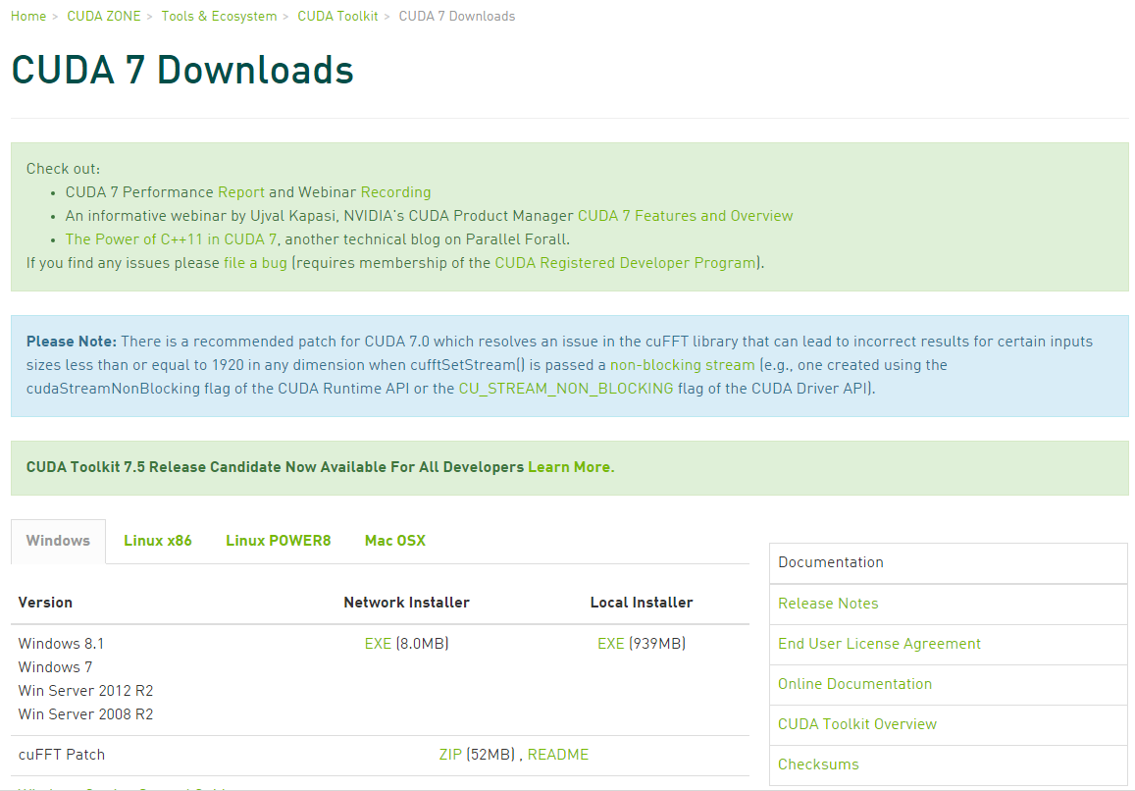
PA1 – Playing with OptiX
Prerequisite - CUDA Toolkit
NVIDIA’s GPGPU interface
Download latest version at: https://developer.nvidia.com/cuda-downloads

Slide 5
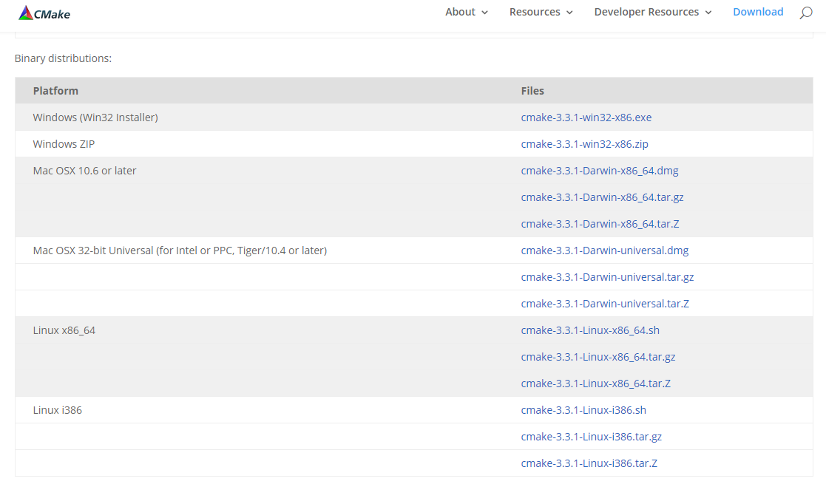
PA1 – Playing with OptiX
Prerequisite - CMake
Used for generate various open-source build environments, including OptiX samples
Download latest version at: http://www.cmake.org/download/

Slide 6
PA1 – Playing with OptiX
Once both prerequisites are installed, grab OptiX from following location:
ftps://sglab.kaist.ac.kr/ (Use FTP-over-SSL clients like Filezilla)
ID: CS482
PW: CS482-InteractiveComputerGraphics-Fall2015-Files
Install OptiX version based on following:
CUDA version 7.0: OptiX 3.8.0
CUDA version under 6.5: OptiX 3.7.0

Slide 7
PA1 – Playing with OptiX
Let’s make project files for OptiX samples!
Run cmake-gui
1) Set source code to OptiX SDK location
In Windows, default location is following:
%ProgramData%\NVIDIA Corporation\OptiX SDK {version}\SDK
2) Set destination to a new folder
Don’t set it to the same folder of SDK itself
1)_____________________________
2)_____________________________

Slide 8
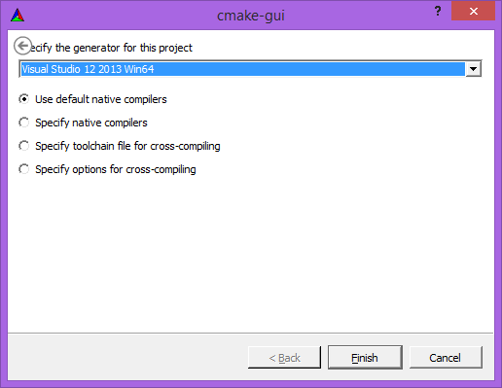
PA1 – Playing with OptiX
Let’s make project files for OptiX samples!
3) Click “Generate” button below
4) Set appropriate build environment
Now you have your build environment!

Slide 9
PA1 – Playing with OptiX
Compile with your environments
In Unix-like OS, default is Makefile
Just compile it with “make all”
In Windows, use Visual Studio solutions
Build “ALL_BUILD” project to compile everything

Slide 10
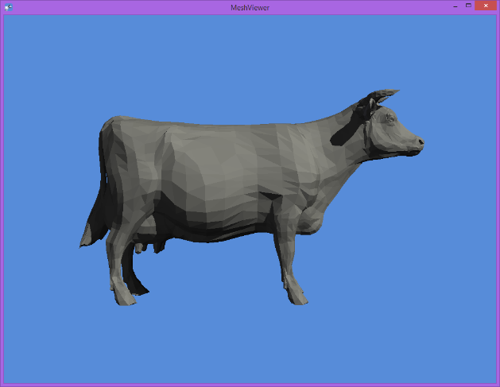
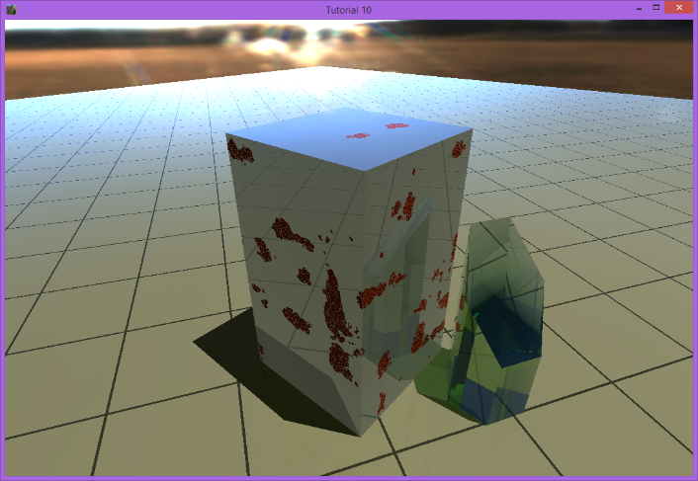
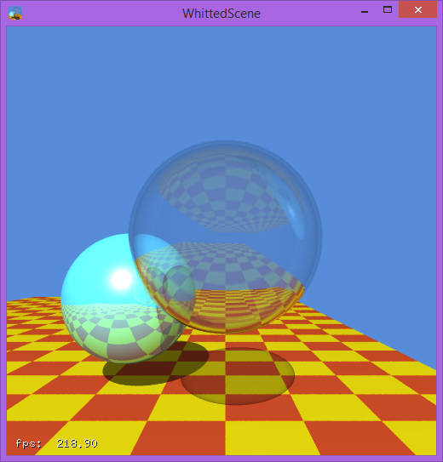
PA1 – Playing with OptiX
PA1 (OptiX) Submit 3 screenshots of different projects
Example: path_tracer, ocean, cook
Also, take a look at codes for simple projects to learn how they works
sample1~8, tutorial, whitted

Slide 11
PA1 – Playing with Embree
Intel Embree Ray Tracing Kernel
Intel’s ray tracing kernel optimized for Intel processors
tineKhome by JakubCech
A commercial renderer “Corona” is built upon Embree kernel

Slide 12
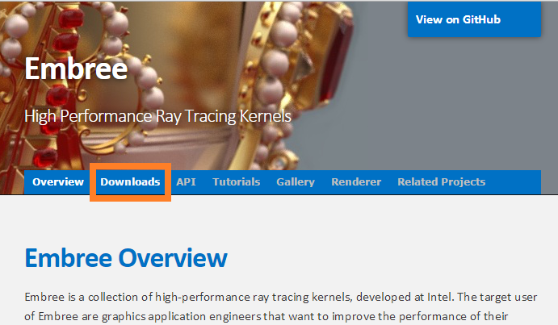
PA1 – Playing with Embree
Installing Embree Binary
Access https://embree.github.io/

Slide 13
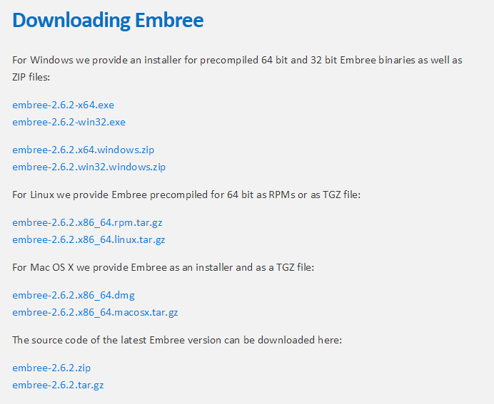
PA1 – Playing with Embree
Binary
for
Win/
Linux/
Mac
src

Slide 14
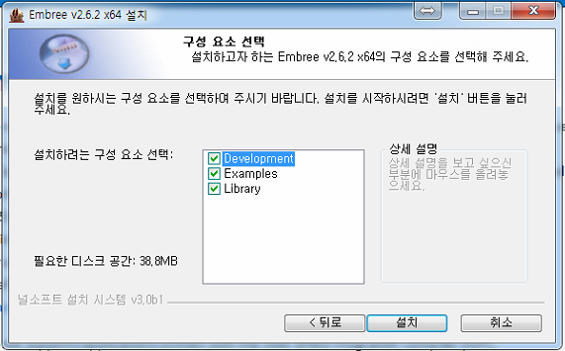
PA1 – Playing with Embree
Installing Embree Binary
Select all of the component for the walkthrough

Slide 15
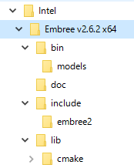
PA1 – Playing with Embree
Embree Binary Directory Tree
Examples
Documentations
For Development
(include/lib)

Slide 16
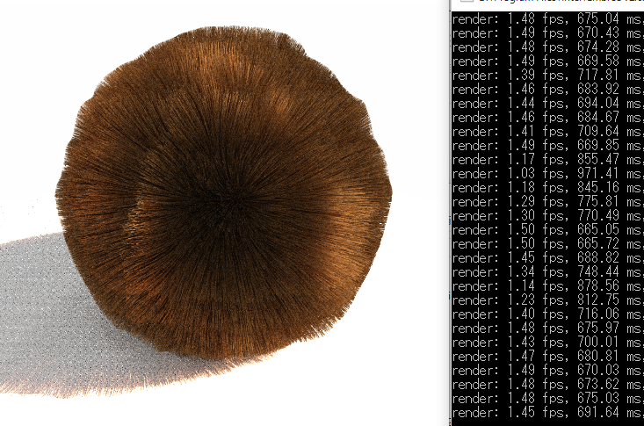
PA1 – Playing with Embree
Play with some examples
hair_geometry; look at that fps

Slide 17
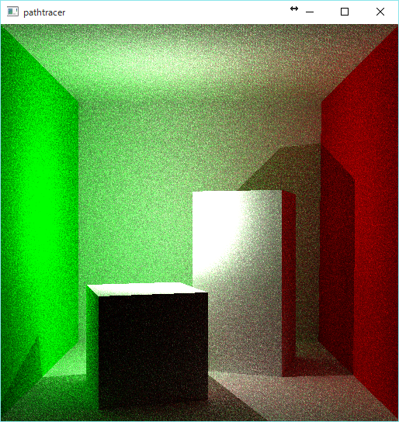
PA1 – Playing with Embree
Play with some examples
path_tracer; noise degrades as the time passes

Slide 18
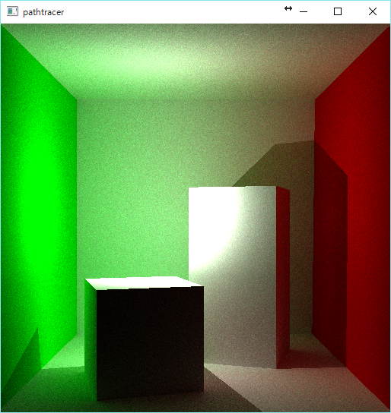
PA1 – Playing with Embree
Play with some examples
path_tracer; noise degrades as the time passes

Slide 19
PA1 – Playing with Embree
Play with some examples
path_tracer; noise degrades as the time passes

Slide 20
PA1 – Playing with Embree
Embree Binary Directory Tree
Examples
Documentations
For Development
(include/lib)

Slide 21
PA1 – Playing with Embree
Documentation Contents
How to install
How to compile
API Documentation
Tutorials with Examples
Read it thoroughly!

Slide 22
PA1 – Submission
Submit to the following mail
cs482.fall.2015@gmail.com
Title should start with [PA1] <ID> <Name>
E.g., [PA1] 20151234 Hong GilDong
Your submission should include following:
The name of the engine
The name of three samples you have chosen
Screenshots of three samples
Submit them directly in the mail content, or via PDF attachment

Slide 23
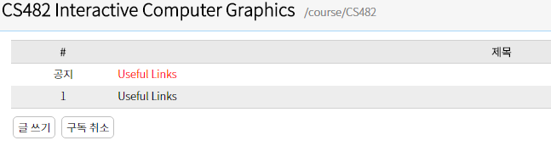
PA1 – Questions?
Have a question?
Post it on a Noah board http://noah.kaist.ac.kr/course/CS482
Or send mail to TA’s
nedsociety@gmail.com
byungyoonc@gmail.com
Good Luck!

