Slide 1
PA2 – Specification
Goal
To see how Instant Radiosity is done
Objective
Compile and run our skeleton code for the Instant Radiosity
Send three screenshots with different VPLs after compilation

Slide 2
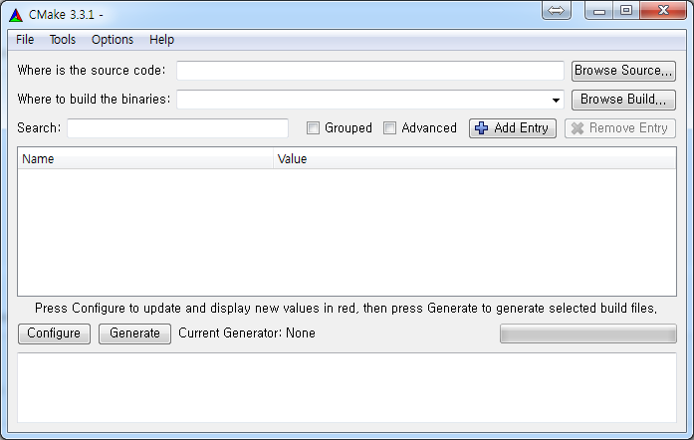
PA2 – Compiling Skeleton Code
Prerequisites: cmake
Get one from https://cmake.org/
cmake-gui for Windows

Slide 3
PA2 – Compiling Skeleton Code
Prerequisites: Visual Studio 2015
Or corresponding other compilers supporting up to C++14
VS2015 Community Edition
https://www.visualstudio.com/en-us/downloads/download-visual-studio-vs.aspx
LLVM 3.7.0
http://llvm.org/releases/download.html

Slide 4
PA2 – Compiling Skeleton Code
Prerequisites: Git
A version control system developed by Linus Torvalds
Get one from https://git-scm.com/

Slide 5
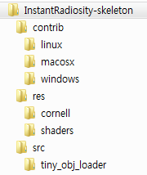
PA2 – Compiling Skeleton Code
Skeleton code directory tree
Precompiled Embree binary
for various platforms
Resources
(3D models, shaders)
Source codes

Slide 6
PA2 – Compiling Skeleton Code
We have CMakeLists configured for you

Slide 7
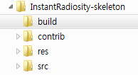
PA2 – Compiling Skeleton Code
How to establish building environment using CMake-GUI
Step 1. Create an empty folder in the root of the project folder
Brand new

Slide 8
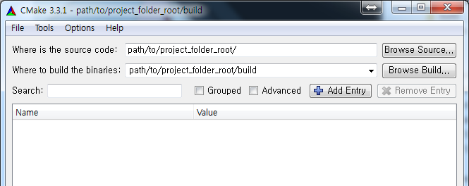
PA2 – Compiling Skeleton Code
How to establish building environment using CMake-GUI
Step 2. Configure CMake-GUI to have source code and binary build path like the following:
Folder which contains ‘CMakeLists.txt’
Where to establish the building environment

Slide 9
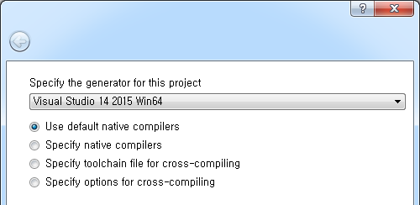
PA2 – Compiling Skeleton Code
How to establish building environment using CMake-GUI
Step 3. Hit “Configure”, and specify the generator for the project
Please ask for the assistance for the case other than VS2015 Win64

Slide 10
PA2 – Compiling Skeleton Code
How to establish building environment using CMake-GUI
Step 4. Hit “Generate” after some tweaks for the configuration values
Maybe you don’t want
GLFW test/examples
to be installed

Slide 11
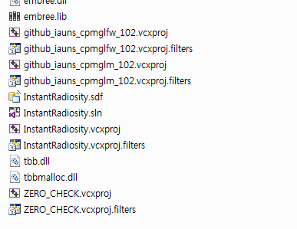
PA2 – Compiling Skeleton Code
How to establish building environment using CMake-GUI
Done!

Slide 12
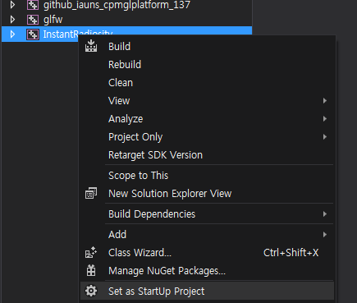
PA2 – Compiling Skeleton Code
Compiling the solution using VS2015
Step 1. Set StartUp Project

Slide 13
PA2 – Compiling Skeleton Code
Compiling the solution using VS2015
Step 2. Set Debugger command arguments
mesh=res/cornell/cornell_box.obj

Slide 14
PA2 – Running Skeleton Code
The program allows the user to navigate through the scene
Controls:
Keyboard W, A, S, D to move around on XZ plane
Keyboard Q, Z to move up/down in Y axis
Keyboard Spacebar to iterate through VPLs
Mouse left button drag to rotate the camera

Slide 15
PA2 – Skeleton Code Limitations
This code is the skeleton code, which is not fully functional
The program does:
Generate rays to generate VPLs
Renders the scene lit by each VPL
The program does not:
Normalize each VPL’s contribution
Accumulate the lightings by VPLs
Generate any shadows

Slide 16
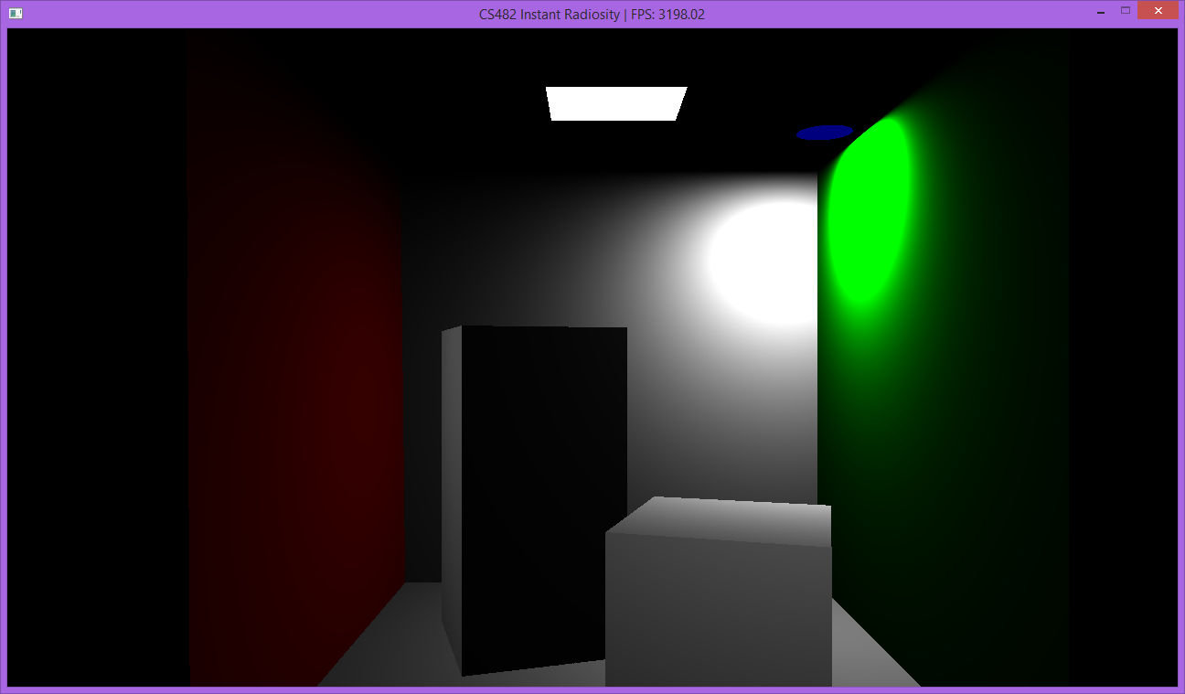
PA2 – Skeleton Code Limitations
Currently it looks like this:

Slide 17
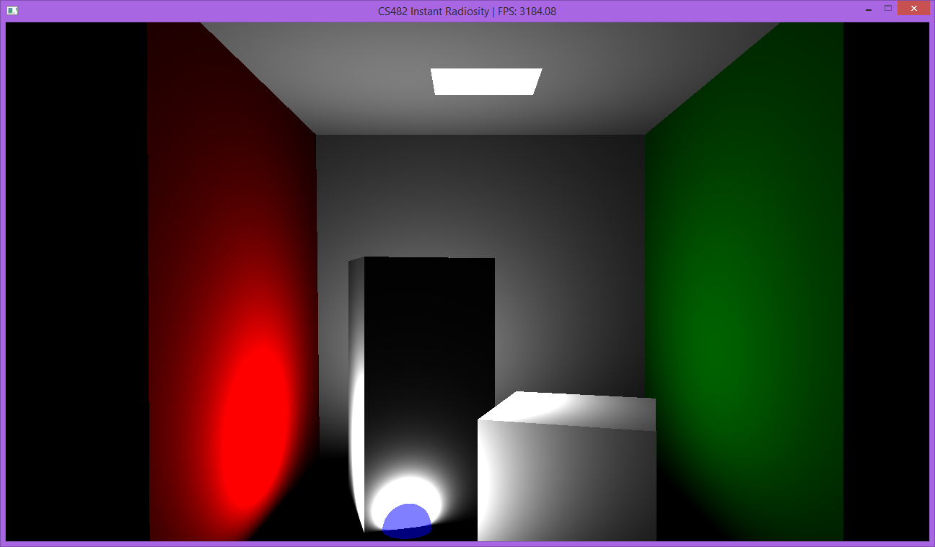
PA2 – Skeleton Code Limitations
Currently it looks like this:

Slide 18
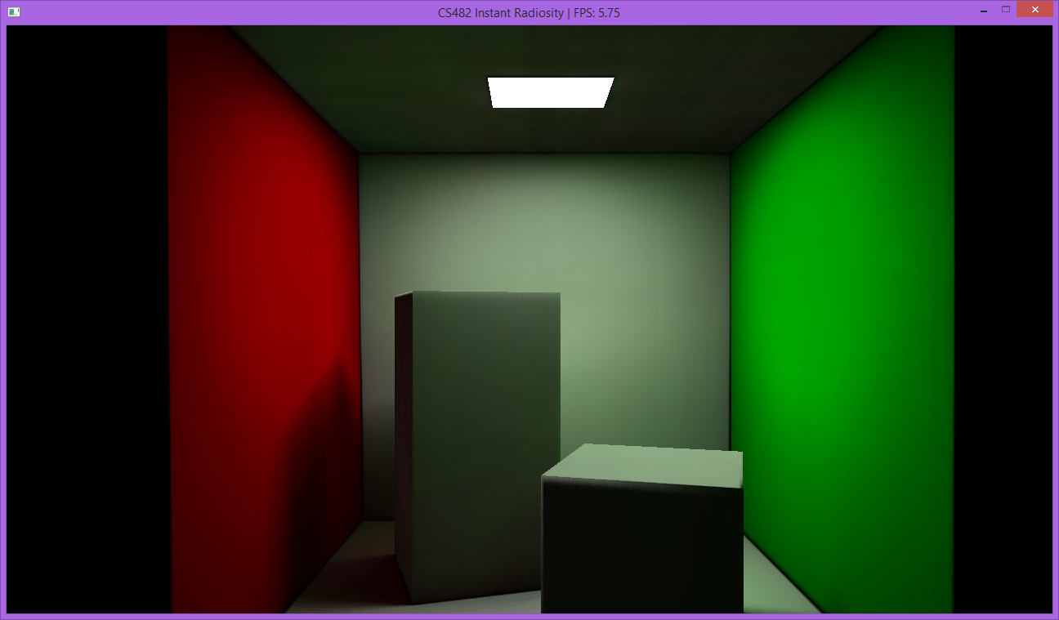
PA2 – Skeleton Code Limitations
The fully functional program should look like this:

Slide 19
PA2 – Submission
Submit to the following mail
cs482.fall.2015@gmail.com
Title should start with [PA2] <ID> <Name>
E.g., [PA2] 20151234 Hong GilDong
Your submission should include following:
Send three screenshots with different VPLs after compilation
Submit them directly in the mail content, or via PDF attachment

Slide 20
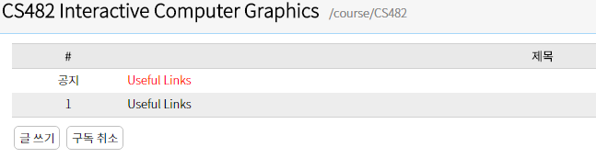
PA2 – Questions?
Have a question?
Post it on a Noah board http://noah.kaist.ac.kr/course/CS482
Good Luck!

Slide 21
PA2 – Useful Links
Instant Radiosity Course slides
http://www.cs.cornell.edu/courses/cs6630/2012sp/slides/Boyadzhiev-Matzen-InstantRadiosity.pdf
Shaderific – GLSL functions
http://www.shaderific.com/glsl-functions/
Modern OpenGL tutorial
https://open.gl/

