Slide 1
PA3 – Specification
Goal
  Finish basic implementation of instant radiosity
  Learn how to transport light in VPL
Objective
  From PA2, implement following features
    Apply weight to irradiance of each VPL
    Accumulate images from each VPL
    Apply shadow
  Send a screenshot of your final image

Slide 2
Prerequisite
Is there any problem in compiling PA2?
Any questions on PA2 skeleton code?

Slide 3
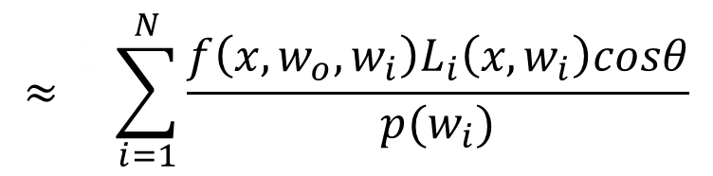
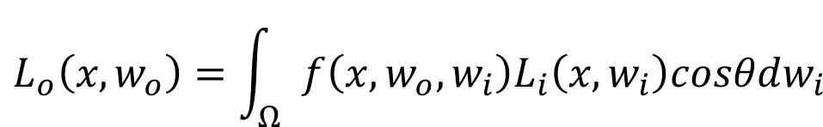
PA3 – Task 1: Apply Weight
VPLs are generated, but their radiance is not weighted in skeleton code
$$L_{o}\left(x,w_{o}\right)=\int_{Ω}{f\left(x,w_{o},w_{i}\right)L_{i}\left(x,w_{i}\right)cosθdw_{i}}$$
$$≈\frac{1}{N}\sum_{i=1}^{N}{\frac{f\left(x,w_{o},w_{i}\right)L_{i}\left(x,w_{i}\right)cosθ}{p(w_{i})}}$$

Slide 4
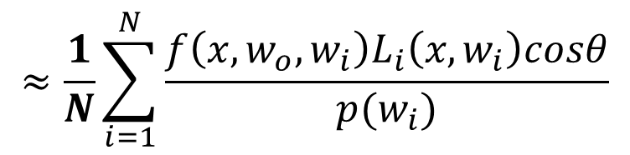
PA3 – Task 1: Apply Weight
VPLs are generated, but their radiance is not weighted in skeleton code
$$L_{o}\left(x,w_{o}\right)=\int_{Ω}{f\left(x,w_{o},w_{i}\right)L_{i}\left(x,w_{i}\right)cosθdw_{i}}$$
$$≈\frac{1}{N}\sum_{i=1}^{N}{\frac{f\left(x,w_{o},w_{i}\right)L_{i}\left(x,w_{i}\right)cosθ}{p(w_{i})}}$$

Slide 5
PA3 – Task 1: Apply Weight
VPLs are generated, but their radiance is not weighted in skeleton code
If N samples are sampled from light sources, we need to divide image by N
  Defined as kVplCount in main.h
$$L_{o}\left(x,w_{o}\right)=\int_{Ω}{f\left(x,w_{o},w_{i}\right)L_{i}\left(x,w_{i}\right)cosθdw_{i}}$$
$$≈\frac{1}{N}\sum_{i=1}^{N}{\frac{f\left(x,w_{o},w_{i}\right)L_{i}\left(x,w_{i}\right)cosθ}{p(w_{i})}}$$

Slide 6
PA3 – Task 1: Apply Weight
Implementation
Change u_numLights from 1 to kVplCount
  To reduce “popping” artifact, we clamp pixel contribution for each VPL images
On generating VPL, divide irradiance by N
  Hint: On recursive VPL tracing, manipulating initial VPL intensity applies to every derived VPLs as well

Slide 7
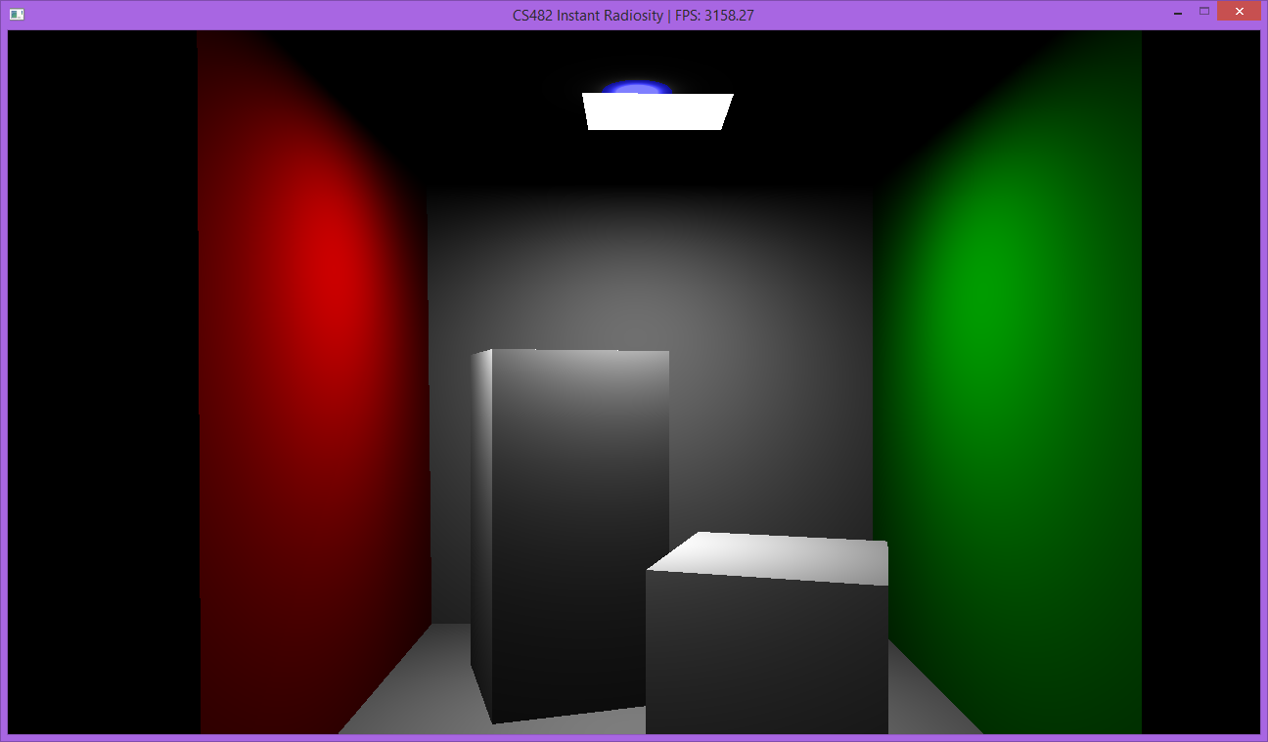
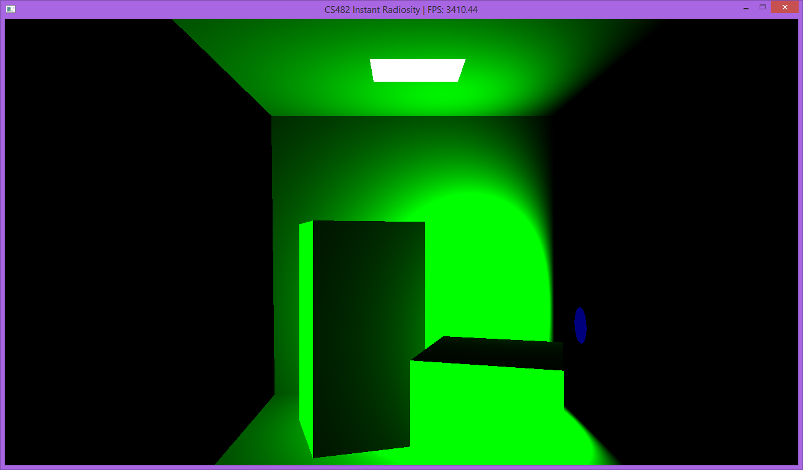
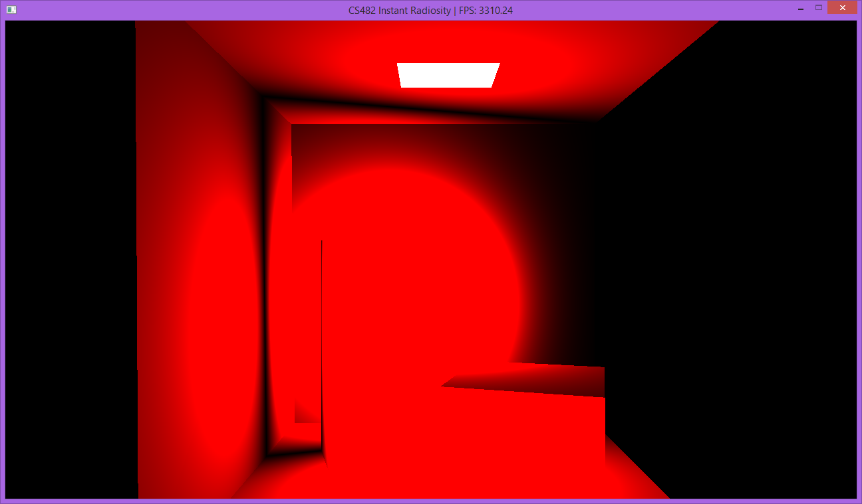
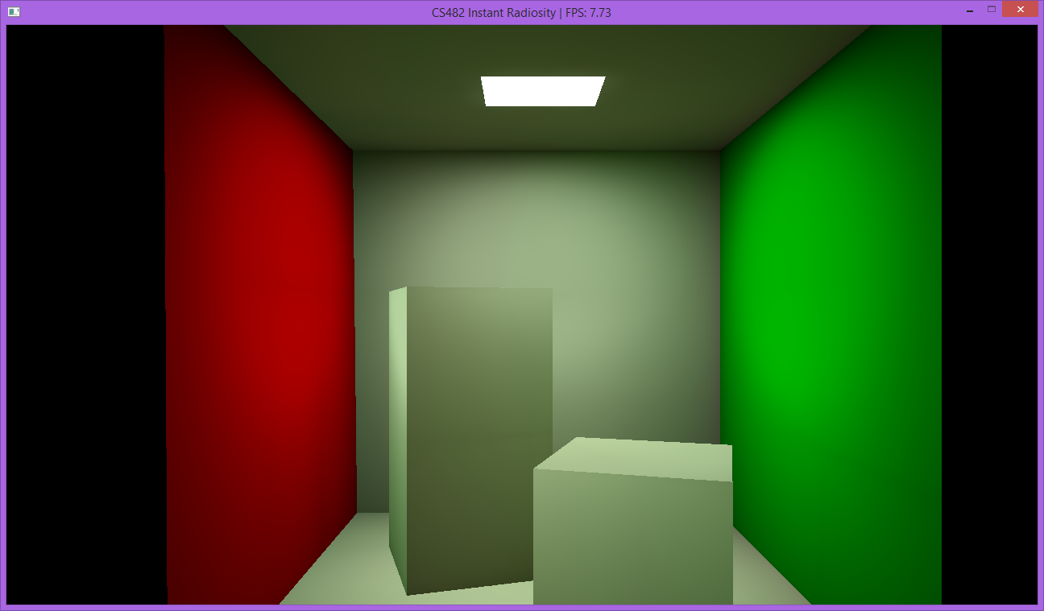
PA3 – Task 2: Accumulate
Currently PA2 only shows individual VPL image
Change it to accumulate all VPL images

Slide 8
PA3 – Task 2: Accumulate
Accumulate VPL images one-by-one
Draw each VPL image on a framebuffer
(e.g., kGlsFramebufferSceneDraw)
Accumulate them into another framebuffer
(e.g., kGlsFramebufferAccumulate)
Show final accumulated image into screen

Slide 9
PA3 – Task 2: Accumulate
Pseudocode
Hint
  Using glBlendFunc(GL_ONE, GL_ONE) causes drawing image additively (= accumulation!) into current framebuffer
for (vpl in VPLs) {
kGlsFramebufferSceneDraw = draw image from vpl;
kGlsFramebufferAccumulate += kGlsFramebufferSceneDraw;
}
kGlsFramebufferScreen = kGlsFramebufferAccumulate;

Slide 10
PA3 – Task 2: Accumulate
After task 2:

Slide 11
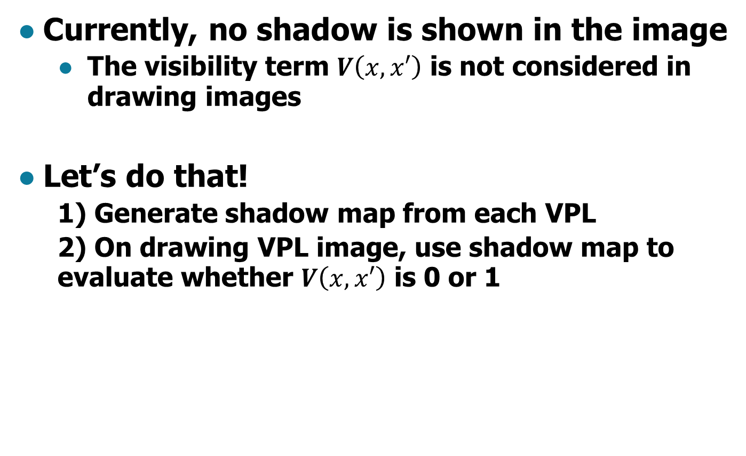
PA3 – Task 3: Generate Shadow
Currently, no shadow is shown in the image
  The visibility term $V\left(x,x′\right)$ is not considered in drawing images
Let’s do that!
  1) Generate shadow map from each VPL
  2) On drawing VPL image, use shadow map to evaluate whether $V\left(x,x′\right)$ is 0 or 1

Slide 12
PA3 – Task 3: Generate Shadow
Generate shadow map from each VPL
  Hint: already implemented in perlight_generate_shadow_map(), just call it!
  Generated shadow map is stored in
  kGlsCubemapFramebufferShadow
  Pass it into shader that draws VPL image
    Related uniform is u_shadowTex

Slide 13
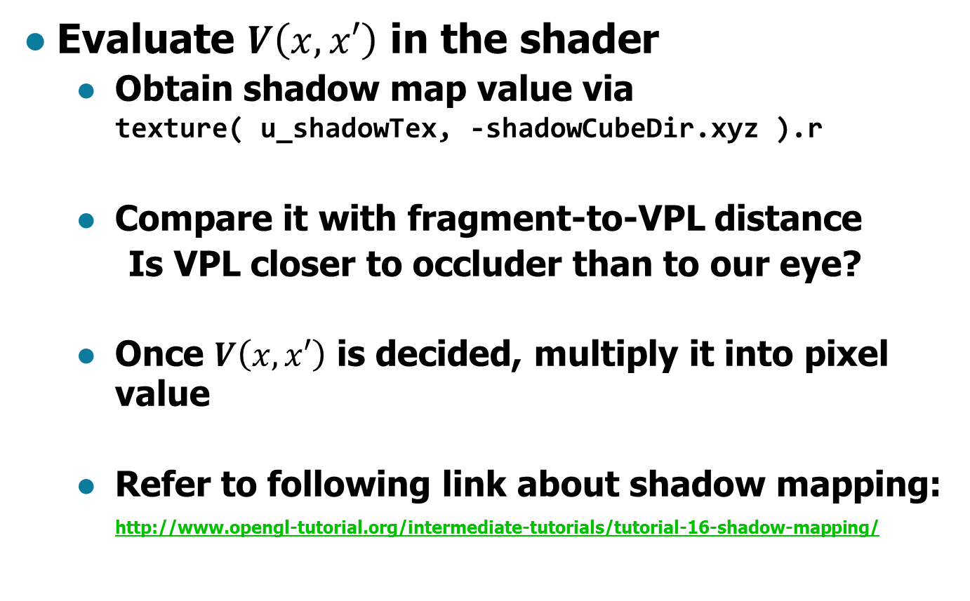
PA3 – Task 3: Generate Shadow
Evaluate $V\left(x,x′\right)$ in the shader
  Obtain shadow map value via
  texture( u_shadowTex, -shadowCubeDir.xyz ).r
  Compare it with fragment-to-VPL distance
    Is VPL closer to occluder than to our eye?
  Once $V\left(x,x′\right)$ is decided, multiply it into pixel value
  Refer to following link about shadow mapping:
  http://www.opengl-tutorial.org/intermediate-tutorials/tutorial-16-shadow-mapping/

Slide 14
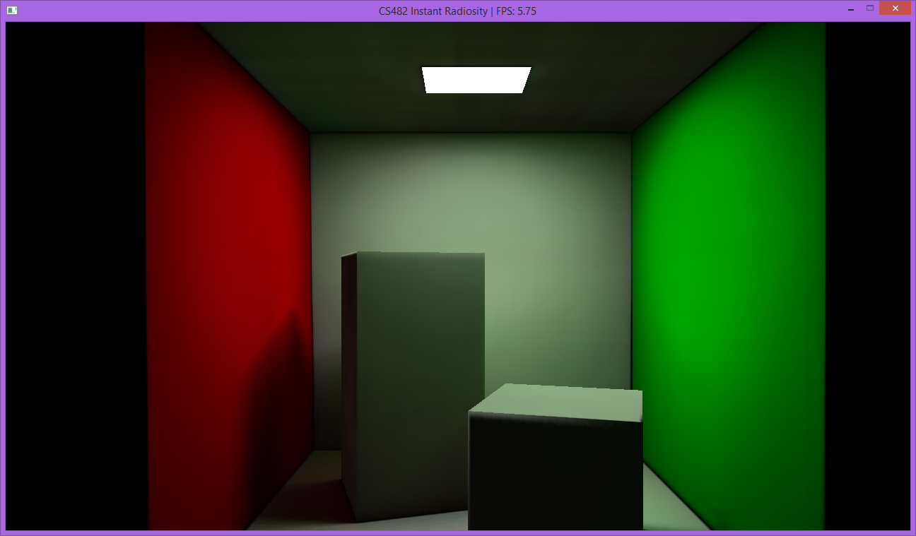
PA3 – Task 3: Generate Shadow
The fully functional program should look somewhat like this:

Slide 15
PA3 – Submission
Submit to the following mail
  cs482.fall.2015@gmail.com
  Title should start with [PA2] <ID> <Name>
    E.g., [PA3] 20151234 Hong GilDong
Your submission should include following:
  A screenshot of your final image
  Your code, zipped
    *You should attach the modified source code,
    except CMake-generated build directory!
Submit them directly in the mail content

Slide 16
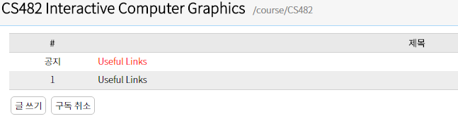
PA3 – Questions?
Have a question?
  Post it on a Noah board
  http://noah.kaist.ac.kr/course/CS482
Good Luck!

Slide 17
PA3 – Useful Links
Instant Radiosity Course slides
  http://www.cs.cornell.edu/courses/cs6630/2012sp/slides/Boyadzhiev-Matzen-InstantRadiosity.pdf
Shaderific – GLSL functions
  http://www.shaderific.com/glsl-functions/
Modern OpenGL tutorial
  https://open.gl/

