Slide 1
Denoising with Kernel Prediction and Asymmetric Loss Functions
20180475 Seeha Lee

Slide 2
The limit of MC rendering
MC rendering algorithms can satisfy strict quality requirements, they do so at an immense computational cost and with convergence characteristics that require long rendering times for noise-free images.
Noisy image
Construction time : t
Clean image
Construction time : T (>> t)
Requires huge computational power

Slide 3
Denoising images
Goal of denoising : Obtain a filtered estimate that is close as possible to a ground truth result.
Noisy image
Construction time : t
Clean image
Construction time : T (>> t)
Requires huge computational power
Denoised image
Construction time : t + t’
Reasonable computational power

Slide 4
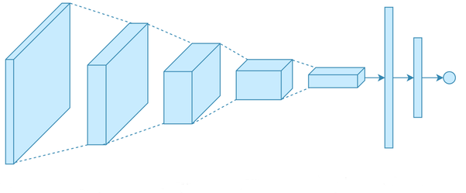
But how?
Linear regression vs CNN
Benefit of using CNNs
More complex network
Can learn non-linear models effectively
Once trained, it is fast to evaluate
No manual tuning and parameter tweaking is required

Slide 5
Previous work : KPCN

Slide 6
Previous work : KPCN
Diffuse/specular decomposition
Various components of the image have different noise characteristics and spatial structure : conflicting denoising constraints.
Decompose to diffuse and specular part
Kernel prediction vs Direct prediction
Use normalized kernel weight to improve convergence

Slide 7
Previous work : KPCN
Pixel p
k by k kernel
Normalize weight
Produce denoised color
$${{[z}_{p}]}_{q} :qth entry of flattened z_{p}$$
Optimizing θ :
Certain loss function

Slide 8
What is different?
Network is based on KPCN, but slightly different
KPCN
Extract features such as color variance, surface normal, albedo
Extract a common, low-level representation to unify the various inputs.

Slide 9
Flickering in animation
Each denoised frame can be slightly ‘different’ to each other
Produces a flickering artifact when the frames are played
Solution : use a multi-frame denoiser(temporal denoiser)

Slide 10
Temporal denoiser
Lock parameters
Train single-frame network and obtain parameters for source encoder and spatial-feature extractor
Interpolate 2M+1 frames
Use i-M, …, i+Mth frames in reconstructing ith frame

Slide 11
Overly smooth results
Input image
Denoised image
Ground truth

Slide 12
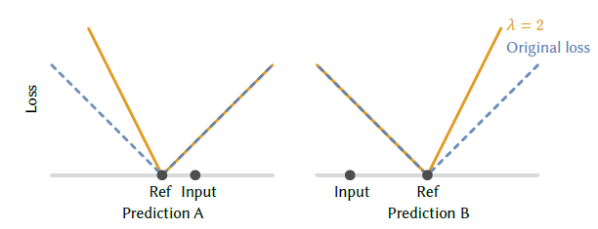
Asymmetric loss
Denoised image
Input
Reference
Result will be closer to the input(=noisy image)
The user can choose their own lamda

Slide 13
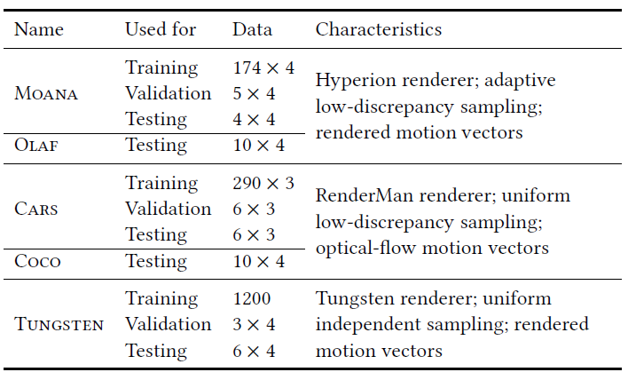
Training the network
Evaluation :
Relative squared error(MrSE)
Structural dissimilarity(DSSIM)

Slide 14
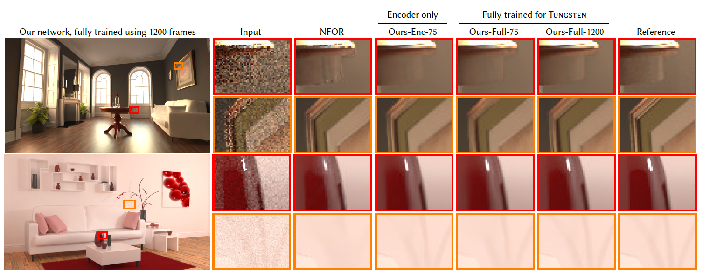
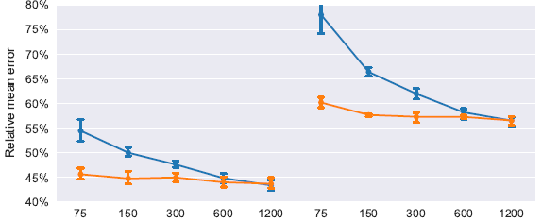
Comparing results

Slide 15
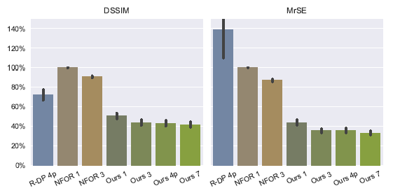
Comparing results

Slide 16
Asymmetric loss
Animated results : https://www.youtube.com/watch?v=cwFTwrJhJOc

