Slide 1
Recap
Learning and aggregating deep local descriptors for instance-level recognition
(Kyubeom Han’s Presentation)

Slide 2
What we have seen the last time
An architecture focusing on local features
Goal: obtaining more precise local features than previous works
Spatial Attention, Withening
Contrastive Loss minimized images match, maximized otherwise
Matching with ASMK
SoTA at that time
Spatial Attention was not learnable
Notes:
What

Slide 3
Global Features are All You Need for Image Retrieval and Reranking
Shihao Shao, Kaifeng Chen, Arjun Karpur, Qinghua Cui, Andrè Araujo, Bingyi Cao, ICCV, 2023
Presented by: Filippo Momentè (20246132)

Slide 4
Introduction & PROBLEM FORMULATION

Slide 5
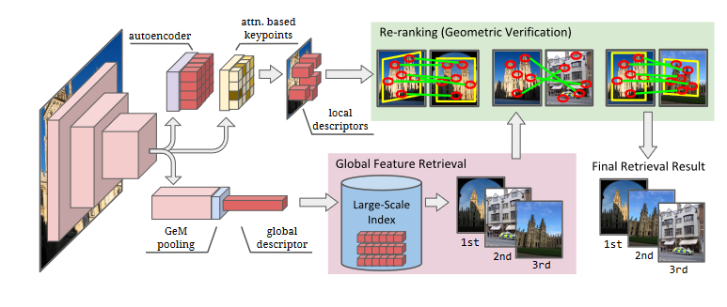
The typical Image retrieval pipeline
Typically, composed by a global feature extractor + reranker
Traditionally, the reranker is based on local features and matching algorithms
Very computationally expensive!
Architecture in the example: DELG (Image credits: Cao et al. 2020)

Slide 6
Overcoming the need for geometric verification
Works aiming to substitute Geometric Verification (GV) have been multiplicating
Two relevant works:
  Instance-level Image Retrieval using Reranking Transformers (Tan et al., 2022)
  Correlation Verification for Image Retrieval (Lee et al., 2022)

Slide 7
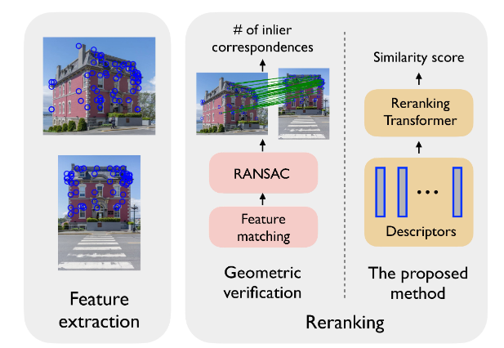
Instance-level Image Retrieval using Reranking Transformers
(Tan et al., 2022)
Here, Geometric Verification substituted by Reranking Transformers (RRT)
A specific Deep Architecture trained for reranking
  It outputs a similarity score between images
Despite outperforming GV while using fewer descriptors, it is still quite expensive memory-wise (half of GV while using DELG)
Credits to the paper’s authors

Slide 8
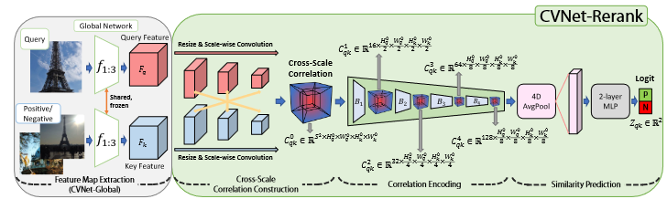
Correlation Verification for Image Retrieval (Lee et al., 2022)
GV substituted by a Deep Neural Network based on stacks of 4D convolutional layers (CVNet-Rerank)
Pyramidal structure for multi-scale inference
Compared to RRT, much less memory required, but around 5 times slower
Credits to the paper’s authors

Slide 9
Overcoming the need for geometric verification
Despite multiple attempts, results have been:
  Partial
  Excessively complicated
Can we do better?

Slide 10
A new reranking strategy
The idea of this paper: let’s use global features for reranking (SuperGlobal Reranking)
They demonstrate that it is possible to obtain effective reranking by leveraging only global features, AvgPool and MaxPool operations
Smart, simple and very effective (64,865 times faster than previous SoTA and 170 times less memory-consuming)

Slide 11
Improving GLOBAL FEATURE EXTRACTION
Not only reranking, but also global feature extraction can be improved
Nowadays, combining GeM pooling with margin-based losses (ArcFace, CurricularFace) is very popular
However, it is a suboptimal strategy

Slide 12
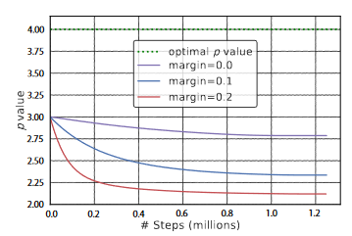
The problem with GeM + margin-based losses
They took DELG (loss: ArcFace)
They computed the optimal p value with grid search
Compared it with the learned p value
Observation: p kept decreasing and going further from the optimal value during training

Slide 13
The proposed solution
A new variant of GeM (GeM+)
Additionally, other two variants proposed:
  Regional-GeM
  Scale-GeM
The new approach is called SuperGlobal Pooling
Goal of these variants: represent better regional information as well as dealing better with multiple scales
They demonstrate their effectiveness

Slide 14
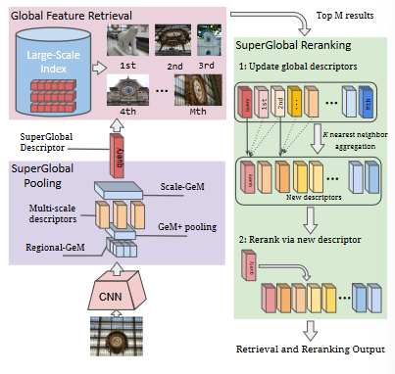
Overall contributions
A new reranking strategy which only makes use of global features
Three new pooling modules for better global features, including one that enables optimal combination of ArcFace and GeM
Resulting in: a new SoTA architecture with great performance improvements
Credits to the paper’s authors

Slide 15
Superglobal pooling

Slide 16
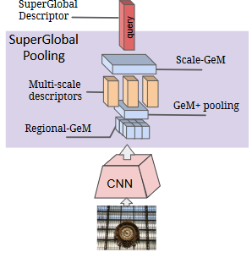
Superglobal pooling
Three new pooling layers stacked on each other
In order:
  Regional-GeM
  GeM+
  Scale-GeM
Credits to the paper’s authors

Slide 17
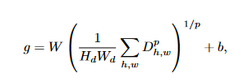

Regional-Gem
A version of GeM acting at regional level
Activations from the feature map D aggregated with convolution
  This generates a new feature map: M
D and M are combined and pooled together

Slide 18
GeM+
Basically, learnable GeM + a parameter tuning stage in a second moment
Tuning stage: inference on ROxford 5k with grid search

Slide 19

Scale-GEM
N: number of scales
gs: the global feature extracted at scale s.
-min(gs): indicates a shift of gs

Slide 20
Superglobal Reranking

Slide 21
Reranking with global features
First, we take the top-M images according to global descriptors
For each image and the query, we take top-K nearest neighbours
  Global feature similarity
  Inspired by QE
Issue: how can we avoid false positives in the nearest neighbours without using GV?

Slide 22
Reranking with global features - 2
We take our M images
  M image + top-K aggregated into one descriptor by weighted avg. pooling
  We obtain a refined descriptor for each of the top-M images

Slide 23
Reranking with global features - 3
We obtained a refined descriptor for each of the top-M images
We take them and get top-K nearest neighbours to query
We apply Max pooling to them
  Result: We get an expanded descriptor for the query

Slide 24
Reranking with global features - 4
Now we have:
  The original query descriptor
  A refined descriptor for the top-M images
  An expanded descriptor for the query

Slide 25
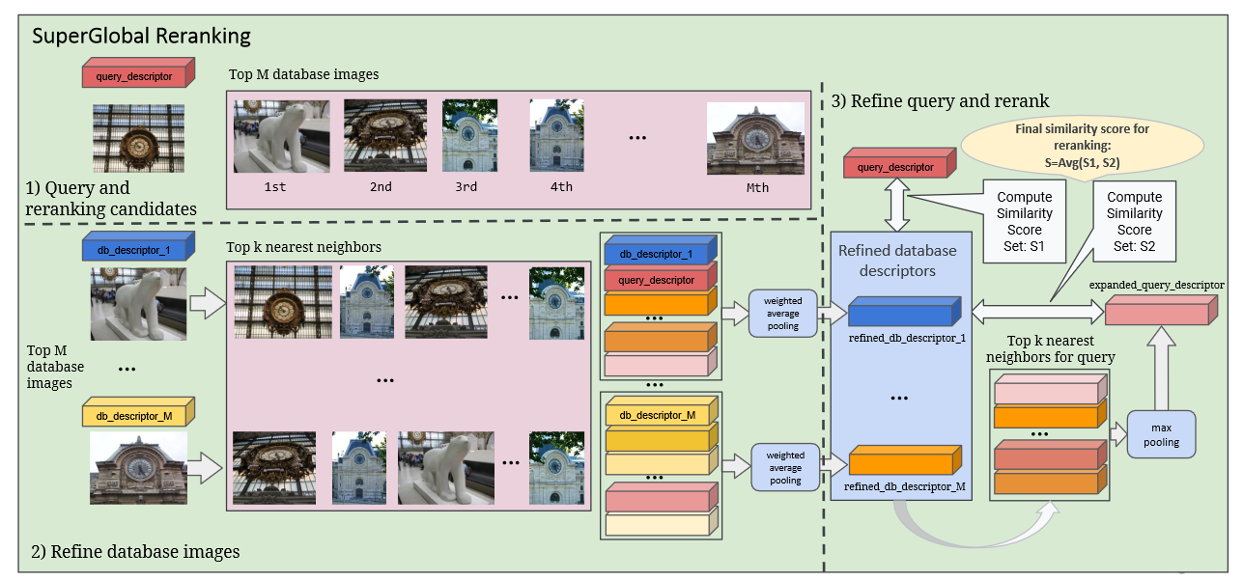
Reranking with global features - 5
Credits to the paper’s authors (edited)

Slide 26
Reranking with global features - 6
Now we are ready for the actual reranking
Two similarity scores are computed
  Similarity between original query descriptor and refined global descriptor for each database image (gdr)
  Similarity between the expanded query descriptor gqe and gdr
The two scores are averaged together

Slide 27

Reranking with global features - 7
Credits to the paper’s authors

Slide 28
Experiments and results

Slide 29
Experiments
The new paradigm compared with many architectures
Datasets: ROxford and RParis

Slide 30
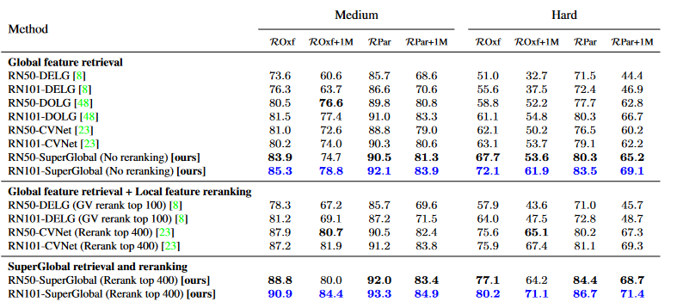
Results

Slide 31
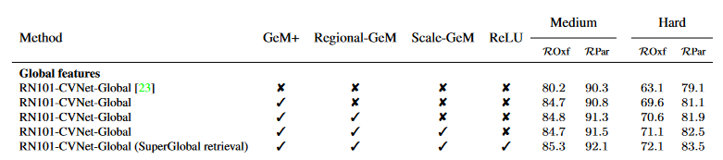
Ablation study

Slide 32
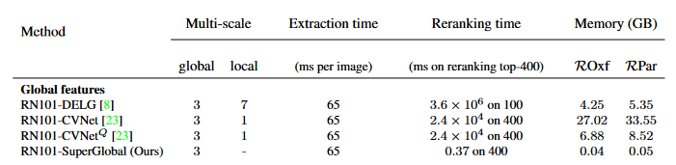
Computational costs improvements

Slide 33
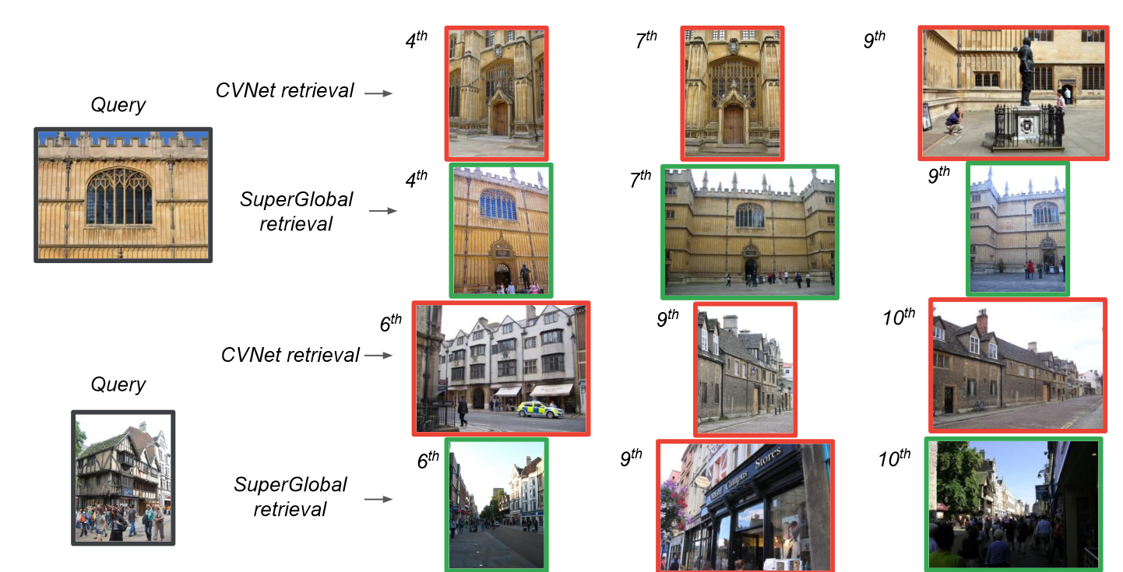
Some qualitative results

Slide 34
Conclusion

Slide 35
limitations
The interpretability is likely worse than previous techniques
They still couldn’t solve the fact that p goes further from the optimal value for GeM over
the course of training. They just find the best p for inference.
Finding this p is likely not efficient
It is also not clear if it is the optimal value or just a better one

Slide 36
recap
Goal: building a fast and efficient reranker for Image Retrieval tasks
  How they did it: by exploiting only global features
  They obtained a single descriptor for the expanded query and for each top-M most
  similar image to the query
  They used different pooling strategies to achieve that
Secondary goal: improving global feature extraction
  They modified GeM to make combination with ArcFace loss optimal
  Additionally, they build poolers focusing on regional features and that worked at
  different scales
Results:
  They obtained a new SoTA and truly impressive reduction of computational costs

Slide 37
Quiz
What prompted them to revisit the GeM pooling layer for global feature extraction ?
  They wanted to speed up global feature extraction
  They observed that the learned p parameter was suboptimal
  They realized GeM pooling is not really a generalization of Avg and Max Pooling in some cases and wanted to fix that
  They wanted to adapt it for local feature extraction
Which of these operations did not occur during SuperGlobal Reranking?
  Weighted average pooling
  Top-k nearest neighbour computation of the refined M-image descriptors
  Scale-GeM Pooling
  Max Pooling

Slide 38
Thank you!

