Slide 1

Learning and Aggregating
Deep Local Descriptors for
Instance-level Recognition
Tobias et al., ECCV 2020
2024-04-22
Kyubeom Han

Slide 2
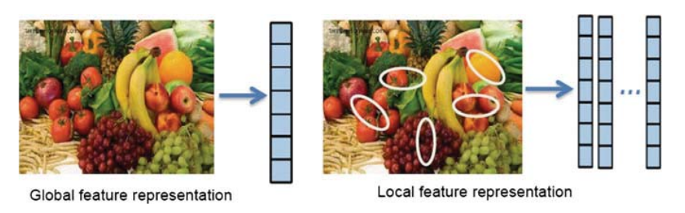
Review – Image Descriptors
Local descriptors : keypoint, regional
Global descriptors : high-level, holistic information
  Aggregation of local descriptors
https://medium.com/@sim30217/what-are-local-features-and-global-features-in-image-baa28451a8ee

Slide 3
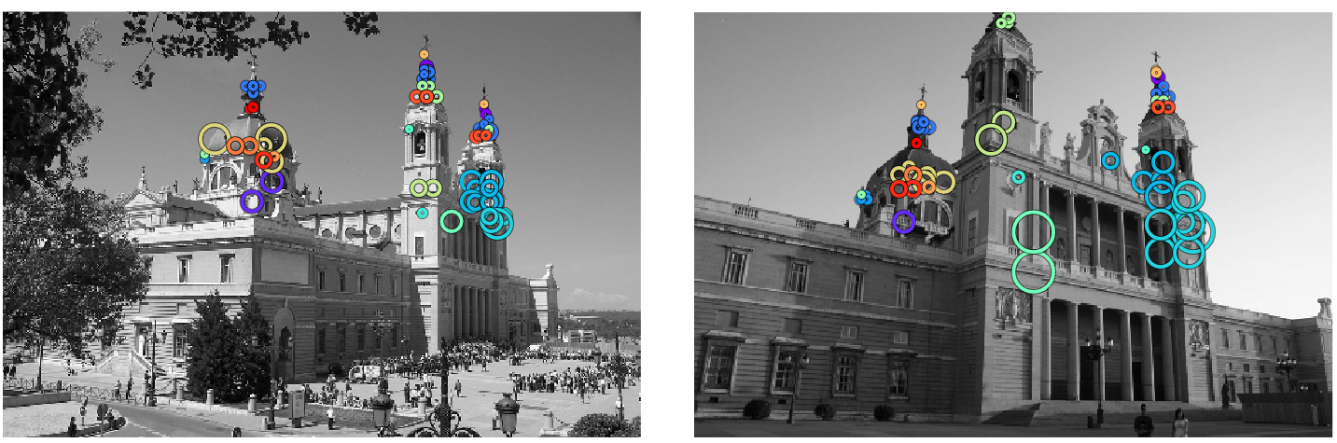
Review – Instance-level Recognition
Local descriptors to provide fine-grain information on dense predictions

Slide 4
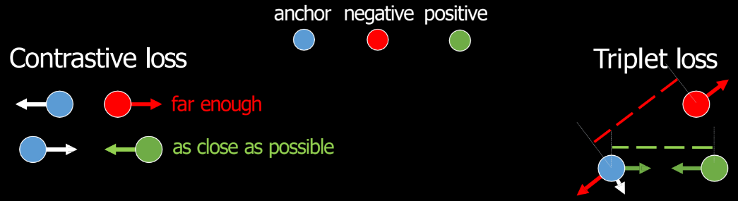
Review – Learning-based Descriptors
Training a neural network to encode descriptors
  Classification loss, Average precision, Metric learning
All based on image labels, not dense labels
  Need a way to extract discriminative local descriptors
Slide from CS588

Slide 5
Motivation
Learning-based Local Descriptors for Instance-level Tasks

Slide 6
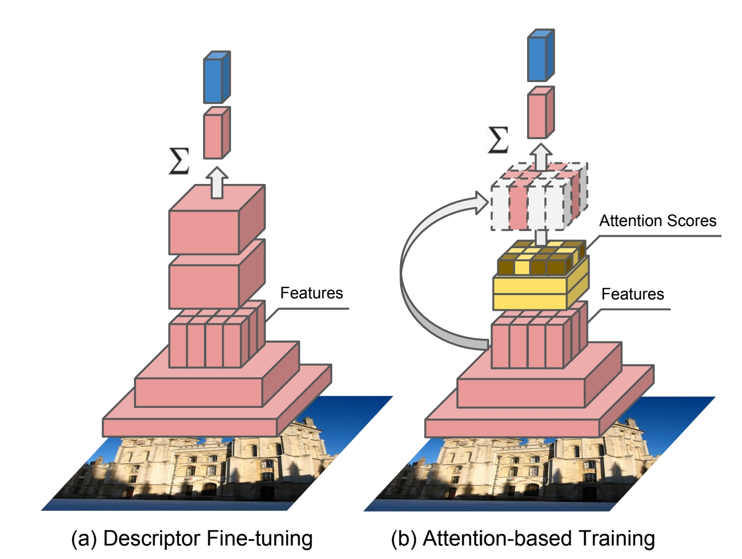
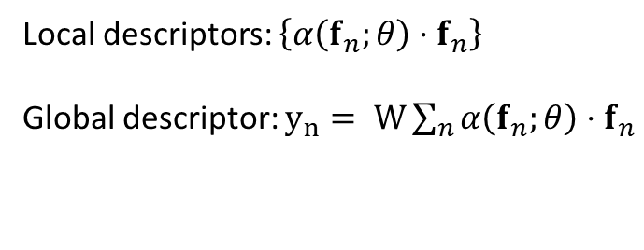
DEep Local Feature (DELF)
Train model w/ image classification
Find local descriptor via learnable spatial attention
  Select discriminative features for classification task
Local descriptors: $\left\{α\left(f_{n};θ\right)⋅f_{n}\right\}$
Global descriptor: $y_{n}= W\sum_{n}{α\left(f_{n};θ\right)⋅f_{n}}$
Large-scale Image Retrieval with Attentive Deep Local Feature, Noh et al., ICCV 2017

Slide 7
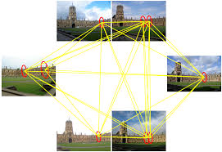
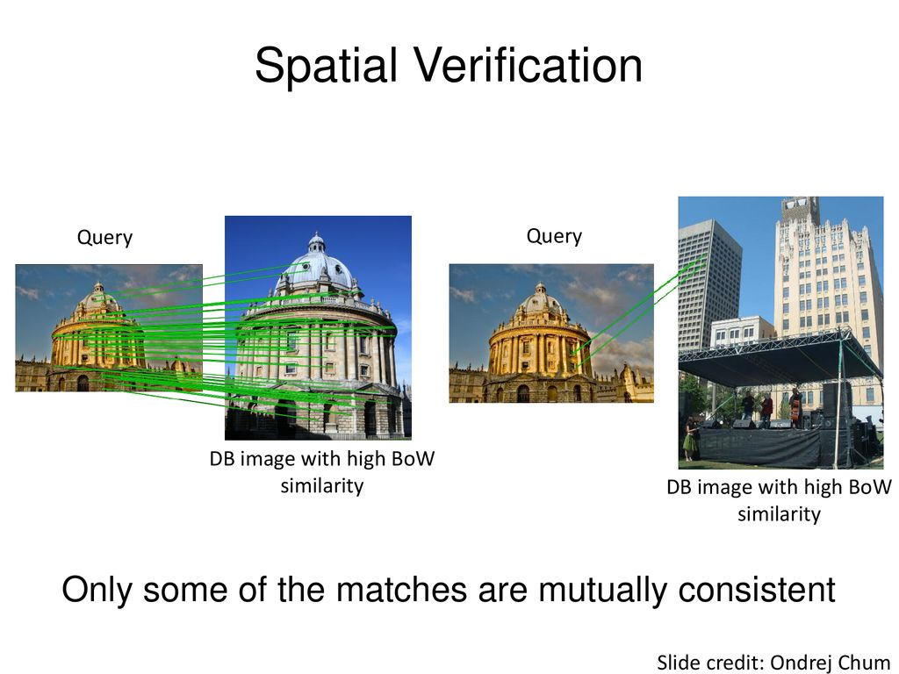
DELF for Image Retrieval
Select K-top descriptors with highest attention score
Perform matching (e.g., ASMK)
(Optional) Re-ranking via Spatial Verification
Shown better performance than learning-based global descriptors
DELF
Matching
Re-ranking
Revisiting Oxford and Paris: Large Scale Image Retrieval Benchmarking Noh et al., CVPR 2018

Slide 8
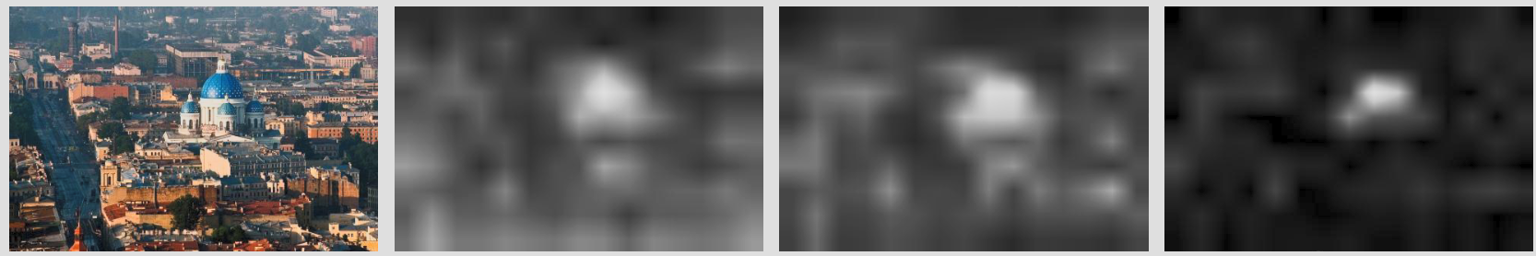
Limitation of DELF-like Descriptors
Image-classification cannot provide enough guidance in locality for instance-level tasks
  Not precisely localized: blurry spatial attention
How can we provide locally distinctive information without dense labels?
Input Image
L2 norm of
local descriptors
Attention-based scores of local descriptors
Large-scale Image Retrieval with Attentive Deep Local Feature, Noh et al., ICCV 2017

Slide 9
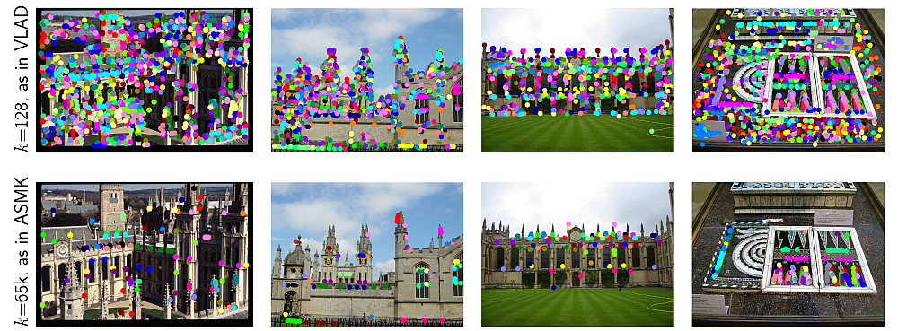

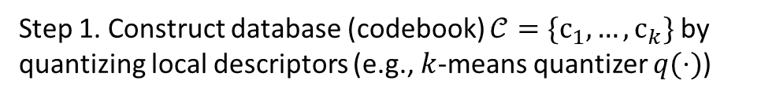
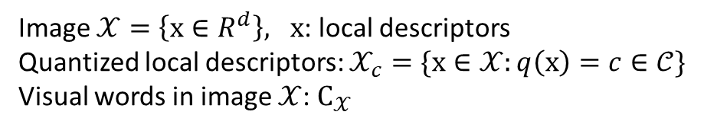
Selective Matching Kernel (SMK)
Indexing and retrieval scheme for local descriptors
Cross-matching all pairs of local descriptors based on matching kernel function $k(⋅)$
Step 1. Construct database (codebook) $𝒞=\{c_{1},…,c_{k}\}$ by quantizing local descriptors (e.g., $k$-means quantizer $q(⋅)$)
Image $𝒳=\left\{x∈R^{d}\right\}, x$: local descriptors
Quantized local descriptors: $𝒳_{c}=\{x∈𝒳:q\left(x\right)=c∈𝒞\}$
Visual words in image $𝒳$: $C_{𝒳}$

Slide 10

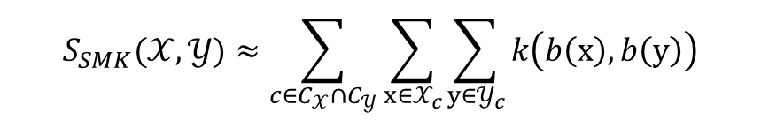
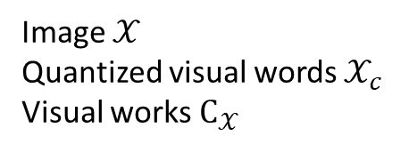
Selective Matching Kernel (SMK)
Indexing and retrieval scheme for local descriptors
Cross-matching all pairs of local descriptors based on matching kernel function $k(⋅)$
Step 2. Calculate similarity based on co-existing codebook descriptors
Image $𝒳$
Quantized visual words $𝒳_{c}$
Visual works $C_{𝒳}$
$$S_{SMK}(𝒳, 𝒴)≈\sum_{c∈C_{𝒳}∩C_{𝒴}}{\sum_{x∈𝒳_{c}}{\sum_{y∈𝒴_{c}}{k\left(b\left(x\right), b\left(y\right)\right)}}}$$
Image $𝒴$
Quantized visual words $𝒴_{c}$
Visual works $C_{𝒴}$
$$b\left(x\right)=sign\left(x−q\left(x\right)\right)$$

Slide 11
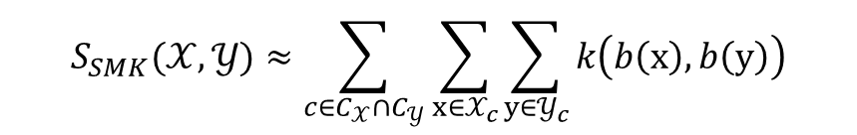
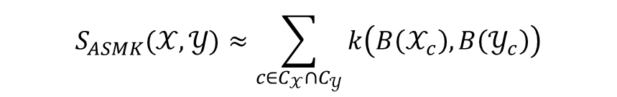

Aggregated SMK (ASMK)
Aggregate all local descriptors on each image before calculating similarity
Efficient calculation, Handle bursty descriptors, Improved matching performance
Image $𝒳$
Quantized visual words $𝒳_{c}$
Visual works $C_{𝒳}$
$$S_{SMK}(𝒳, 𝒴)≈\sum_{c∈C_{𝒳}∩C_{𝒴}}{\sum_{x∈𝒳_{c}}{\sum_{y∈𝒴_{c}}{k\left(b\left(x\right), b\left(y\right)\right)}}}$$
$$S_{ASMK}(𝒳, 𝒴)≈\sum_{c∈C_{𝒳}∩C_{𝒴}}{k\left(B\left(𝒳_{c}\right), B\left(𝒴_{c}\right)\right)}$$
Image $𝒴$
Quantized visual words $𝒴_{c}$
Visual works $C_{𝒴}$
$$B\left(𝒳_{c}\right)=sign\left(\sum_{x∈𝒳_{c}}{\left(x−q\left(x\right)\right)}\right)$$

Slide 12
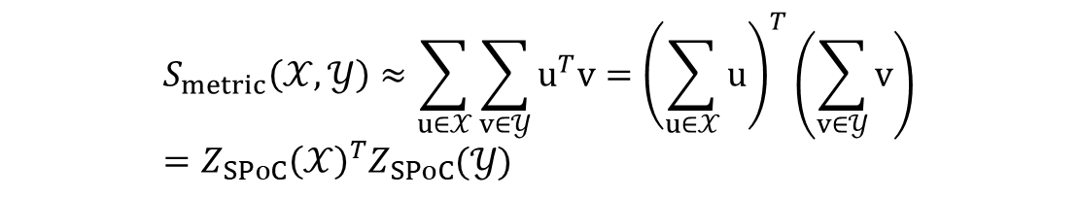
Metric Learning
Metric learning based on pair-wise similarity of dense image features
Same form as metric learning with global image descriptors (SPoC)
Pair-wise
Local descriptor
similairty
Global image descriptor
similarity
Image $𝒳$
Quantized visual words $𝒳_{c}$
Visual works $C_{𝒳}$
$$S_{metric}\left(𝒳, 𝒴\right)≈\sum_{u∈𝒳}{\sum_{v∈𝒴}{u^{T}v}}={\left(\sum_{u∈𝒳}{u}\right)}^{T}\left(\sum_{v∈𝒴}{v}\right) \\ =Z_{SPoC}{\left(𝒳\right)}^{T}Z_{SPoC}(𝒴)$$
Image $𝒴$
Quantized visual words $𝒴_{c}$
Visual works $C_{𝒴}$

Slide 13

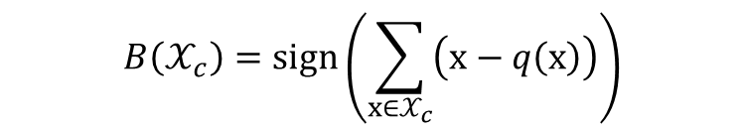

ASMK $≈$ Metric Learning?
Metric learning with global image descriptors is eventually another type of matching kernel of ASMK!
  Can be used as a surrogate task for
  optimizing local descriptors
How does metric learning allow to achieve good dense image features (local descriptors)?
$$B\left(𝒳_{c}\right)=sign\left(\sum_{x∈𝒳_{c}}{\left(x−q\left(x\right)\right)}\right)$$
$$S_{ASMK}(𝒳, 𝒴)≈\sum_{c∈C_{𝓧}∩C_{𝓨}}{k\left(B\left(x\right), B\left(y\right)\right)}$$
$$S_{metric}\left(𝒰, 𝒱\right)≈\sum_{u∈𝒰}{\sum_{v∈𝒱}{u^{T}v}}={\left(\sum_{u∈𝓤}{u}\right)}^{T}\left(\sum_{v∈𝓥}{v}\right)=Z_{SPoC}{\left(𝒰\right)}^{T}Z_{SPoC}(𝒱)$$
Pair-wise
Local descriptor
similairty
Global image descriptor
similarity

Slide 14

Intuition of Metric Learning
Similarity : $u^{T}v=\left\|u\right\|⋅\left\|v\right\|⋅cos\left(u, v\right)$
Case 1. Background features to have small $\left\|u\right\|$
Case 2. Foreground features to have large $\left\|u\right\|$
  Local feature with high $\left\|u\right\|$ as local descriptors

Slide 15
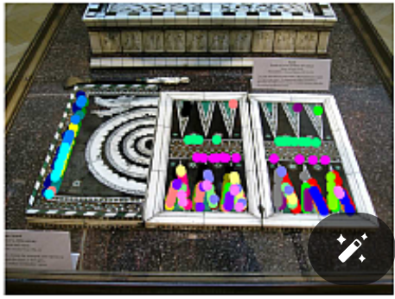

Intuition of Metric Learning
Similarity : $u^{T}v=\left\|u\right\|⋅\left\|v\right\|⋅cos\left(u, v\right)$
Case 3. Corresponding features to be closer
Case 4. Non-corresponding features to be pushed apart
Anchor descriptors
Push
Pull
Positive descriptors
Negative descriptors

Slide 16
Methods
Network Architecture Details and Matching Protocols

Slide 17
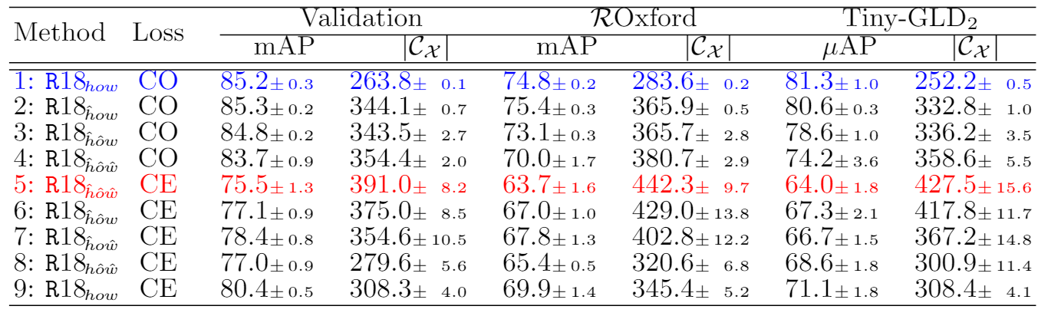
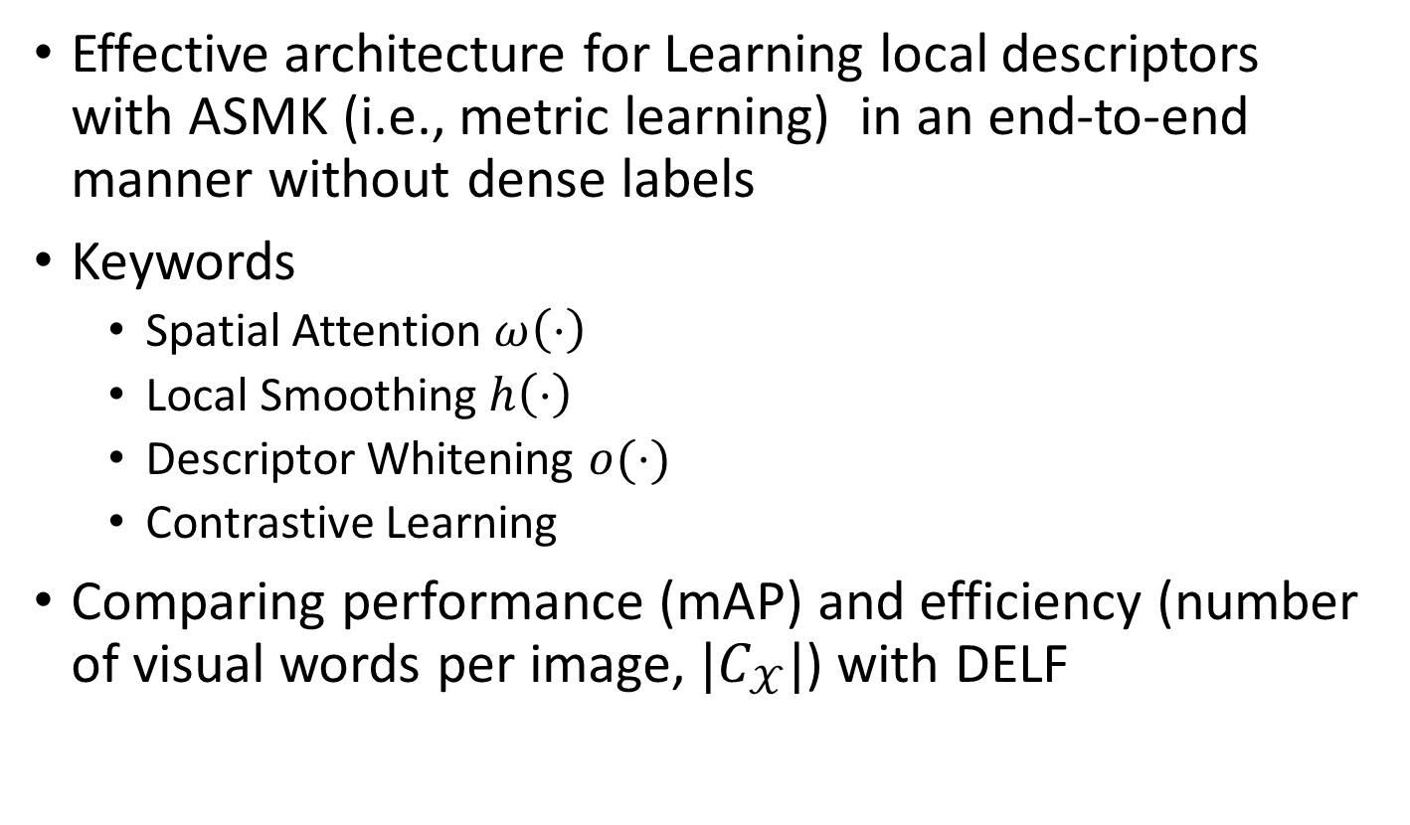
Main Idea
Effective architecture for Learning local descriptors with ASMK (i.e., metric learning) in an end-to-end manner without dense labels
Keywords
  Spatial Attention $ω\left(⋅\right)$
  Local Smoothing $h\left(⋅\right)$
  Descriptor Whitening $o(⋅)$
  Contrastive Learning
Comparing performance (mAP) and efficiency (number of visual words per image, $|C_{𝒳}|$) with DELF

Slide 18
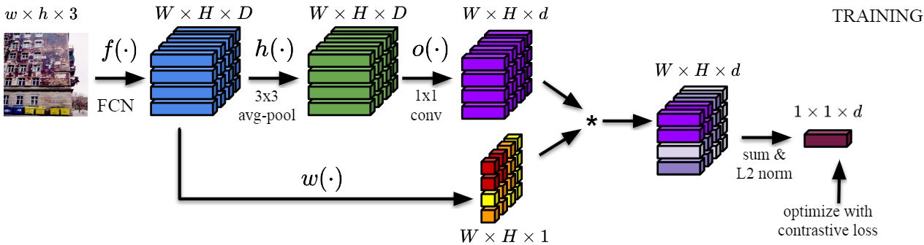


Spatial Attention $ω\left(⋅\right)$
Calculate spatial attention as channel-wise $l_{2}$-norm of FCN activation (e.g., ResNet-18, ResNet-50)
  $ω\left(f(I)\right)=\left\|f(I)\right\|$
Not learnable (DELF use learnable attention)

Slide 19
Local Smoothing ℎ(⋅)
High-dimensional activations are often spatially not-well aligned (burstiness)
Apply avg. pooling to introduce spatial alignment

Slide 20
Descriptor Whitening 𝑜(⋅)
Add learnable whitening 1x1 convolution layer
Initialize parameters with PCA whitening values
  DELF use PCA whitening

Slide 21
Descriptor Whitening 𝑜(⋅)
Add learnable whitening 1x1 convolution layer
Initialize parameters with PCA whitening values
  DELF use PCA whitening

Slide 22
Contrastive Learning
Weighted sum of whitened activations based on spatial attention
Higher performance (mAP) & Lower memory

Slide 23
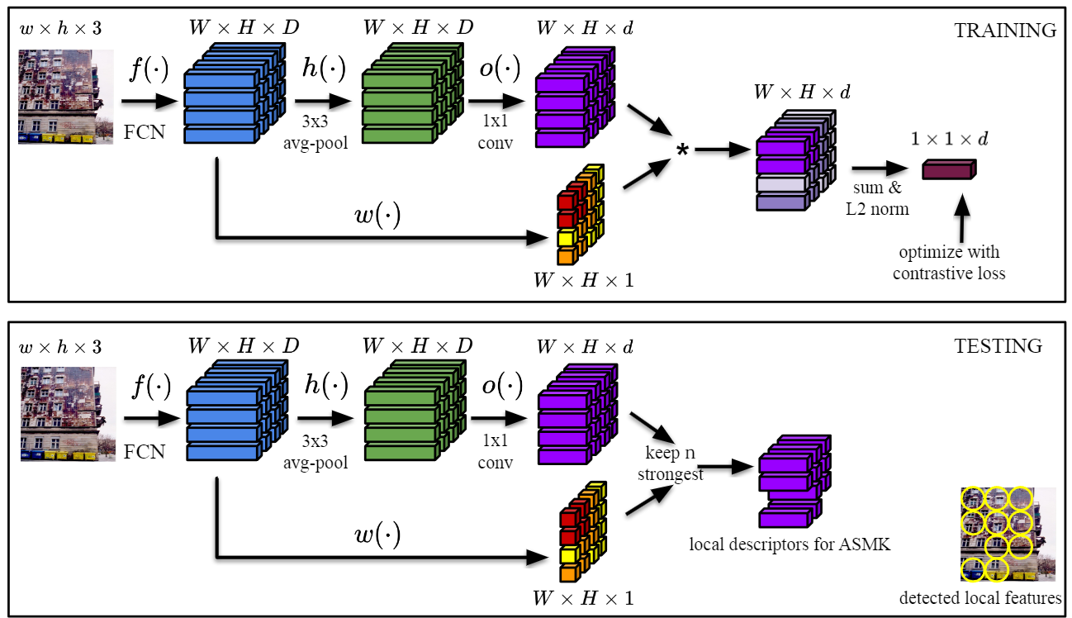
Matching Protocal
K-strongest features as local descriptors, based on spatial attention
Matching via ASMK

Slide 24
Results
Instance-level search (ROxford, RParis)
Instance-level classification (Google Landmarks Dataset, GLD)

Slide 25
Experiment Settings
Training & Validation: SfM120k
Instance-level search: ROxford, RParis
  mAP on Medium and Hard setups
  With and without 1 million distractors (R1M)
  Efficiency as memory required to encode R1M
Instance-level classification: Google Landmarks Dataset
  Accumulate similarity of N top-ranked images per class
  N=1 (CLS1)
  N=10 (CLS2)
  N=10 w/ square rooted similarity (CLS3)

Slide 26
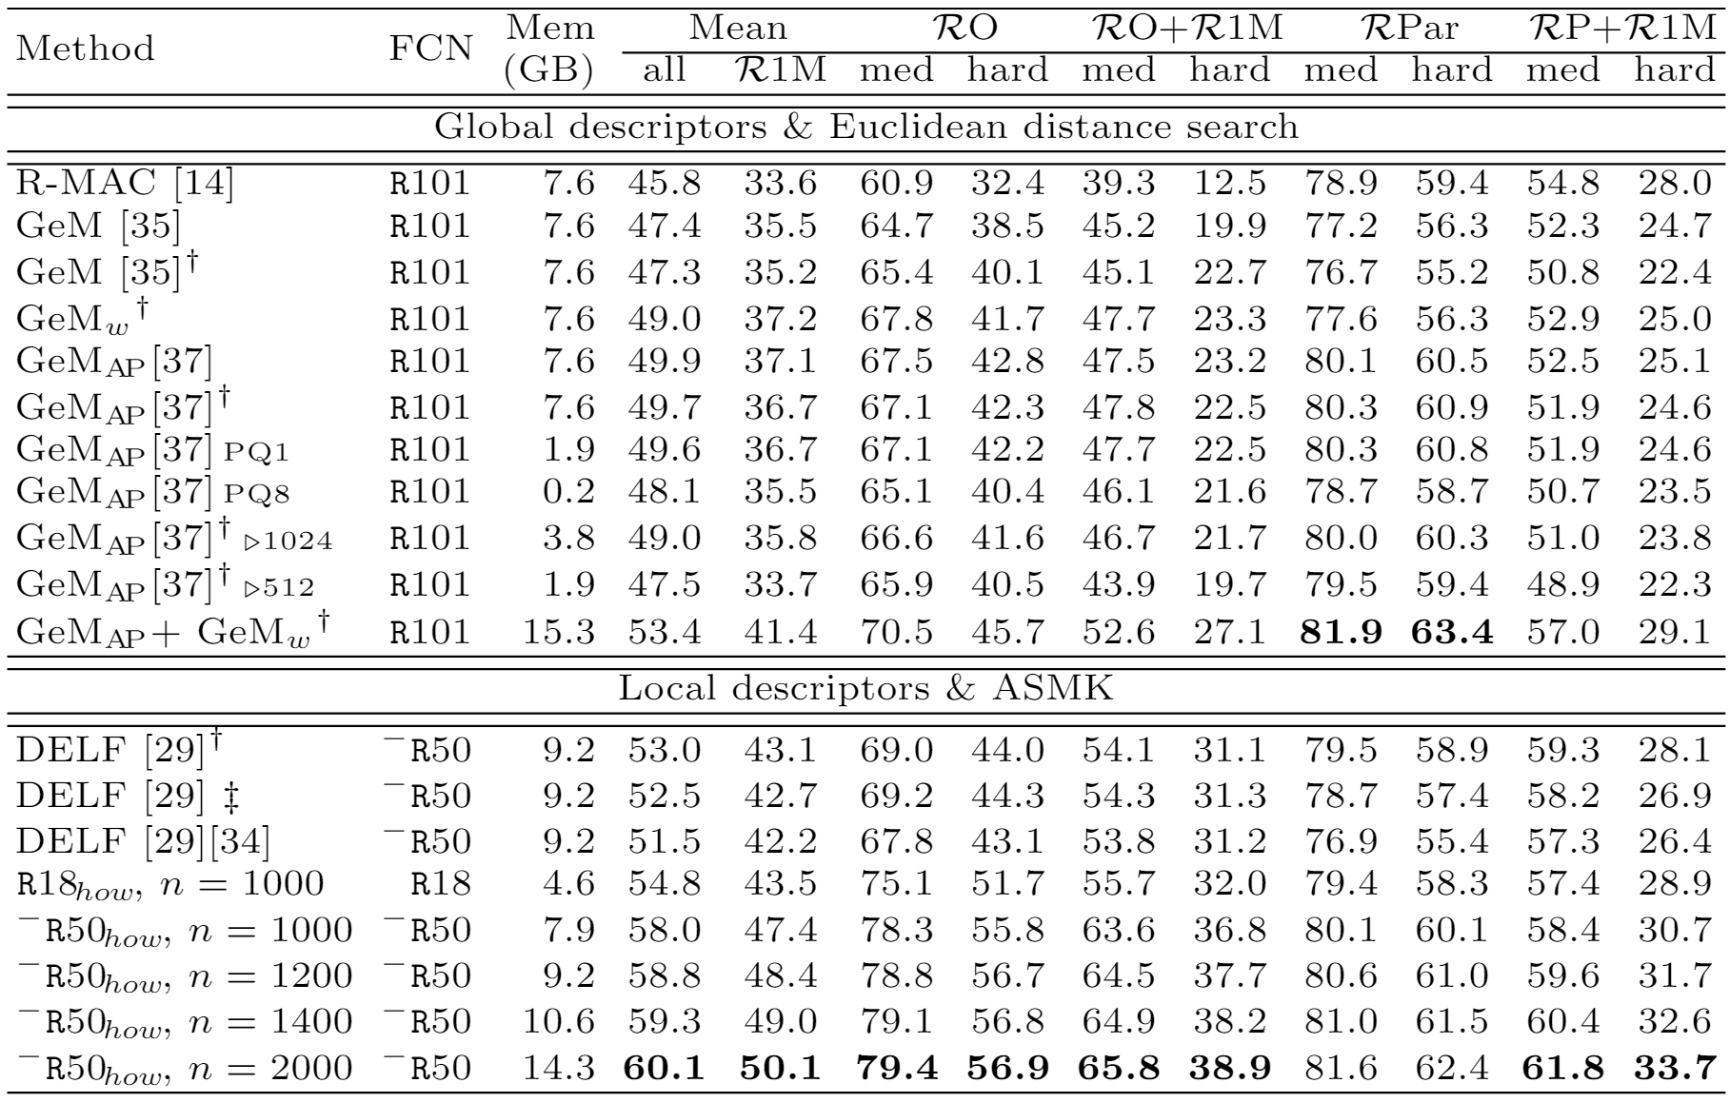
Instance-level Search (w/ Global Des.)
Better performance & efficiency with smaller backbone
  All numbers except Mem. means mAP
  n: number of top score local descriptors for matching

Slide 27
Instance-level Search (w/ DELF)
Better performance & efficiency
  All numbers except Mem. means mAP
  n: number of top score local descriptors for matching

Slide 28
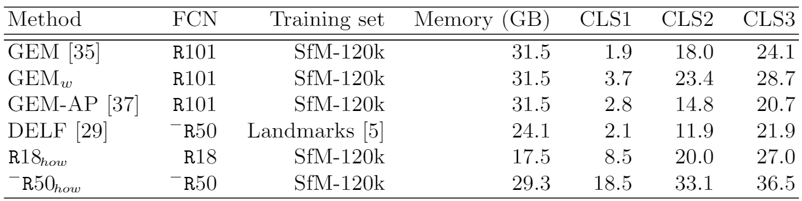
Instance-level Classification
Comparison with various global & local descriptors
  Classification score (CLS) higher the better
  Accumulate similarity of N top-ranked images per class
  N=1 (CLS1)
  N=10 (CLS2)
  N=10 w/ square rooted similarity (CLS3)

Slide 29
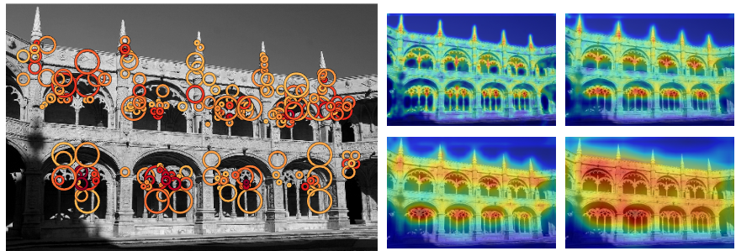
Attention Visualization
Finer spatial attention leading to more robust local descriptors
  Allows to use various scale-level descriptors
X0.25
X0.5
X1
X2
Strongest feature per visual words
Attention map for input images with different scale

Slide 30
Conclusion
Summary & Limitation

Slide 31
Summary
Shown metric learning highly resembes matching algorithm (i.e. ASMK)
Apply metric learning & design effective architecture to learn local descriptors
Improved performance and efficiency

Slide 32
Limitation and Next Paper
Still, metric learning is done based on global descriptor (aggregated local descriptors)
  Could be an uncontrollable discrepancy between the
  global and local descriptors
Learning Super-Features for Image Retrieval
Weinzaepfel et al., ICLR 2022
  Apply metric learning directly on (few) local descriptors

Slide 33
Thank You!

Slide 34
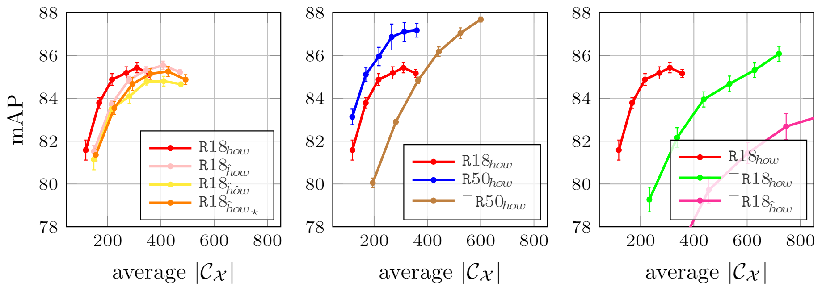
Appx. Ablation study (Efficiency)
Star: random init. for whitening layer 𝑜(⋅)
-: Remove last layer of the model (higher dimension)

Slide 35
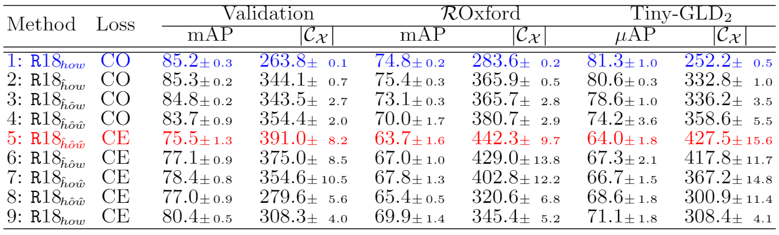
Appx. Ablation study (Architecture)

