Slide 1
Paper Presentation I
Sheikh Shafayat
Deep Learning based Image Search (CS588)

Slide 2
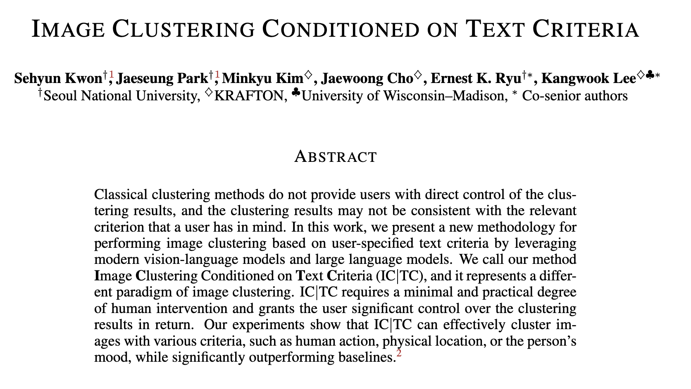
Today’s Paper
*These slides were made by referring to authors’ tweets

Slide 3
Before I go into the details…
2 minutes summary of this paper
Will come back to details

Slide 4
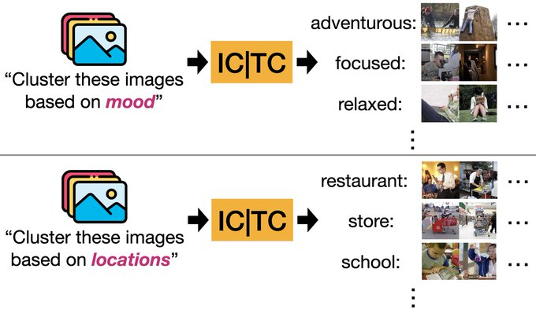
What is the problem?
They are doing image clustering
Not just any kind of clustering
Clustering based on user query
Query is word based
Use cases:
You can cluster the same images in many different ways
By mood, location, event

Slide 5
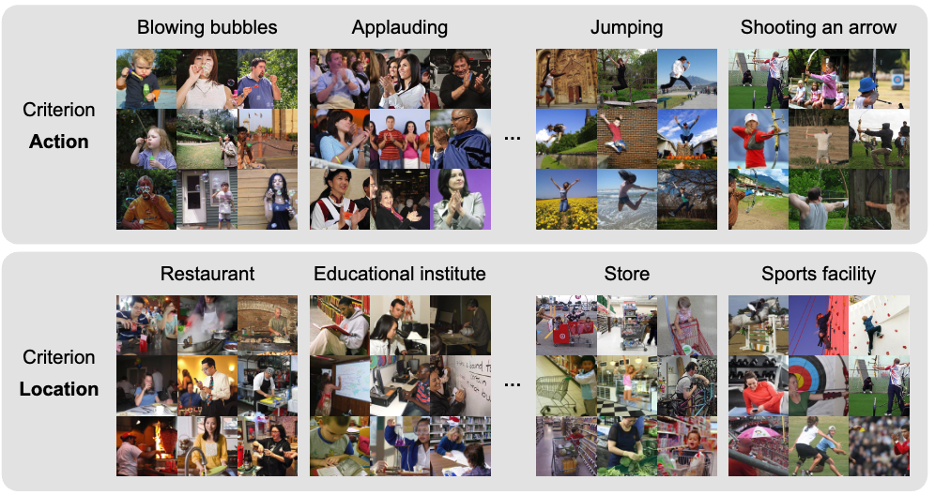
More example…

Slide 6
How does it work?
Pretty simple!
Use a vision-language model like LLaVA to get image captions
Then do text clustering!
Using text clustering algorithm

Slide 7
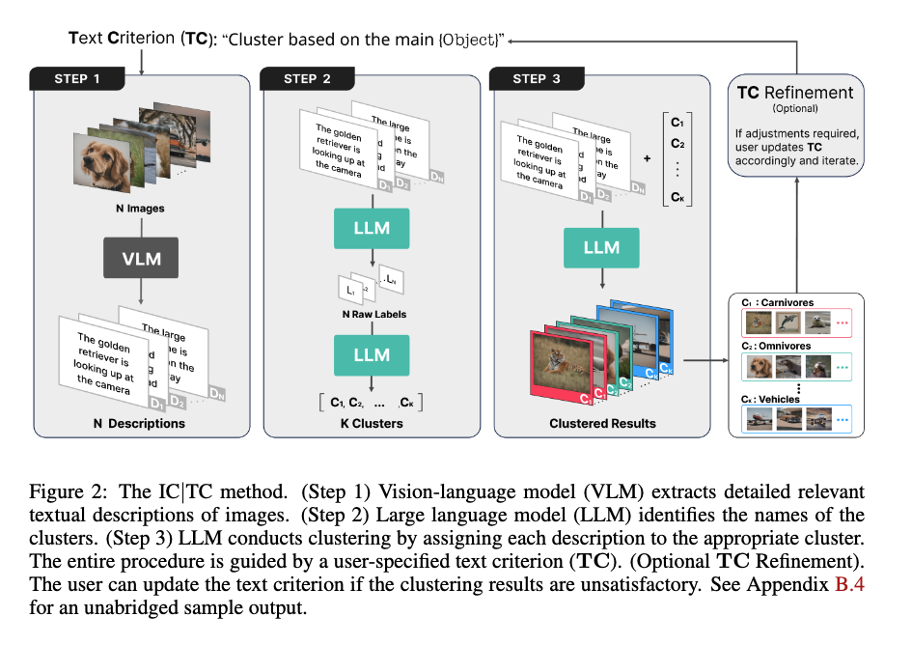
How does it work?

Slide 8
Results…

Slide 9
That was my 2 mins summary
Let’s go back to the details

Slide 10
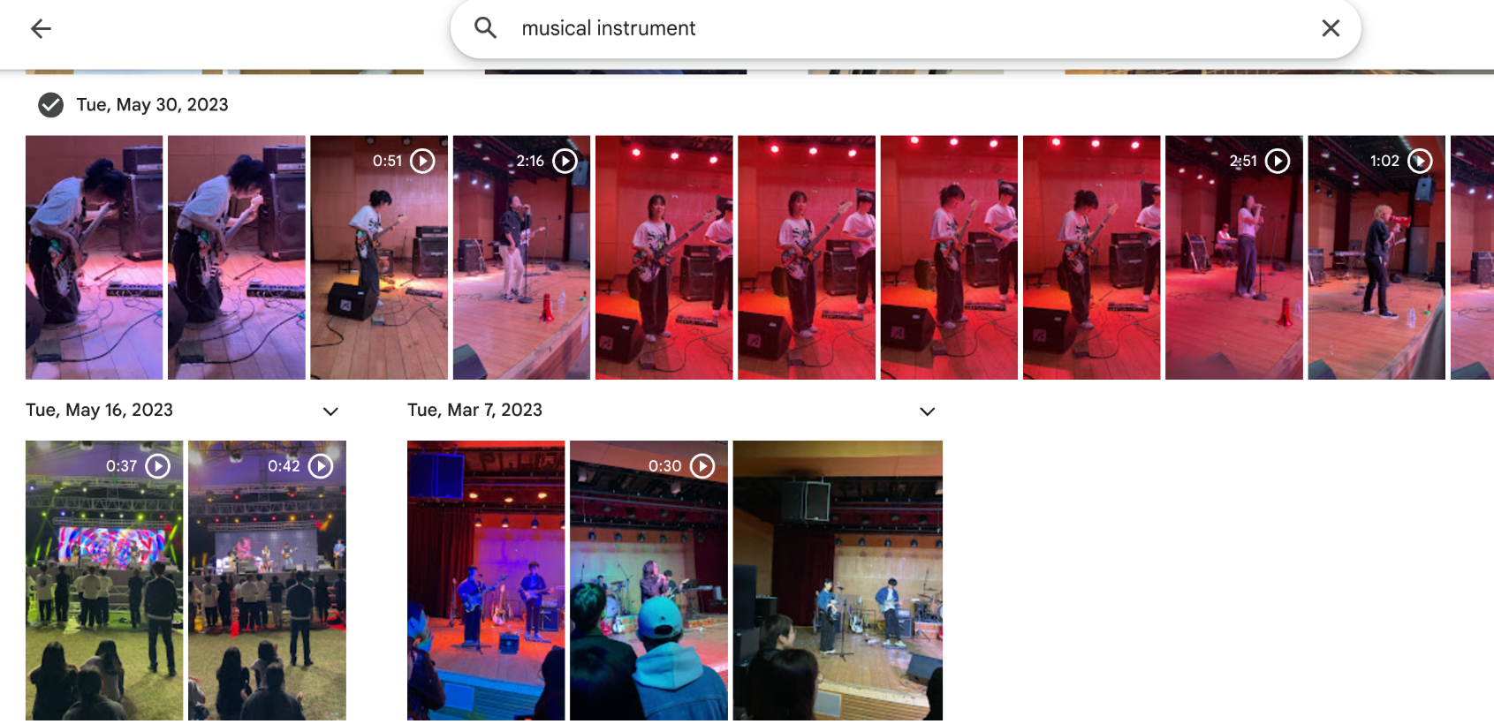
Let’s clear some confusions first…
The problem setting is not like traditional clustering
It’s more like traditional search
Difference with search:
Users also provide k clusters
Search doesn’t have that

Slide 11
Methodology Details…
First you get the image captions
You ask LLM (GPT4) to generate k cluster names from the captions
First, you get the labels for each image
Then you summarize them into k clusters (using GPT4)
Then GPT4 reads each caption and puts them into k cluster

Slide 12
Prompt Details…
Note that you need to provide input query (TC) in every step

Slide 13
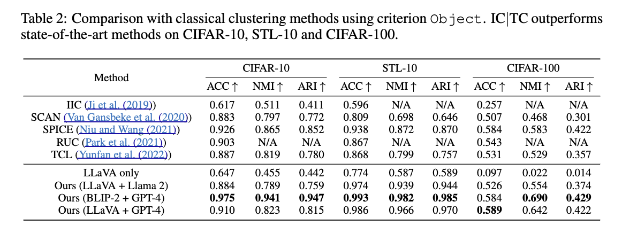
Results
Note that this is a new task,
No baselines to compare
But even as a standard clustering setting, it is the SOTA

Slide 14
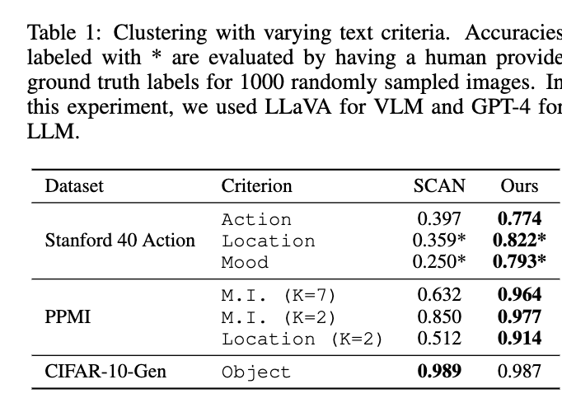
Results
In clustering with text criteria
Traditional algorithms don’t work
No details on how they even made them work
Location and Mood were labelled separately for this paper

Slide 15
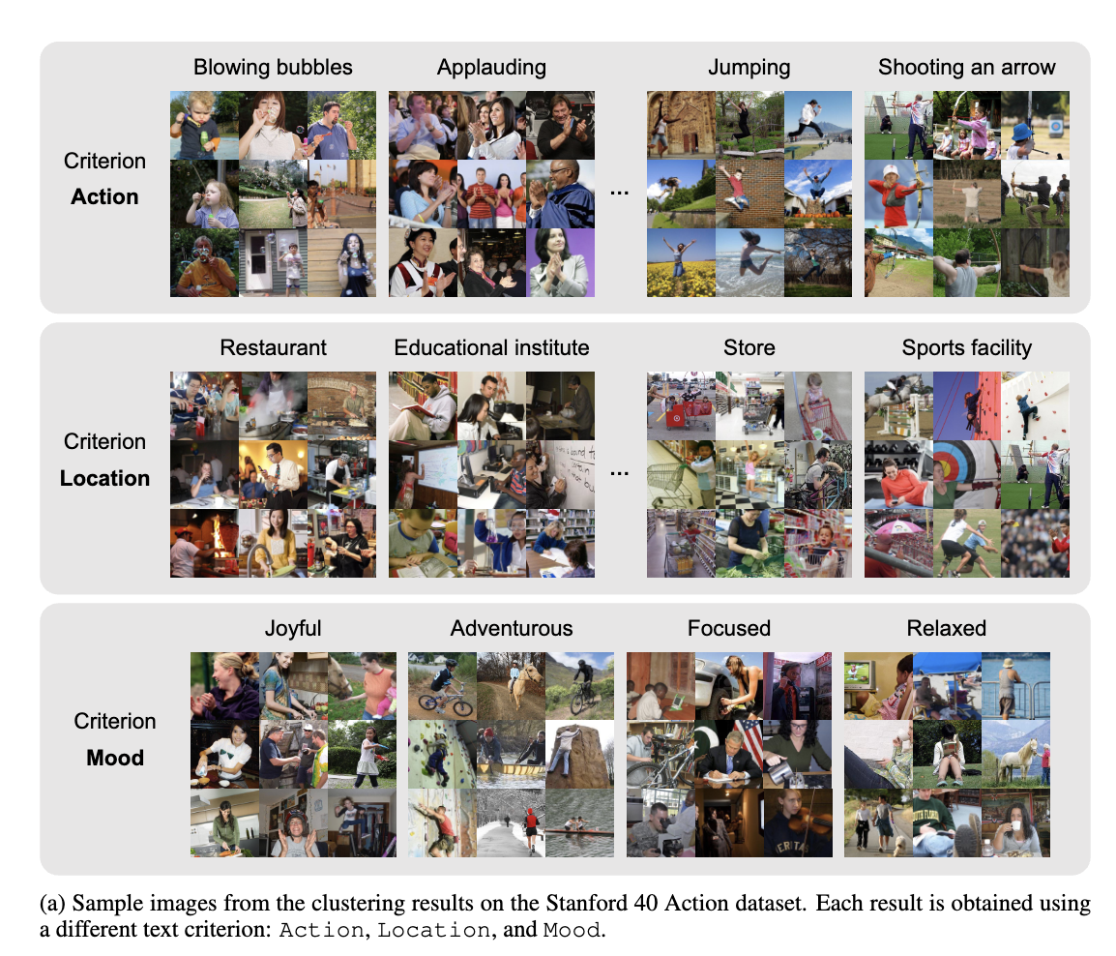
Results

Slide 16
Results
You can even modify the granularity of the clustering criteria
Usually higher k means fine grained

Slide 17
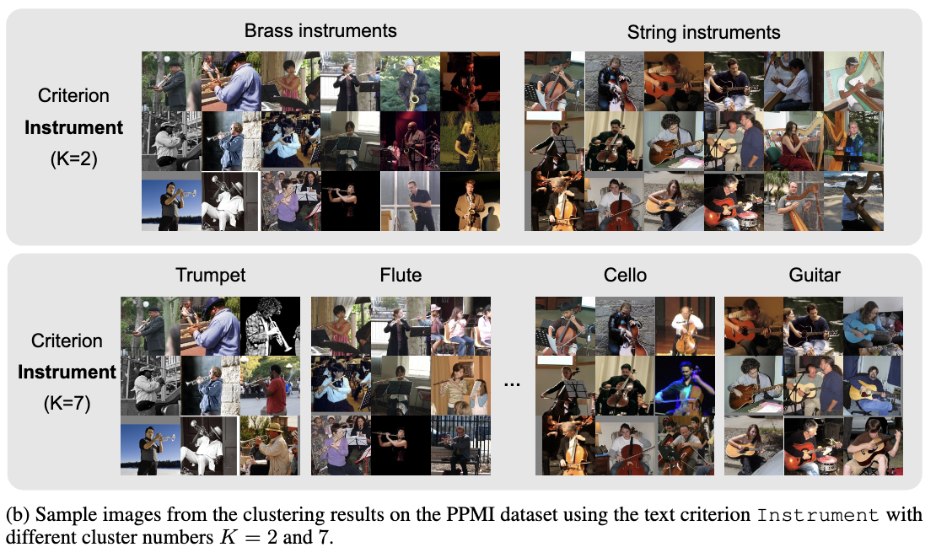
Results
PPMI: People Playing Musical Instruments
Notice the difference between k = 2 and k = 7
GPT4 generated those category names by themselves

Slide 18
Afterthoughts

Slide 19
Pros about the paper… ✅
The task is indeed novel
Unsupervised clustering with user defined control
New paradigm in image clustering
Provide fine grained control over clustering outputs
Clever prompting can reduce gender bias (shown in the paper)

Slide 20
Cons about the paper… 🧐
Computationally VERY expensive
Embedding caching is not possible
Need to run the entire pipeline for every query
Motivation is not clear
How is this problem a “real” problem from a user’s perspective?
And what problem does it solve that zero shot image search can’t solve?

Slide 21
Summary
This paper proposes a new paradigm in image clustering
User gives a text
Algorithm clusters images based on that text
The method works through a chain of VLM and LLMs
The results are good
But
Computationally very expensive at current stage
The motivation is not clear:
Is the problem worth the computational expense

Slide 22
Thanks

