Slide 1

Localizing Objects with Self-Supervised Transformers and no Labels
(BMVC 2021)
Jinhwan Seo
(서진환)
2024/05/22
Notes:
1

Slide 2
RECAP
Follow-up Differential Descriptions: Language Models Resolve Ambiguities for Image Classification
Task
Image classification
Make initial prediction using CLIP (ambiguous)
(Prediction + prompt) into LLM to generate description
(Image + description) into VLM to distinguish class

Slide 3
Task
Unsupervised Object Discovery:
  Identify single object in an image without using labeled examples or pre-defined categories.
  Computationally efficient (60FPS)
Object Discovery

Slide 4
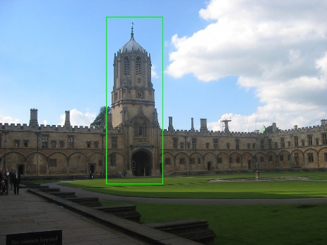
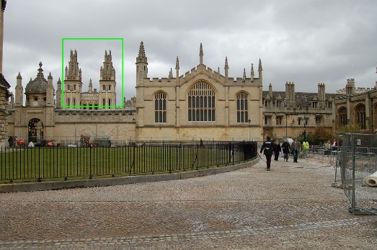
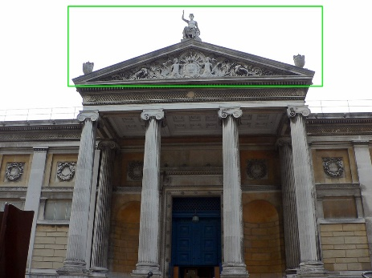
Why UOD?
Unsupervised Object Discovery:
  Identify single object in an image
    Single landmark in image retrieval task
  Computationally efficient (60FPS)
    Large-scale dataset

Slide 5
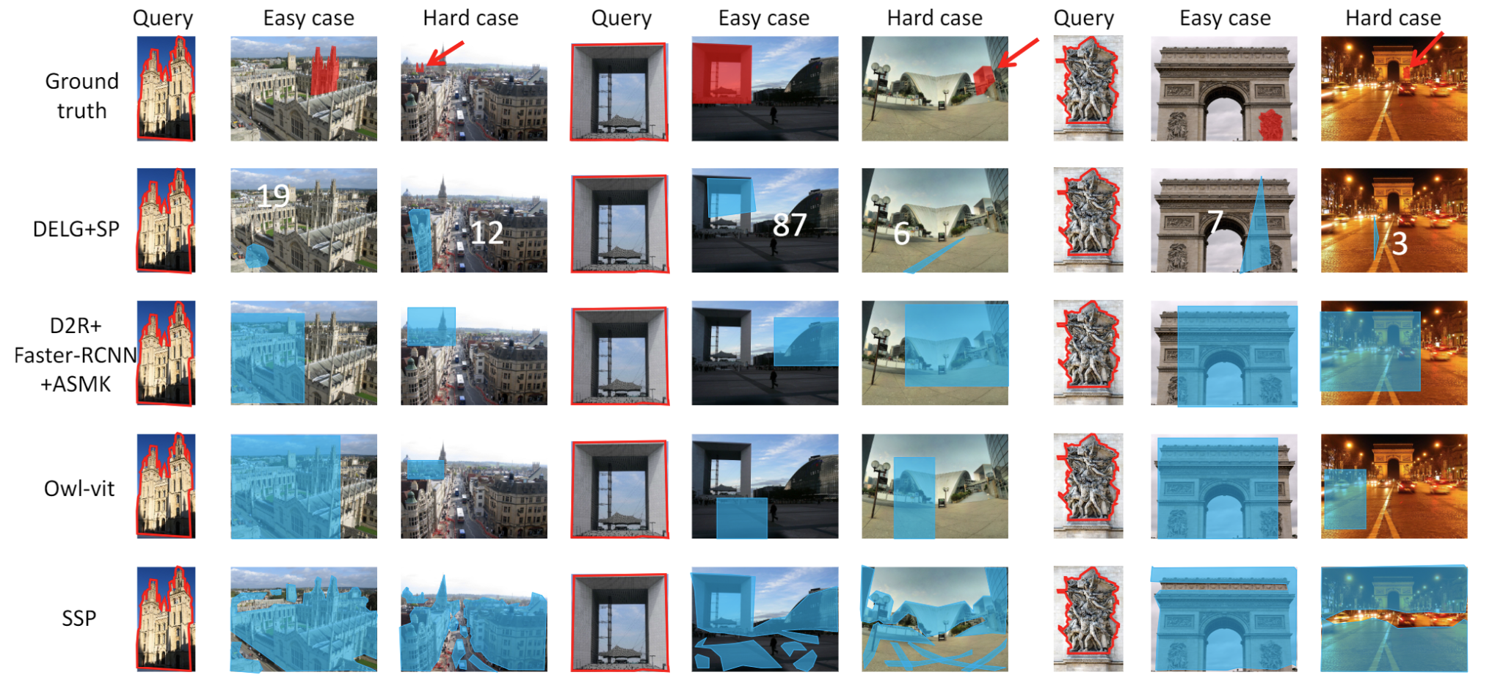
Background
Evaluate localization methods for pixel retrieval
  Spatial Verification: SIFT, DELF and DELG
  One-shot Detection: Faster R-CNN, SSD and D2R
  Dense matching: GLUNet, WarpC, …
An, et al. “Towards Content-based Pixel Retrieval in Revisited Oxford and Paris” ICCV 2023

Slide 6
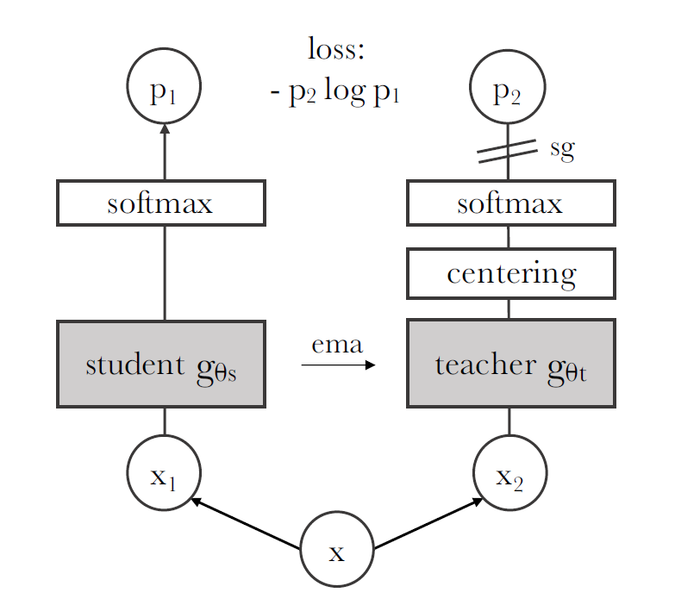
Background
DINO
Self-attention map
Caron, et al. “Emerging Properties in Self-Supervised Vision Transformers” ICCV 2021

Slide 7
Problem
1. Multi-heads attend to different parts of an image
It is not obvious where each head looking at
[Slide Credit]: Oriane Simeoni – Exploiting self-supervised features: unsupervised object localization

Slide 8
Assumption
1. Foreground and background features are less correlated with each other
Sim( , ) = positive
Sim( , ) = negative
Sim( , ) = positive
Sim( , ) = negative

Slide 9
Assumption
2. Less patches of object than background
10
38
# of object patches are less than background patches

Slide 10
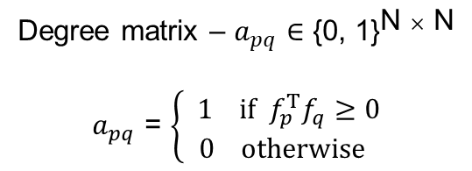

Method
Step 1: Calculate degree for all $N^{}$ nodes (N = H*W)
DINO
flat
…
(H, W, D)
$f_{p}$ - (N, D)
D
…
Degree matrix – $a_{pq}$ $∈$ ${\text{\{0, 1\}}}^{\text{N} × \text{N}}$
$a_{pq}$ = $\left\{\begin{aligned} 1 if f_{p}^{T}f_{q}≥0 \\ 0 otherwise\end{aligned}\right.$
N
…

Slide 11
Method
Step 1: Calculate degree for all $N^{}$ nodes (N = H*W)
…
1 | 1 | 0 | 0 | … | 1 | 1 | 1
 | 1 | 0 | 0 | … | 1 | 1 | 1
 |  | 1 | 1 | … | 0 | 0 | 0
 |  |  | 1 | … | 0 | 0 | 0
 |  |  |  | 1 |  |  | …
 |  |  |  |  | 1 |  | …
 |  |  |  |  |  | 1 | …
 |  |  |  |  |  |  | 1
N
…

Slide 12

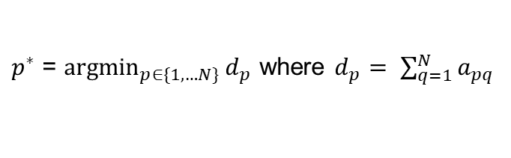
Method
Step 2: Select Initial Seed
…
28 | 30 | 9 | 8 | … | 25 | 19 | 27
$p^{∗}$
$p^{∗}$ = $\underset{p∈\{1, …N\}}{argmin}{d_{p}}$ where $d_{p}= \sum_{q=1}^{N}{a_{pq}}$
10
38
According to the two assumptions
  Foreground are less correlated with background
  Less foreground patches than background
The patch with lowest degree are the most likely to fall in an object

Slide 13
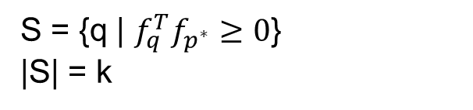
Method
Step 3: Expansion
…
0 | 0 | 1 | 1 | … | 0 | 0 | 0
S = {q | $f_{q}^{T}f_{p^{∗}}≥0$}
|S| = k
K is hyperparameter, k = 100 in this paper

Slide 14
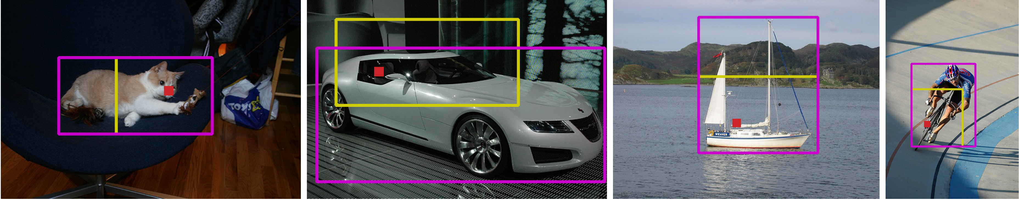
Result
Object seed
Predicted box
Groundtruth

Slide 15
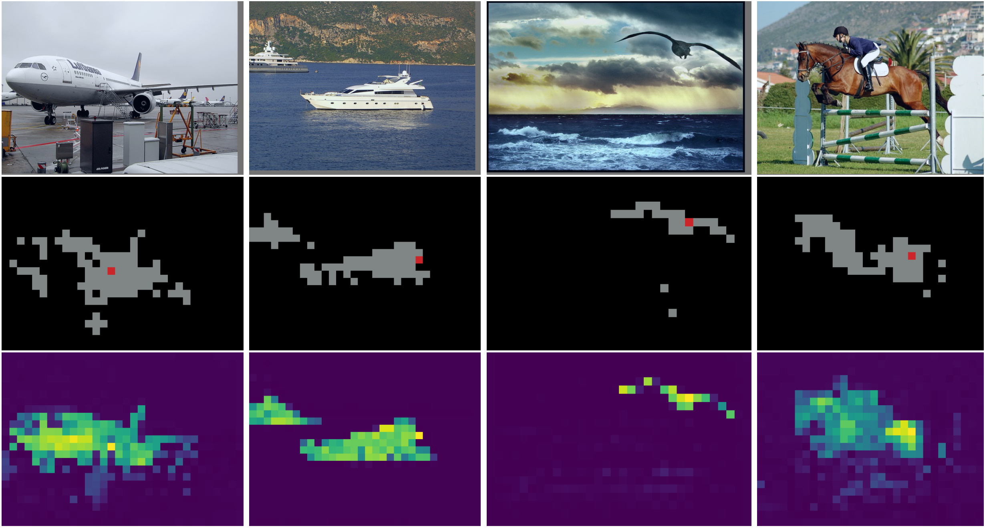
Result
Object seed
Expand patches
Map of inverse degree

Slide 16
Result
CAD: Class-agnostic detector
CorLoc performance on detection dataset
SOTA at 2021

Slide 17
Result
With different backbones
Best on ViT-S/16

Slide 18
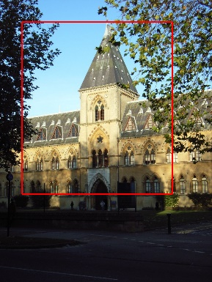
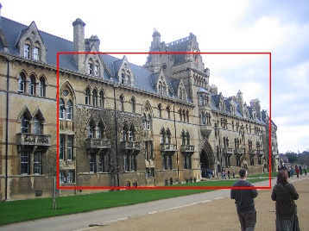
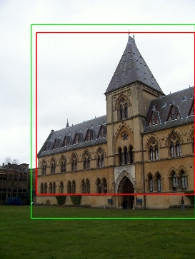
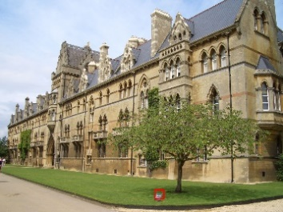
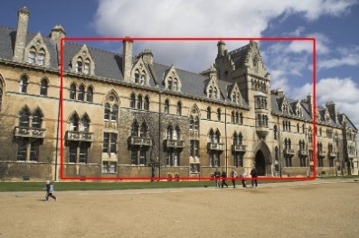
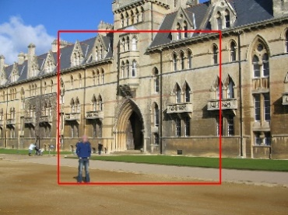
Application
Rank2
Rank1
Query
Rank3
Rank4
Rank5
True Positive
False Positive

Slide 19
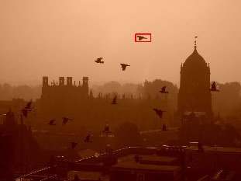
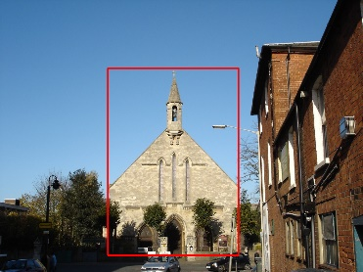
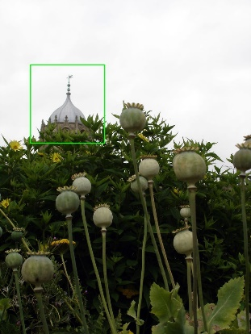
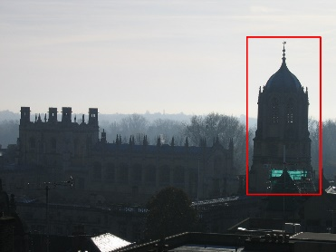
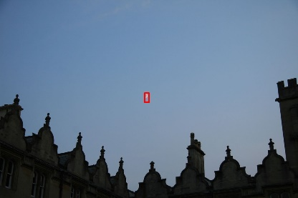
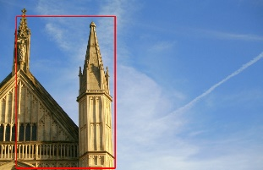
Application
Rank1
Rank2
Query
Rank3
Rank4
Rank5
True Positive
False Positive

Slide 20
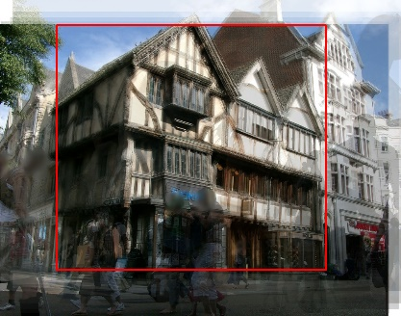
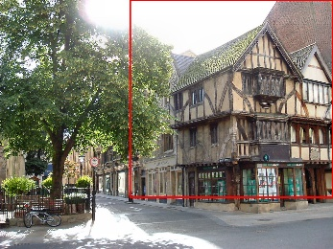
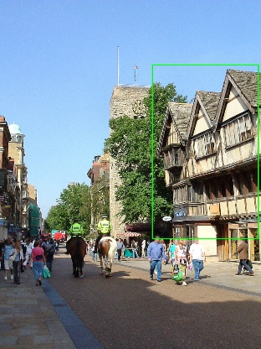
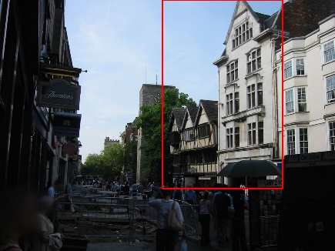
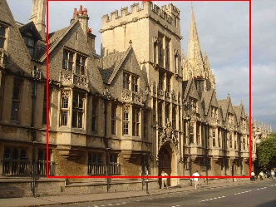
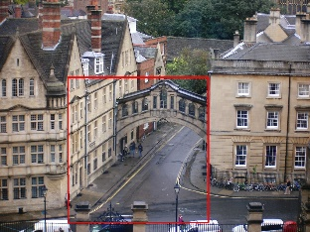
Application
Rank1
Rank2
Query
Rank3
Rank4
Rank5
True Positive
False Positive

Slide 21
Conclusion
Pros
  Simple and effective
  Quick (60FPS)
  Applicability
Cons
  Single object localization
  Issues when object covers most of image

Slide 22
Quiz

