Slide 1
Learning Super-Features for Image Retrieval
ICLR 2022
2024-05-27
Kyu Beom Han

Slide 2
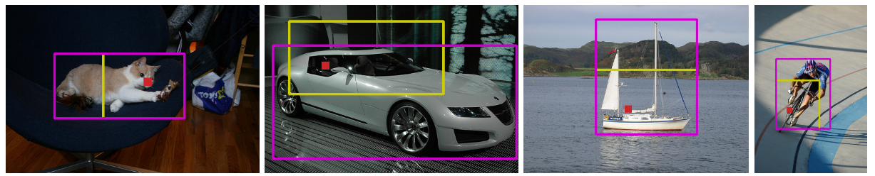
Review – Localizing Objects with Self-Supervised Transformers and no Labels
Goal : Localizing object without supervision in real-time (~60 fps)
Finding a representative seed that localizes the foreground object using self-supervised transformer
  Foreground and background features are postiviely correlated to themselves
  and negatively correlated with othres
  Foreground covers less are than the background
Find initial seed feature with least positive correlation with surrounding features (red point)
Expand the seed by finding positively correlated surrounding features

Slide 3
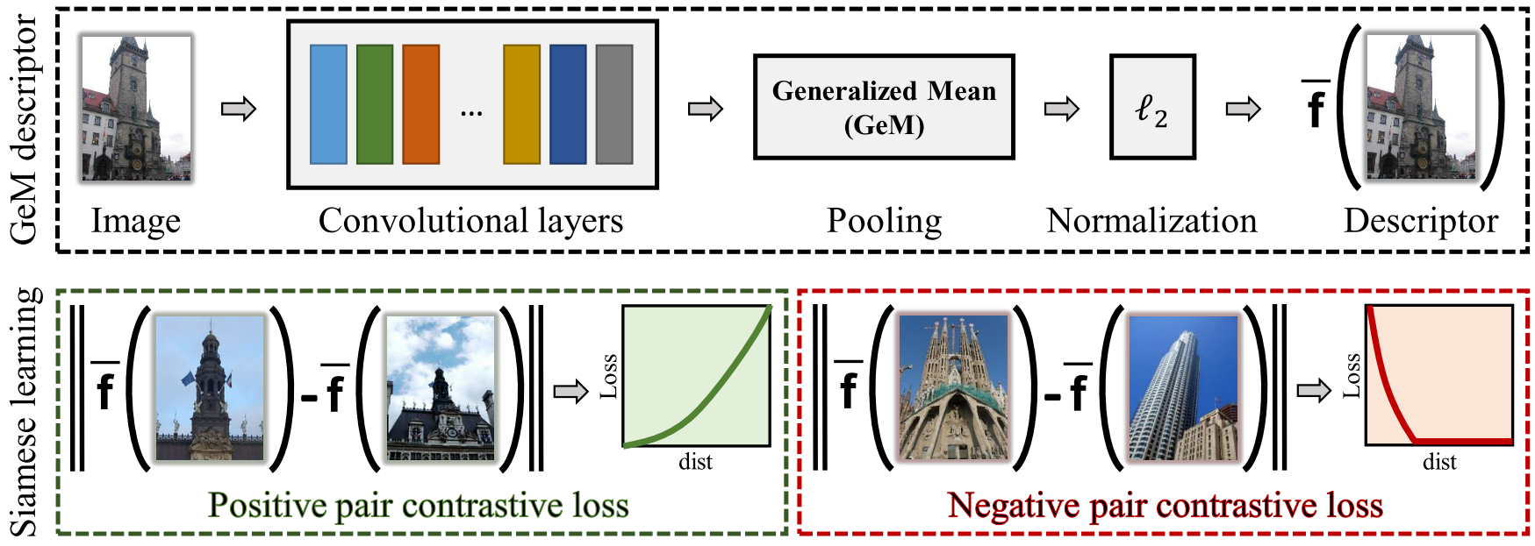
Background – CNN-based Image Retrieval Framework
Global descriptors are earned by pooling local CNN features
Global descriptors trained with metric learning
Fine-tuning CNN Image Retrieval with No Human Annotation, Radenovi et al., TPAMI 2018

Slide 4
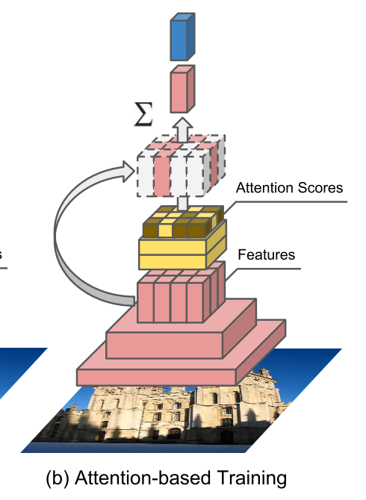
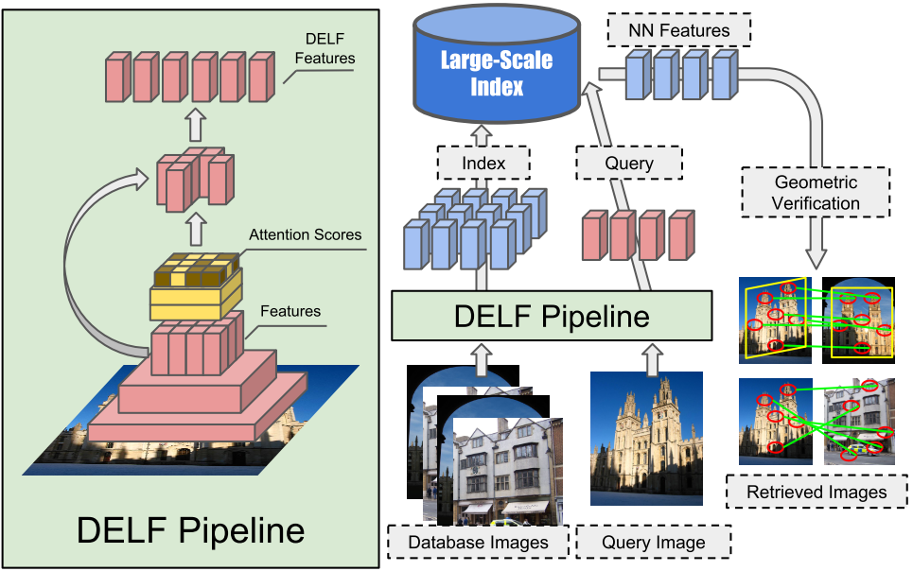
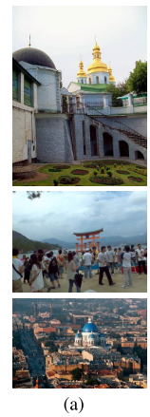
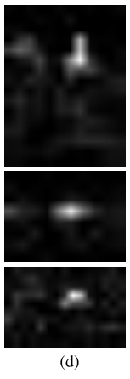
Background – CNN-based Image Retrieval Framework
Local descriptors can be achieved by retrieving important CNN features
Attention mechanism is used to score local descriptors
Trained with weighted sum of local descriptors based on attention
Attention and local descriptos are weakly-supervised by training on global descriptors
Global descriptor for training via
classification
Large-Scale Image Retrieval with Attentive Deep Local Features, Noh et al., ICCV 2017

Slide 5
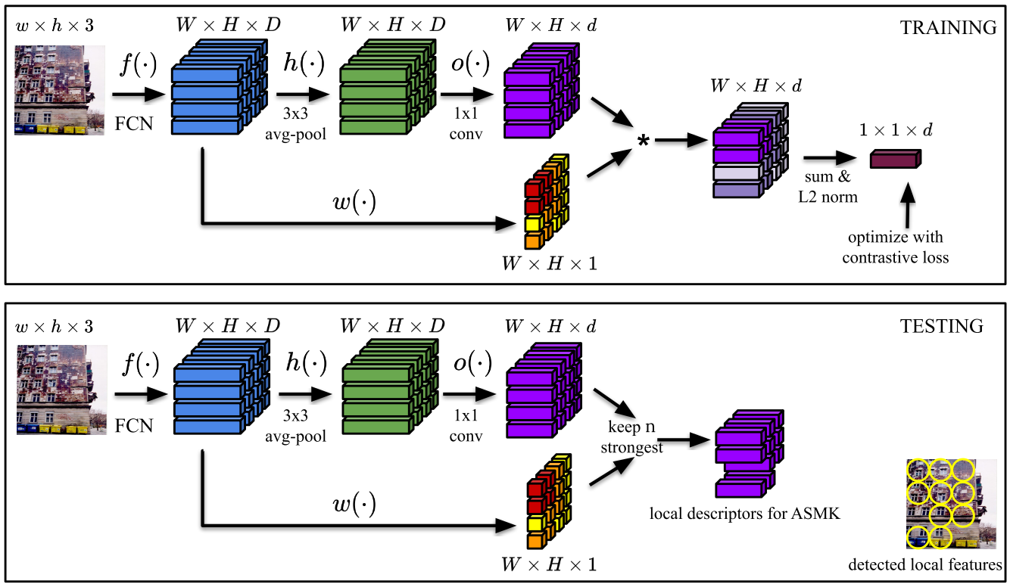
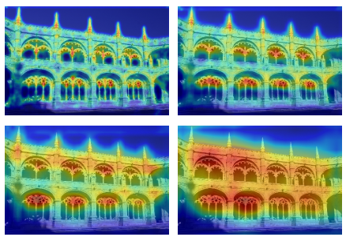
Background – CNN-based Image Retrieval Framework
Local descriptors can be achieved by retrieving important CNN features
Attention mechanism is used to score local descriptors
Trained with weighted sum of local descriptors based on attention
Attention and local descriptos are weakly-supervised by training on global descriptors
Attention map from multi-scale input
X0.25
X0.5
X1.0
X2.0
Learning and Aggregating Deep Local Descriptors for Instance-Level Recognition, Tolias et al., ECCV 2020

Slide 6
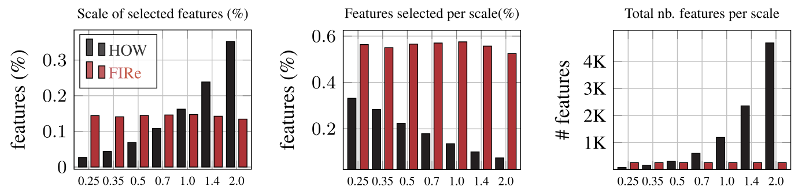
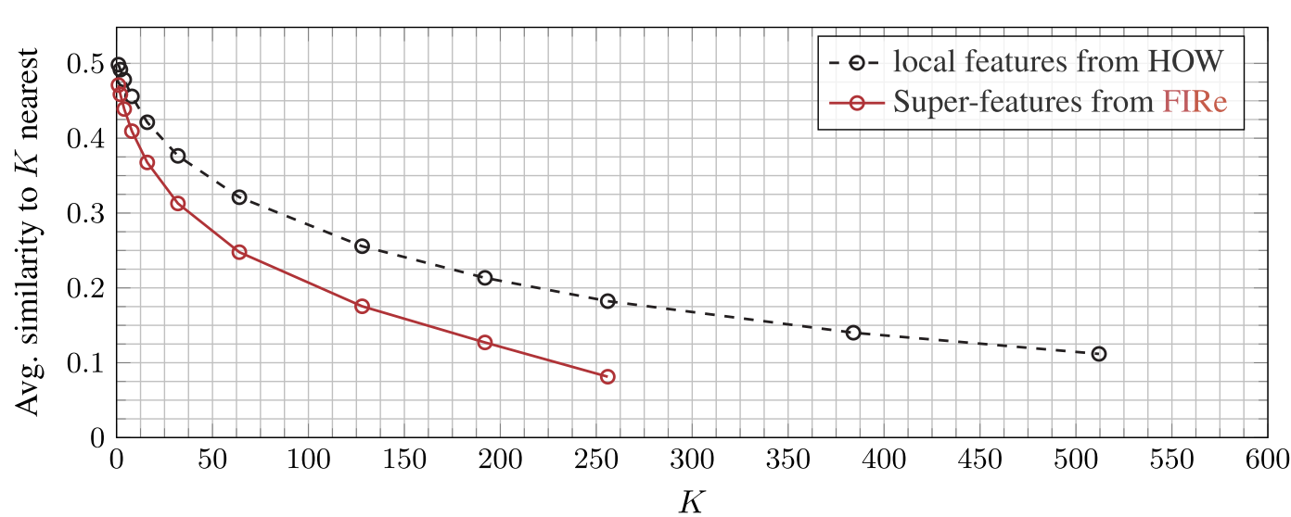
Limitation – Implicit Training Leads to Redundant Local Descriptors
Huge discrepancy when training and testing with local descriptors
  Aggregated via attention for training with classfication or metric learning
  But matched individually during test stage
Local descriptors may be highly redundant
  Attention map trained without supervision cannot represent fine localization information
  Highly-correlated local descriptors
    Multiple local descriptors may highlight same region
May lead to exhaustive computation for matching, and to worse performance
Percentage of selected features on various scale comparing
existing work (HOW) and proposed work (FIRe)
Avg. similarity between K-nearest descriptors comparing existing work (HOW) and proposed work (FIRe)

Slide 7
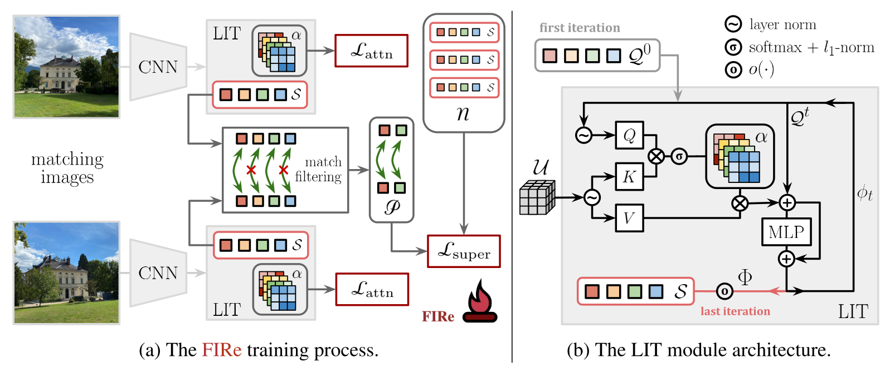

Overview – Training Directly with Local Descriptors
Extract Super-Features $𝒮$ from iterative-refining transformer module (LIT)
  Super-Features: Representative set of local attentional features
  LIT: Local feature Integration Transformer
Apply contrastive loss $ℒ_{super}$ directly on Super-Features
Matching mechanism with Super-Features to identify positive / negative pairs
Attention loss $ℒ_{attn}$ for more diverse & discriminative attention

Slide 8
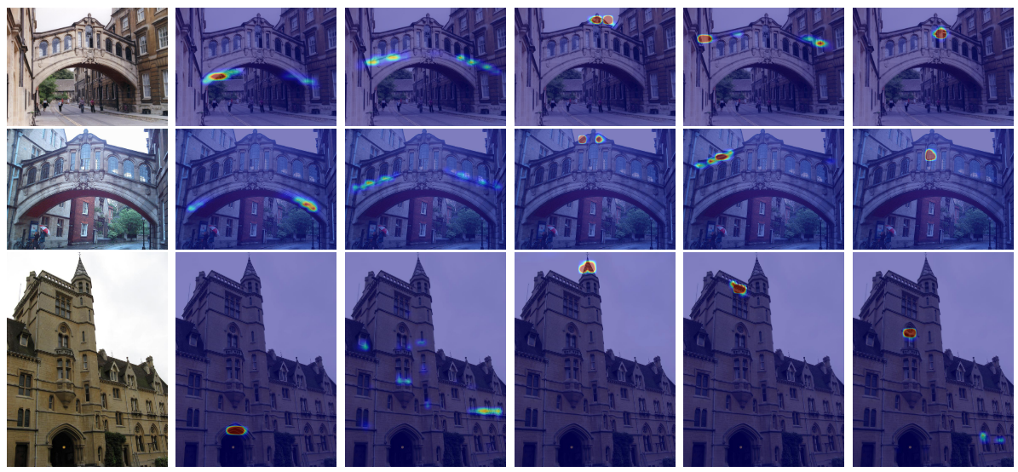

Result – Diverse Local Information from Super-Features
Each super-feature has diverse and discriminative localization in attention map
Final loss = $0.2ℒ_{super}+0.01ℒ_{attn}$ (No global descriptor loss!)
Super-feature #1
Super-feature #2
Super-feature #3
Super-feature #4
Super-feature #5

Slide 9
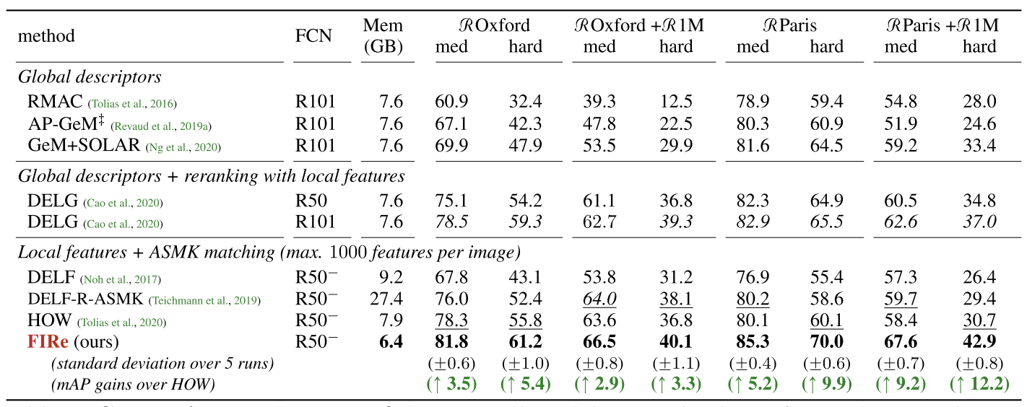
Result – Efficient Matching with Local Descriptors
Proposed work FIRe (Feature Integration-based Retrieval) highly outperforms global descriptor-based methods
Shows better efficiency compared to local feature (descriptor)-based methods

Slide 10
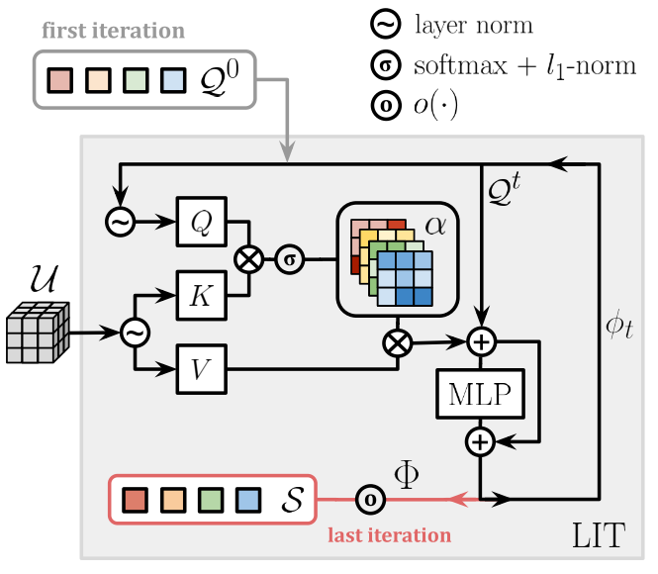
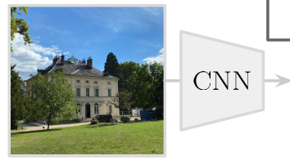

Local-feature Iterative Transformer Module
Prepare template for super-features $𝒬^{0}$
Iterative refinement for T=6 steps
  Calculate attentions $α$ with image-features $𝒰$
    $K\left(𝒰\right)⋅Q(𝒬^{t})$
  Refine template $𝒬^{t+1}=MLP\left(αV\left(𝒰\right)+𝒬^{t}\right)+\left(αV\left(𝒰\right)+𝒬^{t}\right)$
Descriptor Whitening for final super-features $𝒮=o(𝒬^{T})$

Slide 11

Characteristics of Super-features – Ordered Set
Super-feature from the same index come from the same template
Super-feature from the same template show similar localization in attention
Contrastive learning will be applied on super-features from each template
Super-feature #1
Super-feature #2
Super-feature #3
Super-feature #4
Super-feature #5

Slide 12
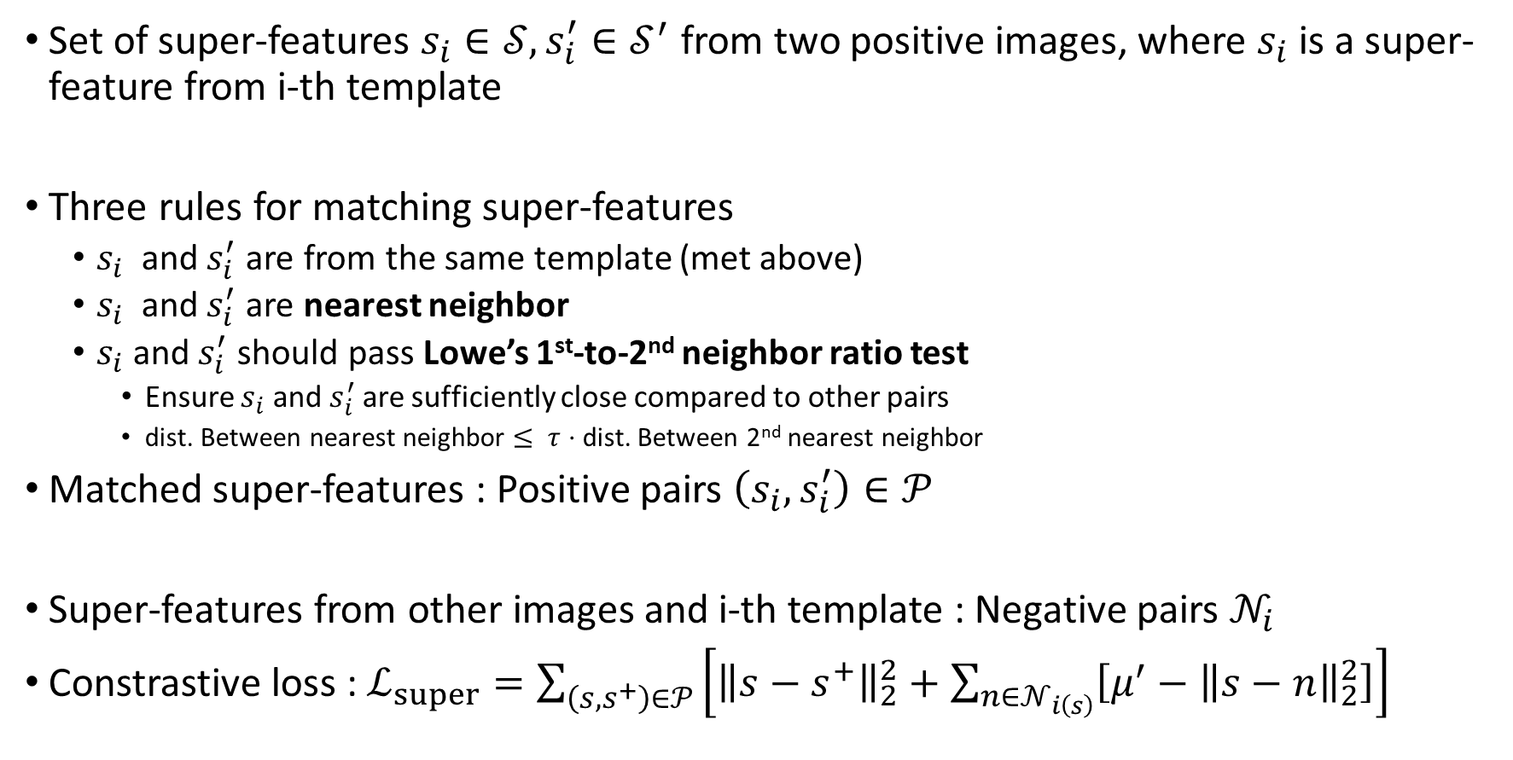
How to Find Positive / Negative Pairs with Super-Features?
Set of super-features $s_{i}∈𝒮, s_{i}^{′}∈𝒮^{′}$ from two positive images, where $s_{i}$ is a super-feature from i-th template
Three rules for matching super-features
  $s_{i}$ and $s_{i}^{′}$ are from the same template (met above)
  $s_{i}$ and $s_{i}^{′}$ are nearest neighbor
  $s_{i}$ and $s_{i}^{′}$ should pass Lowe’s 1st-to-2nd neighbor ratio test
    Ensure $s_{i}$ and $s_{i}^{′}$ are sufficiently close compared to other pairs
    dist. Between nearest neighbor $≤ τ⋅$ dist. Between 2nd nearest neighbor
Matched super-features : Positive pairs $\left(s_{i}, s_{i}^{′}\right)∈𝒫$
Super-features from other images and i-th template : Negative pairs $𝒩_{i}$
Constrastive loss : $ℒ_{super}=\sum_{\left(s, s^{+}\right)∈𝒫}{\left[{\left\|s−s^{+}\right\|}_{2}^{2}+\sum_{n∈𝒩_{i\left(s\right)}}{\left[μ^{′}−{\left\|s−n\right\|}_{2}^{2}\right]}\right]}$
Positive pairs
Negative pairs

Slide 13
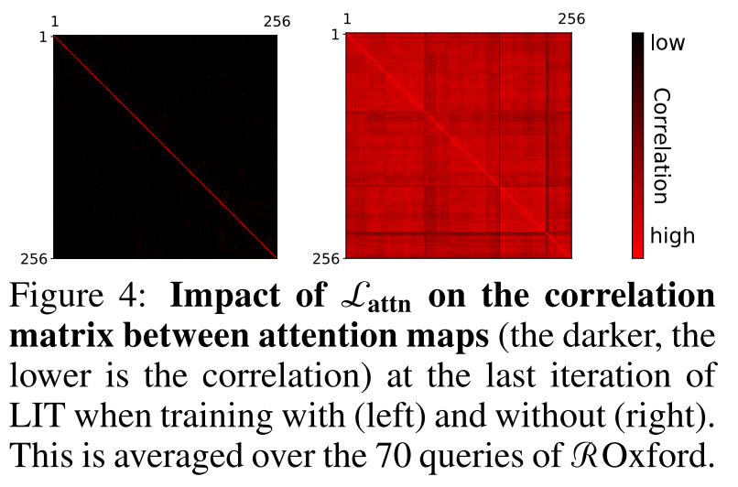

Encouraging Diverse Attention
Want super-features to attend various local information of the image
Reduce correlation between attention maps $α=[α_{1},…,α_{N}]$ from $N$ super-features
Attention decorrelation loss
$ℒ_{attn}\left(x\right)=\frac{1}{N(N−1)}\sum_{i≠j}{\frac{α_{i}^{T}⋅α_{j}}{{\left\|α_{i}\right\|}_{2}{\left\|α_{j}\right\|}_{2}}}$
Correlation matrix of N=256
Super-feature #1
Super-feature #2
Super-feature #3
Super-feature #4
Super-feature #5

Slide 14
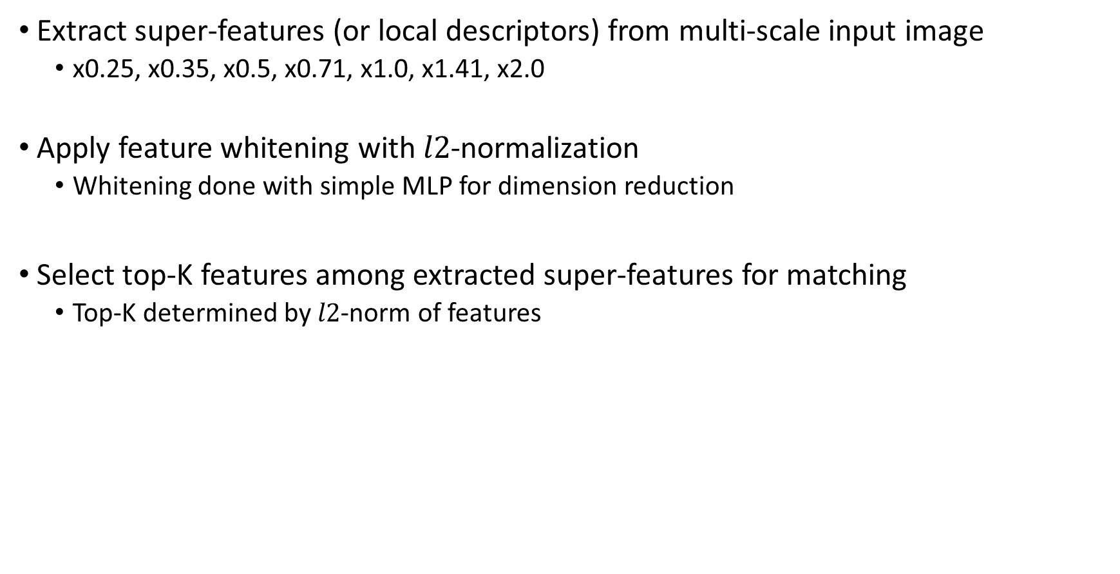
Gathering Super-features (or Local Descriptor) for Matching
Extract super-features (or local descriptors) from multi-scale input image
  x0.25, x0.35, x0.5, x0.71, x1.0, x1.41, x2.0
Apply feature whitening with $l2$-normalization
  Whitening done with simple MLP for dimension reduction
Select top-K features among extracted super-features for matching
  Top-K determined by $l2$-norm of features

Slide 15
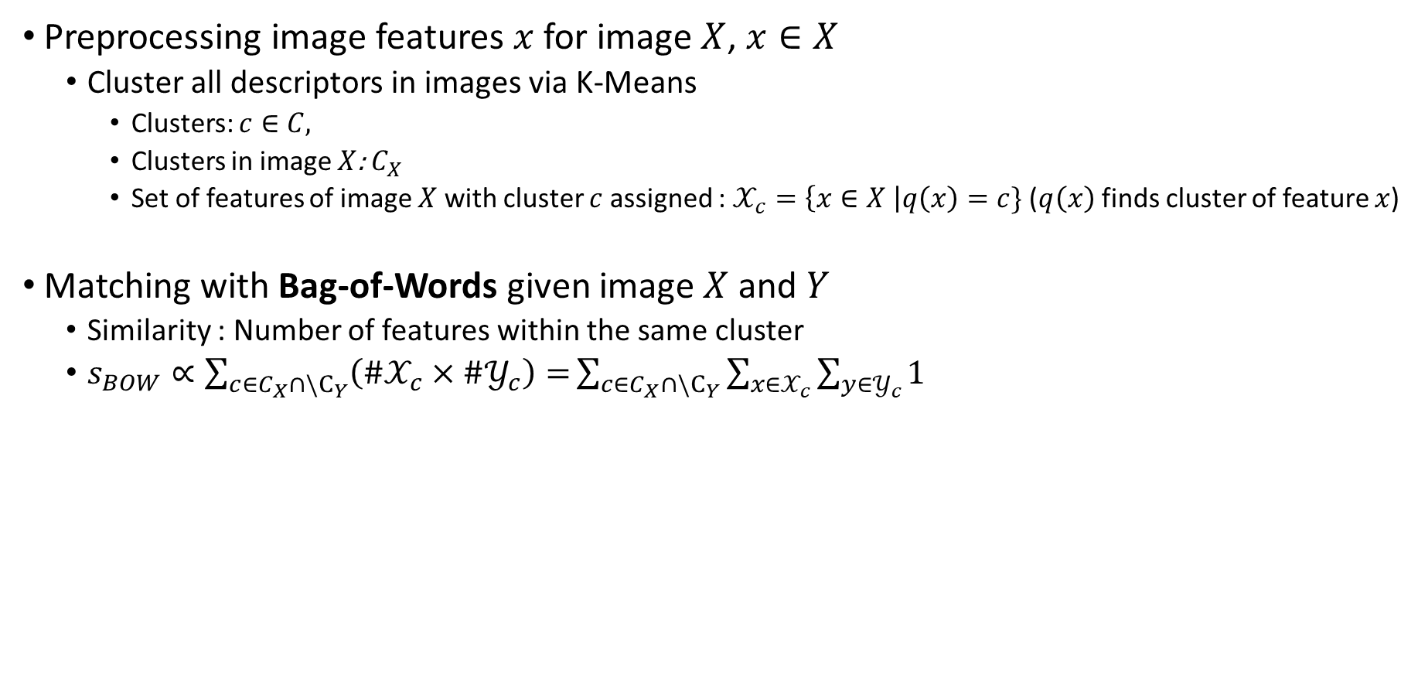
Matching with Super-features (or Local Descriptors) with BOW
Preprocessing image features $x$ for image $X$, $x∈X$
  Cluster all descriptors in images via K-Means
    Clusters: $c∈C,$
    Clusters in image $X$: $C_{X}$
    Set of features of image $X$ with cluster $c$ assigned :$𝒳_{c}=\left\{x∈X \right|q\left(x\right)=c\}$ ($q\left(x\right)$ finds cluster of feature $x$)
Matching with Bag-of-Words given image $X$ and $Y$
  Similarity : Number of features within the same cluster
  $s_{BOW}∝\sum_{c∈C_{X}∩\backslash C_{Y}}{\left(\#𝒳_{c}×\#𝒴_{c}\right)=}\sum_{c∈C_{X}∩\backslash C_{Y}}{\sum_{x∈𝒳_{c}}{\sum_{y∈𝒴_{c}}{1}}}$
To Aggregate or Not to Aggregate: Selective Match Kernels for Image Search, Tolias et al., ICCV 2013

Slide 16
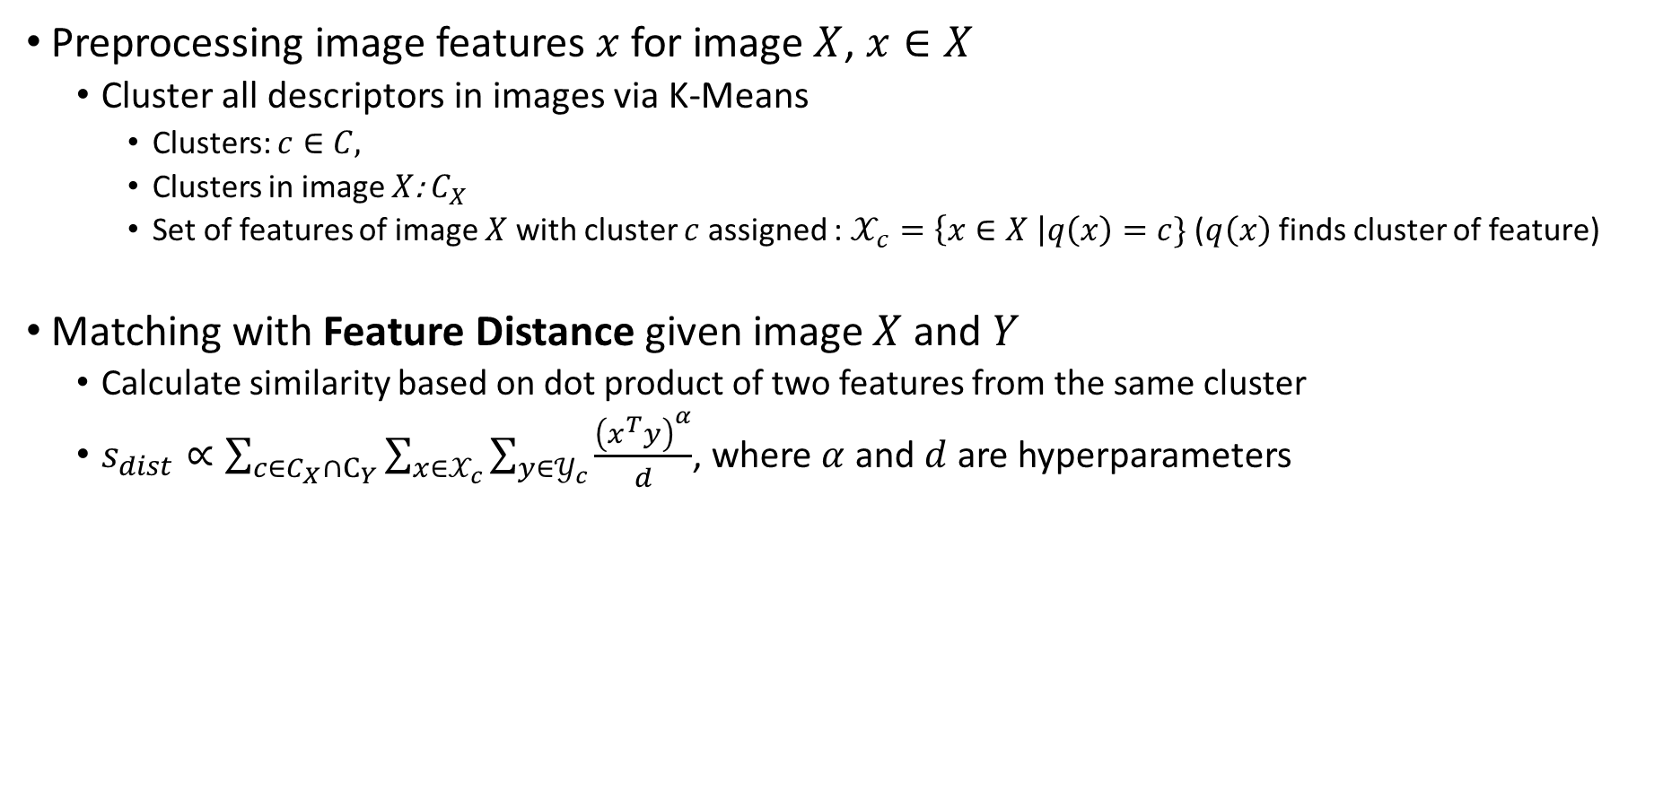
Matching with Super-features (or Local Descriptors) with Distance
Preprocessing image features $x$ for image $X$, $x∈X$
  Cluster all descriptors in images via K-Means
    Clusters: $c∈C,$
    Clusters in image $X$: $C_{X}$
    Set of features of image $X$ with cluster $c$ assigned :$𝒳_{c}=\left\{x∈X \right|q\left(x\right)=c\}$ ($q\left(x\right)$ finds cluster of feature)
Matching with Feature Distance given image $X$ and $Y$
  Calculate similarity based on dot product of two features from the same cluster
  $s_{dist}∝\sum_{c∈C_{X}∩C_{Y}}{\sum_{x∈𝒳_{c}}{\sum_{y∈𝒴_{c}}{\frac{{\left(x^{T}y\right)}^{α}}{d}}}}$, where $α$ and $d$ are hyperparameters
To Aggregate or Not to Aggregate: Selective Match Kernels for Image Search, Tolias et al., ICCV 2013

Slide 17
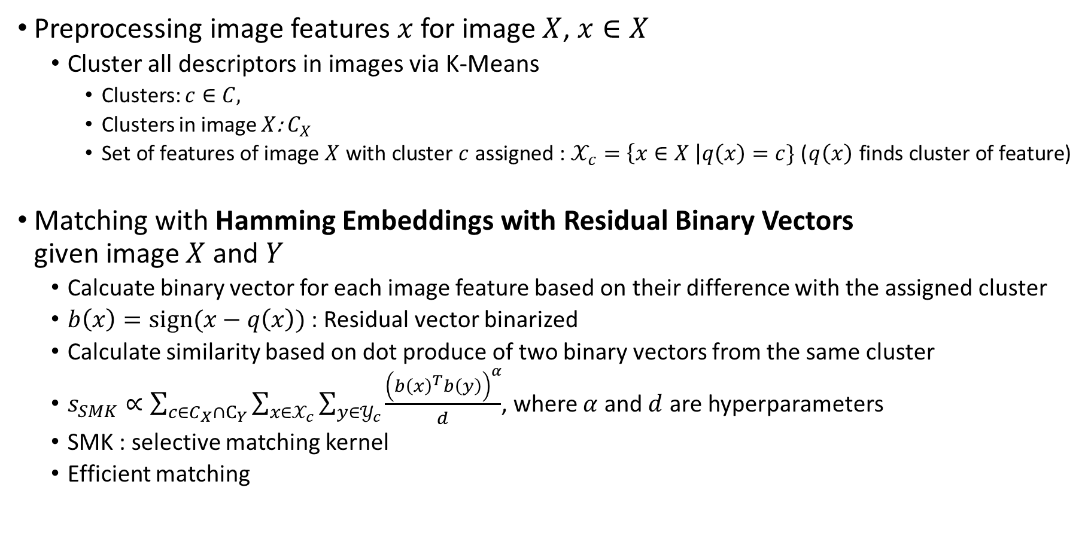
Matching with Super-features (or Local Descriptors) with SMK
Preprocessing image features $x$ for image $X$, $x∈X$
  Cluster all descriptors in images via K-Means
    Clusters: $c∈C,$
    Clusters in image $X$: $C_{X}$
    Set of features of image $X$ with cluster $c$ assigned :$𝒳_{c}=\left\{x∈X \right|q\left(x\right)=c\}$ ($q\left(x\right)$ finds cluster of feature)
Matching with Hamming Embeddings with Residual Binary Vectors
given image $X$ and $Y$
  Calcuate binary vector for each image feature based on their difference with the assigned cluster
  $b\left(x\right)=sign(x−q\left(x\right))$ : Residual vector binarized
  Calculate similarity based on dot produce of two binary vectors from the same cluster
  $s_{SMK}∝\sum_{c∈C_{X}∩C_{Y}}{\sum_{x∈𝒳_{c}}{\sum_{y∈𝒴_{c}}{\frac{{\left(b{\left(x\right)}^{T}b\left(y\right)\right)}^{α}}{d}}}}$, where $α$ and $d$ are hyperparameters
  SMK : selective matching kernel
  Efficient matching
To Aggregate or Not to Aggregate: Selective Match Kernels for Image Search, Tolias et al., ICCV 2013

Slide 18
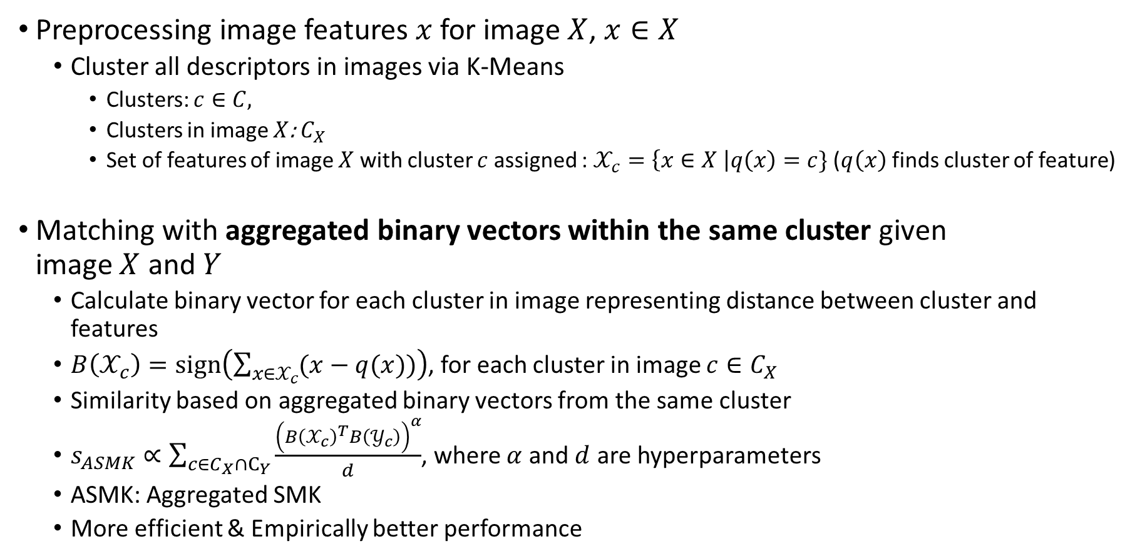
Matching with Super-features (or Local Descriptors) with ASMK
Preprocessing image features $x$ for image $X$, $x∈X$
  Cluster all descriptors in images via K-Means
    Clusters: $c∈C,$
    Clusters in image $X$: $C_{X}$
    Set of features of image $X$ with cluster $c$ assigned :$𝒳_{c}=\left\{x∈X \right|q\left(x\right)=c\}$ ($q\left(x\right)$ finds cluster of feature)
Matching with aggregated binary vectors within the same cluster given
image $X$ and $Y$
  Calculate binary vector for each cluster in image representing distance between cluster and features
  $B\left(𝒳_{c}\right)=sign\left(\sum_{x∈𝒳_{c}}{(x−q(x))}\right)$, for each cluster in image $c∈C_{X}$
  Similarity based on aggregated binary vectors from the same cluster
  $s_{ASMK}∝\sum_{c∈C_{X}∩C_{Y}}{\frac{{\left(B{\left(𝒳_{c}\right)}^{T}B\left(𝒴_{c}\right)\right)}^{α}}{d}}$, where $α$ and $d$ are hyperparameters
  ASMK: Aggregated SMK
  More efficient & Empirically better performance
To Aggregate or Not to Aggregate: Selective Match Kernels for Image Search, Tolias et al., ICCV 2013

Slide 19
Result – Efficient Matching with Local Descriptors
FIRe highly outperforms global descriptor-based methods
Shows better efficiency compared to local feature (descriptor)-based methods

Slide 20
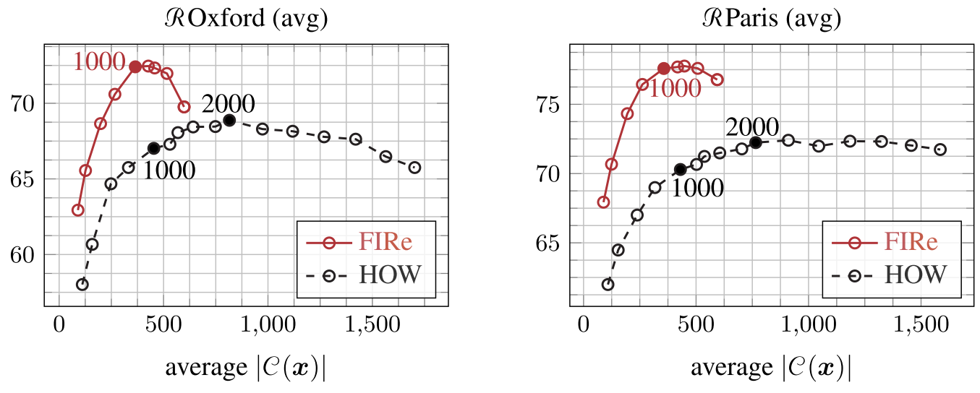
Result – Performance v.s. Memory
FIRe matches best performance of existing method (HOW) with reduced memory footprint by a factor of 4
Performance measured by varying number of features by 200 per image for matching
x4
x4
Clusters per image
Clusters per image

Slide 21
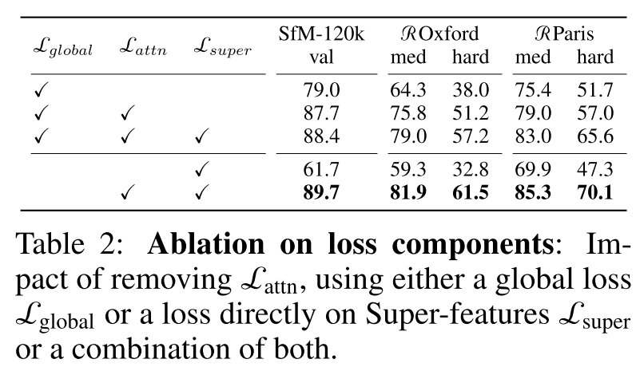

Analysis – Loss Functions Ablation
Training with global descriptor loss $ℒ_{global}$ shows worse performance

Slide 22
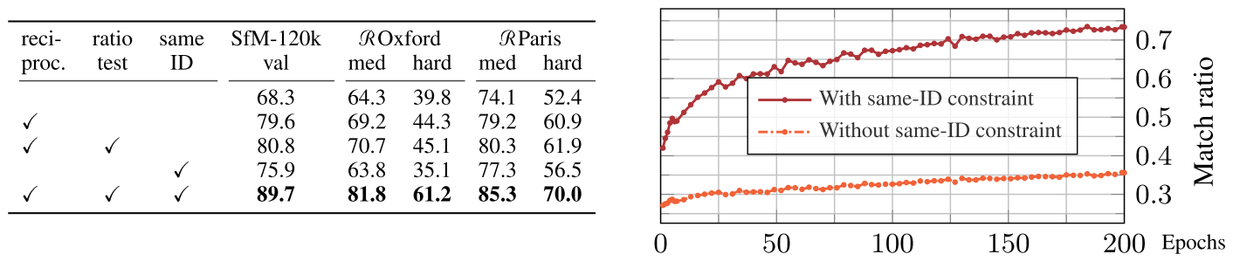
Analysis – Importance of Orderedness of Super-Features
Applying contrastive learning only on super-features with same template (i.e., ID) shows significant performance increase
Ratio of postivie image pair mathces
during training
Nearest neighbor
Same
template

Slide 23
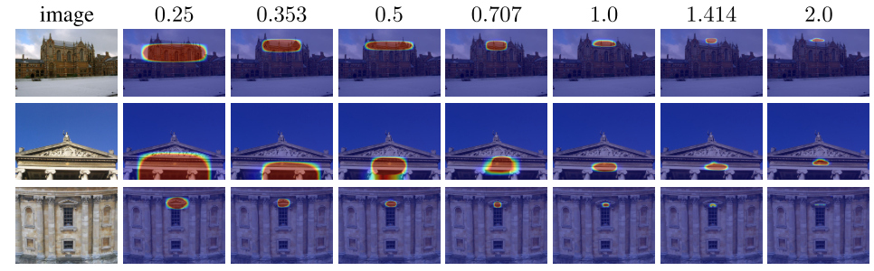
Analysis – Consistent Feature Importance throughout Scale
Matching with local features from various input scale (0.25~2.0)
Number of features and their importance are consistent throughout scale compared to existing local descriptor method (HOW)

Slide 24
Summary
Motivation : Directly training and matching with local descriptors to reduce the redundancy
Method : Super-features to represent local descriptors
  Allows contrastive learning on local descriptors
  Higher performance with memory efficiency
Limitation : Requires 10% more time to process super-features compared to previous local descriptors

Slide 25
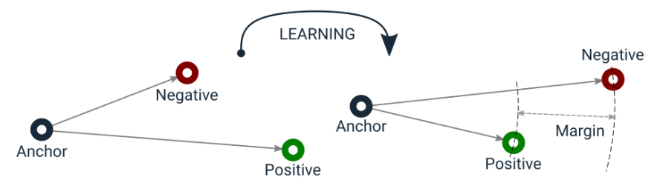

Appx. Margin Contrastive Loss
Margin on negative pairs guarantees well separated features
$\sum_{\left(s, s^{+}\right)∈𝒫}{\left[{\left\|s−s^{+}\right\|}_{2}^{2}+\sum_{n∈𝒩_{i\left(s\right)}}{\left[μ^{′}−{\left\|s−n\right\|}_{2}^{2}\right]}\right]}$
https://qdrant.tech/articles/triplet-loss/

Slide 26
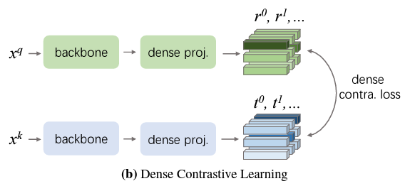
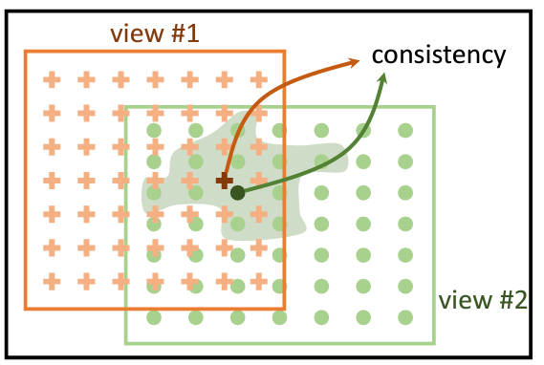
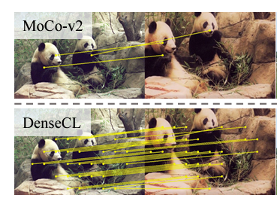
Appx. – Implicit Training of Local Descriptors
Local descriptors are trained implicitly by using their aggregate (i.e., global descriptor)
Attention mechanism is not discriminative enough without direct supervision
  Attentions are all trained with weak-supervision from classification / contrastive learning
Recent works use additional supervision, but still indirect or requires additional information
[Wang et al. 2021] use dense contrastive learning with local features and
multi-view consistency for detection & segmetation
[Xie et al. 2021] use pixel-space consistency by augmenting input images
Propagate Yourself: Exploring Pixel-Level Consistency for Unsupervised Visual Representation Learning, Xie et al., CVPR 2021
Dense Contrastive Learning for Self-Supervised Visual Pre-Training, Wang et al., CVPR 2021

Slide 27
Background - Training CNN-based Image Retrieval Framework
Local descriptors are trained implicitly by using their aggregate (i.e., global descriptor)
Attention mechanism is not discriminative enough without any supervision
  Attentions are all trained with weak-supervision from classification / contrastive learning
Training directly with local descriptor is exhaustive
  Thousands of local features, but only portion of them are used for matching
Global descriptor for training
Top-K
features
Large-Scale Image Retrieval with Attentive Deep Local Features, Noh et al., ICCV 2017

Slide 28
Test Protocal
Refine step T=6, # of Super-fetaures N=256
Following matching protocals from previous local descriptor matching works
  Gather super-features from multi-scale image inputs (0.25, 0.35, 0.5, 0.71, 1.0, 1.41, 2.0)
  Select top-1000 super-features
  Apply local descriptor matching algorithms

Slide 29
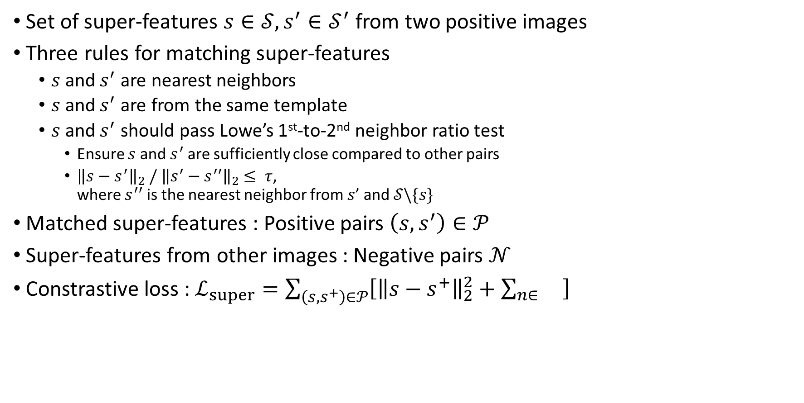
How to Find Positive /Negative Pairs with Super-Features?
Set of super-features $s∈𝒮, s^{′}∈𝒮^{′}$ from two positive images
Three rules for matching super-features
  $s$ and $s^{′}$ are nearest neighbors
  $s$ and $s^{′}$ are from the same template
  $s$ and $s^{′}$ should pass Lowe’s 1st-to-2nd neighbor ratio test
    Ensure $s$ and $s^{′}$ are sufficiently close compared to other pairs
    ${\left\|s−s^{′}\right\|}_{2} /{ \left\|s^{′}−s^{′′}\right\|}_{2}$ $≤ τ$,
    where $s^{′′}$ is the nearest neighbor from $s$’ and $𝒮\backslash \{s\}$
Matched super-features : Positive pairs $\left(s, s^{′}\right)∈𝒫$
Super-features from other images : Negative pairs $𝒩$
Constrastive loss : $ℒ_{super}=\sum_{\left(s, s^{+}\right)∈𝒫}{\left[{\left\|s−s^{+}\right\|}_{2}^{2}+\sum_{n∈}{}\right]}$

Slide 30
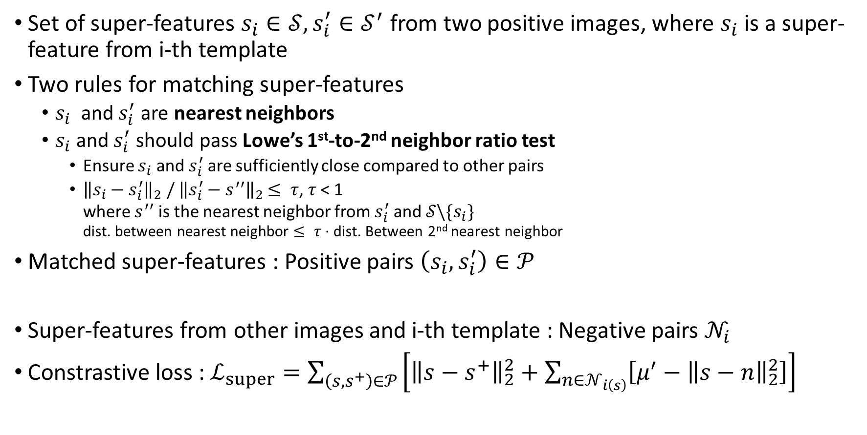
How to Find Positive / Negative Pairs with Super-Features?
Set of super-features $s_{i}∈𝒮, s_{i}^{′}∈𝒮^{′}$ from two positive images, where $s_{i}$ is a super-feature from i-th template
Two rules for matching super-features
  $s_{i}$ and $s_{i}^{′}$ are nearest neighbors
  $s_{i}$ and $s_{i}^{′}$ should pass Lowe’s 1st-to-2nd neighbor ratio test
    Ensure $s_{i}$ and $s_{i}^{′}$ are sufficiently close compared to other pairs
    ${\left\|s_{i}−s_{i}^{′}\right\|}_{2} /{ \left\|s_{i}^{′}−s^{′′}\right\|}_{2}$ $≤ τ$, $τ$ < 1
    where $s^{′′}$ is the nearest neighbor from $s_{i}^{′}$ and $𝒮\backslash \{s_{i}\}$
    dist. between nearest neighbor $≤ τ⋅$ dist. Between 2nd nearest neighbor
Matched super-features : Positive pairs $\left(s_{i}, s_{i}^{′}\right)∈𝒫$
Super-features from other images and i-th template : Negative pairs $𝒩_{i}$
Constrastive loss : $ℒ_{super}=\sum_{\left(s, s^{+}\right)∈𝒫}{\left[{\left\|s−s^{+}\right\|}_{2}^{2}+\sum_{n∈𝒩_{i\left(s\right)}}{\left[μ^{′}−{\left\|s−n\right\|}_{2}^{2}\right]}\right]}$
Positive pairs
Negative pairs

