Slide 1
NetVLAD: CNN architecture for weakly supervised place recognition
CVPR 2016
Relja Arandjelovi´c , Petr Gronat, Akihiko Torii , Tomas Pajdla, Josef Sivic
Chungsu Jang
Notes:
1

Slide 2
Contents
Motivation
Related Work
Proposed Method
Experiment
Conclusion
Quiz

Slide 3
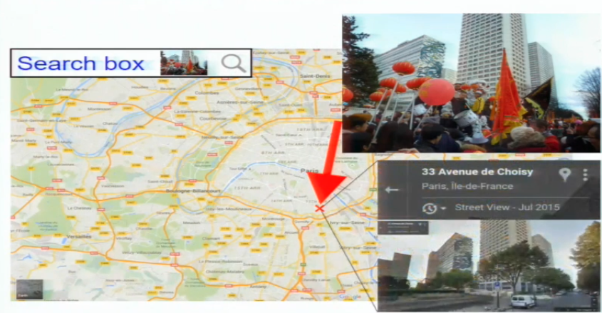
Motivation
The Goal : Visual Place Recognition

Slide 4
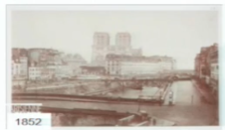
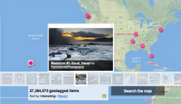
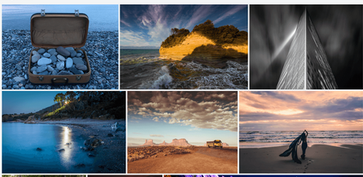
Motivation
Importance of Visual Place Recognition
  Legacy and historical imagery
  Improve accuracy of GPS
  Understand personal photo collections

Slide 5
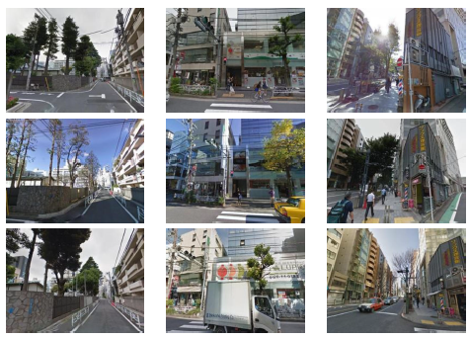
Motivation
Difficulty of Visual Place Recognition
  Light Changes : Different time of day / year
  Changes in camera viewpoint
  Ambiguous objects
  Word scale localization

Slide 6
Contents
Motivation
Related Work
Proposed Method
Experiment
Conclusion
Quiz

Slide 7
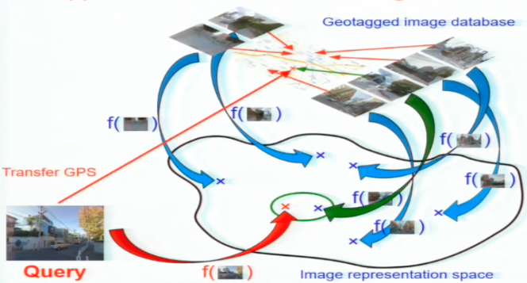
Related Work
Approach
  Visual place recognition → Visual instance recognition
    Represent the world by a set of geotagged images
    Design an “image representation” ➔ extractor f(I)
    Match query image with geotagged image database

Slide 8
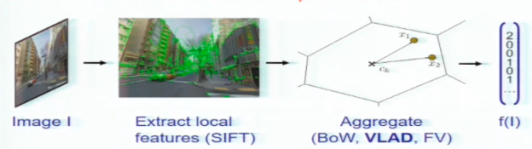
Related Work
Approach
  Local Feature based method
    Learn better local features
    All start from either hand-engineered descriptors
    Does not train for end-task

Slide 9
Related Work
Approach
  Local Feature based method
    Replace local features with a pre-trained CNN descriptor
    Not trained on the instance recognition task

Slide 10
Contents
Motivation
Related Work
Proposed Method
Experiment
Conclusion
Quiz

Slide 11
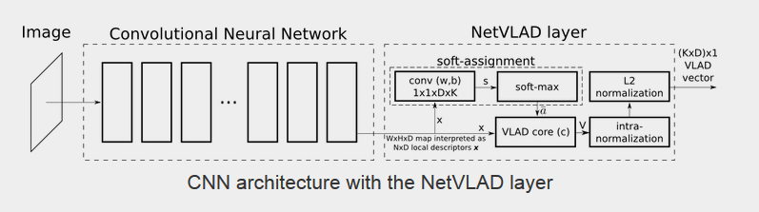
Proposed Method
Is it possible to apply CNNs to place recognition ? (Q1)
  Trainable pooling layer
    Mimic the state-of-the-art architecture

Slide 12
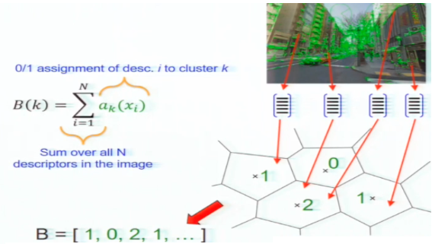
Proposed Method
Mimic the state-of-the-art architecture
  Review
    Pooling local descriptor - Bag-of-Words(BOW)

Slide 13
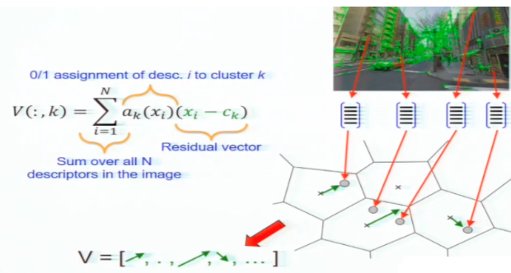
Proposed Method
Mimic the state-of-the-art architecture
  Review
    Vector of Locally Aggregated Descriptors(VLAD)

Slide 14
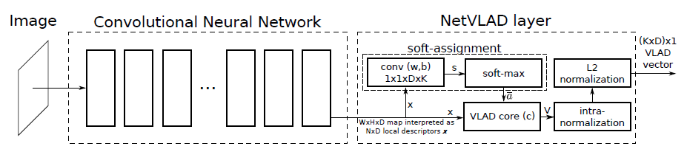
Proposed Method
Mimic the state-of-the-art architecture
  Proposed Method → NetVLAD
    Trainable pooling layer
    Part of the CNN architecture
    Trainable end-to-end

Slide 15
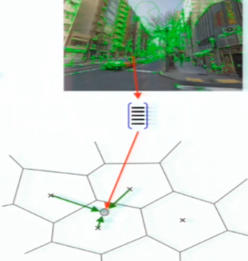

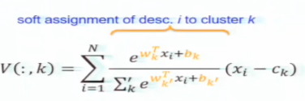
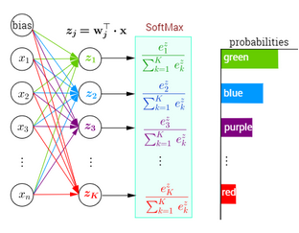
Proposed Method
NetVLAD : Trainable pooling layer
  Replace hard-assignment of descriptors to clusters with soft-assignment

Slide 16
Proposed Method
NetVLAD : Trainable pooling layer
  Replace hard-assignment of descriptors to clusters with soft-assignment

Slide 17
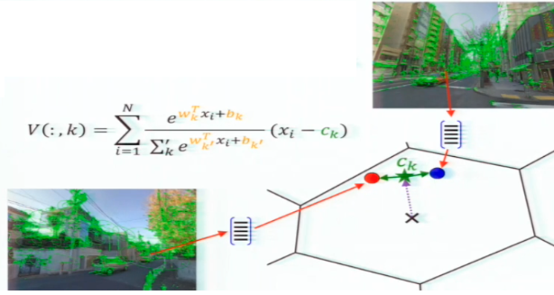
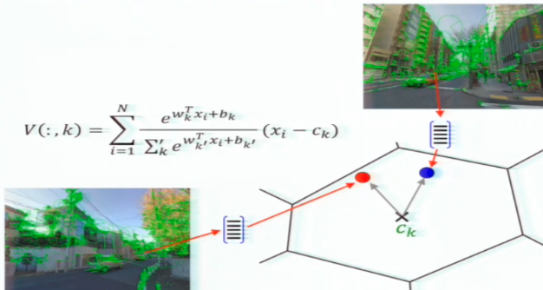
Proposed Method
NetVLAD : Trainable pooling layer
  Decouple assignment (wk, bk) from anchor point Ck

Slide 18
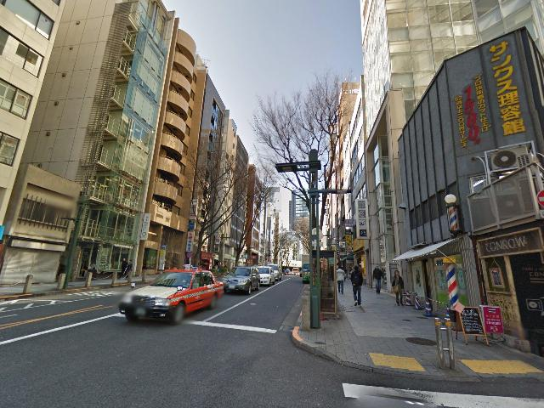
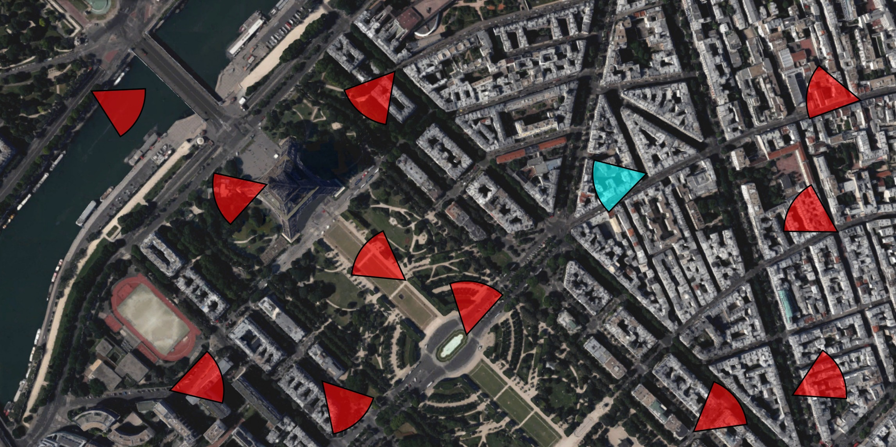
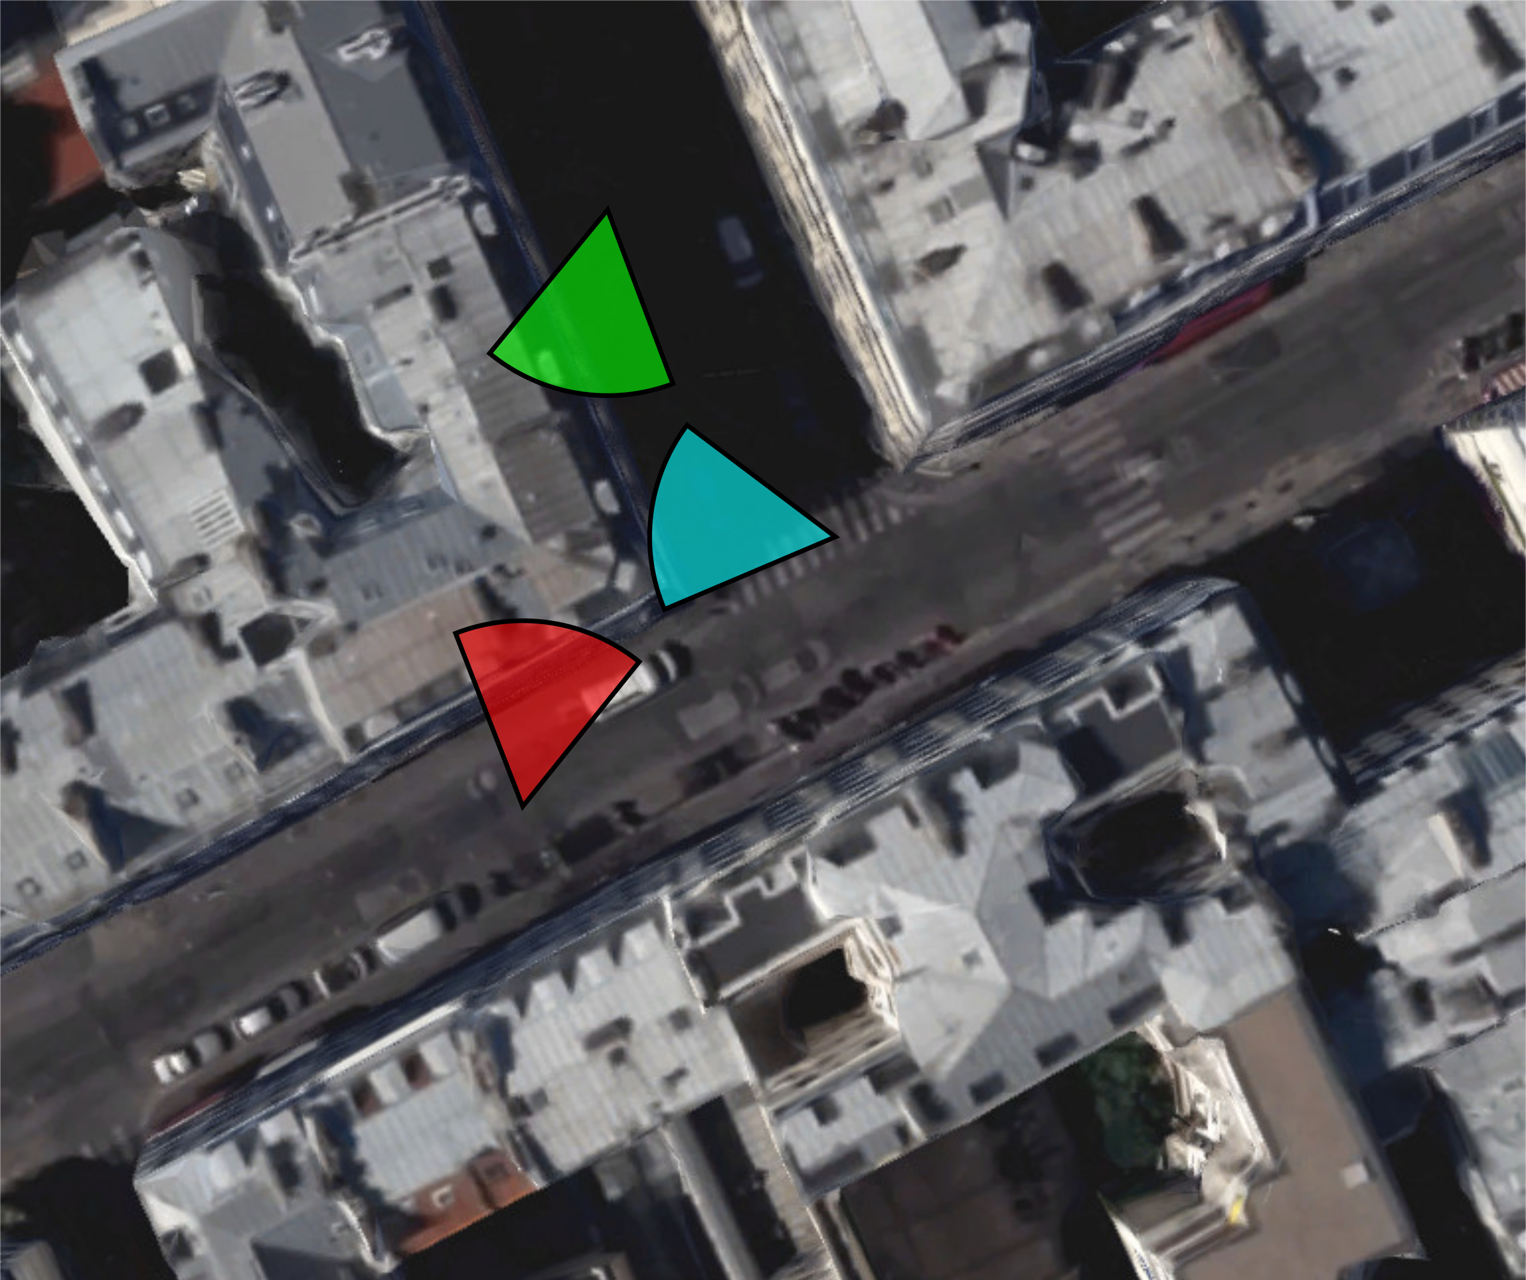
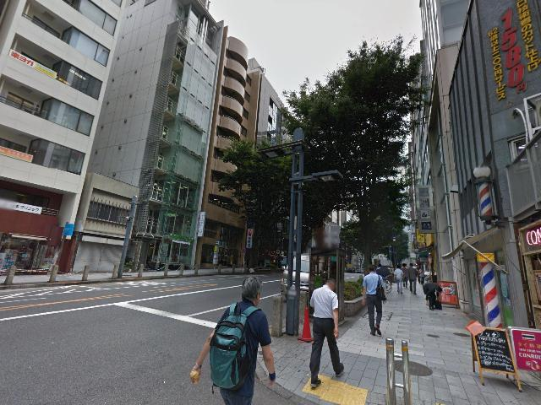
Proposed Method
Is it possible to apply CNNs to place recognition ? (Q1)
  Annotated training data
    Google Street View Time Machine : Same Location at different times
    Negatives : geographically far from the query
    Positive : geographically close from the query
Query
Query

Slide 19
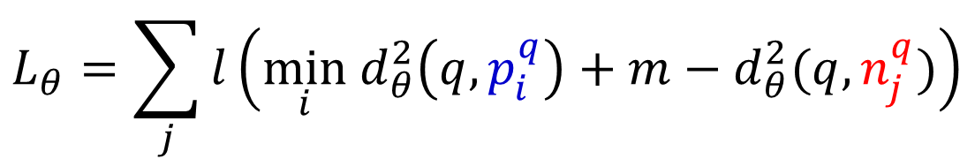
Proposed Method
Is it possible to apply CNNs to place recognition ? (Q1)
  Appropriate loss function for end-to-end training
    Triplet loss function
For a tuple (q, {p_{i}^{q}}, {n_{j}^{q}}) , θ: Stochastic Gradient Descent
  hinge loss
  margin
$$L_{θ}=\sum_{j}{l\left(\min_{i}{ d}_{θ}^{2}\left(q,p_{i}^{q}\right)+m−d_{θ}^{2}(q,n_{j}^{q})\right)}$$
Sum over negatives
Distance to the best potential positive
Distance to the negative

Slide 20
Contents
Motivation
Related Work
Proposed Method
Experiment
Conclusion
Quiz

Slide 21
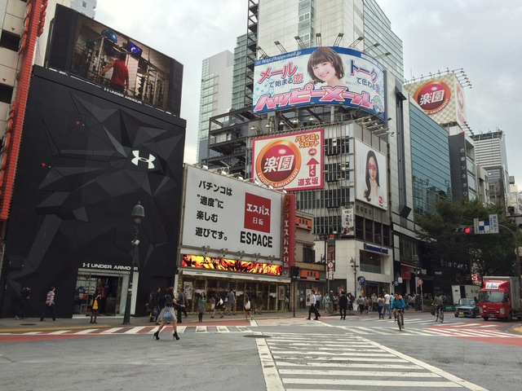
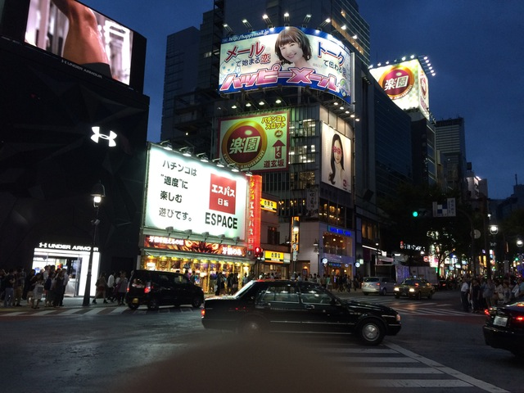
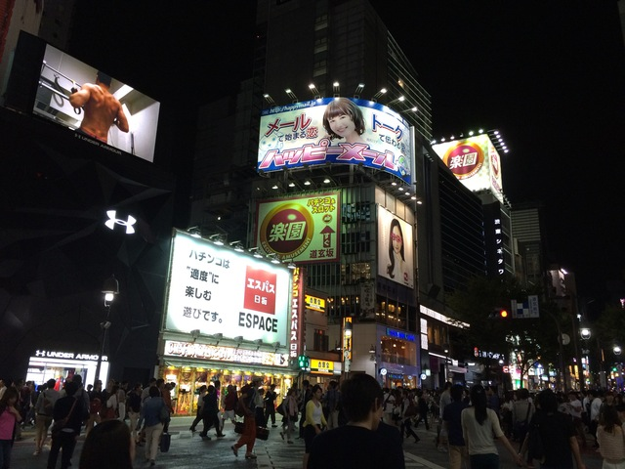
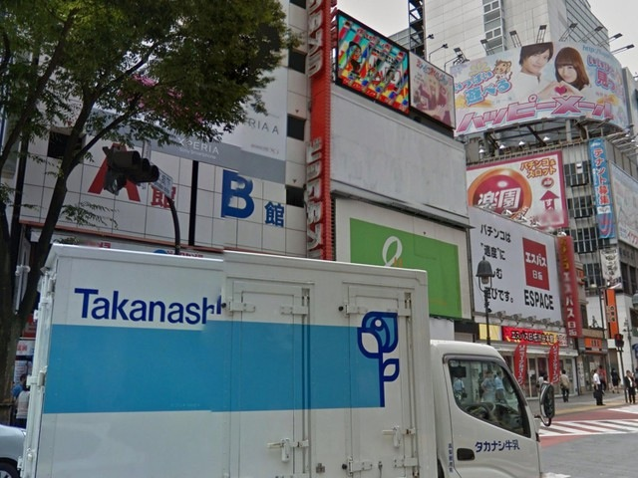
Experiment
Dataset
  Pittsburgh [Torii et al. 13]
    Database: 250k images from Street View
    Queries: 24k images from Street View at other times
  Tokyo 24/7 [Torii et al. 15]
    Database: 76k images from Street View
    Queries: 315 images from mobile phone cameras
Day query
Sunset query
Night query
Database image

Slide 22
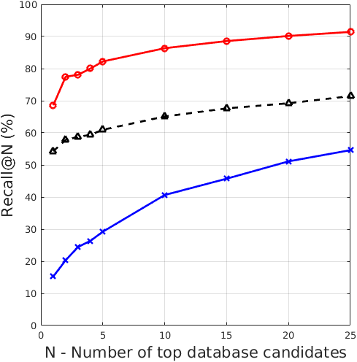
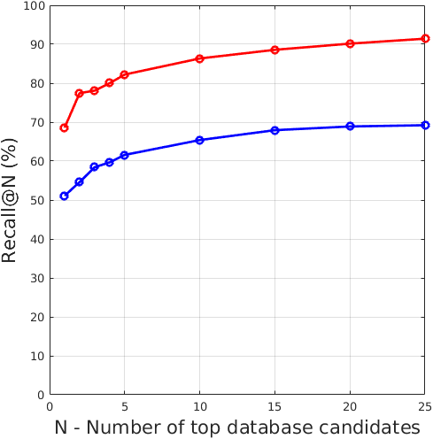
Experiment
New state-of-the-art result on all datasets
End-to-end training vs off-the-shelf
Trained NetVLAD
Ours: Trained NetVLAD
RootSIFT+VLAD+whitening
[Torii et al. CVPR’15]
Off-the-shelf VLAD
Off-the-shelf Max pooling
[Razavian et al. ICLR’15]
 | recall@5
Previous state-of-the-art | 60.9%
Trained NetVLAD | 82.2%
Relative improvement | 35.0%
 | recall@5
Off-the-shelf VLAD | 61.6%
Trained NetVLAD | 82.2%
Relative improvement | 33.4%

Slide 23
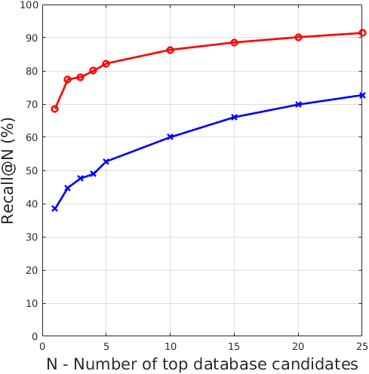
Experiment
NetVLAD vs Max
Ours: Trained NetVLAD
Ours: Trained Max pooling
 | recall@5
Off-the-shelf VLAD | 52.7%
Trained NetVLAD | 82.2%
Relative improvement | 56.0%

Slide 24
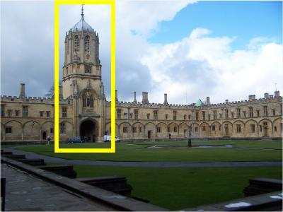
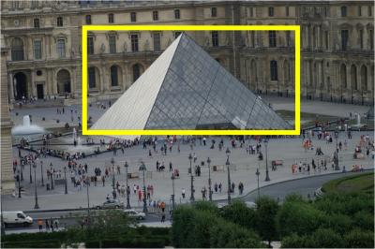
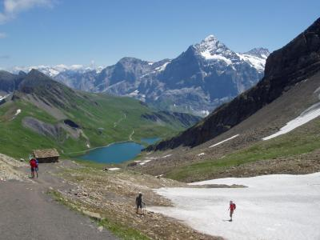
Experiment
Results on standard retrieval benchmarks
Method | Oxford 5k (full) | Oxford 5k (crop) | Paris 6k (full) | Paris 6k (crop) | Holidays (original) | Holidays (rotated)
Jégou and Zisserman CVPR14 |  | 47.2 |  |  | 65.7 | 65.7
Gordo et al. CVPR12 |  |  |  |  | 78.3
Razavian et al. ICLR15 | 53.3 |  | 67.0 |  | 74.2
Babenko and Lempitsky ICCV15 | 58.9 | 53.1 |  |  |  | 80.2
NetVLAD off-the-shelf | 53.4 | 55.5 | 64.3 | 67.7 | 82.1 | 86.0
NetVLAD trained | 62.5 | 63.5 | 72.0 | 73.5 | 79.9 | 84.3
Ours

Slide 25
Contents
Motivation
Related Work
Proposed Method
Experiment
Conclusion
Quiz

Slide 26
Conclusion
State-of-the-art on place recognition and
image retrieval benchmarks
Trainable NetVLAD pooling layer
Street View Time Machine
Weakly supervised ranking loss

Slide 27
Contents
Motivation
Related Work
Proposed Method
Experiment
Conclusion
Quiz

Slide 28
Quiz
Is softmax loss function classifier of category data?
What is triplet structure of annotaed training data?

