Slide 1

CS688: Large-Scale Image & Video Retrieval
Panorama to panorama matching for location recognition
Changho Jo
(조창호)
Notes:
1

Slide 2
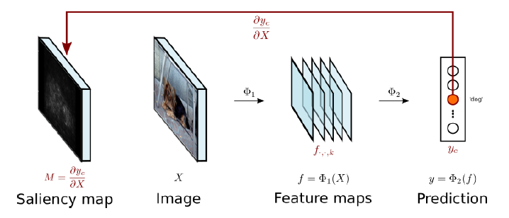
Review) ELF: Embedded Localization of Features in Pre-Trained CNN
Saliency Map
Notes:
The existing pipeline to get saliency map was like this, the saliency map is extracted by backpropagating from prediction
But rather than using it, the paper uses feature maps to get saliency map, and fix the exact location by the image.

Slide 3
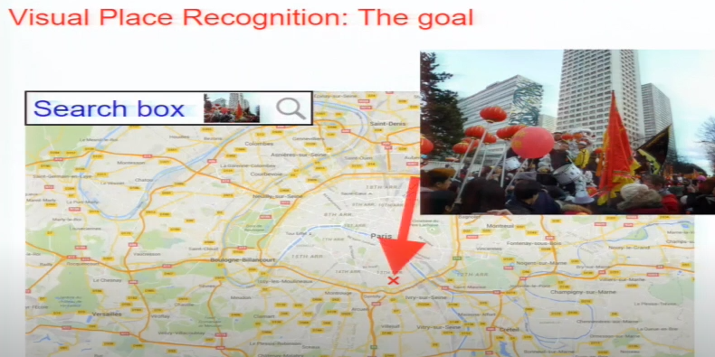
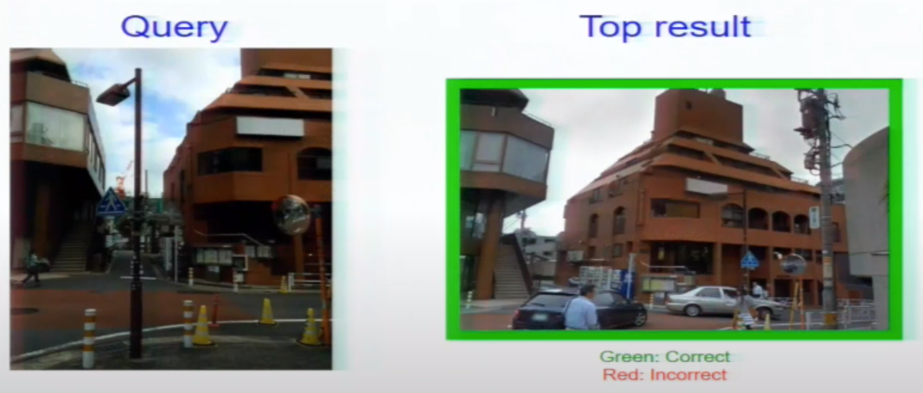
Location recognition
Where am I? Where is it?
Usually(in CV)
  Input: Image(FoV can be varied)
  Output: Panorama at the location
Youtube "NetVLAD: CNN Architecture for Weakly Supervised Place Recognition”
Notes:
What’s the location recognition?
It’s basically the answer about “Where am I? and Where is it?”
Surely you can use GPS and research about it, but usually in CV, it’s the problem that input is an image and the output is the panorama at the location.

Slide 4
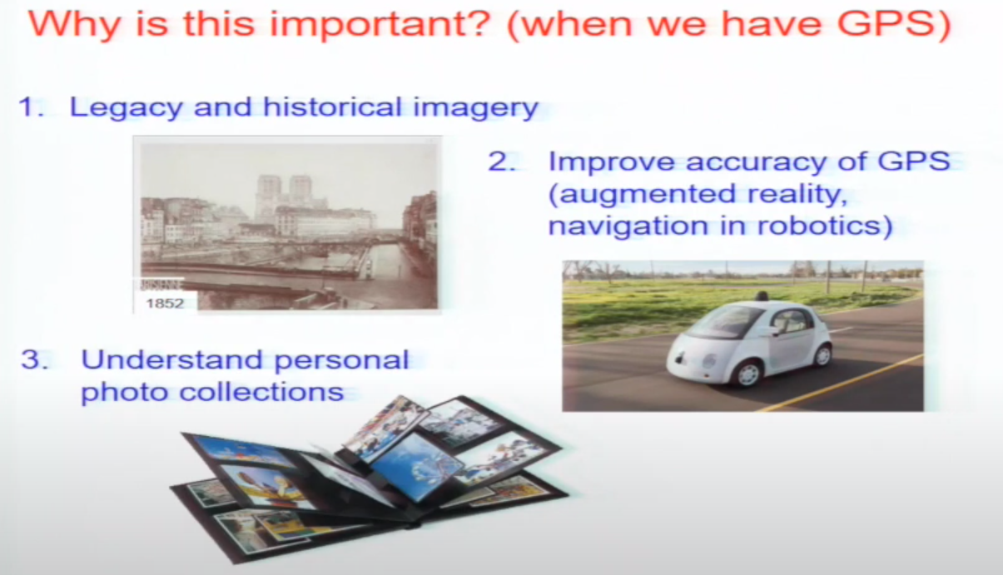
Location recognition
Why is this important?
Youtube "NetVLAD: CNN Architecture for Weakly Supervised Place Recognition”
Notes:
So Why is this important?
Actually I’m not in this field so I just borrowed the silde from the paper NetVLAD
They’re saying like it’s important for ~

Slide 5
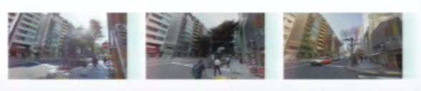
Location recognition
Why is this difficult?
  Changing environment as time flows
    Especially lighting
  Occluders and ambiguous objects
    Especially cars and peoples
  Many view points
Pictures from Google Maps, Tokyo 24/7 dataset, which are from D. M. Chen, City-scale landmark identification on mobile devices. CVPR, 2011.
Notes:
And it is difficult because there’s ~

Slide 6
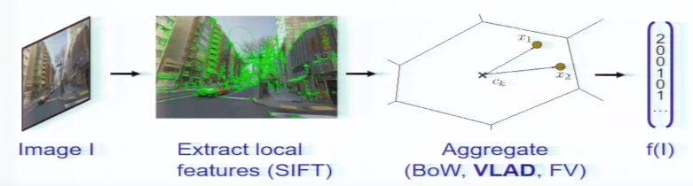
Location recognition
Existing approaches
  View of visual instance retrieval
    Find objects(ex: landmark) and use them
    Most simple way(but SOTA for a long time)
    It is known that learning doesn’t work well because datasets are not diverse enough[1,2]
Youtube "NetVLAD: CNN Architecture for Weakly Supervised Place Recognition”
[1]Johannes L. Schonberger, Hans Hardmeier, Torsten Sattler, and Marc Pollefeys. Comparative evaluation of hand-crafted and learned local features. CVPR 2017.
[2]Working hard to know your neighbor’s margins: Local descriptor learning loss. NIPS 2017
Notes:
In existing approaches, They viewed this problem as visual instance retrieval. I mean, they just finded objects and use them.
And this pipeline was the most simple yet most powerful for a long time. Also, ~

Slide 7
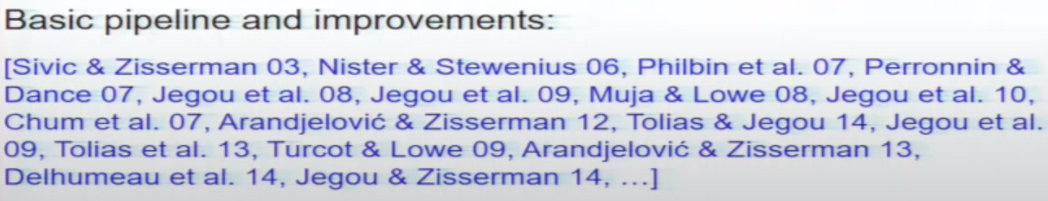
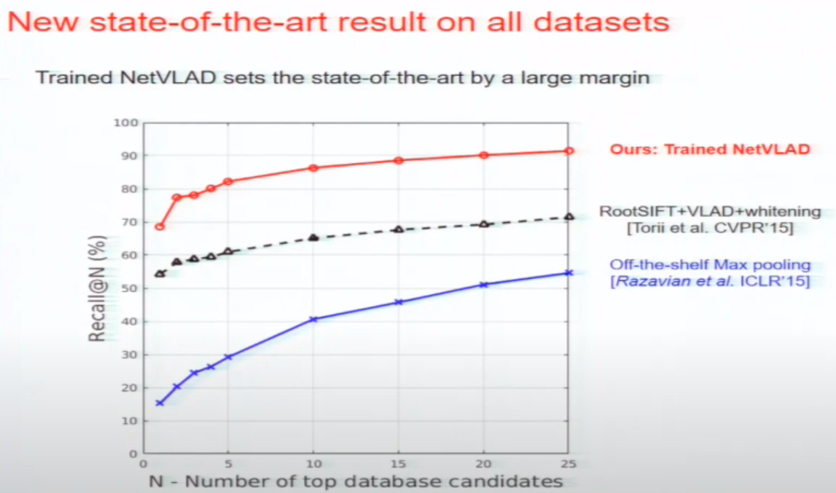
Location recognition
Even there were CNN based architectures, usually the existing pipeline(after improvements) worked better.
But NetVlad(CVPR 2017) breaks it and showed SOTA result at the time.
Youtube "NetVLAD: CNN Architecture for Weakly Supervised Place Recognition”
Notes:
Surely there were ~, however ~

Slide 8
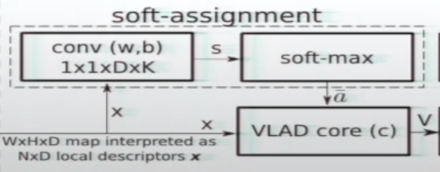
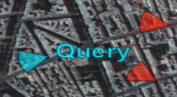
NetVlad
Replaced cluster finding by Conv + Softmax
Dataset: Street View Time Machine
Loss: ranking loss(weakly supervised)
  Assign negative to long distance
Youtube "NetVLAD: CNN Architecture for Weakly Supervised Place Recognition”
Notes:
So Let’s see the netvlad just in moment. Basically, It contributes by replacting the cluster finding process by ~
and by using the dataset, which is ~
and they used weakly supervised ranking loss which assigns negative to places in long distance.
This was a huge success.

Slide 9
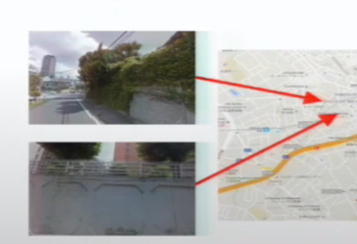
Arguing in the paper
Exisiting pipeline does not apply to sparse “street-view” imagery well.
Street-view is sparse so that same objects could not be emerged in different two(or more) street-view images.
object
camera
Youtube "NetVLAD: CNN Architecture for Weakly Supervised Place Recognition”
Notes:
But This paper arguing that the ~ where it used the network or not. I mean that the ~

Slide 10
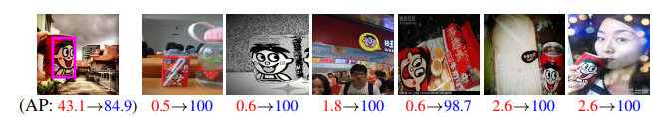
Proof(at the last of the paper)
Comparison to [1]
  [1]:diffusion of region descriptor
  “region” -> image, “image ” -> panorama
  result: 91.9% panorama matched(whereas pan2pan/net showed 96.5% matching)
[1]A. Iscen, G. Tolias, Y. Avrithis, T. Furon, and O. Chum. Efficient diffusion on region manifolds: Recovering small objects with compact cnn representations. In CVPR, 2017.
Notes:
And they actually proved this at the last of the paper. they compared to the paper which uses diffusion of region descriptor, which outperforms to the NetVLAD.
It uses overlapped region and diffuse it so that even this(last) picture can be found in a good AP.

Slide 11
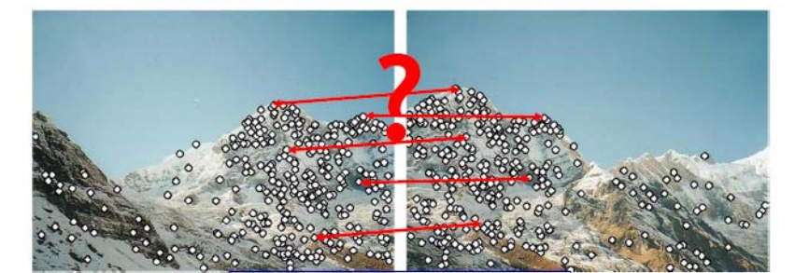
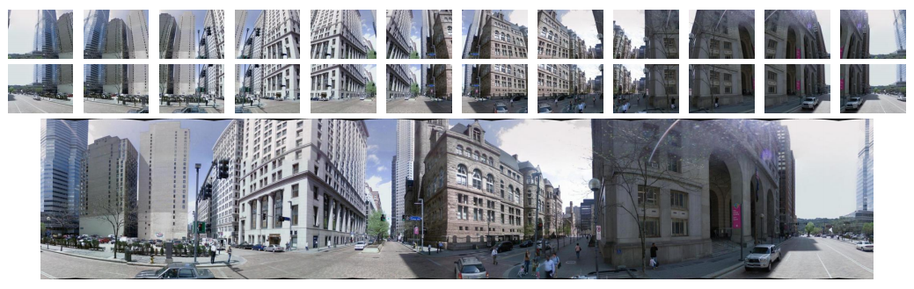
Idea
Rather than comparing local descriptors,
This paper used “set of global descriptors”
picture from Sungeui Yoon, orgianlly from the slide made by Kristen Grauman
Panorama to panorama matching for location recognition, Ahmet Iscen, ICMR 2017
Notes:
Back to the main idea, What’s the key point is that rather than ~
I mean first it finds that global descriptor of each image and makes a united vector of them.

Slide 12

Idea
United vector construction
  Sum vector(idea from [1])
  Pinv vector(idea from [2])
Explicit panorama construction
  Create a panorama image and extract a descriptor from the panorama.
    Descriptor([x_pan]): SIFT & inlier correspondences[from [3]]
descriptor([x1, x2, ..., xn]): SIFT+NetVlad
[1]A. Iscen, T. Furon, V. Gripon, M. Rabbat, and H. Jegou. Memory ´vectors for similarity search in high-dimensional spaces. IEEE Trans. Big Data, 2017
[2] C. R. Rao and S. K. Mitra. Generalized inverse of a matrix and its applications. In Sixth Berkeley Symposium on Mathematical Statistics and Probability, 1972.
[3] M. Brown and D. G. Lowe. Automatic panoramic image stitching using invariant features. IJCV, 74:59–73, 2007
Notes:
In more detail, it constructs united vector by summing the global descriptor vectors or pseudo inversing the global descriptor vectors. also they tried explicit panorama construction by creating a panorama image from perspective images and extract a descriptor from the panorama.

Slide 13
Idea
Aggregating dataset images
  Reduce computation cost of similarity search in query time
  Need only small amount of memory
  performance loss
Aggregating query images
  Multiple images: better handle the problems(occlusion, view-point changes, ...)
Notes:
And there follows theses advantages. Like when you aggregates dataset images, it can significantly ~ in cost of performance loss
And when you aggregate query images, it performs better by leveraging multiple images
This paper adopts both so that it could enjoys speed, memory, and performance improvements.

Slide 14
Results
Pitts250k
  250k database, 24k query images
  Only used test set(83,952 dataset images and 8,280 query images)
  24 images per each panorama
Recall@N=1
  If at least one dataset image is emerged in Top N
  and the retrieved dataset should be within 25 meters from the spatial location of query.
Notes:
For their experiences, they used Pitts250k dataset and there were 24 images per each panorama.
They used evaluation metric Recall@N and they noted that the retrieved dataset should be within 25 meters from the spatial location of query, to make Recall@N 1. When we uses all 24 images for each panorama,

Slide 15
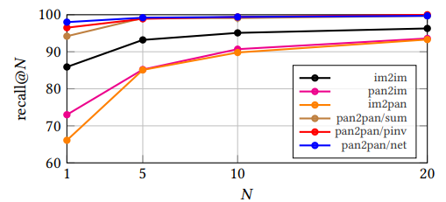
Results
Outperforms NetVLAD(im2im) highly
Only 7 failure queries for pan2pan/net(explicit panorama construction)
24^2 faster, 24 less memory
8280 queries to 345 queries
Notes:
It outperforms NetVLAD very much. These three lines are pan2pan2 methods and the black one is NetVLAD. And there’s ~

Slide 16
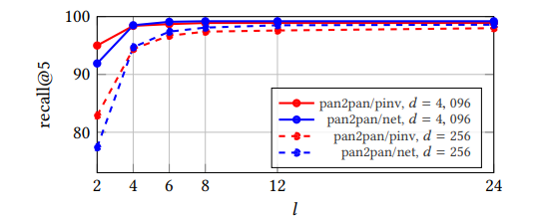
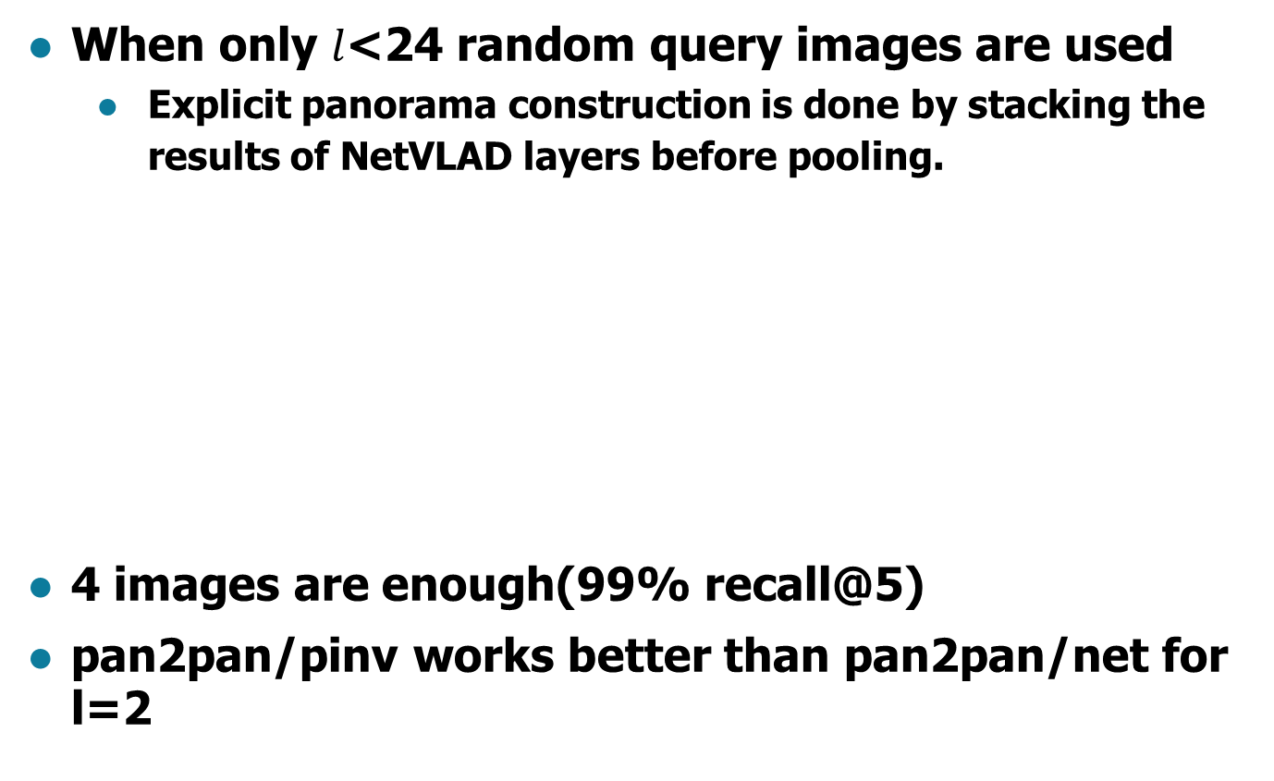
Results
When only $l$<24 random query images are used
  Explicit panorama construction is done by stacking the results of NetVLAD layers before pooling.
4 images are enough(99% recall@5)
pan2pan/pinv works better than pan2pan/net for l=2
Notes:
you should note that the naive explicit panorama construction isn’t possible. So ~
Also, it’s worth to note that ~, it’s because pinv work well when there’s more randomness.
there is some debating in this paper, but I’ll skip here.

Slide 17
Summary
Contribution
  Approaches the “location recognition problem” by focusing on “viewer’s view” rather than “finding similar objects”.
  Very high score for the Pitts250k.
    Too high that it’s difficult to find any paper(about location recognition using panorama) after 2017.
  Utilized well other methods(sum[1], pinv[2], inlier correspondences[3])
[1]A. Iscen, T. Furon, V. Gripon, M. Rabbat, and H. Jegou. Memory ´vectors for similarity search in high-dimensional spaces. IEEE Trans. Big Data, 2017
[2] C. R. Rao and S. K. Mitra. Generalized inverse of a matrix and its applications. In Sixth Berkeley Symposium on Mathematical Statistics and Probability, 1972.
[3] M. Brown and D. G. Lowe. Automatic panoramic image stitching using invariant features. IJCV, 74:59–73, 2007
Notes:
So in summary, they contributed by approaching ~

Slide 18
Summary
But
  Need to construct panorama every time (for pan2pan/net)
    Is it possible for AR/VR mobile devices?
  Practicability?
    Big companies will just want to use the current method(3d reconstuction)
    Really strong at noises?(not dataset, in real environment that everything changes.)
  Unfair comparison
    Only this paper considered panorama.
Notes:
suspicious
#beyond summary, the last remaining feelings that this paper gives to me was like
#I don’t know whether it works in real world but I feel like it’s worth to try this idea also in industry.

Slide 19
Quiz
Rather than comparing local descriptors,
This paper used
A: A global descriptor
B: Set of global descriptors
C: Reduced number of descriptors
Panorama to panorama matching for location recognition, Ahmet Iscen, ICMR 2017

Slide 20
Quiz
This paper argues that Existing pipeline* does not apply because “street-view” images are not that currently.
*Exisiting pipeline includes learning methods.
A: Dense
B: Diverse
C: Noisy

Slide 21

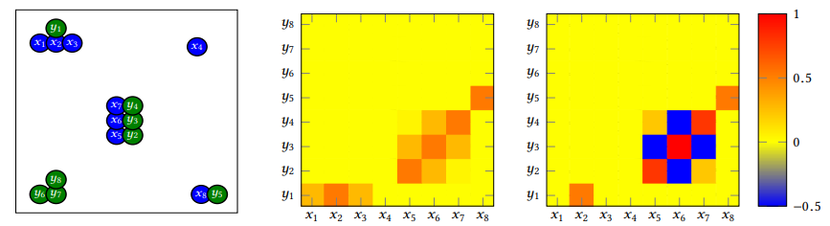

sum vs pinv
Similarity of sum-vectors(inner product)
Similarity of pinv-vectors
$G_{x}^{−1}, G_{y}^{−1}$ handles burstiness phenomenon for local descriptors.

