Slide 1
Feature Super-Resolution: Make Machine See More Clearly, CVPR 2018
Paper presentation
2020.05.19
20205326 Junsik Jung
CS688: Web-scale image retrieval
Notes:
1

Slide 2
Table of Contents
Problems
Related Works
Proposed Method
FSR-GAN
Experimental Results
Conclusion

Slide 3
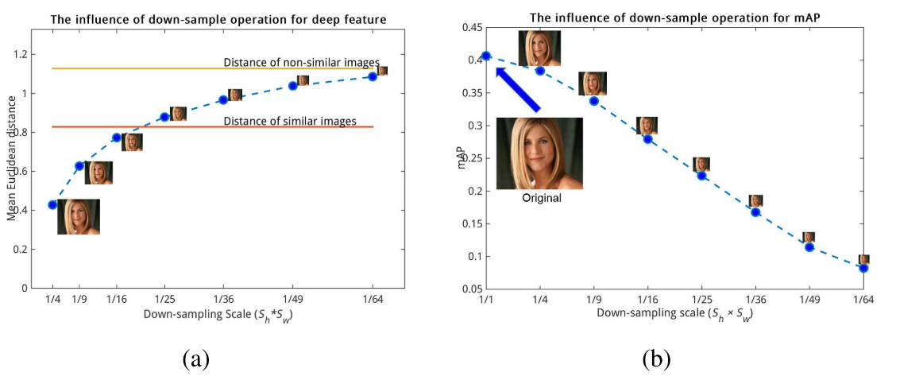
Problems
Impact of different low-resolutions on deep representations
The feature distance between low-resolution images and high-resolution ones is greater than the distance of similar images.

Slide 4
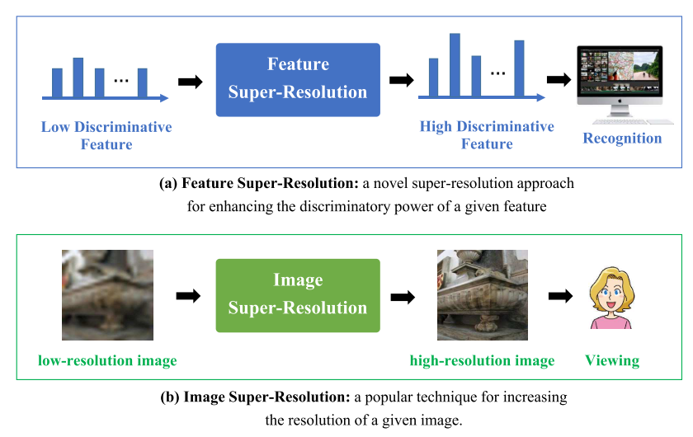
Problems
Solution: Feature Super Resolution (FSR)
A novel super-resolution technique

Slide 5
Problem
The point is…
It aims to enhance the discriminatory power of a given representation (extracted from low-resolution images or small objects) in order to providing high recognition precision for machine.

Slide 6
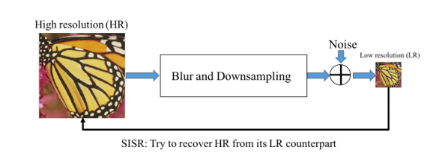
Related Works
Image Super Resolution
It estimates a high-resolution image from low-resolution images.
It tries to increase the discriminative ability of representation from low-resolution images by applying enhancement in pixel space.
In this paper, SRCNN and VDSR are used for comparison.

Slide 7
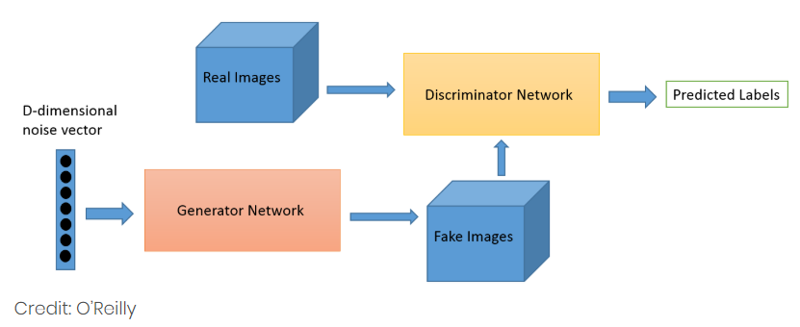
Related Works
Generative Adversarial Network
G captures the data distribution. D estimates the probability that a sample came from the training data rather than G.

Slide 8
Proposed Method
Proposed FSR-GAN
It consists three blocks, i.e., general feature extraction model, feature generative network, and feature discriminative network.

Slide 9
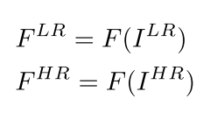
Proposed Method
General feature extraction model
Where $F$ denotes the general feature extraction model (pretrained VGG16, in this paper).

Slide 10
Proposed Method
Feature Generative Network (G)
Goal: train G that learns to transfer the poor representations of low-resolution images to super representations similar to those of high-resolution images.
Focal loss for training G

Slide 11
Proposed Method
Focal loss?
Original GAN loss
Problem: the better the discriminator, the more serious the generator gradient disappears
As a result, the generator can no longer generate better samples!

Slide 12
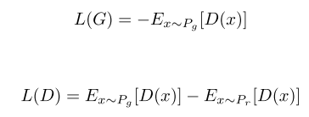
Proposed Method
Wasserstein GAN (WGAN) loss
Loss function of WGAN is formulated as measuring the Wasserstein distance between $p_{r},p_{g}$
Addressed and solved imbalance D(x) and G(z) training problem.

Slide 13
Proposed Method
Adding MSE
It has been demonstrated that adding a stronger constraint (MSE, in this case) to the generative network, it can help guide G to converge better.
Above equation does not take into account the imbalance of examples with different down sampling scales

Slide 14
Proposed Method
Focal loss
They propose a new focal loss for representation enhancement
The larger the value of $r$, the greater the weight of hard examples.
$r$ is empirically set to 2.

Slide 15
Experimental results
Dataset
Oxford5k dataset
It consists of 5,062 images and 55 query images (11 landmarks). This dataset is collected by searching Flickr.
Holidays dataset
It contains 1,491 images, 500 queries, and 991 corresponding relevant images.
Paris dataset
It consists of 6,412 images with particular Paris landmarks. Similar to Oxford5K, it contains 55 query images.

Slide 16
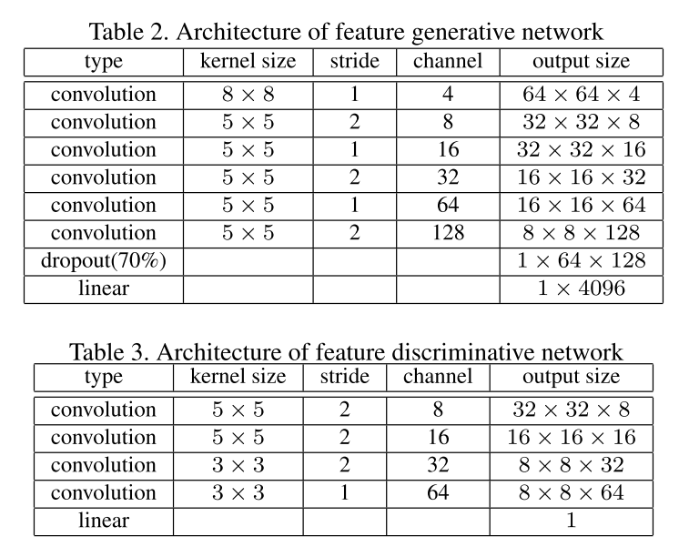
Experimental results
Network Architectures
A large kernel in the first convolution layer is employed to fully exploit the latent information in the input representations.

Slide 17
Experimental results
Parameter Settings
Loss functions
Adam optimizer with an initial learning rate of 0.0008 for G and D.
The parameter $r$ of focal loss is set to 2.
Typically, the FSR-GAN takes 6 epochs for training, and is capable of producing high- discriminative features.

Slide 18
Experimental results
Comparison of Euclidean distance.
SRCNN and VDSR only obtain good performance at relatively large size image, e.g., 1/4 scale.
However, FSR-GAN approach shows its effectiveness even the images are down-scaled to 1/64.

Slide 19
Experimental results
Application on image retrieval task.
As we can observe ,even when the query images have been down- sampled to 1/64, FSR approach achieves considerable retrieval accuracy and outperforms other methods.

Slide 20
Conclusion
Low-resolution images not only impact the extracted deep features, but also seriously decrease the retrieval accuracy.
Experimental results suggest that FSR-GAN approach is an effective solution for enhancing deep features.

