Slide 1
Deep Hashing with Category Mask for Fast Video Retrieval
CVPR 2018
Xu Liu, Lili Zhao, Dajun Ding, Yajiao Dong
Chungsu Jang
Notes:
1

Slide 2
Contents
Motivation
Related Work
Contribution
Proposed Method
Experiment
Conclusion
Quiz

Slide 3

Motivation
One open question
  How to efficiently retrieve the relevant video from the large-scale video database, which requires efficient video representation learning
Any Video
Feature DB
/ Meta DB

Slide 4
Motivation
Three key qualities in industrial application
  Content representative
  Storage Effective
  Low computational complexity
One approach → Learning based video hashing

Slide 5
Contents
Motivation
Related Work
Contribution
Proposed Method
Experiment
Conclusion
Quiz

Slide 6
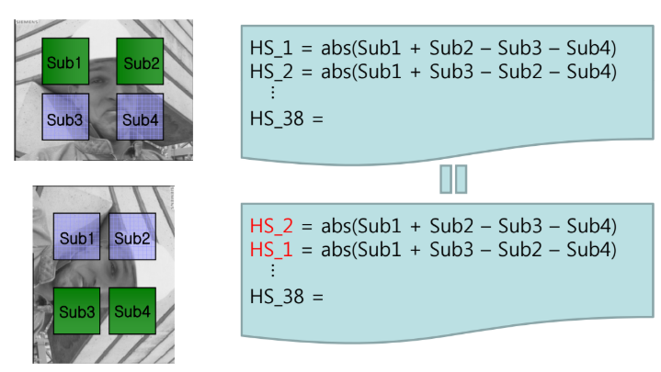
Related Work
Non – Deep Hash Learning
  H(fi) : samples to binary codes → statistical learning techniques
    Weiss et al(2009), Liu et al(2012), Jiang and Li(2015), …
Sample Hash : Hierarchical Symmetric Method

Slide 7
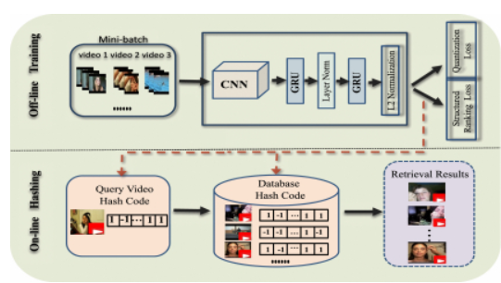
Related Work
Deep Hash Learning
  Krizhevsky et al(2012), Simonyan and Zisserman(2014), He et al(2016)

Slide 8
Related Work
Constrints
  Relatively fewer video deep hashing method than image
  More challenging than image (diverse and complex visual information)
  Offline processing with deep learning ( Wu et al, 2017)

Slide 9
Contents
Motivation
Related Work
Contribution
Proposed Method
Experiment
Conclusion
Quiz

Slide 10
Contribution
End-to-end deep video hashing framework
  Inter-class diversity / Intra-class identity as training objectives
  Hash code bit distribution correlated with the data categories
  Category mask for efficient retrieval

Slide 11
Contents
Motivation
Related Work
Contribution
Proposed Method
Experiment
Conclusion
Quiz

Slide 12
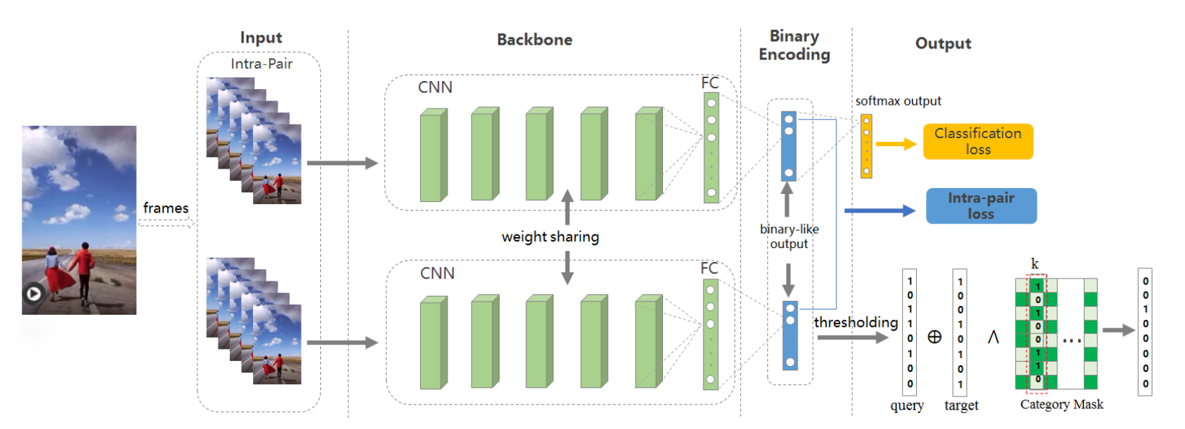
Proposed Method
End-to-end deep video hashing framework

Slide 13
Proposed Method
End-to-end deep video hashing framework
I∗≜ {Ia,Ib}
Ia≜ (xa1,xa2,⋅⋅⋅,xaN)
Ib≜ (xb1,xb2,⋅⋅⋅,xbN)
Ia∩Ib≡∅
Iq≜ (xq1,xq2,⋅⋅⋅,xqN).
F≜ [F(x1),F(x2),⋅⋅⋅,F(xN)]⋅[ω1,ω2,⋅⋅⋅,ωN]T
F(xi)≜ [f1(xi),f2(xi),⋅⋅⋅,fC(xi)], j∈[1,C]. [ω1,ω2,⋅⋅⋅,ωN]

Slide 14



Proposed Method
End-to-end deep video hashing framework

Slide 15


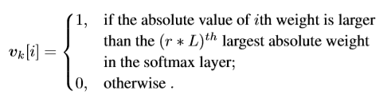
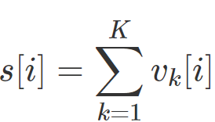

Proposed Method
Category Mask
  K categories, binary vector
    L, k=1,2,⋅⋅⋅,K. Given a ratio r, binary vector for the kth category is set as in Equation

Slide 16
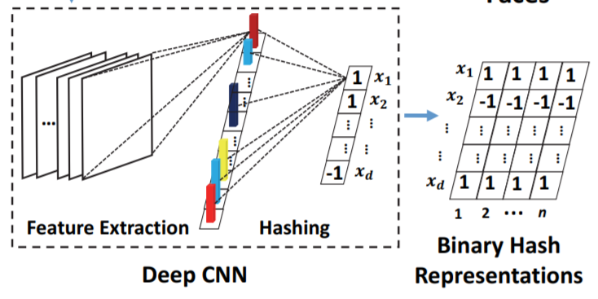
Proposed Method
Category Mask

Slide 17
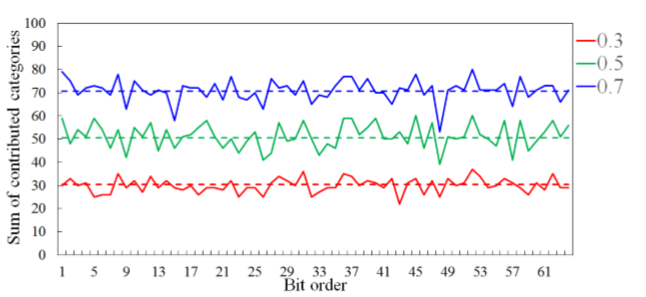
Proposed Method
Category Mask
  Observation

Slide 18
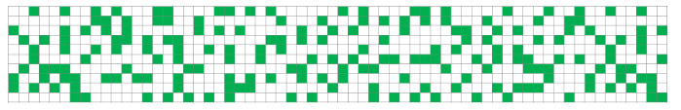
Proposed Method
Category Mask
  Observation (ration 0.3, 10 category, from 0 to 63 bitorder

Slide 19


Proposed Method
Apply with Category Mask

Slide 20
Contents
Motivation
Related Work
Contribution
Proposed Method
Experiment
Conclusion
Quiz

Slide 21
Experiments
Two benchmark datasets
  UCF101
    101 action categories from 13320 realistic action videos, covering ﬁve activity types: human-object interaction, body-motion only, human-human interaction, playing musical instruments, andsports. TheclipdurationformostvideosinUCF101 is less than 10 seconds

Slide 22
Experiments
Two benchmark datasets
  HMDB51
    6766 videos with 51 distinct action categories, covering various facial actions and body movements. The clip duration for most videos in HMDB51 is less than 5 seconds

Slide 23
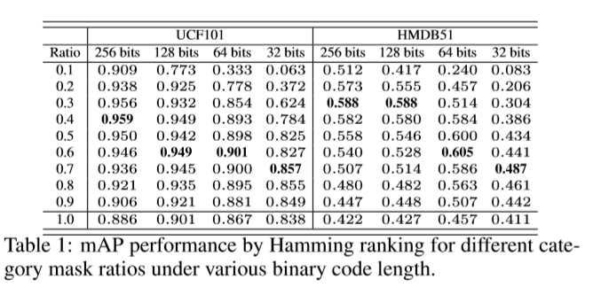
Experiment
Mean Average Precision Performance

Slide 24
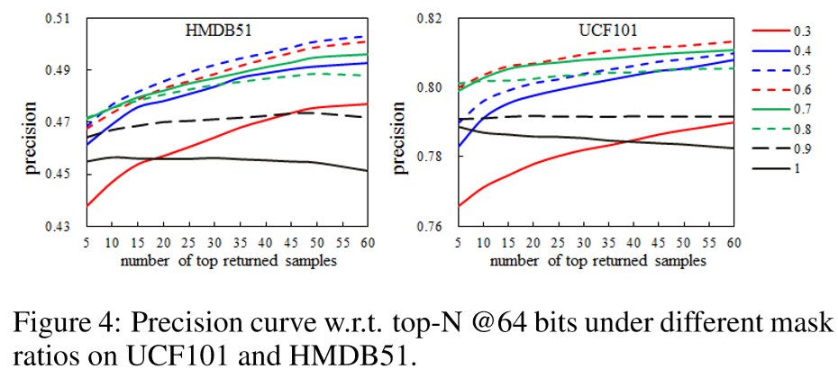
Experiment
Top-N Precision Curve

Slide 25
Experiment
Top-N Precision Curve

Slide 26
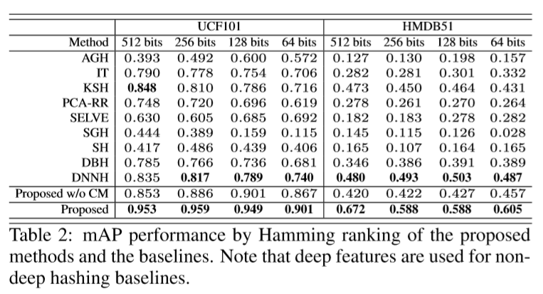
Experiment
Comparison with other method

Slide 27
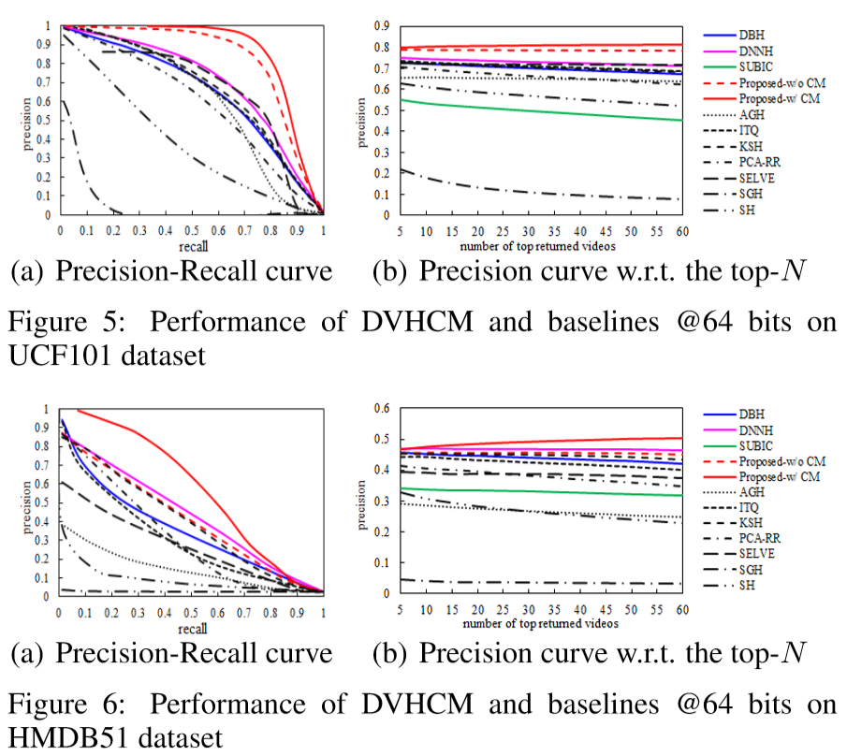
Experiment
Comparison with other method

Slide 28
Contents
Motivation
Related Work
Contribution
Proposed Method
Experiment
Conclusion
Quiz

Slide 29
Conclusion
Propose
  DVHCM, an end-to-end deep hashing approach with category mask for fast video retrieval.
    Intra-pair and learn hash model by optimizing the classiﬁcation loss and the intra-pair loss.
    binary bits distribution related to categories
    category masking scheme to improve accuracy
Experiment
  Superior performance under various evaluation metrics

Slide 30
Contents
Motivation
Related Work
Contribution
Proposed Method
Experiment
Conclusion
Quiz

Slide 31
Quiz
What is the result of masking?
  Query : 101101111
  Target : 100101010
  Category Mask: 000100010

