Slide 1

Learning a Discriminative Feature Network for Semantic Segmentation
YIN XU
Contact: yinofcqudpt@gmail.com
Notes:
1

Slide 2
Content
Background:
  What is semantic segmentation?
  Current problems of semantic segmentation.
Related Work
Idea: learn discriminative features
Proposed Method
    The Smooth network
    The border network
Experiments
Summary

Slide 3
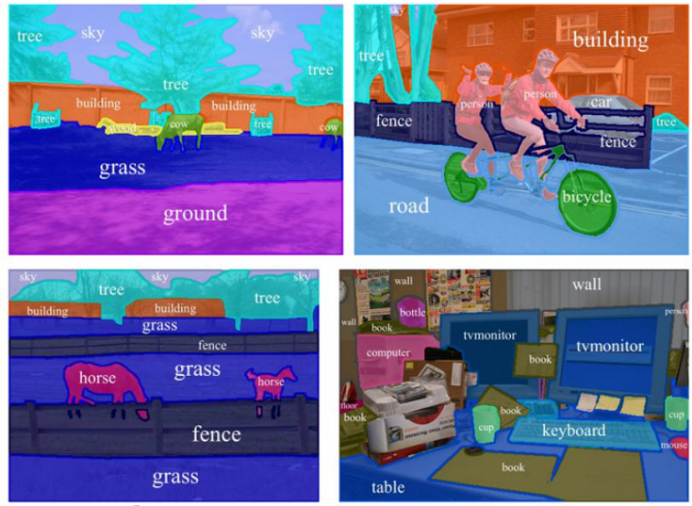
Background: semantic segmentation
What is semantic segmentation?
  Idea: recognizing, understanding what's in the image in pixel level.
Potential Applications:
  Medical Image Analysis
  Self-driving
  Robotic Vision
Notes:
Factorization 응용한듯

Slide 4
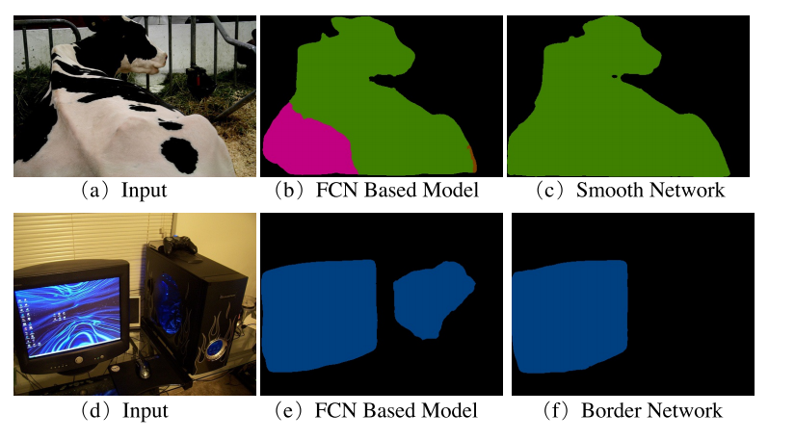
Background: Target Problems
Intra-class Inconsistency: The same semantic label but different appearances
Inter-class Indistinction: Different semantic labels but with similar appearances

Slide 5
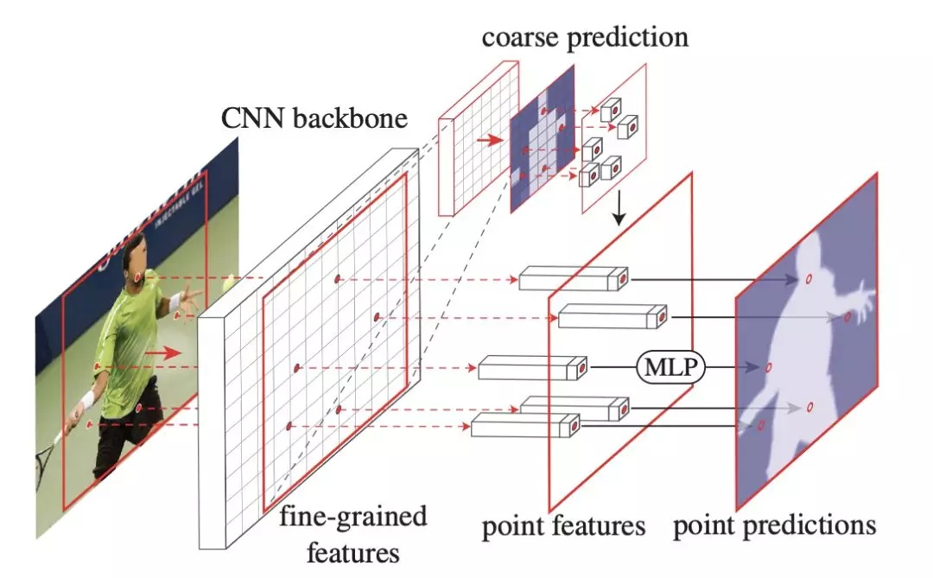
Related Work--- Tricks
PointRend: image Segmentation as Rendering , CVPR 2020
Notes:
Factorization 응용한듯

Slide 6
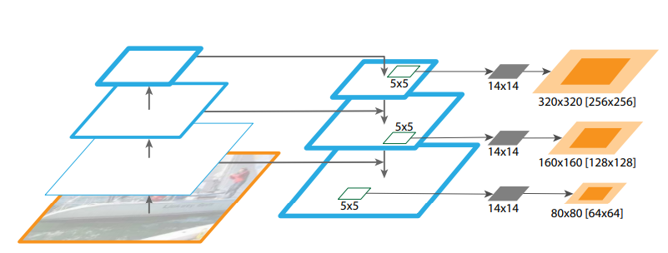
Related Work---Increase models’ representation Ability
Feature pyramid networks for object detection. CVPR 2017
Notes:
Factorization 응용한듯

Slide 7
Idea:
Is it possible to learn discriminative features?
How about regarding semantic segmentation as a process of assigning consistent labels to a category of things, instead a pixel classification process ?
---- Features that expected to learn should not only be representative, but also discriminative.
Notes:
Factorization 응용한듯

Slide 8
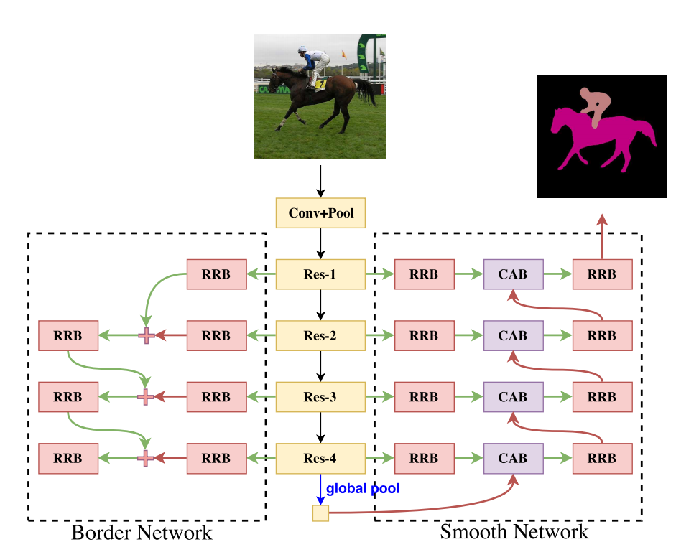
Proposed Method: DFN
Components:
---Border Network:
learning edge information
---Smooth Network:
improve representation ability
Units:
---RRB: Refinement residual block
---CAB: Channel attention block
Notes:
Factorization 응용한듯

Slide 9
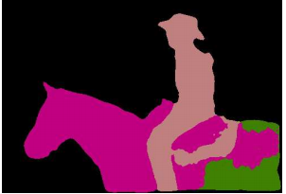
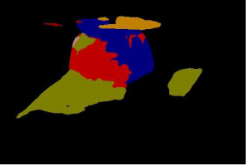
Component: Smooth Network
Aim: solve the problem of intra-class inconsistency
Cause analysis: the lack of context
Solution:
--- Global Average Pooling:
--- Multi-stage feature fusion:
low: spatial info
high: abstract semantics
---Channel Attention:
maintain consistency
obtain discriminative features
Cases
Notes:
Factorization 응용한듯

Slide 10
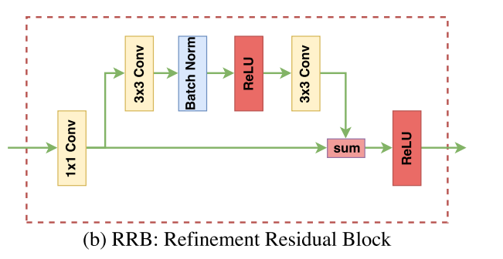
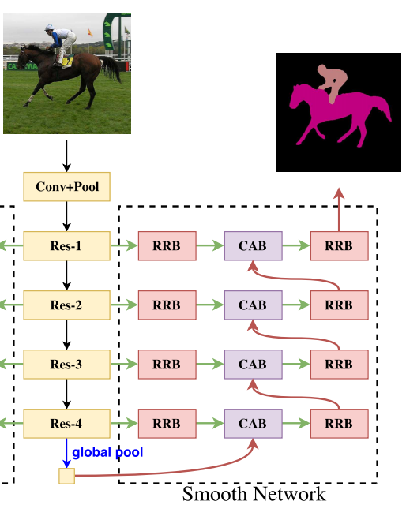
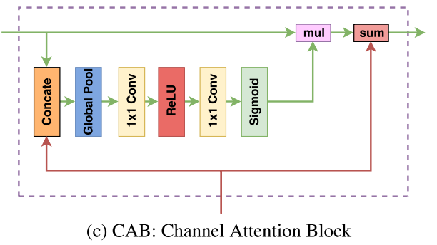
Component: Smooth Network
Notes:
Factorization 응용한듯

Slide 11
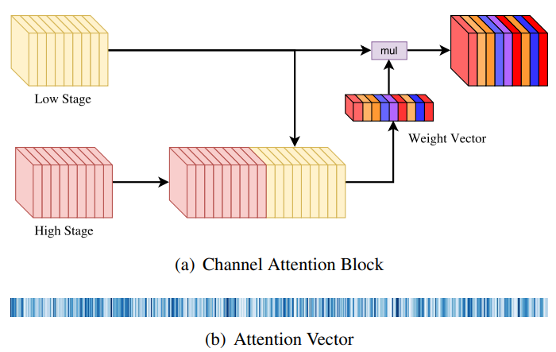
Component: Smooth Network
Notes:
Factorization 응용한듯

Slide 12
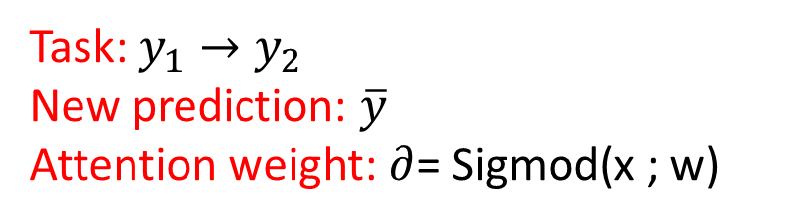
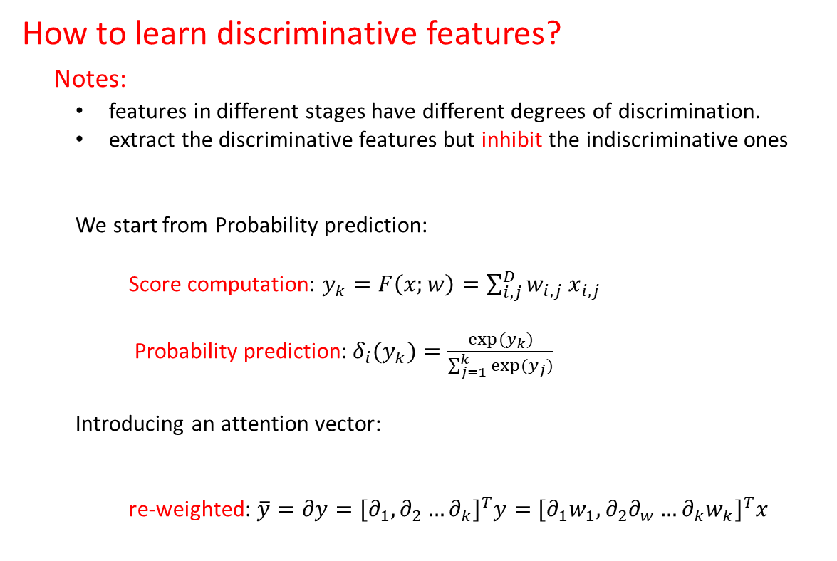
Component: Smooth Network
How to learn discriminative features?
Notes:
  features in different stages have different degrees of discrimination.
  extract the discriminative features but inhibit the indiscriminative ones
  We start from Probability prediction:
  Score computation: $y_{k}=F\left(x;w\right)=\sum_{i,j}^{D}{w_{i,j}}$ $x_{i,j}$
  Probability prediction:${δ_{i}(y}_{k})=\frac{exp⁡(y_{k})}{\sum_{j=1}^{k}{exp⁡(y_{j})}}$
  Introducing an attention vector:
  re-weighted: $\overline{y}=∂y={[∂_{1},∂_{2}…∂_{k}]}^{T}y=$ ${[∂_{1}w_{1},∂_{2}∂_{w}…∂_{k}w_{k}]}^{T}x$
Task: $y_{1}→y_{2}$
New prediction: $\overline{y}$
Attention weight: $∂$= Sigmod(x ; w)
Notes:
Factorization 응용한듯

Slide 13
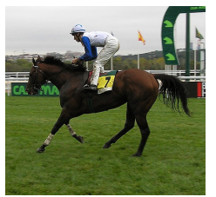
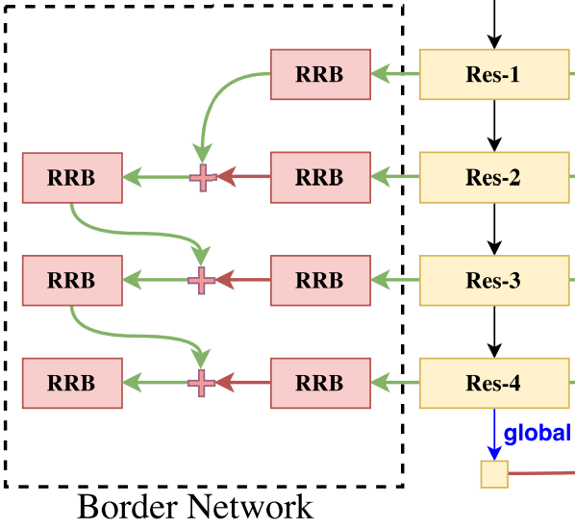

Component: Border Network
Aim: solve the problem of inter-class indistinction
Input
Cause analysis: different categories with similar appearance.
Solution: a bottom-up boundary supervisory.
Label
Edge detection
Edge detection
Boundary loss
Notes:
Factorization 응용한듯

Slide 14
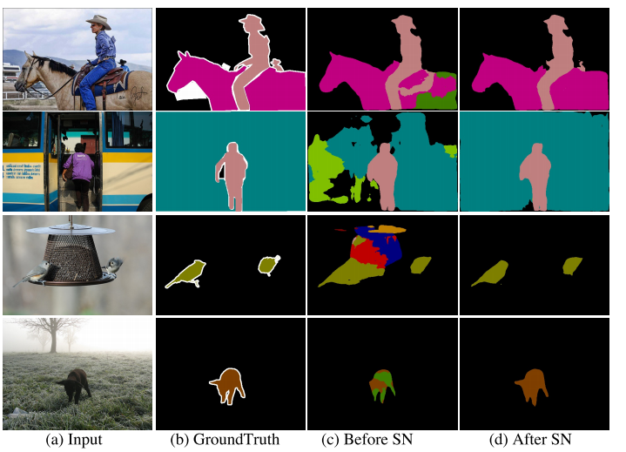
Experiment: Ablation Study
Smooth network
Notes:
Factorization 응용한듯

Slide 15
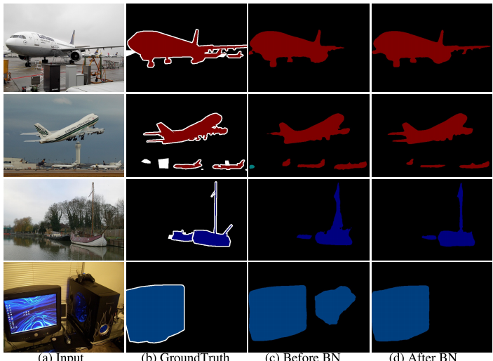
Experiment: Ablation Study
Border network
Notes:
Factorization 응용한듯

Slide 16
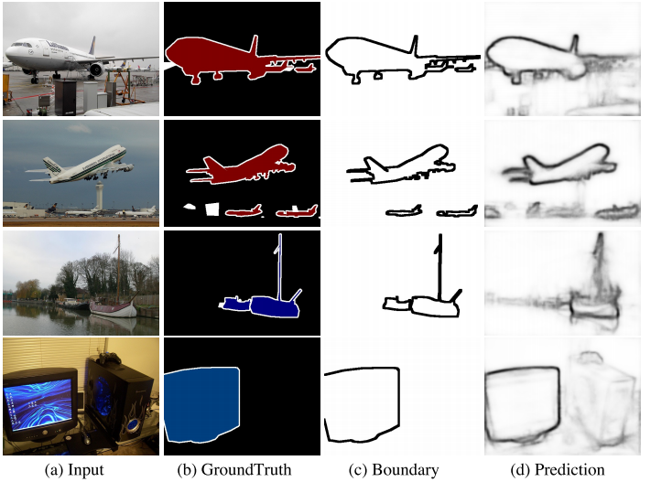
Experiment: Ablation Study
Boundary Supervision
Pascal Voc
Notes:
Factorization 응용한듯

Slide 17
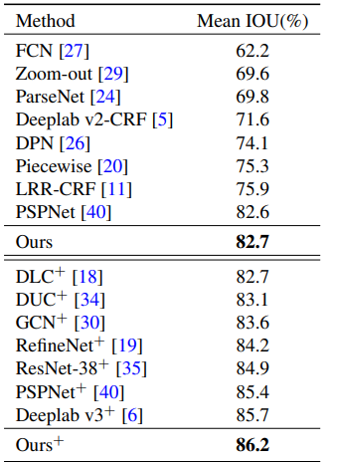
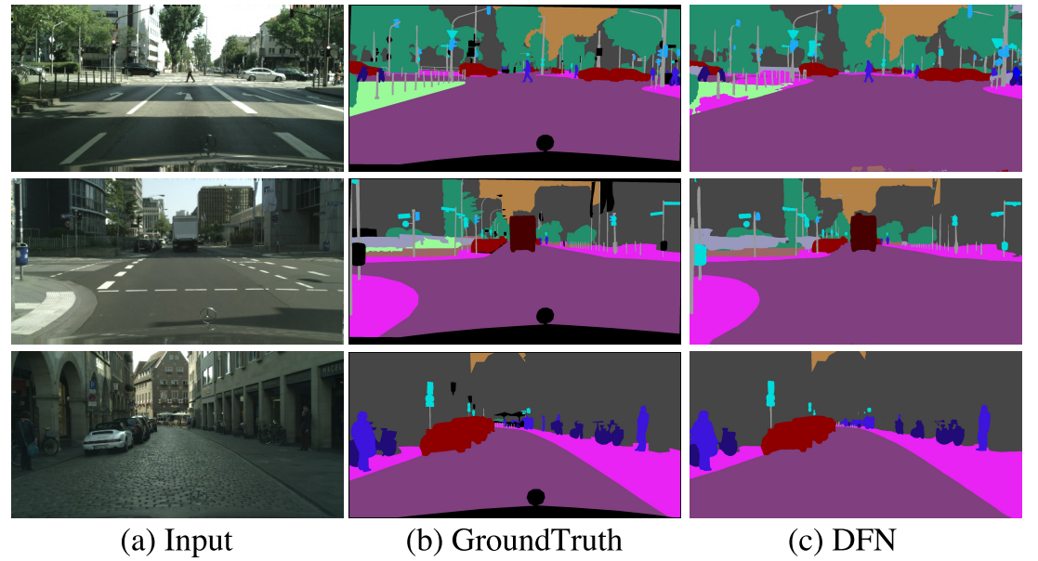
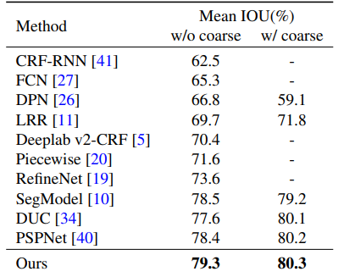
Experiment: Segmentation
Cityscapes
Notes:
Factorization 응용한듯

Slide 18
Summary:
Proposed a Discriminative Feature Network to simultaneously address two challenging problems: “intra-class consistent” and “inter-class variation” issues
Presented a Smooth Network to enhance the intraclass consistency with the global context and the Channel Attention Block.
Achieved state-of-the-art performance 86.2% mean IOU on PASCAL VOC 2012 and 80.3% mean IOU on Cityscapes dataset.
Notes:
Factorization 응용한듯

Slide 19
Q & A
19
Notes:
Factorization 응용한듯

Slide 20
Quiz:
1. Please describe problems of inter-class inconsistency and intra-class indistinction in a sentence?
2. How many blocks are proposed in this work and what are they?
20
Notes:
Factorization 응용한듯

