Slide 1
EDVR: Video Restoration with Enhanced Deformable Convolutional Networks, CVPR 2019 Workshop
Paper presentation
2020.06.04
20205326 Junsik Jung
CS688: Web-scale image retrieval
Notes:
1

Slide 2
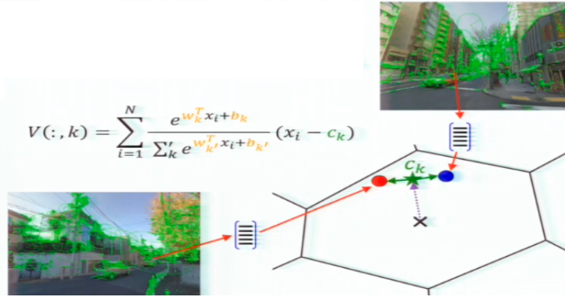
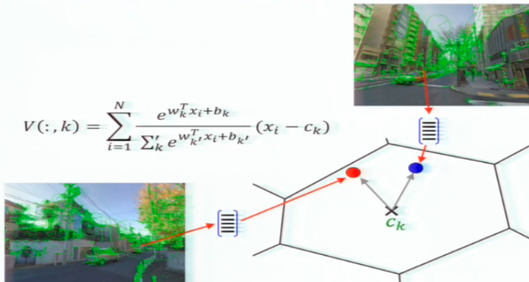
Review
NetVLAD: CNN architecture for weakly supervised place recognition
It is a trainable pooling layer: pools extracted descriptors into a fixed image representation!
It is possible to learn a better anchor (★) point

Slide 3
Table of Contents
Introduction
Related works
Proposed method
Experimental results
Conclusion

Slide 4
Table of Contents
Introduction
Related works
Proposed method
Experimental results
Conclusion

Slide 5
Introduction
The proposed Video Restoration framework with Enhanced Deformable convolutions (EDVR) wins the champions in the NTIRE19[1] Challenge at CVPR 2019
EDVR also demonstrates SOTA performance on video super-resolution and video deblurring.
[1] https://data.vision.ee.ethz.ch/cvl/ntire19//

Slide 6
Introduction
Video Super Resolution (VSR)
So, In VSR, most methods employ four stages - i.e., feature extraction(E), alignment(A), fusion(F) and reconstruction(R).

Slide 7
Introduction
Applying Single Image Super Resolution (SISR) method on each frame?
The SISR methods do not consider the temporal relationship between frames.
This will result in flickering-artifact
To obtain high-quality HR video outputs, we have to…
(1) align and establish accurate correspondences among multiple frames (temporal alignment)
(2) effectively fuse the aligned features for reconstruction.

Slide 8
Table of Contents
Introduction
Related works
Proposed method
Experimental results
Conclusion

Slide 9
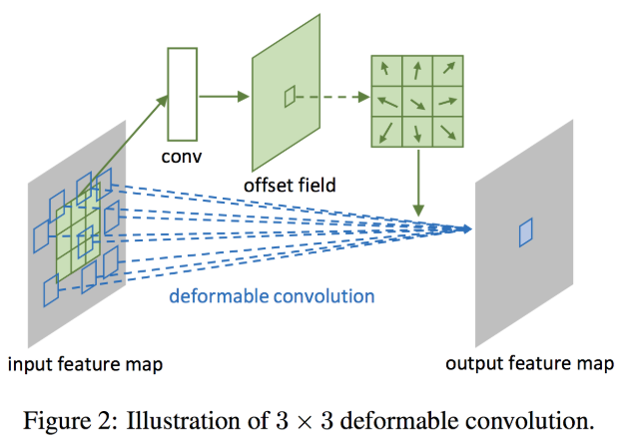
Related works
Deformable Convolution[2]
Note: the arrow in the offset field corresponds to how the blue squares are shifted in the input feature map
[2] Dai, Jifeng, et al. "Deformable convolutional networks." Proceedings of the IEEE international conference on computer vision. 2017.

Slide 10
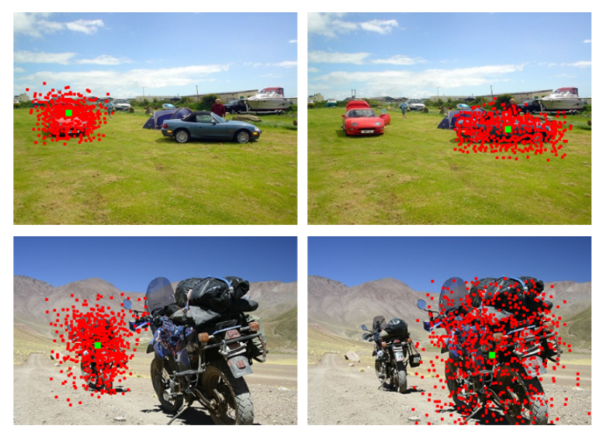
Related works
Deformable Convolution
Simply, It can be regarded as a “learnable” dilated (atrous) convolution which the dilated rate is learned and can be different for each input.
Note: Red dots are sampling locations (from the learned offset) of a deformable convolution filter. Green squares are corresponding outputs. Filter on larger object has larger receptive field.

Slide 11
Table of Contents
Introduction
Related works
Proposed method
Experimental results
Conclusion

Slide 12
Proposed Method
EDVR
This can be easily replaced by any other advanced modules in SISR

Slide 13
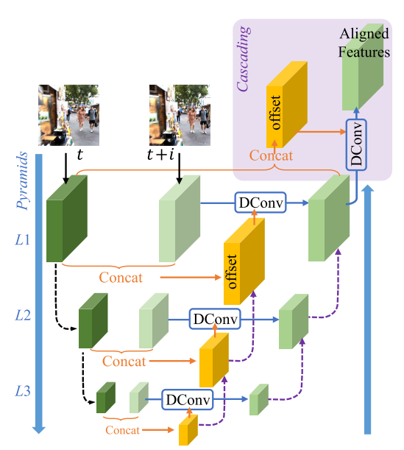
Proposed Method
PCD Align Module - Overview

Slide 14
Proposed Method
PCD Align Module – Deformable Conv

Slide 15
Proposed Method
PCD Align Module – Pyramid, Cascading
Strided convolution for
Downsampling
Bilinear interpolation for
Upsampling

Slide 16
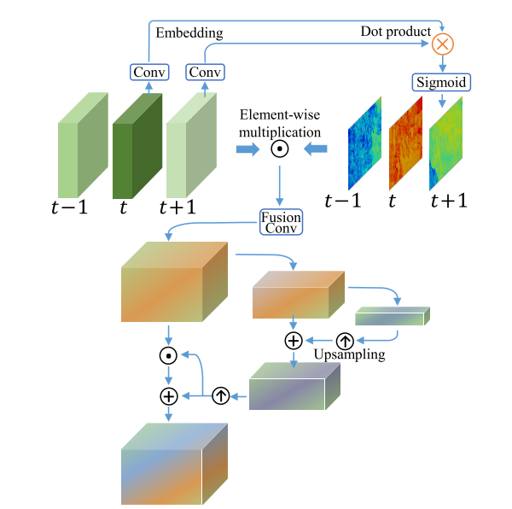
Proposed Method
TSA Fusion Module - Overview

Slide 17
Proposed Method
TSA Fusion Module - Temporal Attention
1x1 Conv

Slide 18
Proposed Method
TSA Fusion Module – Spatial Attention
$${\tilde{F}}_{fusion}^{l}=γ⨀F_{fusion}^{l}⨁β$$
$$F_{fusion}^{l}$$
$$F_{fusion}^{l+1}$$
$$F_{fusion}^{l+2}$$
$$γ$$
$$β$$
$${\check{F}}_{fusion}^{l+1}$$
$${\tilde{F}}_{fusion}^{l}$$

Slide 19
Table of Contents
Introduction
Related works
Proposed method
Experimental results
Conclusion

Slide 20
Experimental Results
Qualitative comparison

Slide 21
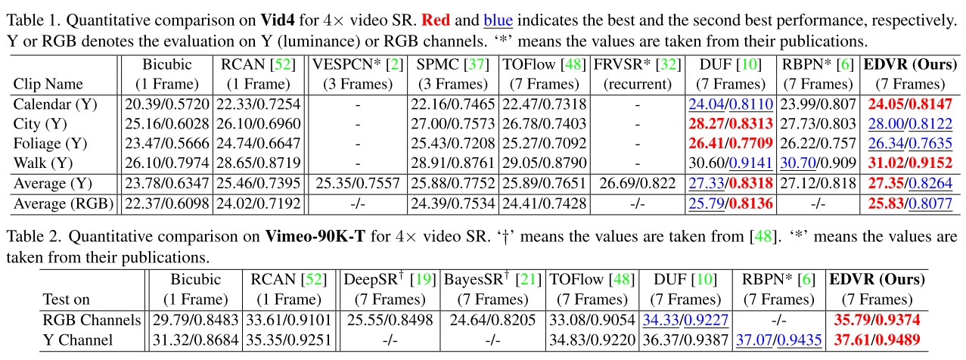
Experimental Results
Quantitative comparison

Slide 22
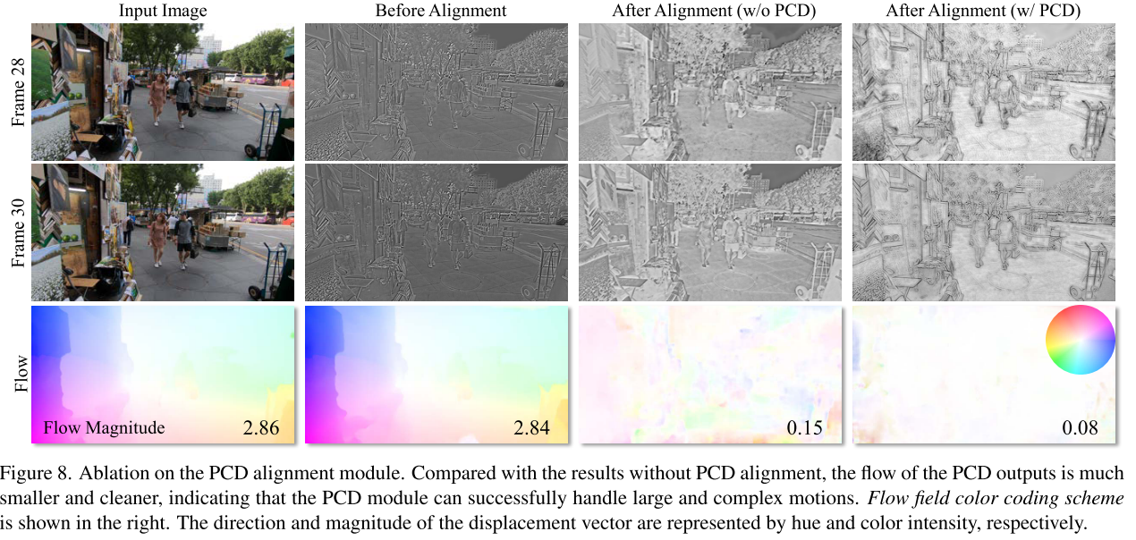
Experimental Results
Ablation study (PCD module)

Slide 23
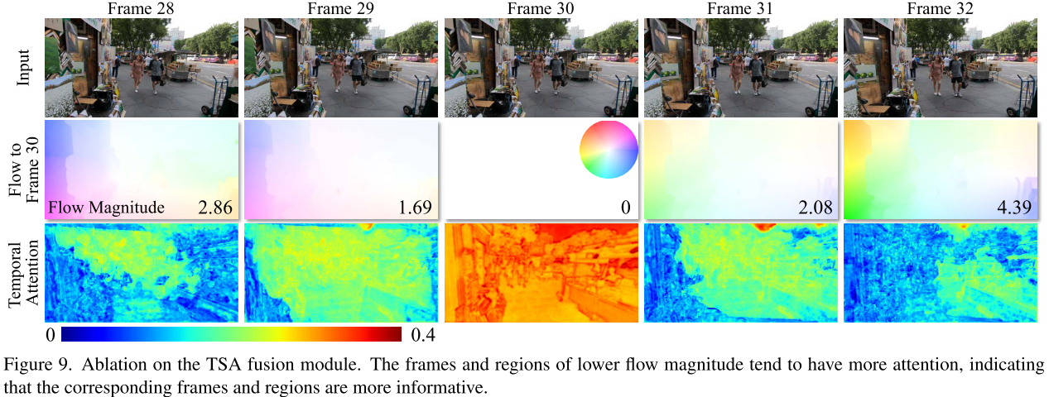
Experimental Results
Ablation study (TSA module)

Slide 24
Table of Contents
Introduction
Related works
Proposed method
Experimental results
Conclusion

Slide 25
Conclusion
With PCD alignment module and TSA fusion module, they achieve good temporal alignment and fusion quality.
The proposed EDVR demonstrates superior performance to existing methods on several benchmarks of video super resolution and deblurring

