Slide 1
CS686:
Reinforcement Learning 2
Sung-Eui Yoon
(윤성의)
Course URL:
http://sgvr.kaist.ac.kr/~sungeui/MPA

Slide 2
Class Objectives
Taxonomy of RL methods
RL methods beyond Deep Q Network (DQN)
  Policy gradient (PG)
    Temporal decomposition
    Baseline subtraction
    Value function estimation
  Trust region policy optimization (TRPO)
  Proximal policy optimization (PPO)
Last time: Discuss basic concepts of reinforcement learning (RL)

Slide 3
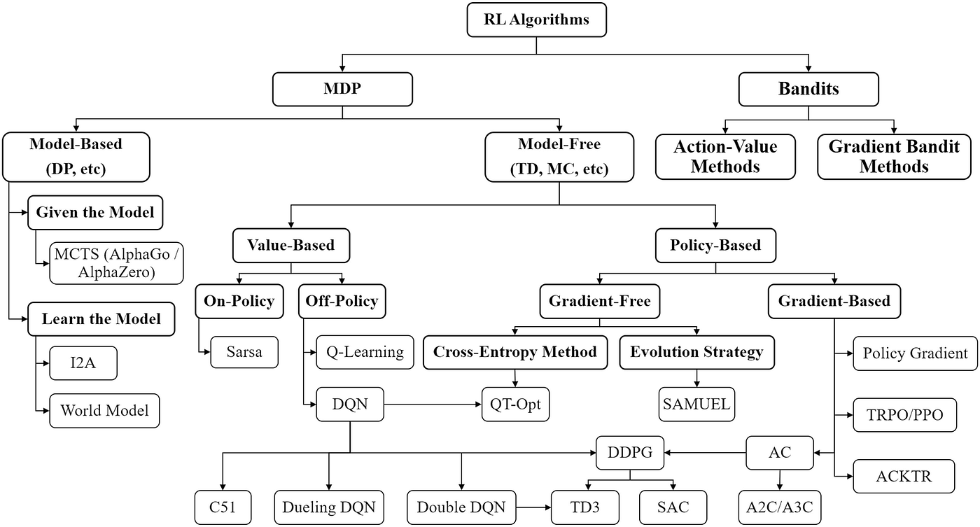
Taxonomy of RL methods

Slide 4
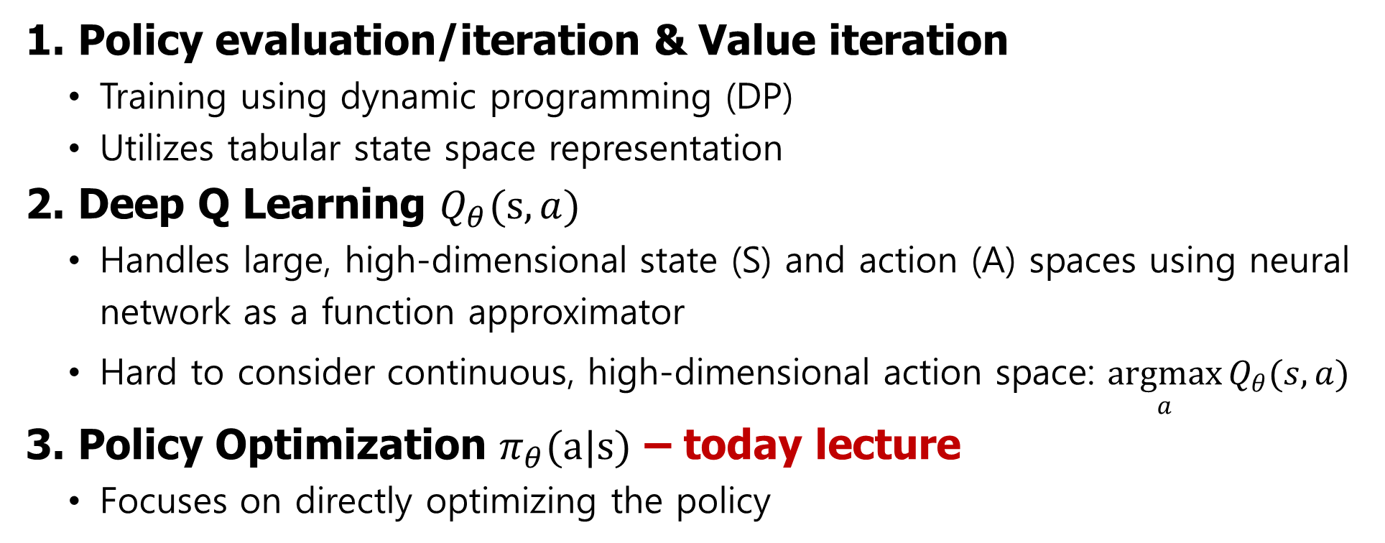
From Value function method to Policy method
1. Policy evaluation/iteration & Value iteration
  Training using dynamic programming (DP)
  Utilizes tabular state space representation
2. Deep Q Learning $Q_{θ}(s, a)$
  Handles large, high-dimensional state (S) and action (A) spaces using neural network as a function approximator
  Hard to consider continuous, high-dimensional action space: $\underset{a}{argmax}{Q_{θ}(s, a)}$
3. Policy Optimization $π_{θ}(a|s)$ – today lecture
  Focuses on directly optimizing the policy

Slide 5
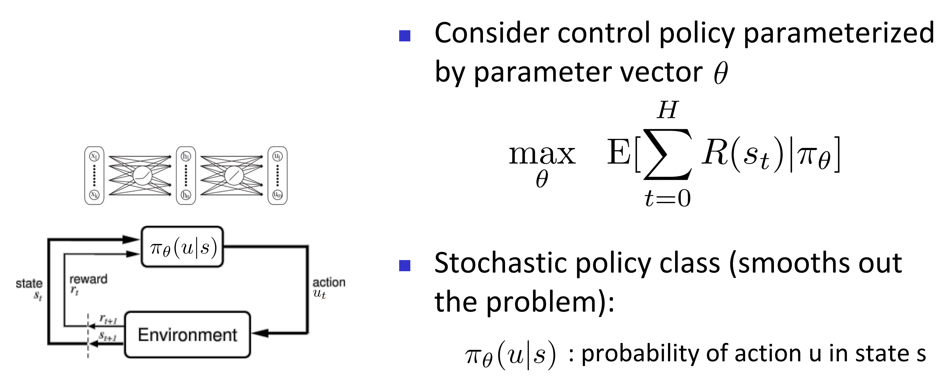
Policy Optimization

Slide 6
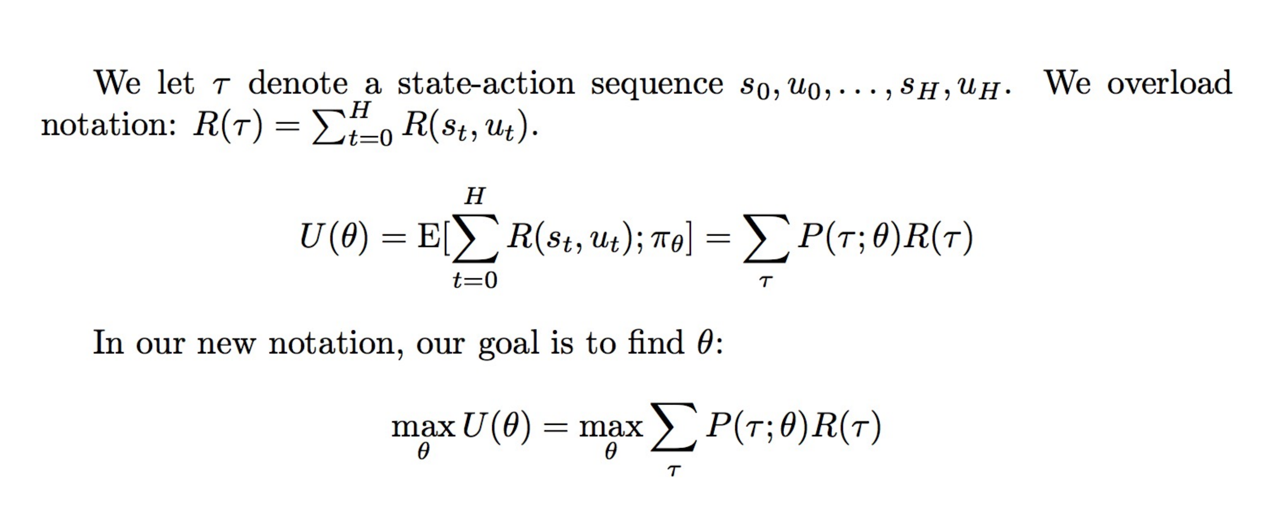
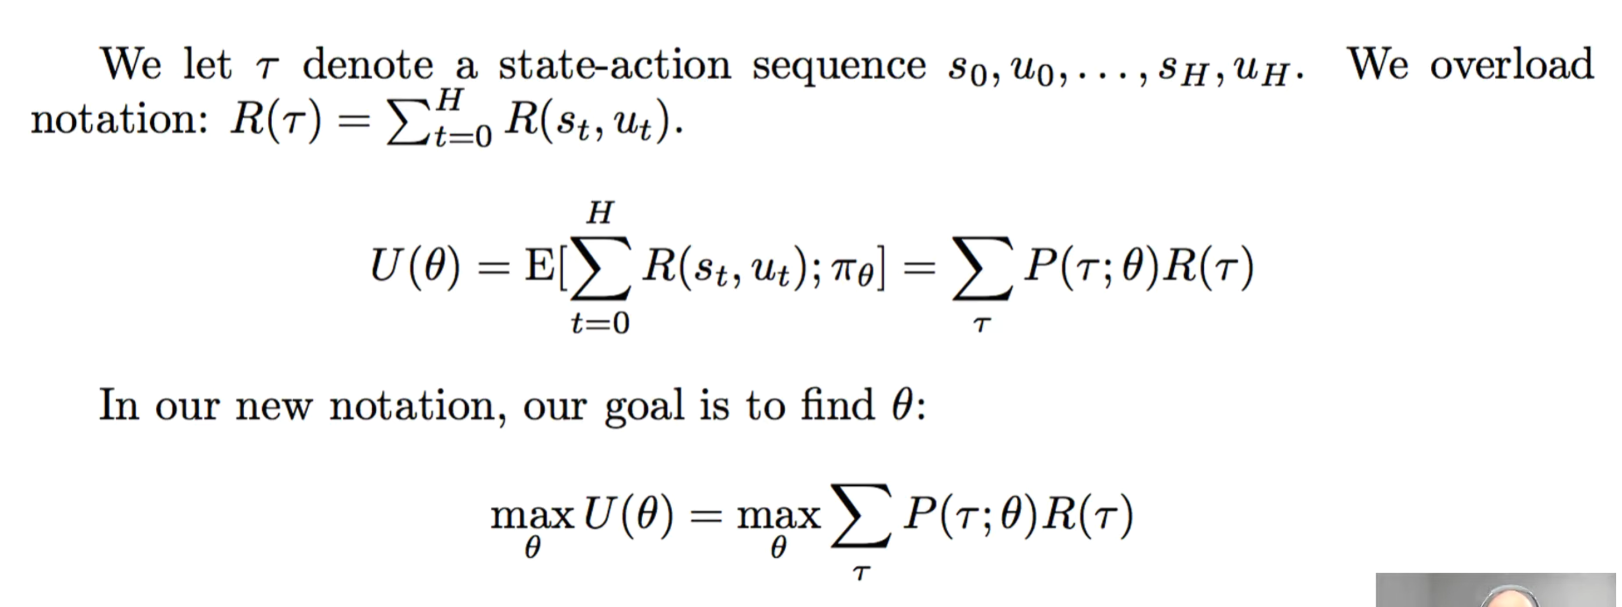
Policy Gradient (PG)
* $P\left(τ;θ\right):probabilistic distribution of trajectories, τ,under the parameterized policy, π_{θ}$

Slide 7
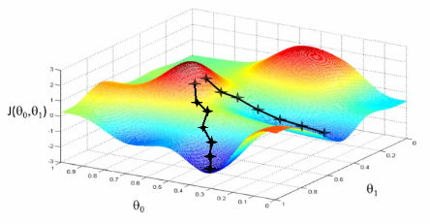
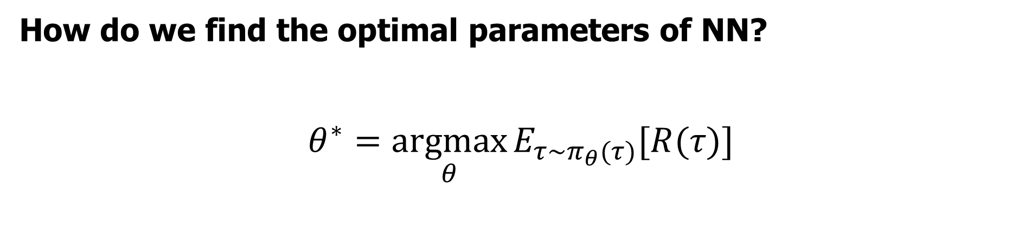
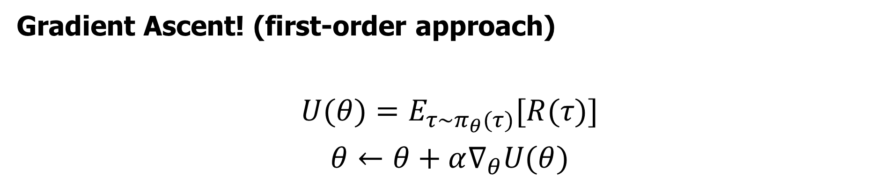
Policy Gradient
How do we find the optimal parameters of NN?
$$θ^{∗}=\underset{θ}{argmax}{E_{τ\sim π_{θ}(τ)}[R(τ)]}$$
Gradient Ascent! (first-order approach)
$$U(θ)=E_{τ\sim π_{θ}(τ)}[R(τ)]$$
$$θ←θ+α∇_{θ}U(θ)$$

Slide 8
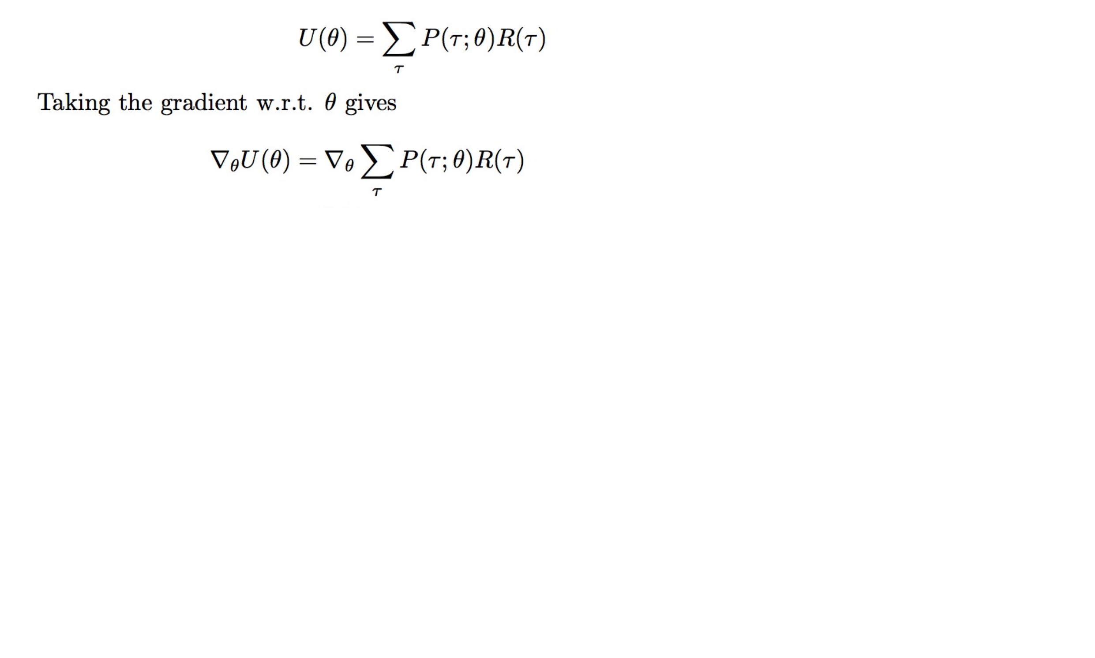
Policy Gradient

Slide 9
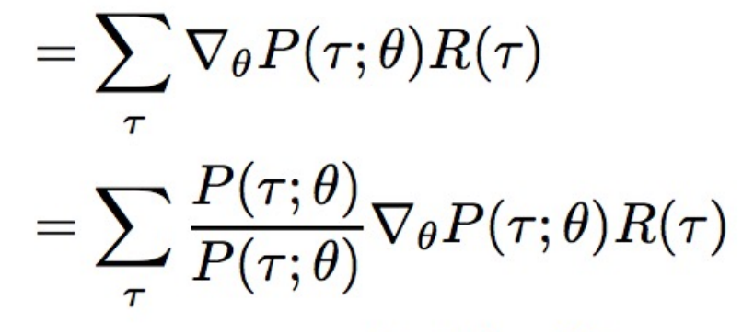
Policy Gradient

Slide 10
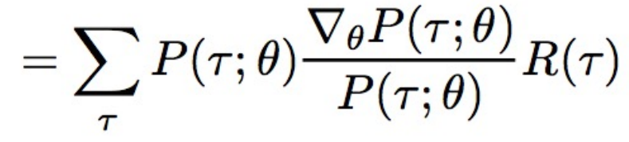
Policy Gradient

Slide 11
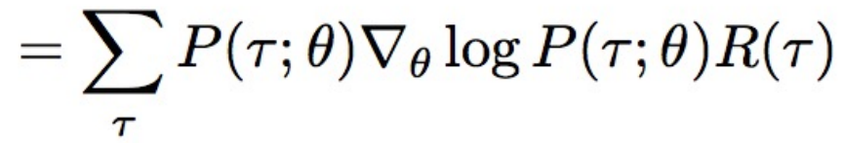
Policy Gradient

Slide 12
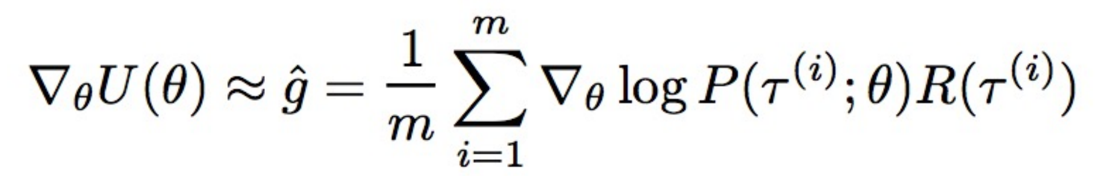
Policy Gradient
The empirical estimate
for m sample paths

Slide 13
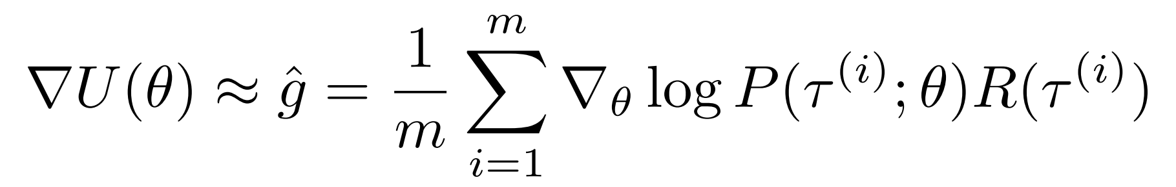
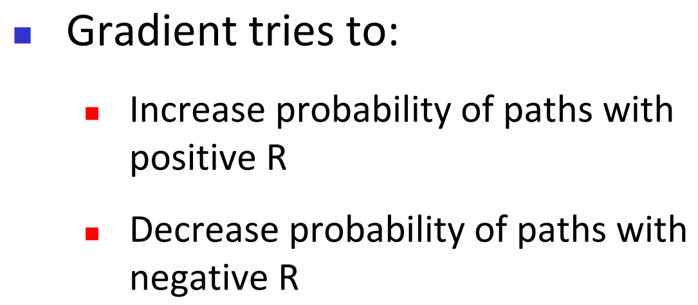
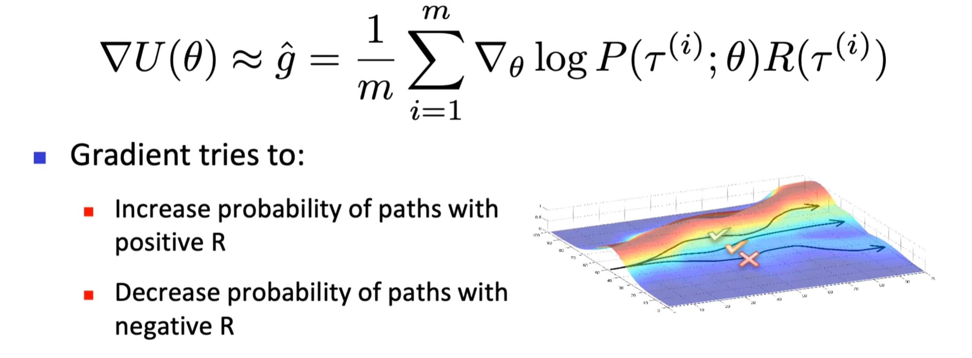
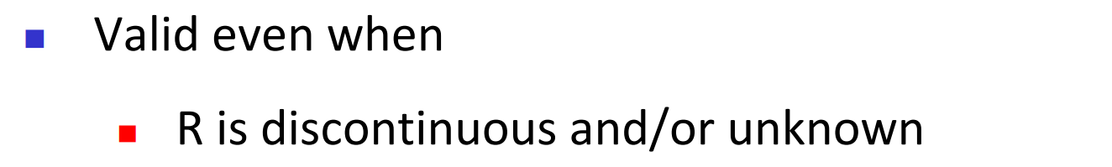
Policy Gradient
Likelihood ratio changes probabilities of experienced paths

Slide 14
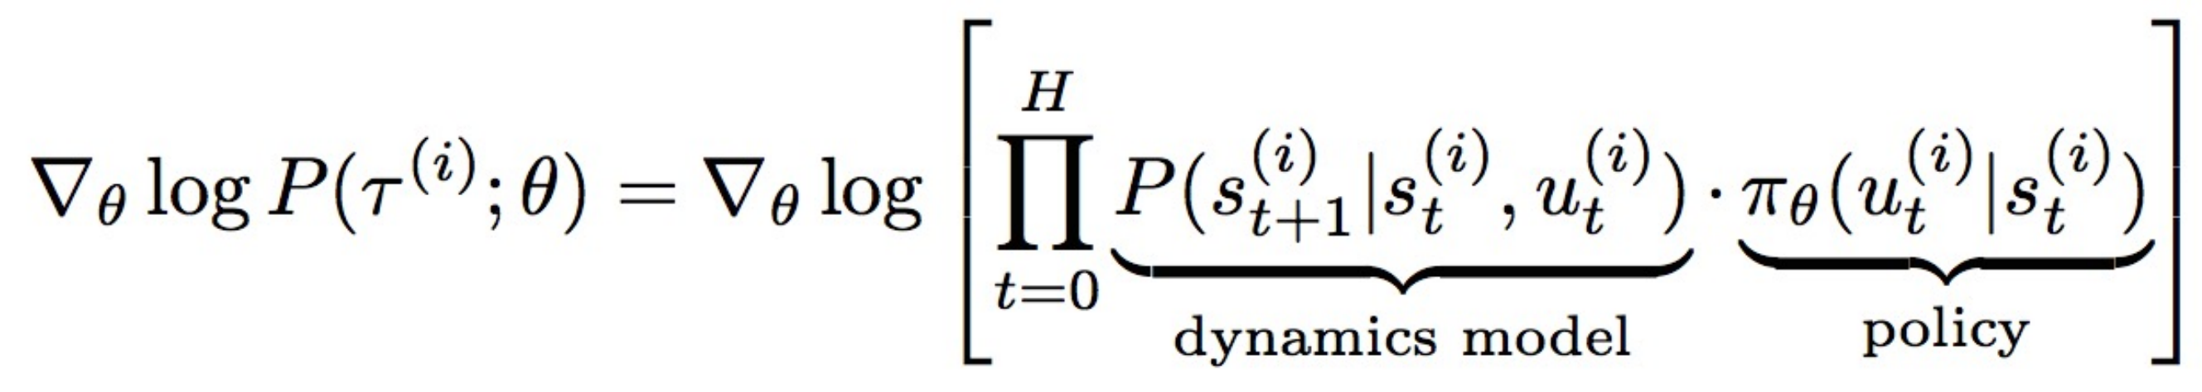
Decompose Path into States and Actions

Slide 15
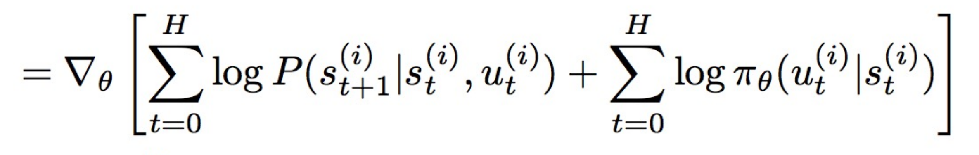
Decompose Path into States and Actions

Slide 16
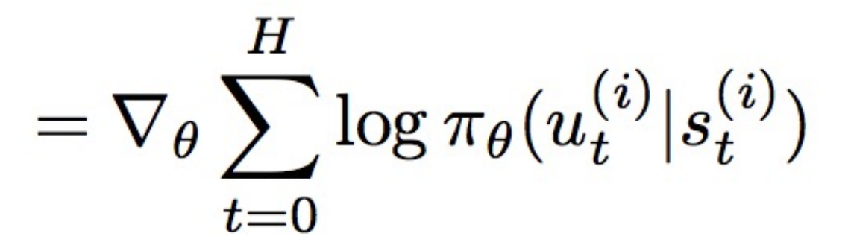
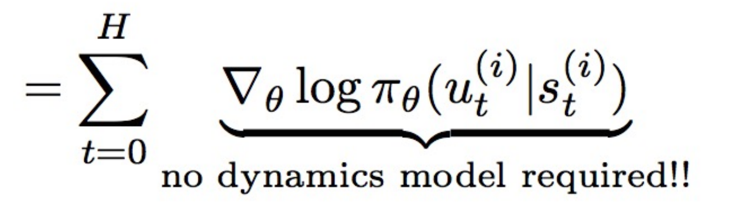
Decompose Path into States and Actions
0

Slide 17
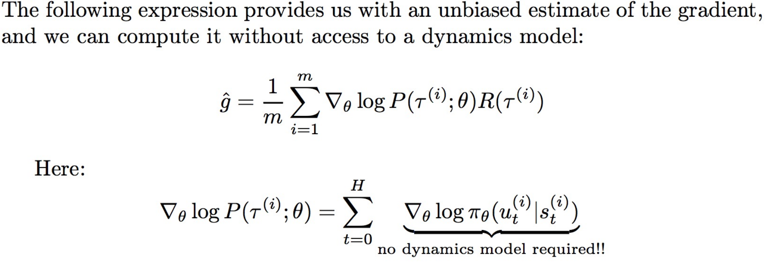
Decompose Path into States and Actions

Slide 18
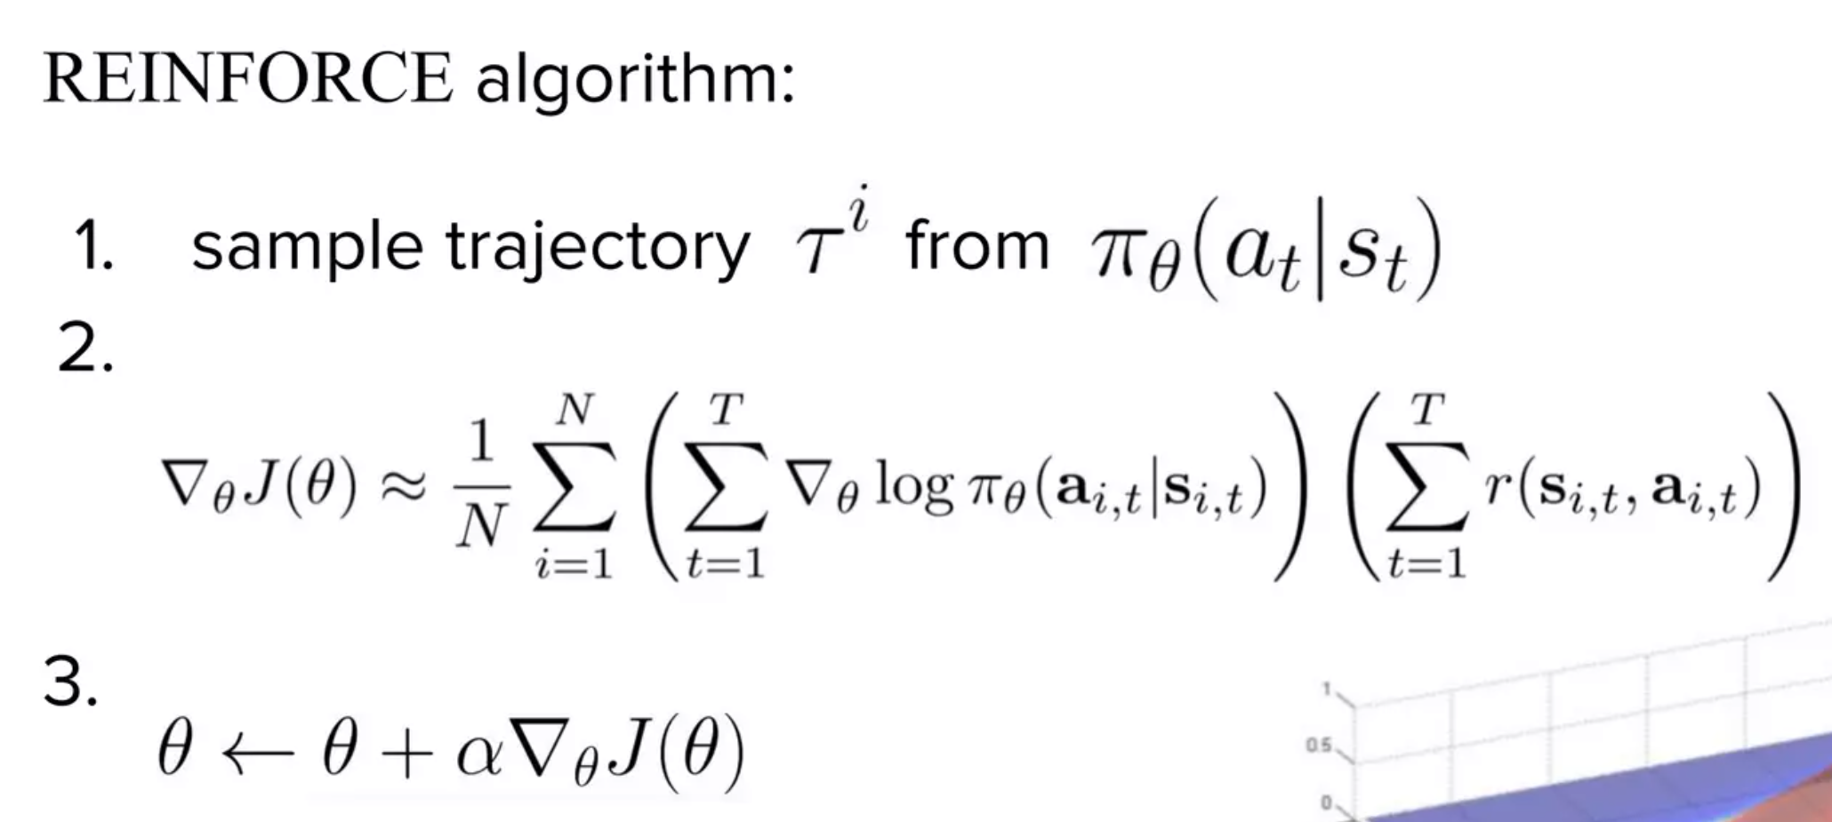
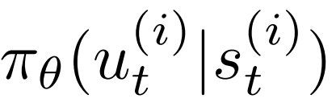
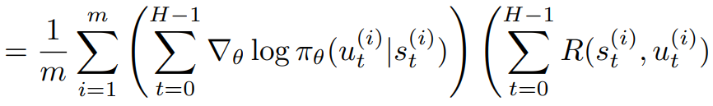
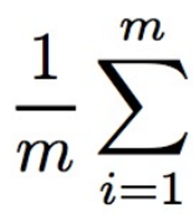
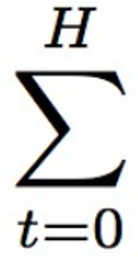

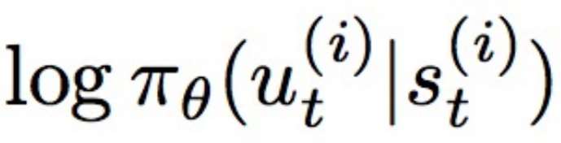
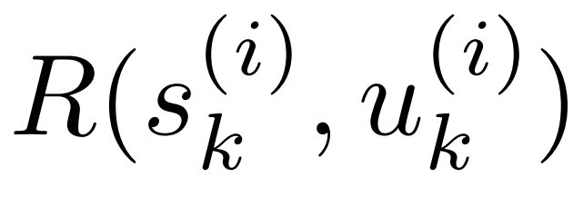

Vanilla Policy Gradient (REINFORCE algorithm)

Slide 19
Features of PG method
Advantages:
Better convergence
Effective in high-dimensional or continuous action space
Disadvantage:
Local optimal rather than global optimal (doesn’t update full state, action spaces per iteration)
High variance

Slide 20
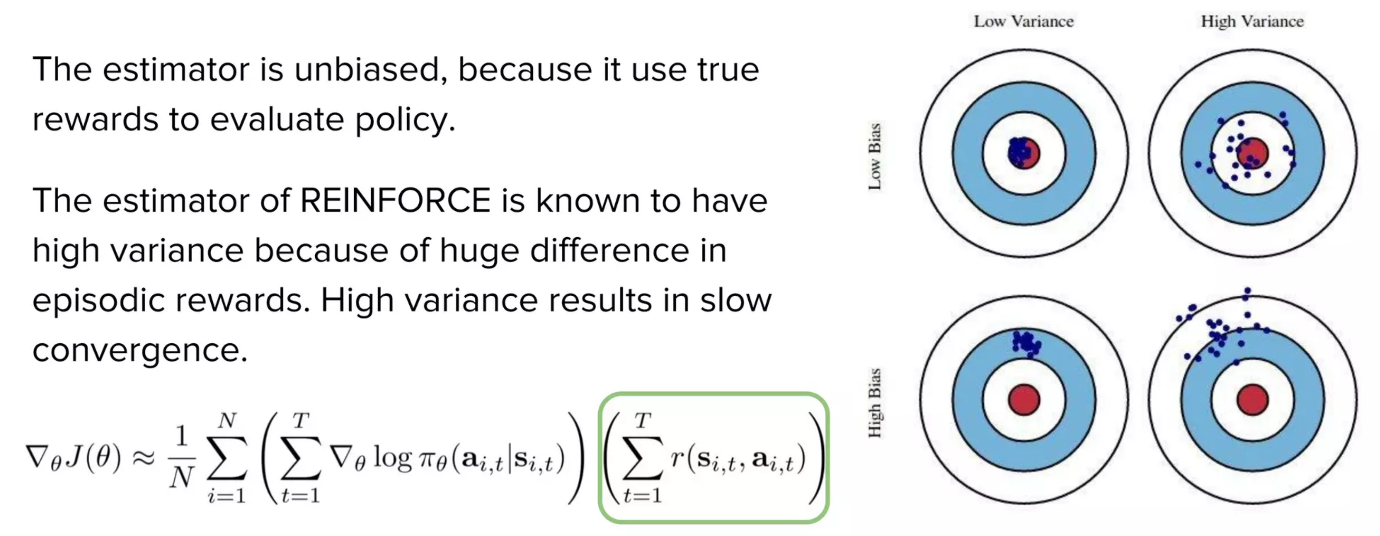
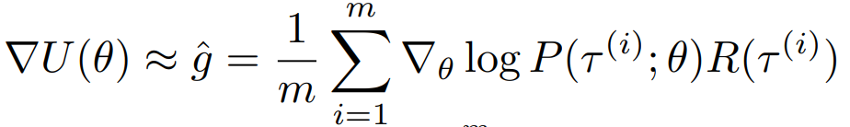
Bias and Variance
Monte-Carlo estimate

Slide 21
Variance reduction techniques
Causality: Temporal decomposition
Baseline subtraction

Slide 22
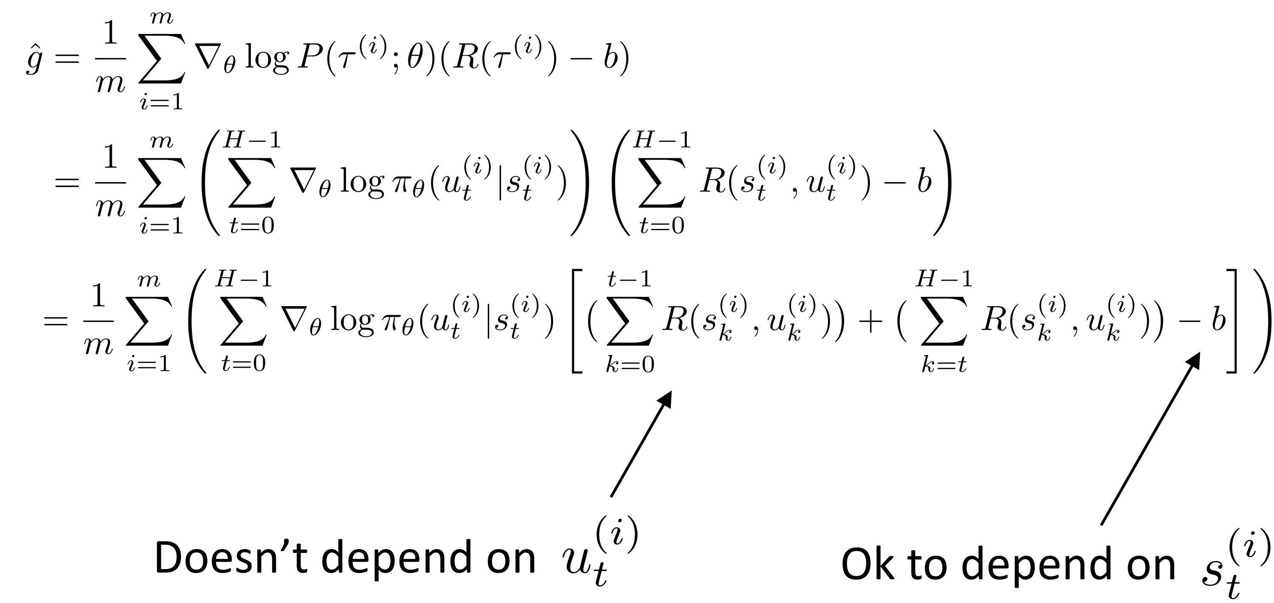
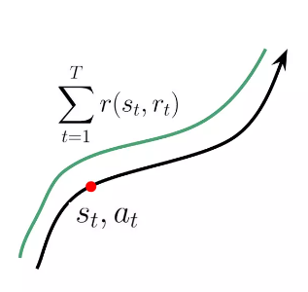
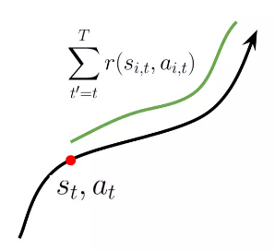
Variance reduction: Causality
Causality: policy at time t cannot affect reward at time t’ when t’ < t.

Slide 23
Variance reduction: Causality
0

Slide 24
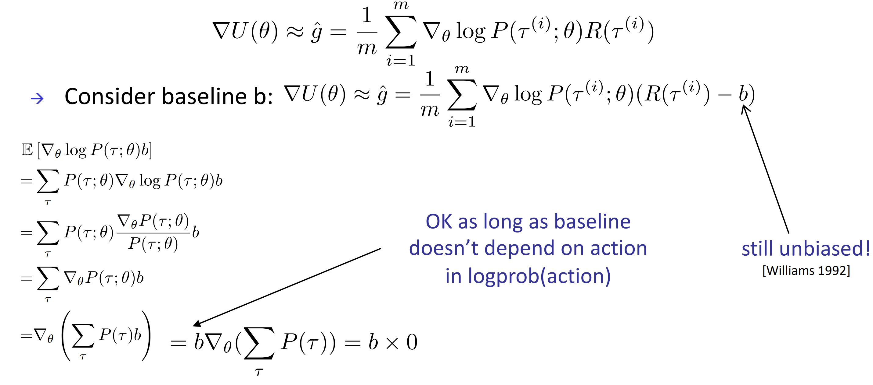
Variance reduction: Baseline subtraction
Does baseline subtraction introduce bias in expectation?

Slide 25
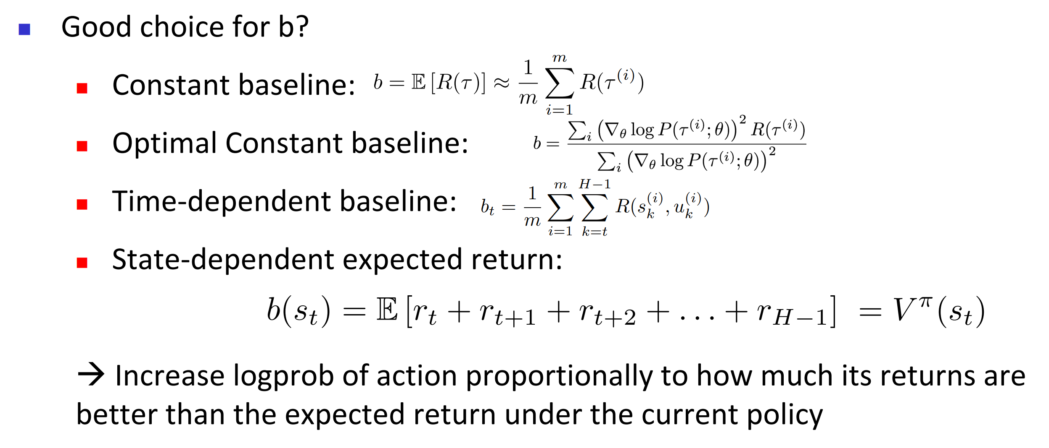
Variance reduction: Baseline subtraction

Slide 26
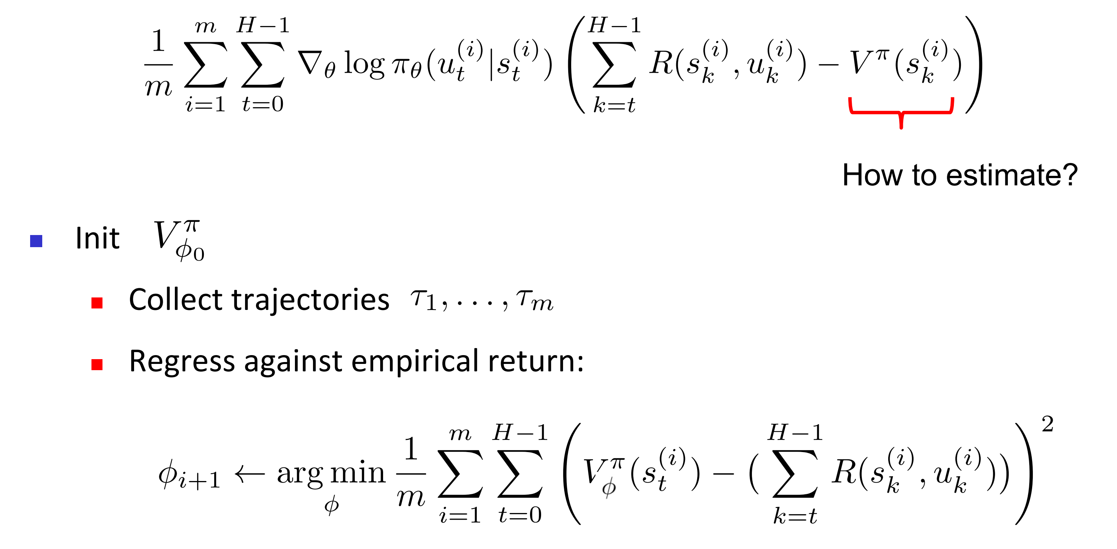

Monte Carlo Estimation of $V^{π}$

Slide 27
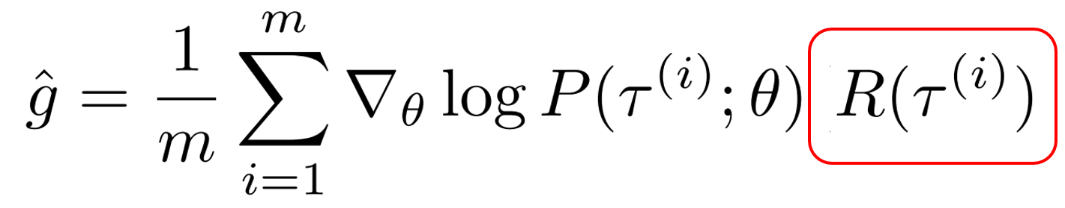
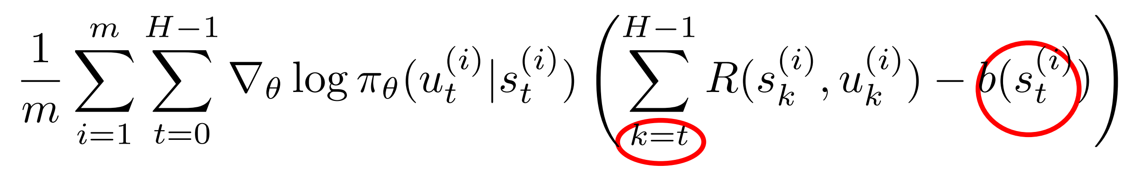

Variance reduction: Causality + baseline
Causality
Baseline

Slide 28
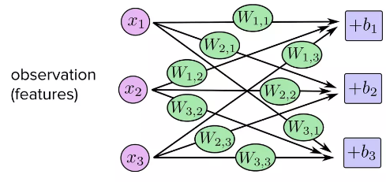
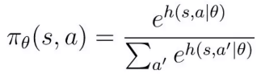
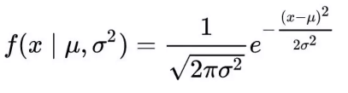
Action space of Policy
Policy gradient can be apply to discrete & continuous action spaces
Discrete action space: SoftMax Policy
Continuous action space: Gaussian Policy

Slide 29
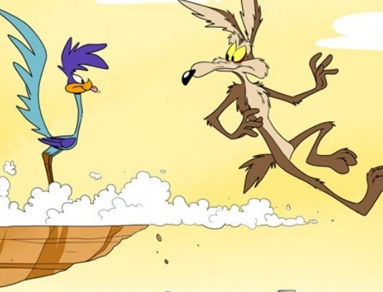
Further improvement
Policy Gradient informs the direction, but how far?
Step-sizing problem
We will look at higher-order optimization method
(i.e., TRPO and PPO algorithms)

Slide 30
What’s in a step-size?
Terrible step sizes, always an issue, but how about just not so
great ones?
Supervised learning
Step too far → a next update will correct for it
Reinforcement learning
Step too far → terrible policy
Next mini-batch: collected under this terrible policy!
Not clear how to recover short of going back and shrinking the step size

Slide 31
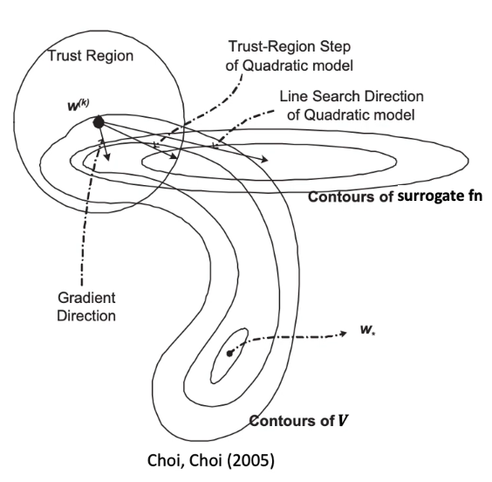
Line Search and Trust Region
Line search method: search along the direction of gradient
  - Simple, but expensive
  - Naïve: ignores where the first-order approximation is good/poor
Trust region method: constrain the update region
- Approximation of objective function is trustable only in a small region

Slide 32
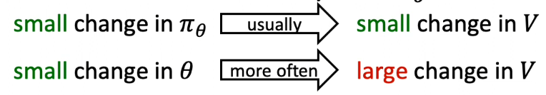
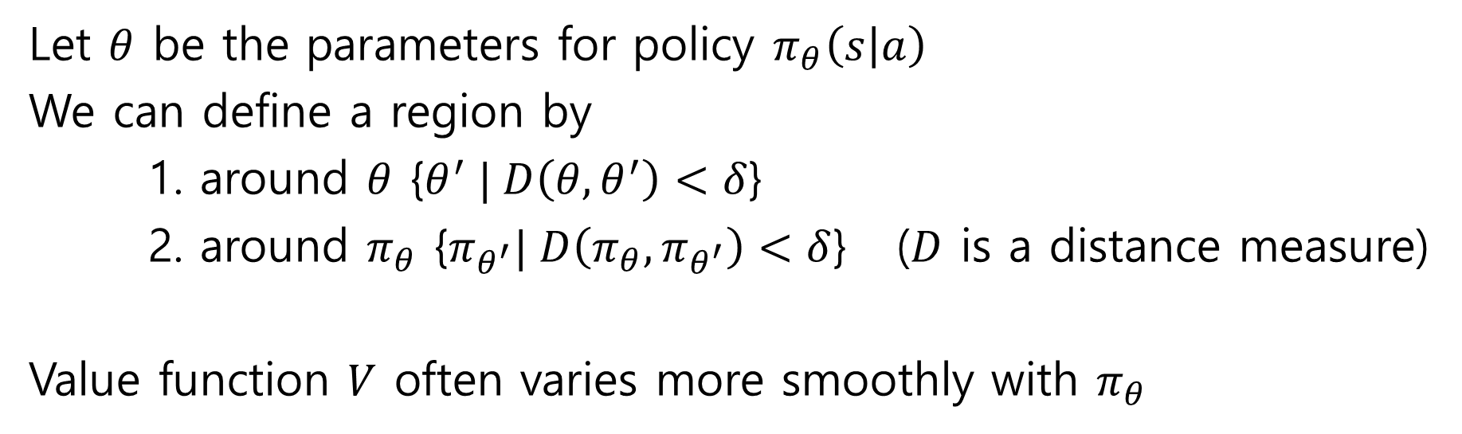
Trust region for Policies
Let $θ$ be the parameters for policy $π_{θ}\left(s | a\right)$
We can define a region by
1. around $θ$ {$θ^{′} | D\left(θ,θ^{′}\right)<δ$}
2. around $π_{θ}$ {$π_{θ^{′}}| D\left(π_{θ},π_{θ^{′}}\right)<δ$} ($D$ is a distance measure)
Value function $V$ often varies more smoothly with $π_{θ}$

Slide 33
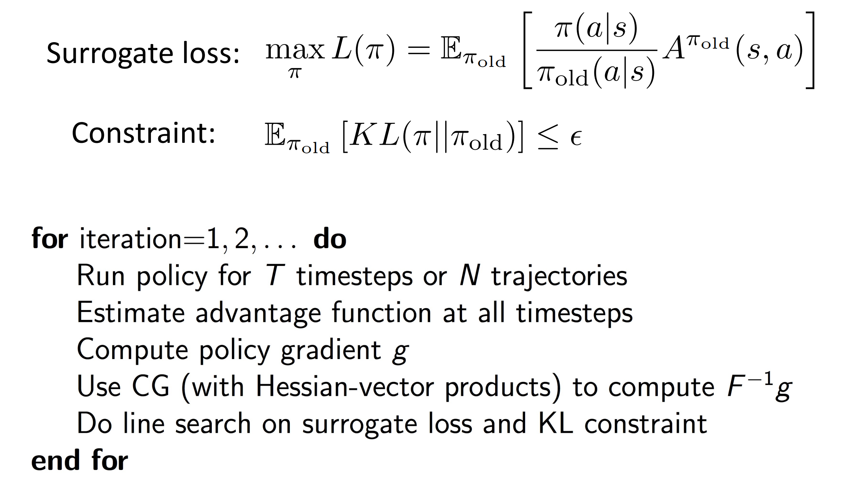

Trust region policy optimization
Relative update perspective:
$$[V^{π}(s_{0})−V^{π_{old}}(s_{0})]$$
Global objective perspective:

Slide 34
Trust region policy optimization
Linear approximation (with gradient)
Quadratic form with gaussian policy
TRPO is conceptually and computationally challenging due to the constraint in the optimization.
Second-order constrained optimization problem (complex)
Cannot harness good first-order optimizers like Adam, RMSprop

Slide 35
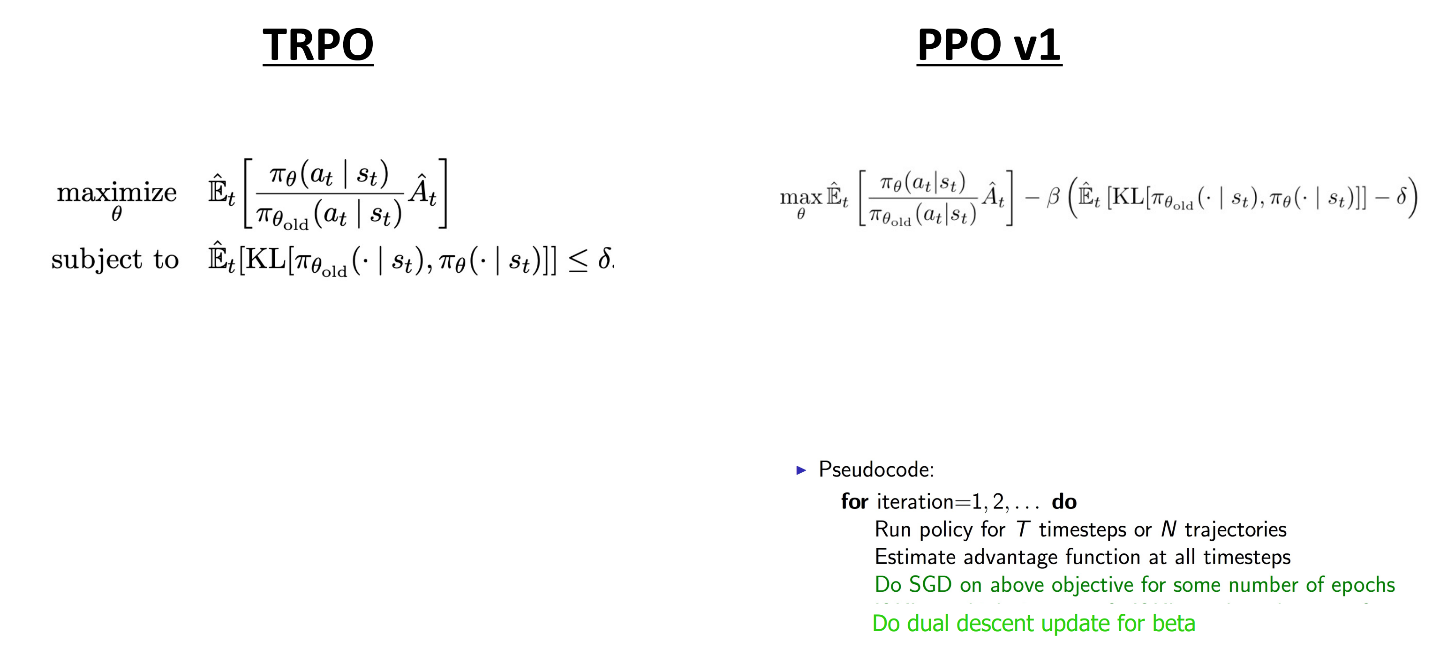
Proximal Policy Optimization V1: “Dual Descent TRPO”
Let’s convert a constrained optimization problem into an unconstrained optimization problem.
Solve second-order constraint optimization problem
Conduct stochastic gradient descent for some number of epochs
Do dual descent update for beta

Slide 36
Effect of TRPO’s constraint term
The dual decent approach requires gradient decent to be performed twice, so calculations are still complicated. Is there a simpler way to restrict the update to local?
→ Restrict the changes in this term
What is the effect of KL divergence?

Slide 37
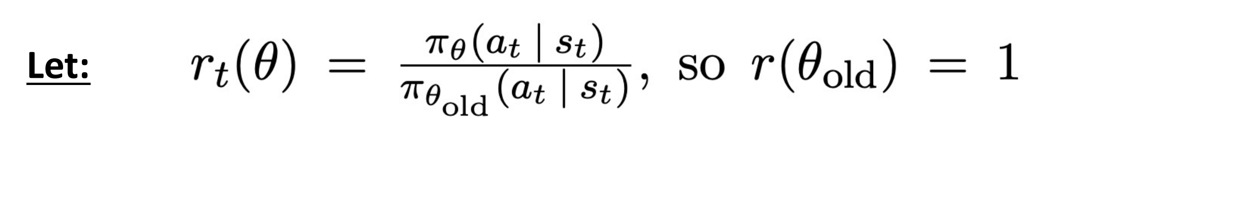
Proximal Policy Optimization V2: “Clipped Surrogate Loss”
Let's use the clipping technique to prevent updates from samples that cause large policy changes.

Slide 38
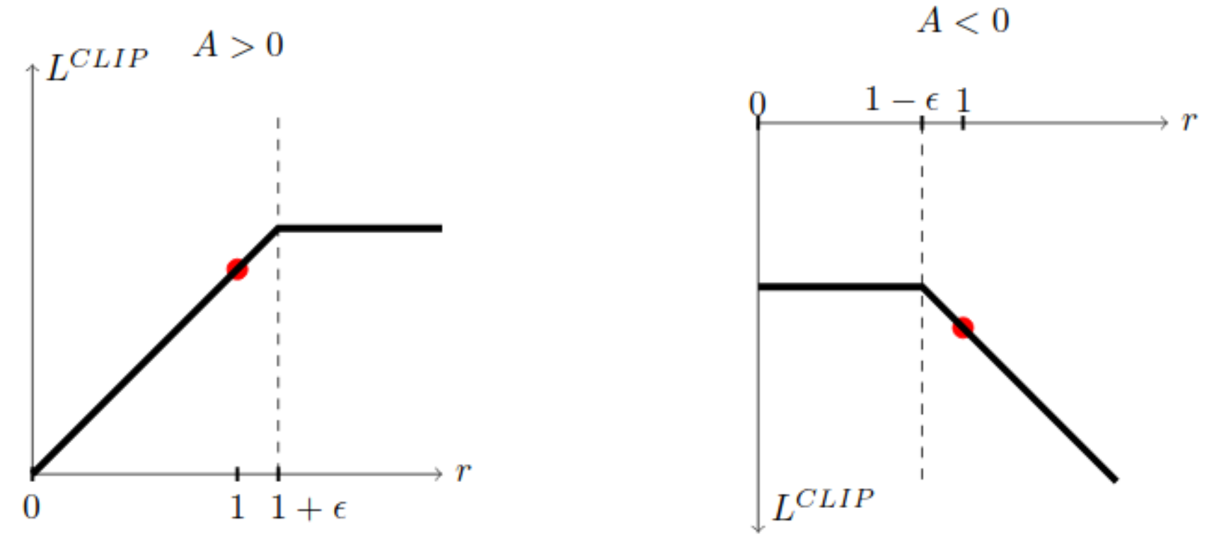

Proximal Policy Optimization V2: “Clipped Surrogate Loss”
Let's use the clipping technique to prevent updates from samples that cause large policy changes.

Slide 39

OpenAI-5 was trained with PPO
[Gaming] continuous and discrete state & action spaces / multi-agent control

Slide 40

OpenAI In-Hand Re-Orientation
[Robotics] continuous state and action control

Slide 41

Summary of This Lecture
Journey of PG:
We first induced a policy gradient $\hat{g}$ to optimize the objective function (i.e., maximizing the return)
To reduce the variance of $\hat{g}$, we learned variance reduction techniques (1. causality, 2. baseline subtraction)
We tried to consider the step-sizing problem.
It led to the constrained optimization problem (i.e., trust region).
But, we wanted to stick to the first-order optimization method.
Thus, it led to PPO v1 and PPO v2!

Slide 42
Reference
Deep RL Foundations in 6 Lectures by Pieter Abbeel:
  https://www.dropbox.com/s/bodgpysmm6lu998/l4-TRPO-PPO.pdf?dl=0
  https://www.dropbox.com/s/7y82w1q70ftt2fv/l3-policy-gradient-and-advantage-estimation.pdf?dl
CS 294, Berkeley lecture 4: http://rll.Berkeley.edu/deeprlcourse/
David Sliver RL course lecture 7:
http://www0.cs.ucl.ac.uk/staff/d.silver/web/Teaching_files/pg.pdf
Baseline Subtraction from Shan-Hung Wu:
https://www.youtube.com/watch?v=XnXRzOb0Pc8
Andrej Kapathy’s blog: http://karpathy.github.io/2016/05/31/rl/
Policy Gradient in python:
https://github.com/pytorch/examples/tree/master/reinforcement_learning
Policy gradient by Jie-Han Chen:
https://www.slideshare.net/zhihua98/policy-gradient-98034864

