Slide 1

Reactive Navigation in Crowds for Non-holonomic Robots with Convex Bounding Shape
IEEE ROBOTICS AND AUTOMATION LETTERS 2021
CS686 Paper Presentation I
20233201 JIHYEOK KIM

Slide 2
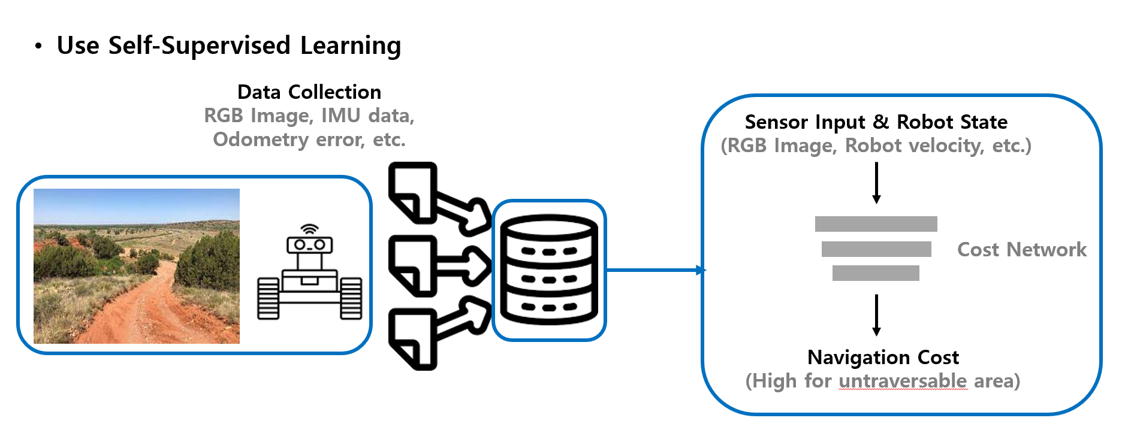
REVIEW
TerraPN: Unstructured Terrain Navigation using Online Self-Supervised Learning
Improve navigability cost using non-uniform sample patches
Compute collision free trajectories with Dynamic Window Approach
1

Slide 3
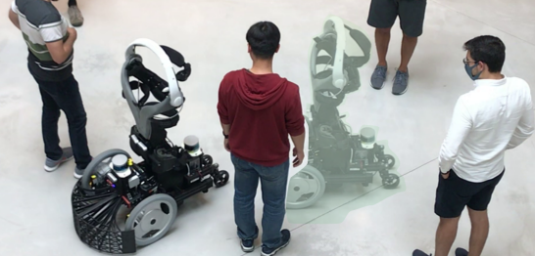
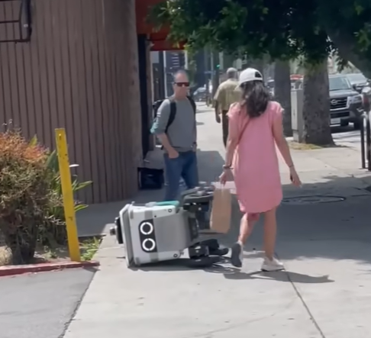
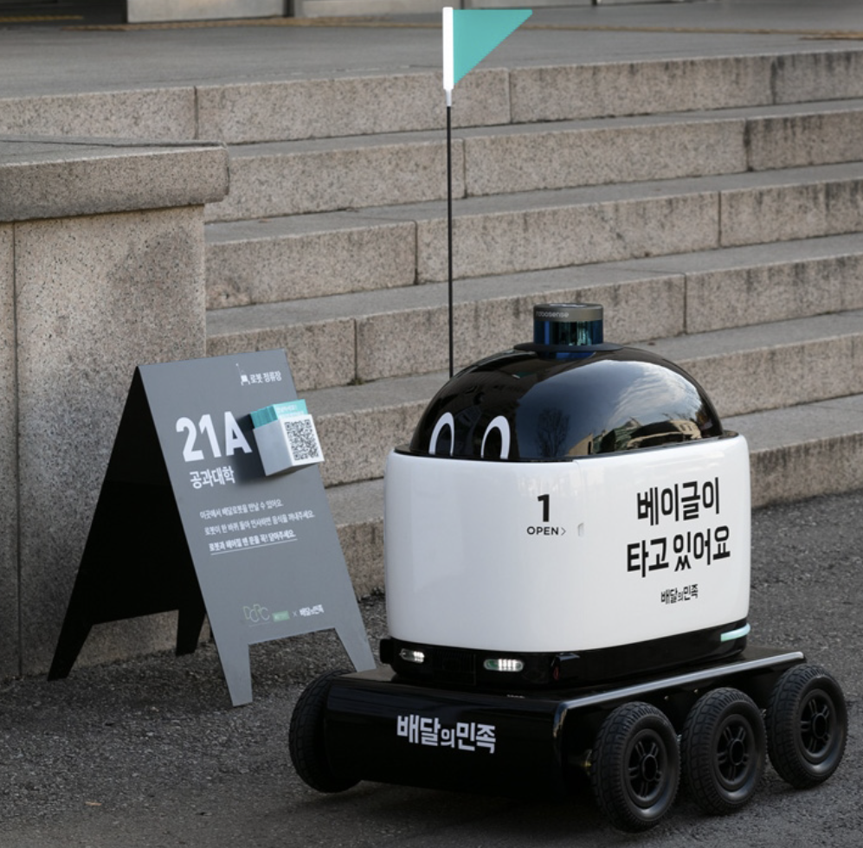
BACKGROUND
Robot navigation in crowded environment
need to coordinate with pedestrian
should predict their intentions and avoid collision safely

Slide 4
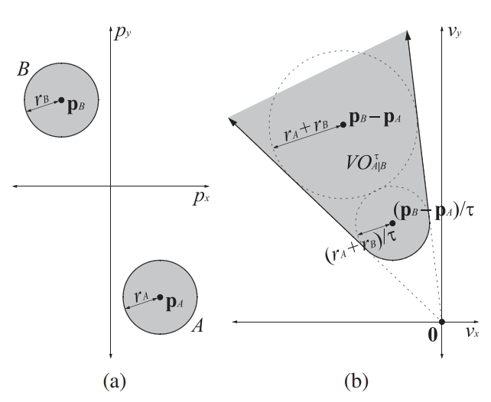
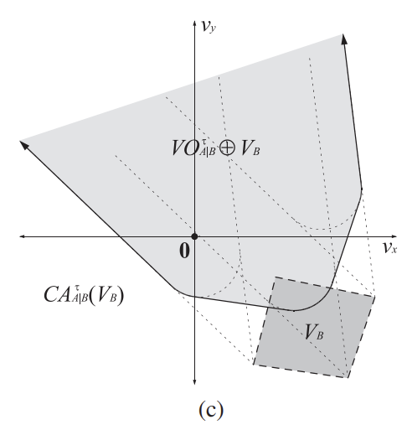
BACKGROUND
Velocity Obstacle
velocity based approach to avoid collisions with moving obstacles
Velocity obstacle
Minkowski Sum
Collision-avoidance velocity

Slide 5
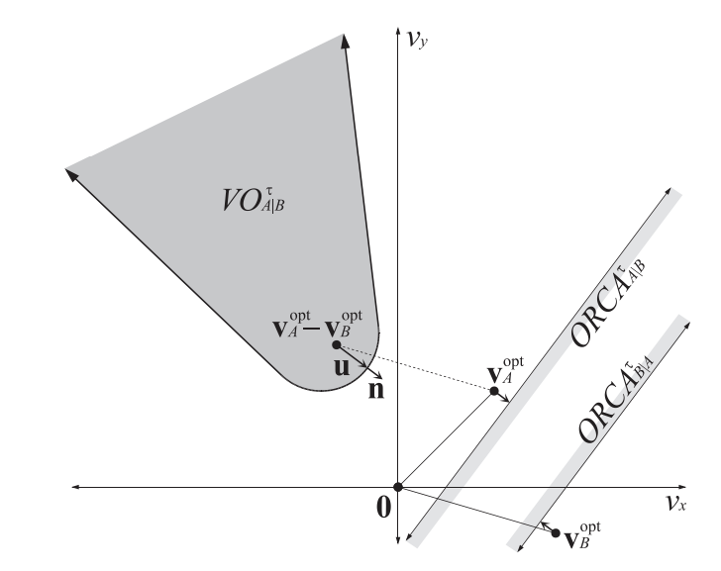
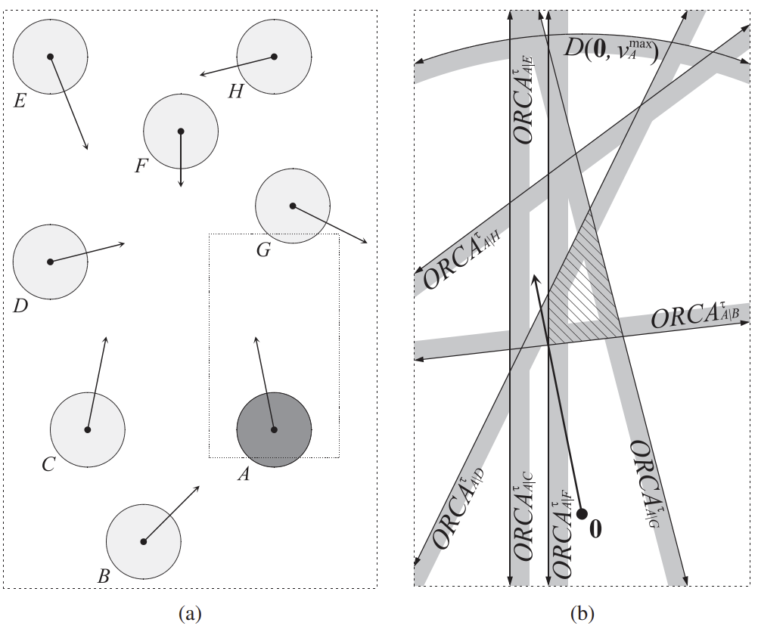


RELATED WORK
Optimal Reciprocal Collision Avoidance (ORCA)
Assume circular holonomic agents
Reduce the capability for non-holonomic agents to plan through narrow passage

Slide 6
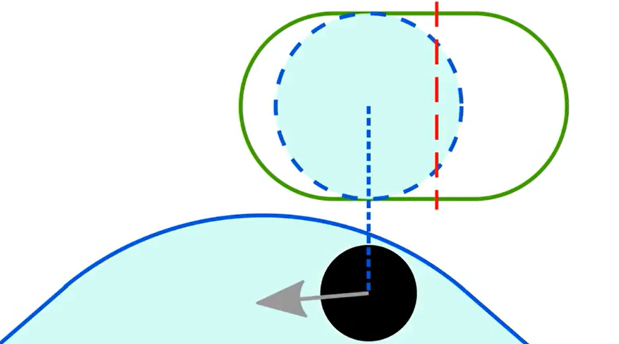
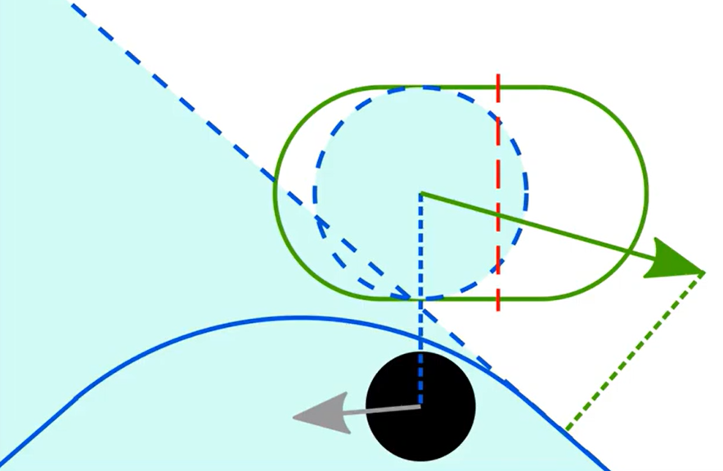
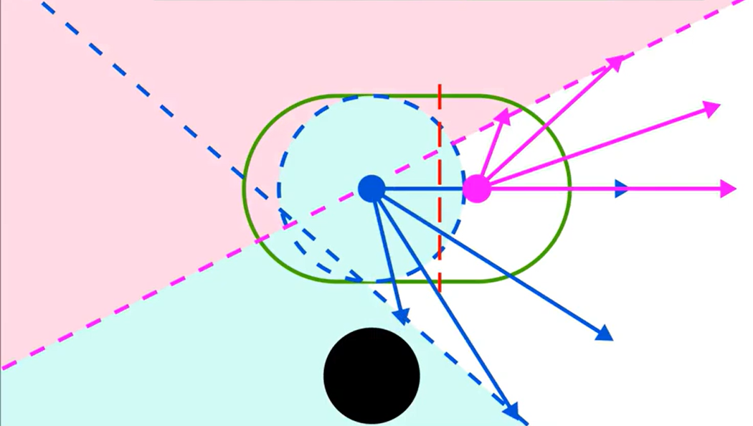
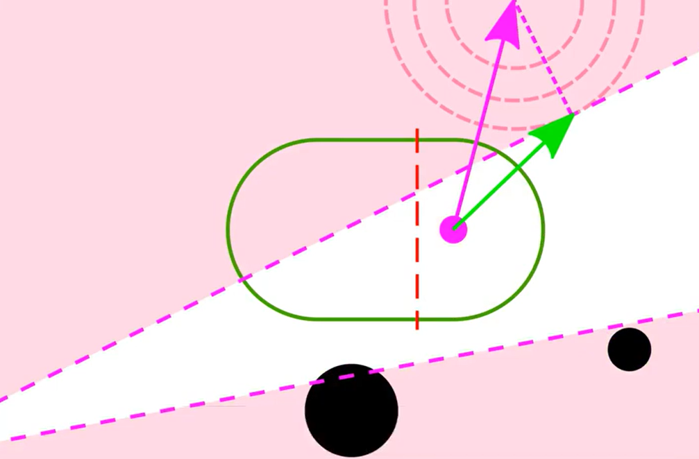
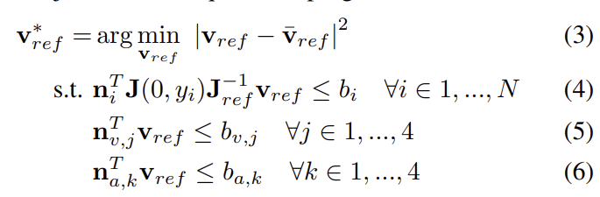
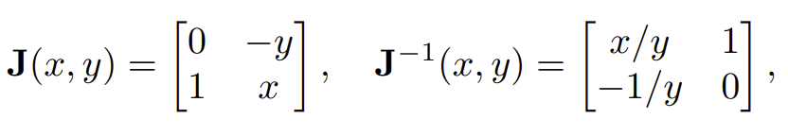
METHODS
Reactive Driving Support (RDS)
Using capsule model to describe the robot’s shape
Model accounts for non-holonomic kinematics preventing sideways motions
Optimization Problem

Slide 7
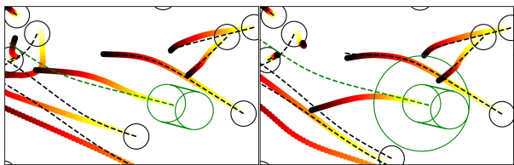
EXPERIMENT:
Simulation
Simulation Framework
pedestrians
Reference trajectory:
Robot (RDS)
Robot (ORCA)
Robot and pedestrians follows the reference trajectory
Pedestrians avoid each other and the robot by ORCA
Robot uses RDS or ORCA

Slide 8

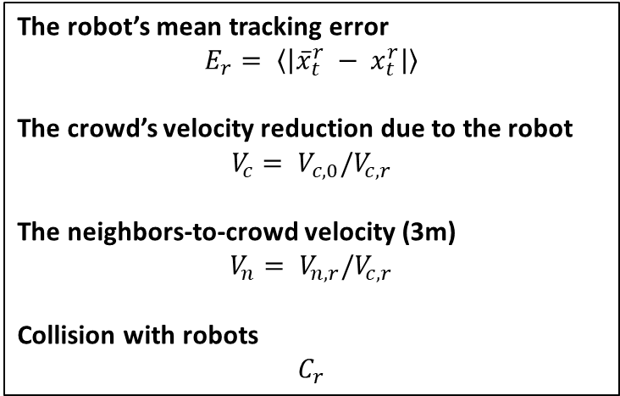
EXPERIMENT:
Simulation
Performance Metrics
The robot’s mean tracking error
$$E_{r}= \left\langle \left|{\overline{x}}_{t}^{r} − x_{t}^{r}\right|\right\rangle$$
The crowd’s velocity reduction due to the robot
$$V_{c}= V_{c,0}/V_{c, r}$$
The neighbors-to-crowd velocity (3m)
$$V_{n}= V_{n,r}/V_{c, r}$$
Collision with robots
$$C_{r}$$

Slide 9
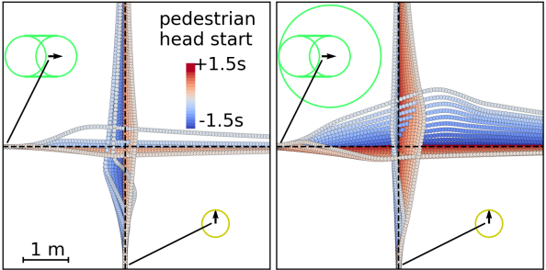
EXPERIMENT:
Simulation I
Crossing with Variable Head Start
Speed: 1.3 m/s

Slide 10
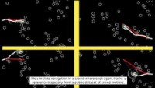

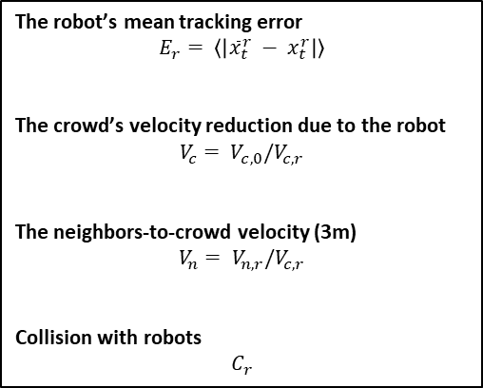
EXPERIMENT:
Simulation II
Navigating in a Sparse Crowd
The robot’s mean tracking error
$$E_{r}= \left\langle \left|{\overline{x}}_{t}^{r} − x_{t}^{r}\right|\right\rangle$$
The crowd’s velocity reduction due to the robot
$$V_{c}= V_{c,0}/V_{c, r}$$
The neighbors-to-crowd velocity (3m)
$$V_{n}= V_{n,r}/V_{c, r}$$
Collision with robots
$$C_{r}$$
RDS
Baseline

Slide 11
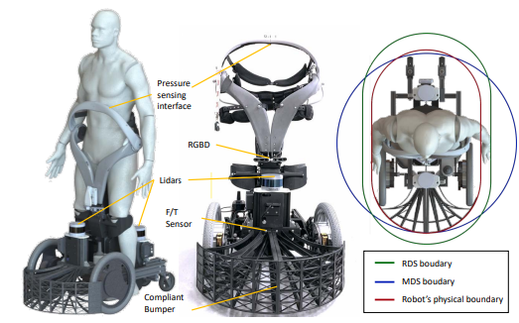
EXPERIMENT:
Real Robot
Qolo: Electrically powered standing wheelchair
1) SLAM:
- LiDAR SLAM (hector slam)
2) Person Detection & Tracking:
- LiDAR + RGBD Cam
3) Collision Avoidance:
- Reactive Driving Support

Slide 12
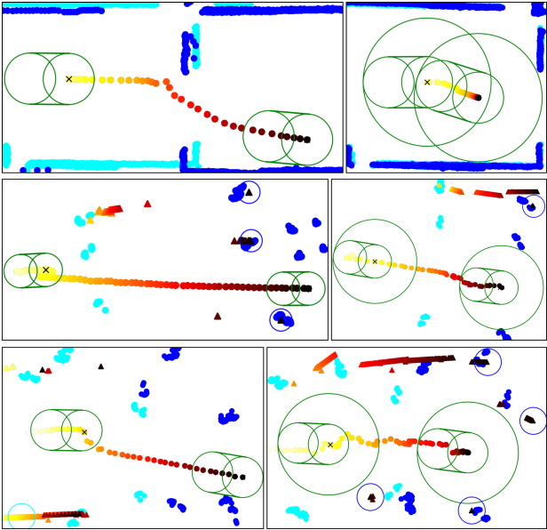
EXPERIMENT:
Real Robot I, II
Test in Static Environment: Door
Test with Pedestrians
RDS
Baseline
RDS
Baseline

Slide 13
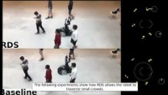
EXPERIMENT:
Real Robot II
Test with Pedestrians: Video

Slide 14
CONCLUSION
Developed a method to apply the Velocity Obstacle to non-holonomic capsule-shaped robots
More advantageous in crowds due to its ability to lead through narrow gaps
Successfully avoid static or dynamic obstacles in both simulation and real world

Slide 15
QUIZ
Q1) This paper developed a method to apply the VO to non-holonomic capsule-shaped robots. What is VO?
a) Visual Odometry b) Value Object c) Virtual Override d) Velocity Obstacle
Q2) Which one is True about Reactive Driving Support (RDS)?
Using circular model to describe the robot’s shape
Model accounts for non-holonomic kinematics preventing sideways motions

Slide 16
THANK YOU
Thank You

