Slide 1

EWareNet: Emotion-Aware Pedestrian Intent Prediction and Adaptive Spatial Profile Fusion for Social Robot Navigation
ICRA 2023
Paper Presentation II
2023.11.22
Jihyeok Kim
Notes:
1

Slide 2
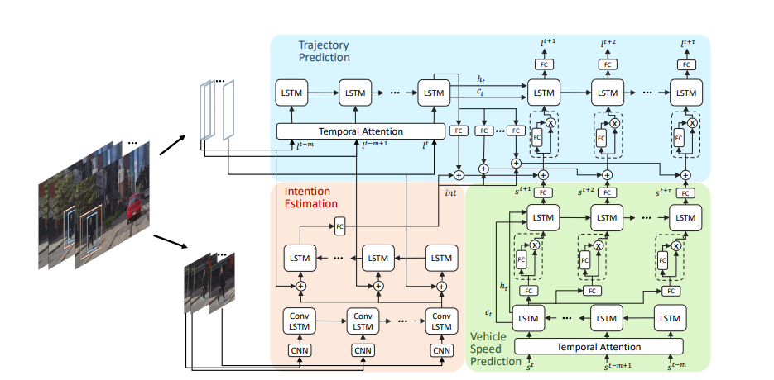
Review
PIE: A Large-Scale Dataset and Models for Pedestrian Intention Estimation and Trajectory Prediction
A large-scale pedestrian intention estimation (PIE) dataset
Trajectory prediction algorithm that achieves state-of-the-art performance on PIE and JAAD datasets

Slide 3
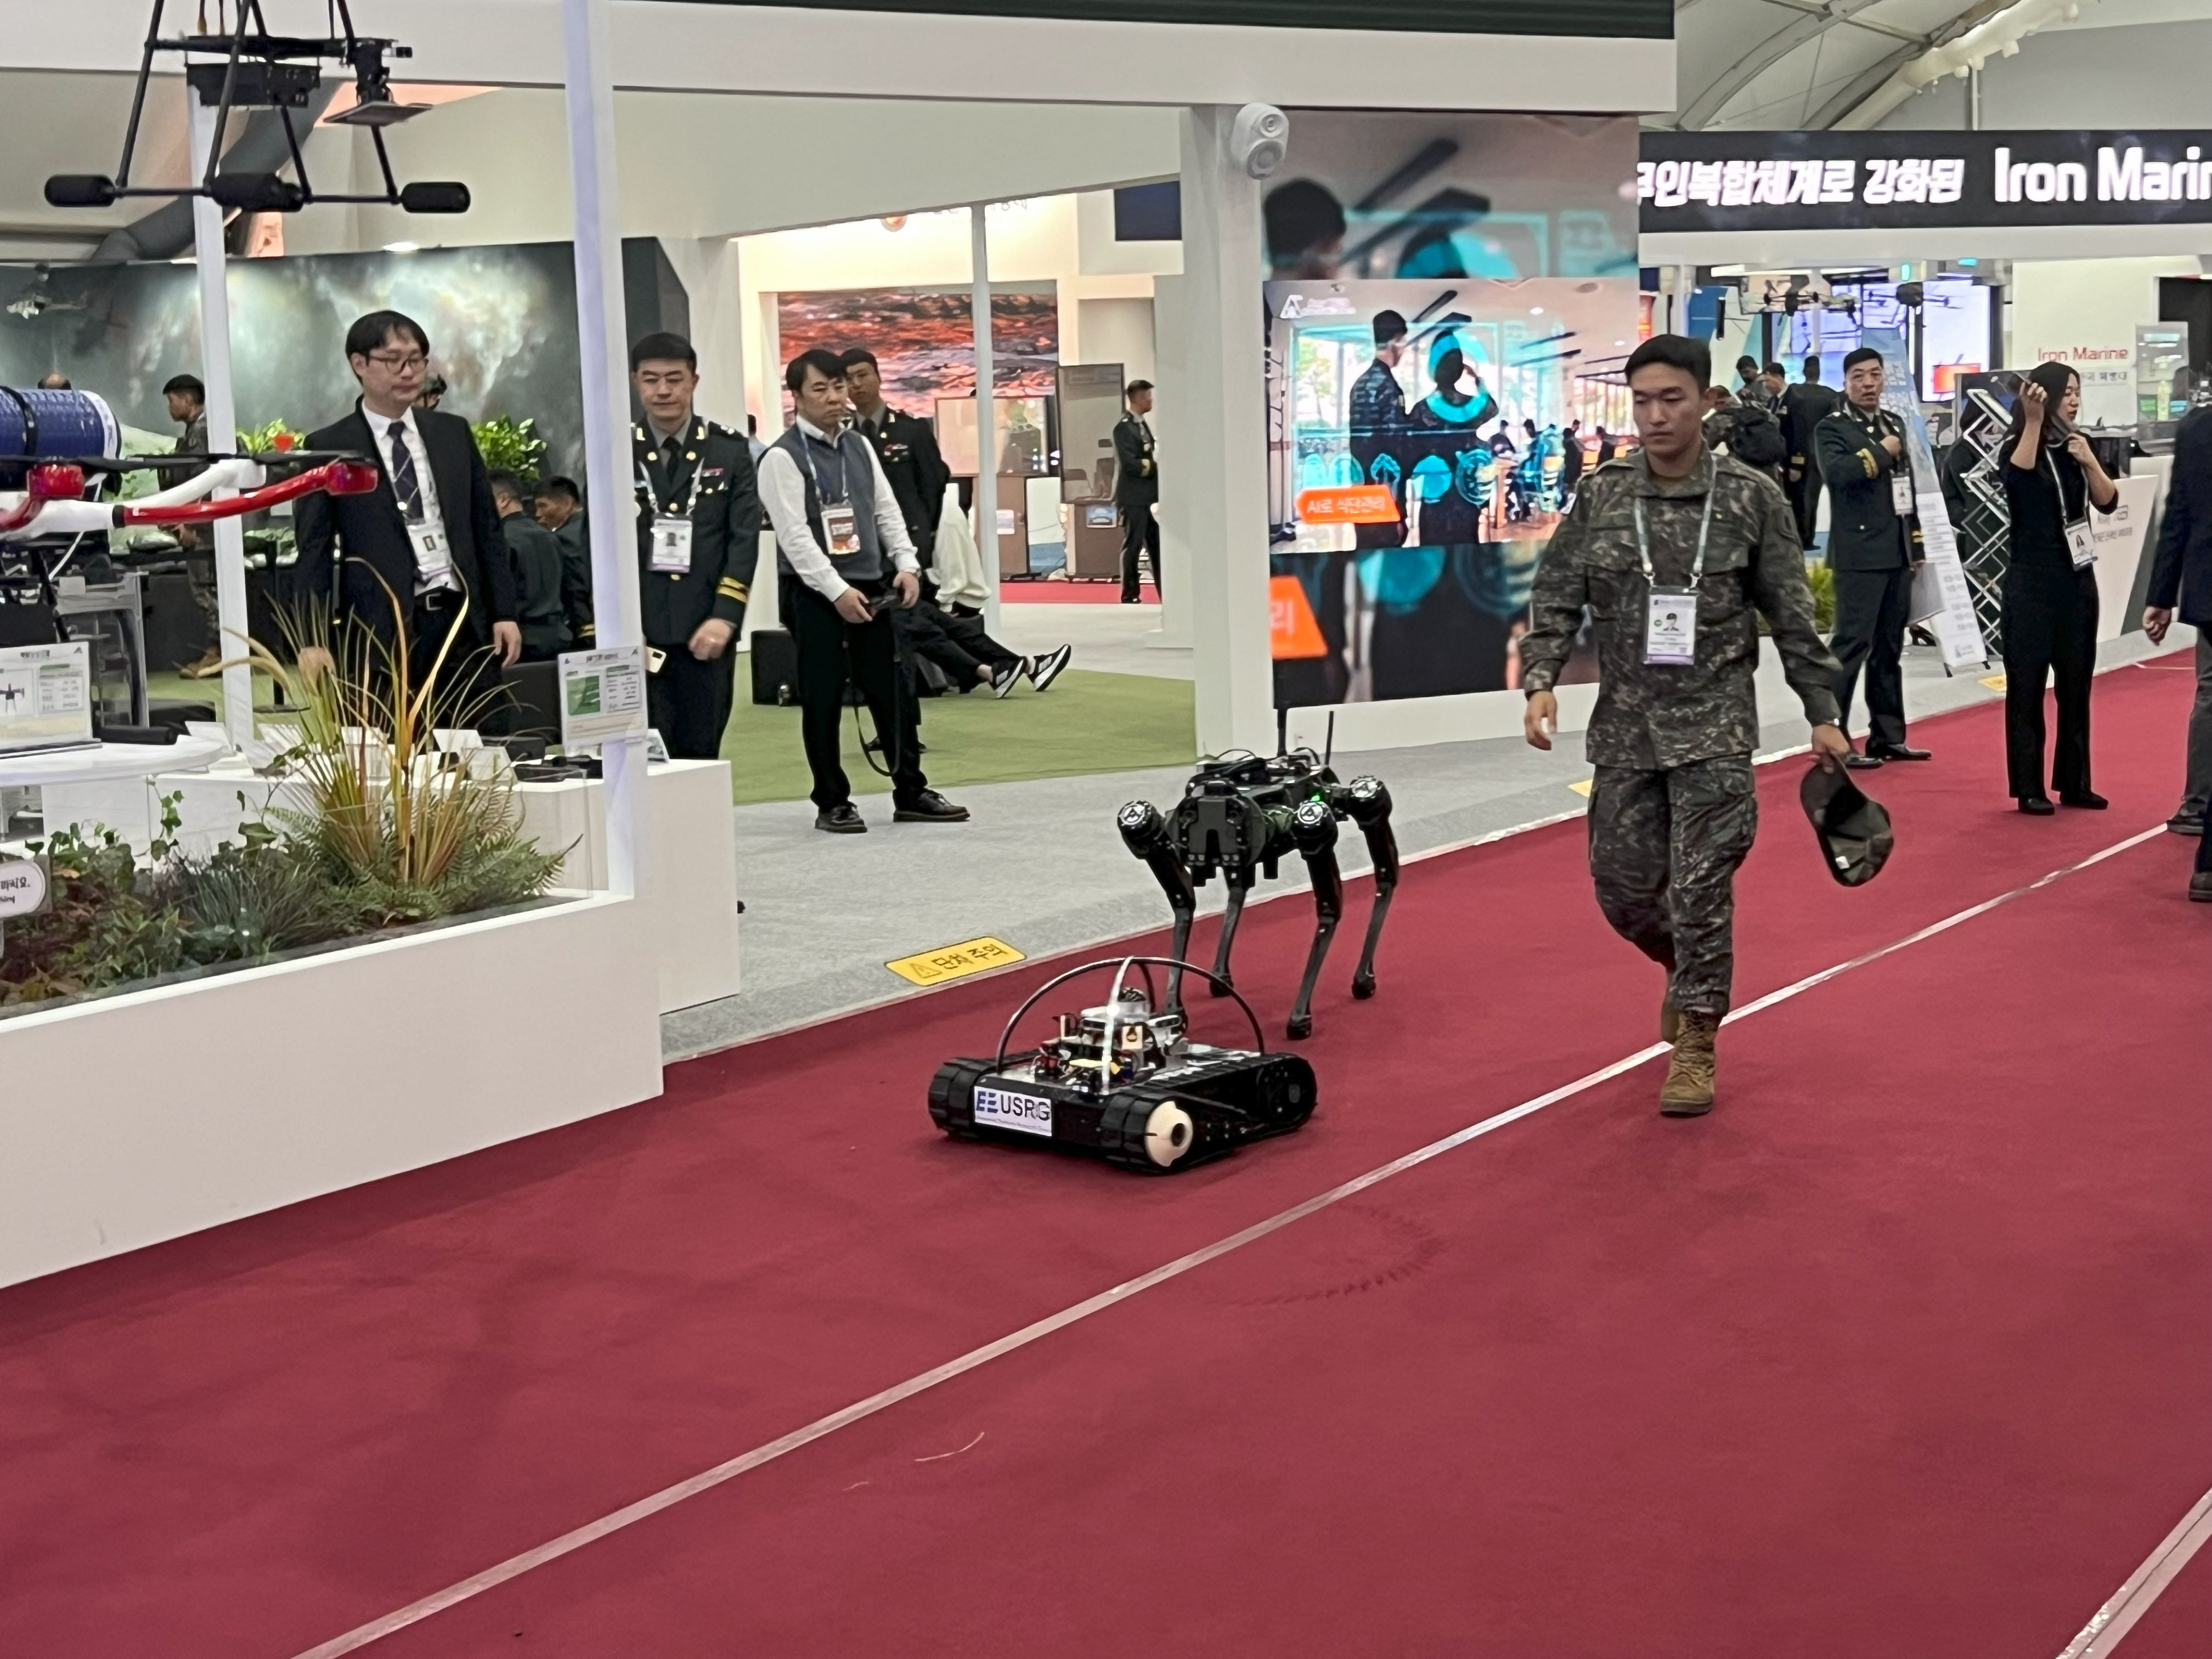
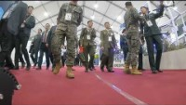
Background
Technological advancements make human-robot collaborations increasingly important
There is a growing interest in “Socially acceptable robot navigation” in densely crowded area
Notes:
Go round and round in its place

Slide 4
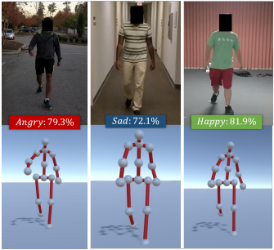
Related Works
Emotion prediction using pedestrian pose estimation
Identify perceived emotion of pedestrian as 4 classes (angry, sad, happy, neutral) based on their walking styles
Source: T. Randhavane, A. Bera, K. Kapsaskis, U. Bhattacharya, K. Gray, and D. Manocha, “Identifying emotions from walking using affective and deep features,” arXiv preprint arXiv:1906.11884, 2019.
Notes:
T Randhavane

Slide 5
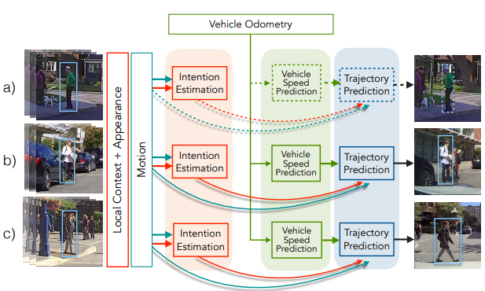
Related Works
Intention (trajectory) prediction using past trajectories
Using a history of observed trajectories and location around pedestrians, predict the future trajectories of pedestrian
Source: A. Rasouli, I. Kotseruba, T. Kunic, and J. K. Tsotsos, “Pie: A large-scale dataset and models for pedestrian intention estimation and trajectory prediction,” in Proceedings of the IEEE International Conference on Computer Vision, 2019, pp. 6262–6271.

Slide 6
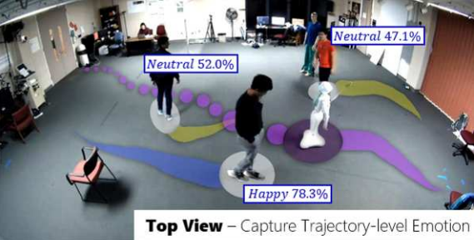
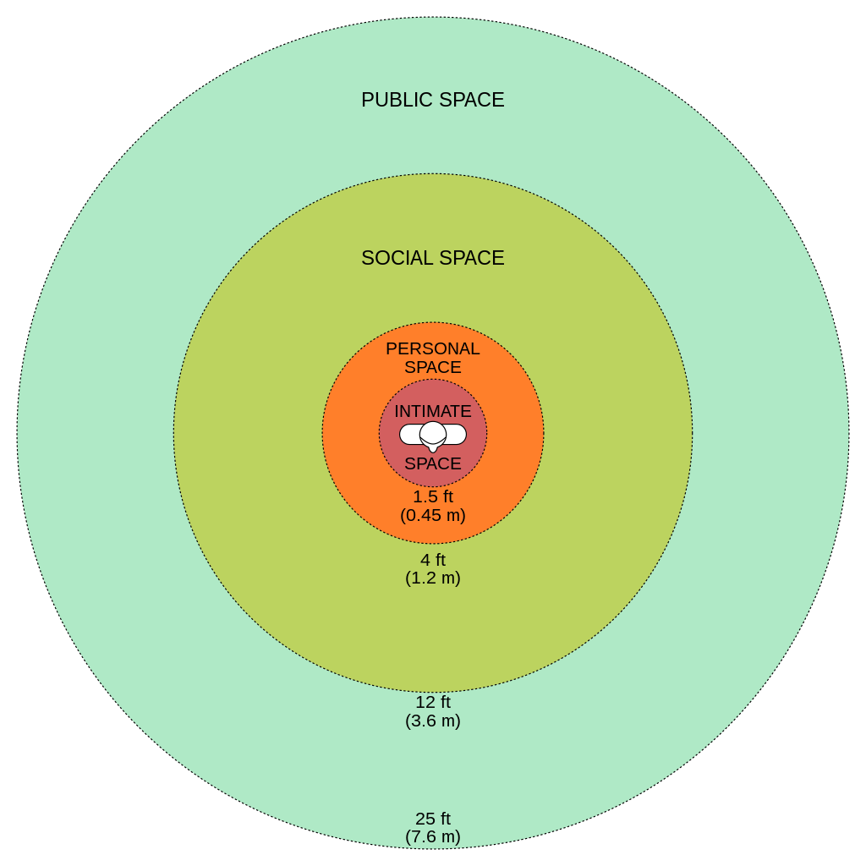
Related Works
Proxemic constraints modeling
To avoid discomforting pedestrians, robot maintains proper “comfort space” with the pedestrians depending on their emotions
Source: A. Bera, T. Randhavane, and D. Manocha, “The emotionally intelligent robot: Improving socially-aware human prediction in crowded environments,” in Proceedings of the IEEE Conference on Computer Vision and Pattern Recognition Workshops, 2019.

Slide 7
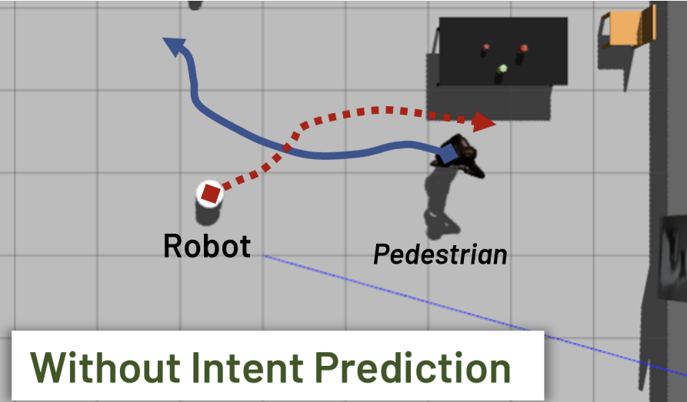
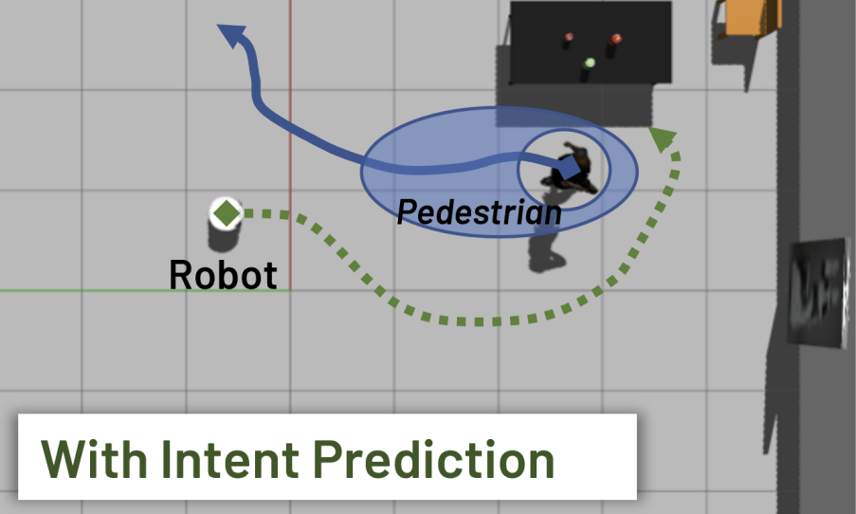
Overview
EWareNet
Emotion prediction + Intention prediction + Proxemic modeling
Socially-acceptable navigation

Slide 8
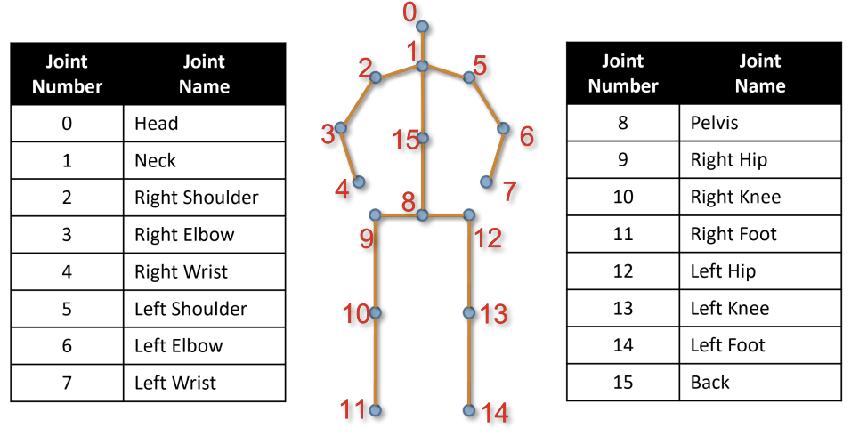

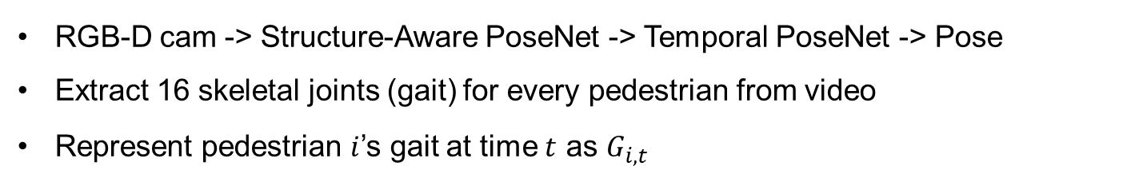
Method
Pedestrian Pose Extraction
RGB-D cam -> Structure-Aware PoseNet -> Temporal PoseNet -> Pose
Extract 16 skeletal joints (gait) for every pedestrian from video
Represent pedestrian $i$’s gait at time $t$ as $G_{i, t}$
RGB-D
Images
S
A
P
T
P
$$G_{i, t}$$

Slide 9
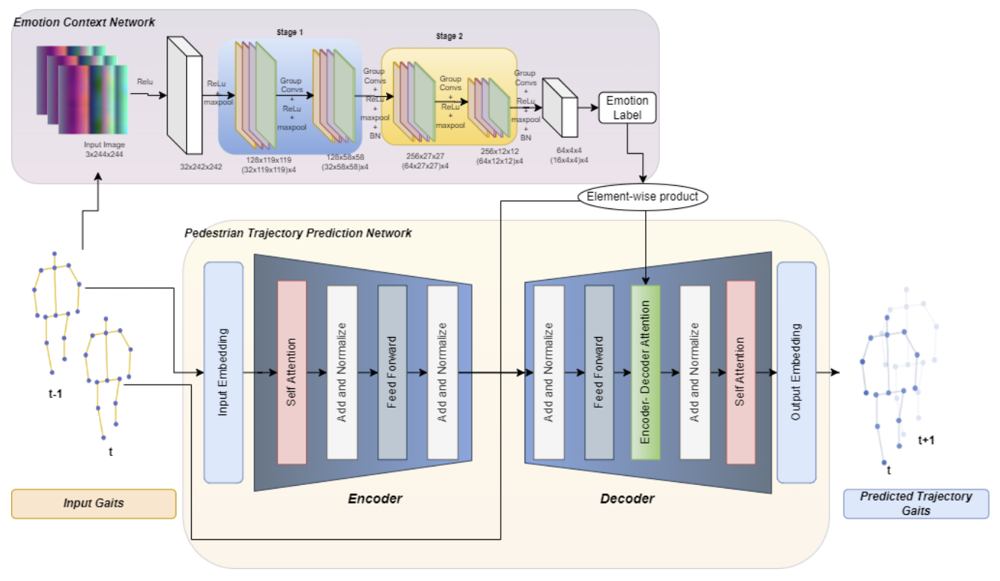
Method
Pedestrian Intent Prediction

Slide 10

Method
Pedestrian Intent Prediction
(1) ECN
4 emotions
(Happy, Sad, Angry, Neutral
75 time steps
Notes:
The intent prediction system consists of three parts, (i) an Emotion Context Network (ECN), (ii) Pedestrian Trajectory Forecasting Network.
First the ECN network takes in the gait sequences (I_i) consisting of 16 joints for 75 time steps to classify them into one of 4 emotions (Happy, Sad, Angry, Neutral), e_i.
The gait sequences are processed into image embeddings, which are fed to the classification network. The classification network, ECN, consists of multiple layers of grouped convolutions which aid in classifying the emotions for different camera angle view groups. So each gait sequences is assigned an emotion label, e_i.

Slide 11
Method
Pedestrian Intent Prediction
(2) PTPN
Notes:
The Pedestrian Trajectory Forecasting network predicts the intent-aware future full-body gait trajectories for every pedestrian based on past gaits.
The input gait sequences for each pedestrian are fed to a linear encoding layer, and that embedded gaits inputs are provided to the transformer network.
The transformer network follows an encoder-decoder style network which is composed of a self attention module, a feed-forward fully-connected module, and two residual connections.
This network predicts future trajectories using input gaits and labeled emotion.

Slide 12
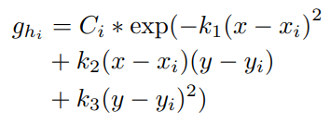

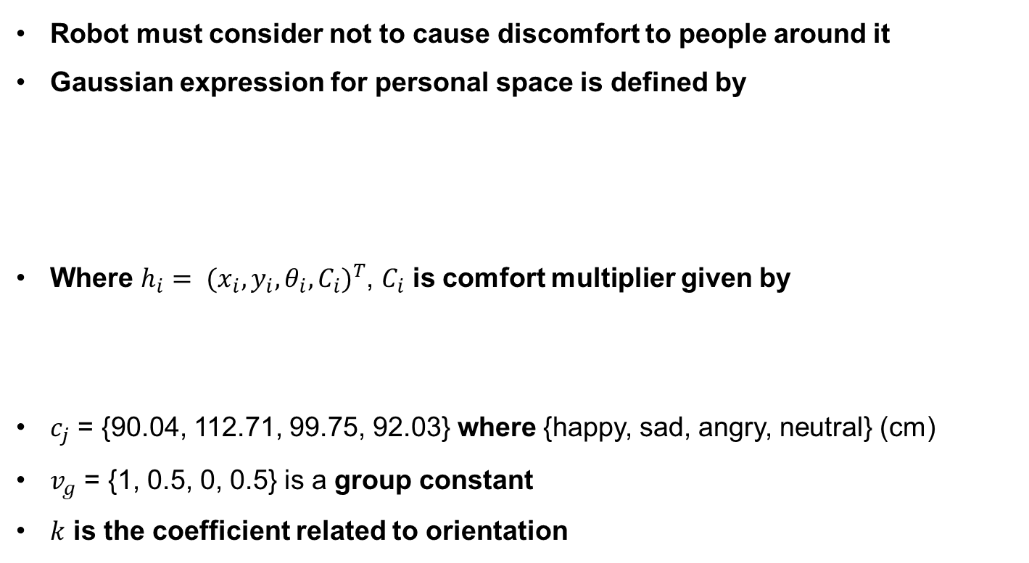
Method
Proxemic Constraints Modeling
Robot must consider not to cause discomfort to people around it
Gaussian expression for personal space is defined by
Where $h_{i}= {(x_{i}, y_{i}, θ_{i}, C_{i})}^{T}$, $C_{i}$ is comfort multiplier given by
$c_{j}$ = {90.04, 112.71, 99.75, 92.03} where {happy, sad, angry, neutral} (cm)
$v_{g}$ = {1, 0.5, 0, 0.5} is a group constant
$k$ is the coefficient related to orientation

Slide 13
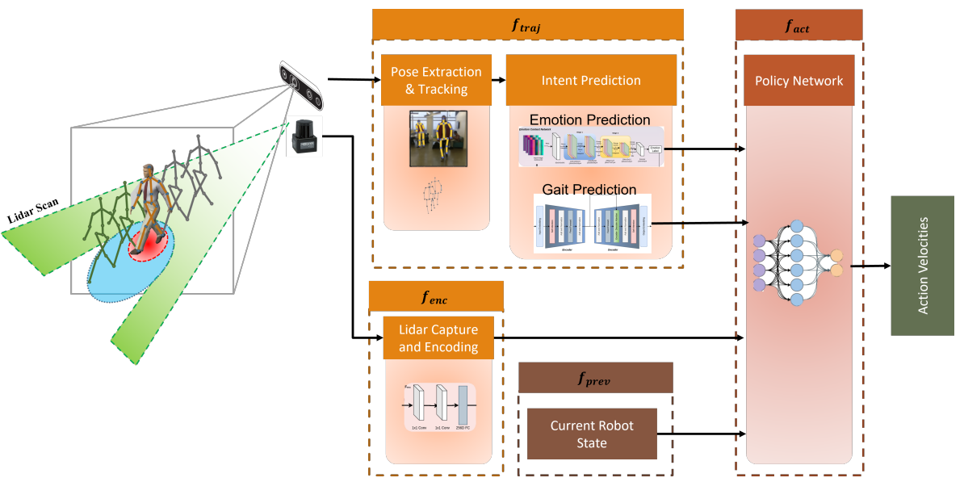
Method
Intent-Aware Navigation
3 consecutive lidar frames
Notes:
Navigation framework is defined as a policy network trained to reach the goal while adjusting to the obstacles and personal space constraints of the pedestrians.

Slide 14



Method
Intent-Aware Navigation
State Space
Action Space
Policy Network
$f_{traj}$: encode intention prediction, $f_{enc}$: encode LiDAR frames,
$f_{prev}$: previous state of robot, $f_{act}$: predict action velocities
Notes:
Navigation framework is defined as a policy network trained to reach the goal while adjusting to the obstacles and personal space constraints of the pedestrians.

Slide 15





Method
Intent-Aware Navigation
Rewards
$r_{g}^{t}:$reaching goal, $r_{c}^{t}:$ avoiding collision,
$r_{w}^{t}:$moving smoothly, $r_{e}^{t}:$avoiding negative impact on pedestrian
$$r_{arrival}=15, w_{g}=2.5, r_{collision}=−15, w_{w}=−0.1, r_{e}=−2.5, ξ=0.1$$
Notes:
Navigation framework is defined as a policy network trained to reach the goal while adjusting to the obstacles and personal space constraints of the pedestrians.

Slide 16
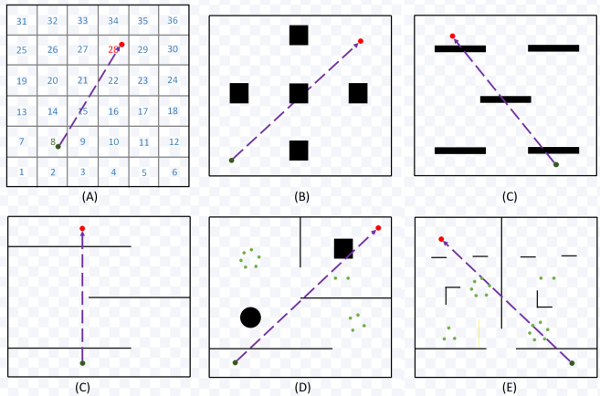
Experiment
Train Intention Prediction Module with Datasets
Train with Pedestrian Emotion Datasets, Pedestrian Intent Datasets
2177 gait samples with emotion labeled, trajectories dataset respectively
Intent-Aware Navigation
Use Stage Mobile Robot Simulator to generate multiple scenarios

Slide 17
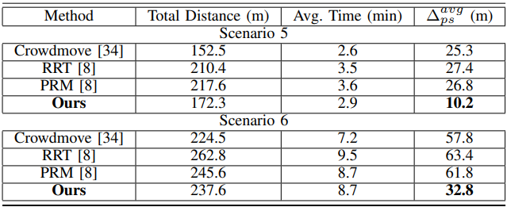
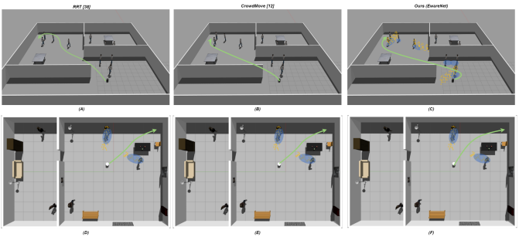
Experiment
Intent-Aware Navigation - Results

Slide 18
Conclusion
EWareNet presents Transformer-Attention Networks to predict human trajectories based on historical gait sequences
Ewarenet presents a novel navigation planning algorithm considering personal comfort space based on reinforcement learning

Slide 19
Quiz
Q1) EWareNet presents socially-acceptable navigation algorithm considering p_____ constraints.
Proxemic
Probability
Pedestrian
Q2) What is the most appropriate meaning of “intent” in “intent-aware navigation”?
Why does the pedestrian stand in my way?
How will the pedestrian move?
Will the pedestrian cross the crosswalk or not?

Slide 20
Thank You
Thank You

