Slide 1
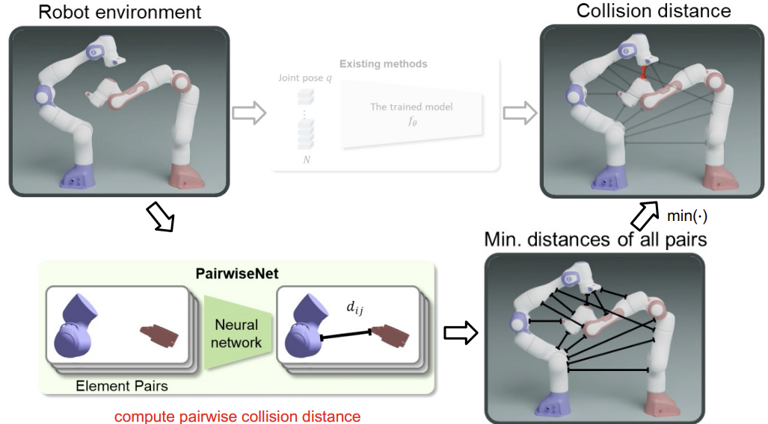
Review for MinJae’s presentation (PairwiseNet)
Collision distance
Minimum distance between robot and nearest obstacle
Proposed a way to calculate distance between pairwise elements
Useful for non-convex objects
Generalizability (# robot, etc.)
Scalable Graphics, Vision & Robotics Lab

Slide 2
TerraPN: Unstructured Terrain Navigation using Online Self-Supervised Learning (IROS 2022)
Taegeun Yang
2023. 10. 30.
Scalable Graphics, Vision & Robotics Lab

Slide 3
Introduction
Scalable Graphics, Vision & Robotics Lab

Slide 4
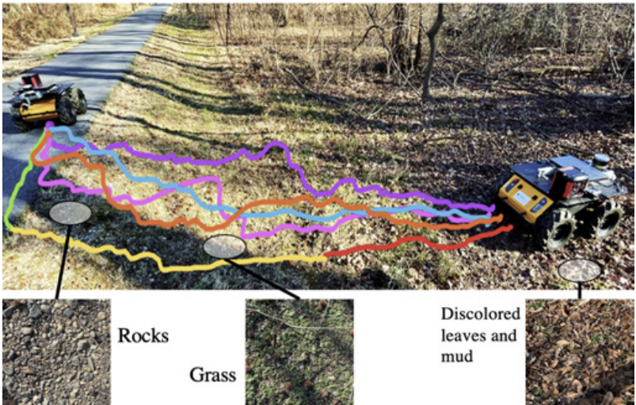
Problem of Off-Road Navigation
Off-Road environment ⇒ different surface characteristics
Surface’s texture (traction)
Bumpiness (vibration)
Deformability (slip & stuck)
It affects the robot’s navigation
⇒ need to consider these features for planning
Scalable Graphics, Vision & Robotics Lab

Slide 5
How to address the problem? (Related works)
Need to know the environment in advance
Utilize vision information (e.g. RGB Camera)
Early studies
Terrain classification using large image datasets
Pre-defined traversability (e.g. water ⇒ untraversable)
⇒ However, do not account for robot’s properties and might misclassify
RUGD dataset
Scalable Graphics, Vision & Robotics Lab

Slide 6
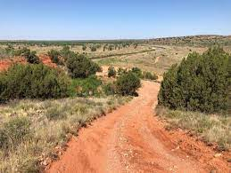
How to address the problem? (Related works)
Use Self-Supervised Learning
Data Collection
RGB Image, IMU data,
Odometry error, etc.
Sensor Input & Robot State
(RGB Image, Robot velocity, etc.)
Cost Network
Navigation Cost
(High for untraversable area)
Scalable Graphics, Vision & Robotics Lab

Slide 7
Contributions
Novel method for training neural network using online self-supervised method
Existing methods take a long time to re-train
Improve navigability cost representation using non-uniform sample patches
Low inference times
Novel outdoor navigation algorithm
Computes dynamically feasible collision-free trajectories
DWA based algorithm
Scalable Graphics, Vision & Robotics Lab

Slide 8
Methods
Scalable Graphics, Vision & Robotics Lab

Slide 9
Data Collection
Grass
Concrete
Low speed
High speed
Autonomous Data Collection
Moving along a rectangular path
Moving in a serpentine trajectory
Random motion
Collision avoidance using DWA (Local planning)
Cover all the [v, w] pairs
Training is started and performed online once sufficient data is collected (~6min)
Collecting Data
RGB image, velocity, odometry, 6-DOF IMU, 3D LiDAR
Calculate odometry error (LiDAR-based odometry – robot’s odometry) and IMU PCA variances
IMU PCA variances
Scalable Graphics, Vision & Robotics Lab

Slide 10
Overall Architecture
Non-uniform image patches ⇒ Boundaries between surfaces (use Sobel edge detection)
Supervised Learning (Label: IMU PCA variances, Odometry error)
Cost map comes out the same size as the input RGB image
Scalable Graphics, Vision & Robotics Lab

Slide 11
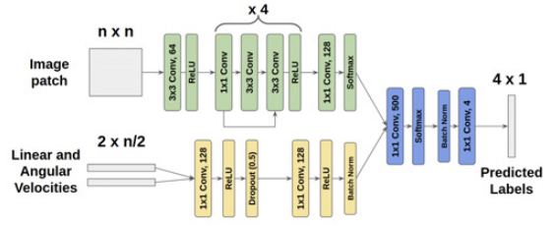
Training
Output $λ= {\left[σ_{PC1} σ_{PC2} d_{error} θ_{error}\right]}^{T}$ (4 x 1)
Large image patches (2n x 2n, 4n x 4n, etc.) ⇒ resize to n x n
Linear & Angular velocities for the past n/2 instances
Scalable Graphics, Vision & Robotics Lab

Slide 12
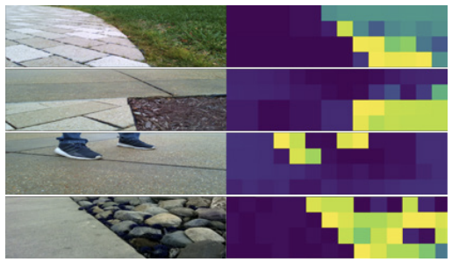
Cost Calculation
Network output $λ={\left[{\tilde{σ}}_{PC1} {\tilde{σ}}_{PC2} {\tilde{d}}_{error} {\tilde{θ}}_{error}\right]}^{T}$
Navigability Cost $c = \sqrt{{\tilde{λ}}^{T}W\tilde{λ}}$
Compute for each patch
W is a diagonal matrix with positive weights
Weight for each element of the network output
High Cost
Low Cost
Scalable Graphics, Vision & Robotics Lab

Slide 13
Navigation Algorithm (DWA based)
Dynamically feasible $(v, w)$space ⇒ $V$
Optimization
$for \left(v, w\right)∈V, maximize objective function=α∙head+β∙dist+γ∙vel −δ∙sur$
$head\left(v, w\right):progress toward the robot^{′}s goal$
$dist\left(v, w\right):distance to the closest obstacle$
$vel\left(v, w\right):forward velocity →encourage higher velocities$
$sur\left(v,w\right):navigability cost$
Image Plane
Trajectory candidate
Scalable Graphics, Vision & Robotics Lab

Slide 14
Results
Scalable Graphics, Vision & Robotics Lab

Slide 15
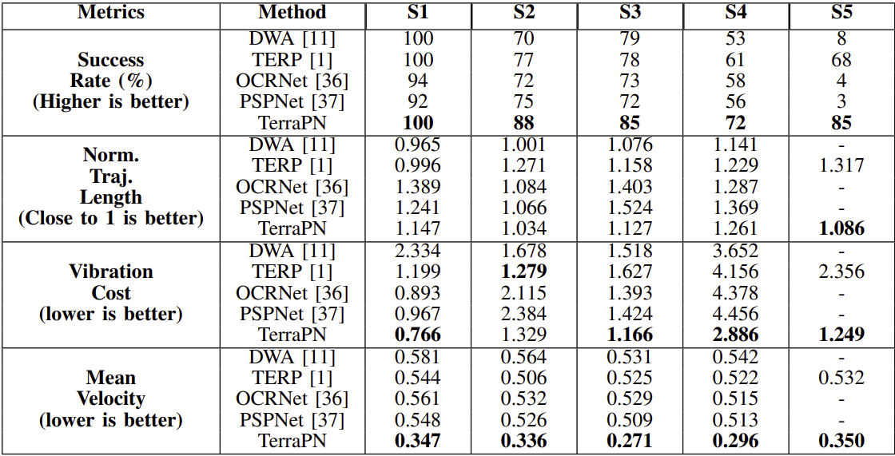
Results
Scenario num
Evaluation Metric
Success Rate
Normalized Trajectory length
Vibration Cost
Mean Velocity
Inference Time
Non-uniform image patches
Baseline: OCRNet (uniform sampling)
Reduces inference time by 47.27%
Scalable Graphics, Vision & Robotics Lab

Slide 16
Results
High speed
Medium speed
Low speed
Scalable Graphics, Vision & Robotics Lab

Slide 17
Results
Scalable Graphics, Vision & Robotics Lab

Slide 18
Conclusion
Scalable Graphics, Vision & Robotics Lab

Slide 19
Conclusion
Novel approach that uses self-supervised learning to identify the surface characteristics in complex outdoor environment
RGB images and robot’s velocity ⇒ IMU variations and odometry errors
Novel navigation algorithm that accounts for the surface cost
Limitations
Cannot be applied on completely non-traversable surfaces (no training data)
Cannot distinguish elevation changes in the same or similar surfaces (unavailability of depth)
Scalable Graphics, Vision & Robotics Lab

Slide 20
Questions
Scalable Graphics, Vision & Robotics Lab

Slide 21
Quiz
Scalable Graphics, Vision & Robotics Lab

Slide 22
Quiz
Q1. Which of the following is not a "surface characteristic" as defined in the paper?
1. Texture
2. Color
3. Bumpiness
4. Deformability
Q2. Which learning technique was utilized in this paper?
Scalable Graphics, Vision & Robotics Lab

