Slide 1

City-Scale Grid-Topological Hybrid Maps for
Autonomous Mobile Robot Navigation in Urban Area
International Conference on Intelligent Robots and System (IROS)
2020
CS686 Student PresentationⅠ
Je In You
Notes:
1

Slide 2



BACKGROUND
GNSS NOT STABLE is often in Urban Environment
Single nationwide 2D grid map requires huge
computational cost and memory usage
Notes:
GPS no line of sight and multipath problem where signal reaches the receiver after one or more reflections.
Using single 2D map requires huge computational cost and memory cost

Slide 3
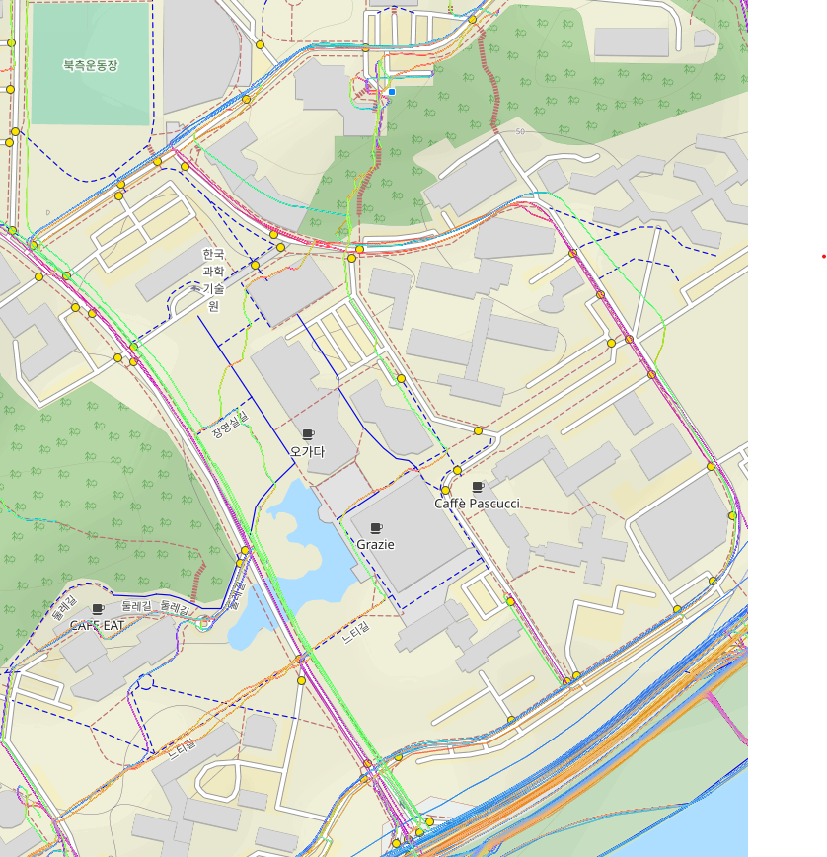
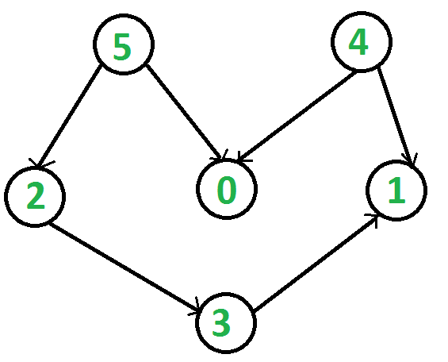
BACKGROUND
Topological Graph
OpenStreetMap
Notes:
A topological graph is a representation of a graph in the plane, where the vertices of the graph are represented by distinct points and the edges by Jordan arcs (connected pieces of Jordan curves) joining the corresponding pairs of points.

Slide 4
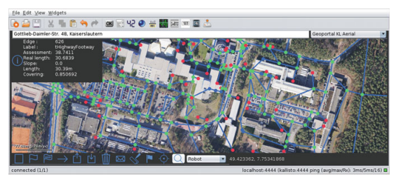
Related Work
Topological Graph Generated from OSM
(Fleischmann, 2017)
Notes:
A topological graph is a representation of a graph in the plane, where the vertices of the graph are represented by distinct points and the edges by Jordan arcs (connected pieces of Jordan curves) joining the corresponding pairs of points.

Slide 5
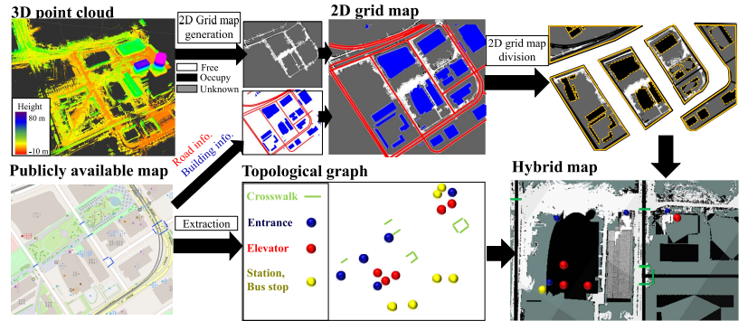
Map Configuration

Slide 6
Map Configuration
System Definition of Topological Graph
Local 2D Grid Maps
id = unique name of the node
p = position and pose that define the target position and pose of a robot
s = status information (where and what the point is)
Node
Edge
id₁, id₂ = connected nodes
c = cost to take such route
s = status between the nodes
e,g, automatic_door, access = no

Slide 7
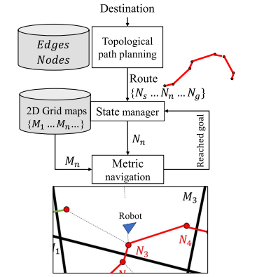
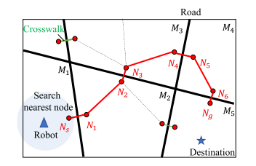
Map-Based Navigation
Simple Navigation Example
System Pipeline

Slide 8
Map-Based Navigation
System Definition of Topological Graph
Local 2D Grid Maps
id = unique name of the node
p = position and pose that define the target position and pose of a robot
s = status information (where and what the point is)
Node
Edge
id₁, id₂ = connected nodes
c = cost to take such route
s = status between the nodes
e,g, automatic_door, access = no

Slide 9
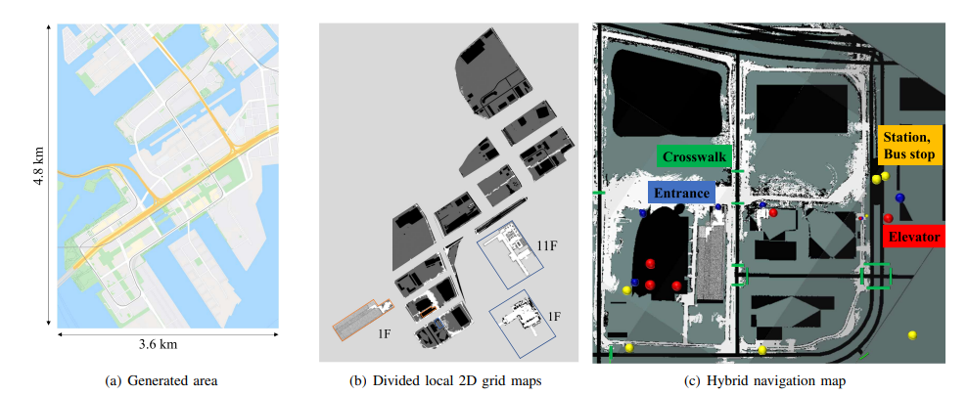
Evaluation
Black: No Entry
White: Free
Gray : Unknown
Example of Hybrid Map Generation

Slide 10
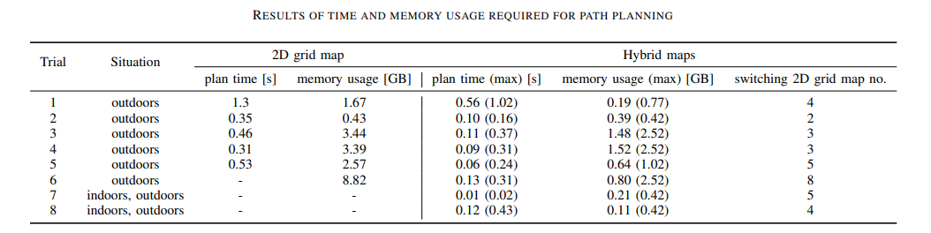
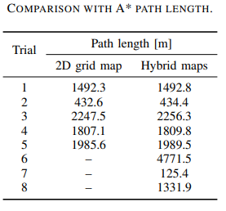
Evaluation

Slide 11
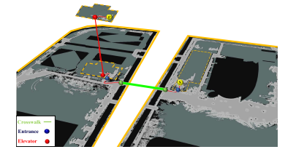
Pros and Cons
Pros
Cons
The 3D point cloud must be computed before planning for map generation
Map generation is incomplete as the authors mentioned that the map was manually corrected to some extent
Allows path planning between layers (e,g, elevators and escalators)
Notes:
Mobile Mapping System (MMS) and the other by Cartographer

Slide 12
Overview
Hybrid map generation from publicly available maps and given 3D point cloud
Allows Path Planning between different levels of the building as it uses local 2D maps
Near optimal result for path planning and significant reduction of computation and memory usage
Notes:
Mobile Mapping System (MMS) and the other by Cartographer

Slide 13
Quiz
1. Why might GPS not work near buildings and other tall objects?
2. Which one of the options is NOT properties of an edge in this method?
IDs of the connected nodes
Cost
Status between nodes
Position and pose of the nodes

