Slide 1
Deep Reinforcement Learning for Robots
20187048 Eojin Rho
Notes:
1

Slide 2
Overview
Overview of reinforcement learning
Related works
DQN
A3C
Problems with using Deep Reinforcement Learning in robots
Target-driven Visual Navigation Indoor Scenes using Deep Reinforcement Learning
Applying Asynchronous Deep Classification Networks and Gaming Reinforcement Learning-Based Motion Planners to Mobile Robots
Quiz

Slide 3
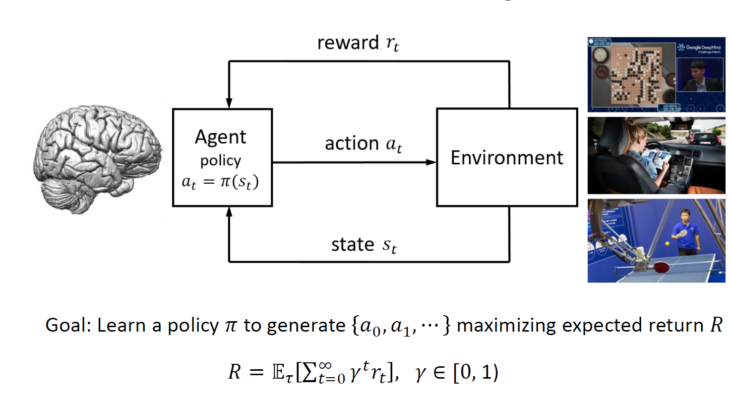
Reinforcement Learning

Slide 4
Markov Decision Process(MDP)
Set of possible states 𝑠 ∈ 𝑆
Set of possible actions 𝑎 ∈ 𝐴
Transition probability
Deterministic policy function 𝑎 = 𝜋(𝑠)
Reward function 𝑟=𝑟(𝑠,𝑎) with discount factor 𝛾 ∈ [0,1)
Model-free

Slide 5
Optimal Bellman Equation
State value function V :
State-action value function Q :
Bellman equation :
Optimal Bellman equation :

Slide 6
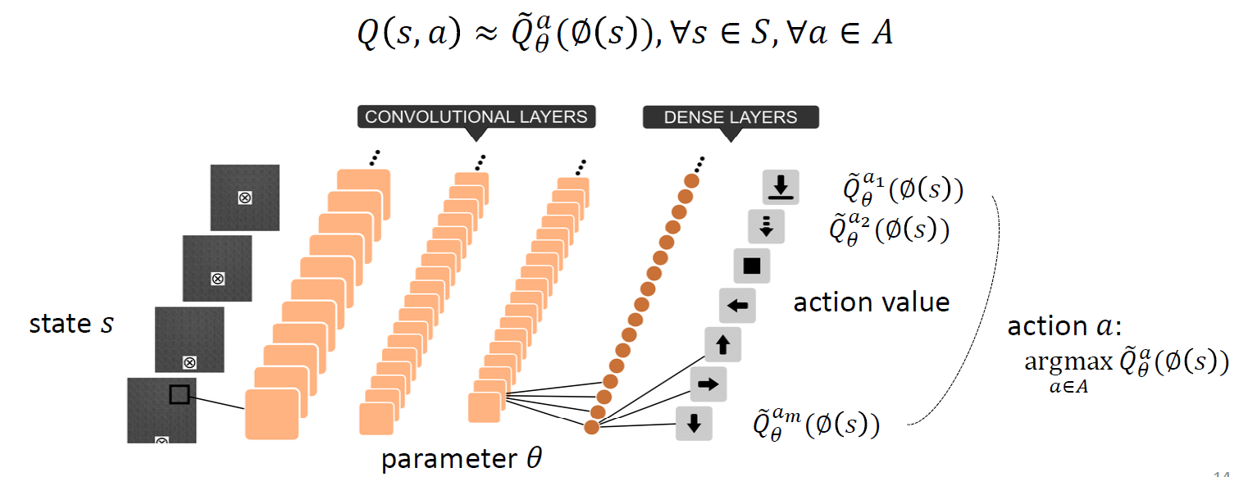
DQN : Deep Q-Network
DQN = Q-learning + Function Approximation + Deep Network
Stabilize training with experience replay
End-to-end RL approach, flexible

Slide 7
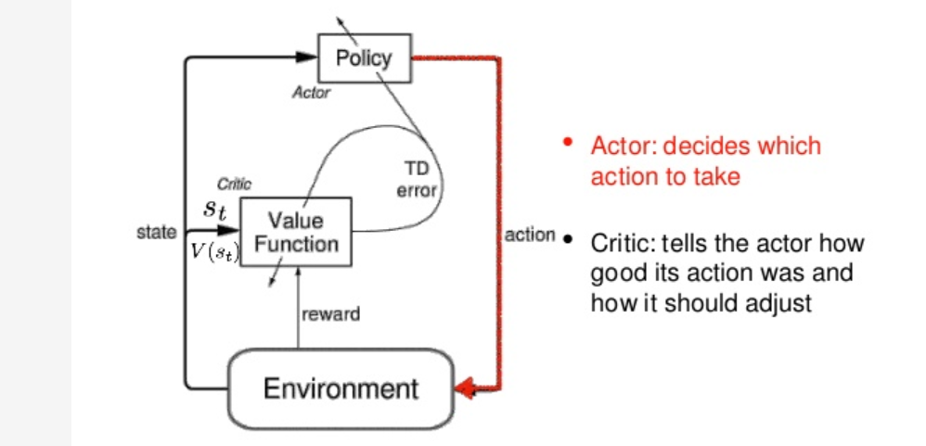
Actor-Critic
Actor : learning the optimal policy
Critic : evaluates the action by computing the value function

Slide 8
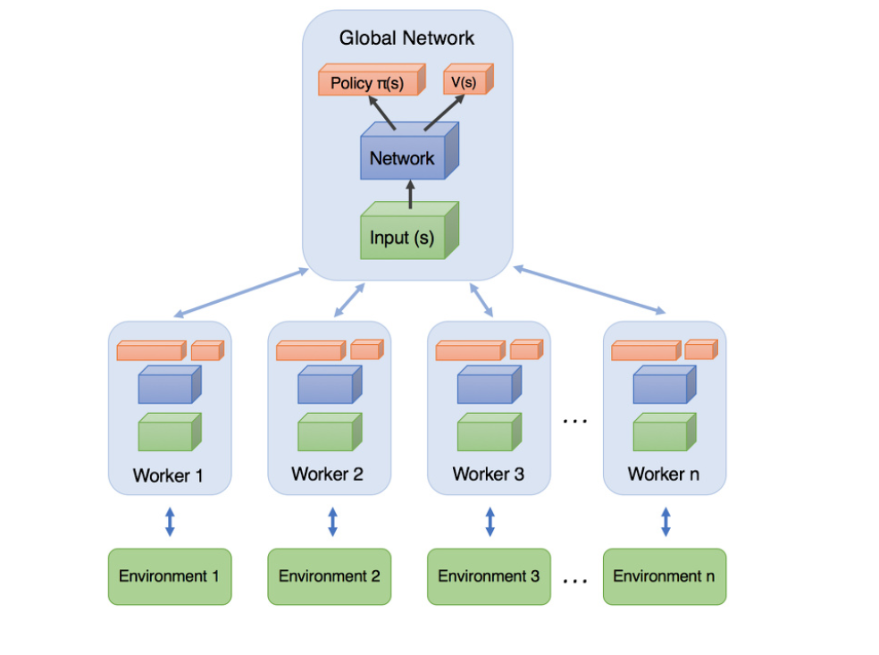
Asynchronous Advantage Actor-Critic (A3C)
Advantage Actor-Critic (A2C)
Use advantage function instead of Q-function
A3C : Asynchronously update the global network

Slide 9
Problems with using Deep Reinforcement Learning in robots
Trying all kind of action is dangerous
It breaks robots and the environment
Real robot cannot be run in hyper-speed
Learning massive episode is difficult unlike games.
Many tasks are not game–like
It is difficult to know the reward.
Limited computational resources for robot
Delay can be caused by Deep RL

Slide 10
Paper list
Target-driven Visual Navigation in Indoor Scenes using Deep Reinforcement Learning
Yuke Zhu et al. (ICRA 2017)
Applying Asynchronous Deep Classification Networks and Gaming Reinforcement Learning-Based Motion Planners to Mobile Robots
Gilhyun Ryou et al. (ICRA 2018)

Slide 11
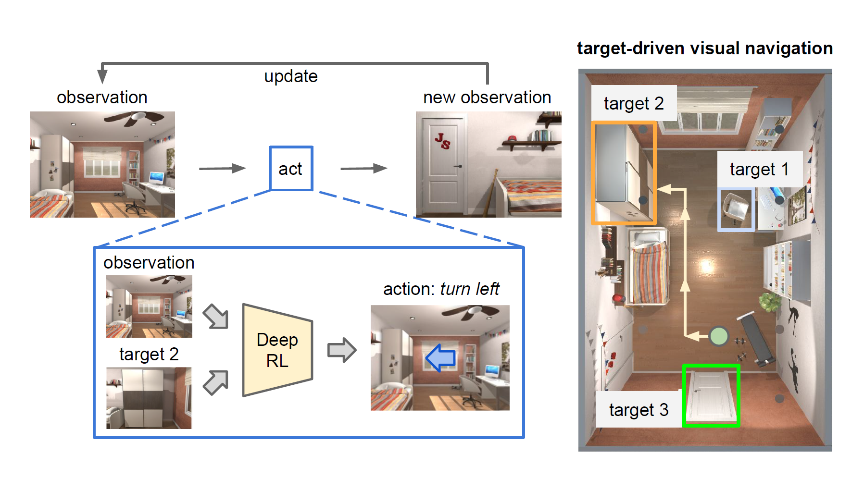
Target-driven Visual Navigation in Indoor Scenes using Deep Reinforcement Learning
Developed deep reinforcement learning algorithm based only on visual input to navigate the given target

Slide 12
Virtual Framework for RL
AI2 THOR Framework

Slide 13
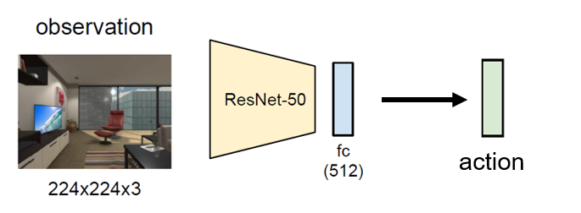
Previous Methods

Slide 14
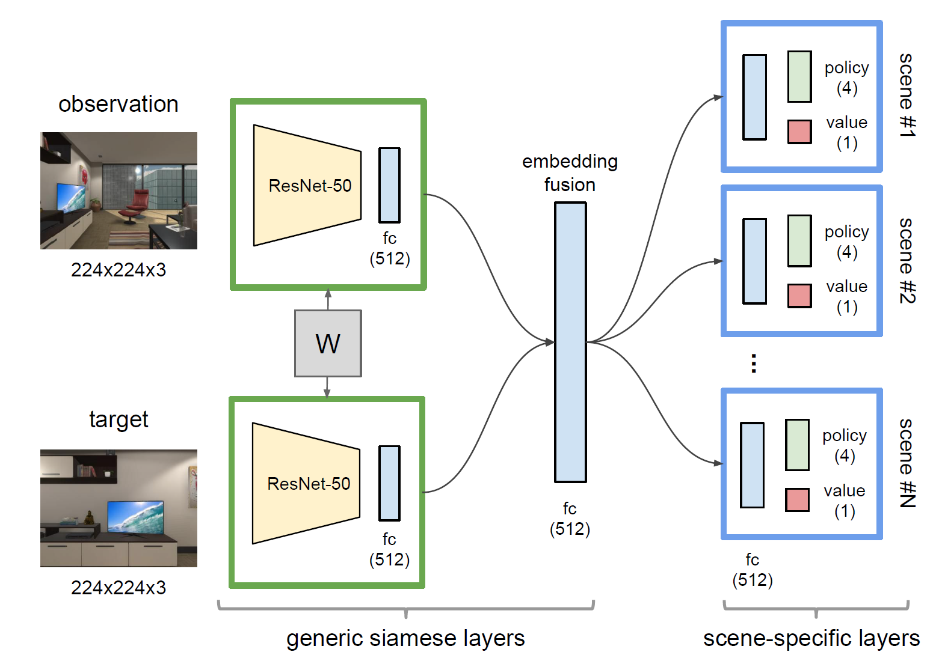
Proposed Model

Slide 15
Training episode example

Slide 16
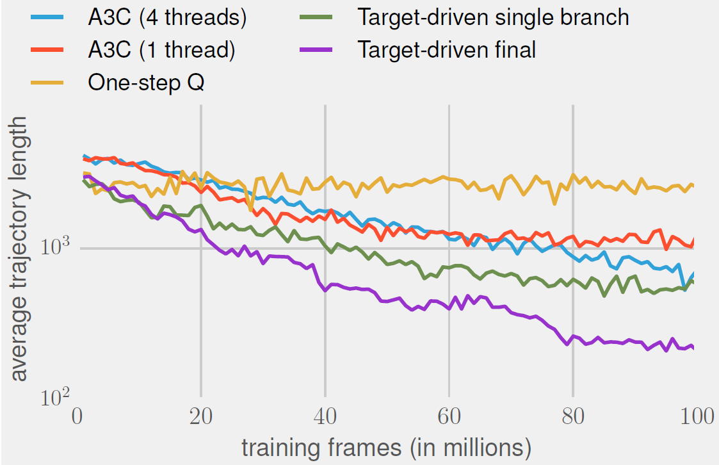
Learning Efficiency

Slide 17
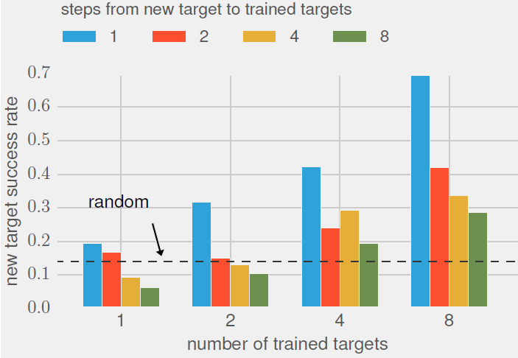
Target Generalization

Slide 18
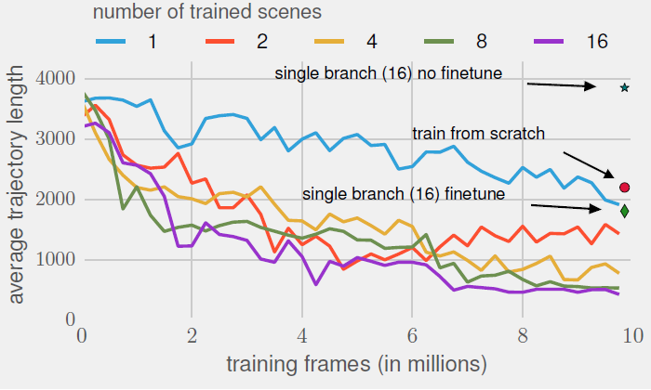
Scene Generalization

Slide 19
Real World Implementation

Slide 20
Strength & Limitation
Able to navigate into multiple targets without retraining.
Can be generalized into untrained targets and scenes
Applicable to real world problem
Does not require 3D map to navigate
High level approximation of the environment (Grid based movement, 90 degree turn)
Need to define the scenes in the learning model

Slide 21
Applying Asynchronous Deep Classification Networks and Gaming Reinforcement Learning-Based Motion Planners to Mobile Robots
Limitations of Deep Learning on mobile robots
Low compatibility between previously developed robotic software & hardware
Requiring visionary perception that demands large computing power
Application-specific training methods of various reinforcement learning algorithms

Slide 22
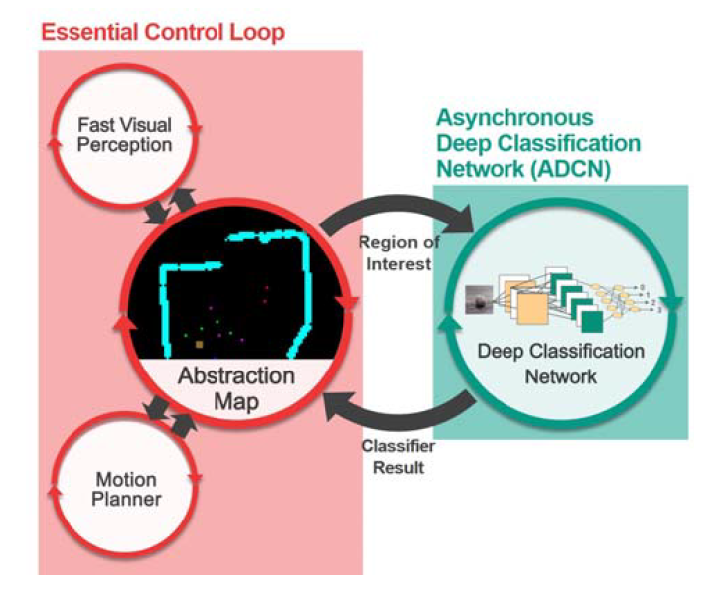
Proposed Method : Asynchronous Deep Classification Network
Deep classification network is isolated from essential control loop
The fast visual perception recognizes objects position and update abstraction map
While tracking the objects on the abstraction map, ADCN asynchronously classifies the object.

Slide 23
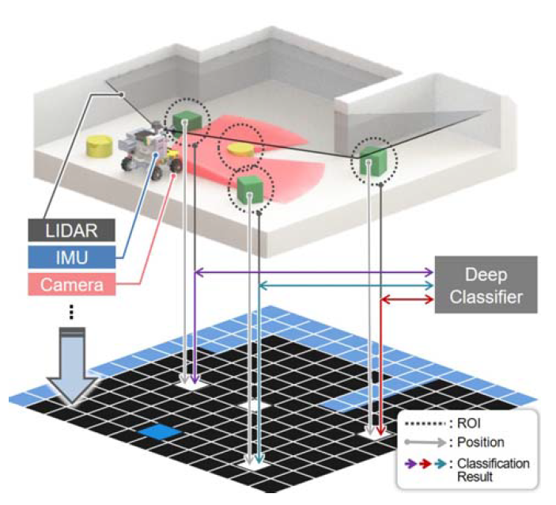
Abstraction Map
The detected target objects position are projected onto the abstraction map
Regions of Interest : cropped image surrounding the target object is saved
Deep classifier asynchronously classifies the object and updates the abstraction map.

Slide 24
Gaming Reinforcement Learning—Based Motion Planner (GRL-planner)
The motion planning environment designed similar to video game
The abstraction map is given as input state of RL
Output actions are abstracted in the form of joystick control signal
A3C algorithm was used to train the network

Slide 25
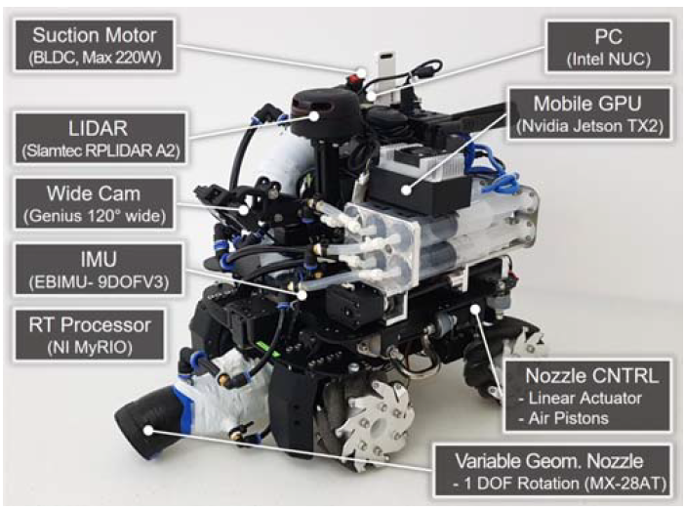
Mobile Robot Design
Designed stand-alone target tracking and collecting mobile robot
Used Intel NUC as processor, and Jetson TX2 for GPU
Deep classifier takes 315ms, object recognition takes 80ms

Slide 26
Result

Slide 27
Strength & Limitation
Proposed the method for applying deep classification and deep reinforcement learning in a mobile robot environment with limited computational resources
Using GRL-planner, we can applying deep reinforcement learning to mobile robot environment just like video game.
The proposed method can only applied to flat environment due to mapping object position with matrix transformation.
The method is very task specific.

Slide 28
Recap
Problems with using deep reinforcement learning in robots
Target-driven Visual Navigation Indoor Scenes using Deep Reinforcement Learning : Target image based, generalization, simulation to real world
Applying Asynchronous Deep Classification Networks and Gaming Reinforcement Learning-Based Motion Planners to Mobile Robots : Abstraction Map that buffers the delay of deep classifier

Slide 29
Quizzes
The proposed model in Target-driven Visual Navigation in Indoor Scenes using Deep Reinforcement Learning receives the target image as an input. (T/F)
Applying deep reinforcement learning to robots is very difficult. (T/F)

