Slide 1
Deep Visual Foresight for Planning Robot Motion
ICRA 2017

Slide 2
Limitations of previous research
Previous robotic manipulation methods rely on accurate modeling
Pipelined model-based approaches break when introduced to new environments or objects that cause significant modeling error
Then how about using reinforcement learning techniques?
Requires a task-specific reward function / goal

Slide 3
Main contributions
Reinforcement learning with minimal human interference using video data
Learns in self-supervised fashion
More generalizable and flexible compared to other models
Does not need calibrated camera, an instrumented training set-up, nor precise sensing and actuation
Can even handle novel objects not seen during training

Slide 4
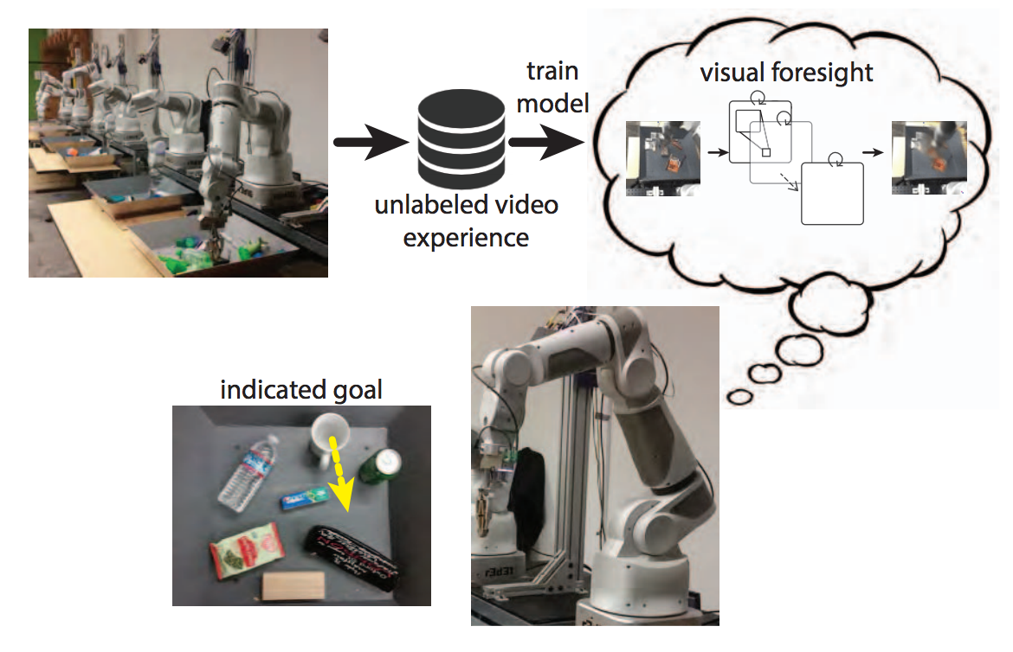
Problem

Slide 5
Dataset
50,000 pushing attempts
10 7-DoF arm robots
Hundreds of objects.
Bin contains between 10 and 20
Each push attempt starts with a random initial pose along the outside border of the bin
Iteratively select a random new target gripper pose a_{t} and moves towards it at each time step t ∈ {1,...,T} (5 Hz)
Each pose is a vector of length 5: 3D coordinates and rotations pitch and yaw
Sensor readings of the RGB camera image of the workspace I_{t}, a_{t}, and current gripper pose x_{t} at 10 Hz

Slide 6
Model
Inputs at each timestep
Current and previous images (I_{0:1})
Current and previous poses (x_{0:1})
Sequence of future commands (a_{1:Hp})
Outputs at each timestep
Future image frames (I_{2:Hp+1})

Slide 7
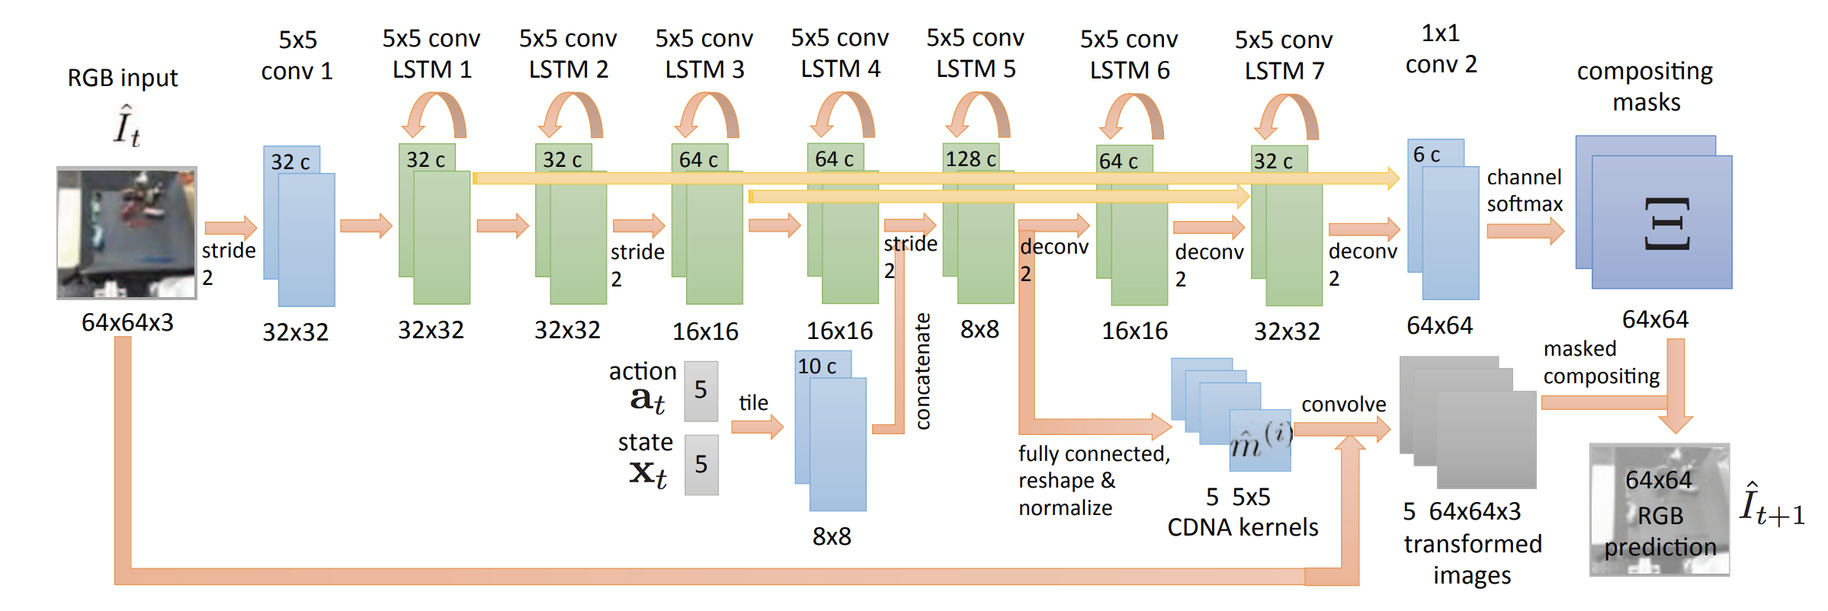
Model ARCHITECTURE
Notes:
The model uses a set of normalized convolution kernels {mc} to capture the motion of object c by providing a distribution over nearby pixel locations at the next timestep.
The flow map Fˆ t(x, y, k,l) denotes the probability of pixel (k,l) at time t +1 originating from location (x,y) at time t, and is given by the following.

Slide 8
Model ARCHITECTURE
Only supervision required is the input image!
Notes:
The model uses a set of normalized convolution kernels {mc} to capture the motion of object c by providing a distribution over nearby pixel locations at the next timestep.
The flow map Fˆ t(x, y, k,l) denotes the probability of pixel (k,l) at time t +1 originating from location (x,y) at time t, and is given by the following.

Slide 9
TESTING
Specifying a task
Objects are not explicitly modeled, so use pixels instead
User chooses pixels and their goal destinations
Very generalizable!
Construct probability distribution over pixel’s position at the time step P(s_{t}).
Current position of pixel d_{t} = (x_{d},y_{d}) is known at time t, as it is provided by a user at t = 0
Thus, we define the distribution at the current time step t as P(s_{t}) = 1 if s_{t} = d_{t}, 0 otherwise
Compute the distribution over the designated pixel’s position at the end of the MPC horizon, denoted P(s_{H}|I_{t−1:t}, x_{t−1:t}, a_{t:t+H−1}, d_{t}), and choose the actions that maximize the probability P(s_{H} = g|I_{t−1:t}, x_{t−1:t}, a_{t:t+H−1}, d_{t})
P_{t+k+1} = convolution of F_{t+k} and P_{t+k}
Notes:
The flow map Fˆ t(x, y, k,l) denotes the probability of pixel (k,l) at time t +1 originating from location (x,y) at time t, and is given by the following.

Slide 10
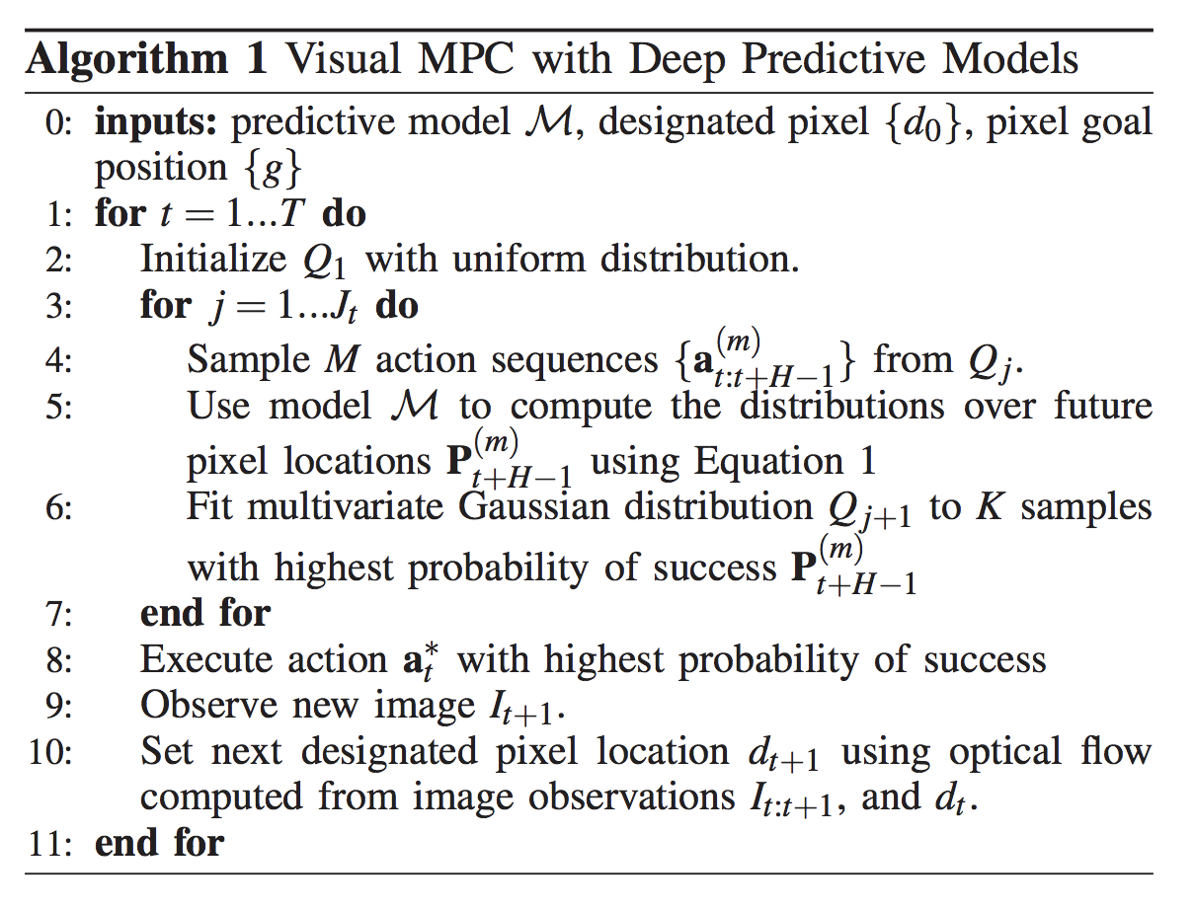
Getting future action sequences

Slide 11
VIDEO
https://www.youtube.com/watch?v=6k7GHG4IUCY

Slide 12
Jointly Learning to Construct and Control Agents using Deep Reinforcement Learning
ICRA 2019

Slide 13
Limitations of previous research
For most tasks, a physical design is picked first, and then a control policy is optimized for it
The design and policy are inherently coupled; should optimize for design as well
Trying out a bunch of designs by trial and error is infeasible, as a separate controller must be trained for each design

Slide 14
Main contributions
Reinforcement learning that jointly optimizes for design and policy

Slide 15
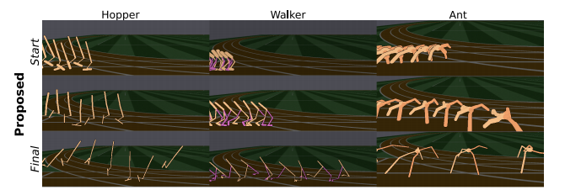
Problem

Slide 16
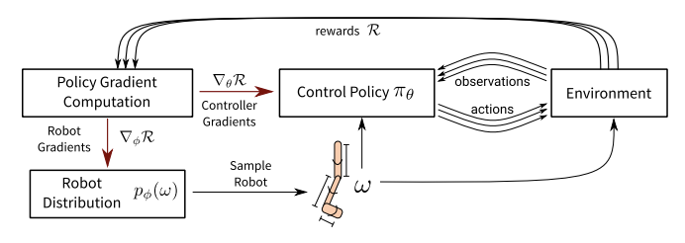
MODEL
Notes:
{S, A, p, r, p0}, where S ⊆ R d is the state space, A ⊆ R n the action space, p the (unknown) transition model between states, r the reward function, and p0 the initial state distribution. An agent in state st ∈ S at time t takes action at ∈ A and the environment returns the agent’s new state st+1 according to the unknown transition function p(st+1|st, at), along with the associated reward rt = r(st, at). The goal is to learn the control policy π ∗ : S → A mapping states to actions that maximizes the expected reward Eπ[Rt], which takes into account rewards at future time-steps Rt = P∞ i=0 γ i rt+i with a discount factor γ ∈ [0, 1).

Slide 17
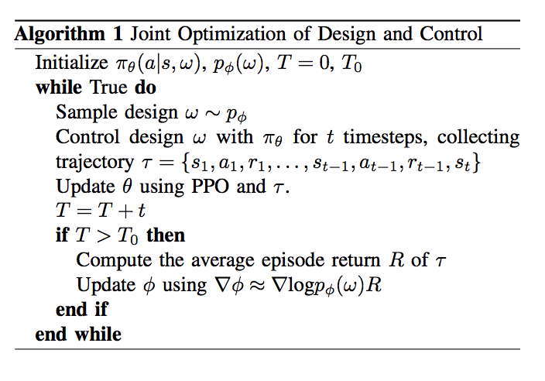
MODEL
Notes:
PPO = proximal policy optimization : policy gradient method that improves the stability of the learning process by continuously sampling from the environment to optimize
The MDPs differ only in their transition dynamics p(st+1|st, at, ω) according to their design ω

Slide 18
VIDEO
Notes:
We parameterize each morphology in terms of the length and radius (e.g., mass) of each link, and the spherical body radius for the ant. We impose symmetry over both legs of the Walker, but optimize over independent design parameters for each of the four legs of the Ant. Consequently, the Hopper and Walker both have eight learnable parameters, while the Ant has twenty-five. We limit the values of each parameter to lie within a reasonable range (as a proxy for fabrication constraints).
The MDP state st is comprised of joint angles and velocities, center-of-mass velocity, height of the torso, and direction to the target.

Slide 19
Quiz (T/F)
1. Deep Visual Foresight for Planning Robot Motion assigns tasks with pixel-level information, not object-level information.
2. Jointly Learning to Construct and Control Agents using Deep Reinforcement Learning optimizes three types of robots: Hopper, Walker, and Spider.

