Slide 1

Final presentation:
Novel Learning and Sampling-based Motion Planner for High-Dimensional Robotic System
Minh-Tuan Tran - Andrea Finazzi - Shinjeong Kim
2020.12.8
Notes:
1

Slide 2
Content
I. Introduction
II. Background and Relative work
III. Problem of Current Technique
IV. Proposed Method
V. Role of Members

Slide 3
I. Introduction
1. Motion Planning Problem definition & applications
2. Motion Planning for High-dimensional Robotic System

Slide 4
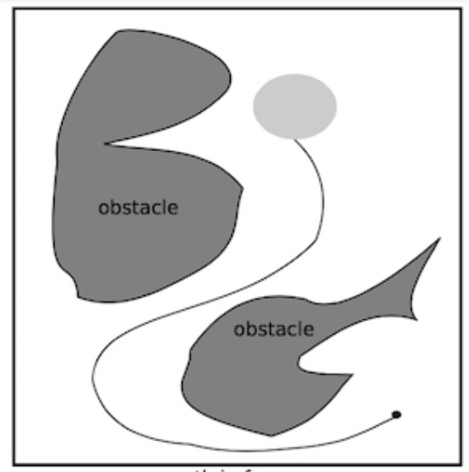




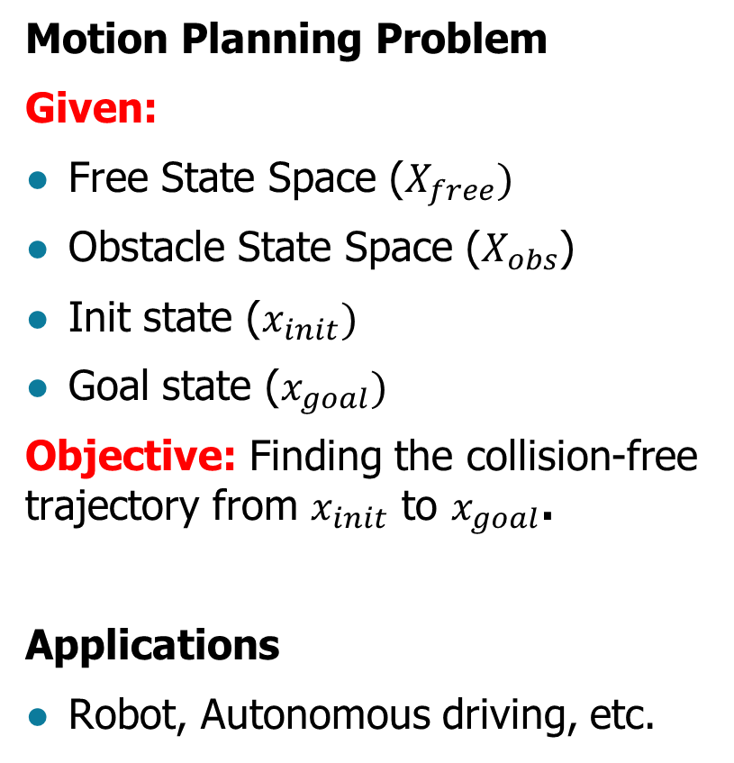
1. Motion Planning Problem definition & Applications
$$X_{free}$$
Motion Planning Problem
Given:
Free State Space ($X_{free})$
Obstacle State Space ($X_{obs}$)
Init state ($x_{init})$
Goal state ($x_{goal})$
Objective: Finding the collision-free trajectory from $x_{init}$ to $x_{goal}$.
Applications
Robot, Autonomous driving, etc.
$$X_{obs}$$
$$x_{goal}$$
collision-free
trajectory
$$x_{init}$$

Slide 5
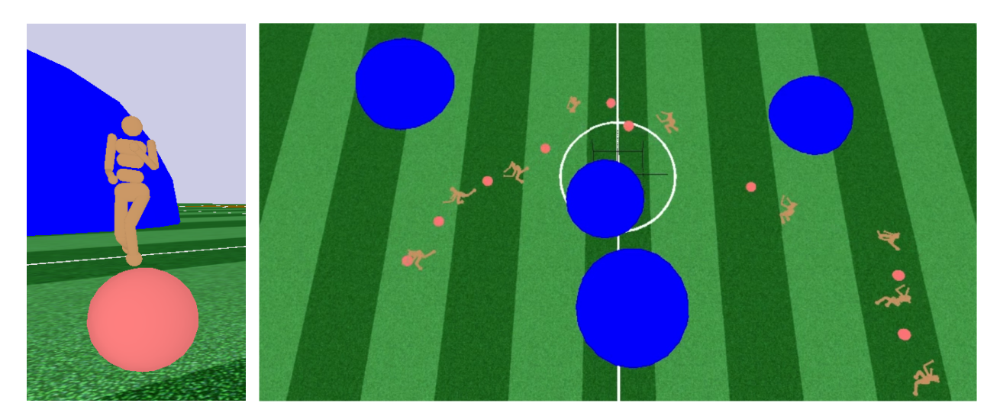
2. Motion Planning for High-dimensional Robotic System
Humanoid Robot
OpenAI RoboSchool : 50 DOF
Existing approaches did not succeed to manage high DOF
A high performance, novel approach for high-dimensional C-space is necessary.

Slide 6
II. Background and Relative work
2. Deeply Informed Neural Sampling (DeepSMP)
4. Learned Latent Rapidly-exploring Random Trees (L2RRT)
1. RRT and RRT*
3. Motion Planning for High-dimensional robotic

Slide 7


1. RRT and RRT*
a. Rapidly-exploring Random Tree (RRT)
Repeatedly expand tree until reach goal
Probabilistically complete
Not Optimal
$$x_{goal}$$
b. RRT*
RRT + Connection refinement (Rewire)
Probabilistically complete
Asymptotically optimal
Low speed for complicated C-space

Slide 8








2. Deeply Informed Neural Sampling (DeepSMP)
Offline
Online
$$x_{obs}$$
1.
$$x_{obs}$$
$$(x_{T},x_{t},Z)$$
Encoder
Encoder
2.
DeepSampler
$$(x_{T},{\hat{x}}_{t},Z)$$
$$Z= f(x_{obs};θ^{e})$$
Decoder
DeepSampler
$${\hat{x}}_{t+1}$$
$${\hat{x}}_{obs}=g(Z;θ^{d})$$
$${\hat{x}}_{t+1}$$
Contractive
AutoEncoder
Deep Sampler
Neural Sampling
(DeepSMP)
Speed was improved
Still not suitable for high dimensional problem

Slide 9
3. Motion Planning for High-dimensional robotic
Previous methods cannot handle high-dimension.
Why?
RRT family : designed for mobile robots and low DOF robotic arms
  → not suitable for high-dimensional problem [1]
DeepSMP family : heavily rely on training data
  → e.g. DeepSMP : DeepSampler is trained by path from RRT*; also not suitable

Slide 10
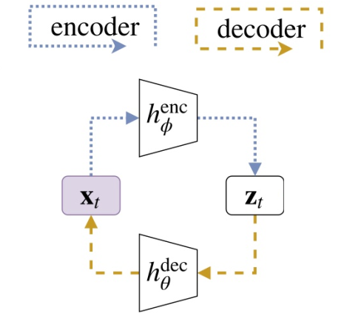
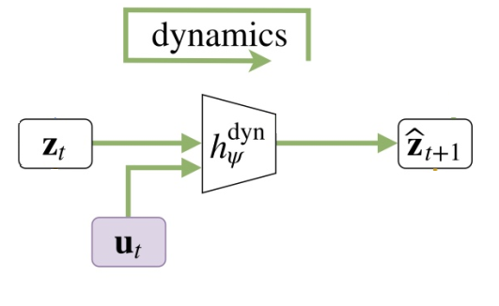
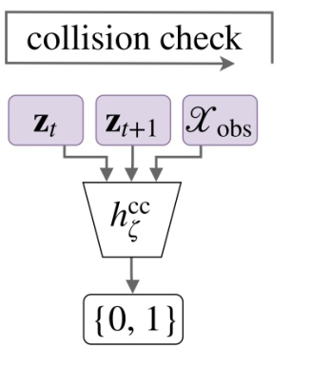
4. Learned Latent Rapidly-exploring Random Trees (L2RRT)
a. Latent Sampling-based Motion Planning (L-SBMP)
This model is divided into three parts:
Autoencoder
Network
Dynamics
Network
Collision
Checker

Slide 11








4. Learned Latent Rapidly-exploring Random Trees (L2RRT)
Differences compared to RRT
All operations are done on latent space (e.g. sampling, tree extension)
Use dynamics network to extend tree
Use collision check network to check if successive states are collision-free
Main Idea
Project all high-dimensional states to lower states and handle them
Then, high-dimensional problem can be handled (e.g. Humanoid robot)
$$z_{goal}$$
$$z_{prop}$$
$$z_{2}$$
$$z_{sample}$$
$$z_{1}$$
$$u_{1}$$
$$u_{0}$$
$$z_{init}$$

Slide 12
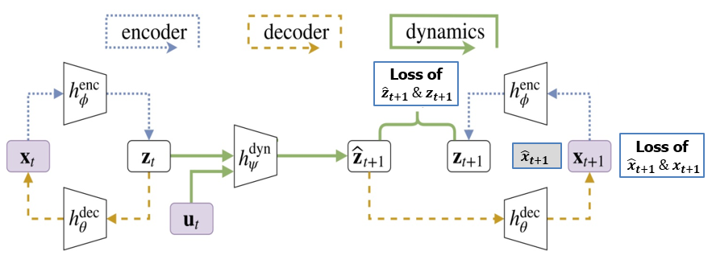

III. Problem of Current Technique
What is the main weak point of L2RRT
They use the random $u_{t}$ for dynamic network
Both of those loss function just use for checking whether latent predicted state is correct with real predicted state
So that, this approach just lead the dynamic network to learn the path of the random sampling like RRT in full state problem. So, it leads to the poor performance of L2RRT.

Slide 13
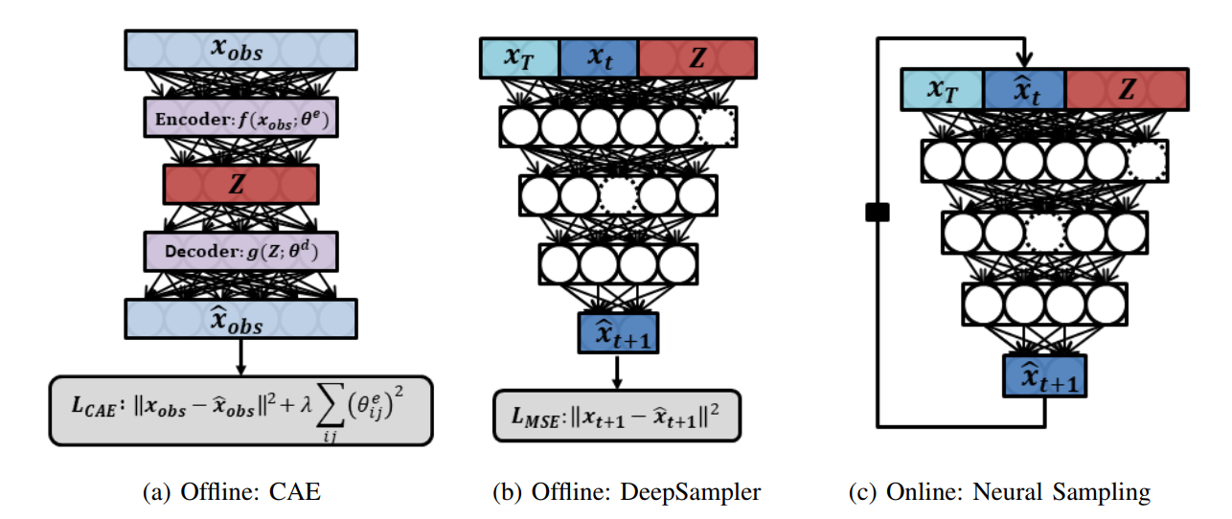
III. Problem of Current Technique
What is the main weak point of DeepSMP:
DeepSMP don’t suitable for high-dimensional motion planning due to the lack of training data.

Slide 14
IV. Proposed Method
1. Training L-SBMP
2. L2RRT*
3. Training DeepControlSampler
4. Predict Phase

Slide 15
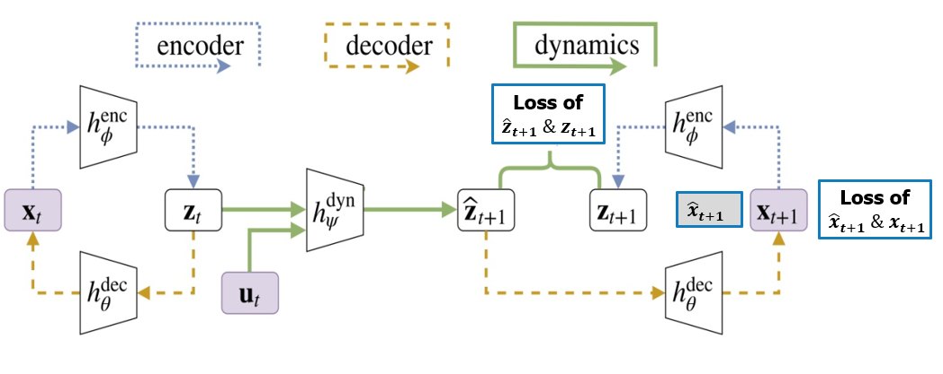
IV. Proposed Method
1. Training L-SBMP
The training data for the autoencoder and dynamics network consists of 10,000 environments, each with a trajectory of 10 successive states and control inputs.
The training data for the collision checking network consists of 25,000 environments, again with 10 pairs of states and a collision label.

Slide 16

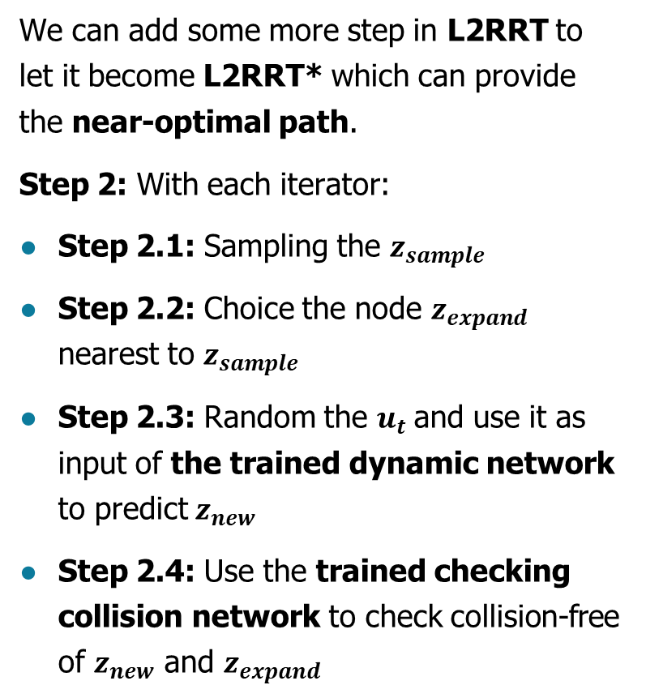



IV. Proposed Method
2. L2RRT*
We can add some more step in L2RRT to let it become L2RRT* which can provide the near-optimal path.
Step 2: With each iterator:
Step 2.1: Sampling the $z_{sample}$
Step 2.2: Choice the node $z_{expand}$ nearest to $z_{sample}$
Step 2.3: Random the $u_{t}$and use it as input of the trained dynamic network to predict $z_{new}$
Step 2.4: Use the trained checking collision network to check collision-free of $z_{new}$ and $z_{expand}$
$$z_{goal}$$
$$z_{near}$$
$$z_{new}$$
3
1
$$x_{start}$$
5
2
1

Slide 17



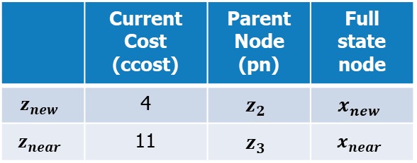
IV. Proposed Method
2. L2RRT*
Step 2.5: check the radius near $x_{new}$ to find the neighbor. Assume that $x_{near}$ is the neighbor.
Step 2.6: computing the cost to move from $x_{new}$ to $x_{near}$.
$$tcost=cost\left(x_{new},x_{near}\right)+ccost_{z_{new}}$$
$$z_{goal}$$
$$z_{near}$$
$$z_{new}$$
3
1
$$z_{2}$$
$$z_{3}$$
$$x_{start}$$
5
2
1
 | Current Cost (ccost) | Parent Node (pn) | Full state node
$$z_{new}$$ | 4 | $$z_{2}$$ | $$x_{new}$$
$$z_{near}$$ | 11 | $$z_{3}$$ | $$x_{near}$$

Slide 18
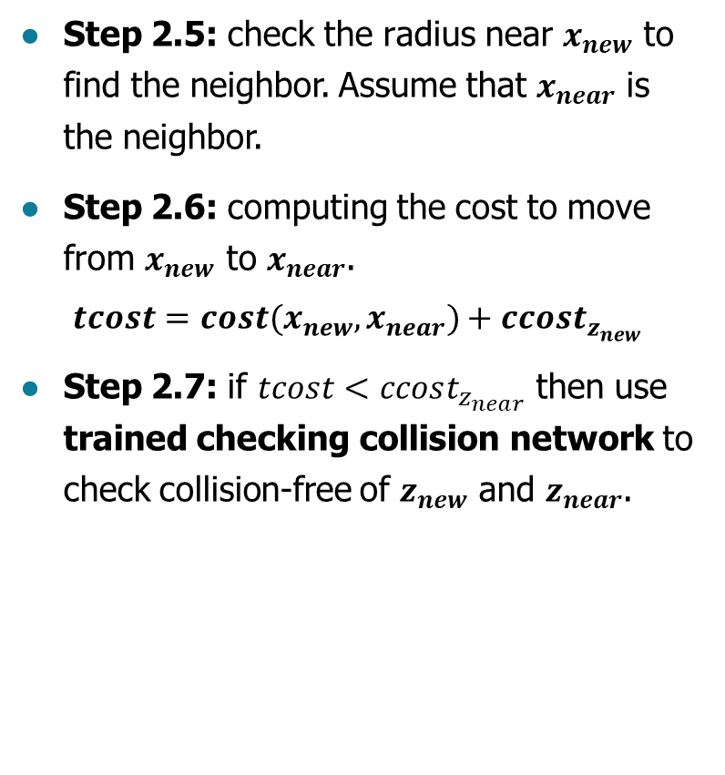
IV. Proposed Method
2. L2RRT*
Step 2.5: check the radius near $x_{new}$ to find the neighbor. Assume that $x_{near}$ is the neighbor.
Step 2.6: computing the cost to move from $x_{new}$ to $x_{near}$.
$$tcost=cost(x_{new},x_{near})+ccost_{z_{new}}$$
Step 2.7: if $tcost<ccost_{z_{near}}$ then use trained checking collision network to check collision-free of $z_{new}$ and $z_{near}$.
$$z_{goal}$$
$$z_{near}$$
$$z_{new}$$
3
1
$$z_{2}$$
$$z_{3}$$
$$x_{start}$$
5
2
1
 | Current Cost (ccost) | Parent Node (pn) | Full state node
$$z_{new}$$ | 4 | $$z_{2}$$ | $$x_{new}$$
$$z_{near}$$ | 11 | $$z_{3}$$ | $$x_{near}$$

Slide 19
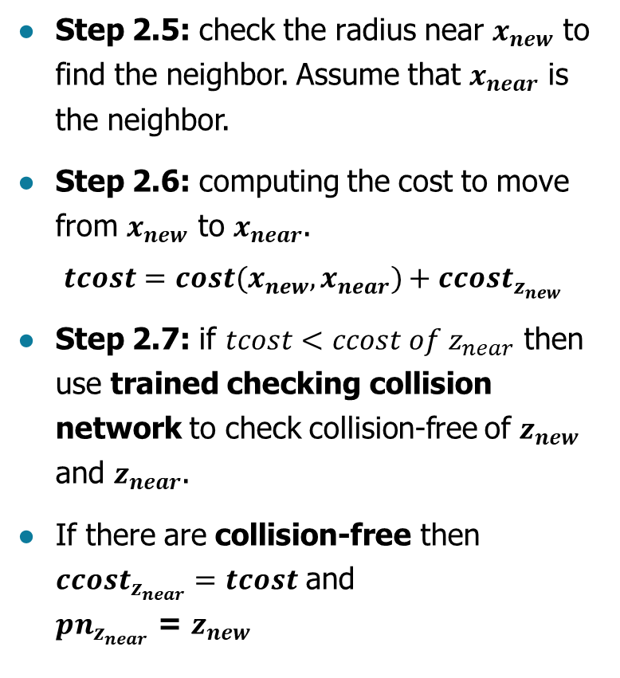

IV. Proposed Method
2. L2RRT*
Step 2.5: check the radius near $x_{new}$ to find the neighbor. Assume that $x_{near}$ is the neighbor.
Step 2.6: computing the cost to move from $x_{new}$ to $x_{near}$.
$$tcost=cost(x_{new},x_{near})+ccost_{z_{new}}$$
Step 2.7: if $tcost<ccost of z_{near}$ then use trained checking collision network to check collision-free of $z_{new}$ and $z_{near}$.
If there are collision-free then $ccost_{z_{near}}=tcost$ and
$pn_{z_{near}}$ = $z_{new}$
$$z_{goal}$$
$$z_{near}$$
2
$$z_{new}$$
1
$$z_{2}$$
$$z_{3}$$
$$x_{start}$$
5
2
1
 | Current Cost (ccost) | Parent Node (pn) | Full state node
$$z_{new}$$ | 4 | $$z_{2}$$ | $$x_{new}$$
$$z_{near}$$ | 6 | $$z_{new}$$ | $$x_{near}$$
Based on L2RRT* we can generate the near-optimal path

Slide 20







IV. Proposed Method
3. Training DeepControlSampler
ObsEncoder
DeepControlSampler
$$X_{obs}$$
encoder
$$z_{Obs}$$
$$z_{Obs}$$
$${ z}_{t}$$
$${ u}_{t}$$
decoder
$$z_{goal}$$
$$X_{obs}$$
With the training data will be generated from the near-optimal path of L2RRT*

Slide 21

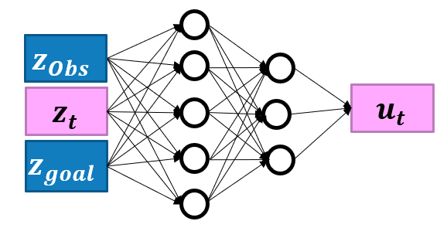

IV. Proposed Method
4. Predict Phase:
Use the trained deep control sampler to predict $u_{t}$

Slide 22
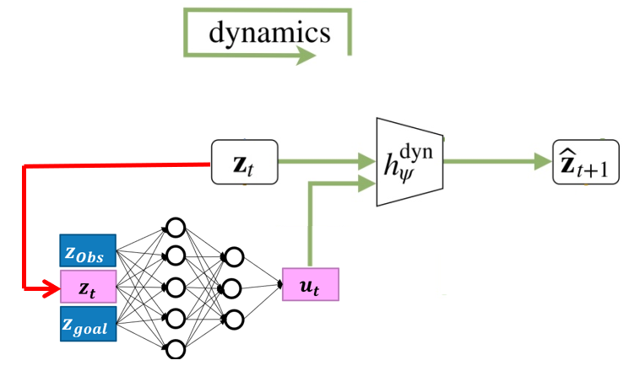

IV. Proposed Method
4. Predict Phase:
Predict ${\hat{z}}_{t+1}$ by the trained dynamic network with $z_{t}$ and $u_{t}$ as the input.

Slide 23
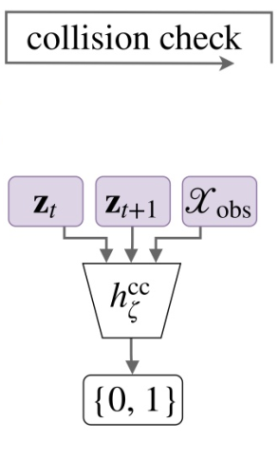

IV. Proposed Method
4. Predict Phase:
Check the collision of $z_{t}$ and $z_{t+1}$ with the trained checking collision network.

Slide 24
IV. Proposed Method
4. Predict Phase:
With this model, We can utilize both of the efficiency of neural network-based predictor and the suitability for high-dimensional of L2RRT.

Slide 25
V. Experiments
2. Training Process
4. Conclusions
1. Network Implementation
3. Evaluation

Slide 26
1. Network Implementation
Environment:
TensorFlow v1 (cpu only) – Ubuntu 20.04 on DELL XPS 15
Network Structure:
Input (516):
  z_t, z_goal, z_Obs
Obstacle space preprocessor, from the CC network (pre-trained):
  5 dense layers with 50% dropout
Control network:
  5 dense layers with 50% dropout
Output (2):
  u_t

Slide 27
2. Training Process: Training Data
We used L2RRT to generate trajectories for our model training.
100 problems: 70 for training, 20 for testing, 10 for evaluation
Training: ~500 rows
Testing: ~100 rows
Each best trajectory of training and test data is represented as a sequence of control inputs.
u_t
z_goal
For each best trajectory we gather multiple segments (rows):
{z_t, z_goal, z_obs, u_t}
Z_t
Z_0

Slide 28
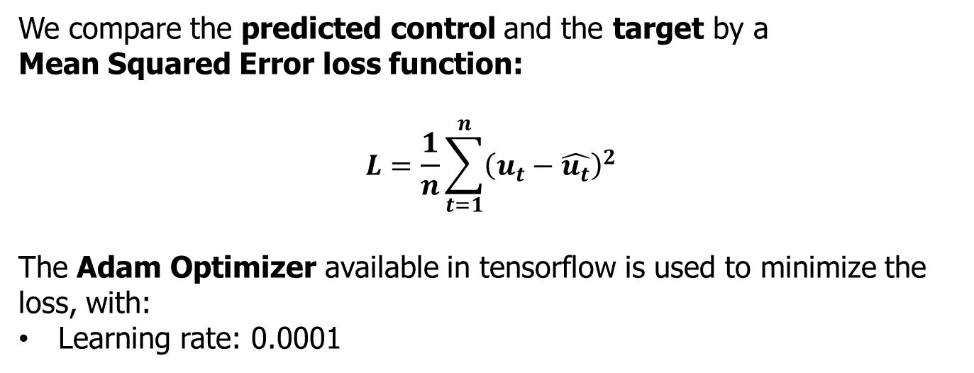
2. Training Process
We compare the predicted control and the target by a
Mean Squared Error loss function:
$$L=\frac{1}{n}\sum_{t=1}^{n}{{\left(u_{t}−\hat{u_{t}}\right)}^{2}}$$
The Adam Optimizer available in tensorflow is used to minimize the loss, with:
Learning rate: 0.0001

Slide 29
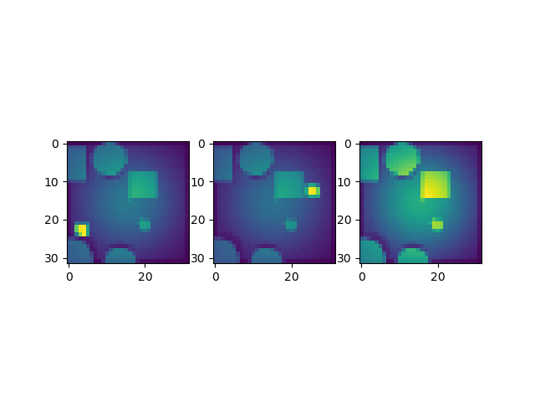
3. Evaluation
Planning problem in a 32x32 pixels environment

Slide 30
3. Evaluation
10 Evaluation Problems are solved with max 5000 samples.
5 Different Scenarios:
  Random control (L2RRT)
  25% learned control
  50% learned control
  75% learned control
  100% learned control
2 Evaluation Rates:
  Success Rate: number of solved problem at each iteration
  Cost Rate: normalized cost of the best solution at each iteration

Slide 31
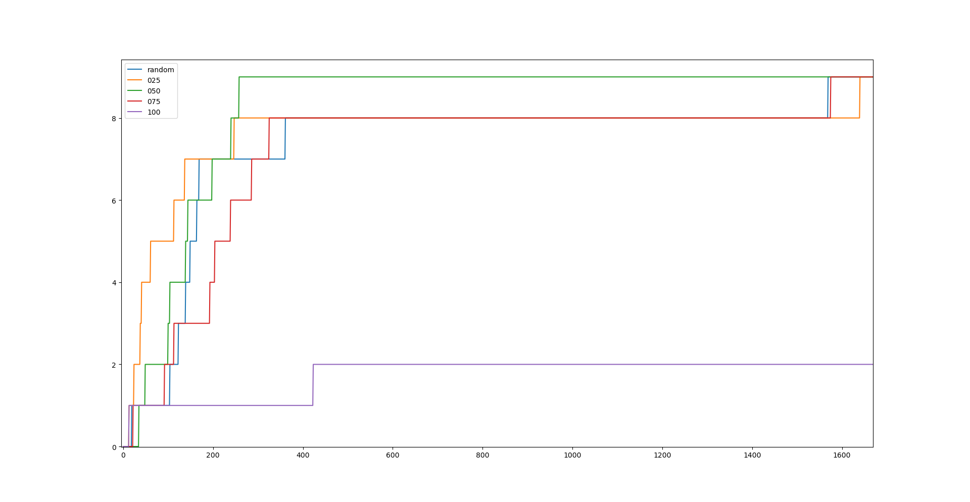
3. Evaluation: Success Rate
Solved
problems
Samples

Slide 32
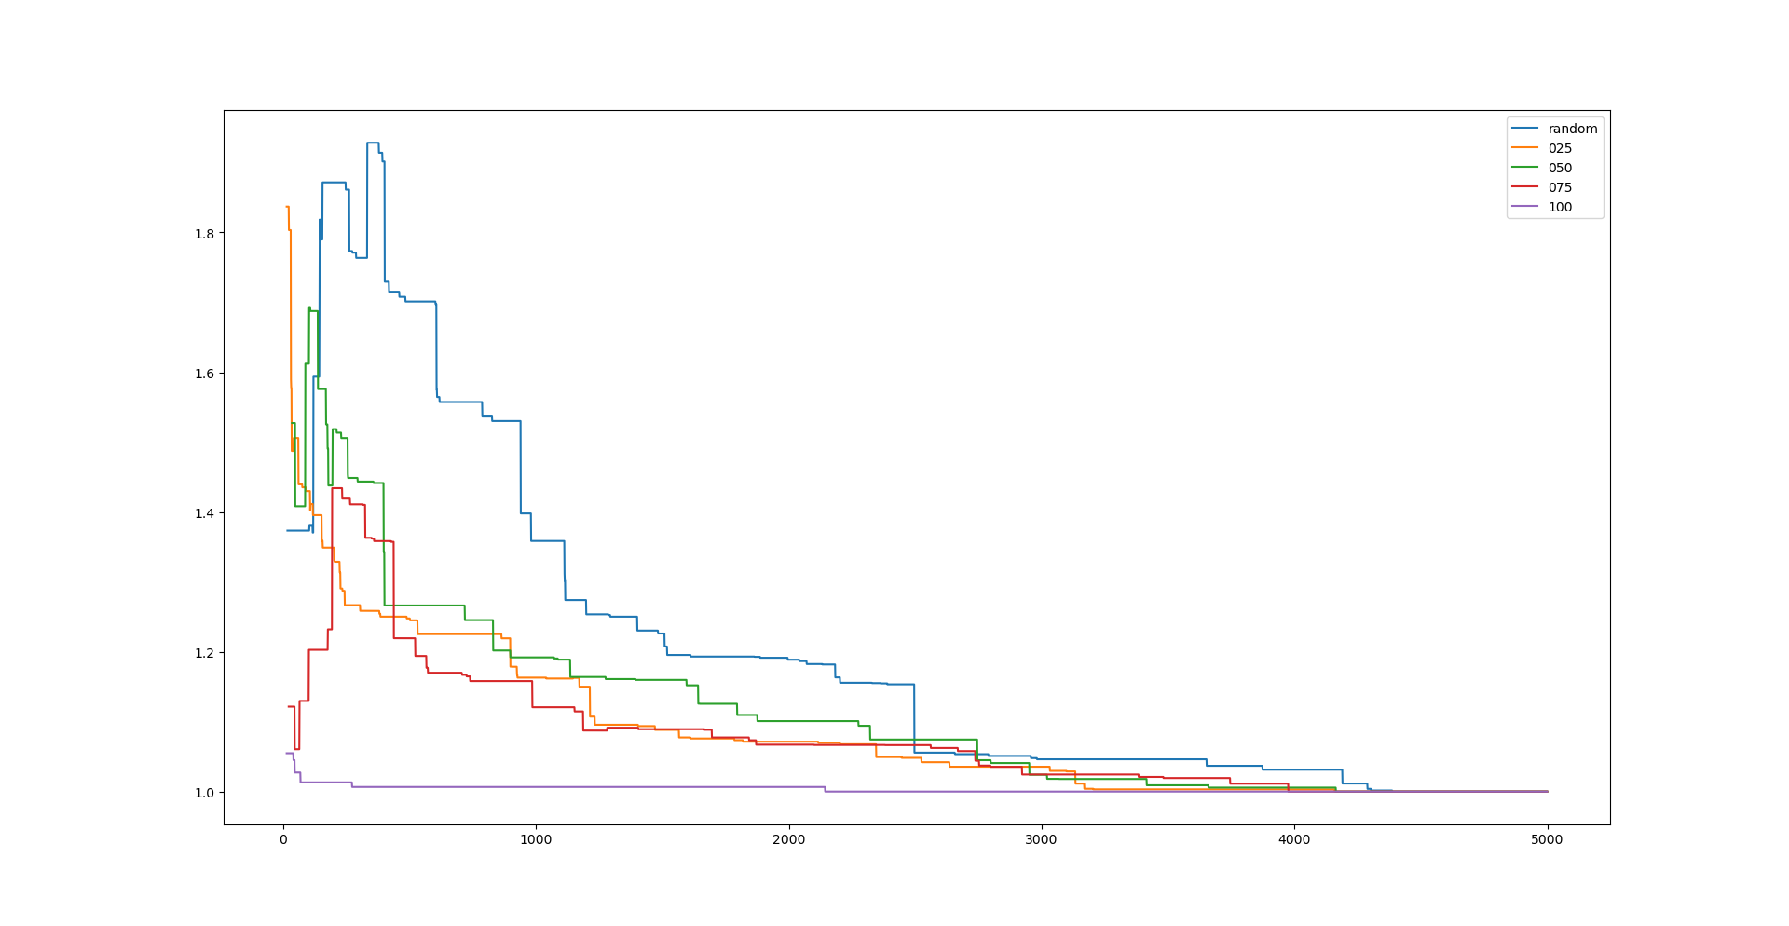
3. Evaluation: Cost Rate
Cost
(normalized)
samples

Slide 33
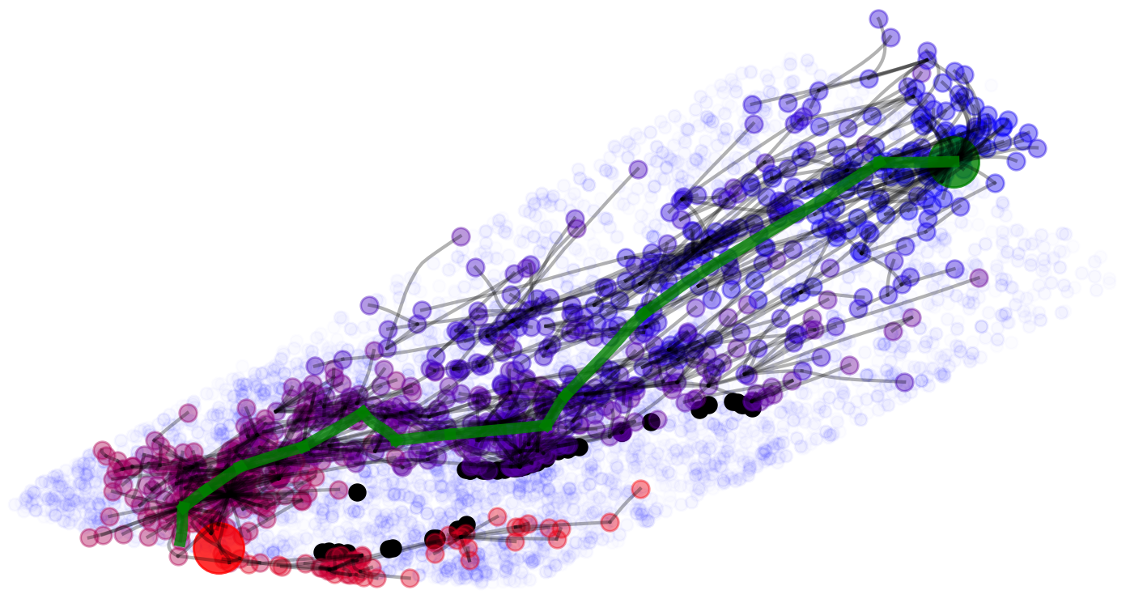
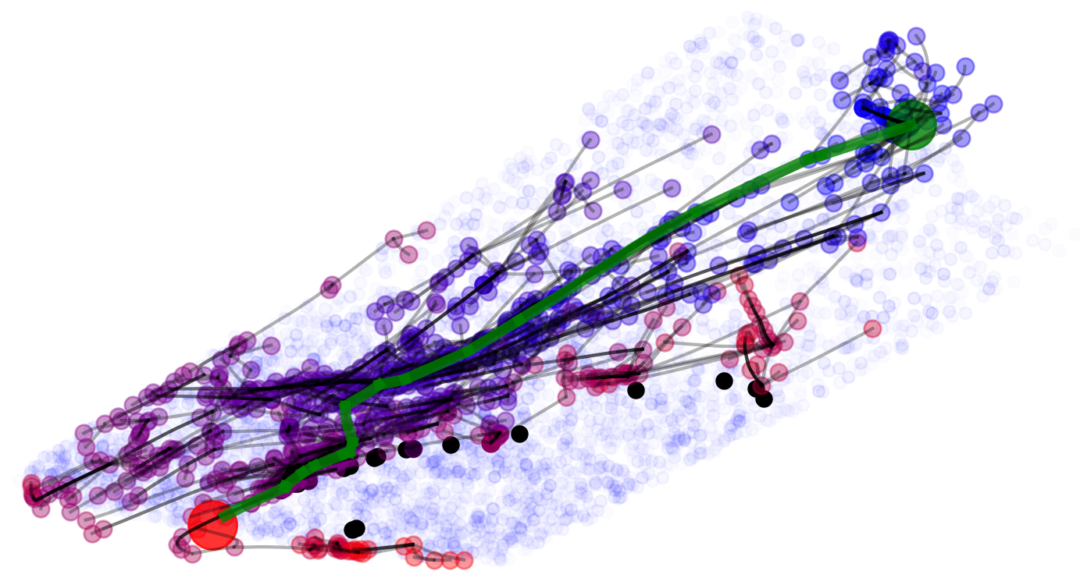
3. Evaluation: Latent Space Visualization
Random
*Third problem of the evaluation set.
1000 samples limit
50% Learned

Slide 34
4. Conclusions
First results are promising
We faced some limitations implementing and evaluating the algorithm:
  Training data at our disposal was limited.
  The complexity of the visual problem is limited.
  L2RRT* cannot be implemented without inverse kinematics, so optimal controls cannot be generated.

Slide 35
4. Conclusions
Besides, we could further improve our model by:
  Improving the network design process.
  Generate new problems or augment the environment complexity (e.g. humanoid robot)
  Evaluate the effectiveness of collision checking in control generation, defining a collision rate parameter.

Slide 36
VI. Role of Members
Member | Role
Shinjeong Kim | Write the Introduction and Relative work sections Discuss about proposed method Discuss about implementation approach and results
Andrea Finazzi | Write the Experiment section Discuss about proposed method Implement and evaluate the experiments
Minh-Tuan Tran | Write the Proposed Method section Discuss about proposed method Discuss about implementation approach and results

