Slide 1
Learning-based path planning for Aerial Multi-View Stereo Reconstruction
Team 3:
20204513 Hochang Lee
20194195 Truong Giang Khang

Slide 2
Contents
Introduction
Related Works
Our Approach
Experimental Results
Future Works

Slide 3
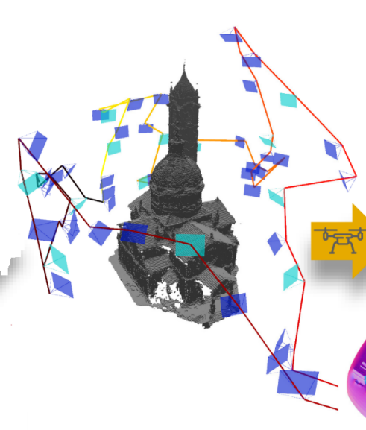
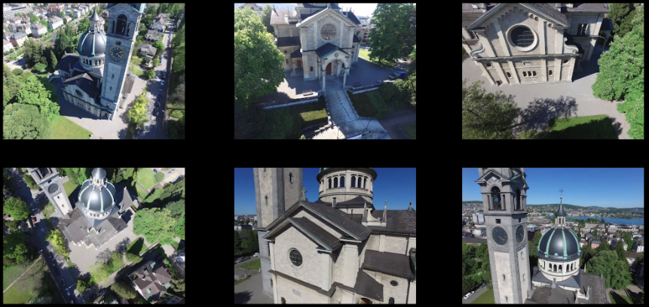
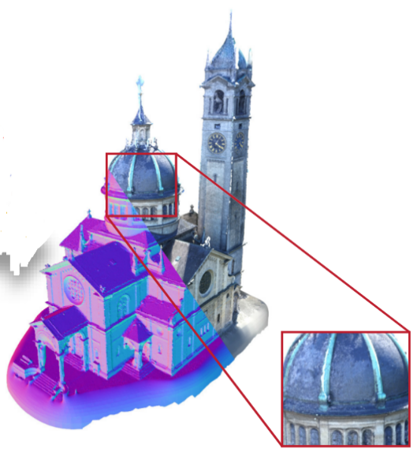
Introduction : Overview
Overview of 3D Aerial Scanning:
Captured 2D images
Images Captured
By drones
View selection
& Path planning
Reconstruction Pipeline
Reconstructed 3D model

Slide 4
Introduction : View Selection & Path Planning
Our study is focused on :
View selection and path planning: Choose View points and design an Optimal trajectory for drones to capture the images that can produce a high-quality 3D model
Optimal trajectory: Minimum travel budget.
Images Captured
By drones
Optimal trajectory
2D images

Slide 5
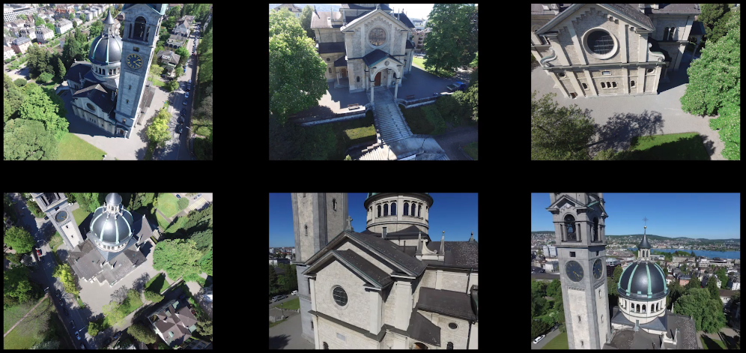
Introduction : 3D Reconstruction
3D Reconstruction: take a set of images as input and produce a 3D model of scene
Reconstruction Pipeline: COLMAP [1], DL-based [2]
Reconstruction Pipeline
Captured 2D images
Reconstructed 3D model

Slide 6
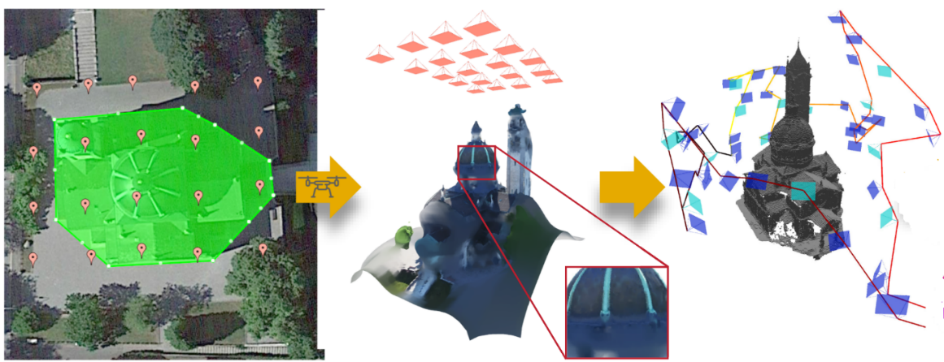
Related Works : Common Approach
Explore-then-Exploit:
Explore: Generate a coarse estimate of scene geometry and scene’s free space
Fly drone along a default trajectory
Put acquired images to 3D reconstruction pipeline
Exploit: Use the acquired information above as input
Design a utility function based on heuristic
Generate trajectory by maximizing the utility function, respecting limited travel budget.
Initial trajectory
Coarse 3D model
Optimal trajectory
explore
exploit

Slide 7
Related Works : Studies

Slide 8
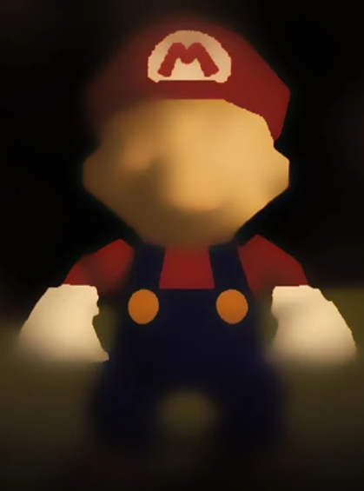
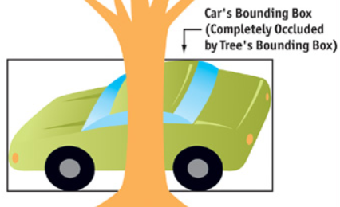
Our Approach : Overview
Existing approaches: Define heuristic scores between each view point and surface point
However, this approach may not be applicable in cases the surface is textureless or has occlusions
Therefore, instead of predefining the rules, we switch over to learning based approaches
Textureless
Occlusion

Slide 9
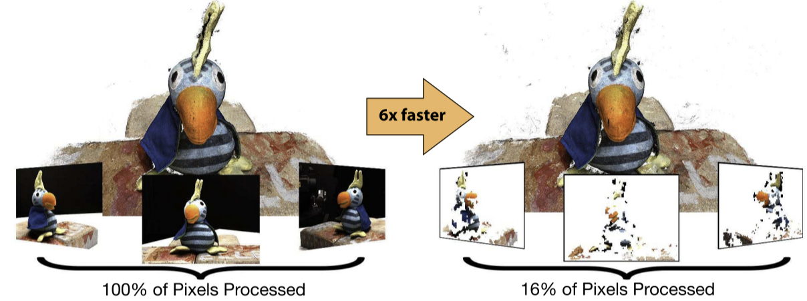
Our Approach : Overview
Our Method: Predict “Reconstructability” score for each view by using a DL network
Reconstructability: Serve as a proxy for the accuracy of surface estimate produced by each view
Similar to definition in [5]
process subset of pixels instead of whole image for Multi-View Stereo (MVS)
→ Accelerating MVS

Slide 10
Our Approach : Reconstructability Score
Define via ground truth depth and estimated depth by a reconstruction pipeline
where, $I_{p}$ indicates the pixel p of view image $I$
$D$ is the depth value estimated by 3D reconstruction pipeline
$D^{∗}$ is the ground truth depth value
$E$ is the depth error which is related to reconstructability
Define the reconstructability score $R$ via $E$ by a form of sigmoid function
Hyperparameter $α, τ$ normalize value of R in range (0,1)

Slide 11
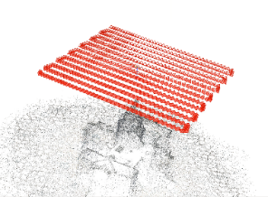
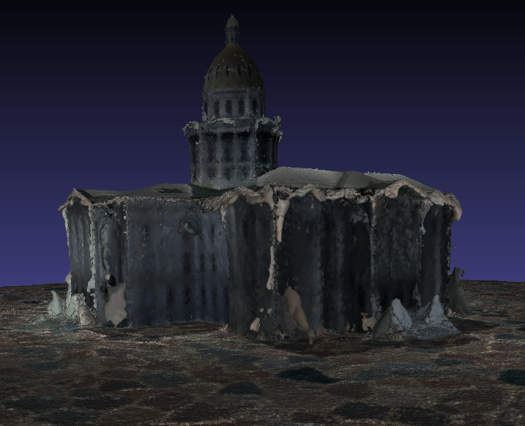
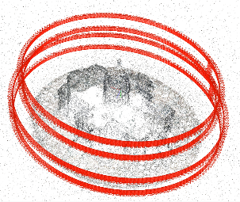
Our Approach : Explore-then-Exploit
Coarse 3D model
Explore
Default Trajectory
Exploit
Optimal trajectory and 3D reconstruction models
Grid view points
Path planning
Heuristic Approach to Select View Points for Path Planning
- User Made Utility Function are used to guess how useful each view points are at discovering unknown surfaces

Slide 12
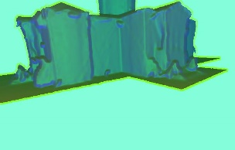
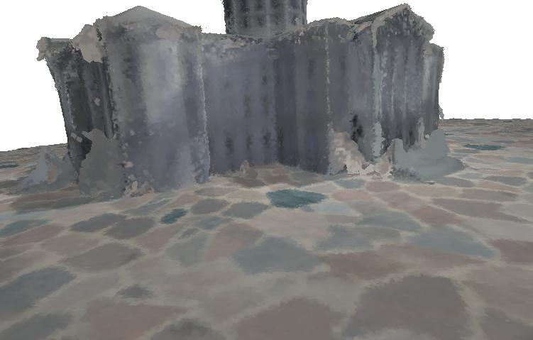
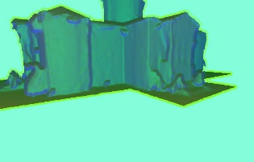
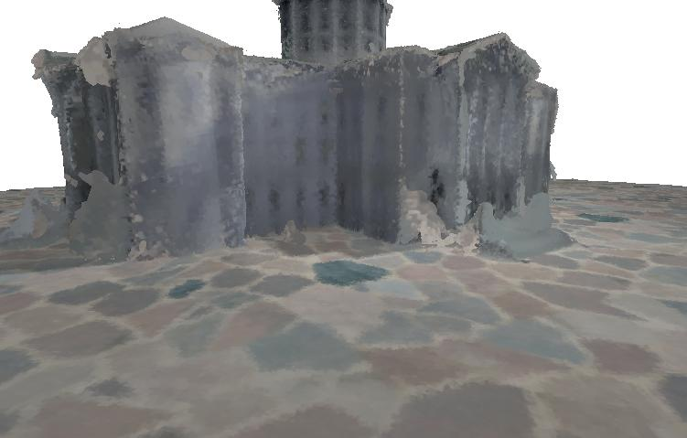
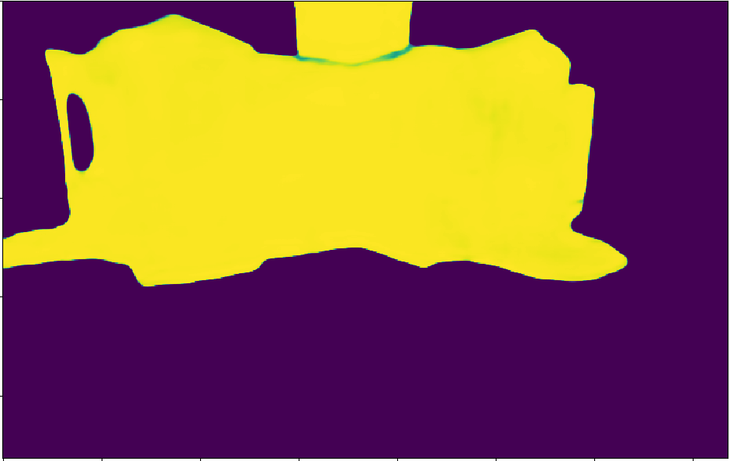
Our Approach : Explore-then-Exploit
Coarse 3D model
Explore
Default Trajectory
Exploit
Optimal trajectory and 3D reconstruction models
Grid view points
Path planning
Deep learning model
Depth + normal features rendered from coarse model
Images rendered from coarse model
Predicted reconstructability score maps

Slide 13
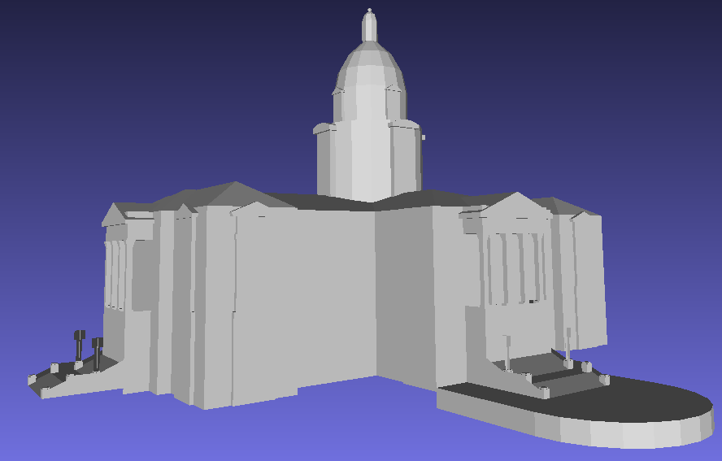
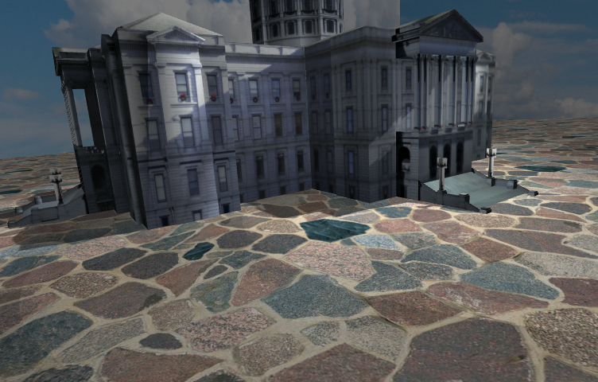
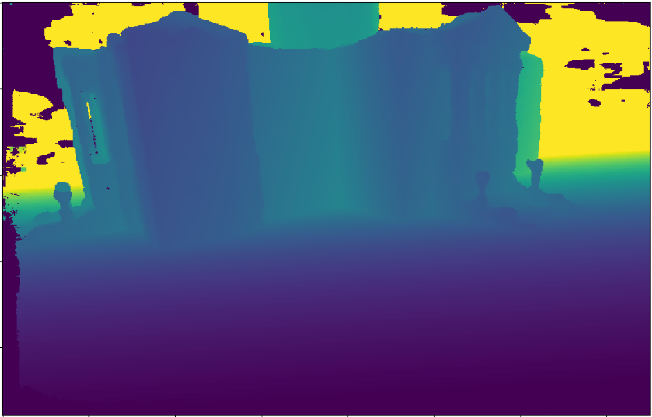
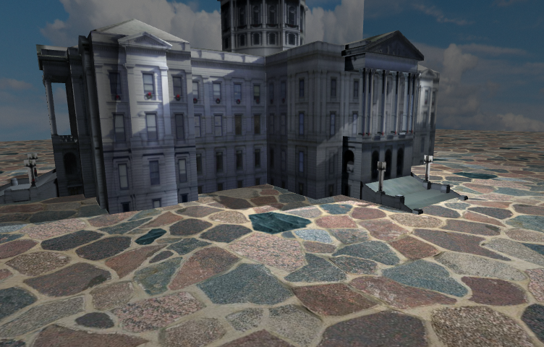
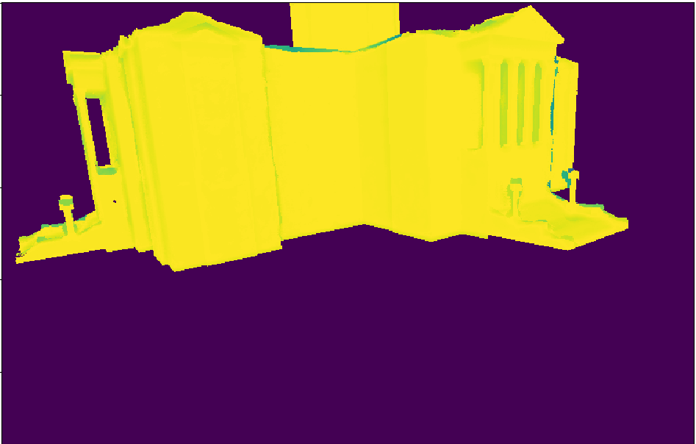
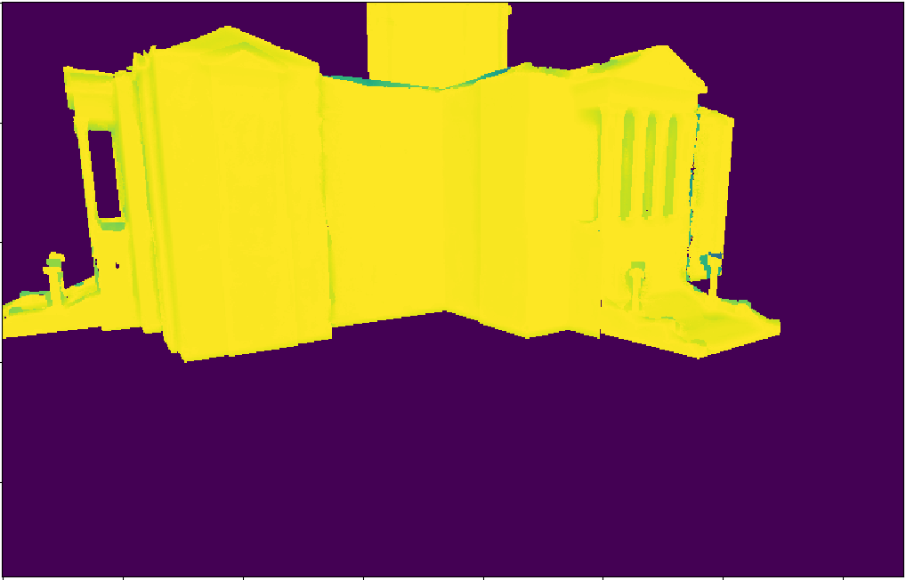
Our Approach : Training
Coarse model
Ground truth (GT) model
Depth maps rendered from GT
Images rendered from GT model
Depth maps estimated by COLMAP
dcdcdcdcd
GT score maps
MSE loss
Deep learning model
Depth + normal features rendered from coarse model
Images rendered from coarse model
Predicted score maps
Training model

Slide 14
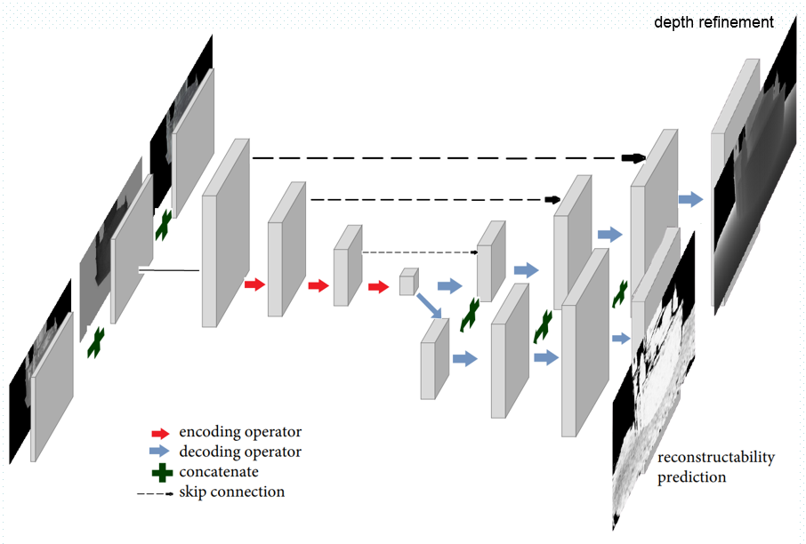
Our Approach : Network Architecture - RecNet
4 encoding blocks
4 decoding blocks for depth refinement
4 decoding blocks for Reconstructability prediction

Slide 15
Our Approach : Loss Function
Optimize two losses simultaneously
Loss 1: Depth reconstruction loss
$$L_{depth}=\frac{1}{N}\sum_{i}{{\left\|{\hat{D}}_{i}−D_{i}\right\|}^{2}}$$
where, ${\hat{D}}_{i}$ is refined depth, $D_{i}$ is ground truth depth
Loss 2: Reconstructability prediction loss
Use mean squared error loss between predicted map and ground truth
$$L_{rec}=\frac{1}{N}\sum_{i}{{\left\|{\hat{R}}_{i}−R_{i}\right\|}^{2}}$$
Total loss: $L=λL_{rec}+\left(1−λ\right)L_{depth}$
where $λ=0.3$to control the influence of losses

Slide 16
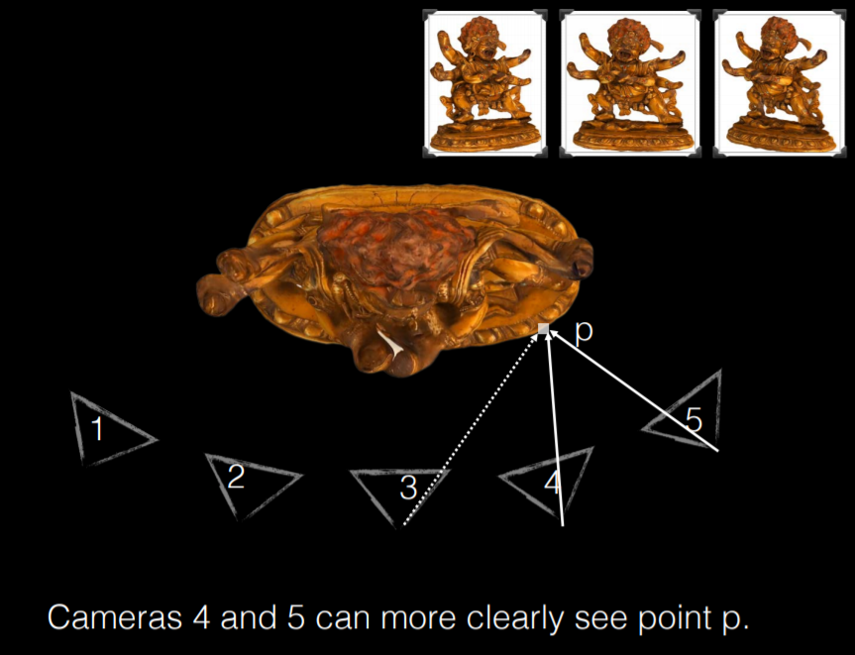
Our Approach : Path planning
Preprocessing
Construct a ground set C – all possible camera poses around the scene.
Each camera pose has 2 information: 3D Position and Camera Orientation
Sample a set of surface points S on the coarse 3D model
Define an objective function for path planning from Reconstructability predictions:
Camera poses $c_{1:M}$, surface points $s_{1:N}$
Reconstructability at surface point $s_{j}$ induced by $c_{i}$: $R_{ij}v_{ij}$,
$v_{ij}$ is indicator for visibility of $s_{j}$ with $c_{i}$
$f(C)=\sum_{j=1}^{N}{\sum_{i=1}^{M}{R_{ij}v_{ij}}}$

Slide 17
Our Approach : Path planning
P is a trajectory, P = (p₀, u₀), (p₁, u₁),…,(p_{q}, u_{q}), where $p_{k}$ is camera position, $u_{k}$ is camera orientation
Find optimal path P*:
(C_{P} $⊆$C)
Similar to [3], use algorithm in [3] to solve this problem.

Slide 18
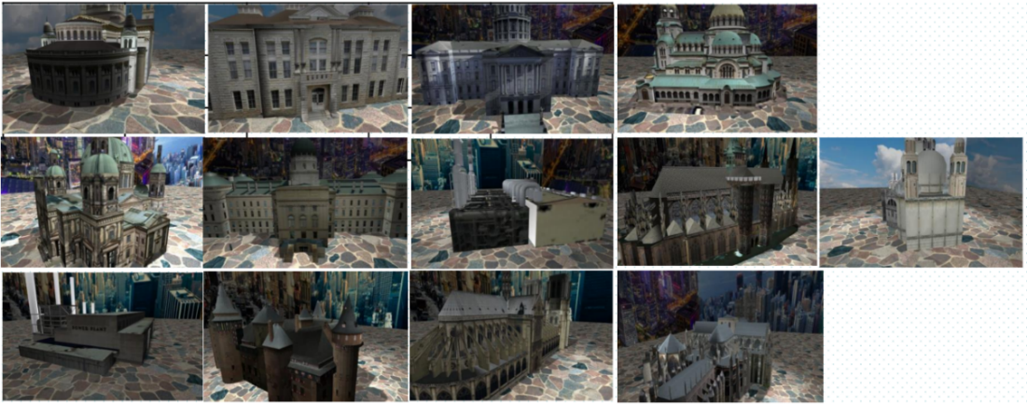
Experiment Results
Dataset for training and test:
Simulation dataset - Training : 9 Scenes & Testing : 4 Scenes
DTU dataset – Training : 97 scenes & Testing : 22 scenes

Slide 19
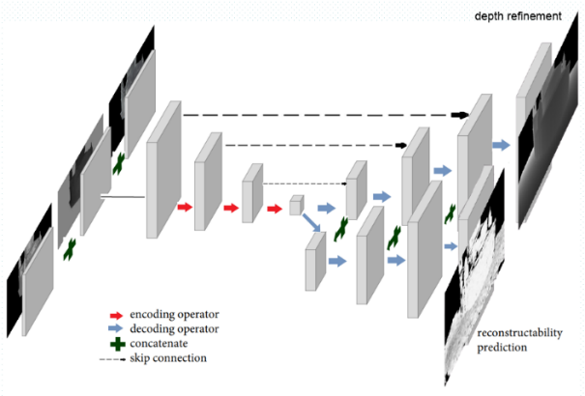
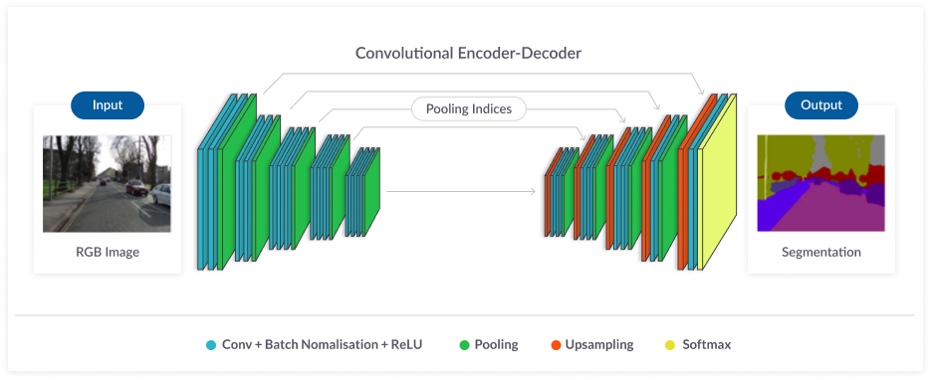
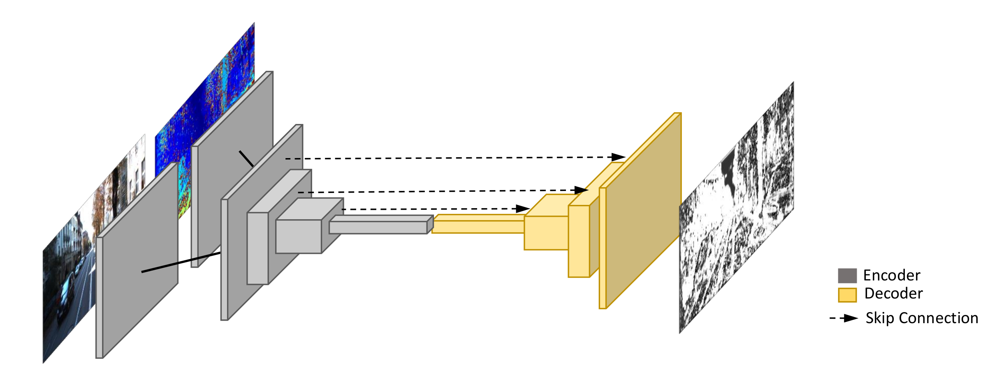
Experiment Results
Reconstructability Prediction
Compare with other baselines: Unet [7] and ConfNet [8]
Evaluation metrics: MAE, RMSE
 | MAE |  |  | RMSE
 | Simulation | DTU | Overall | Simulation | DTU | Overall
Unet | 0.258 | 0.080 | 0.173 | 0.140 | 0.037 | 0.091
ConfNet | 0.192 | 0.070 | 0.134 | 0.099 | 0.034 | 0.068
RecNet (Ours) | 0.181 | 0.071 | 0.128 | 0.082 | 0.034 | 0.059
Unet [7]
ConfNet [8]
RecNet (Ours)

Slide 20
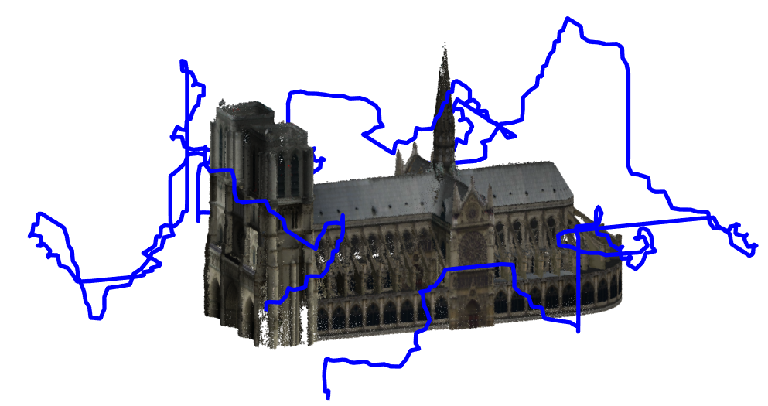
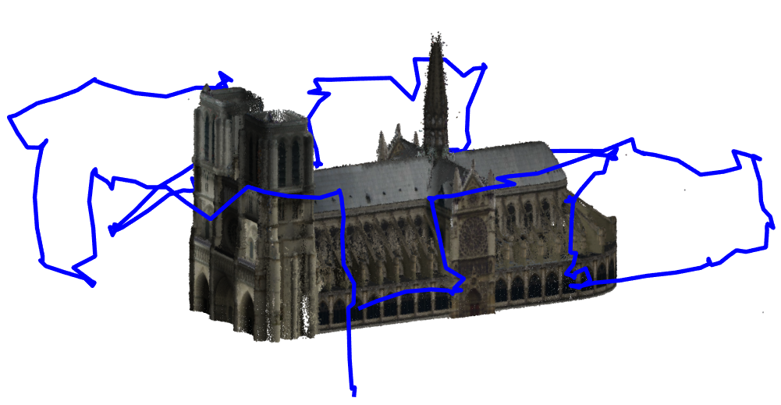
Experimental Results
3D Modeling : Path Planning
Compared with Sub-modular Coverage (Sub-Cov [3])
Same path length budget
Captured the set of images in ROS simulation
Reconstruction Pipeline : CasMVSNet
Constructed 3D Models with Coverage Paths
(a) Sub-Cov
(b) Ours

Slide 21
Experimental Results
3D Modeling
Qualitative results
Scenario 1 (Notre-Dame de Paris) |  | Scenario 2 (Alexander Nevsky)
(a) Sub-Cov
(b) Ours

Slide 22
Experimental Results
3D Modeling
Quantitative comparison
Our method had better performance in Precision, Recall, and F-Score
Sub-Cov scans the entire surface evenly, but our method scans more low-score surfaces.
→ Improvement in Modeling Performance
→ Effective for scanning complex structures
(a) Sub-Cov
(b) Ours
 | Scenario1 |  |  | Scenario2
 | Precision | Recall | F-Score | Precision | Recall | F-Score
Sub-Cov | 0.8172 | 0.7257 | 0.7687 | 0.8628 | 0.8836 | 0.8731
Ours | 0.8302 | 0.7922 | 0.8108 | 0.8734 | 0.9062 | 0.8895
Precision : Percentage of reconstructed points that lie within threshold distance to the ground truth
Recall : Percentage ground truth points that lie within the threshold distance to the reconstructed points
F-Score : Mean between the Precision and Recall

Slide 23
Conclusion
Conclusion
Proposed a learning-based approach for path planning in Aerial 3D Scanning.
Achieve a good performance for both reconstructability prediction and 3D reconstruction.
Future Works:
Compare with more path planning methods
Evaluate on the real-world scenes.

Slide 24
References
https://colmap.github.io/
Yao, Yao, et al. "Mvsnet: Depth inference for unstructured multi-view stereo." Proceedings of the European Conference on Computer Vision (ECCV). 2018.
Roberts, Mike, et al. "Submodular trajectory optimization for aerial 3d scanning." Proceedings of the IEEE International Conference on Computer Vision. 2017.
Smith, Neil, et al. "Aerial path planning for urban scene reconstruction: a continuous optimization method and benchmark." (2018).
Hepp, Benjamin, Matthias Nießner, and Otmar Hilliges. "Plan3d: Viewpoint and trajectory optimization for aerial multi-view stereo reconstruction." ACM Transactions on Graphics (TOG) 38.1 (2018): 1-17.
Hepp, Benjamin, et al. "Learn-to-score: Efficient 3d scene exploration by predicting view utility." Proceedings of the European Conference on Computer Vision (ECCV). 2018.
Ronneberger, Olaf, Philipp Fischer, and Thomas Brox. "U-net: Convolutional networks for biomedical image segmentation." International Conference on Medical image computing and computer-assisted intervention. Springer, Cham, 2015.
Tosi, Fabio, et al. "Beyond local reasoning for stereo confidence estimation with deep learning." Proceedings of the European Conference on Computer Vision (ECCV). 2018.

