Slide 1

Robust robot navigation against imperfect sensor data
20203397 Hyeongyeol Ryu
20203408 Minsung Yoon
20203474 Sebin Lee
2020.11.12
Notes:
1

Slide 2
Table of contents
Introduction & Research goal
Related Work
Background
Our approach
Current progress & Future work
Schedule & Role

Slide 3
Table of contents
Introduction & Research goal
Related Work
Background
Our approach
Current progress & Future work
Schedule & Role

Slide 4
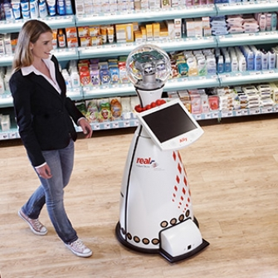
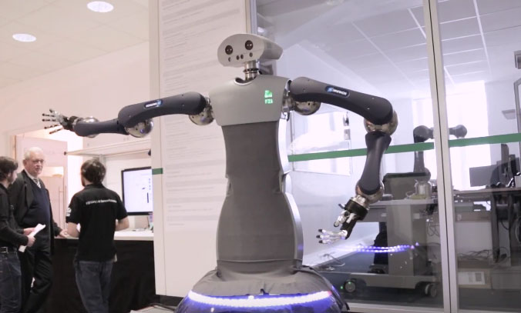
Introduction
These days, many mobile-robots are around humans
Mobile service robots

Slide 5
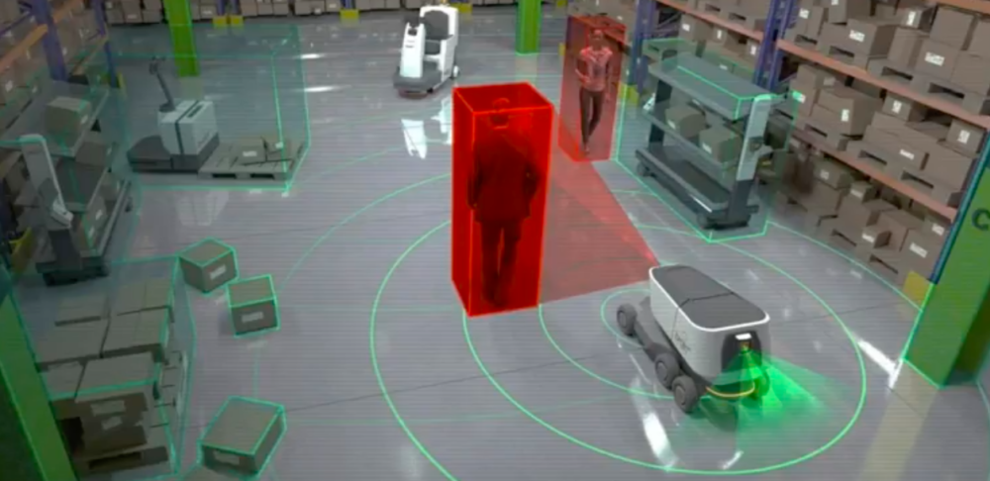
Introduction
These days, many mobile-robots are around humans
  One of the most essential abilities of the robots is the autonomous navigation
  Using its on-board sensors (e.g., LIDAR, RGB-D camera)
Reach the goal while avoiding collision
Autonomous navigation

Slide 6
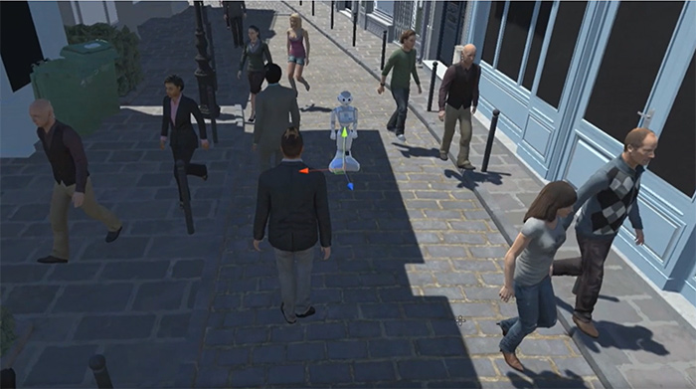



Introduction
But the problem is …
  What if the robot could not get perfect sensor data because of
    Humans’ mistakes (e.g., ice-cream, gum, curiosity, prank)
    Papers/Leaves blowing in the wind
    Sudden malfunction
Collision!
This may cause temporal occlusion, limited FOV problems

Slide 7


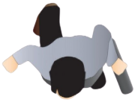

Research goal
Our goal is to propose robust navigation method dealing with unexpected accidents by occlusion/limited FOV
Goal
Goal
Q: How can we solve this?

Slide 8
Table of contents
Introduction & Research goal
Related Work
Background
Our approach
Current progress & Future work
Schedule & Role

Slide 9
Related Work
There have not been related works that target this problem
Instead, we introduce some papers trying to solve similar problems
  Navigation with limited FOV [ICRA19]
  Navigation under uncertainty [ICRA20]

Slide 10
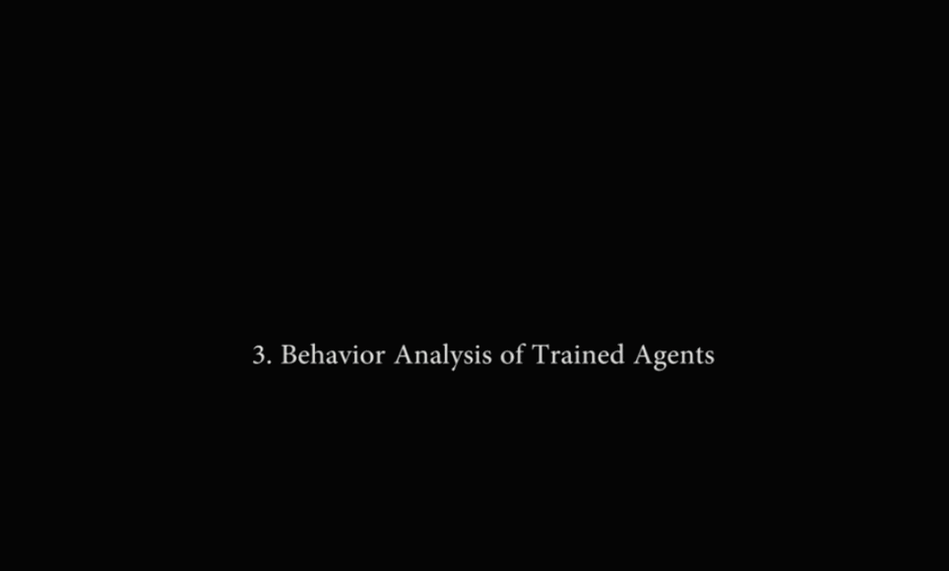
Related Work
^{[1]}Deep Reinforcement Learning of Navigation in a Complex and Crowded Environment with a Limited Field of View [ICRA19]
LSTM + Local Map [90⁰]
FOV: 270⁰
FOV: 120⁰
FOV: 90⁰
Only CNN [90, 120, 180⁰]

Slide 11
Related Work
^{[2]}Learning Resilient Behaviors for Navigation Under Uncertainty [ICRA20]
  Navigation under two uncertainty:
  Lidar sensor data uncertainty + Robot system uncertainty
 | Efficiency | Safety
Over-confident | High | Low
Over-conservative | Low | High
Balanced policy | High | High
High uncertainty
Low uncertainty

Slide 12
Table of contents
Introduction & Research goal
Related Work
Background
Our approach
Current progress & Future work
Schedule & Role

Slide 13
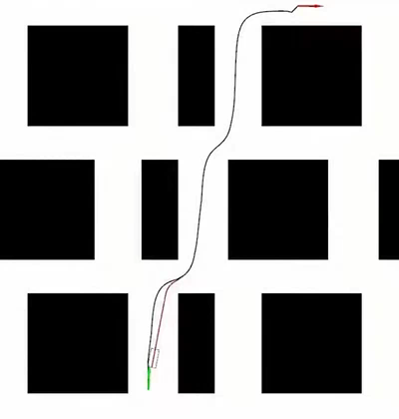
Background
Global Path Planning → Navigation (Local planning or control)
For robustness of navigation
Consider :
1. Temporal occlusion
2. Partially damaged FOV
Black Line: Global path
Red Line: Navigation (Local planning or control)

Slide 14
Table of contents
Introduction & Research goal
Related Work
Background
Our approach
Current progress & Future work
Schedule & Role

Slide 15



Our approach
Problems
Problem1: Temporal occlusion
Problem Modeling and RL
&
Novel Architecture
Normal
Problem2: Partially damaged FOV

Slide 16

Our approach: Problem Modeling and RL
Problem Modeling
2D Lidar observation
Usual case
Problem case

Slide 17
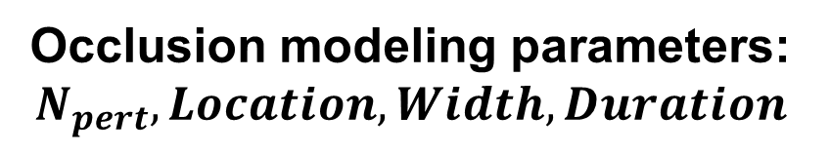
Our approach: Problem Modeling and RL
Problem Modeling
Occlusion modeling parameters:
$$N_{pert}, Location, Width, Duration$$
2D Lidar observation
Modeling

Slide 18
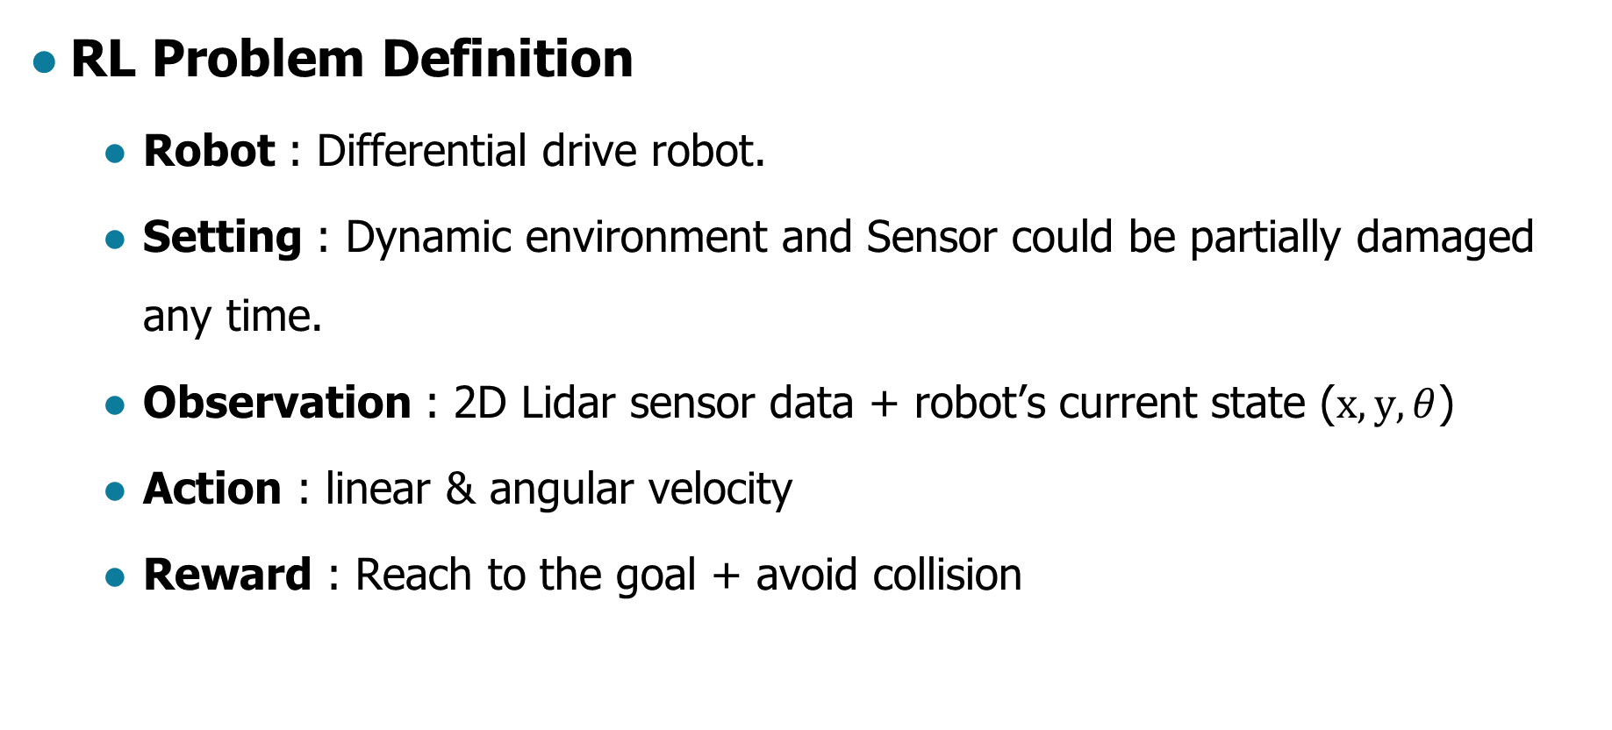
Our approach: Problem Modeling and RL
RL Problem Definition
  Robot : Differential drive robot.
  Setting : Dynamic environment and Sensor could be partially damaged any time.
  Observation : 2D Lidar sensor data + robot’s current state ($x,y, θ$)
  Action : linear & angular velocity
  Reward : Reach to the goal + avoid collision

Slide 19

Our approach: Novel Architecture
Observation embeddings
Partition
Conv1
Attention
Module
Conv1
Conv2
FC
Stacked
LIDAR observation
Conv2
Conv3
FC
LSTM
FC
…
…
Output
ConvK
Linear &
Angular velocity
Robot’s state
FC
Goal location
from current state

Slide 20
Our approach: Novel Architecture
Stacking N frames of sequential sensor input
Partitioning stacked sensor data into K splits
N
Stacked N frames of sensor data
(Robust to temporal occlusion)

Slide 21
Our approach: Novel Architecture
Stacking N frames of sequential sensor input
Partitioning stacked sensor data into K splits
…
N
Stacked N frames of sensor data
(Robust to temporal occlusion)
…
K

Slide 22




Our approach: Novel Architecture
Apply the individual CNNs into the K splits of partitioned sensor data.
Conv1
$$F_{1}$$
Conv2
$$F_{2}$$
K
Conv3
$$F_{3}$$
…
ConvK
$$F_{K}$$
Partitioned sensor data
Feature maps

Slide 23
Our approach: Novel Architecture
Extract attention weight at each partition
Feature Attention
Attention
Module
…
Conv1
$$F_{1}$$
Conv2
$$F_{2}$$
K
Conv3
$$F_{3}$$
…
ConvK
$$F_{K}$$
Partitioned sensor data
Feature maps

Slide 24
Our approach: Novel Architecture
Weighted sum of feature maps
Feature Attention
Attention
Module
…
Conv1
$$F_{1}$$
Conv2
$$F_{2}$$
K
Conv3
$$F_{3}$$
…
ConvK
$$F_{K}$$
Partitioned sensor data
Feature maps

Slide 25
Our approach: Novel Architecture
Observation embeddings
Partition
Conv1
Attention
Module
Conv1
Conv2
FC
Stacked
LIDAR observation
Conv2
Conv3
FC
LSTM
FC
…
…
Output
ConvK
Linear &
Angular velocity
Robot’s state
FC
Goal location
from current state

Slide 26
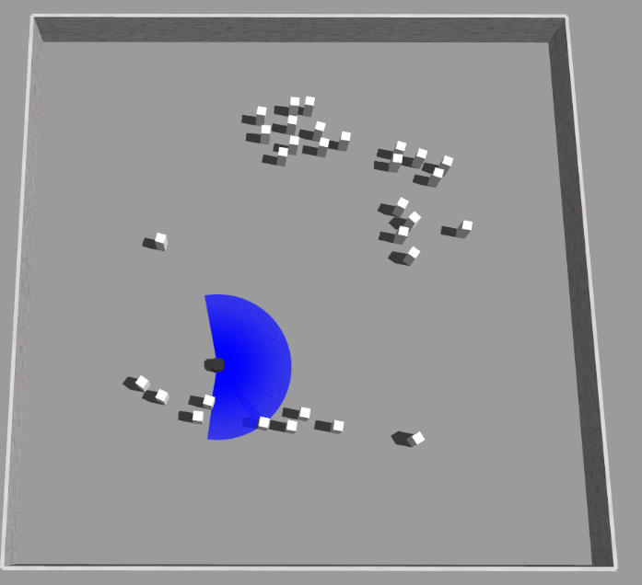
Our approach
Expected results
 | Navigation (without Ours) | Navigation (with Ours)
Collision rate | High | Low
Success(arrival) rate | Low | High
Without Ours
With Ours

Slide 27
Table of contents
Introduction & Research goal
Related Work
Background
Our approach
Current progress & Future work
Schedule & Role

Slide 28
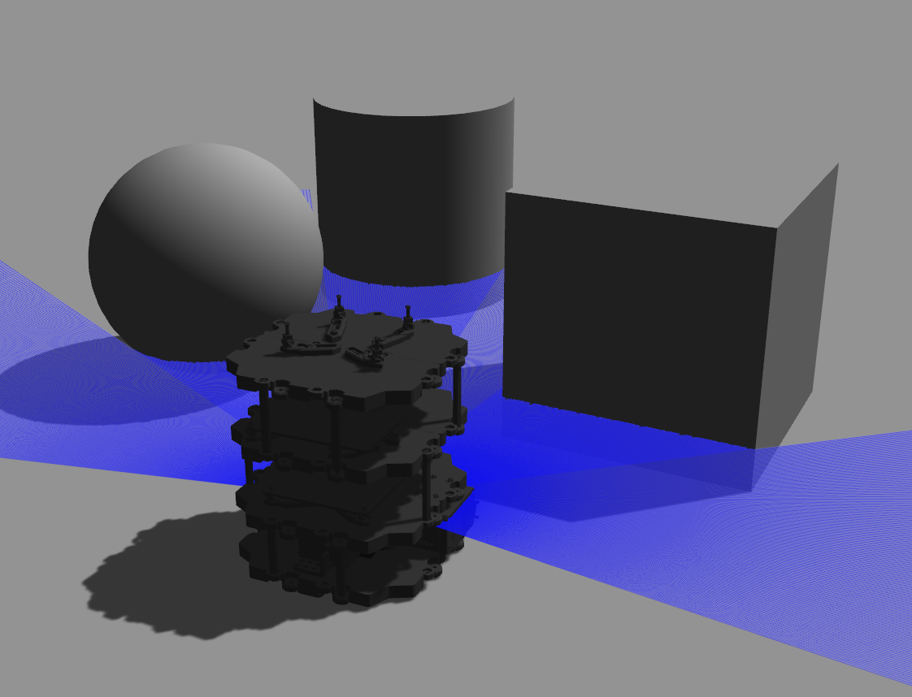
Current progress
Modeling robot with sensor

Slide 29
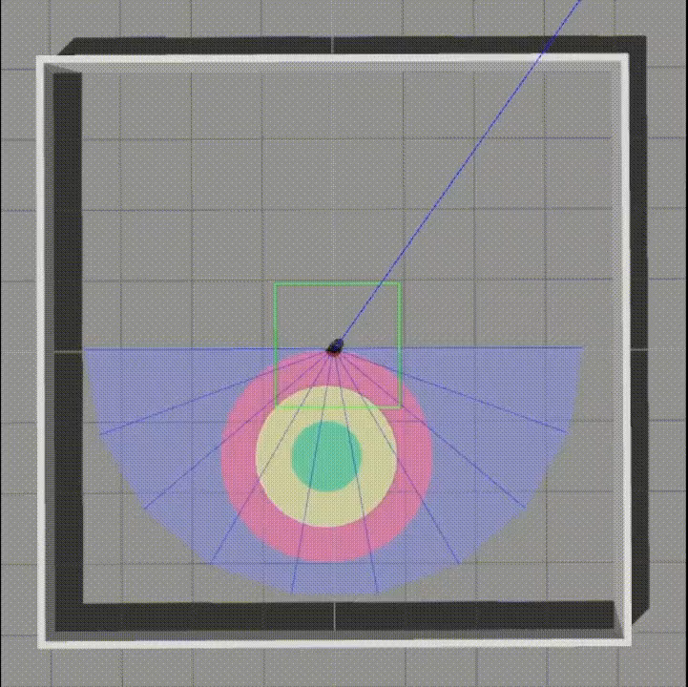
Current progress
Test RL agent in simple environment

Slide 30
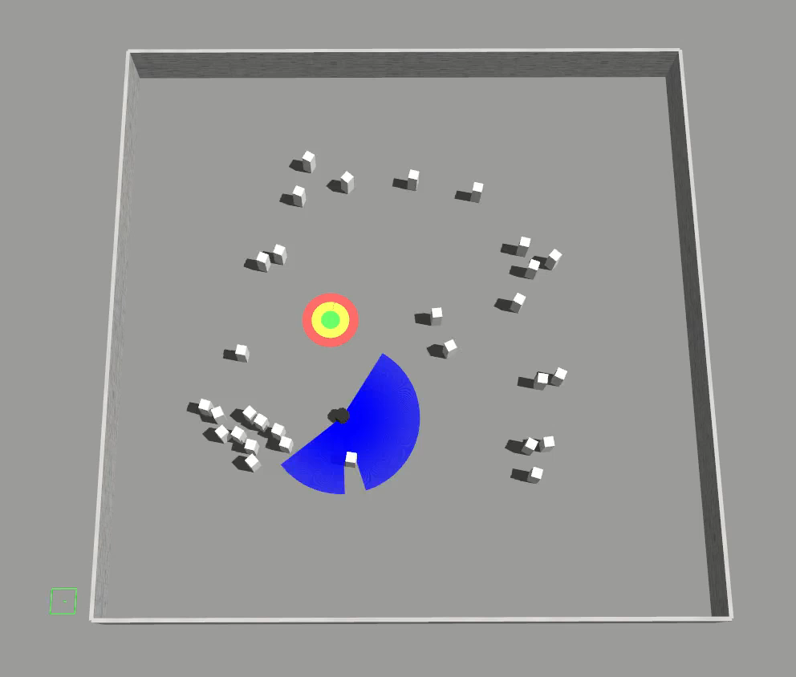
Current progress
Training RL agent in dynamic environment

Slide 31
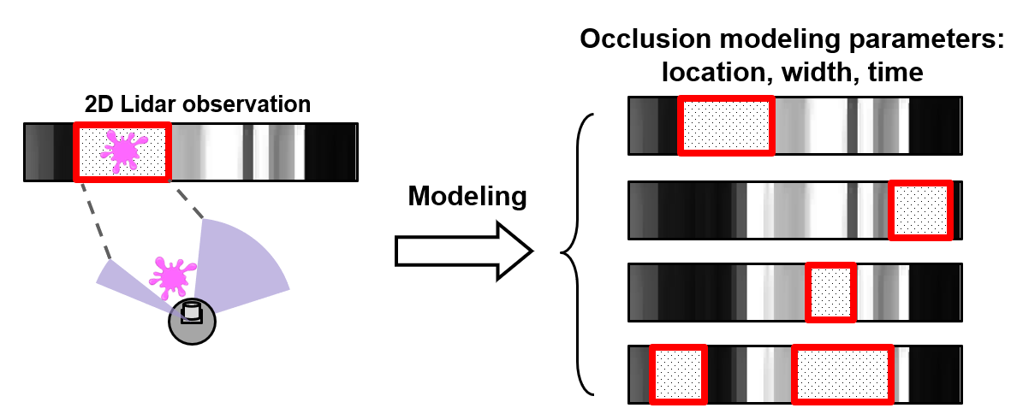
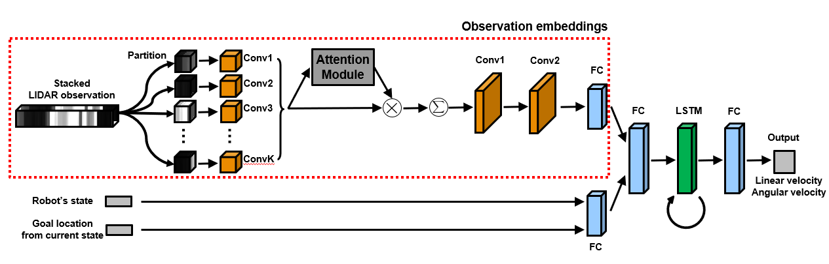
Future work
Problem modeling
Build novel architecture

Slide 32
Table of contents
Introduction & Research goal
Related Work
Background
Our approach
Current progress & Future work
Schedule & Role

Slide 33
Schedule & Role
 | ~10.27 | ~11.12 | ~11.19 | ~11.26 | ~12.03 | ~12.08
Survey problem
Build training environment
Mid-term presentation
Build architecture
Training RL agent
Testing & collecting results
Final presentation
today

Slide 34
Schedule & Role
 | Survey problem | Build training environment | Mid-term presentation | Build architecture | Defining reward function | Training RL agent | Testing & collecting results | Final presentation
Hyeongyeol | O | O | O |  |  | O | O | O
Minsung | O |  | O |  | O | O | O | O
Sebin | O |  | O | O |  | O | O | O

Slide 35
Reference
Papers
[1] J. Choi, K. Park, M. Kim and S. Seok, "Deep Reinforcement Learning of Navigation in a Complex and Crowded Environment with a Limited Field of View," 2019 International Conference on Robotics and Automation (ICRA), Montreal, QC, Canada, 2019, pp. 5993-6000, doi: 10.1109/ICRA.2019.8793979.
[2] T. Fan, P. Long, W. Liu, J. Pan, R. Yang and D. Manocha, "Learning Resilient Behaviors for Navigation Under Uncertainty," 2020 IEEE International Conference on Robotics and Automation (ICRA), Paris, France, 2020, pp. 5299-5305, doi: 10.1109/ICRA40945.2020.9196785.
[3] A. Faust et al., "PRM-RL: Long-range Robotic Navigation Tasks by Combining Reinforcement Learning and Sampling-Based Planning," 2018 IEEE International Conference on Robotics and Automation (ICRA), Brisbane, QLD, 2018, pp. 5113-5120, doi: 10.1109/ICRA.2018.8461096.
[4] J. Jin, N. M. Nguyen, N. Sakib, D. Graves, H. Yao and M. Jagersand, "Mapless Navigation among Dynamics with Social-safety-awareness: a reinforcement learning approach from 2D laser scans," 2020 IEEE International Conference on Robotics and Automation (ICRA), Paris, France, 2020, pp. 6979-6985, doi: 10.1109/ICRA40945.2020.9197148.
[5] F. Leiva and J. Ruiz-del-Solar, "Robust RL-Based Map-Less Local Planning: Using 2D Point Clouds as Observations," in IEEE Robotics and Automation Letters, vol. 5, no. 4, pp. 5787-5794, Oct. 2020, doi: 10.1109/LRA.2020.3010732.
[6] C. Chen, Y. Liu, S. Kreiss and A. Alahi, "Crowd-Robot Interaction: Crowd-Aware Robot Navigation With Attention-Based Deep Reinforcement Learning," 2019 International Conference on Robotics and Automation (ICRA), Montreal, QC, Canada, 2019, pp. 6015-6022, doi: 10.1109/ICRA.2019.8794134.
[7] Jin, Jun, et al. "Mapless Navigation among Dynamics with Social-safety-awareness: a reinforcement learning approach from 2D laser scans." 2020 IEEE International Conference on Robotics and Automation (ICRA). IEEE, 2020.
[8] Gao, Wei, et al. "Intention-net: Integrating planning and deep learning for goal-directed autonomous navigation." arXiv preprint arXiv:1710.05627 (2017).
[9] Everett, Michael, Yu Fan Chen, and Jonathan P. How. "Motion planning among dynamic, decision-making agents with deep reinforcement learning." 2018 IEEE/RSJ International Conference on Intelligent Robots and Systems (IROS). IEEE, 2018.
Media Contents
[1] Professionelle mobile Service-Roboter - MetraLabs
[2] HoLLiE Mobile Service Robot Can Bend to Reach the Floor – roboticgizmos
[3] https://www.artificialinventive.com/blog/
[4] https://developer.softbankrobotics.com/blog/crowdbot-safe-navigation-robots-dense-crowds

Slide 36
Thank you for watching
Hope you enjoyed! 🤣
Q & A

