Slide 1
Learning-based path planning for Aerial Multi-View Stereo Reconstruction
Team 3:
20204513 Hochang Lee
20194195 Truong Giang Khang
2020.11.16

Slide 2
Contents
Introduction
Related Works
Our Approach
Current Progress
Future Works

Slide 3
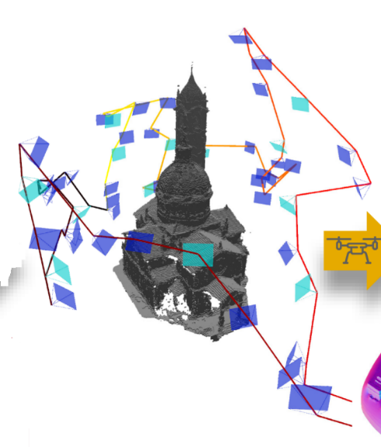
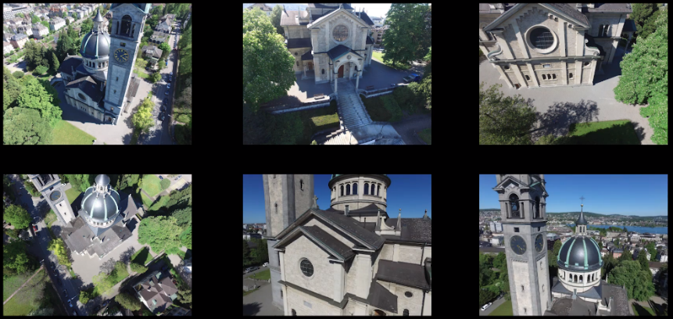
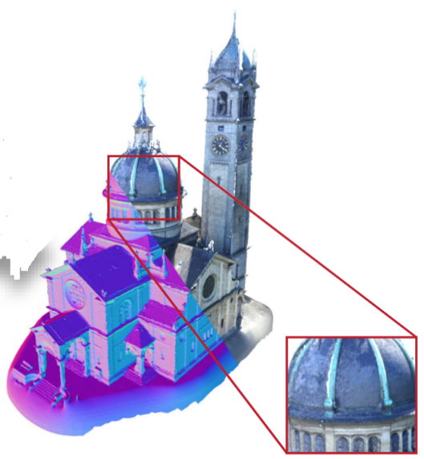
Introduction : Overview
Overview of 3D Aerial Scanning:
Captured 2D images
Images Captured
By drones
View selection
& Path planning
Reconstruction Pipeline
Reconstructed 3D model

Slide 4


Introduction : View Selection & Path Planning
Our study is focused on :
  View selection and path planning: Choose View points and design an Optimal trajectory for drones to capture the images that can produce a high-quality 3D model
  Optimal trajectory: Minimum travel budget.
Images Captured
By drones
Optimal trajectory
2D images

Slide 5

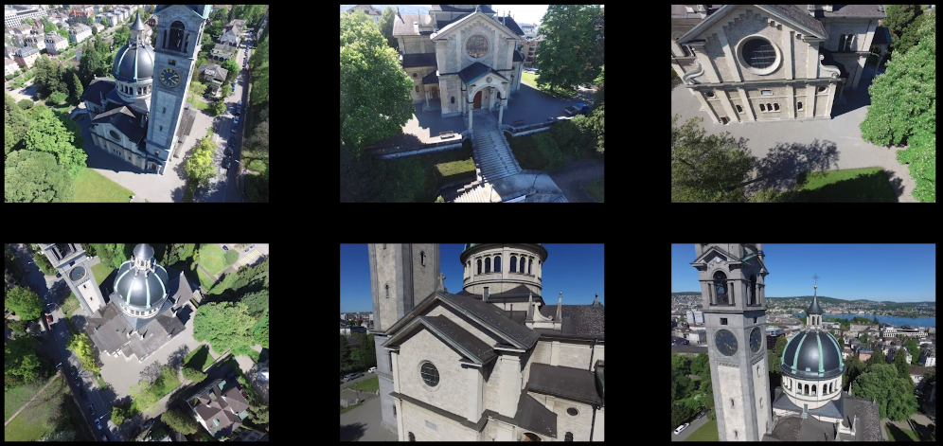
Introduction : 3D Reconstruction
3D Reconstruction: take a set of images as input and produce a 3D model of scene
Reconstruction Pipeline: COLMAP [1], DL-based [2]
Reconstruction Pipeline
Captured 2D images
Reconstructed 3D model

Slide 6
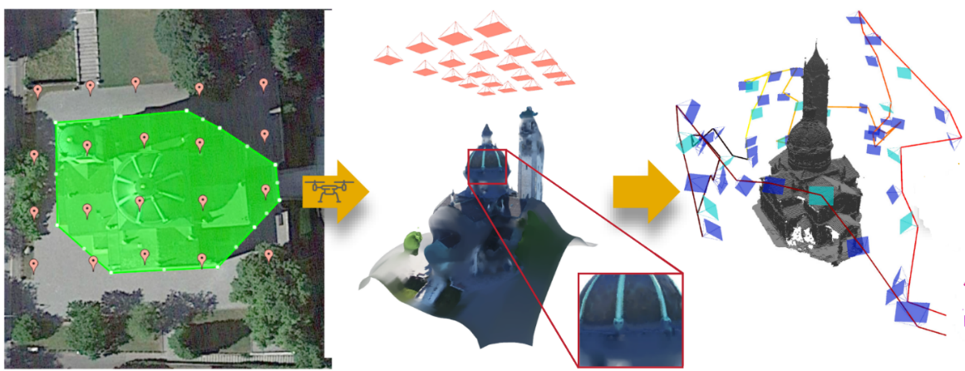
Related Works : Common Approach
Explore-then-Exploit:
  Explore: Generate a coarse estimate of scene geometry and scene’s free space
    Fly drone along a default trajectory
    Put acquired images to 3D reconstruction pipeline
  Exploit: Use the acquired information above as input
    Design a utility function based on heuristic
    Generate trajectory by maximizing the utility function, respecting limited travel budget.
Initial trajectory
Coarse 3D model
Optimal trajectory
explore
exploit

Slide 7
Related Works : Studies
Robert et al. [3]: utility function is a coverage model, each view point gives a coverage region on surface. submodular property.
Smith et al. [4]: heuristic function built from 3 observations of multi-views reconstruction. Use a continuous optimization to maximize this function
Benjamin et al. [5]: submodular function but using a different optimization strategy.
Benjamin et al. [6]: Utility Function to uncover unknown areas, based on Deep Learning (end-to-end)

Slide 8
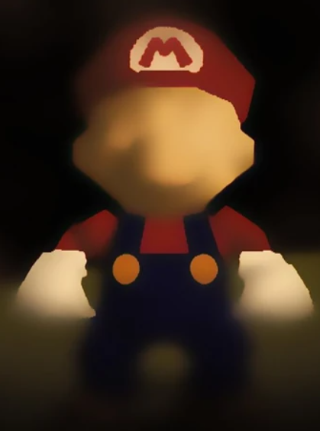
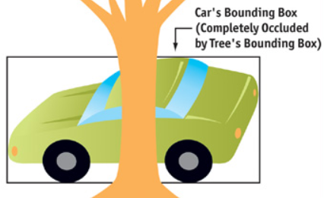
Our Approach : Overview
Existing approaches: Define heuristic scores between each view point and surface point
However, this approach may not be applicable in cases the surface is textureless or has occlusions
Therefore, instead of predefining the rules, we switch over to learning based approaches
Textureless
Occlusion

Slide 9
Our Approach : Overview
Our Method: Predict “Reconstructability” score for each view by using a DL network
Reconstructability: Serve as a proxy for the accuracy of surface estimate produced by each view
  This concept is first defined in [5] but it is used to select subset of pixels instead of whole image for Multi-View Stereo (MVS)
  → Accelerating MVS

Slide 10
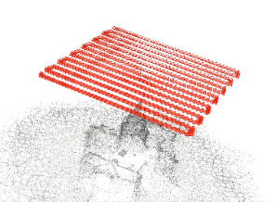
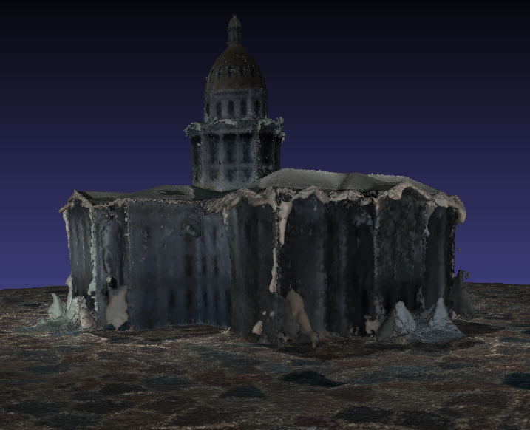
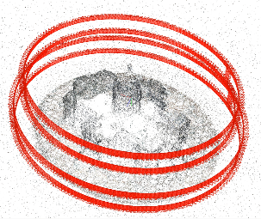
Our Approach : Explore-then-Exploit
Coarse 3D model
Explore
Default Trajectory
Exploit
Optimal trajectory and 3D reconstruction models
Grid view points
Path planning
Heuristic Approach to Select View Points for Path Planning
- User Made Utility Function are used to guess how useful each view points are at discovering unknown surfaces

Slide 11
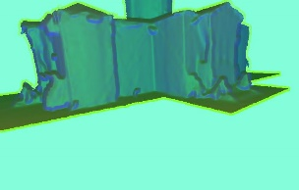
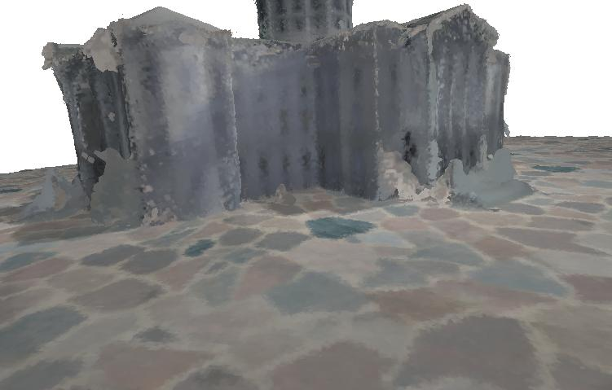
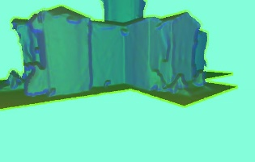
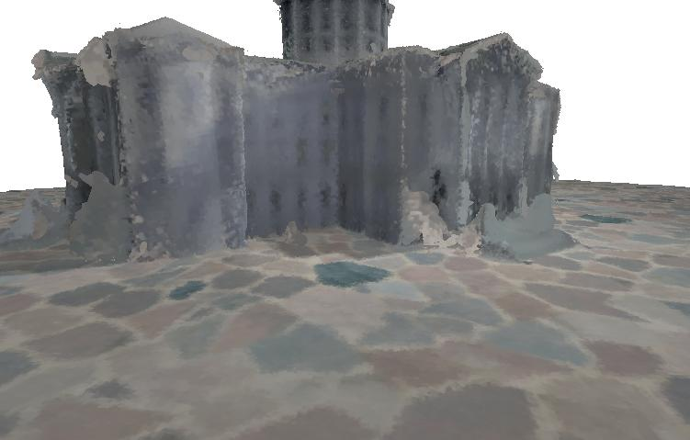
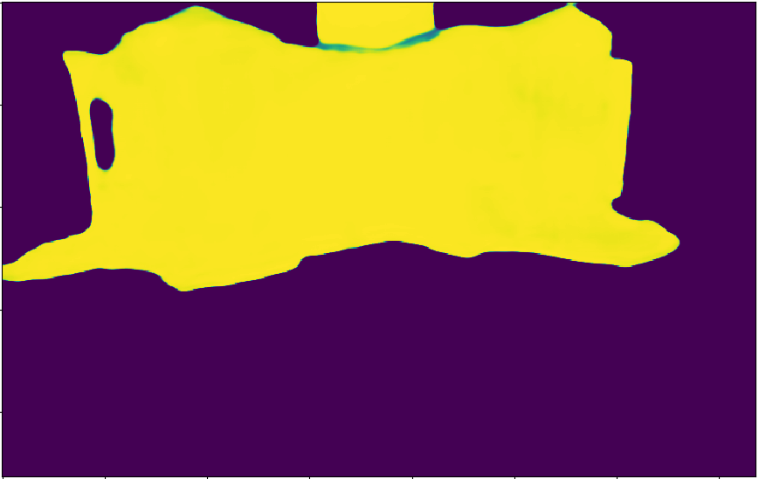
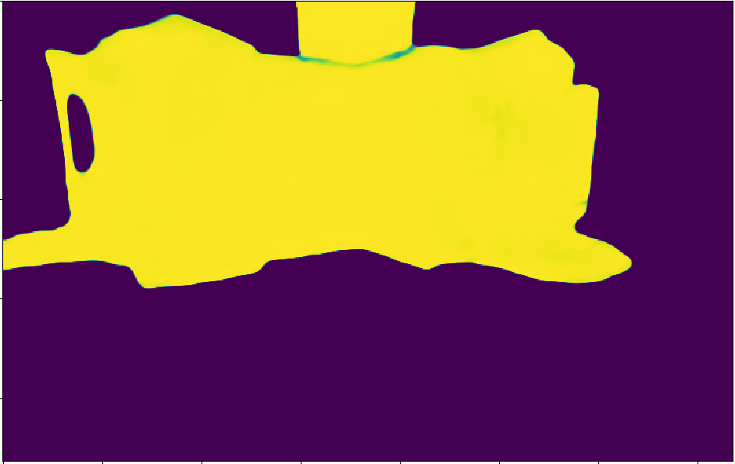
Our Approach : Explore-then-Exploit
Coarse 3D model
Explore
Default Trajectory
Exploit
Optimal trajectory and 3D reconstruction models
Grid view points
Path planning
Deep learning model
Depth + normal features rendered from coarse model
Images rendered from coarse model
Predicted reconstructability score maps

Slide 12
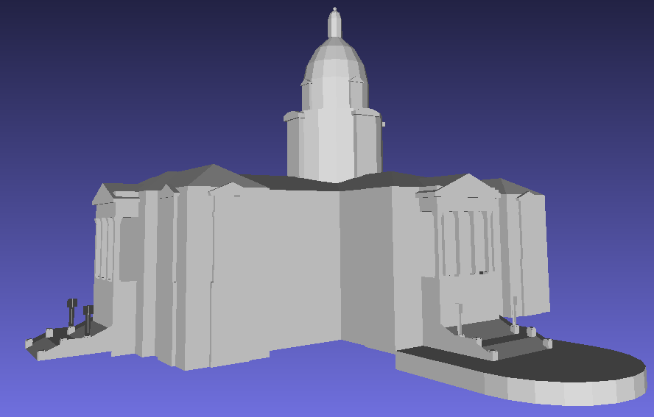
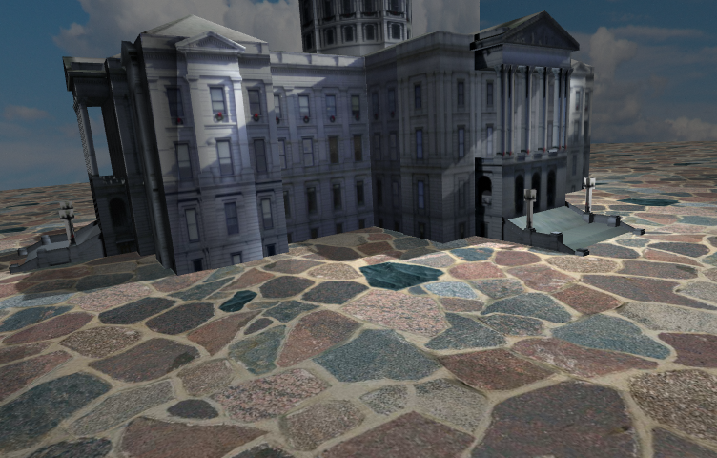
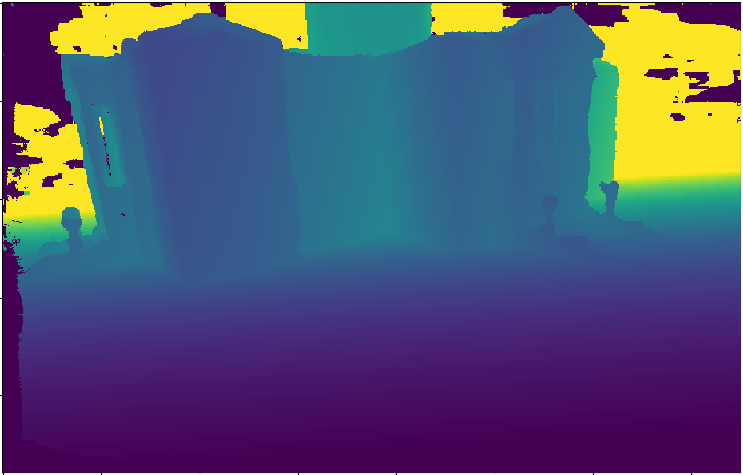

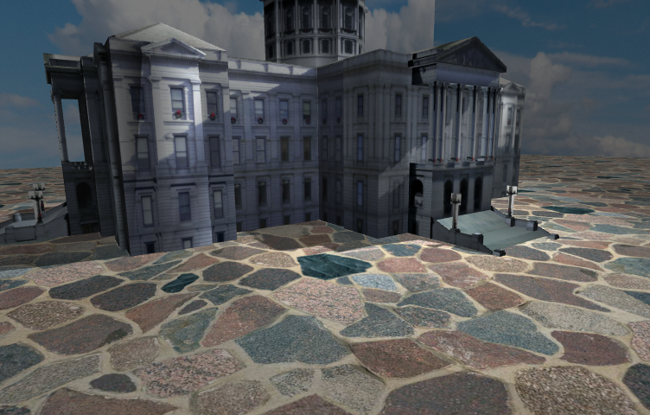
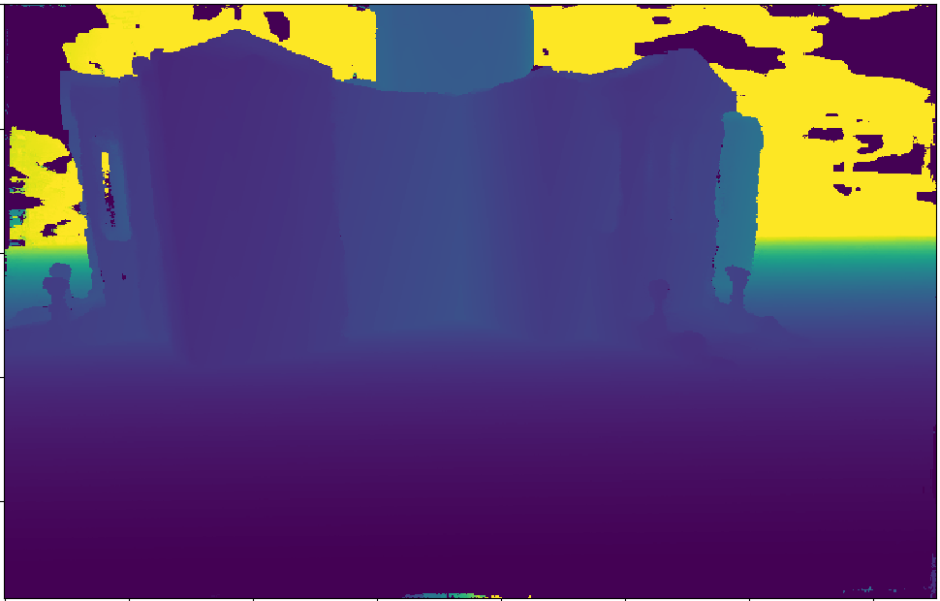

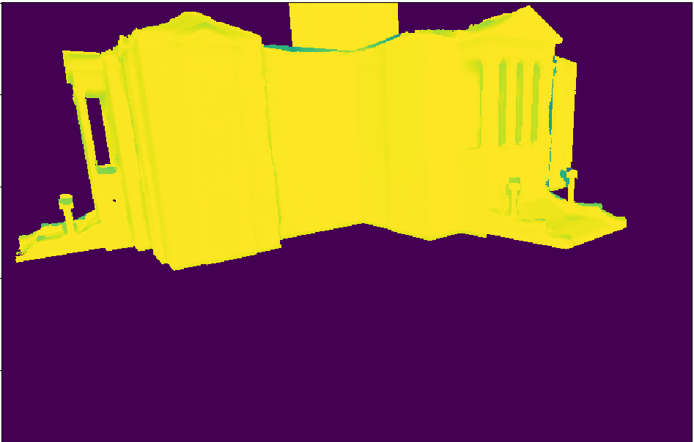
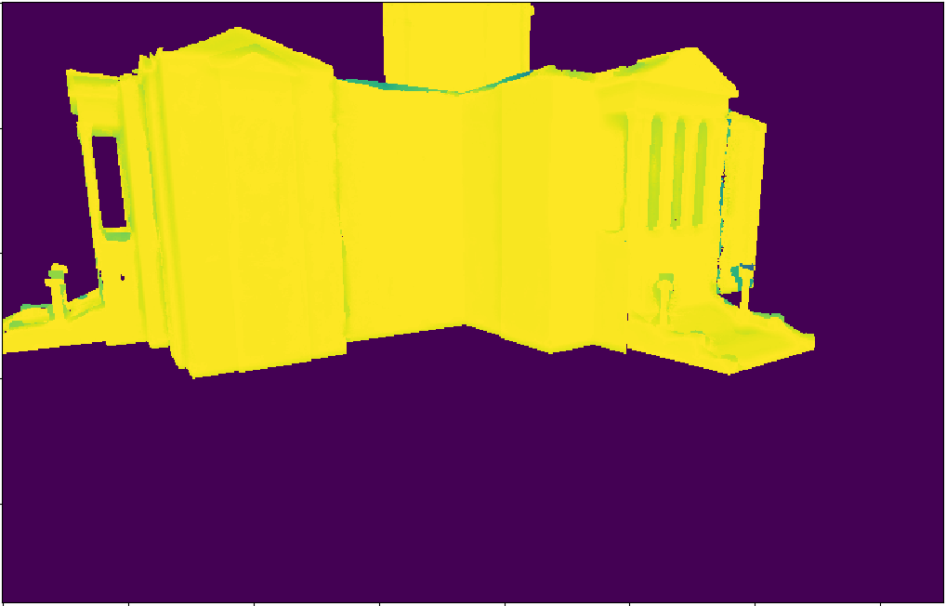
Our Approach : Training
Coarse model
Ground truth (GT) model
Depth maps rendered from GT
Images rendered from GT model
Depth maps estimated by COLMAP
dcdcdcdcd
GT score maps
MSE loss
Deep learning model
Depth + normal features rendered from coarse model
Images rendered from coarse model
Predicted score maps
Training model

Slide 13
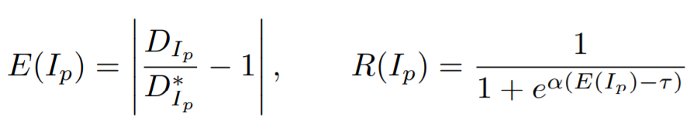
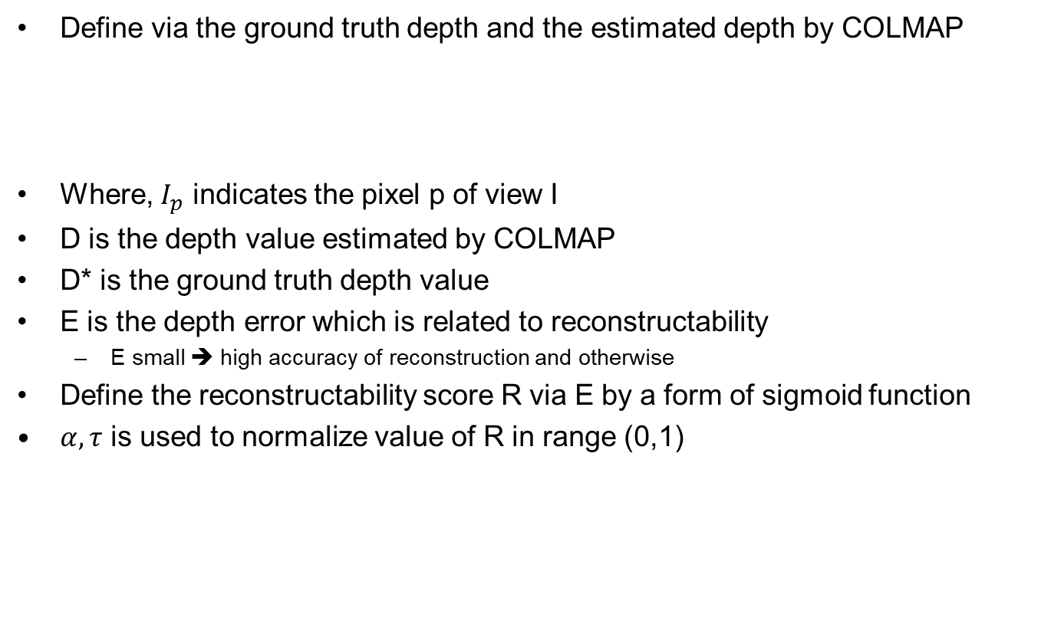
Our Approach : Reconstructability Score
Define via the ground truth depth and the estimated depth by COLMAP
Where, $I_{p}$ indicates the pixel p of view I
D is the depth value estimated by COLMAP
D* is the ground truth depth value
E is the depth error which is related to reconstructability
  E small ➔ high accuracy of reconstruction and otherwise
Define the reconstructability score R via E by a form of sigmoid function
$α, τ$ is used to normalize value of R in range (0,1)

Slide 14
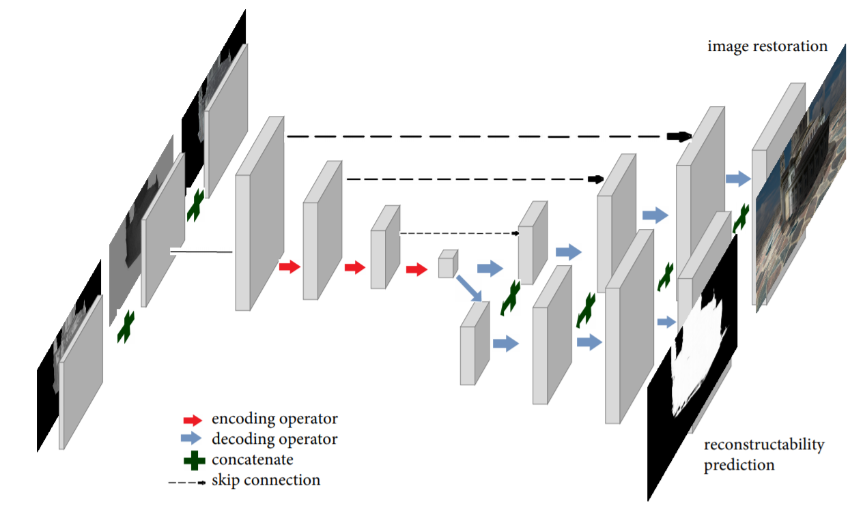
Our Approach : Network Architecture - RecNet
4 encoding blocks
4 decoding blocks for image restoration
4 decoding blocks for Reconstructability
1st encoding block: 3 sub-block, each for extract features in each input information
Each features block is downsampling, then is concatenated to forward to the next encoding block

Slide 15
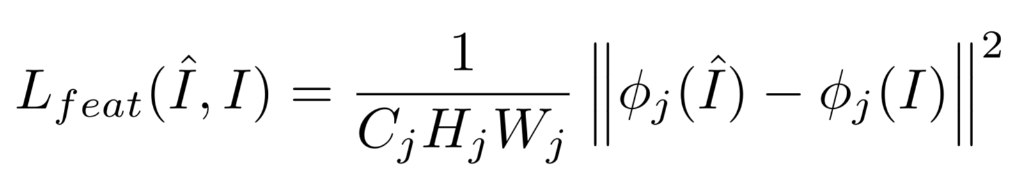

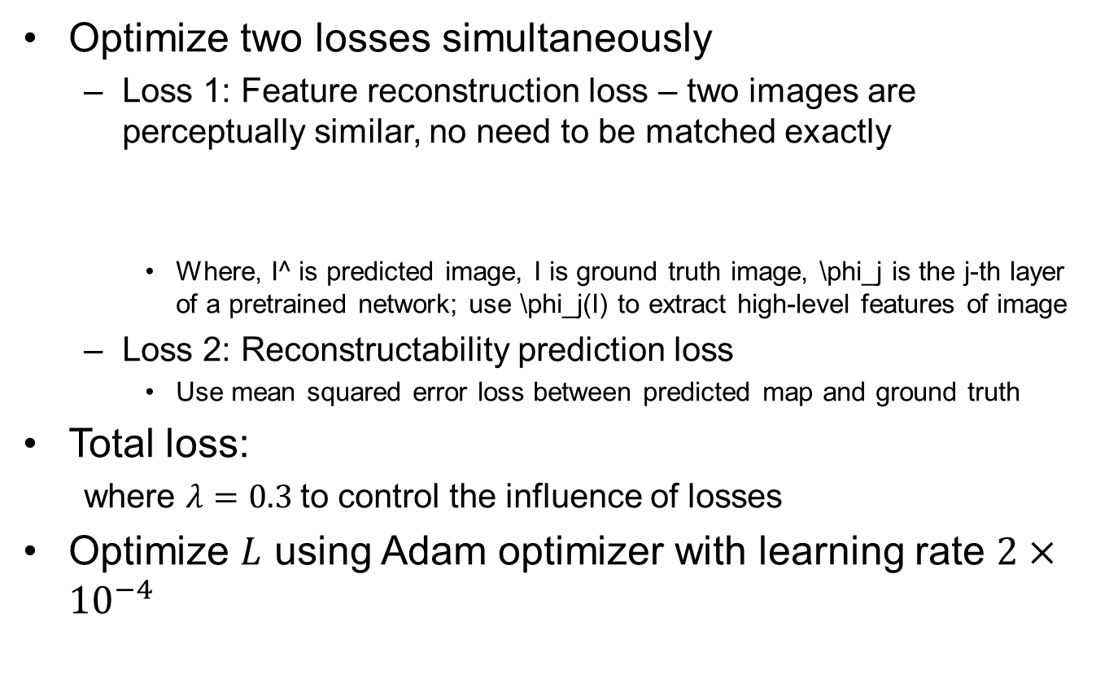
Our Approach : Loss Function
Optimize two losses simultaneously
  Loss 1: Feature reconstruction loss – two images are perceptually similar, no need to be matched exactly
    Where, I^ is predicted image, I is ground truth image, \phi_j is the j-th layer of a pretrained network; use \phi_j(I) to extract high-level features of image
  Loss 2: Reconstructability prediction loss
    Use mean squared error loss between predicted map and ground truth
Total loss:
  where $λ=0.3$to control the influence of losses
Optimize $L$ using Adam optimizer with learning rate $2×{10}^{−4}$

Slide 16
Our Approach : Prediction
Coarse 3D model
Explore
Default Trajectory
Exploit
Optimal trajectory and 3D reconstruction models
Grid view points
Path planning
Deep learning model
Depth + normal features rendered from coarse model
Images rendered from coarse model
Predicted reconstructability score maps

Slide 17
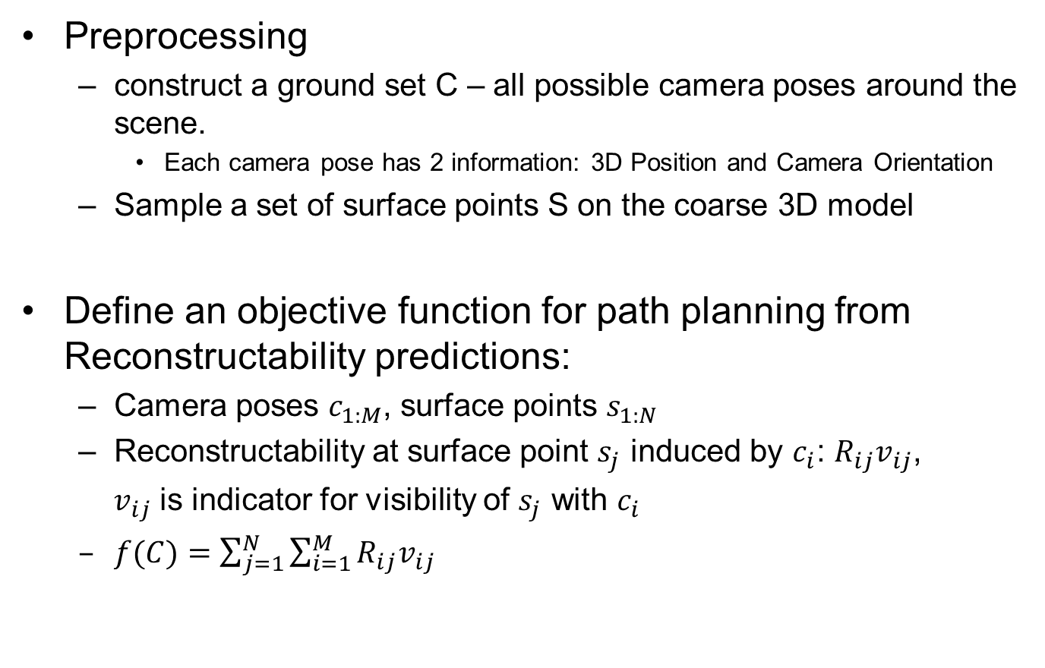
Our Approach : Path planning
Preprocessing
  construct a ground set C – all possible camera poses around the scene.
    Each camera pose has 2 information: 3D Position and Camera Orientation
  Sample a set of surface points S on the coarse 3D model
Define an objective function for path planning from Reconstructability predictions:
  Camera poses $c_{1:M}$, surface points $s_{1:N}$
  Reconstructability at surface point $s_{j}$ induced by $c_{i}$: $R_{ij}v_{ij}$,
  $v_{ij}$ is indicator for visibility of $s_{j}$ with $c_{i}$
  $f(C)=\sum_{j=1}^{N}{\sum_{i=1}^{M}{R_{ij}v_{ij}}}$

Slide 18
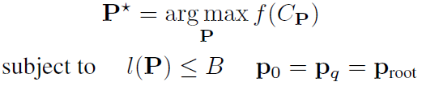
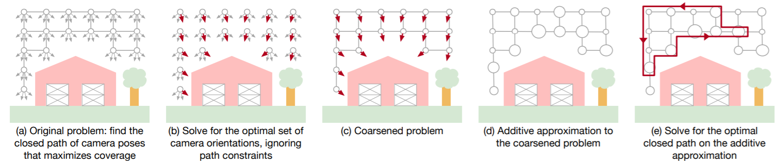

Our Approach : Path planning
P is a trajectory, P = (p₀, u₀), (p₁, u₁),…,(p_{q}, u_{q}), where $p_{k}$ is camera position, $u_{k}$ is camera orientation
Find optimal path P*:
(C_{P} $⊆$C)
Similar to [3], use algorithm in [3] to solve this problem.

Slide 19
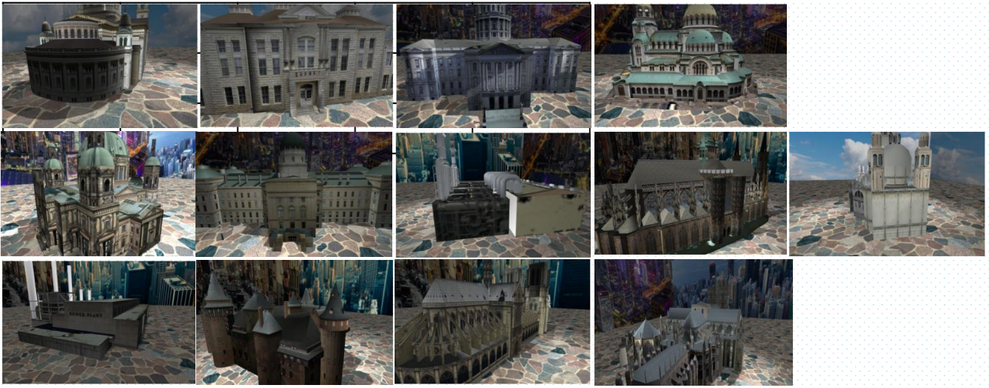
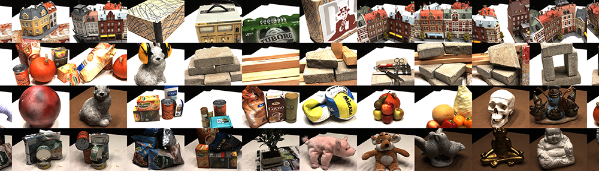
Current Progress
Generate dataset for training and test:
  Simulation dataset - Training : 9 Scenes & Testing : 4 Scenes
  DTU dataset – Training : 97 scenes & Testing : 22 scenes

Slide 20
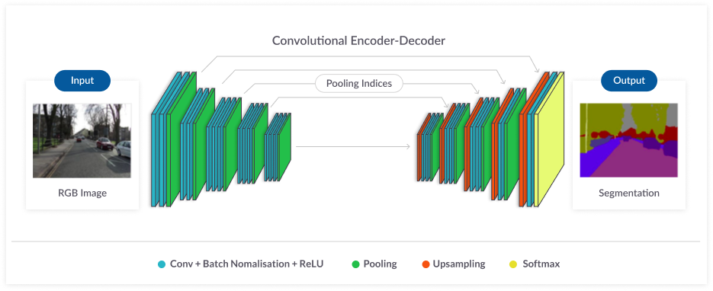
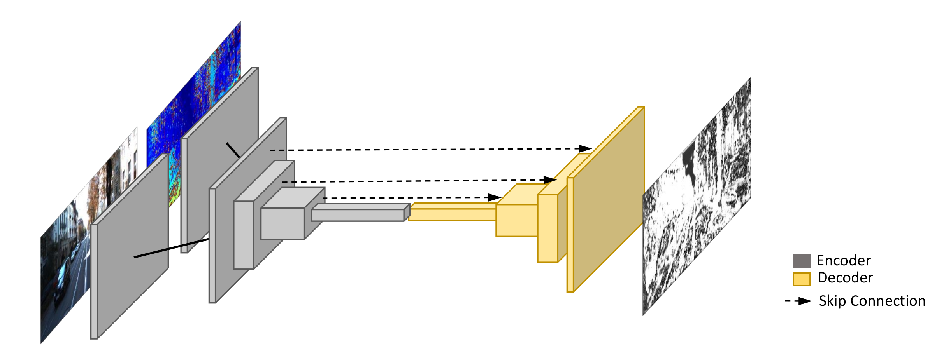

Current Progress
Implementation and evaluation for RecNet:
  Compare with other baselines: Unet [7] and ConfNet [8]
  Evulation metrics: mean absolute error (MAE) and root mean square error (RMSE)
  Finish all implementations but need to tune parameters for RecNet
  Expectation result: better
Unet [7]
ConfNet [8]
RecNet (Ours)

Slide 21
Future Works
Implementation and evaluation for path planning:
  Implement path planning algorithm (possibly refer to [3])
  Baselines for comparison: the other heuristic-based path planning approaches (source code available)
  Evaluation metrics: accuracy and completeness of 3D model results.

Slide 22
Schedule & Roles
 | < 10.29 | ~11.17 | ~11.24 | ~12.01 | ~12.08
Survey problem
Propose novel architecture RecNet
Generate dataset
Mid-term presentation
Implement path planning
Training and test RecNet
Evaluate path planning
Final presentation

Slide 23
Schedule & Roles
 | Survey Problem | Propose Novel Architecture RecNet | Generate Dataset | Progress Presentation | Implement Path Planning | Training & Testing RecNet | Path Planning Evaluation | Final Presentation
Hochang | x |  | x | x | x |  | x | x
Khang | x | x |  | x |  | x | x | x

Slide 24
References
https://colmap.github.io/
Yao, Yao, et al. "Mvsnet: Depth inference for unstructured multi-view stereo." Proceedings of the European Conference on Computer Vision (ECCV). 2018.
Roberts, Mike, et al. "Submodular trajectory optimization for aerial 3d scanning." Proceedings of the IEEE International Conference on Computer Vision. 2017.
Smith, Neil, et al. "Aerial path planning for urban scene reconstruction: a continuous optimization method and benchmark." (2018).
Hepp, Benjamin, Matthias Nießner, and Otmar Hilliges. "Plan3d: Viewpoint and trajectory optimization for aerial multi-view stereo reconstruction." ACM Transactions on Graphics (TOG) 38.1 (2018): 1-17.
Hepp, Benjamin, et al. "Learn-to-score: Efficient 3d scene exploration by predicting view utility." Proceedings of the European Conference on Computer Vision (ECCV). 2018.
Ronneberger, Olaf, Philipp Fischer, and Thomas Brox. "U-net: Convolutional networks for biomedical image segmentation." International Conference on Medical image computing and computer-assisted intervention. Springer, Cham, 2015.
Tosi, Fabio, et al. "Beyond local reasoning for stereo confidence estimation with deep learning." Proceedings of the European Conference on Computer Vision (ECCV). 2018.

