Slide 1
CS686: Robot Motion Planning and Applications
Curiosity Driven Learning with Imagination
Changho Jo
(조창호)
Notes:
1

Slide 2
Index
Introduction
Problem
Goal
Approach
To do

Slide 3
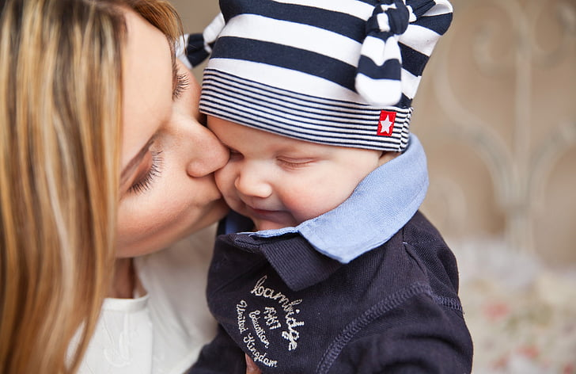
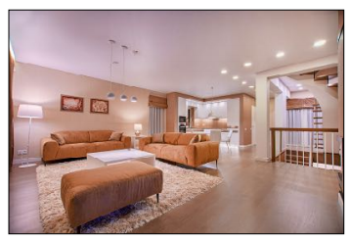
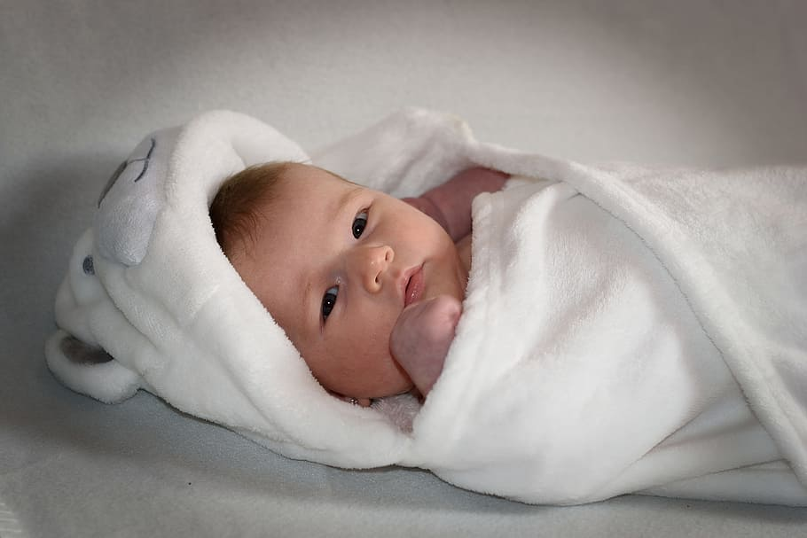
Introduction
How human finds a spoon?
We want a robot to do the same.
Bring me a spoon!
https://www.youtube.com/watch?v=b73PMajVVS8&feature=emb_logo
https://www.pxfuel.com/en/free-photo-oqnrr
https://www.pickpik.com/mother-daughter-family-girl-woman-female-89977

Slide 4
Introduction
How RL find the goal?
Pure trials & errors
https://www.youtube.com/watch?v=eOuonMhEsxI: Target-driven Visual Navigation in Indoor Scenes using Deep Reinforcement Learning, ICRA 2017, Yuke Zhu

Slide 5
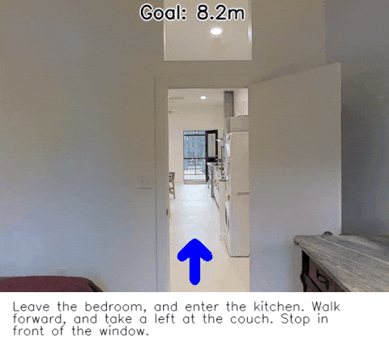
Introduction
How RL find the goal?
Pure trials & errors
Vision-and-Language Navigation: Interpreting visually-grounded navigation instructions in real environments, CVPR 2018, Peter Anderson

Slide 6
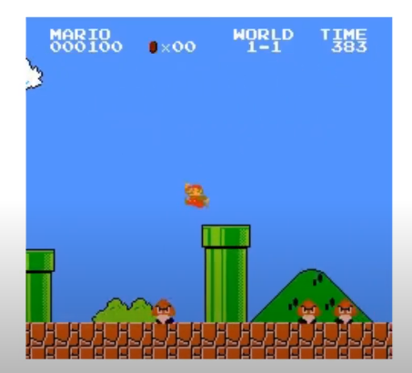
Introduction
How RL find the goal?
Curiosity
https://github.com/openai/large-scale-curiosity

Slide 7
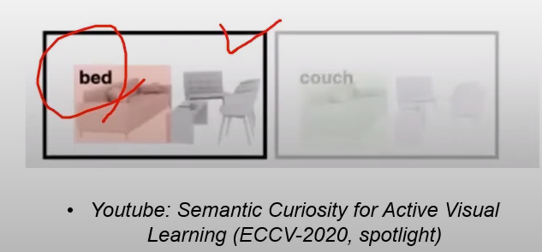
Introduction
How RL find the goal?
Curiosity
Keep finding “different things”

Slide 8
Problem
But we were smarter and lazier than robots like this.
We usually don’t make 10^7~10^8 attempts to get to the sofa
We were somehow better than these, because we have understood of some environments(ex. house).

Slide 9
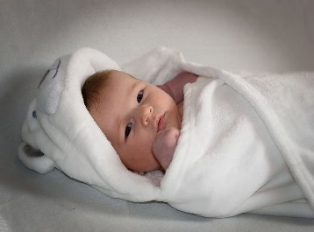
Goal
Use scene understanding as prior knowledge, to navigate better
Bring me a spoon!
https://www.youtube.com/watch?v=b73PMajVVS8&feature=emb_logo
https://www.pxfuel.com/en/free-photo-oqnrr
https://www.pickpik.com/mother-daughter-family-girl-woman-female-89977

Slide 10
Approach
Our intrinsic ability of semantic extrapolation

Slide 11
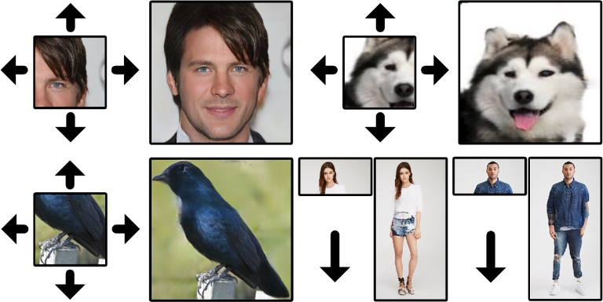
Approach
Wide-Context Semantic Image Extrapolation(Yi Wang, CVPR 2019)

Slide 12
Wide-Context Semantic Image Extrapolation(Yi Wang, CVPR 2019)
Network learns semantics of GT from semantics of input image
Feature expansion operator: Expand semantics(feature)
Context normalization: Corresponds semantics of GT to expanded feature

Slide 13
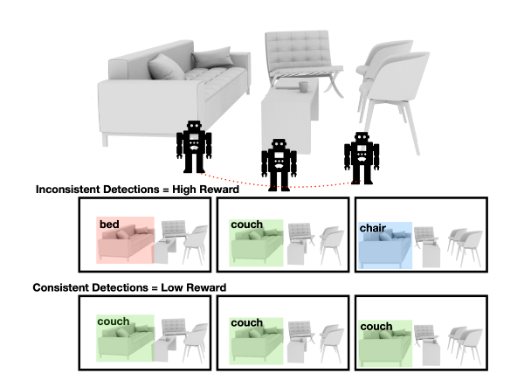
Approach
First plan: As a reward of curiosity-based house navigation task, use trained semantic extrapolation network
Devendra Singh Chaplot, Semantic Curiosity for Active Visual Learning. ECCV 2020

Slide 14
Approach
More harder version of Large-scale-curiosity
Semantic extrapolation
Large-Scale-Curiosity
https://github.com/openai/large-scale-curiosity

Slide 15
To do
Tested Large-Scale-Curiosity network(done)
Add semantic extrapolation network as a reward of Large-Scale-Curiosity(doing now)
Pretrain semantic extrapolation network
Visualize the difference

Slide 16
To do

