Slide 1
Radiative Transfer & Volume Path Tracing
CS295, Spring 2017
Shuang Zhao Computer Science Department University of California, Irvine
Modified from the original slides

Slide 2
Today’s Lecture
Radiative transfer
  The mathematical model to simulate light scattering in participating media (e.g., smoke) and translucent materials (e.g., marble and skin)
Volume path tracing (VPT)
  A Monte Carlo solution to the radiative transfer problem
  Similar to the normal PT from previous lectures

Slide 3
Radiative Transfer
CS295: Realistic Image Synthesis

Slide 4
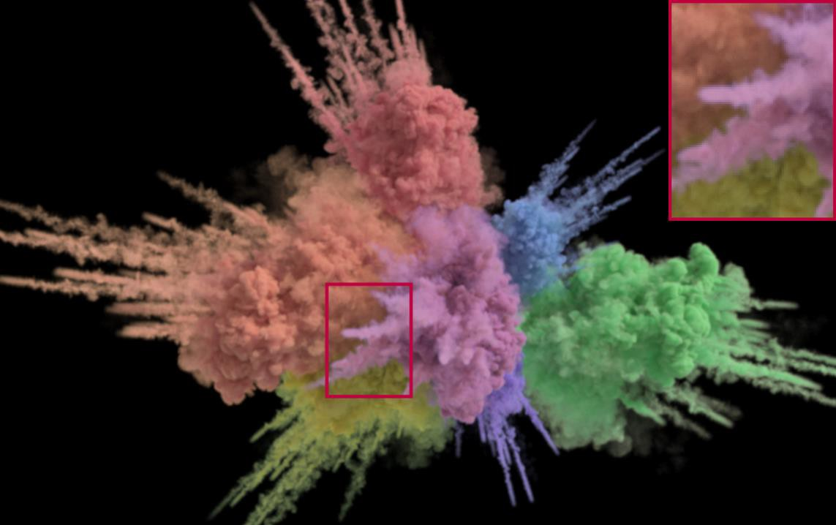
Participating Media
[Kutz et al. 2017]

Slide 5
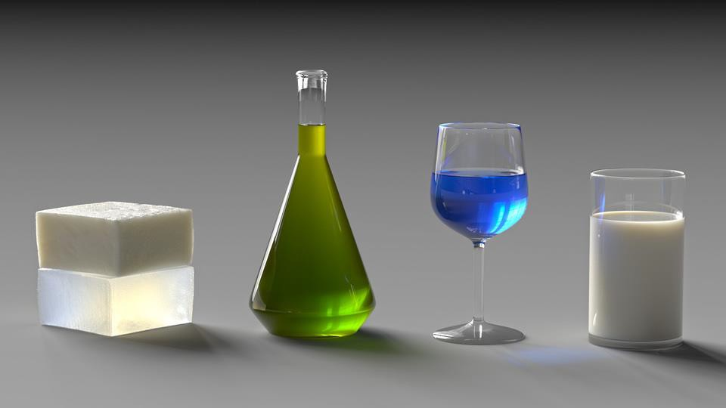
Translucent Materials
[Gkioulekas et al. 2013]

Slide 6
Subsurface Scattering
Light enters a material and scatters around
before eventually leaving or absorbed
X Absorbed
Participating medium

Slide 7
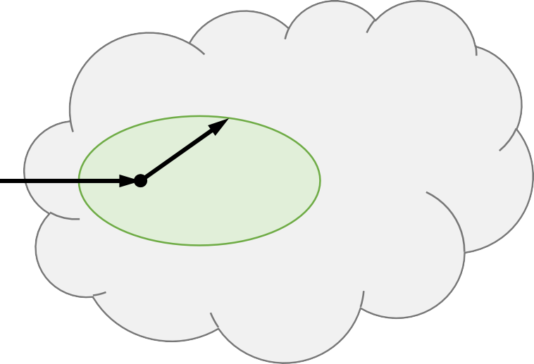
Subsurface Scattering
Light enters a material and scatters around
before eventually leaving or absorbed
Scattered
Participating medium

Slide 8
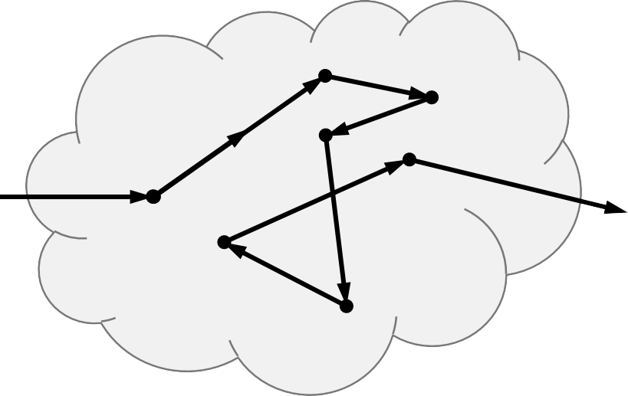
Subsurface Scattering
Light enters a material and scatters around
before eventually leaving or absorbed
Participating medium

Slide 9
Can we use the rendering equation?
Radiance is not constant for each ray segment!
We need to consider how the radiance change during the ray segment
Participating medium

Slide 10
Radiative Transfer
A mathematical model describing how light
interacts with participating media
  Originated in physics
  Now used in many areas
    Astrophysics (light transport in space)
    Biomedicine (light transport in human tissue)
    Graphics
    Nuclear science & engineering (neutron transport)
    Remote sensing
    …

Slide 11
Radiative Transfer Equation (RTE)
Focus on how radiance changes at each point and direction
Consider , not

Slide 12
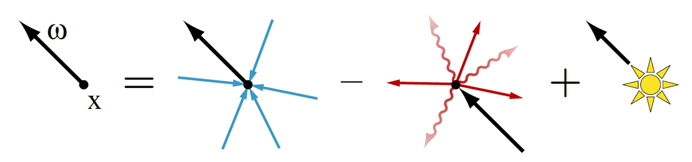
Radiative Transfer Equation (RTE)
Differential radiance
In-scattering
Out-scattering & absorption
Emission
In-scattering
Out-scattering Emission & absorption

Slide 13




Radiative Transfer Equation (RTE)
In-scattering
Out-scattering Emission
& absorption
The RTE is a first-order integro-differential equation
For a participating medium in a volume with boundary , the RTE governs the radiance values inside this volume (i.e., for all )
The boundary condition is the radiance field on the boundary (i.e., L(x, ω) for all )

Slide 14





Radiative Transfer Equation (RTE)
In-scattering
Out-scattering Emission
& absorption
Differential radiance
Scattering coefficient:
Phase function:
given x and ω_{i}
Extinction coefficient:
Source term:
,
, a probability density over

Slide 15
Radiative Transfer Equation (RTE)
In-scattering
Out-scattering Emission
& absorption
σ_{t} controls how frequently light scatters and is also
known as the optical density
The ratio between σ_{s} and σ_{t} controls the fraction of radiant energy not being absorbed at each scattering and is also known as the single-scattering albedo

Slide 16
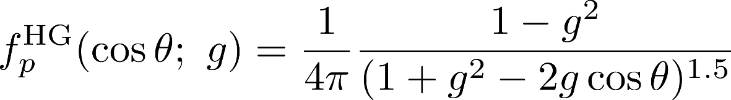
Radiative Transfer Equation (RTE)
In-scattering
Out-scattering Emission
& absorption
The phase function f_{p} is usually parameterized as a
function on the angle between ω_{i} and ω. Namely,
Example: the Henyey-Greenstein (HG) phase function
with parameter -1 < g < 1 (more forward scattering):

Slide 17
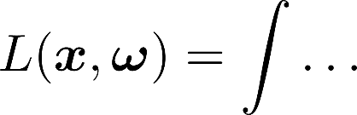
The Integral Form of the RTE
Integro-differential equation
Integral equation
It is desirable to rewrite the RTE as an integral equation
  which can then be solved numerically using Monte Carlo
methods

Slide 18











Integral Form of the RTE
For any
, let h(x, ω) denotes the minimal
distance for the ray (x, -ω) to hit the boundary . In other words,
When (x, -ω) never hits the boundary,
  This can happen when the volume is infinite
For any with
, let

Slide 19


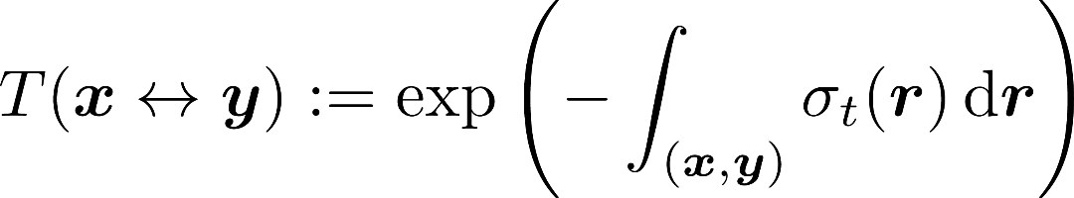


Integral Form of the RTE
For any
, the attenuation between x and y is
A line integral between x and y
•
for all x and y
For homogeneous media with
,

Slide 20

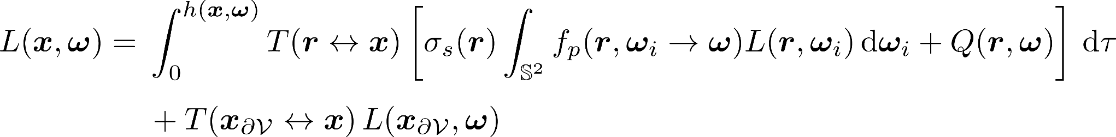

Integral Form of the RTE
Attenuation
In-scattering
Emission
where
Attenuation Boundary cond.
(The second term vanishes when
)

Slide 21
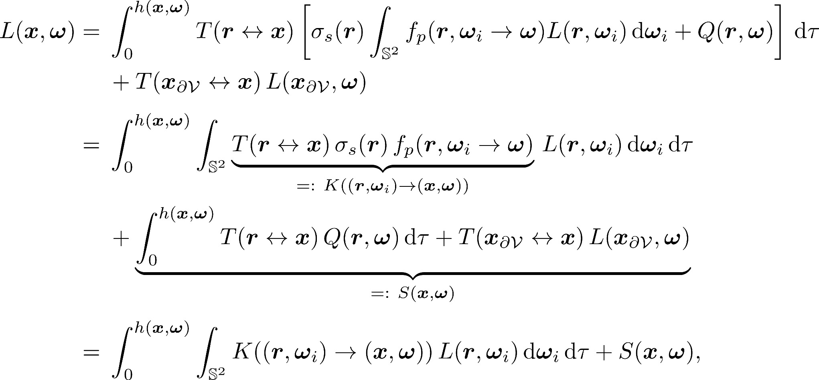
Kernel Form of the RTE
Kernel function
Source function (known term)
where

Slide 22


Operator Form of the RTE
Phase space:
For any real-valued function g on Γ, define
operator K as
where
Then, the RTE becomes
  Similar to the RE!
  Yield Neumann series

Slide 23
Start from here…
Volume Path Tracing
CS295: Realistic Image Synthesis

Slide 24
Solving the RTE
Given the similarity between the RTE and the RE, Monte Carlo solutions to the RE can be adapted to solve the RTE
  Volume path tracing
  Volume adjoint particle tracing
  Volume bidirectional path tracing
  …

Slide 25



Volume Path Tracing
where
Known
Basic idea
  Draw from
  Draw ω_{i} from p(ω_{i})
  Evaluate L(r, ω_{i}) recursively

Slide 26
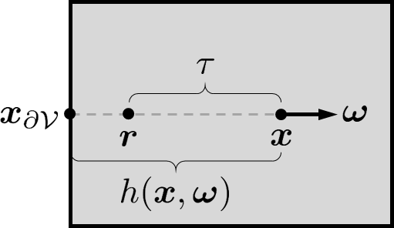
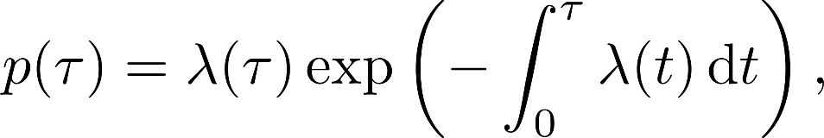
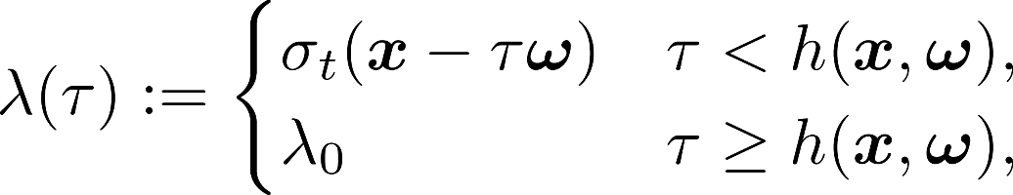
Free Distance Sampling
is called the “free distance” and is sampled from
where
with λ₀ being an arbitrary positive number
p gives an exponential distribution with varying parameters

Slide 27
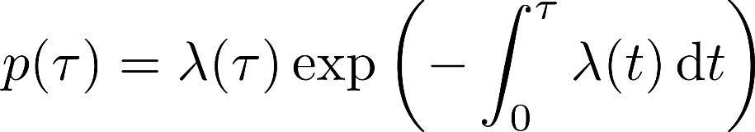

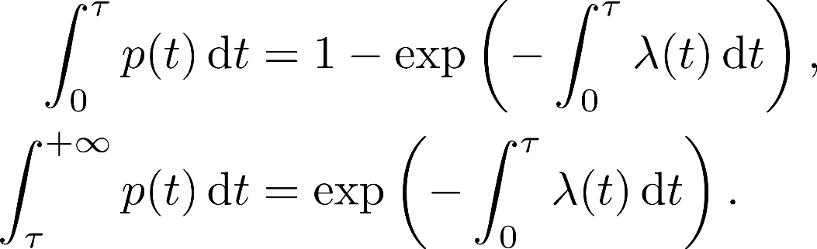
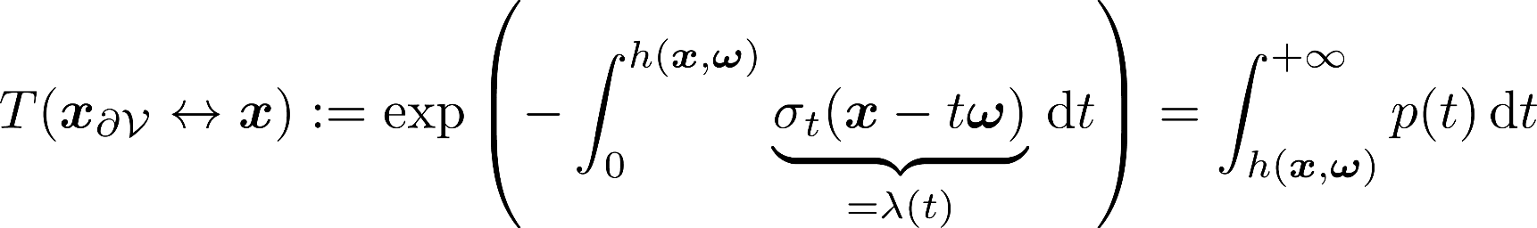
Free Distance Sampling
For all
, it holds that

Slide 28
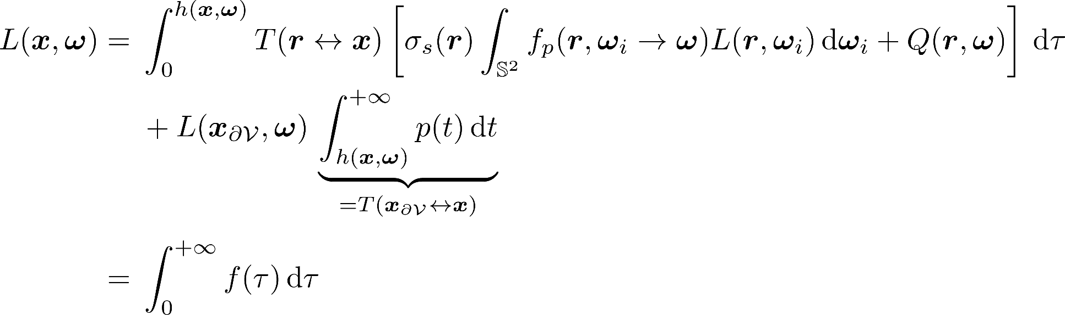
Free Distance Sampling
where

Slide 29
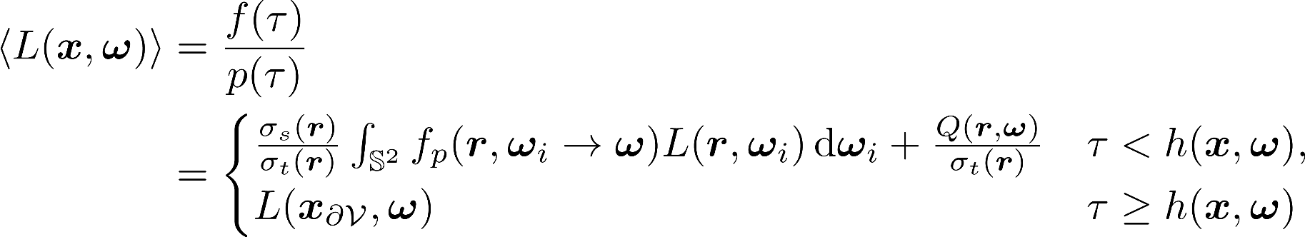


Free Distance Sampling
By applying Monte Carlo integration, we have
Pseudocode:
Draw
If
from p
, return
Otherwise, return

Slide 30


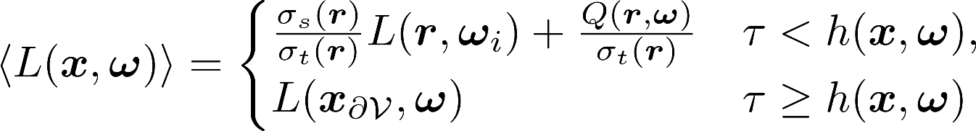
Direction Sampling
One extra integral remains:
ω_{i} can be sampled based on
  In practice,
probability density on ω_{i}, yielding
is usually a valid

Slide 31
Volume Path Tracing
radiance(x, ω):
compute h = h(x, ω) # using ray tracing
draw τ
if τ < h:
How to implement this?
r = x – τ*ω
draw ω_{i}
return σ_{s}(r)/σ_{t}(r)*radiance(r, ω_{i}) + Q(r, ω)/σ_{t}(r) else:
return boundaryRadiance(x – h*ω, ω)

Slide 32




Free Distance Sampling Methods
How to draw samples from this distribution?
Homogeneous media
•
  Let , then
and
In this case, method:
can be drawn using the inversion

Slide 33


Free Distance Sampling Methods
Heterogeneous media
  varies with x, causing to vary with
  p does not have a close-form expression in general
Common sampling methods
  Ray marching
  Delta tracking

Slide 34
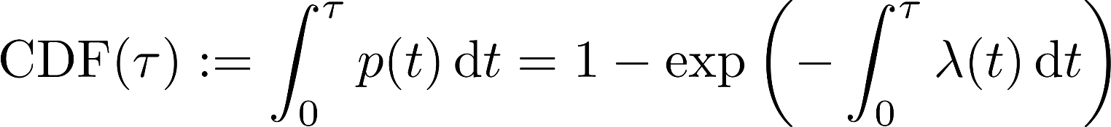



Ray Marching
One can apply the inversion method by
  Drawing ξ from U(0, 1)
  Finding satisfying
    This is usually achieved numerically by iteratively increasing with some fixed step size until reaches ξ
    The step size is generally picked according to the
underlying representation of σ_{t}(x) (e.g., voxel size)

Slide 35


Ray Marching
Pros
  For each sample ,
can be obtained easily
Cons
  Biased (for any finite step size )
  Resolution dependent
    needs to be picked based on the resolution of the density (σ_{t}) field
    Slow for high-resolution density fields

Slide 36




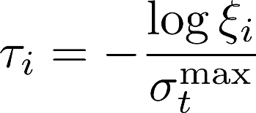



Delta Tracking
Also known as Woodcock tracking
Basic idea
  Consider the medium to have homogeneous density
, and use it to draw free distances
  To compensate the fact that “phantom” densities have been
introduced, the sampling process continues with probability
at each r_{i}

Slide 37
Delta Tracking
Pseudocode:
deltaTracking(x, ω, σ_{t} )
max
compute h using ray tracing
τ = 0
while τ < h:
τ += -log(rand())/σ_{t}
max
r = x - τ*ω
if rand() < σ_{t}(r)/σ_{t} :
max
break
return τ

Slide 38
Delta Tracking
Pros
  Unbiased
  Resolution independent
Cons
  For each sample available
, is not immediately
Slow for density fields with widely varying σ_{t} values
(i.e., σ_{t}^{max} >> σ_{t}(x) for many x)

Slide 39


Volume Path Tracing (VPT)
radiance(x, ω):
compute h = h(x, ω) draw τ
if τ < h:
r = x – τ*ω
draw ω_{i}
return σ_{s}(r)/σ_{t}(r)*radiance(r, ω_{i}) + Q(r, ω)/σ_{t}(r) else:
return boundaryRadiance(x – h*ω, ω)
This basic version can be improved using techniques we have seen earlier:
Russian roulette
Next-event estimation
Multiple importance sampling

Slide 40


VPT with Next-Event Estimation
The RTE implies that . Namely,
where
By drawing
from the aforementioned exponential
distribution, we have

Slide 41
VPT with Next-Event Estimation
The remaining integral is then split into two:
Estimate recursively by drawing ω_{i} based on f_{p} “indirect illumination”
Estimate directly by area sampling or MIS “direct illumination”

Slide 42
VPT with Next-Event Estimation
Pseudocode:
scatteredRadiance(x, ω):
compute h = h(x, ω) # using ray tracing
draw τ
if τ < h:
r = x – τ*ω
rad = directIllumination(r, ω) draw ω_{i}
rad += scatteredRadiance(r, ω_{i})
return σ_{s}(r)/σ_{t}(r)*rad else:
return 0

Slide 43
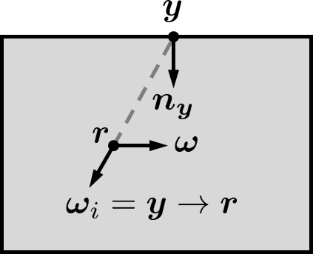
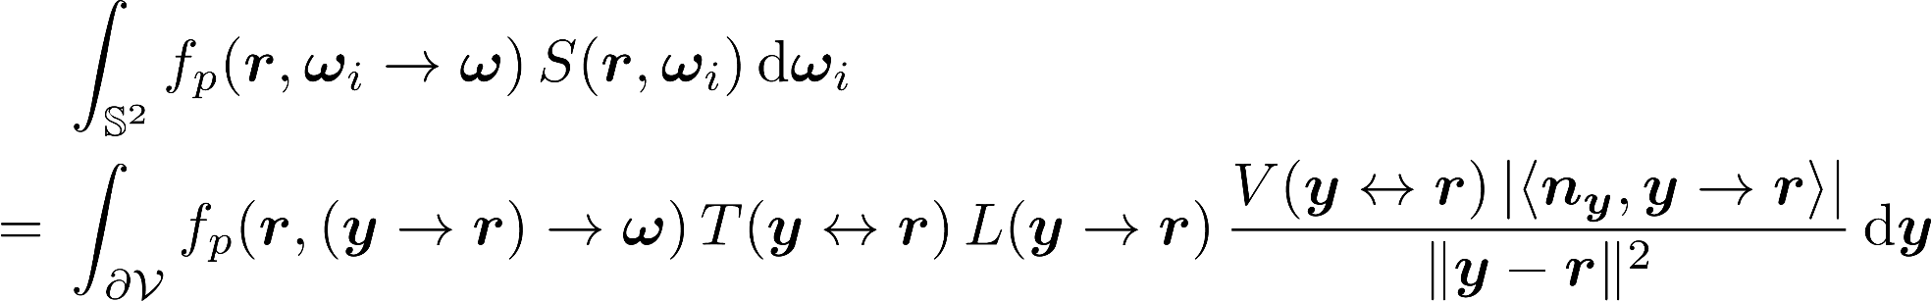

Direct Illumination for VPT
Recall that
For non-emissive materials, Q vanishes and
In this case,
Boundary radiance
Change of measure
The area integral can be further restricted to the subset of where the boundary radiance is non-zero

Slide 44
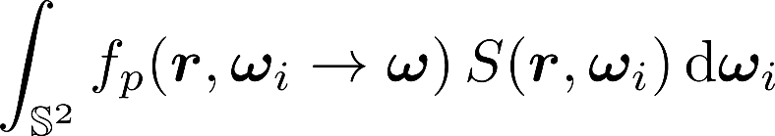

Direct Illumination for VPT
Phase function sampling:
Draw ω_{i} based on f_{p}
Area sampling:
Draw y from
The two strategies can be combined using MIS

