Slide 1
CS580:
Ray Tracing
Sung-Eui Yoon
(윤성의)
Course URL:
http://sglab.kaist.ac.kr/~sungeui/GCG/
Notes:
1

Slide 2
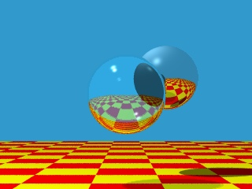
Recursive Ray Casting
Gained popularity in when Turner Whitted (1980) recognized that recursive ray casting could be used for global illumination effects

Slide 3
Ray Casting and Ray Tracing
Trace rays from eye into scene
Backward ray tracing
Ray casting used to compute visibility at the eye
Perform ray tracing for arbitrary rays needed for shading
Reflections
Refraction and transparency
Shadows

Slide 4
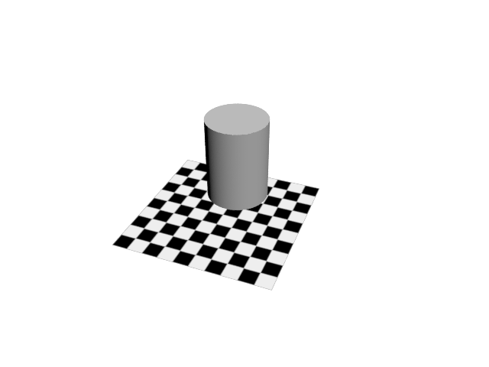
Basic Algorithms
Rays are cast from the eye point through each pixel in the image

Slide 5
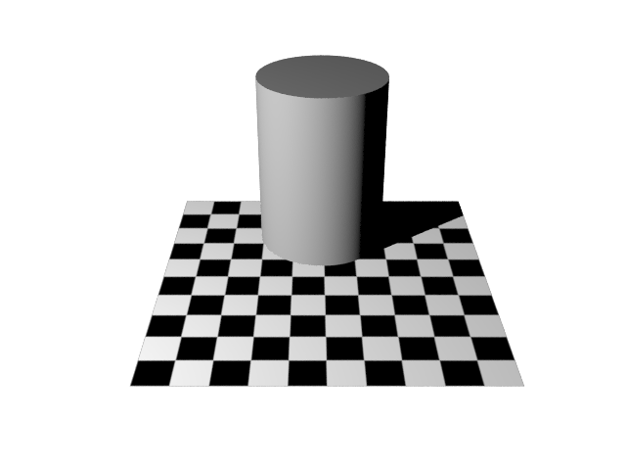
Shadows
Cast ray from the intersection point to each light source
Shadow rays
Used 3ds Max

Slide 6
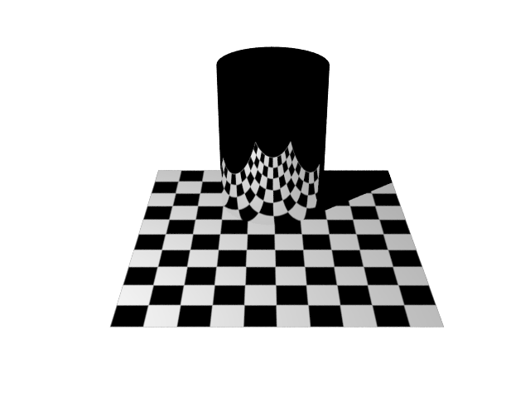
Reflections
If object specular, cast secondary reflected rays

Slide 7
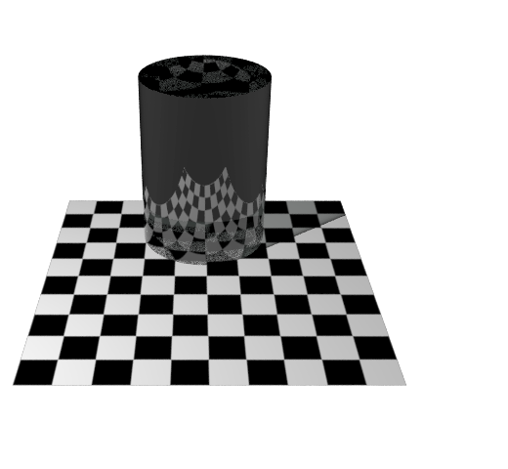
Refractions
If object tranparent, cast secondary refracted rays

Slide 8
An Improved Illumination Model [Whitted 80]
Phong illumination model
Whitted model
S and T are intensity of light from reflection and transmission rays
Ks and Kt are specular and transmission coefficient

Slide 9
OpenGL’s Illumination Model
From Wikipedia

Slide 10
Ambient Light Source
A simple hack for indirect illumination
Incoming ambient illumination (I_{i,a}) is constant for all surfaces in the scene
Reflected ambient illumination (I_{r,a} ) depends only on the surface’s ambient reflection coefficient (k_{a}) and not its position or orientation
These quantities typically specified as (R, G, B) triples

Slide 11
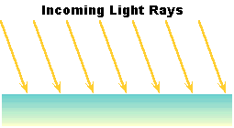
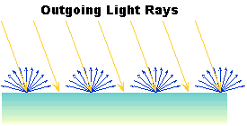
Ideal Diffuse Reflection
Ideal diffuse reflectors (e.g., chalk)
Reflect uniformly over the hemisphere
Reflection is view-independent
Very rough at the microscopic level
Follow Lambert’s cosine law

Slide 12
Lambert’s Cosine Law
The reflected energy from a small surface area from illumination arriving from direction is proportional to the cosine of the angle between and the surface normal

Slide 13
Computing Diffuse Reflection
Constant of proportionality depends on surface properties
The constant k_{d} specifies how much of the incident light I_{i} is diffusely reflected
When the incident light is blocked by the surface itself and the diffuse reflection is 0
Diffuse reflection for varying light directions
Notes:
Why are sphere’s used to show shading

Slide 14
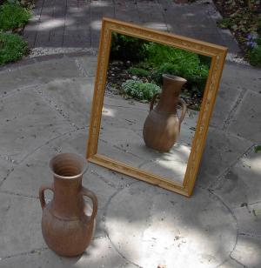
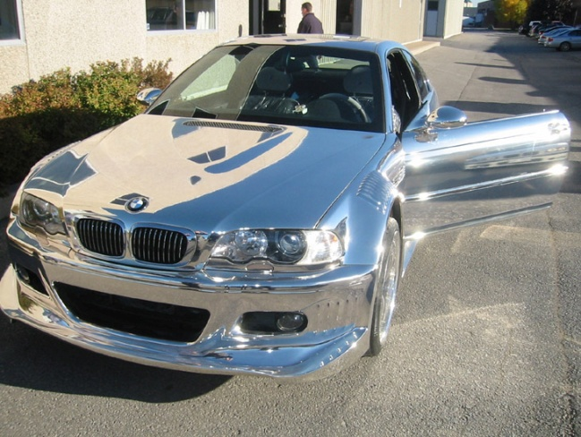
Specular Reflection
Specular reflectors have a bright, view dependent highlight
E.g., polished metal, glossy car finish, a mirror
At the microscopic level a specular reflecting surface is very smooth
Specular reflection obeys Snell’s law
Image source: astochimp.com and wiki

Slide 15
Snell’s Law
The relationship between the angles of the incoming and reflected rays with the normal is given by:
n_{i} and n_{o} are the indices of refraction for the incoming and outgoing ray, respectively
Reflection is a special case where n_{i} = n_{o} so θ_{o} = θ_{i}
The incoming ray, the surface normal, and the reflected ray all lie in a common plane

Slide 16
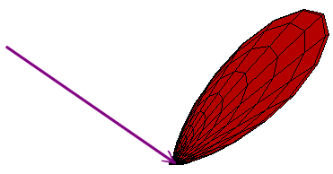
Non-Ideal Reflectors
Snell’s law applies only to ideal specular reflectors
Roughness of surfaces causes highlight to “spread out”
Empirical models try to simulate the appearance of this effect, without trying to capture the physics of it

Slide 17
Phong Illumination
One of the most commonly used illumination models in computer graphics
Empirical model and does not have no physical basis
is the direction to the viewer
is clamped to [0,1]
The specular exponent n_{s} controls how quickly the highlight falls off

Slide 18
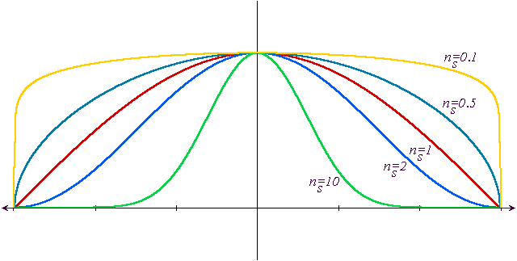
Effect of Specular Exponent
How the shape of the highlight changes with varying n_{s}

Slide 19
Examples of Phong
varying light direction
varying specular exponent

Slide 20
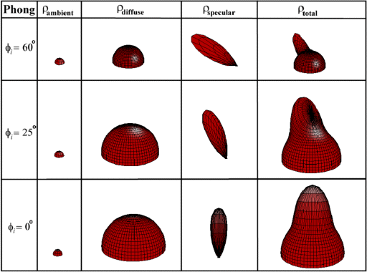
Putting it All Together

Slide 21
An Improved Illumination Model [Whitted 80]
Phong illumination model
Whitted model
S and T are intensity of light from reflection and transmission rays
Ks and Kt are specular and transmission coefficient

Slide 22
Ray Tree
e
s₂
s₁
f
s₀
a
c
d
eye
b
eye
R
T
a
s₀
b
R
T
R
T
e
s₂
f
c
s₁
b

Slide 23
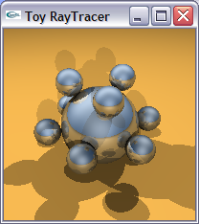
Acceleration Methods for Ray Tracing
Rendering time for a ray tracer depends on the number of ray intersection tests per pixel
The number of pixels X the number of primitives in the scene
Early efforts focused on accelerating the ray-object intersection tests
Ray-triangle intersection tests
More advanced methods required to make ray tracing practical
Bounding volume hierarchies
Spatial subdivision (e.g., kd-trees)

Slide 24
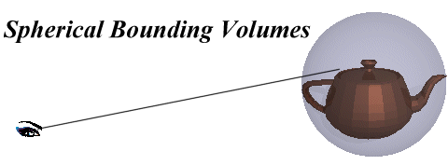
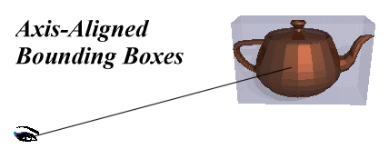
Bounding Volumes
Enclose complex objects within a simple-to-intersect objects
If the ray does not intersect the simple object then its contents can be ignored
The likelihood that it will strike the object depends on how tightly the volume surrounds the object.
Spheres are simple, but not tight
Axis-aligned bounding boxes often better
Can use nested or hierarchical bounding volumes

Slide 25
Bounding Volumes
Sphere [Whitted80]
Cheap to compute
Cheap test
Potentially very bad fit
Axis-Aligned Bounding Box
Very cheap to compute
Cheap test
Tighter than sphere

Slide 26
Bounding Volumes
Oriented Bounding Box
Fairly cheap to compute
Fairly Cheap test
Generally fairly tight
Slabs / K-dops
More expensive to compute
Fairly cheap test
Can be tighter than OBB
Notes:
Discrete orientation polytopes

Slide 27
Hierarchical Bounding Volumes
Organize bounding volumes as a tree
Choose a partitioning plane and distribute triangles into left and right nodes
Each ray starts with the scene BV and traverses down through the hierarchy
☑
☒
☒
☑
☑
☑
☒
☑
r
☒

Slide 28
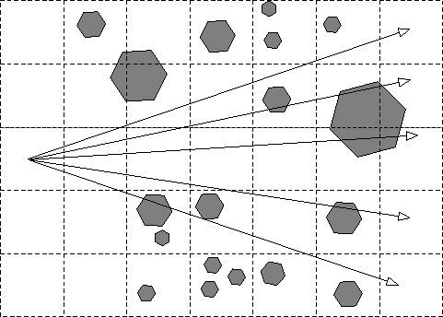
Spatial Subdivision
Idea: Divide space in to subregions
Place objects within a subregion into a list
Only traverse the lists of subregions that the ray passes through
“Mailboxing” used to avoid multiple test with objects in multiple regions
Many types
Regular grid
Octree
BSP tree
kd-tree

Slide 29
Overview of kd-Trees
Binary spatial subdivision (special case of BSP tree)
Split planes aligned on main axis
Inner nodes: subdivision planes
Leaf nodes: triangle(s)

Slide 30
Example

Slide 31
Example

Slide 32
Example

Slide 33
Example

Slide 34
Example
What about triangles overlapping the split?

Slide 35
Example

Slide 36
Split Planes
How to select axis & split plane?
Largest dimension, subdivide in middle
More advanced:
Surface area heuristic
Makes large difference
50%-100% higher overall speed

Slide 37
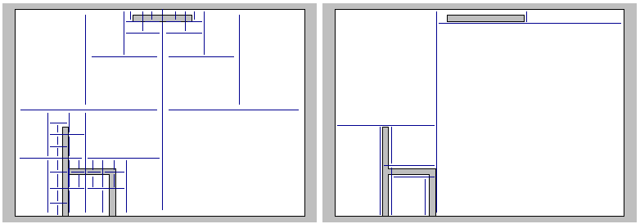
Median vs. SAH
(from [Wald04])

Slide 38
Ray Tracing with kd-tree
Goal: find closest hit with scene
Traverse tree front to back (starting from root)
At each node:
If leaf: intersect with triangles
If inner: traverse deeper

Slide 39
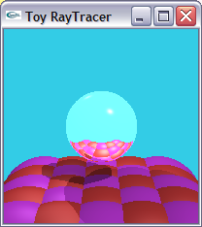
Classic Ray Tracing
Gathering approach
From lights, reflected, and refracted
directions
Pros of ray tracing
Simple and improved realism over
the rendering pipeline
Cons:
Simple light model, material, and light propagation
Not a complete solution
Hard to accelerate with special-purpose H/W

Slide 40
History
Problems with classic ray tracing
Not realistic
View-dependent
Radiosity (1984)
Global illumination in diffuse scenes
Monte Carlo ray tracing (1986)
Global illumination for any environment

Slide 41
Class Objectives were:
Understand a basic ray tracing
Know the Phong illumination model
Implement its acceleration data structure and know how to use it

Slide 42
Any Questions?
Come up with one question on what we have discussed in the class and submit at the end of the class
1 for already answered questions
2 for typical questions
3 for questions with thoughts
Submit questions at least four times before the mid-term exam
Multiple questions for the class is counted as only a single time

Slide 43
Homework
Go over the next lecture slides before the class
Watch 2 SIGGRAPH videos and submit your summaries right brefore every Tue. class
Just one paragraph for each summary
Example:
Title: XXX XXXX XXXX
Abstract: this video is about accelerating the performance of ray tracing. To achieve its goal, they design a new technique for reordering rays, since by doing so, they can improve the ray coherence and thus improve the overall performance.

Slide 44
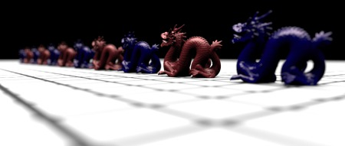
PA1
Get to know pbrt

Slide 45
Next Time
Radiosity

Slide 46
Figs.

Slide 47
Basic Algorithms

Slide 48
Shadows

Slide 50
Refractions
If object tranparent, cast secondary refracted rays

