Slide 1

CS580:
Monte Carlo Ray Tracing:
Part I
Sung-Eui Yoon
(윤성의)
Course URL:
http://sglab.kaist.ac.kr/~sungeui/GCG
Notes:
1

Slide 2
Class Objectives
Understand a basic structure of Monte Carlo ray tracing
  Russian roulette for its termination
  Stratified sampling
Quasi-Monte Carlo ray tracing

Slide 3
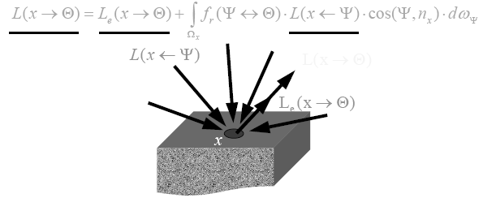
Why Monte Carlo?
Radiace is hard to evaluate
Sample many paths
  Integrate over all incoming directions
Analytical integration is difficult
  Need numerical techniques
From kavita’s slides

Slide 4
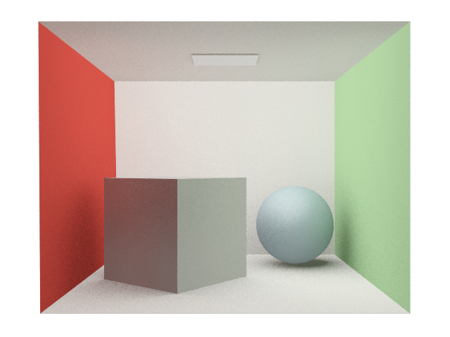
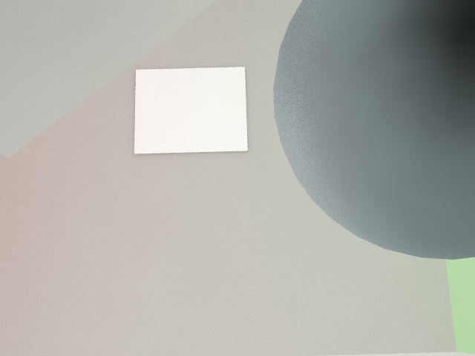
Rendering Equation

Slide 5
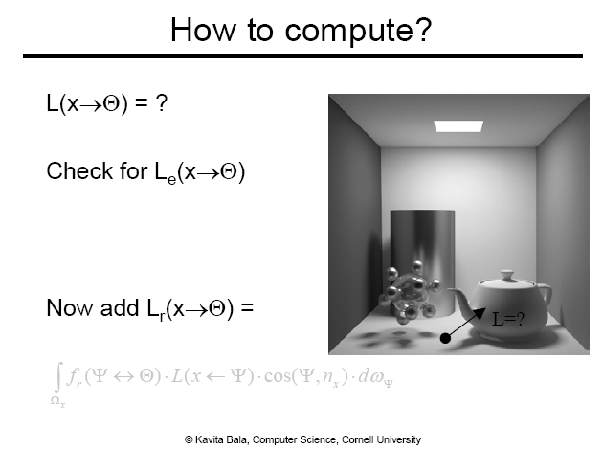

Slide 6
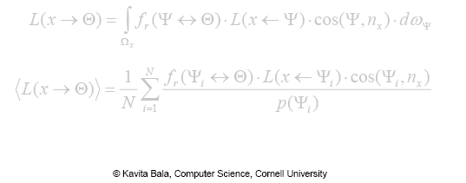
How to compute?
Use Monte Carlo
Generate random directions on hemisphere Ω_{X} using pdf p(Ψ)

Slide 7
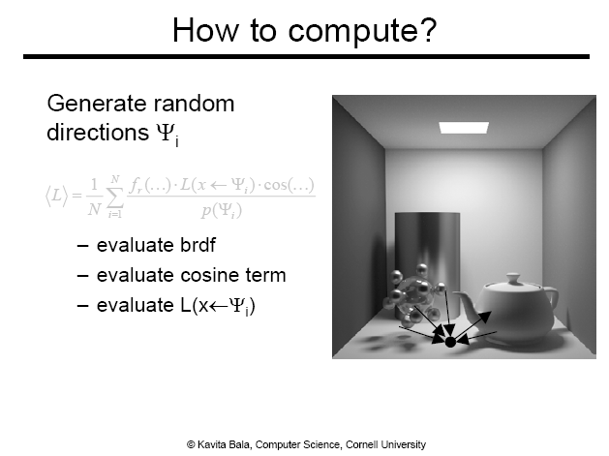

Slide 8
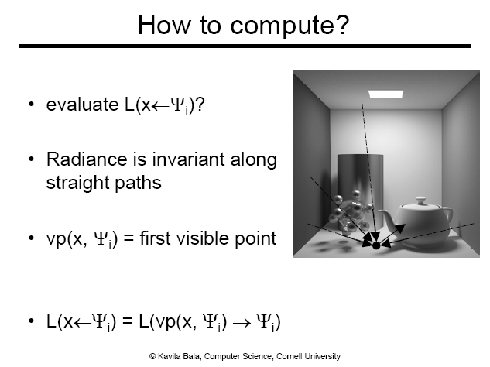

Slide 9
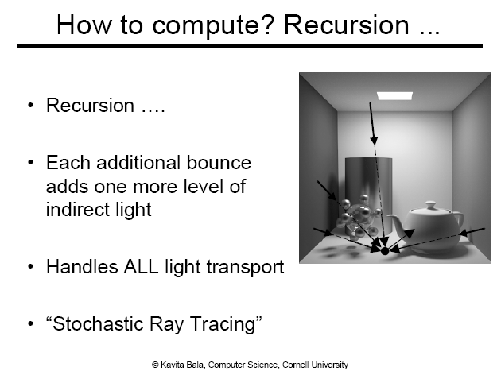

Slide 10
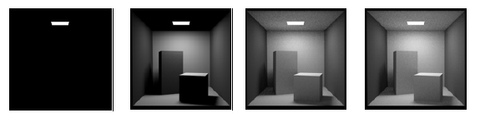
When to end recursion?
Contributions of further light bounces become less significant
  Max recursion
  Some threshold for radiance value
If we just ignore them, estimators will be biased
From kavita’s slides

Slide 11
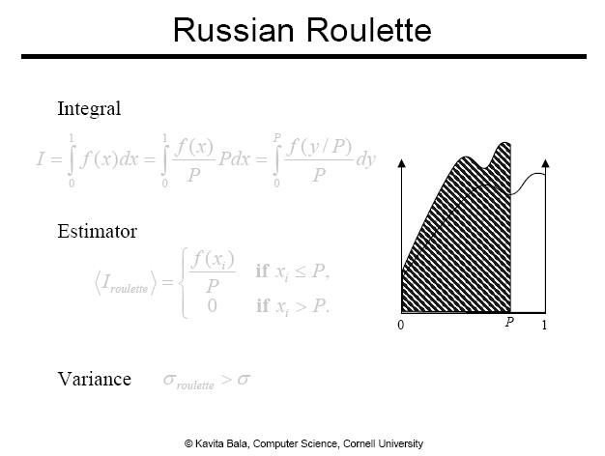

Slide 12
Russian Roulette
Pick absorption probability, α = 1-P
  Recursion is terminated
1- α = P is commonly to be equal to the reflectance of the material of the surface
  Darker surface absorbs more paths

Slide 13
Algorithm so far
Shoot primary rays through each pixel
Shoot indirect rays, sampled over hemisphere
Terminate recursion using Russian Roulette

Slide 14

Pixel Anti-Aliasing
Compute radiance only at the center of pixel
  Produce jaggies
Simple box filter
  The averaging method
We want to evaluate using MC

Slide 15
Stochastic Ray Tracing
Parameters
  Num. of starting ray per pixel
  Num. of random rays for each surface point (branching factor)
Path tracing
  Branching factor = 1

Slide 16
Path Tracing
1 spp 4 spp 16 spp
Pixel sampling + light source sampling folded into one method

Slide 17
Algorithm so far
Shoot primary rays through each pixel
Shoot indirect rays, sampled over hemisphere
  Path tracing shoots only 1 indirect ray
Terminate recursion using Russian Roulette

Slide 18
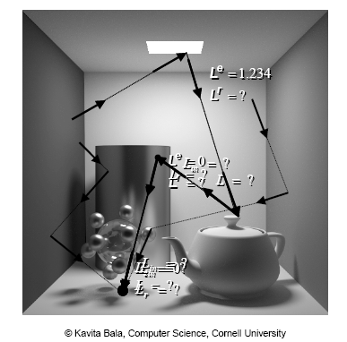
Algorithm

Slide 19
Performance
Want better quality with smaller # of samples
  Fewer samples/better performance
  Stratified sampling
  Quasi Monte Carlo: well-distributed samples
Faster convergence
  Importance sampling

Slide 20
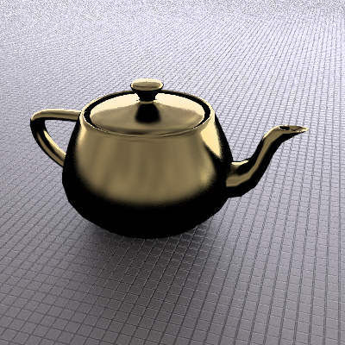
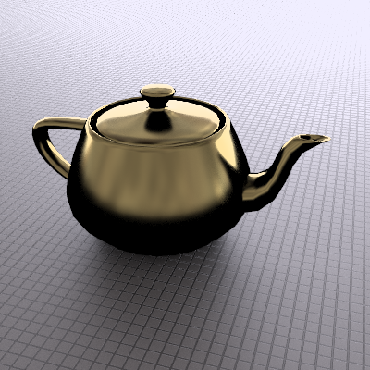

PA2
Uniform sampling Adaptive sampling Reference
(64 samples per pixel)

Slide 21
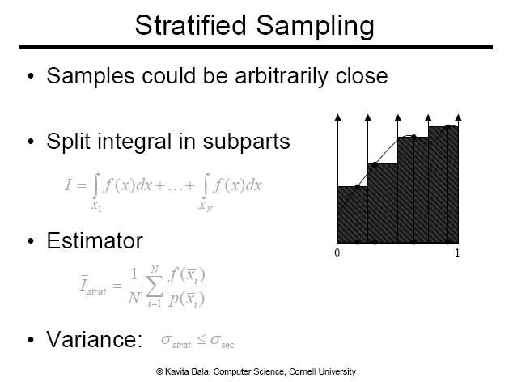

Slide 22
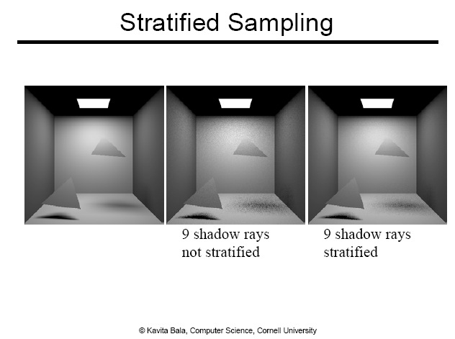

Slide 23
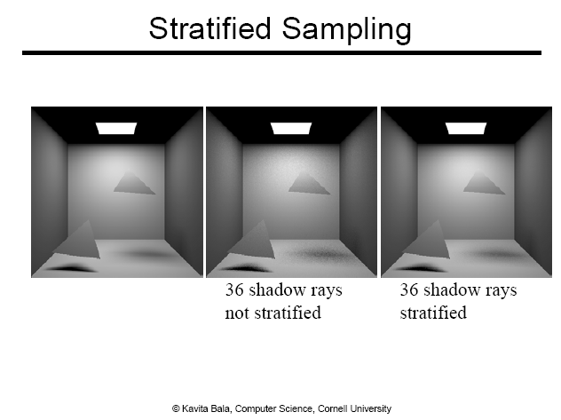

Slide 24
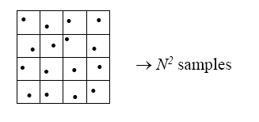
High Dimensions
Problem for higher dimensions
Sample points can still be arbitrarily close to each other

Slide 25
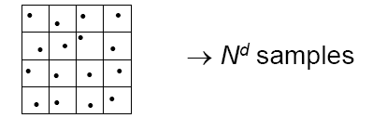
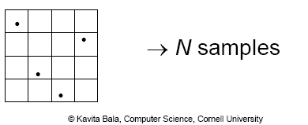
Higher Dimensions
Stratified grid sampling
N-rooks (or Latin hypercube) sampling

Slide 26
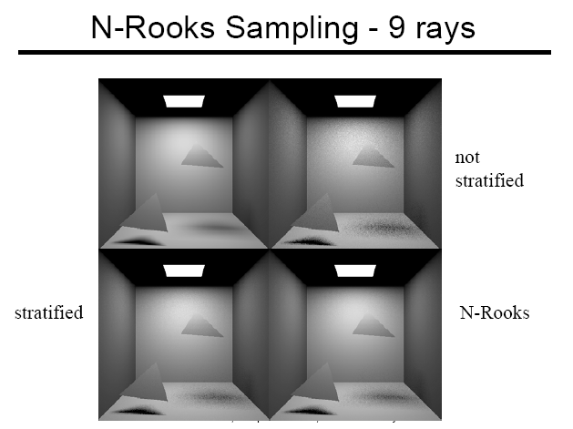

Slide 27
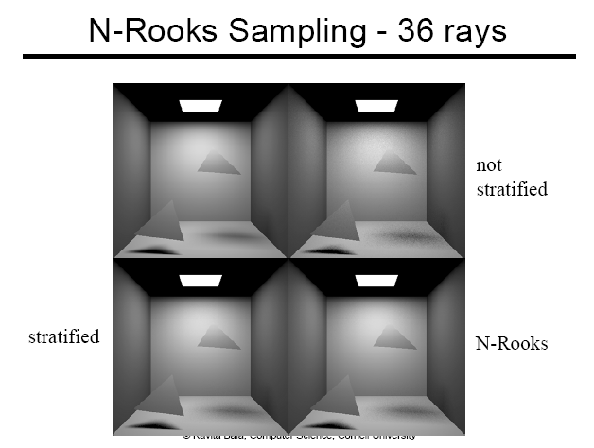

Slide 28
Sobol Sequence
Attempt to have one sample in different elementary intervals
All elementary intervals having the volume of 1/16
Jittered Sobol N-Rooks
Images are from Kollig and Keller’s EG 2002

Slide 29
Quasi-Monte Carlo
Eliminate randomness, but find well-distributed samples
Samples are deterministic, and look random
Credit: SIGGRAPH 2012 Course: Advanced (Quasi-) Monte Carlo Methods for Image Synthesis

Slide 30
Quasi-Monte Carlo
Notion of variance and expectation do not apply
Introduce discrepancy
  Mimic the notion of variance
  E.g., given a subset of a unit interval [0, x]
    n are in the subset among N samples
    Discrepancy: |x – n/N|
Use low-discrepancy sequence
  Sobol sequence is the one implemented in pbrt

Slide 31
Example: van der Corput Sequence
One of simplest low-discrepancy sequences
Radical inverse function, Φ_{b}(n)
  Given n = ,
  Φ_{b}(n) = 0.d₁d₂d₃ … d_{n}
  E.g., Φ₂(i): 111010₂ → 0.010111
van der Corput sequence, x_{i}=Φ₂(i)

Slide 32
Example: van der Corput Sequence
One of simplest low-discrepancy sequences
x_{i}=Φ₂(i)
i | Base 2 | Φ₂(i)
1 | 1 | .1 = 1/2
2 | 10 | .01 = 1/4
3 | 11 | .11 = 3/4
4 | 100 | .001 = 1/8
5 | 101 | .101 = 5/8
. . . | . . . | . . .

Slide 33
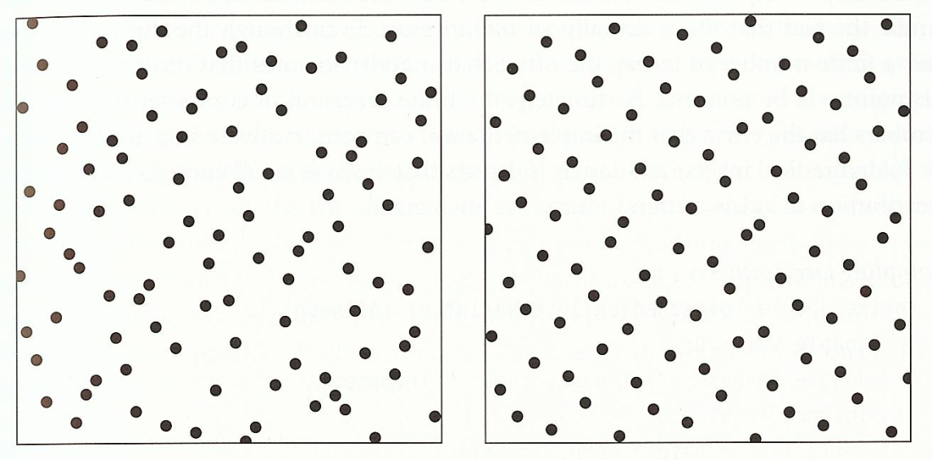
Halton and Hammersley
Halton
  x_{i}=(Φ₂(i), Φ₃(i), Φ₅(i), …, Φ_{prime}(i))
Hammersley
  x_{i}=(1/N, Φ₂(i), Φ₃(i), Φ₅(i), …, Φ_{prime}(i))
  Assume we know the number of samples, N
  Has slightly lower discrepancy
Halton
Hammersley

Slide 34

Why Use Quasi Monte Carlo?
No randomness
  Provide deterministic error bounds
Much better than pure Monte Carlo method at some cases
  Reduces O($\frac{log N^{D−1}}{N}$)

Slide 35
Current State
4D rendering problems
Randomized Quasi shows slightly better performance than N-Rooks sampling
Need to be improved further
Excepted from Kollig et al. 02

Slide 36
Performance and Error
Want better quality with smaller number of samples
  Fewer samples → better performance
  Stratified sampling
  Quasi Monte Carlo: well-distributed samples
Faster convergence
  Importance sampling: next-event estimation

Slide 37
Class Objectives were:
Understand a basic structure of Monte Carlo ray tracing
  Russian roulette for its termination
  Stratified sampling
Quasi-Monte Carlo ray tracing

Slide 38
Homework
Go over the next lecture slides before the class
Watch 2 SIGGRAPH videos and submit your summaries every Tue. class
  Just one paragraph for each summary
Example:
Title: XXX XXXX XXXX
Abstract: this video is about accelerating the performance of ray tracing. To achieve its goal, they design a new technique for reordering rays, since by doing so, they can improve the ray coherence and thus improve the overall performance.

Slide 39
Any Questions?
Come up with one question on what we have discussed in the class and submit at the end of the class
  1 for already answered questions
  2 for typical questions
  3 for questions with thoughts
Submit questions at least four times before the mid-term exam
  Multiple questions for the class is counted as only a single time

Slide 40
Next Time
Importance sampling for MC ray tracing

Slide 41
Figures

