Slide 1

CS580:
MC Ray Tracing:
Part II, Importance Sampling
Sung-Eui Yoon
(윤성의)
Course URL:
http://sglab.kaist.ac.kr/~sungeui/GCG
Notes:
1

Slide 2
Class Objectives:
Importance sampling for:
  Direct terms
  Lights
  Indirect terms

Slide 3
Performance and Error
Want better quality with smaller number of samples
  Fewer samples → better performance
  Stratified sampling
  Quasi Monte Carlo: well-distributed samples
Faster convergence
  Importance sampling: next-event estimation

Slide 4
Path Tracing
Sample the hemisphere uniformly
Can we do better?
  Importance sampling: sample toward regions emitting high energy
  Send rays directly to lights
1 spp 4 spp 16 spp

Slide 5
Path Tracing w/ and w/o Direct Illumination Sampling
1 spp 4 spp 16 spp
w/o direct illumination sampling
w/ direct illumination sampling

Slide 6
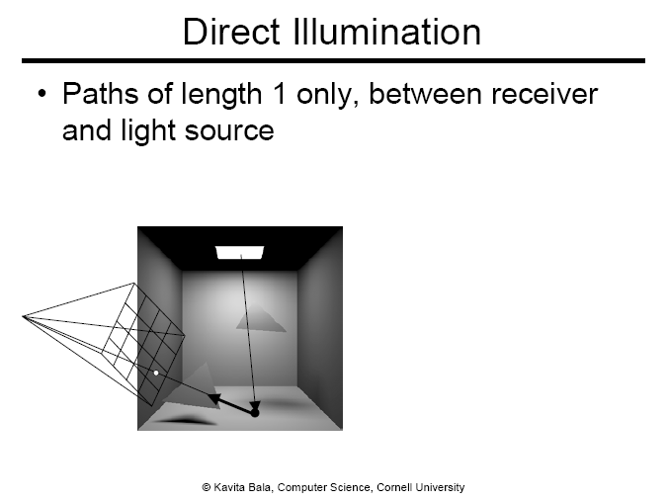

Slide 7
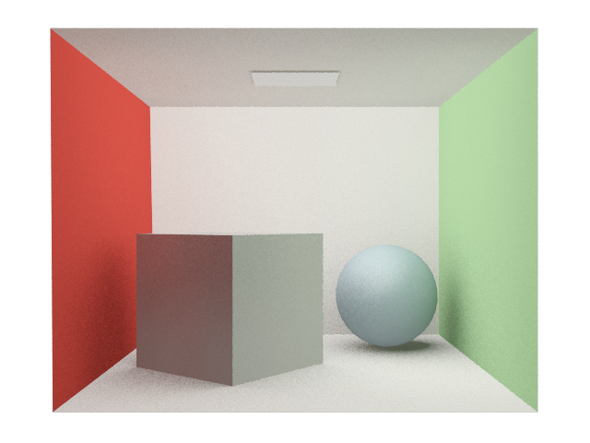

Importance Sampling

Slide 8




Importance Sampling
$$L_{d} + L_{i}$$

Slide 9
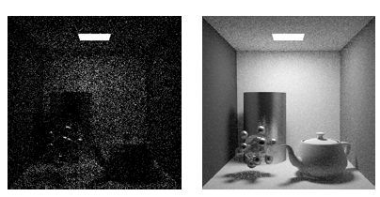
Comparison
With and without considering direct illumination
  16 samples / pixel
From kavita’s slides

Slide 10
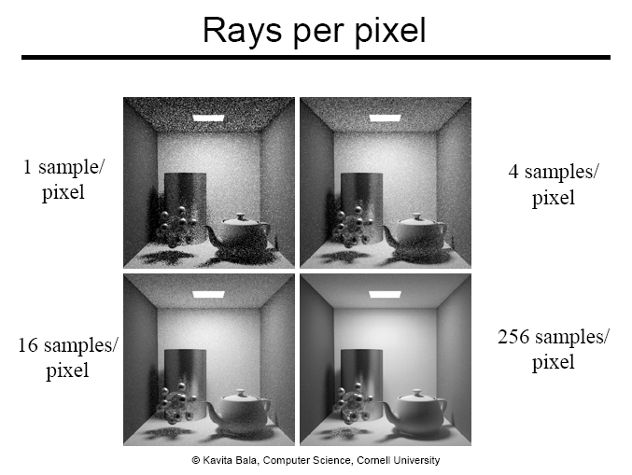

Slide 11
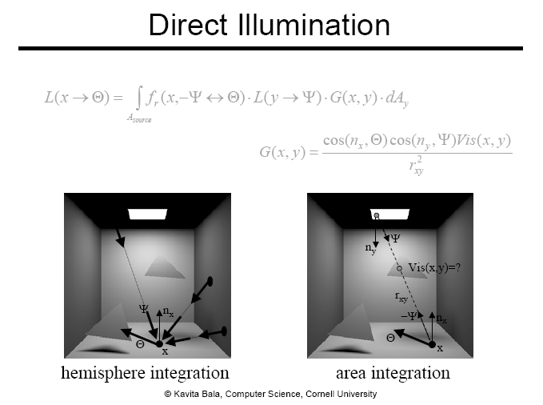

Slide 12
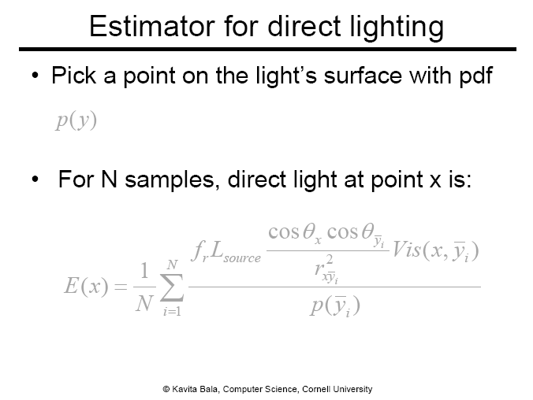
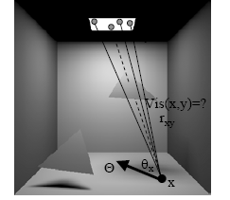

Slide 13
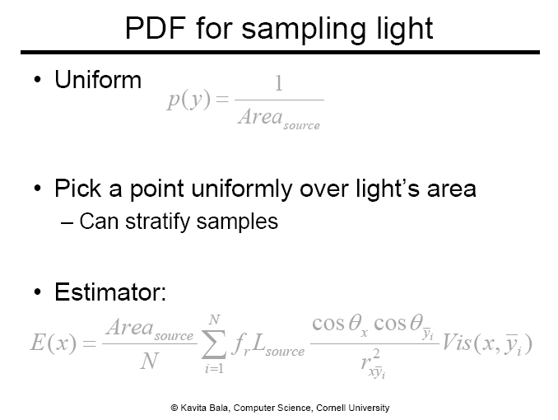

Slide 14
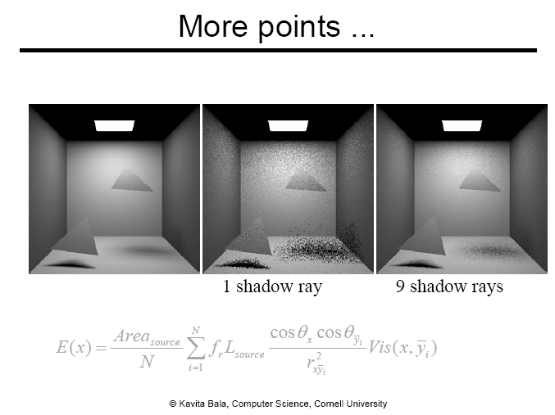

Slide 15
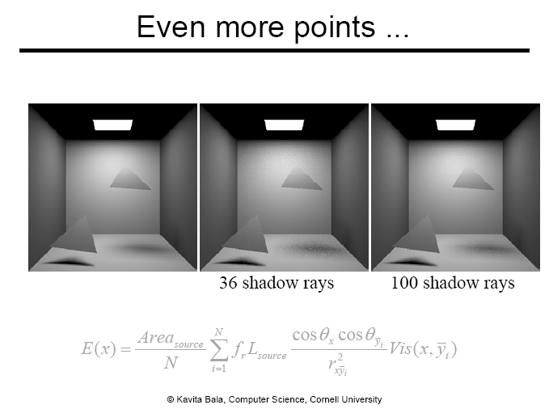

Slide 16
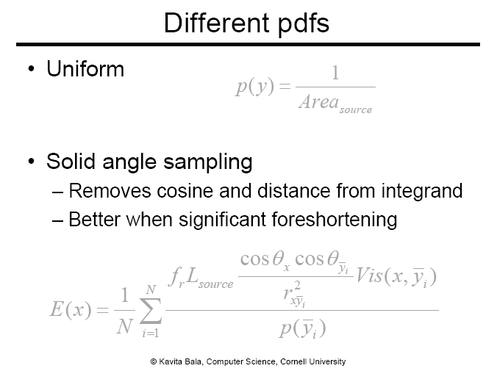

Slide 17
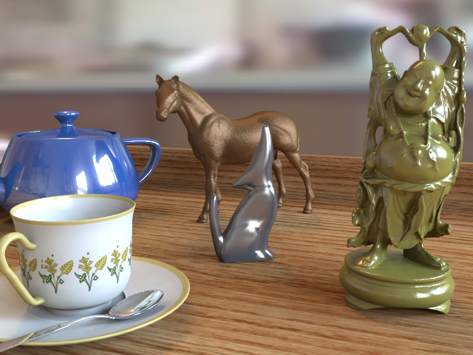
Scenes with Many Lights
Thousands of lights become common setting
Light Tree
Representative light (clusters)
4
1
4
1
2
3
4
Individual lights
Lightcuts: a scalable approach to illumination, SIG. 05

Slide 18
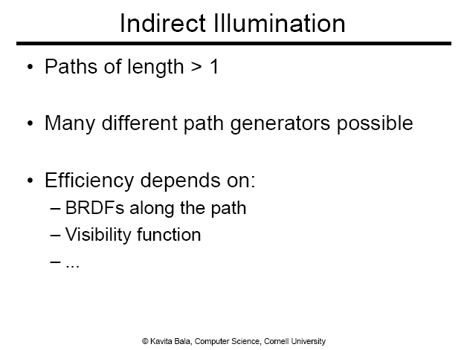

Slide 19
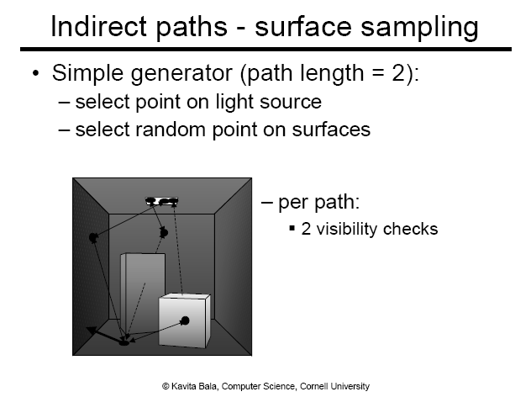

Slide 20
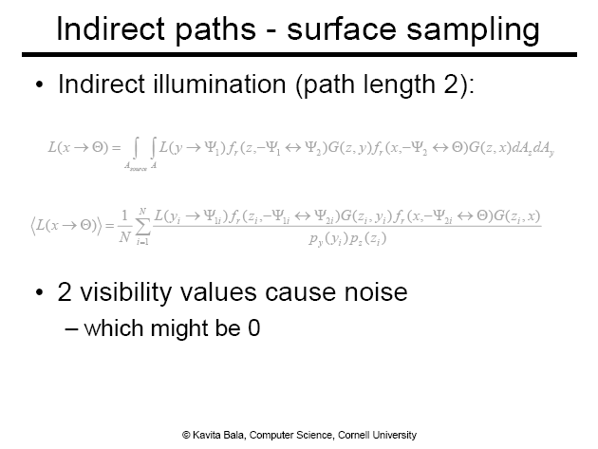
y → z → x

Slide 21
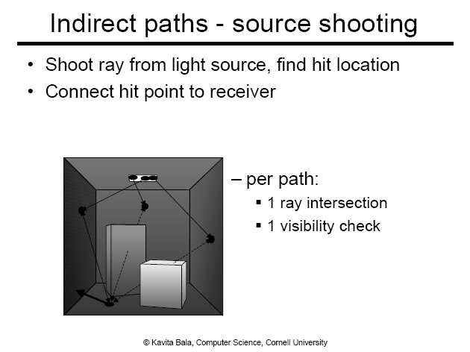

Slide 22


Slide 23
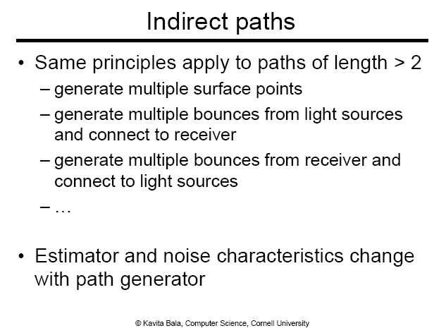

Slide 24
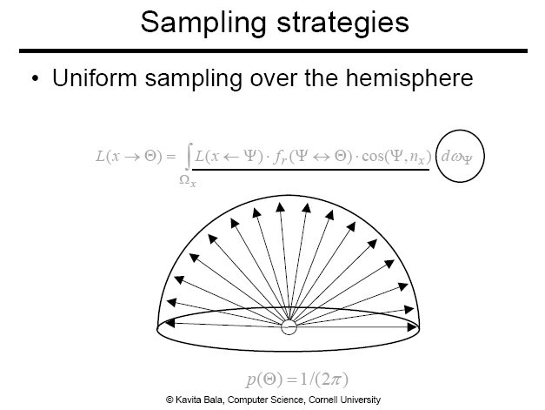

Slide 25
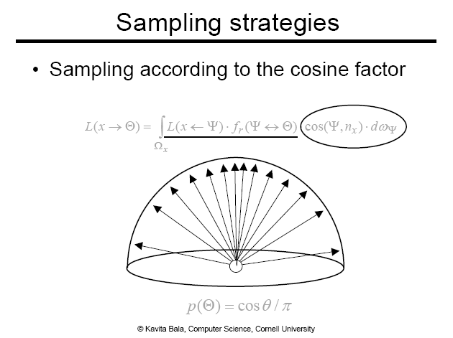

Slide 26
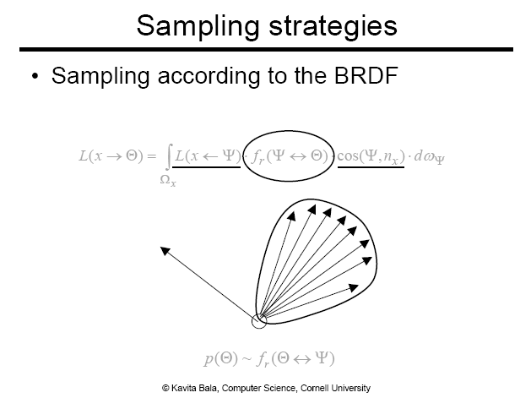

Slide 27
Sampling Light or BRDF
Small
Big lights
Glossy
Diffuse
Optimally Combining Sampling Techniques for Monte Carlo Rendering, Veach et al., SIG. 05

Slide 28
Multiple Importance Sampling
Use the unbiased, combined estimator:
  Use a weighted sum of different estimators
Use the balanced heuristic for the weights:
,
where c_i is the relative number of samples

Slide 29
Multiple Importance Sampling

Slide 30
General GI Algorithm
Design path generators
Path generators determine efficiency of GI algorithm
Black boxes
  Evaluate BRDF, ray intersection, visibility evaluations, etc

Slide 31
Class Objectives were:
Importance sampling for:
  Direct terms
  Lights
  Indirect terms

Slide 32
Homework
Go over the next lecture slides before the class
Watch 2 SIGGRAPH videos and submit your summaries every Tue. class
  Just one paragraph for each summary
Example:
Title: XXX XXXX XXXX
Abstract: this video is about accelerating the performance of ray tracing. To achieve its goal, they design a new technique for reordering rays, since by doing so, they can improve the ray coherence and thus improve the overall performance.

Slide 33
Any Questions?
Come up with one question on what we have discussed in the class and submit at the end of the class
  1 for already answered questions
  2 for typical questions
  3 for questions with thoughts
Submit questions at least four times before the mid-term exam
  Multiple questions for the class is counted as only a single time

Slide 34
Next Time
Biased techniques

Slide 35
Used Fig

Slide 36
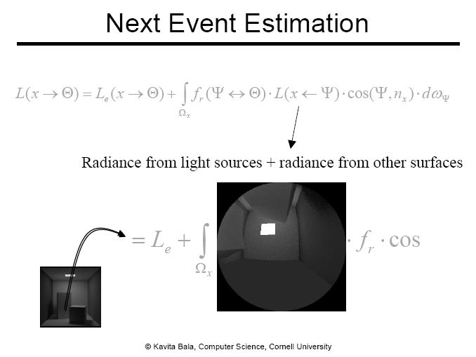
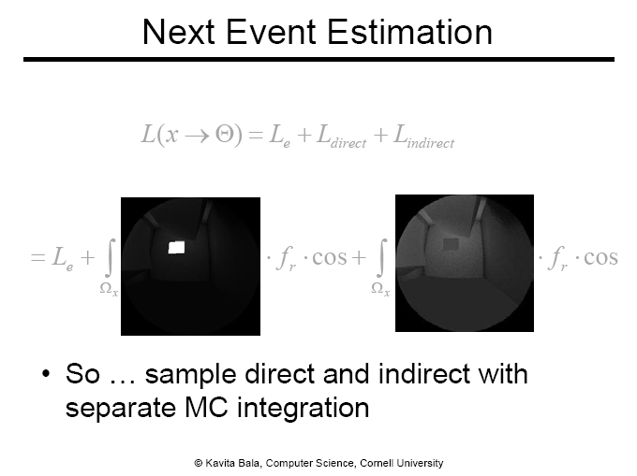
Importance Sampling

Slide 37
Importance Sampling

Slide 38
Sampling Light or BRDF
Small
Big lights
Glossy
Diffuse

