Slide 1
CS580:
Monte Carol Integration
Sung-Eui Yoon
(윤성의)
Course URL:
http://sglab.kaist.ac.kr/~sungeui/GCG
Notes:
1

Slide 2
Class Objectives
Sampling approach for solving the rendering equation
Monte Carlo integration
Estimator and its variance
Sampling according to the pdf
Refer to the chapter of Monte Carlo Integration of my book

Slide 3
Two Forms of the Rendering Equation
Hemisphere integration
Area integration

Slide 4
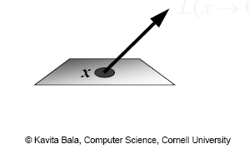
Radiance Evaluation
Fundamental problem in GI algorithm
Evaluate radiance at a given surface point in a given direction
Invariance defines radiance everywhere else

Slide 5
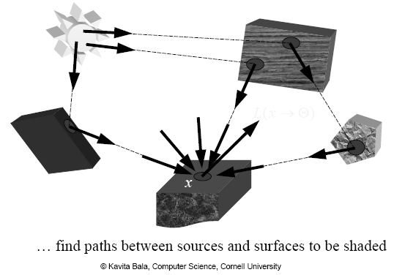
Radiance Evaluation

Slide 6
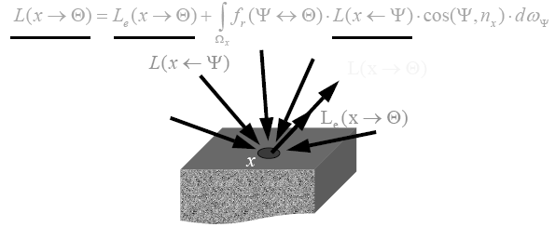
Why Monte Carlo?
Radiace is hard to evaluate
Sample many paths
Integrate over all incoming directions
Analytical integration is difficult
Need numerical techniques
From kavita’s slides

Slide 7
Monte Carlo Integration
Numerical tool to evaluate integrals
Use sampling
Stochastic errors
Unbiased
On average, we get the right answer

Slide 16
Notes:
Assume: iid (Independent and identically distributed random variables)

Slide 21
Notes:
I_prim is chosen to set I_prim * p(x) to be f(x)

Slide 23
Consider p(x) for estimate
We will study it as importance sampling later

Slide 28
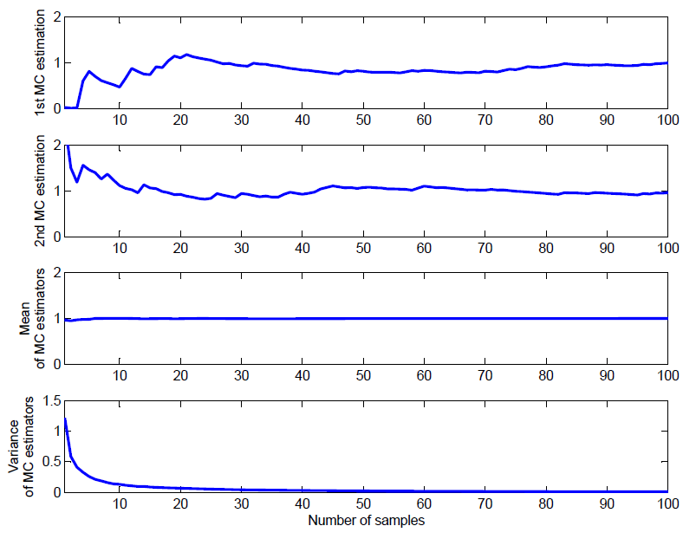
MC Integration - Example
Code:
mc_int_ex.m

Slide 32
Advantages of MC
Convergence rate of
Simple
Sampling
Point evaluation
General
Works for high dimensions
Deals with discontinuities, crazy functions, etc.

Slide 34
Notes:
We will study how to generate samples based on a pdf later.

Slide 35
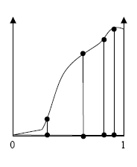
Importance Sampling
Take more samples in important regions, where the function is large
From kavita’s slides

Slide 40
Sampling according to pdf
Inverse cumulative distribution function
Rejection sampling

Slide 41
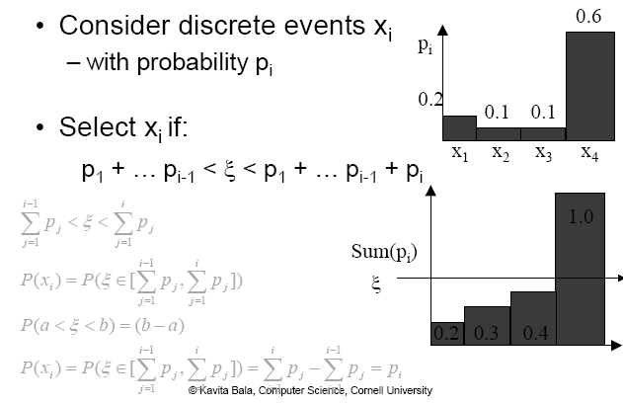
Inverse Cumulative Distribution Function – Discrete Case
, given uniform sampling
Notes:
Given y, the random var, pick an event.

Slide 42
Continuous Random Variable
Algorithm
Pick u uniformly from [0, 1)
Output y = P⁻¹(u), where

Slide 46
Notes:
1 – cos^2 a = sin ^ 2 a

Slide 47
Rejection Method
accept

Slide 48
Class Objectives were:
Sampling approach for solving the rendering equation
Monte Carlo integration
Estimator and its variance
Sampling according to the pdf

Slide 49
Homework
Go over the next lecture slides before the class
Watch 2 SIGGRAPH videos and submit your summaries every Tue. class
Just one paragraph for each summary
Example:
Title: XXX XXXX XXXX
Abstract: this video is about accelerating the performance of ray tracing. To achieve its goal, they design a new technique for reordering rays, since by doing so, they can improve the ray coherence and thus improve the overall performance.

Slide 50
Any Questions?
Come up with one question on what we have discussed in the class and submit at the end of the class
1 for already answered questions
2 for typical questions
3 for questions with thoughts
Submit questions at least four times before the mid-term exam
Multiple questions for the class is counted as only a single time

Slide 51
Next Time
Monte Carlo ray tracing

Slide 53
accept

