Slide 1
CS380: Computer Graphics
Introduction
Sung-Eui Yoon
(윤성의)
Course URL:
http://sglab.kaist.ac.kr/~sungeui/CG
Notes:
1

Slide 2
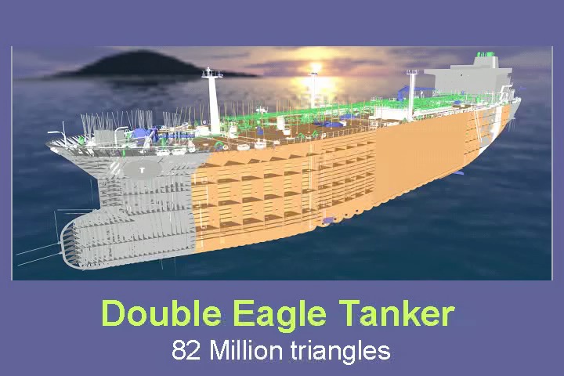
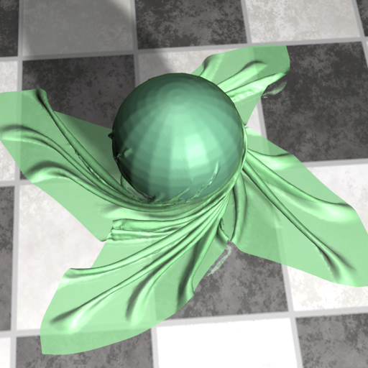
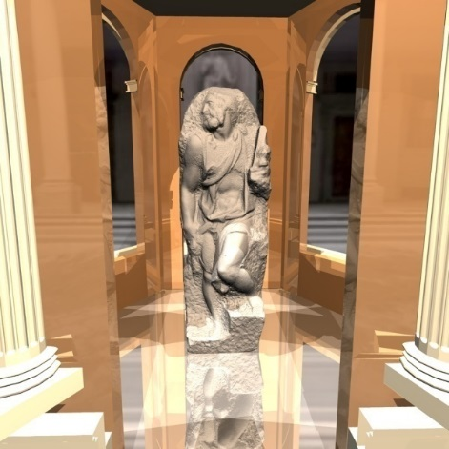
About the Instructor
Main Research Focus
Handle massive data for various computer graphics and geometric problems
Paper and video: http://sglab.kaist.ac.kr/papers.htm
YouTube videos: http://www.youtube.com/user/sglabkaist

Slide 3
About the Instructor
Notable recognitions
Co-chairs at ACM Symp. on Interactive 3D Graphics and Games
Best paper award at Pacific Graphics
Test-of-time award at High Performance Graphics
Interns/post.doc/collaborations at Disney, Adobe, AMD, Pixar
Produced two professors on rendering (GIST) and related topics

Slide 4
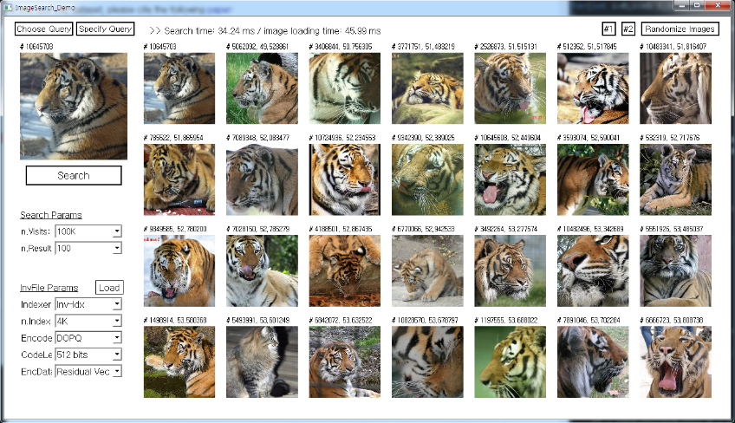
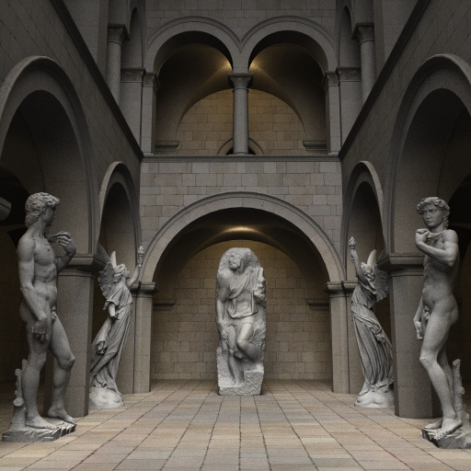
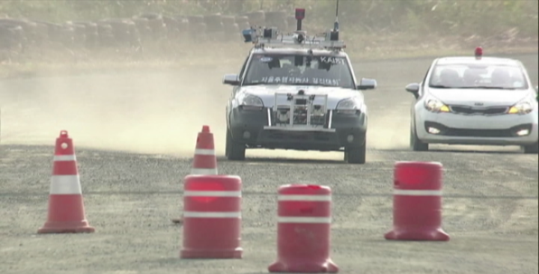
Present: Scalable Ray Tracing, Image Search, Motion Planning
Designing scalable graphics and geometric algorithms to efficiently handle massive models on commodity hardware
Image search
Motion planning
Photo-realistic rendering
Notes:
11 min

Slide 5
Course Information of CS380
Instructor: Sung-eui Yoon
Email: sungeui@gmail.com
Office: 3432 at CS building
Office hours: Right after class time (or by appt.)
Course webpage: http://sglab.kaist.ac.kr/~sungeui/CG/
Noah discussion page:
Use this one for sharing Q&A with other students, instead of personal communication to TAs
KLMS: homework submissions

Slide 6
Class Time
Date: every TTh
Time: 4:00pm ~ 5:15pm
4 credit course
A few (2) OpenGL courses given by TAs

Slide 7
TAs
TA email address: cs380ta@gmail.com
Use noah board, if possible
MyungBae Sohn (손명배)
Office: E3-1, 3443호
YoungKi Kown (권영기)
Office: E3-1, 3443호
HeeChan Shin (신희찬)
Office: E3-1, 3443호
HyunHo Ha (하현호)
Office: E3-1, 3422호
InSoo Kim (김인수)
Office: E3-1, 3422호

Slide 8
Prerequisites
Basic knowledge of linear algebra
E.g., matrix multiplication
Basic knowledge of programming skill
Preferably with C-like language (e.g., C and C++)
If you are unsure, consult the instructor at the end of this class

Slide 9
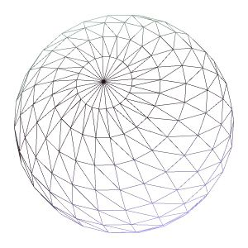
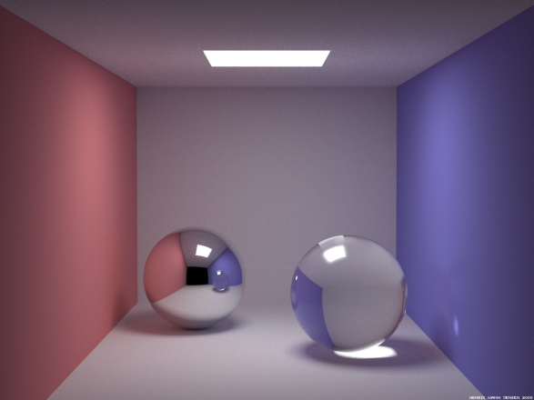
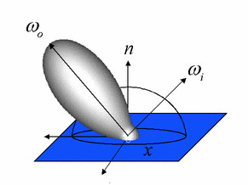
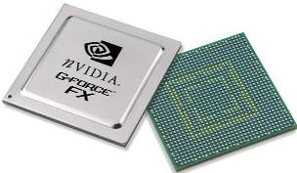
Overview
We will discuss various parts of computer graphics
Modelling
Simulation & Rendering
Image
Computer vision inverts the process
Image processing deals with images

Slide 10
Application of Computer Graphics
Games
Movies and film special effects
Product design and analysis
Medical applications
Scientific visualization

Slide 11
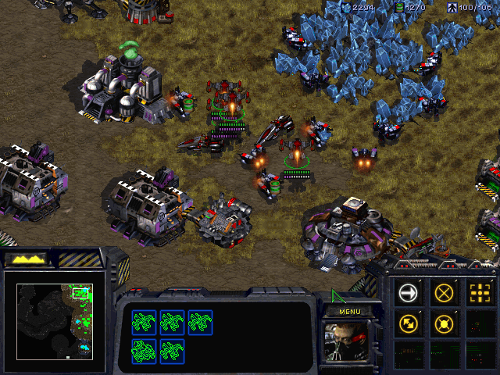
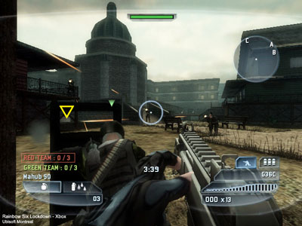
Games
2D game
3D shooting game

Slide 12
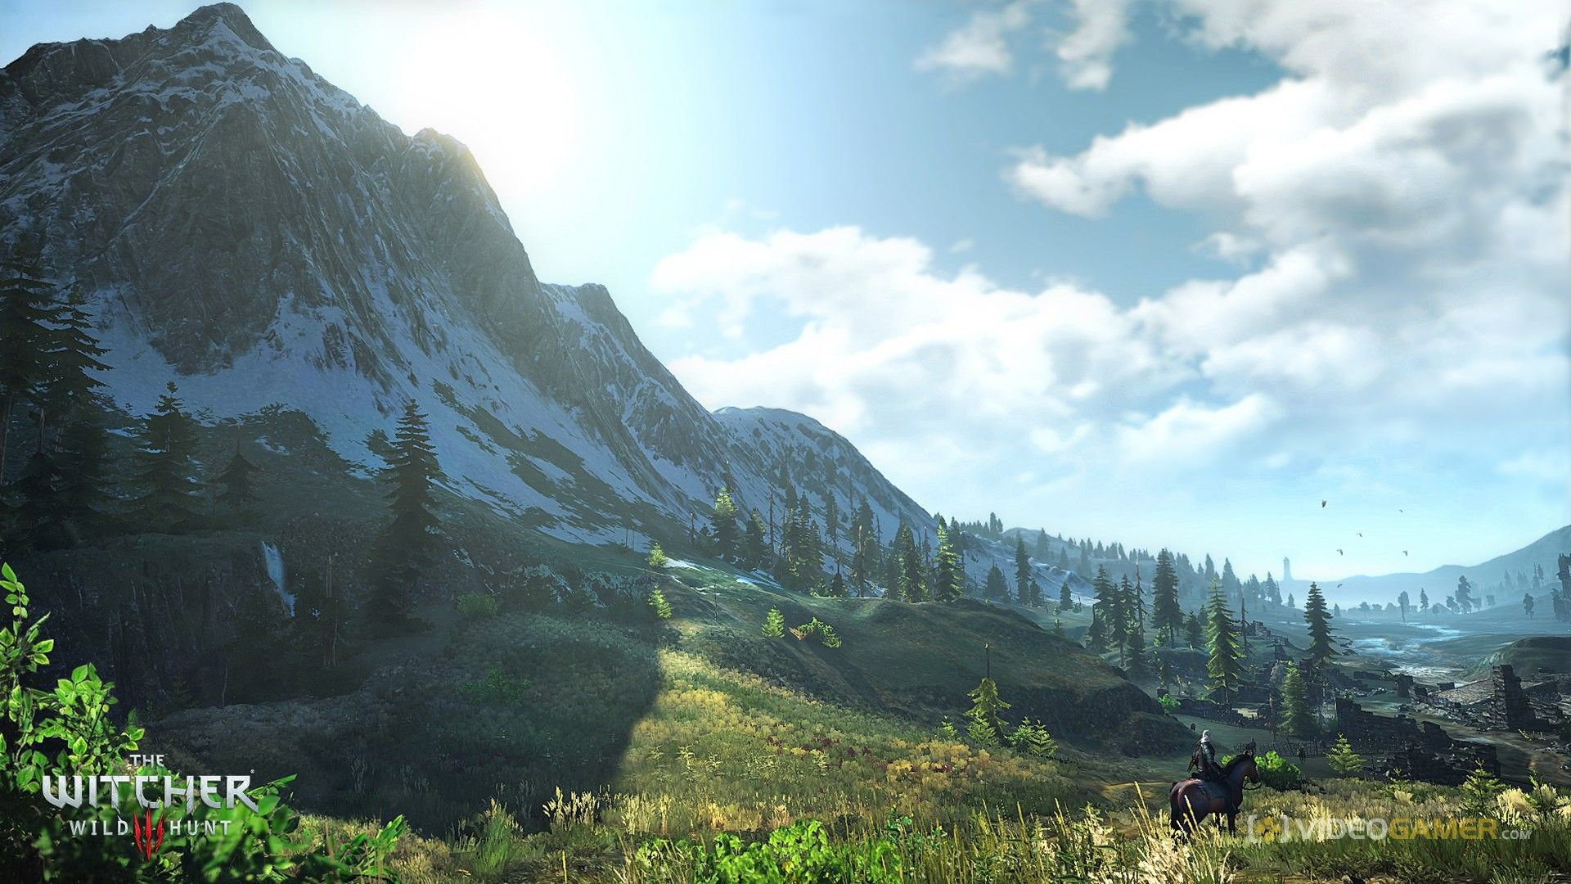
Large-Scale Open World w/ High Quality Rendering
Witcher 3
Used its own engine

Slide 13
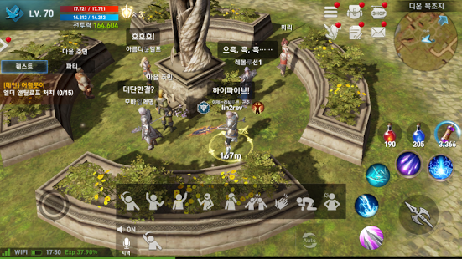
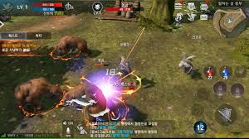
High Quality Mobile Games
Lineage 2 – Revolution
Based on Unreal engine

Slide 14
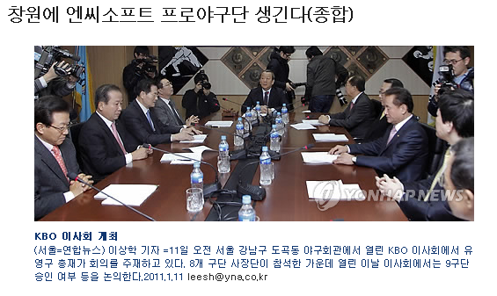
Game Industry at Korea
One of biggest IT sectors in Korea
A game company can have its own pro. Baseball team (e.g., NC Dinos)
새롭게 창단하는 구단은 모기업의 당기 순이익이 1천억원 이상이거나, …

Slide 15
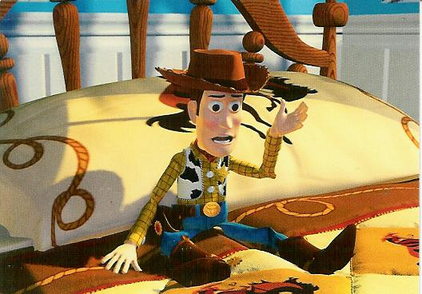
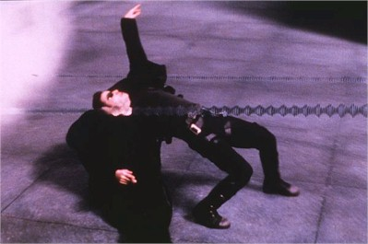
Movies and Film Special Effects
Toy story
Matrix

Slide 16
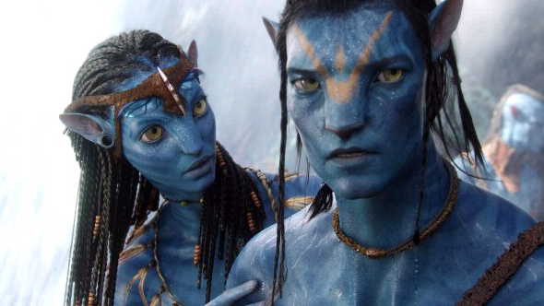
3D Movies
Avatar

Slide 17
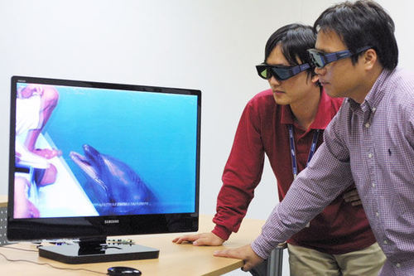
3D TV
Samsung 3D TV

Slide 18
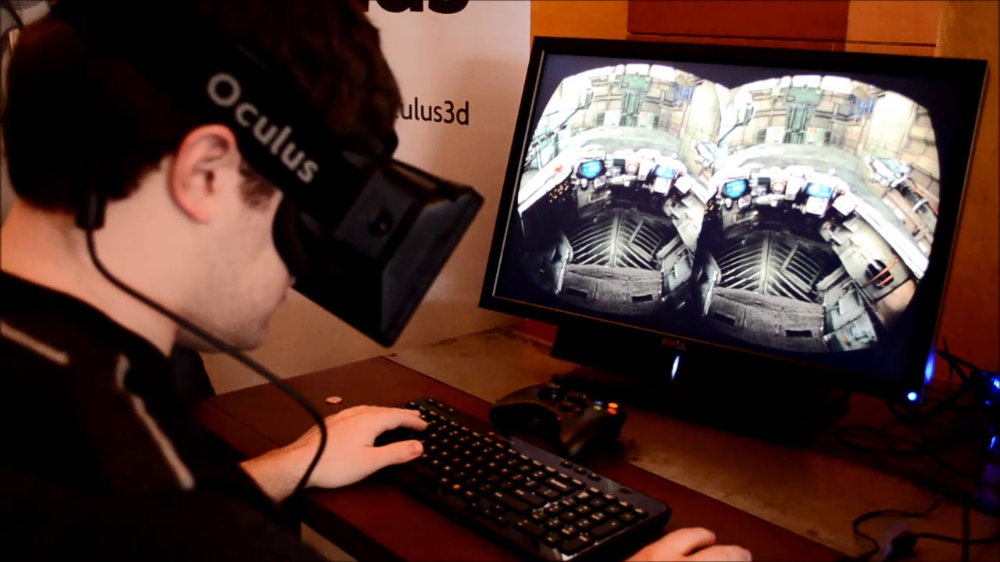
Head-Mounted Display (HMD) for VR

Slide 19
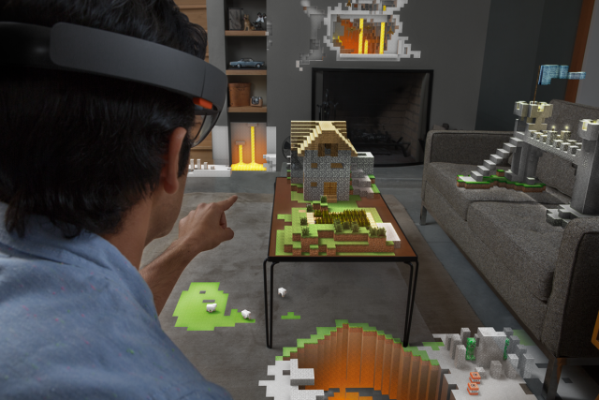
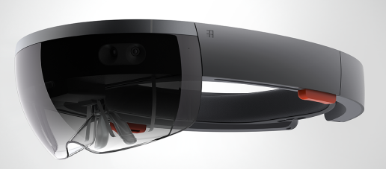
HoloLens for Augmented Reality (AR)
MS

Slide 20
Killer App. For AR

Slide 21
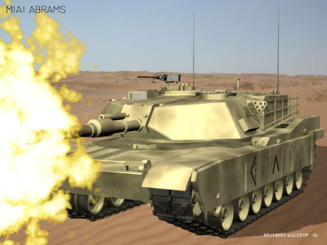
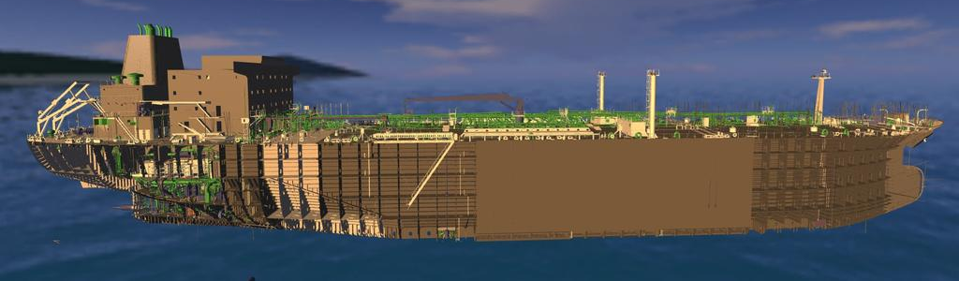
Product Design and Analysis
Computer-aided design (CAD)

Slide 22
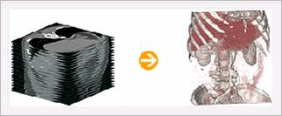
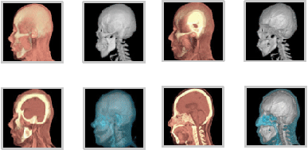
Medical Applications
Visualizing data of CT, MRI, etc
Rapidia homepage

Slide 23
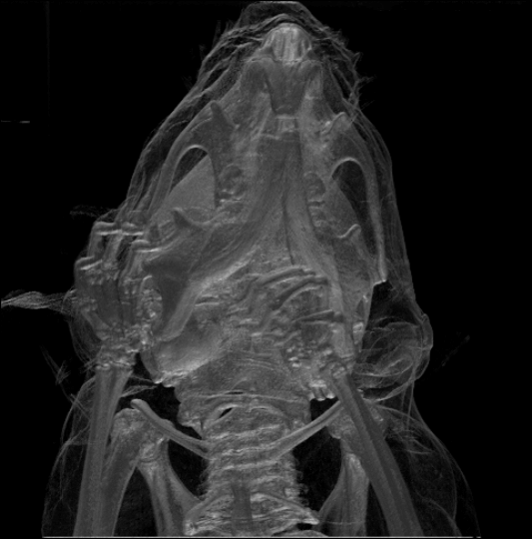
Medical Applications
Visualizing data of CT, MRI, etc
Wikipedia
Mouse skull (CT)

Slide 24
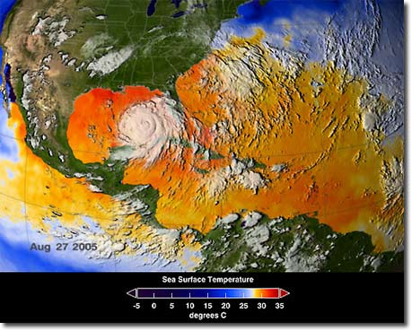
Scientific Applications
Weather visualization
LLNL

Slide 25
Topics
Mathematical tools
3D models and interaction
Hidden surface removal
Rasterization
Lighting and shading
Shadows
Texture mapping
Ray tracing
Global illumination
Curves and surfaces
Simplification and levels of detail
Collision detection
Graphics hardware, etc

Slide 26
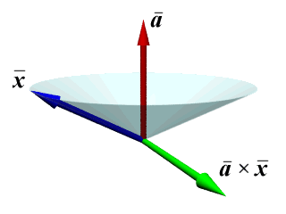
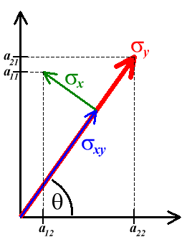
Mathematical Tools
Homogeneous coordinates
Vectors
Planes
Frames
Transformations

Slide 27
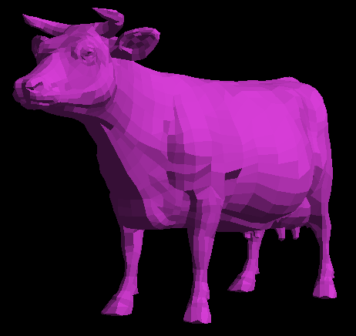
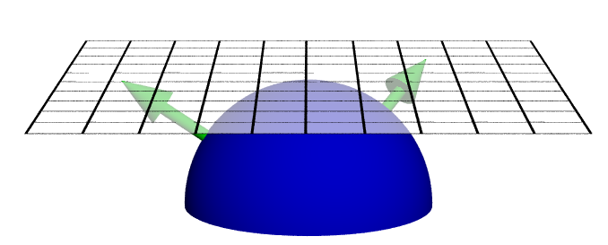
3D Models and Interaction
Loading and view models
Picking and selection
Modeling a trackball
Virtual reality (VR) is all about interaction

Slide 28
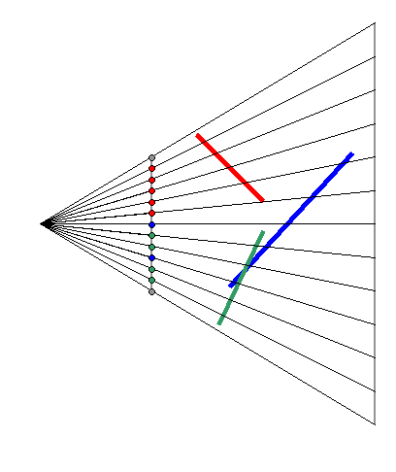
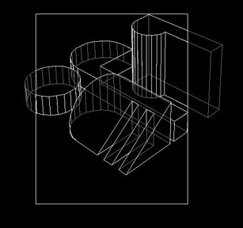
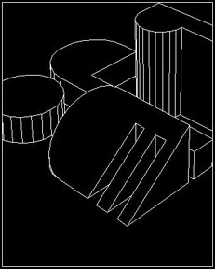
Hidden Surface Removal
Classic problem
BSP trees
Ray casting
Depth buffering

Slide 29
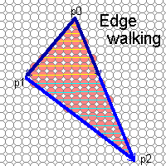
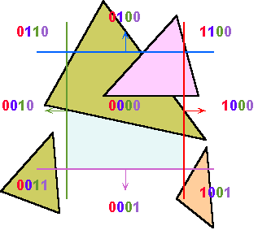
Rasterization
Clipping
Scan conversion

Slide 30
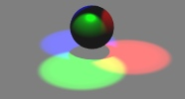
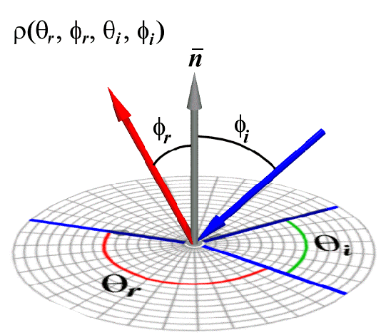
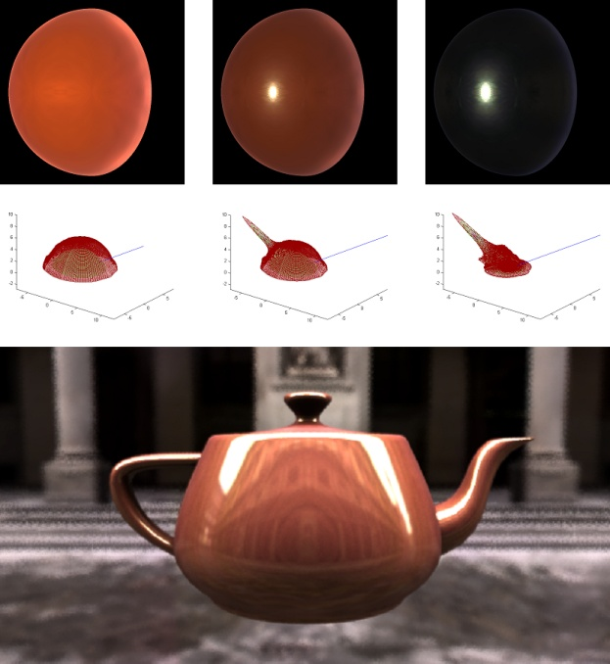
Lighting and Shading
Flat, gouraud, and phong shading
Empirical and physically-based illumination models
BRDFs

Slide 31
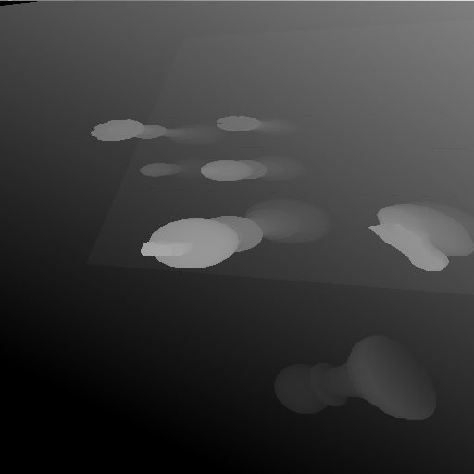
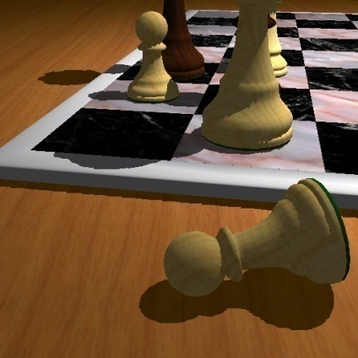
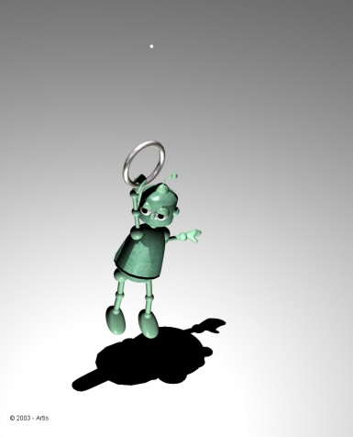
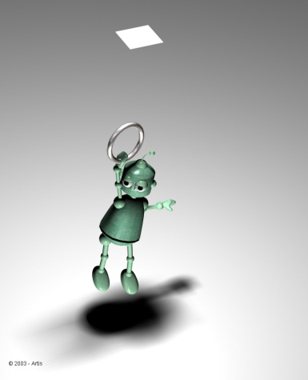
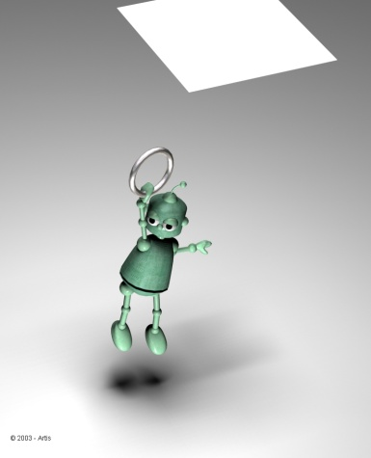
Shadows
Shadow volumes
Shadow maps
Images courtesy of Stamminger and Drettakis 02
Umbra
Penumbra

Slide 32
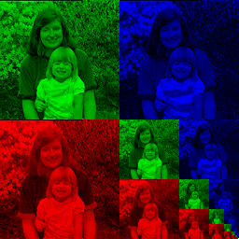
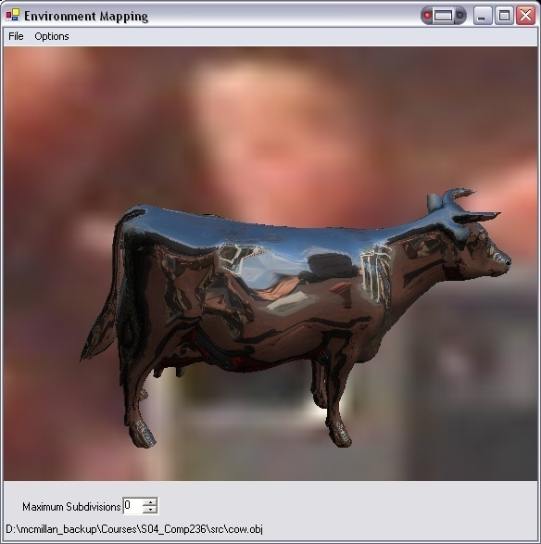
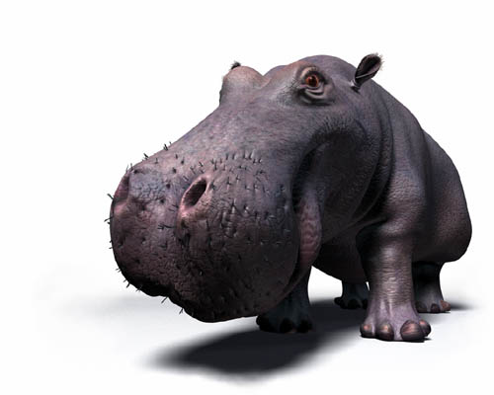
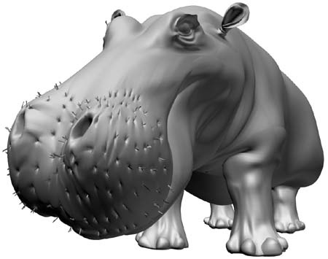
Texture Mapping
Surface parameterization
Mipmaps and filtering
Reflection and environment mapping

Slide 33
Ray Tracing
Object intersection
Reflection and refraction
Depth-of-field, motion blur, glossy reflections, soft shadows

Slide 34
Global Illumination
Rendering equation
Path tracing, photon mapping, radiosity
Images courtesy of Caligari (www.caligari.com)

Slide 35
Curves and Surfaces
Bezier curves and B-splines
NURBS and subdivision surfaces
Parametric solids
0-levels
1-level
2-levels
3-levels
4-levels
5-levels

Slide 36
Simplification and LOD
Levels of detail
Progressive meshes
82 million triangles

Slide 37
Graphics Hardware
History
Architecture
Shading languages
Future

Slide 38
Animation
Keyframing
Parameteric splines
Motion capture
Simulation

Slide 39
Textbook
A book of Rendering
Draft, Sung-eui Yoon
1st Edition near the end of 2017
Available freely as a pdf file through the course web page

Slide 40
Reference – OpenGL
OpenGL Programming Guide
Addison-Wesley Professional
Ver 4.3 is ordered to KAIST library
Version 1.1 is available at internet and the course webpage
Reference book is also available
http://www.glprogramming.com/blue

Slide 41
Reference
Fundamentals of Computer Graphics
Peter Shirley et al.
AK Peters
Available at the KAIST library

Slide 42
Resource on Physically-based Rendering
Reference
Physically based renderig, Matt Pharr et al.
Advanced Global Illumination, Philip Dutre et al. 2nd edition
Realistic Image Synthesis Using Photon Mapping, Henrik Jensen
Realistic Ray Tracing, 2nd edition, Peter Shirley et al.

Slide 43
Other Reference
Technical papers
Graphics-related conference (SIGGRAPH, etc)
http://kesen.huang.googlepages.com/
Course homepages
Google or Google scholar

Slide 44
Program Assignments (PAs)
6 or 7 PAs
Viewing and manipulating 3D models with OpenGL
Rasterization and clipping
Texture mapping and lighting
Raytracing
Their difficulty is growing!

Slide 45
Grading
Mid-term: 20% Final-term: 30% Quiz and assignments: 50%
Late policy
No score for late submissions
Submit your work before the deadline!

Slide 46
Class Attendance Rule
Late two times → count as one absence
Every two absences →lower your grade (e.g., A- → B+)
To check attendance, I’ll call your names or take pictures
If you are in situations where you should be late, notify earlier

Slide 47
Honor Code and Etiquette
Collaboration encouraged, but assignments must be your own work
Cite any other’s work if you use their codes
If you copy someone else’s codes, you will get F
We will use a code copy checking tool to find any copy
Classroom etiquette
Help you and your peer to focus on the class
Turn off cell phones
Arrive to the class on time
Avoid private conversations
Be attentive in class

Slide 48
Official Language in Class
English
I’ll give lectures in English
I may explain again in Korean if materials are unclear to you
You are also recommended to use English, but not required

Slide 49
Other Related Courses
CS580 (Graduate-level introductory CG, Spring semester)
Focus on high quality rendering, which will be briefly touched at the end of CS380
Undergraduate students can take the course
CS380 (Spring semester)
CS482 (Fall semester)
Focus on advanced, real-time rendering techniques
All the courses will be given among me, Prof. Park, and Prof. Kim.

Slide 50
Homework for Each Class
Go over the next lecture slides before the class
Just 10 min ~ 20 min for this should be okay
Two video abstract submission every week
Question submissions at least four times before the mid-term exam

Slide 51
Next Time...
Screen & world space
Basic OpenGL usage

Slide 52
About You
Name
What is your major?
Previous graphics experience
Any questions?

