Slide 1

CS380: Computer Graphics
Viewing Transformation
Sung-Eui Yoon
(윤성의)
Course URL:
http://sglab.kaist.ac.kr/~sungeui/CG/
Notes:
1

Slide 2
Class Objectives (Ch. 7)
Know camera setup parameters
Understand viewing and projection processes

Slide 3
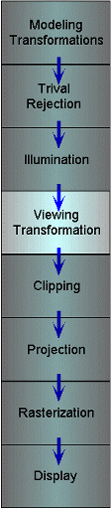
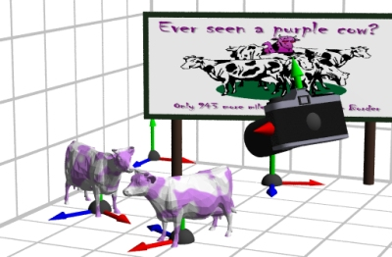
Viewing Transformations
Map points from world spaces to eye space
  Can be composed from rotations and translations

Slide 4
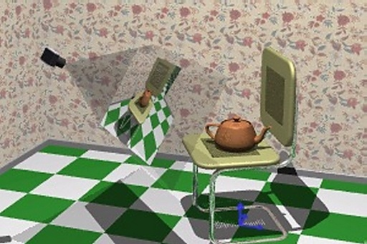
Viewing Transformations
Goal: specify position and orientation of our camera
  Defines a coordinate frame for eye space

Slide 5
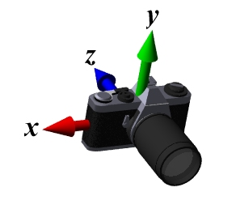
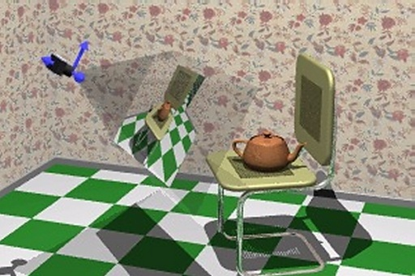
“Framing” the Picture
A new camera coordinate
  Camera position at the origin
  Z-axis aligned with the view direction
  Y-axis aligned with the up direction
More natural to think of camera as an object positioned in the world frame
Notes:
However, it is more “natural” to think of the camera as if it were an object positioned in the world frame. So we will define the mapping between frames using the more intuitive model (considering the camera as a model).

Slide 6
Viewing Steps
Rotate to align the two coordinate frames and, then, translate to move world space origin to camera’s origin

Slide 7
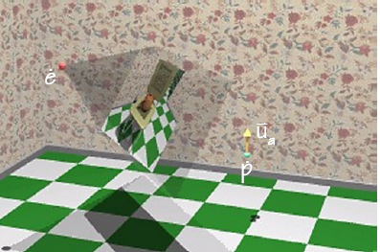
An Intuitive Specification
Specify three quantities:
  Eye point (e) - position of the camera
  Look-at point (p) - center of the image
  Up-vector ( ) - will be oriented upwards in the image

Slide 8
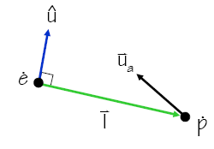
Deriving the Viewing Transformation
First compute the look-at vector and normalize
Compute right vector and normalize
  Perpendicular to the look-at and up vectors
Compute up vector
  is only approximate direction
  Perpendicular to right and look-at vectors

Slide 9
Rotation Component
Map our vectors to the cartesian coordinate axes
To compute we invert the matrix on the right
  This matrix M is orthonormal (or orthogonal) – its rows are orthonormal basis vectors: vectors mutually orthogonal and of unit length
  Then,
  So,
Notes:
M(t) * M = I

Slide 10
Translation Component
The rotation that we just derived is specified about the eye point in world space
  Need to translate all world-space coordinates so that the eye point is at the origin
  Composing these transformations gives our viewing transform, V
Transform a world-space point into a point in the eye-space
Notes:
W c = e R T c
RT = a matrix converting from world to eye

Slide 11
Viewing Transform in OpenGL
OpenGL utility (glu) library provides a viewing transformation function:
gluLookAt (double eyex, double eyey, double eyez,
  double centerx, double centery, double centerz,
  double upx, double upy, double upz)
  Computes the same transformation that we derived and composes it with the current matrix

Slide 12
Example in the Skeleton Codes of PA2
void setCamera ()
{ …
// initialize camera frame transforms
for (i=0; i < cameraCount; i++ )
{
double* c = cameras[i];
wld2cam.push_back(FrameXform());
glPushMatrix();
glLoadIdentity();
gluLookAt(c[0],c[1],c[2], c[3],c[4],c[5], c[6],c[7],c[8]);
glGetDoublev( GL_MODELVIEW_MATRIX, wld2cam[i].matrix() );
glPopMatrix();
cam2wld.push_back(wld2cam[i].inverse());
}
….
}

Slide 13
Projections
Map 3D points in eye space to 2D points in image space
Two common methods
  Orthographic projection
  Perspective projection

Slide 14
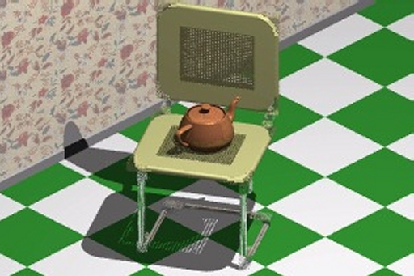
Orthographic Projection
Projects points along lines parallel to z-axis
  Also called parallel projection
  Used for top and side views in drafting and modeling applications
Appears unnatural due to lack of perspective foreshortening
Notice that the parallel lines of the tiled floor remain parallel after orthographic projection!

Slide 15
Orthographic Projection
The projection matrix for orthographic projection is very simple
Next step is to convert points to NDC

Slide 16
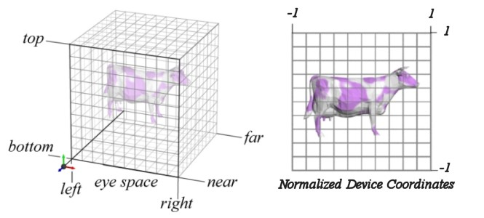
View Volume and Normalized Device Coordinates
Define a view volume
Compose projection with a scale and a translation that maps eye coordinates to normalized device coordinates

Slide 17
Orthographic Projections to NDC
Some sanity checks:
Scale the z coordinate in exactly the same way .Technically, this coordinate is not part of the projection. But, we will use this value of z for other purposes
Notes:
r-l : 2 = x- l : x’ – (-1)

Slide 18
Orthographic Projection in OpenGL
This matrix is constructed by the following OpenGL call:
void glOrtho(double left, double right,
double bottom, double top,
double near, double far );
2D version (another GL utility function):
void gluOrtho2D( double left, GLdouble right,
double bottom, GLdouble top);
, which is just a call to glOrtho( ) with near = -1 and far = 1

Slide 19
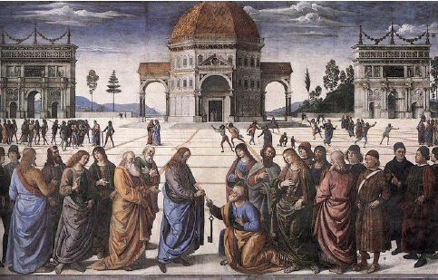
Perspective Projection
Artists (Donatello, Brunelleschi, Durer, and Da Vinci) during the renaissance discovered the importance of perspective for making images appear realistic
Perspective causes objects nearer to the viewer to appear larger than the same object would appear farther away
Homogenous coordinates allow perspective projections using linear operators

Slide 20
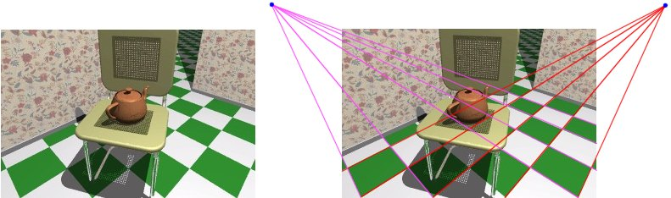
Signs of Perspective
Lines in projective space always intersect at a point

Slide 21





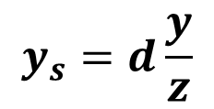




Perspective Projection for a Pinhole Camera
Image sensor
plane
View plane
$$p$$
$$p′$$
$$y$$
$$e$$
$$y_{s}$$
$$p_{d}$$
$$p_{z}$$
$$d$$
$$z$$
$$y_{s}=d\frac{y}{z}$$

Slide 22
Perspective Projection Matrix
The simplest transform for perspective projection is:
We divide by w to make the fourth coordinate 1
  In this example, w = z
  Therefore, x’ = x / z, y’ = y / z, z’ = 0
Notes:
A line maps to a point in 2D space
Then, we can even represent perspective projection as a matrix

Slide 23
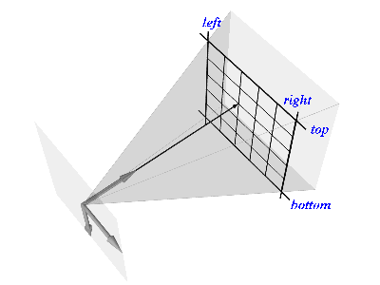
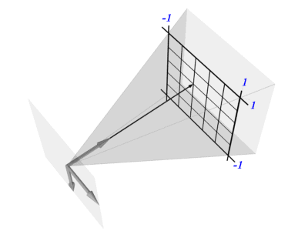
Normalized Perspective
As in the orthographic case, we map to normalized device coordinates
NDC

Slide 24
NDC Perspective Matrix
The values of left, right, top, and bottom are specified at the near depth. Let’s try some sanity checks:
Notes:
It takes many steps to derive in this class.

Slide 25
NDC Perspective Matrix
The values of left, right, top, and bottom are specified at the near depth. Let’s try some sanity checks:

Slide 26
Perspective in OpenGL
OpenGL provides the following function to define perspective transformations:
void glFrustum(double left, double right,
double bottom, double top,
double near, double far);
Some think that using glFrustum( ) is nonintuitive. So OpenGL provides a function with simpler, but less general capabilities
void gluPerspective(double vertfov, double aspect,
double near, double far);

Slide 27
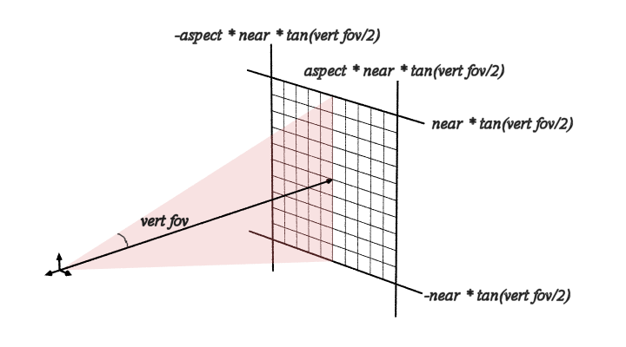
gluPerspective()
Simple “camera-like” model
Can only specify symmetric frustums
Substituting the extents into glFrustum()

Slide 28
gluPerspective()
Substituting the extents into glFrustum()
Simple “camera-like” model
Can only specify symmetric frustums

Slide 29
Example in the Skeleton Codes of PA2
void reshape( int w, int h)
{
width = w; height = h;
glViewport(0, 0, width, height);
glMatrixMode(GL_PROJECTION); // Select The Projection Matrix
glLoadIdentity(); // Reset The Projection Matrix
// Define perspective projection frustum
double aspect = width/double(height);
gluPerspective(45, aspect, 1, 1024);
glMatrixMode(GL_MODELVIEW); // Select The Modelview Matrix
glLoadIdentity(); // Reset The Projection Matrix
}

Slide 30
Class Objectives were:
Know camera setup parameters
Understand viewing and projection processes

Slide 31
Homework
Suggested reading:
  Ch. 12, “Data Structure for Graphics”
Watch SIGGRAPH Videos
Go over the next lecture slides

Slide 32
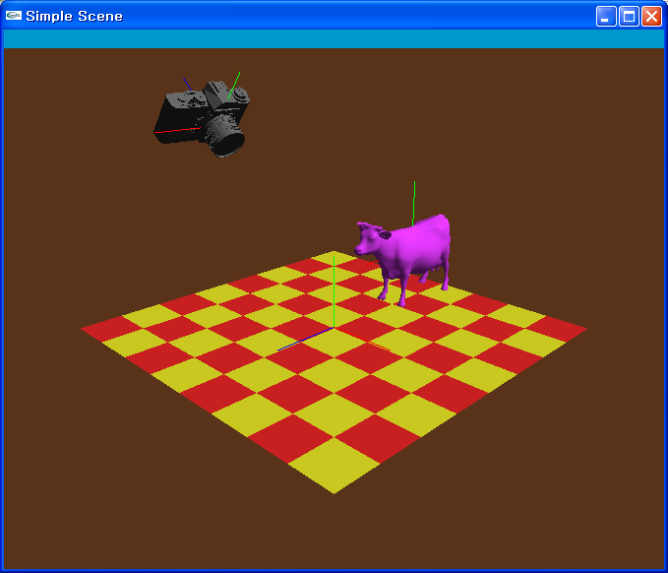
PA3
PA2: perform the transformation at the modeling space
PA3: perform the transformation at the viewing space

Slide 33
Next Time
Interaction

Slide 34
figs

