Slide 1

CS380: Computer Graphics
Clipping and Culling
Sung-Eui Yoon
(윤성의)
Course URL:
http://sglab.kaist.ac.kr/~sungeui/CG/
Notes:
1

Slide 2
Class Objectives
Understand clipping and culling
Understand view-frustum, back-face culling, and hierarchical culling methods
Know various possibilities to perform culling and clipping in the rendering pipeline
Related chapter:
  Ch. 6: Clipping and Culling

Slide 3
Culling and Clipping
Culling
  Throws away entire objects and primitives that cannot possibly be visible
  An important rendering optimization (esp. for large models)
Clipping
  “Clips off” the visible portion of a primitive
  Simplifies rasterization
  Also, used to create “cut-away” views of a model

Slide 4
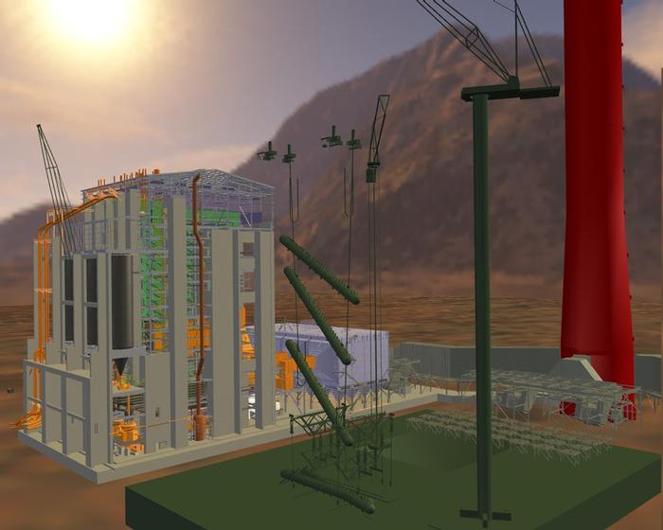
Culling Example
Power plant model
(12 million triangles)

Slide 5
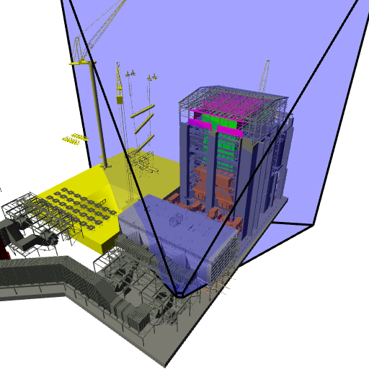
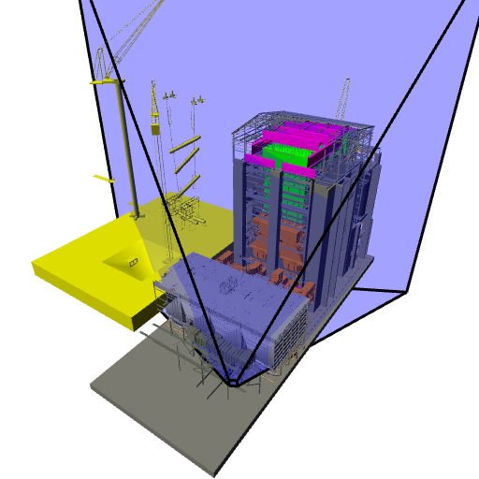
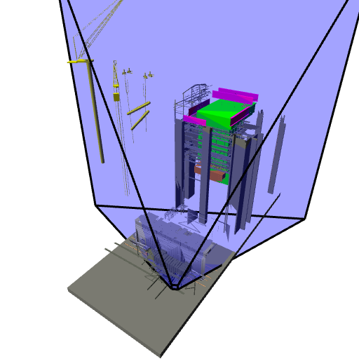
Culling Example
Full model
12 Mtris
View frustum culling
10 Mtris
Occulsion culling
1 Mtris

Slide 6
Lines and Planes
Implicit equation for line (plane):
If is normalized then d gives the distance of the line (plane) from the origin along
⋅
l ⋅ p = 0
d
(0,0)
Notes:
Let (x, y) to be the point that will give you the distance from (0, 0).
Then, Nx * x + Ny * y – d = 0
And, (Nx, Ny) = s( x, y) and Nx*Nx + Ny*Ny = 1.
→ S = d
Then, sqrt (x*x + y*y) = d.

Slide 7
Lines and Planes
Lines (planes) partition 2D (3D) space:
  Positive and negative half-spaces
The intersection of negative half-spaces defines a convex region
⋅
l ⋅ p = 0
d
(0,0)

Slide 8
Testing Objects for Containment
+
+
+
+
−
+
−
−
−
+
+
+
−
−
−
Outside
Straddling
Inside

Slide 9
Conservative Testing
r
r
r
Outside
Indeterminate
Inside
Use cheap, conservative bounds for trivial cases
Can use more accurate, more expensive tests for ambiguous cases if needed
Notes:
Ic will give a distance from c to the plane.
We can prove similar to what we did for the origin.

Slide 10
Hierarchical Culling
Bounding volume hierarchies accelerate culling by rejecting/accepting entire sub-trees at a time
Bounding volume hierarchies (BVHs)
  Object partitioning hierarchies
  Uses axis-aligned bounding boxes
A BVH

Slide 11

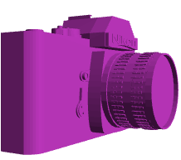

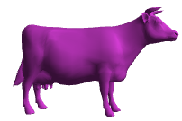
Hierarchical Culling
Simple algorithm:
while( node is indeterminate ) recurse on children
Indeterminate
not visited
visited
Inside
Indeterminate
Inside
Inside
Indeterminate
Outside

Slide 12
View Frustum Culling
Test objects against planes defining view frustum
How do you compute them?
Other planes can be computed similarly
1
-1
1
-1

Slide 13
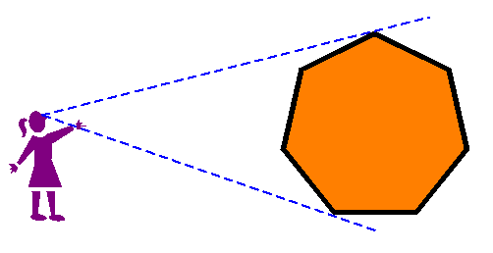
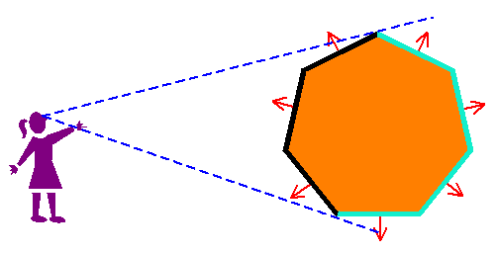

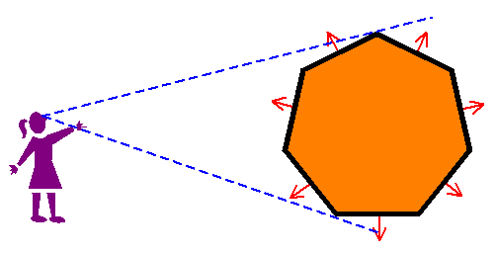
Back-Face Culling
Special case of occlusion - convex self-occlusion
  For closed objects (has well-defined inside and outside) some parts of the surface must be blocked by other parts of the surface
Specifically, the backside of the object is not visible

Slide 14
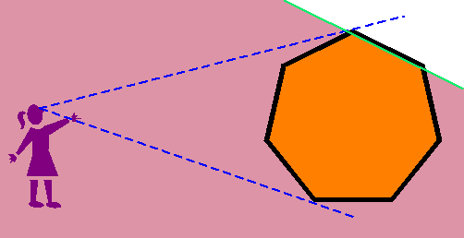
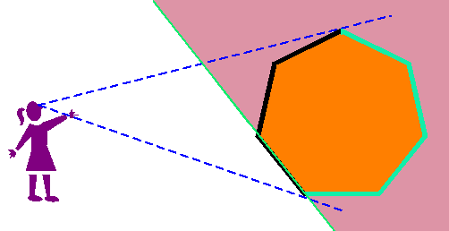
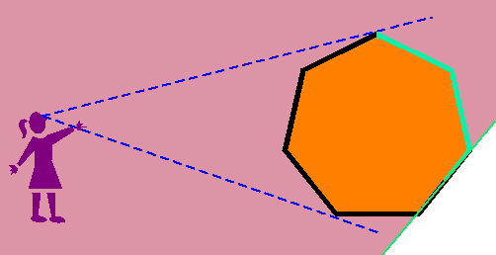
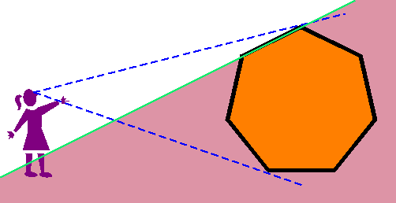
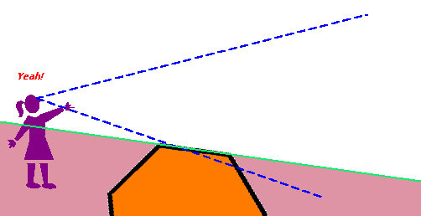
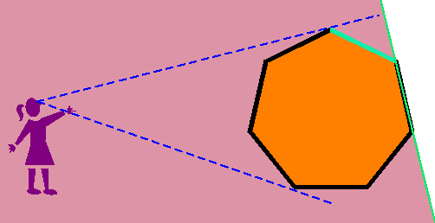
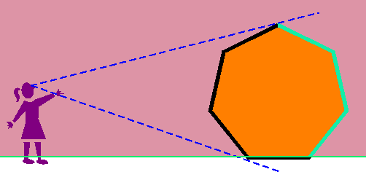
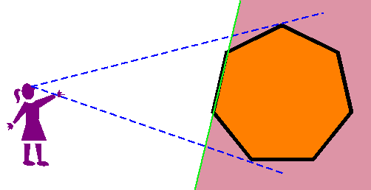
Face Plane Test
Compute the plane for the face:
Cull if eye point in the negative half-space

Slide 15
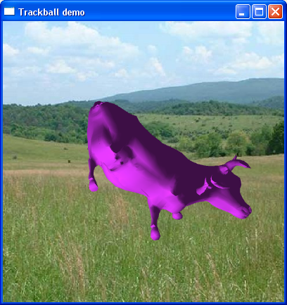
Back-Face Culling in OpenGL
Can cull front faces or back faces
Back-face culling can sometimes double performance
if (cull):
glFrontFace(GL_CCW) # define winding order
glEnable(GL_CULL_FACE) # enable Culling
glCullFace(GL_BACK) # which faces to cull
else:
glDisable(GL_CULL_FACE)
You can also do front-face culling!

Slide 16
Clipping a Line Segment against a Line
First check endpoints against the plane
  If they are on the same side, no clipping is needed
Interpolate to get new point
Vertex attributes interpolated the same way

Slide 17
Clipping a Polygon against a Line
Traverse edges
Keep edges that are entirely inside
Create new point when we exit
Throw away edges entirely outside
Create new point and new edge when we enter

Slide 18
Clipping against a Convex Region
Sutherland-Hodgman
  Just clip against one edge at
  a time

Slide 19
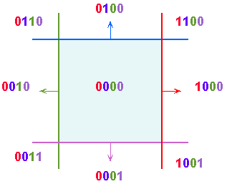
Outcodes
The Cohen-Sutherland clipping algorithm uses outcodes to quickly determine the visibility of a primitive
An outcode is created for each vertex
  It is a bit vector with a bit set for each plane the vertex is outside of
Works for any convex region

Slide 20
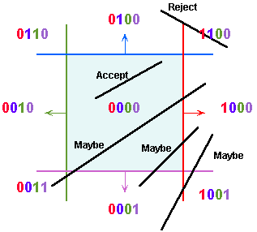
Outcode for Lines
(outcode1 OR outcode2) == 0
  line segment is inside
(outcode1 AND outcode2) != 0
  line segment is totally outside
(outcode1 AND outcode2) == 0
  line segment potentially crosses clip region
  at planes indicated by set bits in
  (outcode1 XOR outcode2)
False positive
  Some line segments that are classified as potentially crossing the clip region actually don’t
Notes:
INPUT OUTPUT
A B A XOR B
0 0 0
0 1 1
1 0 1
1 1 0

Slide 21
Outcodes for Triangles
Combine outcodes from vertices
(outcode1 OR outcode2 OR outcode3) == 0
  triangle is inside
(outcode1 AND outcode2 AND outcode3) != 0
  triangle is outside
(outcode1 AND outcode2 AND outcode3) == 0
  triangle potentially crosses clip region

Slide 22



Clipping in the Pipeline
$$\left(x, y, z, 1\right)$$
Option 1
Various transformations
$$\left(x^{′}, y′, z′, w′\right)$$
Option 2
What is the best place?
- Option 2 (clip space)
Homogeneous divide
1
-1
1
$$\left(x^{′}/w^{′}, y^{′}/w′, z^{′}/w′, 1\right)$$
Option 3
-1

Slide 23
View Frustum Clipping
Points in projective space need to be clipped before projection
Primitives that straddle the z=0 plane “flip” around infinity when projected
project then
draw gives you
this
view frustum
near plane
we don’t want
to see this part
clipped point
eye
Notes:
Near/far clipping is to preserve depth range. Clipping against the side faces adequate for proper projection

Slide 24
Clipping in the Clip Space
NDC simplify view frustum clipping
Clip after applying projection matrix, but before the divide by w
  clip coordinates
Easy in/out test and interpolation
w
x
-1
1
Notes:
3번 space에서 x= 1이 culling plane임. 그럼 2번에서는 x/w= 1→ x= w

Slide 25
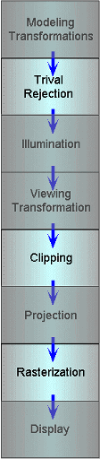
Culling and Clipping in the
Rendering Pipeline
View frustum culling, but performed in the application level
View frustum clipping and
back-face culling can be done here
Back-face culling done in setup phase
of rasterization

Slide 26
Class Objectives were:
Understand clipping and culling
Understand view-frustum, back-face culling, and hierarchical culling methods
Know various possibilities to perform culling and clipping in the rendering pipeline

Slide 27
Reading Assignment
Read the chapter “Raster Algorithms”

Slide 28
Next Time
Triangulating a polygon
Rasterizing triangles
Interpolating parameters
Notes:
What advantages does 3D culling have over 2D trivial rejection? (No need to project points to 2D)

