Slide 1
CS380: Computer Graphics
Triangle Rasterization
Sung-Eui Yoon
(윤성의)
Course URL:
http://sglab.kaist.ac.kr/~sungeui/CG/
Notes:
1

Slide 2
Class Objectives (Ch. 7)
Understand triangle rasterization using edge-equations
Understand mechanics for parameter interpolations
Realize benefits of incremental algorithms

Slide 3
Coordinate Systems
model
world
Modelview matrix
eye
clip
Divide by w
NDC
Viewport transformation
window

Slide 4
Primitive Rasterization
Rasterization converts vertex representation to pixel representation
Coverage determination
Computes which pixels (samples) belong to a primitive
Parameter interpolation
Computes parameters at covered pixels from parameters associated with primitive vertices

Slide 5
Coverage Determination
Coverage is a 2D sampling problem
Possible coverage criteria:
Distance of the primitive to sample point (often used with lines)
Percent coverage of a pixel (used to be popular)
Sample is inside the primitive (assuming it is closed)

Slide 6
Why Triangles?
Triangles are convex
Why is convexity important?
Regardless of a triangle’s orientation on the screen a given scan line will contain only a single segment or span of that triangle
Simplify rasterization processes

Slide 7
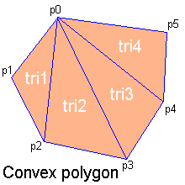
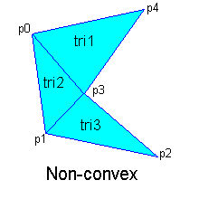
Why Triangles?
Arbitrary polygons can be decomposed into triangles
Decomposing a convex n-sided polygon is trivial
Suppose the polygon has ordered vertices {v₀, v₁, ... v_{n}}
It can be decomposed into triangles {(v₀,v₁,v₂), {v₀,v₂,v₃), (v₀,v_{i},v_{i+1}), ... (v₀,v_{n-1},v_{n})}
Decomposing a non-convex polygon is non-trivial
Sometimes have to introduce new vertices

Slide 8
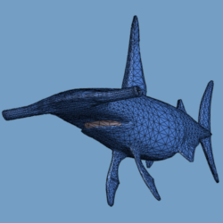
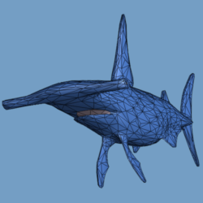
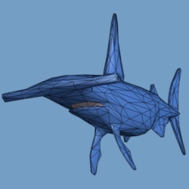
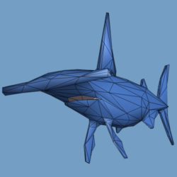
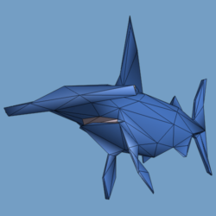
Why Triangles?
Triangles can approximate any 2-dimensional shape (or 3D surface)
Polygons are a locally linear (planar) approximation
Improve the quality of fit by increasing the number edges or faces

Slide 9
Scanline Triangle Rasterizer
Walk along edges and process one scanline at a time; also called edge walk method
Rasterize spans between edges

Slide 10
Scanline Triangle Rasterizer
Walk along edges and process one scanline at a time
Rasterize spans between edges

Slide 11
Scanline Triangle Rasterizer
Walk along edges and process one scanline at a time
Rasterize spans between edges

Slide 12
Scanline Triangle Rasterizer
Walk along edges and process one scanline at a time
Rasterize spans between edges

Slide 13
Scanline Triangle Rasterizer
Walk along edges and process one scanline at a time
Rasterize spans between edges

Slide 14
Scanline Triangle Rasterizer
Walk along edges and process one scanline at a time
Rasterize spans between edges

Slide 15
Scanline Rasterization
Advantages:
Can be made quite fast
Low memory usage for small scenes
Do not need full 2D z-buffer (can use 1D z-buffer on the scanline)
Disadvantages:
Does not scale well to large scenes
Lots of special cases

Slide 16
Rasterizing with Edge Equations
Compute edge equations from vertices
Compute interpolation equations from vertex parameters
Traverse pixels evaluating the edge equations
Draw pixels for which all edge equations are positive
Interpolate parameters at pixels

Slide 17
Edge Equation Coefficients
The cross product between 2 homogeneous points generates the line between them
A pixel at (x,y) is “inside” an edge if E(x,y)>0
$${\overline{e}}_{01}$$
$$A_{01}$$
$$B_{01}$$
$$C_{01}$$
$${E\left(x,y\right)={\overline{e}}_{01}\left(x,y\right)=A_{01}x+B_{01}y+C_{01}}_{}$$
Notes:
Line maps to a plane in 2D homogeneous space.
Then, this plane will pass through the origin (0, 0, 0) of the H-space.
Then, the cross vector of (v0 – origin) and (v1- origin) will compute the normal of the plane.
(A, B, C) (x, y, 1) = 0;

Slide 18
Shared Edges
Suppose two triangles share an edge. Which covers the pixel when the edge passes through the sample (E(x,y)=0)?
Both
Pixel color becomes dependent on order of triangle rendering
Creates problems when rendering transparent objects - “double hitting”
Neither
Missing pixels create holes in otherwise solid surface
We need a consistent tie-breaker!
triangle 1
triangle 2

Slide 19
Shared Edges
A common tie-breaker:
Coverage determination becomes
if( E(x,y) >0 || (E(x,y)==0 && t))
pixel is covered
(A,B)
triangle 1
triangle 2

Slide 20
Shared Vertices
Use “inclusion direction” as a tie breaker
Any direction can be used
Snap vertices to subpixel grid and displace so that no vertex can be at the pixel center
Pixel center
Snapped vertex

Slide 21
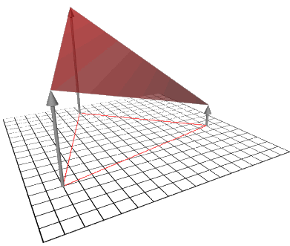
Interpolating Parameters
Specify a parameter, say redness (r) at each vertex of the triangle
Linear interpolation creates a planar function
y
x

Slide 22
Solving for Linear Interpolation Equations
Given the redness of the three vertices, we can set up the following linear system:
with the solution:

Slide 23
Triangle Area
// they are from edge equations
Area = 0 means that the triangle is not visible
Area < 0 means the triangle is back facing:
Reject triangle if performing back-face culling
Otherwise, flip edge equations by multiplying by -1

Slide 24
Interpolation Equation
The parameter plane equation is just a linear combination of the edge equations

Slide 25
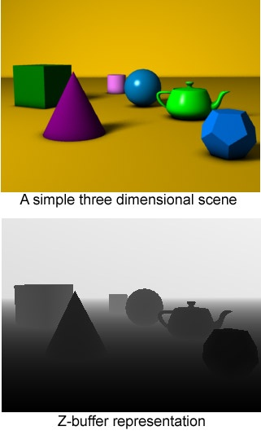
Z-Buffering
When rendering multiple triangles we need to determine which triangles are visible
Use z-buffer to resolve visibility
Stores the depth at each pixel
Initialize z-buffer to 1 (far value)
Post-perspective z values lie between 0 and 1
Linearly interpolate depth (z_{tri}) across triangles
If z_{tri}(x,y) < zBuffer[x][y] write to pixel at (x,y) zBuffer[x][y] = z_{tri}(x,y)
image from wikipedia.com

Slide 26
Traversing Pixels
Free to traverse pixels
Edge and interpolation equations can be computed at any point
Try to minimize work
Restrict traversal to primitive bounding box
Hierarchical traversal
Knock out tiles of pixels (say 4x4) at a time
Test corners of tiles against equations
Test individual pixels of tiles not entirely inside or outside

Slide 27
Incremental Algorithms
Some computation can be saved by updating the edge and interpolation equations incrementally:
Equations can be updated with a single addition!

Slide 28
Triangle Setup
Compute edge equations
3 cross products
Compute triangle area
A few additions
Cull zero area and back-facing triangles and/or flip edge equations
Compute interpolation equations
Matrix/vector product per parameter

Slide 29
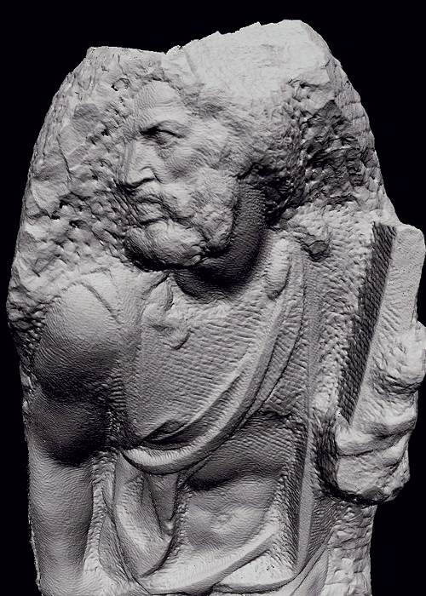
Massive Models
100,000,000 primitives
1,000,000 pixels_____
100 visible primitives/pixel
Cost to render a single triangle
Specify 3 vertices
Compute 3 edge equations
Evaluate equations one
St. Mathew models consisting of about 400M triangles (Michelangelo Project)

Slide 30
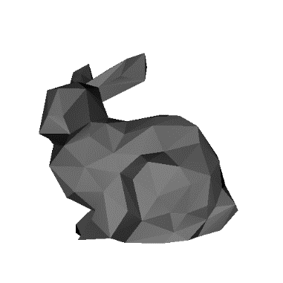
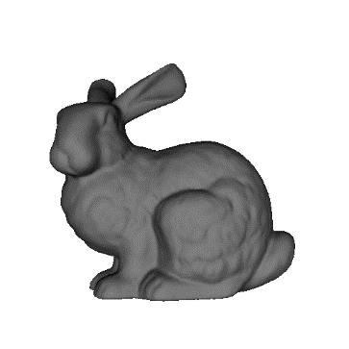
Multi-Resolution or Levels-of-Detail (LOD) Techniques
Basic idea
Render with fewer triangles when model is farther from viewer
Methods
Polygonal simplification
Viewer
Lower
resolution

Slide 31
Polygonal Simplification
Method for reducing the polygon count of mesh
Edge Collapse
Va
Vc
Va
Vb
Vertex Split

Slide 32
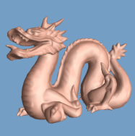
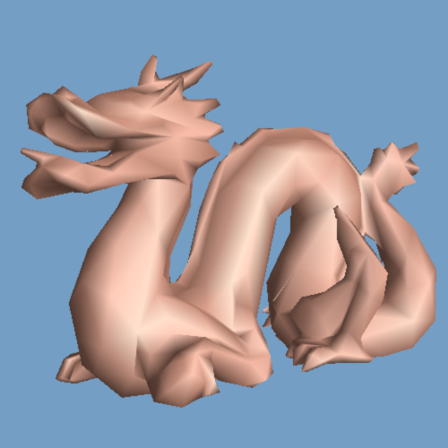
Static LODs
Pre-compute discrete simplified meshes
Switch between them at runtime
Has very low LOD selection overhead
2,000 faces
10,000 faces
50,000 faces
pop
pop
Excerpted from Hoppe’s slides
Notes:
For VDR based on static LOD, we create several approximations of the model at different levels of detail. A simplified mesh is used when the object is far away from the viewer. Its main benefit is its low LOD selection overhead at runtime. However, as a downside, viewer may notice visible popping artifacts that arises when switching between different LODs.

Slide 33
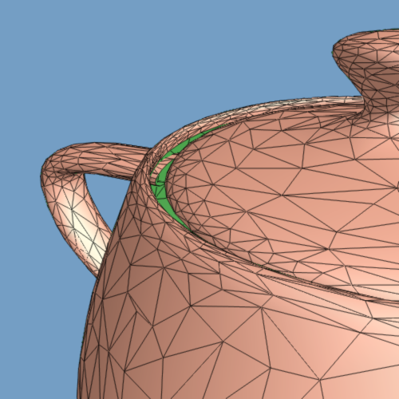
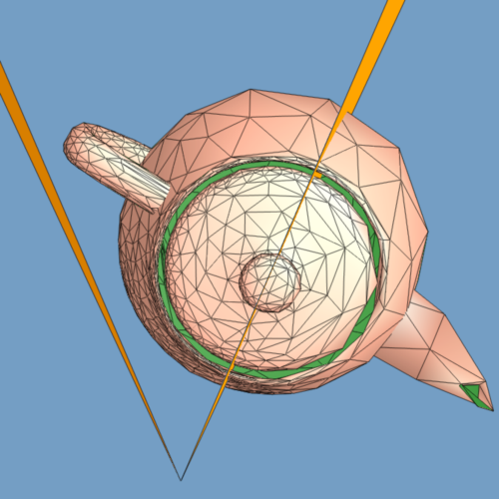
Dynamic Simplification
Provides smooth and varying LODs over the mesh [Hoppe 97]
1st person’s view
3rd person’s view
Play video
Notes:
To reduce this visual popping artifacts, dynamic LODs has been proposed. It provides smooth and varying LODs over the mesh. As you can see in 1st and 3rd person’s view of the teapot in the slide, high resolution is used on the portion of the mesh that are close to the viewer, and resolution of the mesh is gradually going down as portion of the mesh is farther away from the viewer. Although this dynamic simplification can provide superior visual quality, it require per-vertex view-dependent computation. Therefore, it was not scalable method to massive model consisting of tens or hundreds of millions of triangles.

Slide 34
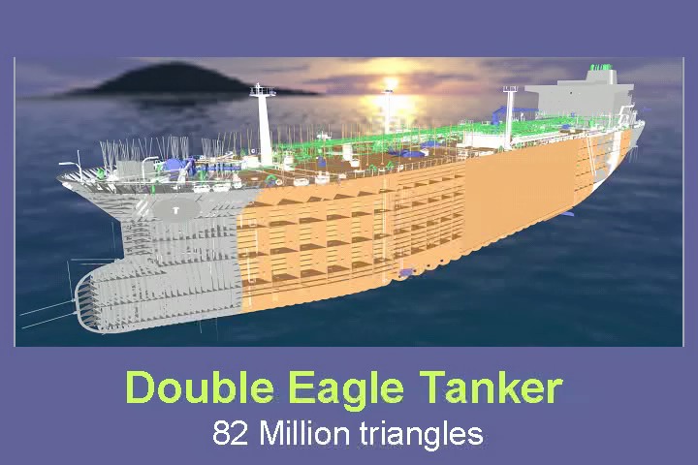
View-Dependent Rendering [Yoon et al., SIG 05]
30 Pixels of
error
Pentium 4
GeForce Go
6800 Ultra
1GB RAM
Notes:
Now, I’d like to show a live demo of VDR of Double eagle tanker in this laptop. To interactively render this complex CAD model with high image quality, I have applied DS and cache-coherent layout techniques that I mentioned earlier. Now, I’m switching to the running demo. I already loaded the data. I also set 20 pixels of error at current image resolution. It means that I’ll choose mesh resolution such that its geometric simplification error projected in the screen space is less than 30 pixels. Now, I’m going to run the path. By using techniques that I mentioned earlier, we are able to achieve interactive performance of rendering DE tanker with high image quality on this laptop.
Even though there has been consistent advance on performance of commodity hardware, novel DS, CO that I designed also have significantly improved this performance of this particular application. Now, I’d like to talk more about these algorithms respectively.

Slide 35
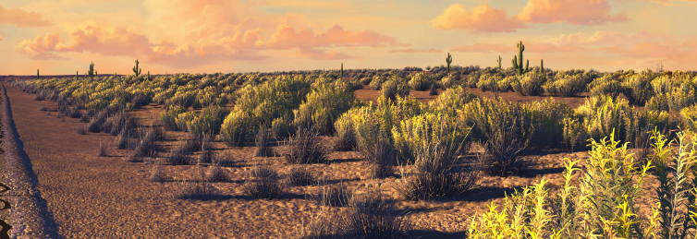
What if there are so many objects?
From “cars”, a Pixar movie

Slide 36
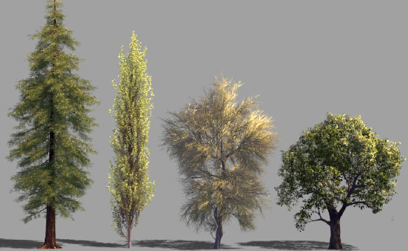
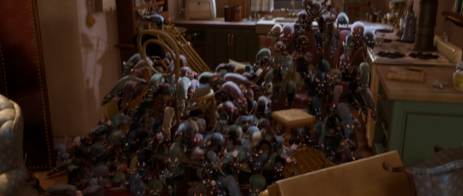
What if there are so many objects?
From a Pixar movie

Slide 37
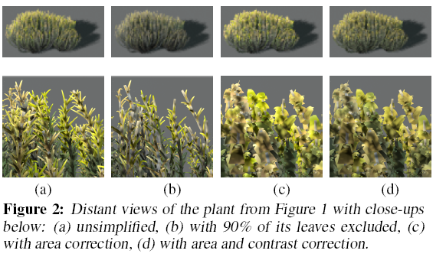
Stochastic Simplification of Aggregate Detail Cook et al., ACM SIGGRAPH 2007

Slide 38
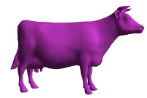
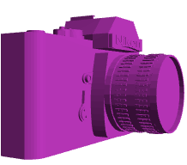
Occlusion Culling with Occlusion Queries
Render objects visible in previous frame
Known as occlusion representation or occlusion map

Slide 39
Occlusion Culling with Occlusion Queries
Turn off color and depth writes
Render object bounding boxes with occlusion queries
An occlusion query returns the number of visible pixels
newly visible

Slide 40
Occlusion Culling with Occlusion Queries
Re-enable color writes
Render newly visible objects

Slide 41
Class Objectives were:
Understand triangle rasterization using edge-equations
Understand mechanics for parameter interpolations
Realize benefits of incremental algorithms

Slide 42
Next Time
Illumination and shading
Texture mapping

Slide 43
Homework
Go over the next lecture slides before the class
Watch 2 SIGGRAPH videos and submit your summaries before every Tue. class
Just one paragraph for each summary

Slide 44
Any Questions?
Come up with one question on what we have discussed in the class and submit at the end of the class
1 for already answered questions
2 for typical questions
3 for questions with thoughts or that surprised me
Submit at least four times during the whole semester

Slide 45
Figs

Slide 46
$${\dot{v}}_{2}$$
$${\overline{e}}_{20}$$
$${\overline{e}}_{12}$$
$${\dot{v}}_{1}$$
$${\dot{v}}_{0}$$
$${\overline{e}}_{01}$$

Slide 47
(A,B)
triangle 1
triangle 2
Pixel center
Snapped vertex

