Slide 1
CS380: Computer Graphics
Illumination and Shading
Sung-Eui Yoon
(윤성의)
Course URL:
http://sglab.kaist.ac.kr/~sungeui/CG/
Notes:
1

Slide 2
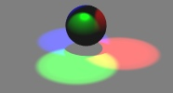
Course Objectives (Ch. 10)
Know how to consider lights
during rendering models
Light sources
Illumination models
Shading
Local vs. global illumination

Slide 3
Question: How Can We See Objects?
Emission and reflection!

Slide 4
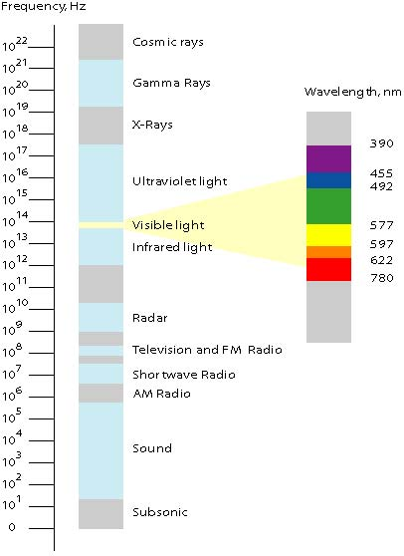
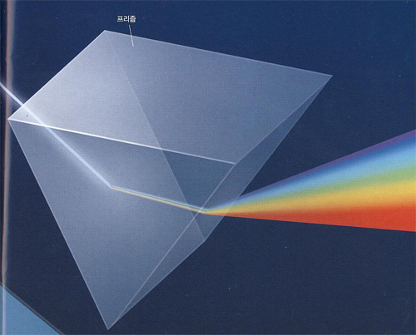
Question: How Can We See Objects?
Light
(sub-class of electromagnetic waves)
Prism
Sun
light
From Newton magazine
eMag Solutions

Slide 5
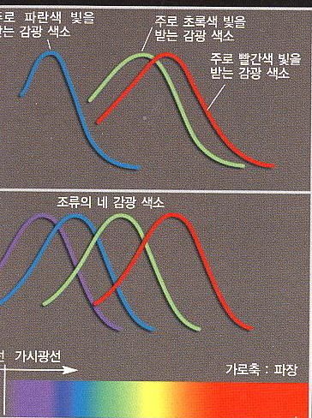
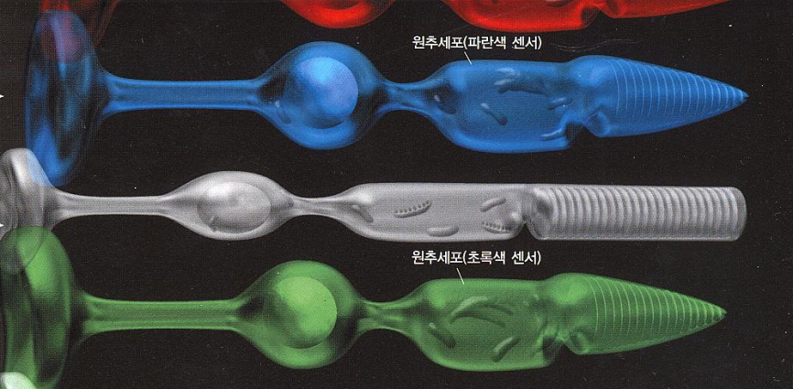
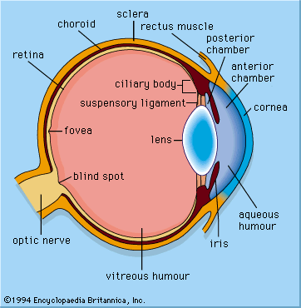
Question: How Can We See Objects?
Human
Sensitivity
Light
(sub-class of electromagnetic waves)
Birds
Rod and cone
Eye
From Newton magazine

Slide 6
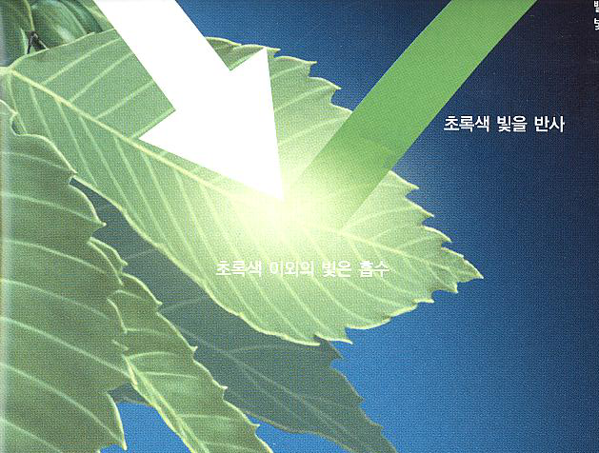
Question: How Can We See Objects?
Emission and reflection!
How about mirrors and white papers?
Light
(sub-class of electromagnetic waves)
White light
Reflect green light
Absorb lights other than green light
Eye
From Newton magazine

Slide 7
Illumination Models
Physically-based
Models based on the actual physics of light's interactions with matter
Empirical
Simple formulations that approximate observed phenomenon
Used to use many empirical models, but move towards using physically-based models

Slide 8
Two Components of Illumination
Light sources:
Emittance spectrum (color)
Geometry (position and direction)
Directional attenuation
Surface properties:
Reflectance spectrum (color)
Geometry (position, orientation, and micro-structure)
Absorption

Slide 9
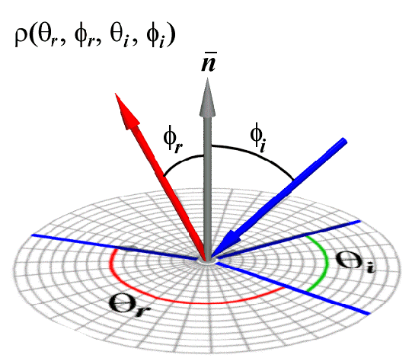
Bi-Directional Reflectance Distribution Function (BRDF)
Describes the transport of irradiance to radiance

Slide 10
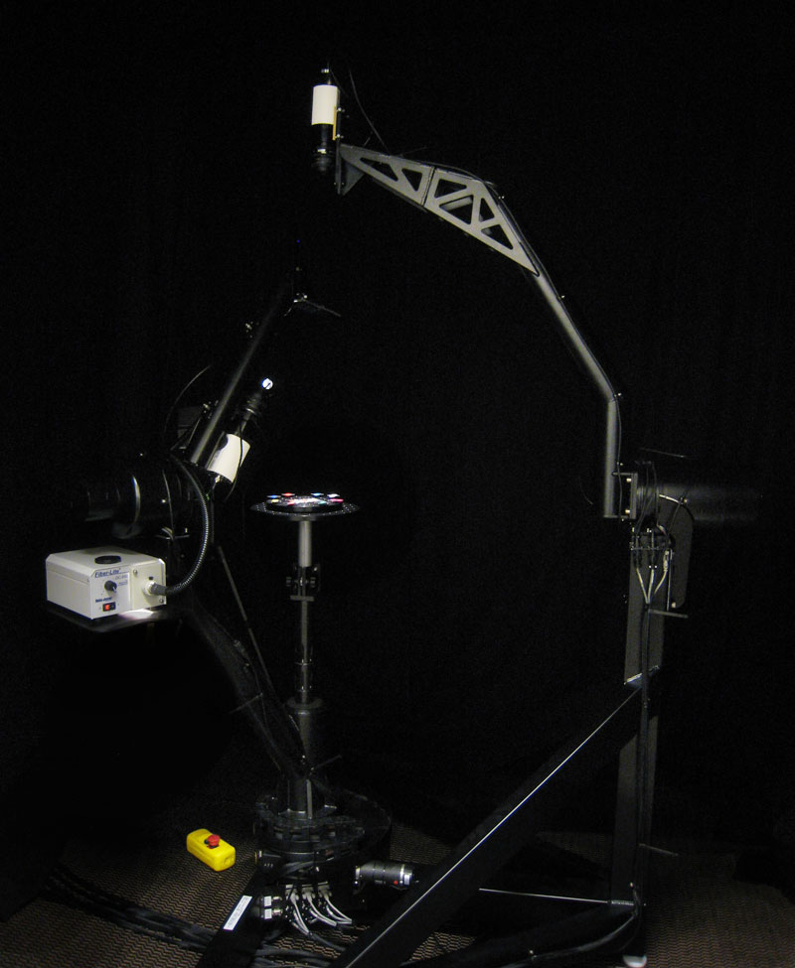
Measuring BRDFs
Gonioreflectometer
One 4D measurement at a time (slow)
Photograph of the University of Virginia Spherical Gantry

Slide 11
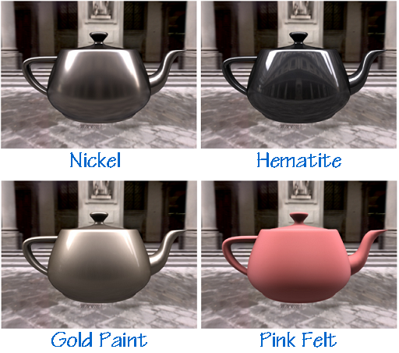
How to use BRDF Data?
One can make direct use of acquired BRDFs in a renderer

Slide 12
Two Components of Illumination
Simplifications used by most computer graphics systems:
Compute only direct illumination from the emitters to the reflectors of the scene
Ignore the geometry of light emitters, and consider only the geometry of reflectors

Slide 13
Ambient Light Source
A simple hack for indirect illumination
Incoming ambient illumination (I_{i,a}) is constant for all surfaces in the scene
Reflected ambient illumination (I_{r,a} ) depends only on the surface’s ambient reflection coefficient (k_{a}) and not its position or orientation
These quantities typically specified as (R, G, B) triples

Slide 14
Point Light Sources
Point light sources emit rays from a single point
Simple approximation to a local light source such as a light bulb
The direction to the light changes across the surface

Slide 15
Directional Light Sources
Light rays are parallel and have no origin
Can be considered as a point light at infinity
A good approximation for sunlight
The direction to the light source is constant over the surface
How can we specify point and directional lights?

Slide 16
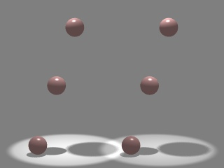
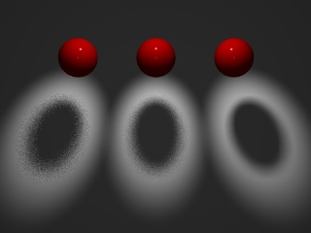
Other Light Sources
Spotlights
Point source whose intensity falls off away from a given direction
Area light sources
Occupies a 2D area (e.g. a polygon or a disk)
Generates soft shadows

Slide 17
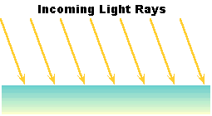
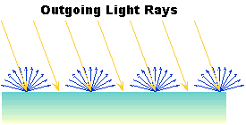
Ideal Diffuse Reflection
Ideal diffuse reflectors (e.g., chalk)
Reflect uniformly over the hemisphere
Reflection is view-independent
Very rough at the microscopic level
Follow Lambert’s cosine law

Slide 18
Lambert’s Cosine Law
The reflected energy from a small surface area from illumination arriving from direction is proportional to the cosine of the angle between and the surface normal

Slide 19
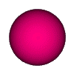
Computing Diffuse Reflection
Constant of proportionality depends on surface properties
The constant k_{d} specifies how much of the incident light I_{i} is diffusely reflected
When the incident light is blocked by the surface itself and the diffuse reflection is 0
Diffuse reflection for varying light directions
Notes:
Why are sphere’s used to show shading

Slide 20
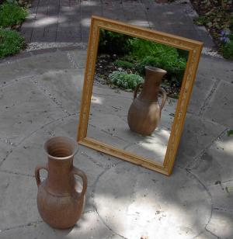
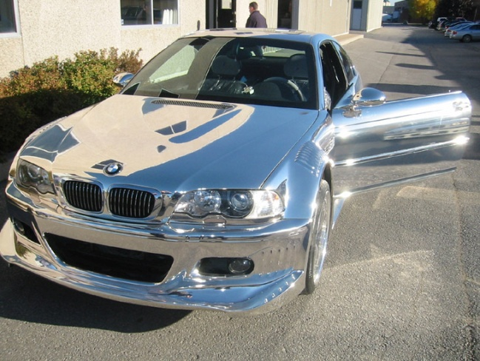
Specular Reflection
Specular reflectors have a bright, view dependent highlight
E.g., polished metal, glossy car finish, a mirror
At the microscopic level a specular reflecting surface is very smooth
Specular reflection obeys Snell’s law
Image source: astochimp.com and wiki

Slide 21
Snell’s Law
The relationship between the angles of the incoming and reflected rays with the normal is given by:
n_{i} and n_{o} are the indices of refraction for the incoming and outgoing ray, respectively
Reflection is a special case where n_{i} = n_{o} so θ_{o} = θ_{i}
The incoming ray, the surface normal, and the reflected ray all lie in a common plane

Slide 22
Computing the Reflection Vector
The vector R can be computed from the incoming light direction and the surface normal as shown below:
How?

Slide 23
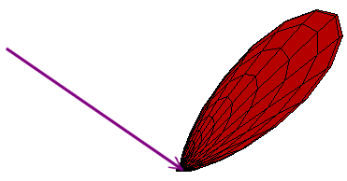
Non-Ideal Reflectors
Snell’s law applies only to ideal specular reflectors
Roughness of surfaces causes highlight to “spread out”
Empirical models try to simulate the appearance of this effect, without trying to capture the physics of it

Slide 24
Phong Illumination
One of the most commonly used illumination models in computer graphics
Empirical model and does not have no physical basis
is the direction to the viewer
is clamped to [0,1]
The specular exponent n_{s} controls how quickly the highlight falls off

Slide 25
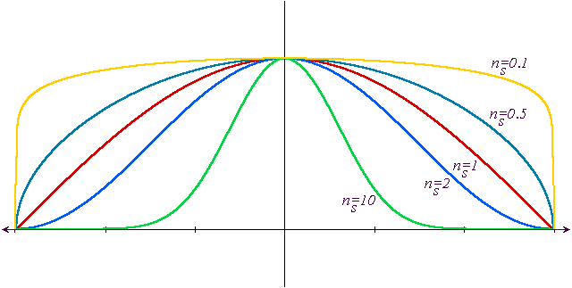
Effect of Specular Exponent
How the shape of the highlight changes with varying n_{s}

Slide 26
Examples of Phong
varying light directions
varying specular exponents

Slide 27
Blinn & Torrance Variation
Jim Blinn introduced another approach for computing Phong-like illumination based on the work of Ken Torrance:
is the half-way vector that bisects the light and viewer directions

Slide 28
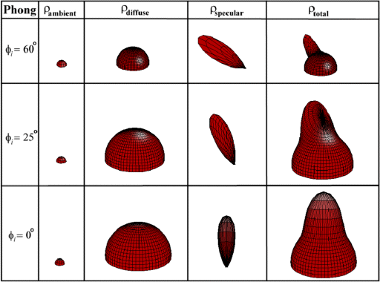
Putting it All Together

Slide 29
Putting it All Together, aka, Phong Illumination
From Wikipedia

Slide 30
OpenGL’s Illumination Model
Problems with empirical models:
What are the coefficients for copper?
What are k_{a}, k_{s}, and n_{s}? Are they measurable quantities?
Is my picture accurate? Is energy conserved?

Slide 31
Lights in OpenGL
Light positions are specified in homogeneous coordinates
They are transformed by the current modelview matrix
Directional light sources have w=0
Notes:
How do you specify a head light?

Slide 32
Lights in OpenGL
# define a directional light
lightDirection = [1, 1, 1, 0]
glLightfv(GL_LIGHT0, GL_POSITION, lightDirection)
glEnable(GL_LIGHT0)
# define a point light
lightPoint = [100, 100, 100, 1]
glLightfv(GL_LIGHT1, GL_POSITION, lightPoint)
glEnable(GL_LIGHT1)
# set up light’s color
glLightfv(GL_LIGHT0, GL_AMBIENT, ambientIntensity)
glLightfv(GL_LIGHT0, GL_DIFFUSE, diffuseIntensity)
glLightfv(GL_LIGHT0, GL_SPECULAR, specularIntensity)
Notes:
How do you specify a head light?

Slide 33
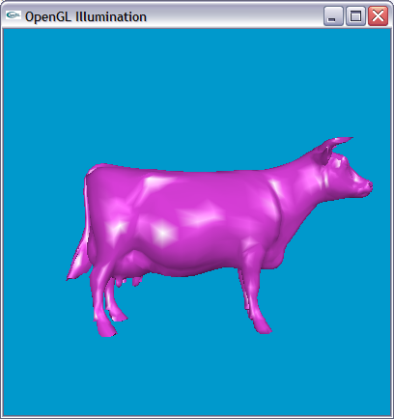
OpenGL Surface Properties
glMaterialfv(GL_FRONT, GL_AMBIENT, ambientColor)
glMaterialfv(GL_FRONT, GL_DIFFUSE, diffuseColor)
glMaterialfv(GL_FRONT, GL_SPECULAR, specularColor)
glMaterialfv(GL_FRONT, GL_SHININESS, nshininess)

Slide 34
Illumination Methods
Illumination can be expensive
Requires computation and normalizing of vectors for multiple light sources
Compute illumination for faces, vertices, or pixels with increasing realism and computing overhead
Correspond to flat, Gouraud, and Phong shading respectively

Slide 35
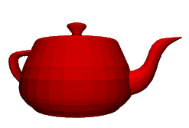
Flat Shading
The simplest shading method
Applies only one illumination calculation per face
Illumination usually computed at the centroid of the face:
Issues?
Notes:
For point light sources the light direction varies over the face
For specular reflections the viewer direction varies over the facet

Slide 36
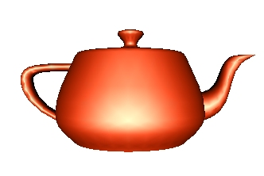
Gouraud Shading
Performs the illumination model on vertices and interpolates the intensity of the remaining points on the surface
Notice that facet artifacts are still visible

Slide 37
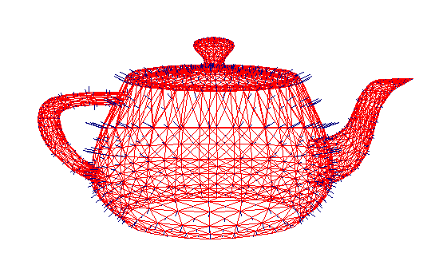
Vertex Normals
If vertex normals are not provided they can often be approximated by averaging the normals of the facets which share the vertex

Slide 38
Phong Shading
Surface normal is linearly interpolated across polygonal facets, and the illumination model is applied at every point
Not to be confused with Phong’s illumination model
Phong shading will usually result in a very smooth appearance
However, evidence of the polygonal model can usually be seen along silhouettes

Slide 39
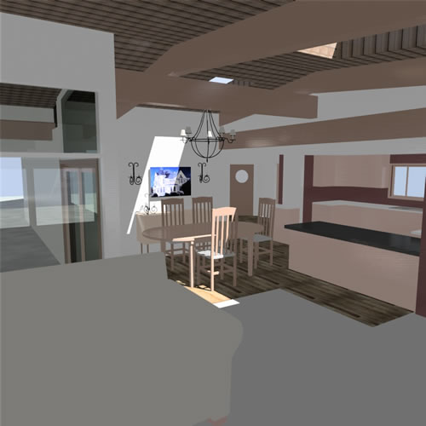
Local Illumination
Local illumination models compute the colors of points on surfaces by considering only local properties:
Position of the point
Surface properties
Properties of any light sources that affect it
No other objects in the scene are considered neither as light blockers nor as reflectors
Typical of immediate-mode renders, such as OpenGL

Slide 40
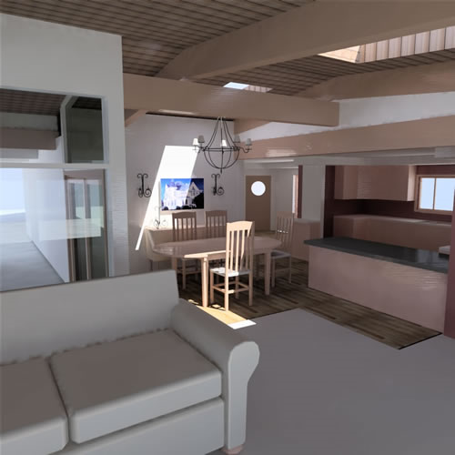
Global Illumination
In the real world, light takes indirect paths
Light reflects off of other materials (possibly multiple objects)
Light is blocked by other objects
Light can be scattered
Light can be focused
Light can bend
Harder to model
At each point we must consider not only every light source, but and other point that might have reflected light toward it

Slide 41
Various Effects using Physically-based Models
There are still many open problems to accurately represent various natural materials and efficiently render them
From slides of Pat Hanrahan

Slide 42
Course Objectives
Know how to consider lights
during rendering models
Light sources
Illumination models
Shading
Local vs. global illumination

Slide 43
Reading Homework
Read a chapter of “Texture Mapping”

Slide 44
Next Time
Texture mapping

Slide 45
Homework
Go over the next lecture slides before the class
Watch 2 SIGGRAPH videos and submit your summaries before every Tue. class
Send an email to cs380ta@gmail.com
Just one paragraph for each summary

Slide 46
Any Questions?
Come up with one question on what we have discussed in the class and submit at the end of the class
1 for already answered questions
2 for all the other questions
Submit at least four times during the whole semester

Slide 47
Figs

Slide 48
$$w$$
$$θ$$
$$w$$
$$θ$$

Slide 49
Snell’s Law

